Slide 1
Goals of Tuning/Systematics Working Group
Afro, Luke, and Xin
For the working group

Slide 2
Outline
Investigation of the so-called “Peelle’s Pertinent Puzzle” in fitting Xs data
Initiating the effort to tune Xs model for SBN and DUNE
Comparison of different Xs model tunes

Slide 3
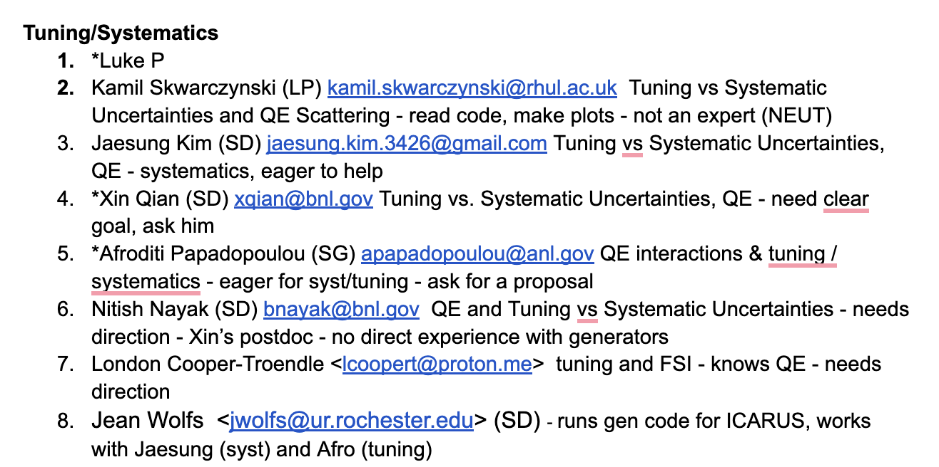

Slide 4
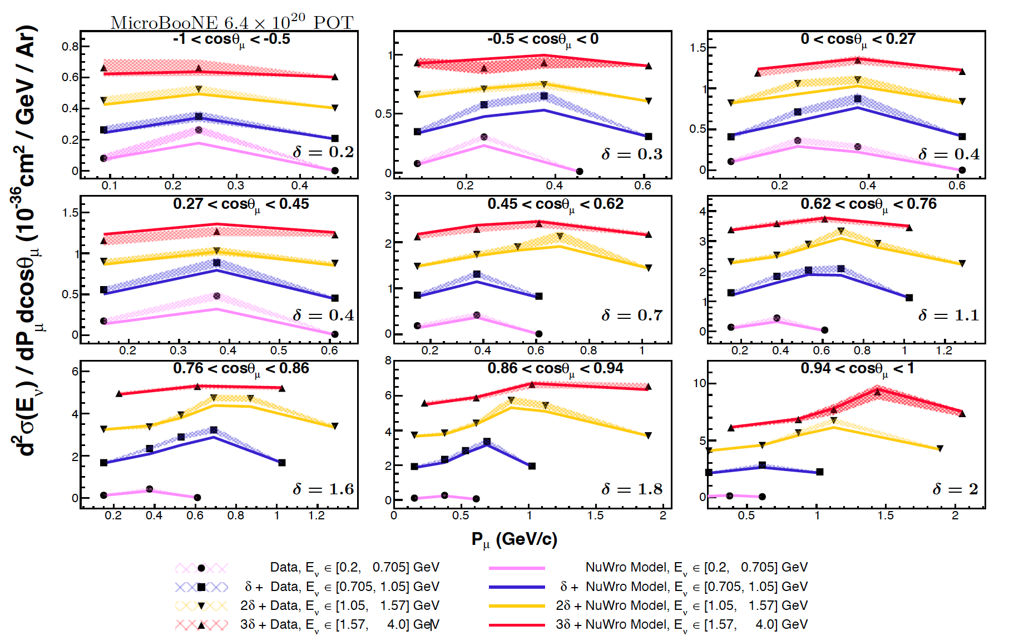
Introduction
Many experiments report Xs measurements
The results usually consist of the CV value and the uncertainties
The latter is generally expressed as a covariance matrix, including correlated uncertainties
These results are useful to improve the Xs models for future usage
London et. al., arXiv:2307.06413

Slide 5
Improve Model: Fit the results with a Model
Introduction @ NuXTract 2023 - Towards a consensus in neutrino cross sections (2-October 6, 2023): Challenges in fitting to xsec data · Indico (cern.ch)
Generally having trouble in doing the fit
Best-fit parameters do not make sense …
People generally do after this:
Ignore correlations …
Somehow, modifying the covariance matrix
Absolute → relative → transformation → relative → absolute
https://arxiv.org/abs/2308.01838

Slide 6
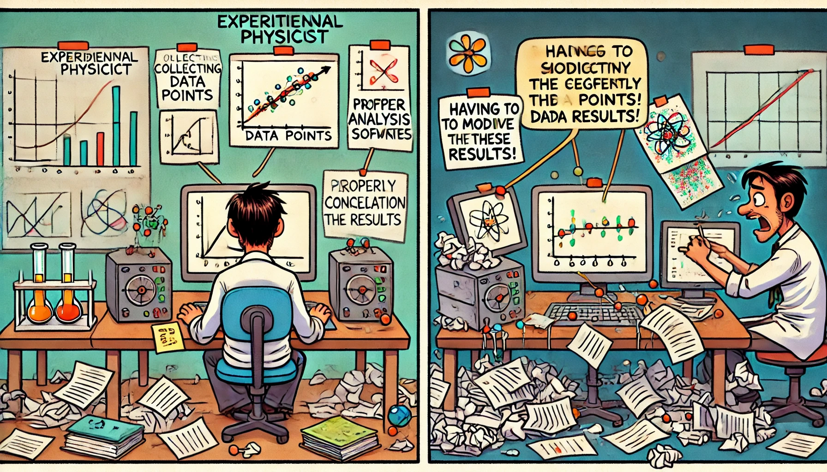
What is going on here???
Modifying the measurement (e.g. covariance matrix) is not satisfactory since lots of effort is invested to properly calculate the correlation on the final results
The “PPP” indicates that the fitted model is incompatible with the results; here are several hypotheses:
Impact of A_{C} matrix with unfolding
(unknown) real vs. nominal flux
Profiling vs. marginalization of additional model parameters
Incompatible models?
The actual PPP issue

Slide 7
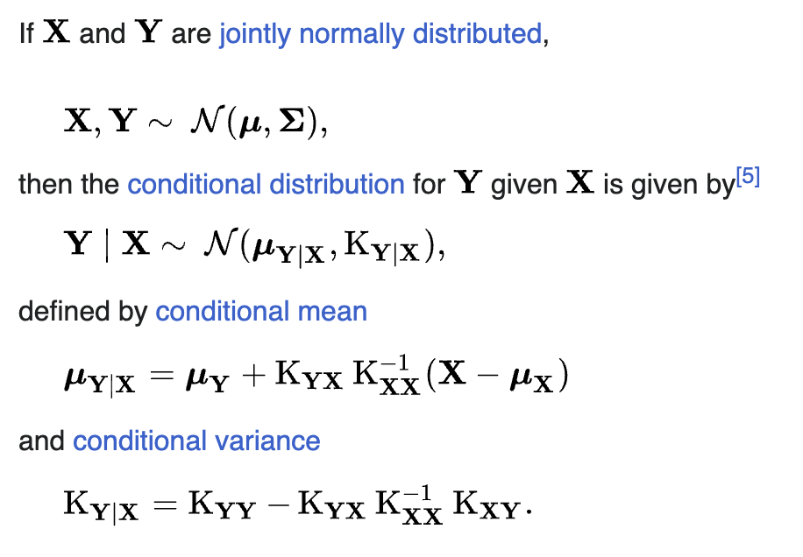
A Case Study
Xs Input:
MicroBooNE inclusive $ν_{μ}$CC Xs results
Xs Models:
GENIE Xs model
Alternatives (NuWro, Neut …)
Fitting Method:
Conditional Covariance Matrix
Actual action items:
Fitting w. vs. w.o. A_{C} matrix
Fitting w. alternative neutrino flux
Fitting with fixed vs. marginalized additional model parameters
Fitting with alternative Xs models
Fitting with modified results (removing correlations, adding uncertainties, modifying correlations …)
Covariance Matrix: Gaussian approximation, numerical stability in covariance matrix, Scan of key parameters …
Goals:
Reproduce “PPP” and then understand where it is coming from
X: Xs measurements
Y: model parameters of interests

Slide 8
Pre-Workshop Homework
Led by Nitish Nayak
Set up Nuisance Workflow using docker container : nuisancemc/nuisance:Q2-2024
Prepared GENIEv3.4 files ("gprep") for Nuisance Input (using splines used for MicroBooNE tune version)
Available here for 100k events : also includes example nuisance configuration for running with MicroBooNE tuned parameters
Also have gprep files for NuWro 19 and NuWro 21 (from Ben Bogart) here
Can run data/MC comparisons + fitting with nuiscomp and nuismin
Collated some instructions (from various sources) based on our own learning here
Implemented recent WireCell CC0pNp measurement (Ben Bogart et al.) within Nuisance
https://arxiv.org/abs/2402.19216
https://arxiv.org/abs/2402.19281
Plan to also write standalone programs for covariance matrix-based ("conditional constraint") fitting vs these datasets
Reweight MC event histograms based on chosen range of generator dials to produce MC covariance matrix (nuissyst)
Constrain parameters using MC cov + data cov
If possible, implement above fitting into Nuisance

Slide 9
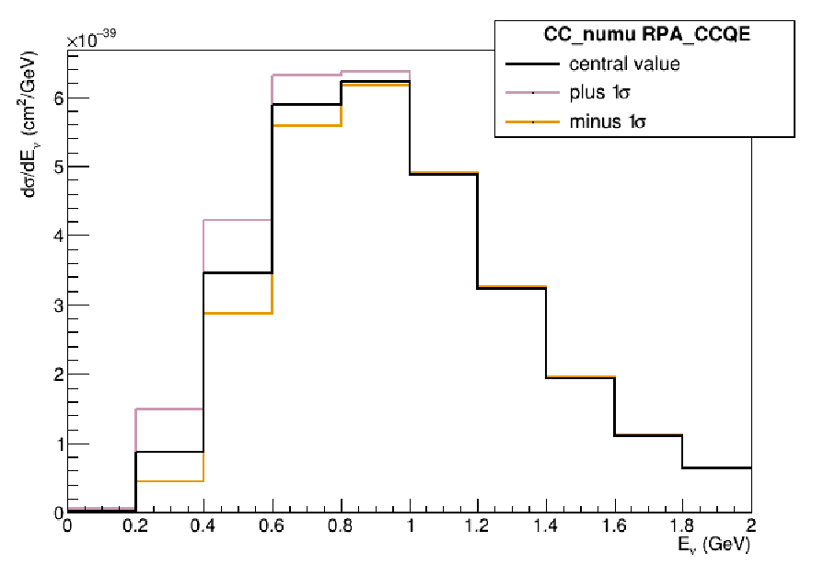
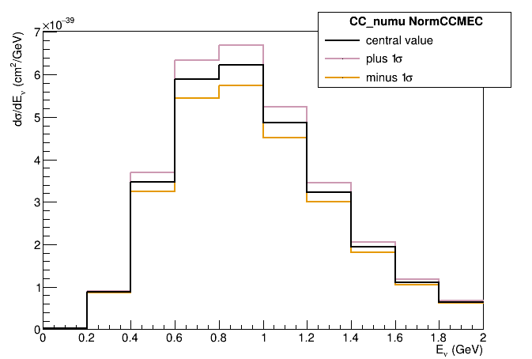
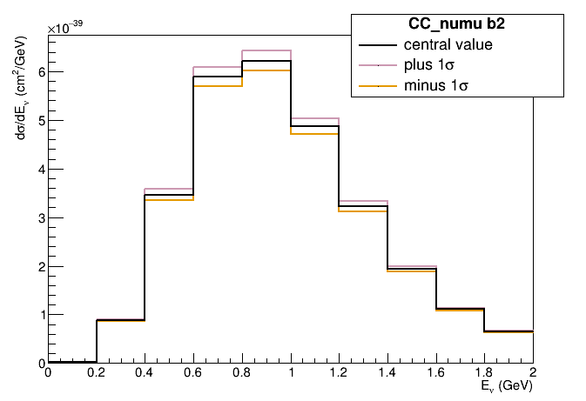
SBN/DUNE Tune
Took a look at all the GENIE ReWeight and NuSystematics free parameters that are currently available
Identified those that seem to be having the greatest impact

Slide 10
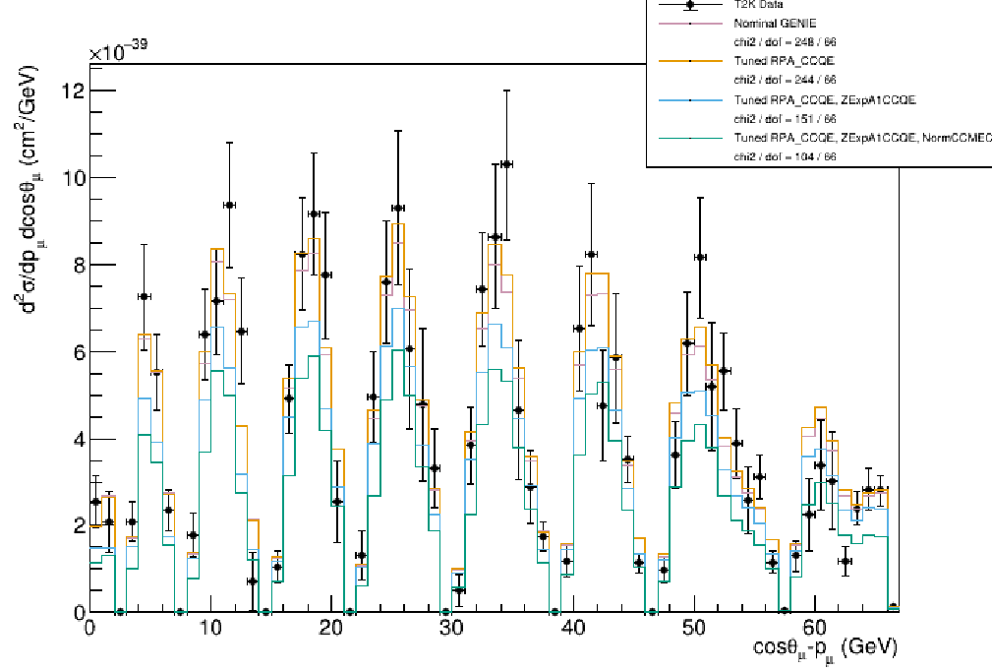
SBN/DUNE Tune
Used the ones with the greatest impact to perform a fit to T2K CC0π data (first one parameter at a time) and demonstrated the impact on the T2K CC0π and MicroBooNE CC1p0π data

Slide 11
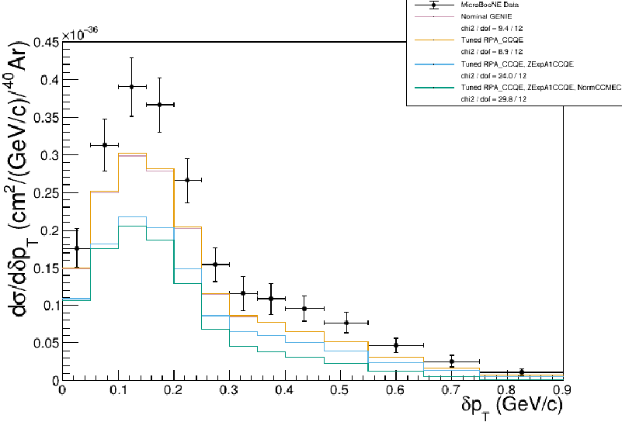
SBN/DUNE Tune
Then we combined all of them and we already have issues with the PPP puzzle :D
Ideas are welcome over the course of the week (eg diff T2K sample)!
Planning on exploring reweighting between different MEC models

Slide 12
July 8th Progress
Xs/sys working group

Slide 13
Action Items
Input Xs Data and Model Fitting …
Covariance Matrix Formalism …
1D inclusive is available (not found)
3D becomes available
3D hadron done (slight missing some functionalities)
T2K 0pi data can be used …
TBD
Single proton, Nproton …
TBD
Validation: Comparison of chi2 with paper → tomorrow morning
Shape vs. total covariance matrix …
Going through the formula in understanding …
Nuisance
Norm vs. Shape

Slide 14
Action Items
Alternative knobs …
Alternative Event Generator in Fitting
Identify the relevant knobs within GENIE that we should include and vary
A and B, randomize the A, B knobs to generate 1000 universe
Construct a covariance matrix (N + 2) dimension
N: T2K reported Cov
N: also have a model part of covariance matrix
Let’s say B is additional knob, → (N + 1) dimension
A^hat =
T = (M-P)^2/(Cov_M+Cov_P)
NuWro (Names?)
Regenerate …
Neut … (knobs )
Some neut files are avable (1M events)

Slide 15
Norm vs. Shape Covariance Matrix
From M. Shaevitz technote
Derivation
Measurement vector : $\left(N_{1}, …N_{n}\right)$
Covariance matrix. : $M_{ij}$
$M_{ij}^{shape}$ is obtained by looking at covariance matrix of $(\frac{N_{1}}{N_{T}}, …\frac{N_{n}}{N_{T}})$
$M_{ij}^{norm}$ is obtained by looking at covariance matrix of $N_{T}$
The rest $M_{ij}^{mixed}$ is a mixture of shape and norm
Note, there is no recipe in how one would use these individual covariance matrix …

Slide 16
Norm vs. Shape Covariance Matrix
New basis: C

Slide 17
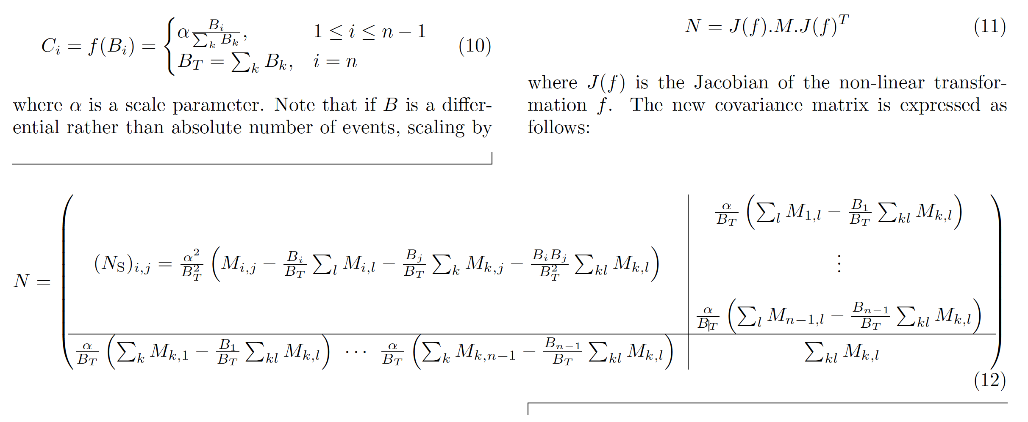
Derivation from arXiv:2308.01838
+

Slide 18
Derivation
Jacobian transformation on the covariance matrix
Mathematica derivation

Slide 19
Derivation
Mathematical derivation
+
Take M11 part of the top matrix, we have $$M11{\left(N1+N2\right)}^{2}−2N1\left(N1+N2\right)M11+N1^{2}M11=N2^{2}M11$$
Take M22 part of the top matrix, we have
$+N1^{2}M22$
…
We obtain equivalent results between the two only with the “+” sign

Slide 20
Checking of the Code
From paper
From Afro
+
There is a typo in the code and paper
+

Slide 21
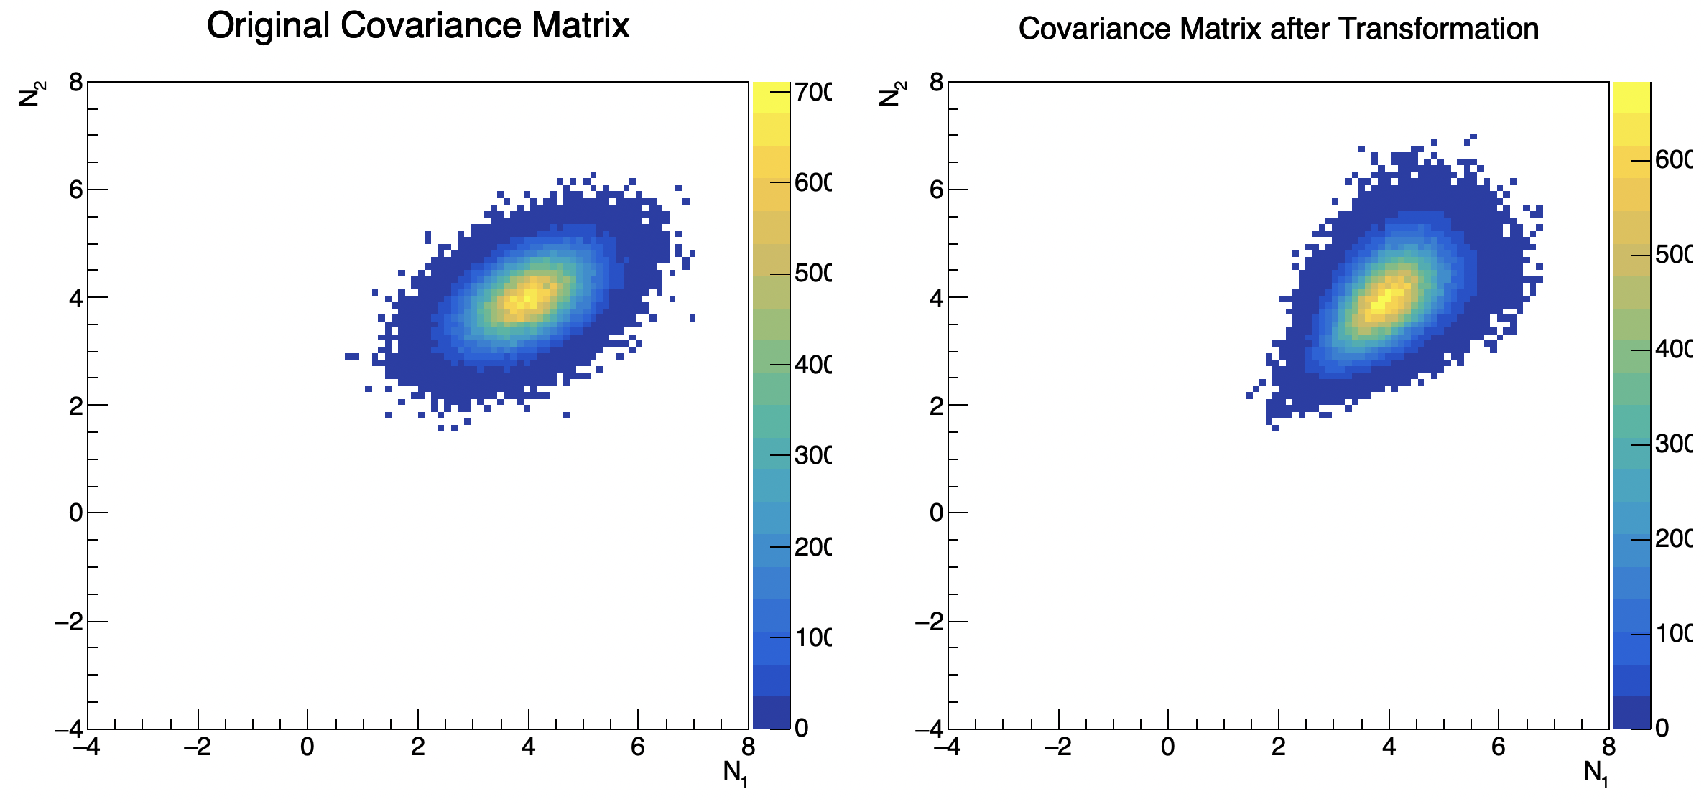
Let’s understand the transformation in a simple Case Study
Case Study
Comparison of the covariance matrix before and after the transformation
$\left(N_{1},N_{2}\right)→\left(\frac{N_{1}}{N_{1}+N_{2}},N_{1}+N_{2}\right)$
Let’s assume
Mean (4,4)
Covariance matrix {{0.4,0.2},{0.2,0.4}}
Based on the formula, after transformation, we have
Mean (0.5,8)
Covariance matrix {{0.0015625,0},{0,1.2}}
With the wrong sign, the covariance matrix is not positively definite

Slide 22
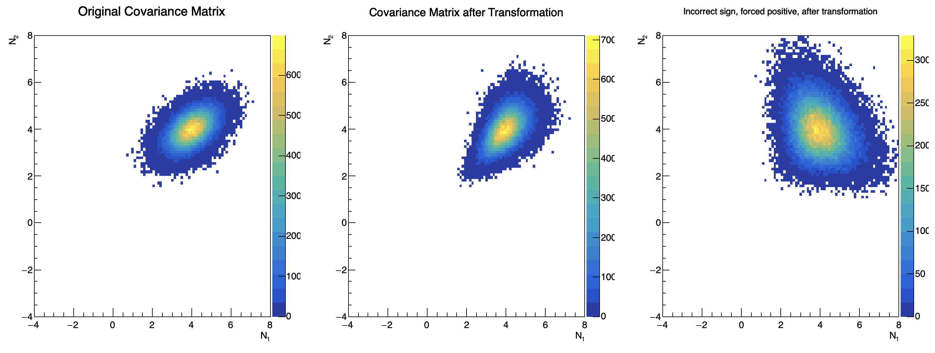
Comparison of Correlations

Slide 23
July 9th Progress
Xs/sys working group

Slide 24
Action Items
Input Xs Data and Model Fitting …
Covariance Matrix Formalism …
1D inclusive is not yet implement (will be done)
3D inclusive becomes available in Nuisance
3D hadron is also done (slight missing some functionalities - "block-wise" combination)
T2K 0pi data can be used …
TBD
Single proton, Nproton …
TBD
Validation: Comparison of chi2 with paper → Done for 3D inclusive, mostly done for 3D hadron
Shape vs. total covariance matrix …
Going through the formula in understanding …
Nuisance
Norm vs. Shape

Slide 25
A Case Study
Xs Input:
MicroBooNE inclusive $ν_{μ}$CC Xs results
Xs Models:
GENIE Xs model
Alternatives (NuWro, Neut …)
Fitting Method:
Conditional Covariance Matrix
Actual action items:
Fitting w. vs. w.o. A_{C} matrix
Fitting w. alternative neutrino flux
Fitting with fixed vs. marginalized additional model parameters
Fitting with alternative Xs models
Fitting with modified results (removing correlations, adding uncertainties, modifying correlations …)
Goals:
Reproduce “PPP” and then understand where it is coming from
X: Xs measurements
Y: model parameters of interests

Slide 26
Fitting Method
X: Xs measurements
Y: model parameters of interests
Can already do the universe generation easily in Nuisance!
We can vary cross-section dials in pre-determined ways (similar to uncertainty model used by experiment) - "Prior"
Generate N universes
X : cross-section bins, Y : actual dial values of interest
Build (X, Y) : covariance using above universes
Constrain X to measurement -> update Y : "Posterior"
Jaesung and Jeanie have already done this for T2K data
London and I are working on generating these for uBooNE (Nearly done)

Slide 27
Genie Model Parameters
MicroBooNE Tune: Workshop Genie Samples
Fully implemented tune version
Applied tune 1sigma range but left CV unchanged
Made no modifications to Genie CV or 1sigma
All other knobs implemented except FrPiProd_pi and FrPiProd_N

Slide 28
Preliminary Comparison
With A_c matrix applied
No A_c matrix applied
Data+MC cov Chi2 = 193.8/138
Data-only cov Chi2 = 336.9/138
Data+MC cov Chi2 = 601.8/138
Data-only cov Chi2 = 8e12/138
Preliminary comparison with CV using uBooNE GENIEv3 tuned Model
Chi2 matches one with paper (with A_c applied) : blows up without
MC Cov matrix included, but need more stats (overnight)
We are generating ~300-500 universes using the uBooNE GENIEv3 uncertainty model => can see results of conditional constraint soon

Slide 29
July 10th Progress
Xs/sys working group

Slide 41
Updates from Nitish & London
Fitting the MicroBooNE 3D numuCC inclusive data

Slide 42
Results of fitting to uBooNE CCinc Data
Using 300 GENIE syst universes thrown around ubTune for building MC cov matrix/fitting
Uses all GENIE parameters used in uB model (53 total)
With Ac -> results make sense, improvement seen in number of bins
Without Ac -> normalisation is quite off : more than what we would expect based on chi2

Slide 43
Results of fitting to uBooNE CCinc Data
Next step :
Playing around with extra Ac -> No Ac uncertainty in the fit (mimics unfolding uncertainty in various measurements)
Fixing some parameters vs marginalizing over many parameters

Slide 44
Summary of PPP Case Studies
 | uBooNE 3D arXiv:2307.06413 | uBoone 1p PRL, PRD | T2K CC0$π$ A1 PHYSICAL REVIEW D 93, 112012 | T2K CC0$π$ A2 PHYSICAL REVIEW D 93, 112012 | T2K CC0 update https://arxiv.org/pdf/1802.05078
GENIE (50+ pars) | Good |  | PPP | ~ PPP
GENIE_fixed_model_para | Good |  | PPP | PPP | Good
GENIE_adhoc_unfolding_error | Good
Neut (6 pars) | Good |  |  |  | PPP
GENIE_no_AC | PPP
GENIE_alter_flux

Slide 45
Updates from Kamil

Slide 46
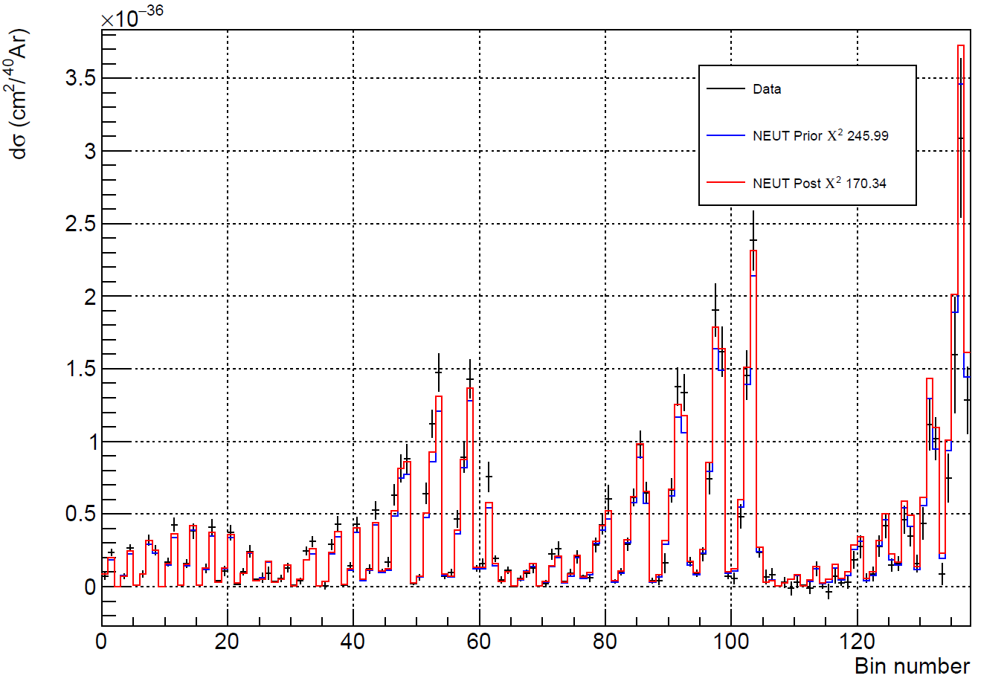
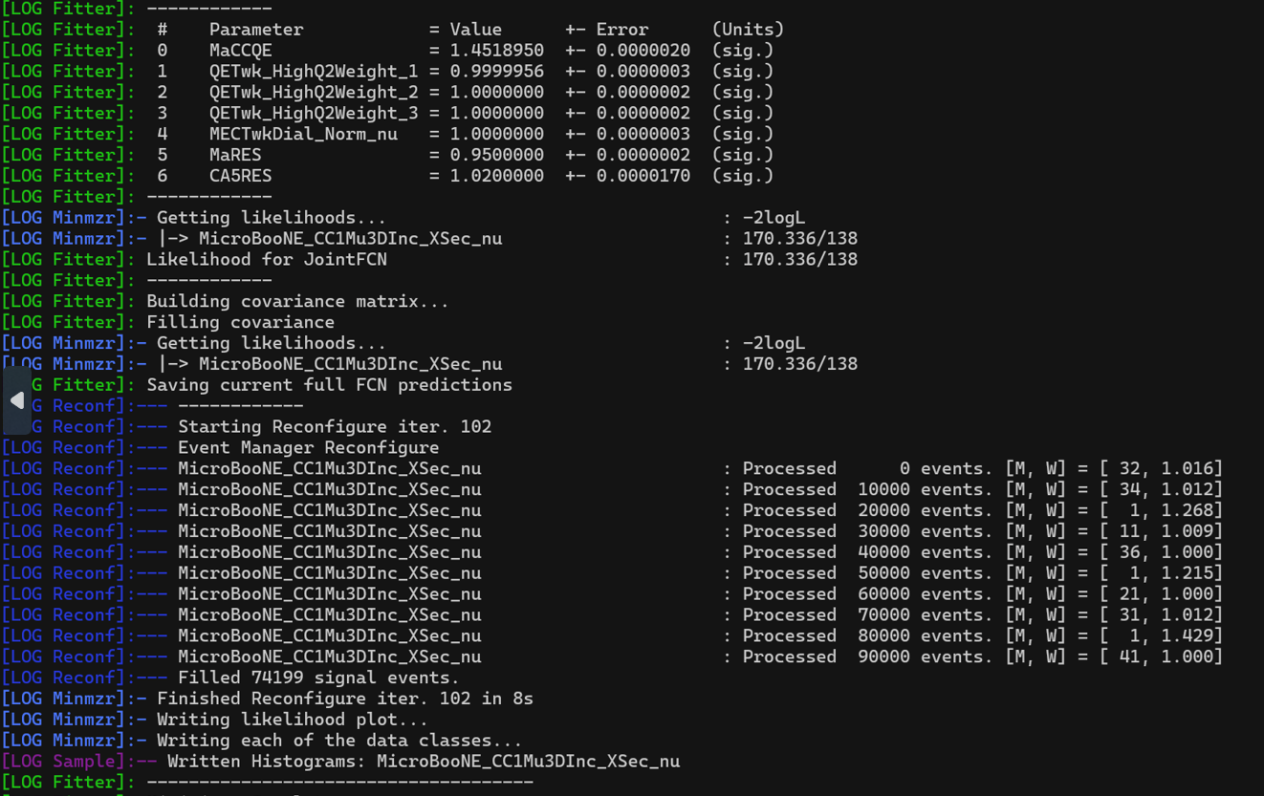
uBooNE CCinc Data Fitted by the NEUT model
While fitting uBooNE 3D Ccinc Data does not show a problem using GENIE model, we want to understand if this can hold for NEUT model
This NEUT model is constructed with six model parameters (instead of 50+ in GENIE)
No PPP issue observed

Slide 47
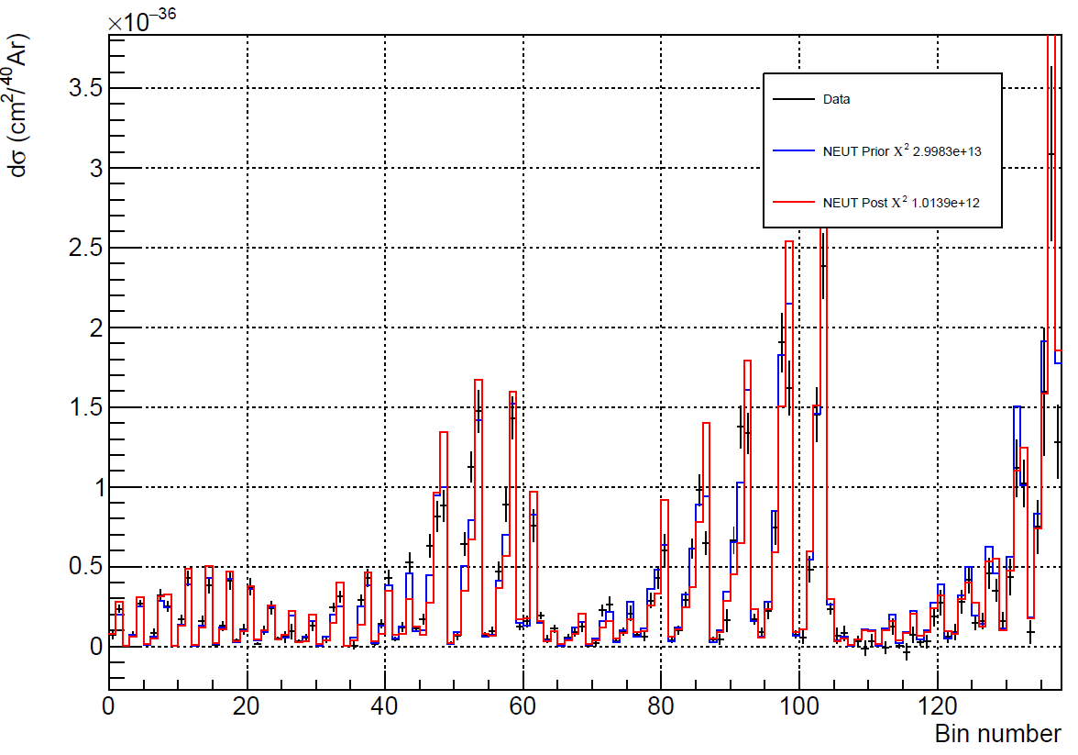
uBooNE CCinc Data Fitted by the NEUT model No Ac
When fitting without AC matrix Chi2 is crazy, nevertheless I didn't observe PPP issue
Need to check if the minimization is indeed converged, given the chi2 is very high here

Slide 48
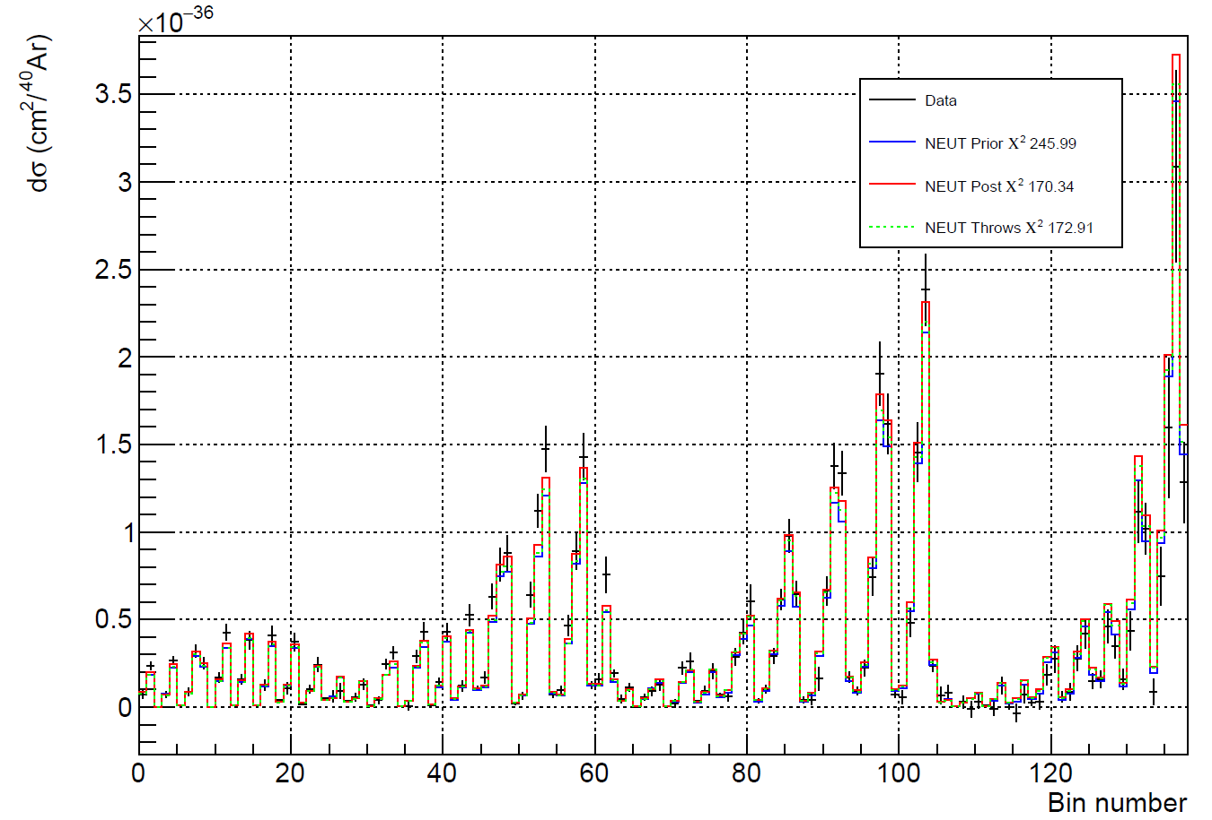
uBooNE CCinc Data Fitted by the NEUT model No Ac
Same as previously but NEUT throws means Conditional Covaraince Matrix method

Slide 49
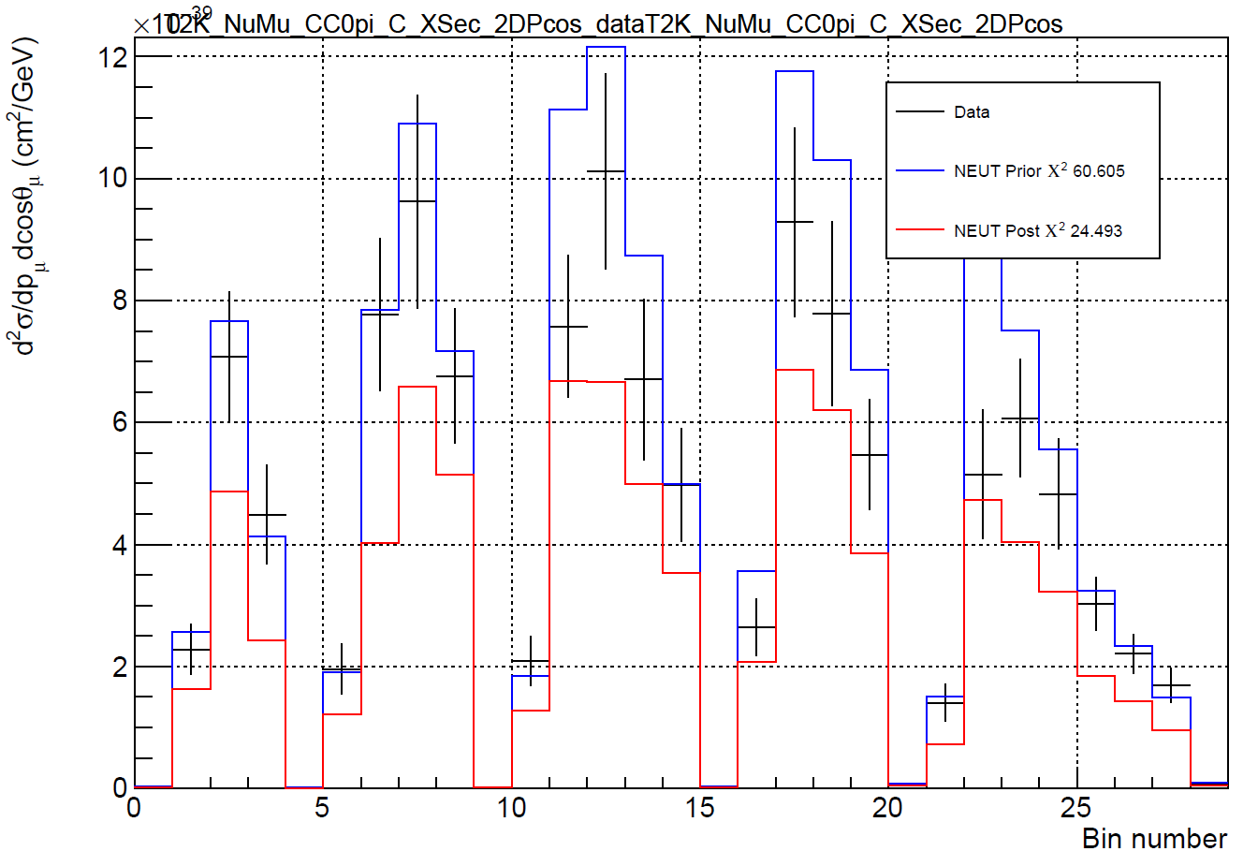
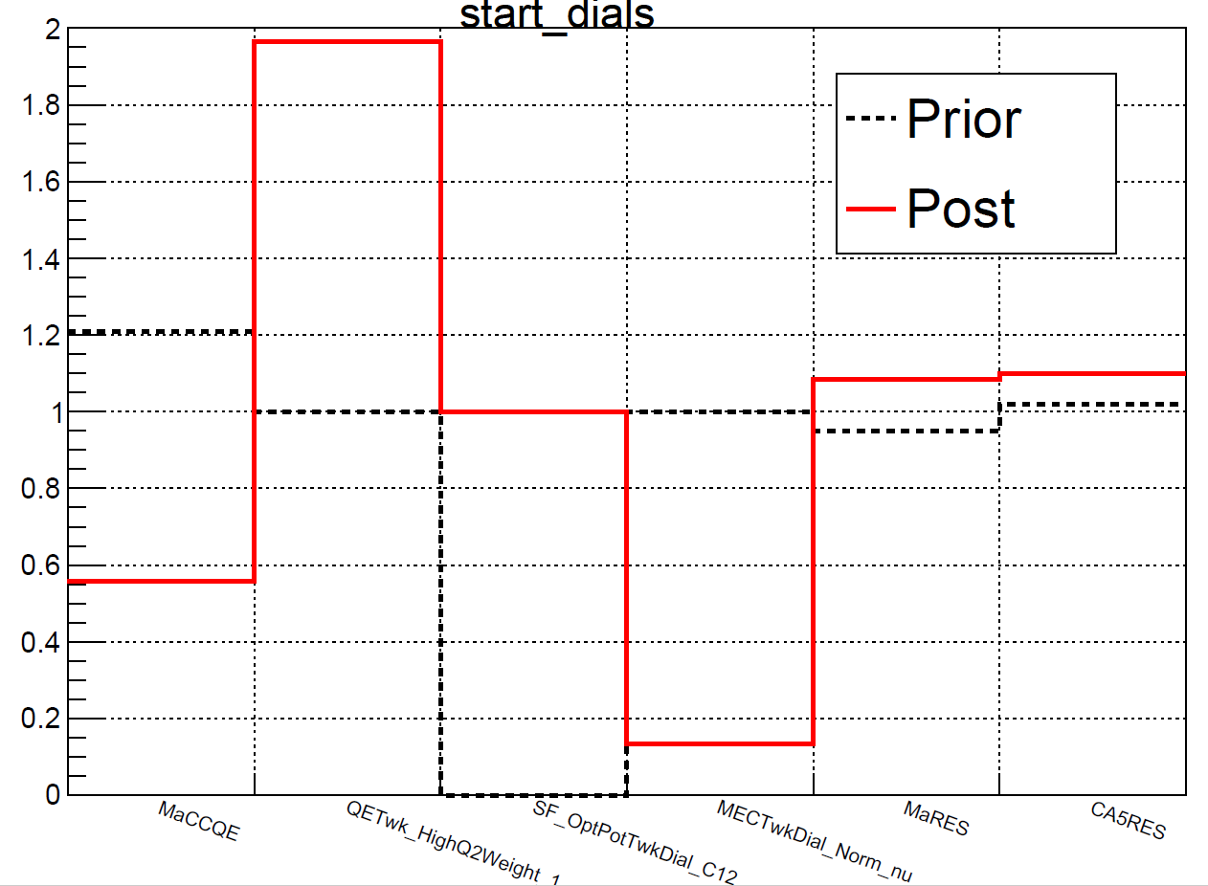
T2K NuMu CC0pi C XSec 2DPcos Data Fitted by the NEUT model
When using NEUT (sligtlhy newer version than one used in the paper)
Observed PPP issue within Neut model

Slide 50
Results of fitting to uBooNE CCinc Data
If we add extra ad-hoc uncertainty (envelope between the With Ac pred and Without Ac pred) :
Fit is modulated better
Recover the normalization
No PPP

Slide 51
Comparison of uBooNE 3D incl data
GENIE fit
Neut fit

Slide 52
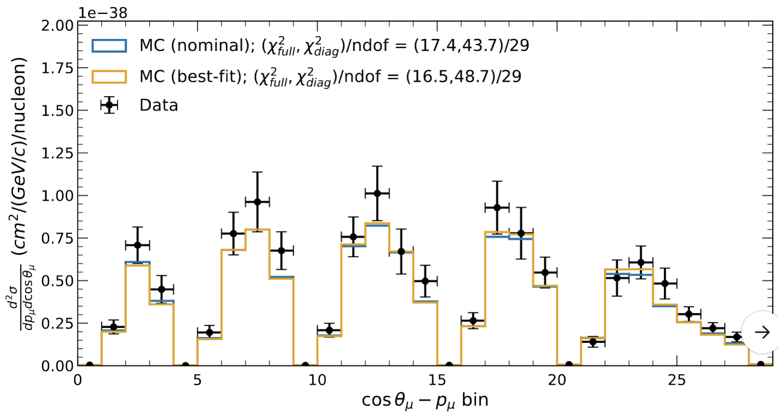
Comparison of T2K 2018 data
GENIE fit
Neut Fit

Slide 53
Comparison
T2K 2018 data
T2K 2016 data

Slide 54
Recap of PPP Investigation
Goal: Investigate potential sources of PPP: Ac matrix, real vs nominal flux, limited model flexibility, ...
Hypothesis: incorrect treatment of data/MC comparison can yield PPP errror
Cov matrices are highly inflexible in some DoF of measurement space (perhaps unphysical)
However, they are very flexible in normalization
Test hypothesis with attempted data/MC fits:
MicroBooNE numuCC 3D inclusive data with Wiener SVD unfolding and nominal flux
Fit with/without Ac
Simulate different flux
Fit with limited model
Fit with NEUT
T2K datasets (analysis 1,2,2018)
Fit with Genie
Fit with NEUT

Slide 55
Fitting to MicroBooNE NumuCC 3D Inclusive
Chi2 / ndf
190.4 / 138
144.6 / 138
154.3 / 138
489.4 / 138
189.4 / 138

Slide 56
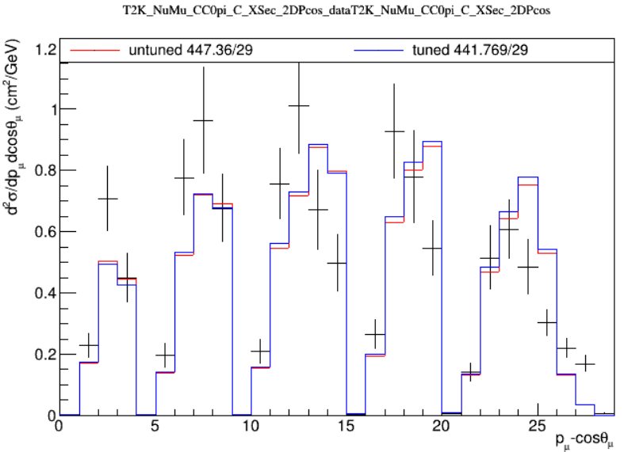
using this data set T2K_NuMu_CC0pi_C_XSec_2DPcos and using the usual 6 parameters for the minimization, seems that we don't have a PPP effect and the fit converges but things barely change wrt the untuned prediction

Slide 57
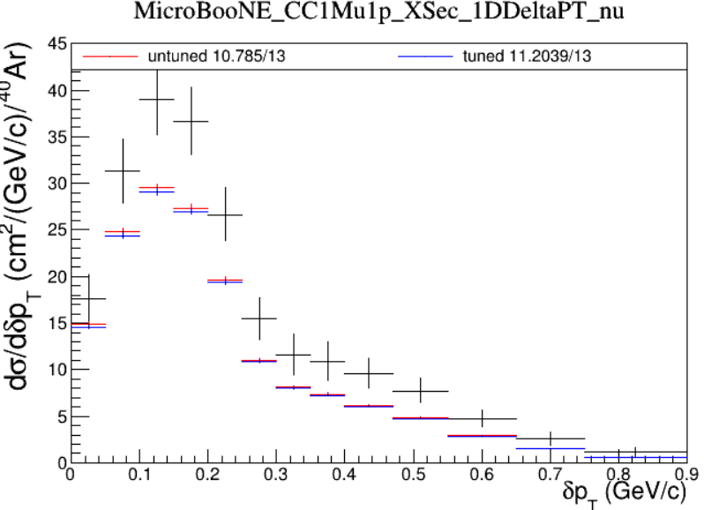
using this data set T2K_NuMu_CC0pi_C_XSec_2DPcos and using the usual 6 parameters for the minimization, seems that we don't have a PPP effect and the fit converges but things barely change wrt the untuned prediction even on MicroBooNE CC1p projection

Slide 58
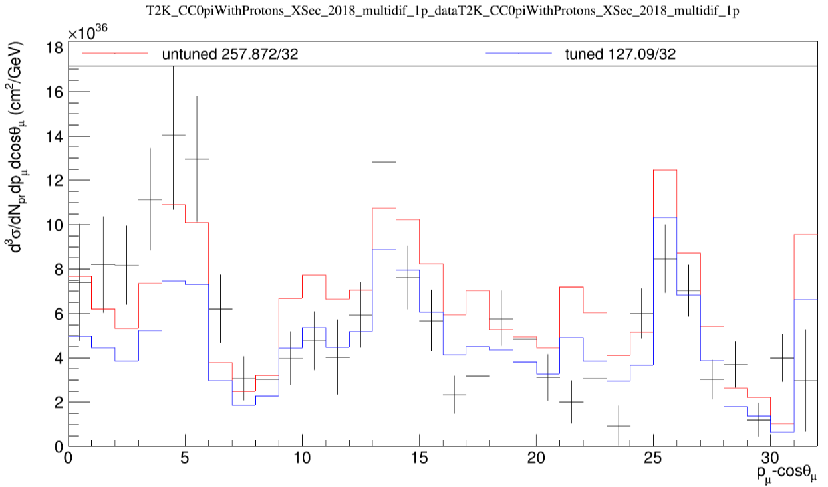
and this is the T2K_CC0piWithProtons_XSec_2018_multidif_1p data set

Slide 59
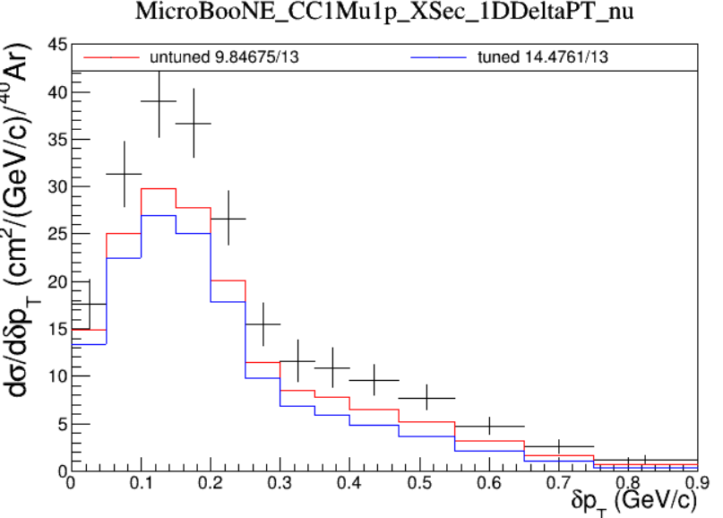
T2K_CC0piWithProtons_XSec_2018_multidif_1p tune projected on MicroBooNE

Slide 60
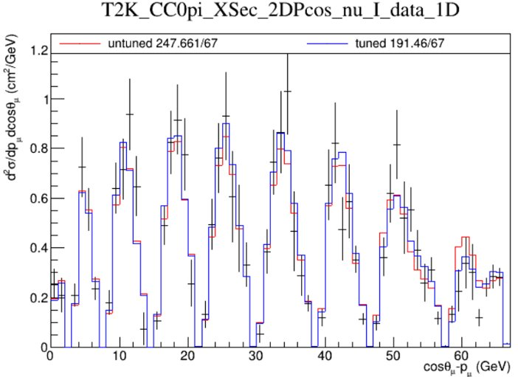
using the reweighting from SuSAv2 to Empirical (thanks to Lars!)

Slide 61
Summary
Luke Pickering, Kamil Skwarczynski, Jaesung Kim, Xin Qian, Afroditi Papadopoulou, Nitish Nayak, London Cooper-Troendle, Jean Wolfs
Also, inputs from Ben, Steve, Callum, and many others
Focused on the first two efforts

Slide 62
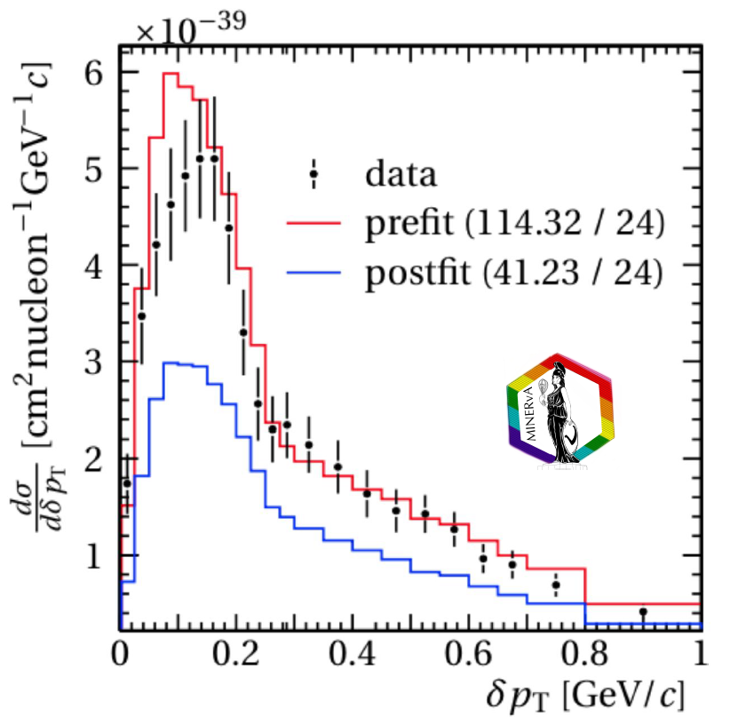
What is PPP?
Stars: Model
Contour: Data
PPP happens when there is a mismatch between data and the model
Insufficient model? Miscommunication between data and model prediction?

Slide 63
What is PPP?
Insufficient model?
Miscommunication between data and model prediction?
Profiling vs. marginalization of additional model parameters
Minuit2 fitting requires significant computation when the number of parameters becomes large
Covariance matrix formalism allows for simultaneous fitting of many parameters
Incompatible models?
Event generator folks’ effort
Impact of A_{C} matrix with unfolding
Any unfolding with regularization (SVD, iterative fit …) leads to this additional AC matrix
Need to apply AC on the prediction to compare
(unknown) real vs. nominal flux
Since model prediction can only be done with nominal flux, it is important for experiment to project the results to the nominal flux from the real flux

Slide 64
Why Investigating PPP?
PPP indicates mismatches between a data set and a model
When multiple data sets are used to improve the model for future oscillation experiments, PPP issue will lead to challenges in the tuning effort
Discard data? Alter data, but what about relative weight? How to assign uncertainties for the model parameters?
Ultimately, we need a satisfactory solution to deal with data with PPP issue

Slide 65
About PPP Issues
Different Data sets:
T2K, MicroBooNE
Two modes:
GENIE, NEUT
Two fitting approaches:
Minuit
Covarnace Matrix
We see PPP in many cases, but not in many other cases
PPP is not a universal issue!
Intentionally introduced mismatch (e.g. AC) can lead to PPP
While one model experiences PPP, the other model may not on the same data
Modern result likely has less issue with PPP

Slide 66
Solutions to PPP (Assuming Model is good)
Remove correlations in data
Norm+Shape transformation of covariance matrix

Slide 67
Preliminary Technote/Publication Plan
Introduction to the PPP issue, and explain the origin (mismatch between data and model)
Elaborate different ways of having mismatches (AC, real vs. nominal, model parameters, model limitations …)
Given recommendations on these issues
Present our case studies supporting some of the above
PPP is an indicator, but not a universal indicator
Recommend model fitting exercise as part of Xs publication
Nuisance makes this exercise easy to do

Slide 68
Xs Model Tuning Effort
Fit to T2K 2018 data
Prediction to MicroBooNE
Are we seeing some inconsistencies between T2K and MicroBooNE measurements?
Still need more investigations

