Slide 1
Accelerator Status
Jason Crnkovic & George Deinlein
Proton PMG/AEM:
May 2, 2024

Slide 2
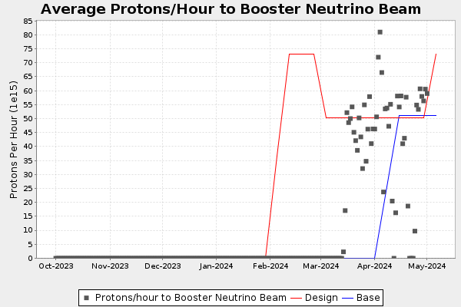
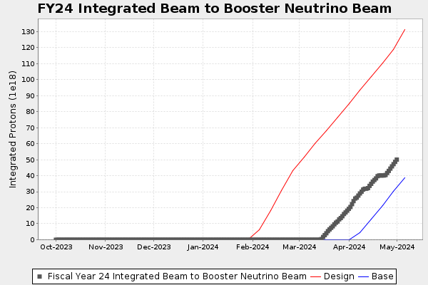
Recent Activities
Linac:
Running well.
Efficiency around 91% (G:LINEFF).
MTA:
Awaiting results of review.
Replacing multiwire planes.
Booster:
Running well.
Planning to have a Booster studies day in May (for the PIP-II era).
Integral: 4.98E19 protons @ May 1 00:00

Slide 3
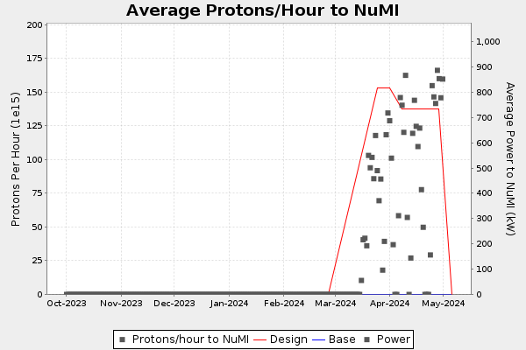
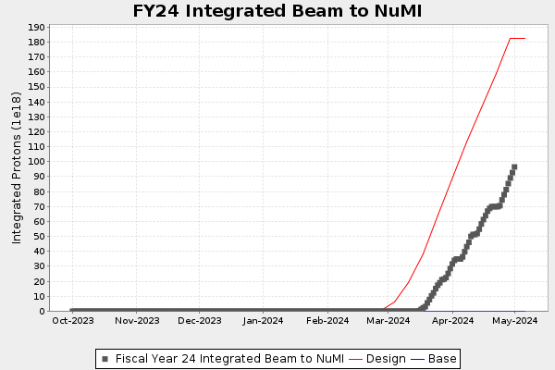
Recent Activities
MI & RR:
Running well.
Setting 8 GeV Collimators
NuMI:
Running well.
Running into 980 kW limit in beam permit.
Tritium production meeting on Friday
Integral: 9.365E19 protons @ May 1 00:00

Slide 4
Recent Activities
Muon Campus:
Working through safety system testing.
Finishing up work.
Swichtyard:
Turning on equipment and shaking out remaining bugs.
Neutrino Muon:
Working through safety system testing.
Turning on equipment and shaking out remaining bugs.
Meson:
Working through safety system testing.
Turning on equipment and shaking out remaining bugs.

Slide 5
Any Questions?

