Slide 1
302.4.04 – Cryo-assemblies Horizontal Test Weekly status report
Guram Chlachidze
Apr. 29th, 2024

Slide 2
CA02 test preparations
Cryo-improvements at TS4 in progress, check work status here:
TS4 action item list - 11_30_2023.xlsx (sharepoint.com)
Top plate is ready for reconnection of the cryogenic lines since Apr. 2
Stand 4 ORC status
APS-TD DSO will be contacted after the cryo-improvements are completed - at least one month before the expected date of CA02 cooldown
Stand 4 related engineering notes are updated, now under review
Cryogenic pipe extensions under review (Jake Kintner)
Review of the updated valve & instrument list and the FMEA is complete (Chris James)
Amendment to the electrical ORC will be initiated for the helium line heater operation this week
New instrumentation (additional Cernox RTDs and Fast pressure transducers ) wiring is complete

Slide 3
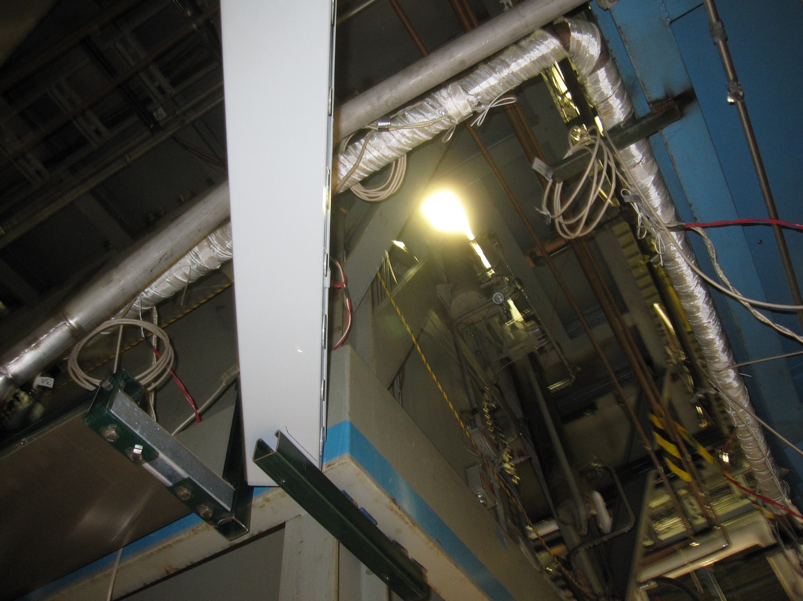
CA02 test preparations (2)
Helium line heater installation
7 heaters are installed
There is room for two more heaters only

Slide 4
CA02 test preparations (2)
CA-02 piping interface document has been finalized
Re-machining piping extensions
Ground insulation improvement on the top plate
Ultem plugs for the TS4 top plate power leads have been fabricated
2nd set of remaining components required for CA transportation and testing
Lead end can – delivered
Cernox sensors – delivered
Return end can – PO # 711063 awarded to Meyer Tools Inc.
Regular Thursday meetings with Meyer Tools Inc.
All material purchased
On track with the delivery last week of May

