Slide 1


QXFA244 Coil Review
Jesse Schmalzle
May 21, 2024

Slide 2
Outline
Coil Fab DRs
Additional Info
  Coil length, Pole gaps
  Reaction plots
  Electrical Data
Notes:
  Series coil.
  After to change for B6 adjustment.

Slide 3
QXFA244 - DRs
DRs posted to interface traveler.
No DRs for this coil.
Critical = Affecting Form, Fit or Function
(as found)

Slide 4
-
Additional Info…

Slide 5
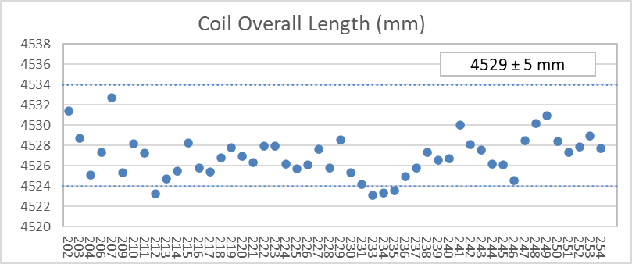
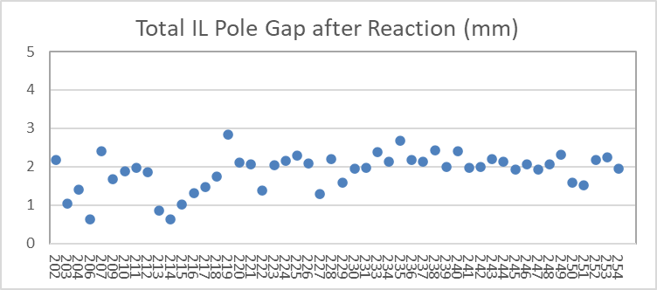
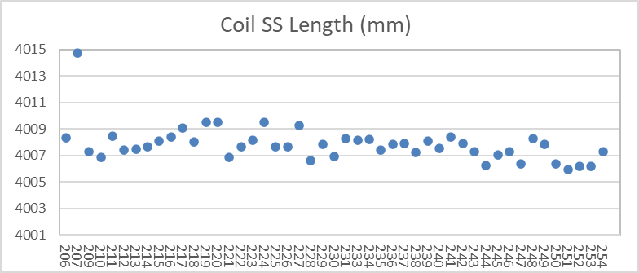
QXFA244 – Length, Gaps
Coil length within spec.
(207 error in initial pole gap setting)

Slide 6
QXFA244 - Reaction
Temperatures and dwell times all within spec.

Slide 7
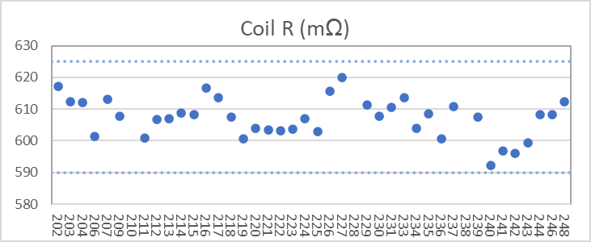
QXFA244 - Electrical
Final electrical checks – all passed

Slide 8
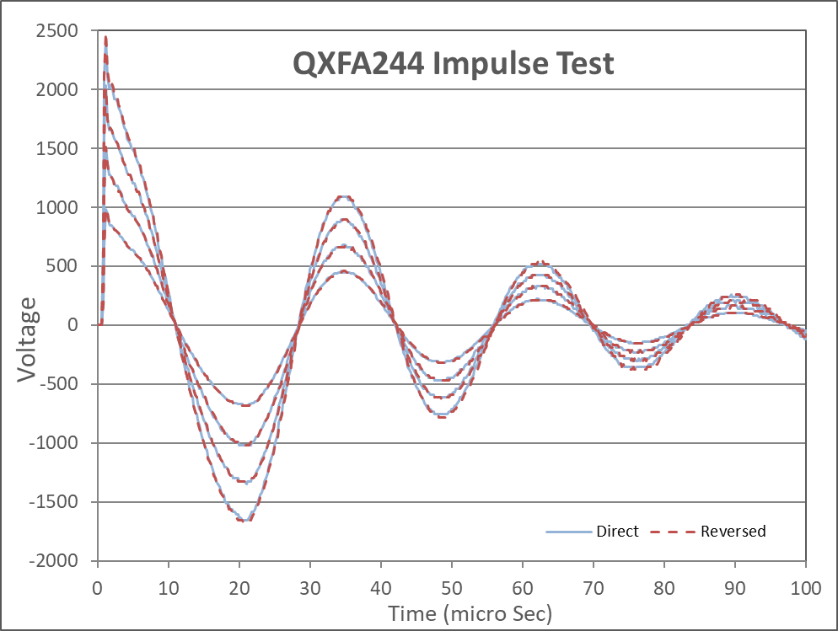
QXFA244 - Electrical

