Slide 1
MQXFA18 Coil Reception Electrical QC Measurements Coils 154, 160, 161, 243, 244, 246
MQXFA18 Coil Selection Review
Bob Memmo, Pardeep Chahal, Dan Cheng
May 21, 2024
LBNL

Slide 2
Overview
New Coils reported on will be
154, 160, 243, 246
Coils 161 and 244 are spares
LBNL EQC Acceptance Data
Summarized in following slides
Now includes acceptance values reviewed by V. Marinozzi

Slide 3
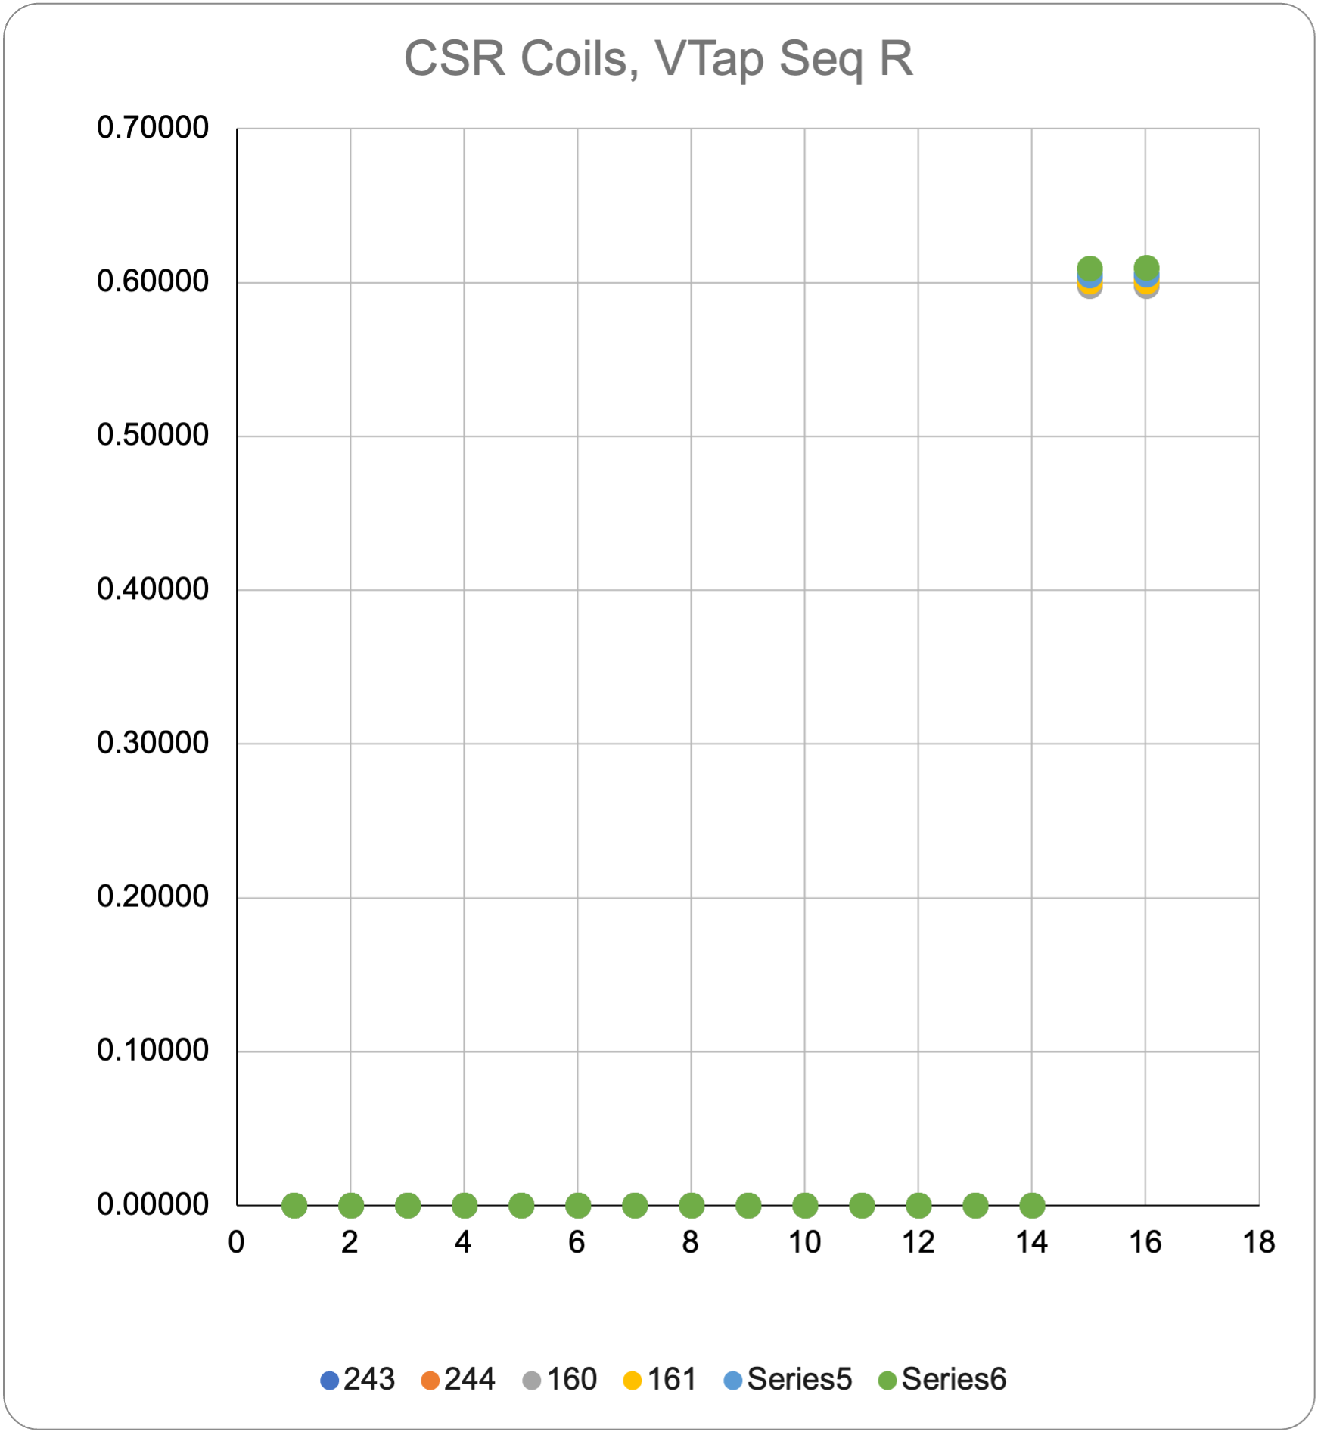
Coil Data
 |  |  | 243 | 244 | 160 | 161 | 154 | 246
See DocDB #956 / SU-1010-1903
RLQ |  |  |  |  |  |  |  |  | Acceptance Range
 | R | (mΩ) | 604 | 604 | 598 | 601 | 605 | 609 | 590-625
 | L_{s} (mH) | 20 Hz | 10.021 | 10.014 | 9.933 | 9.973 | 10.01 | 10.075 | 9.9-10.3
 |  | 100 Hz | 6.423 | 6.419 | 6.403 | 6.407 | 6.409 | 6.394 | 6.2-6.6
 |  | 1 kHz | 5.813 | 5.815 | 5.797 | 5.793 | 5.803 | 5.785 | 5.5-6
 | Q | 20 Hz | 1.289 | 1.289 | 1.3 | 1.294 | 1.288 | 1.274 | 1.2-1.4
 |  | 100 Hz | 5.53 | 5.508 | 5.539 | 5.506 | 5.483 | 5.44 | 5.2-5.8
 |  | 1 kHz | 8.354 | 8.542 | 8.475 | 8.414 | 8.523 | 8.5 | 5.8-10.7
QH R (Ω)
 | NT | A01 | N/A | N/A | N/A | N/A | N/A
 | T | A02 | N/A | N/A | N/A | N/A | N/A
 | T-P | B01 | 2.1 | 2.1 | 2.1 | 2.1 | 2 | 2.2 | 1.4-2.7
 | NT-P | B02 | 2.1 | 2 | 2 | 2.1 | 2.2 | 2.3 | 1.4-2.7
 | T-M | B03 | 2.1 | 2.4 | 2 | 2 | 2.1 | 2.3 | 1.4-2.7
 | NT-M | B04 | 2.1 | 2.3 | 1.9 | 2.1 | 2.2 | 2.3 | 1.4-2.7
VT R (mΩ) Individual coils
@1 Amp |  | A1 | 0.00020 | 0.00007 | 0.00011 | 0.00016 | 0.00007 | 0.00009
 |  | A2 | 0.00025 | 0.00013 | 0.00016 | 0.00021 | 0.00013 | 0.00014
 |  | A3
 |  | A4
 |  | A5
 |  | A6
 |  | A7
 |  | A8
 |  | B8
 |  | B7
 |  | B6
 |  | B5
 |  | B4
 |  | B3
 |  | B2 | 0.60415 | 0.60390 | 0.59770 | 0.60070 | 0.60480 | 0.60930
 |  | B1 | 0.60430 | 0.60410 | 0.59790 | 0.60090 | 0.60520 | 0.60960
HIPOT |  |  | OK | OK | OK | OK | OK
IMPULSE |  |  | OK | OK | OK | OK | OK
All coils are Series coils, with limited voltage taps

Slide 4
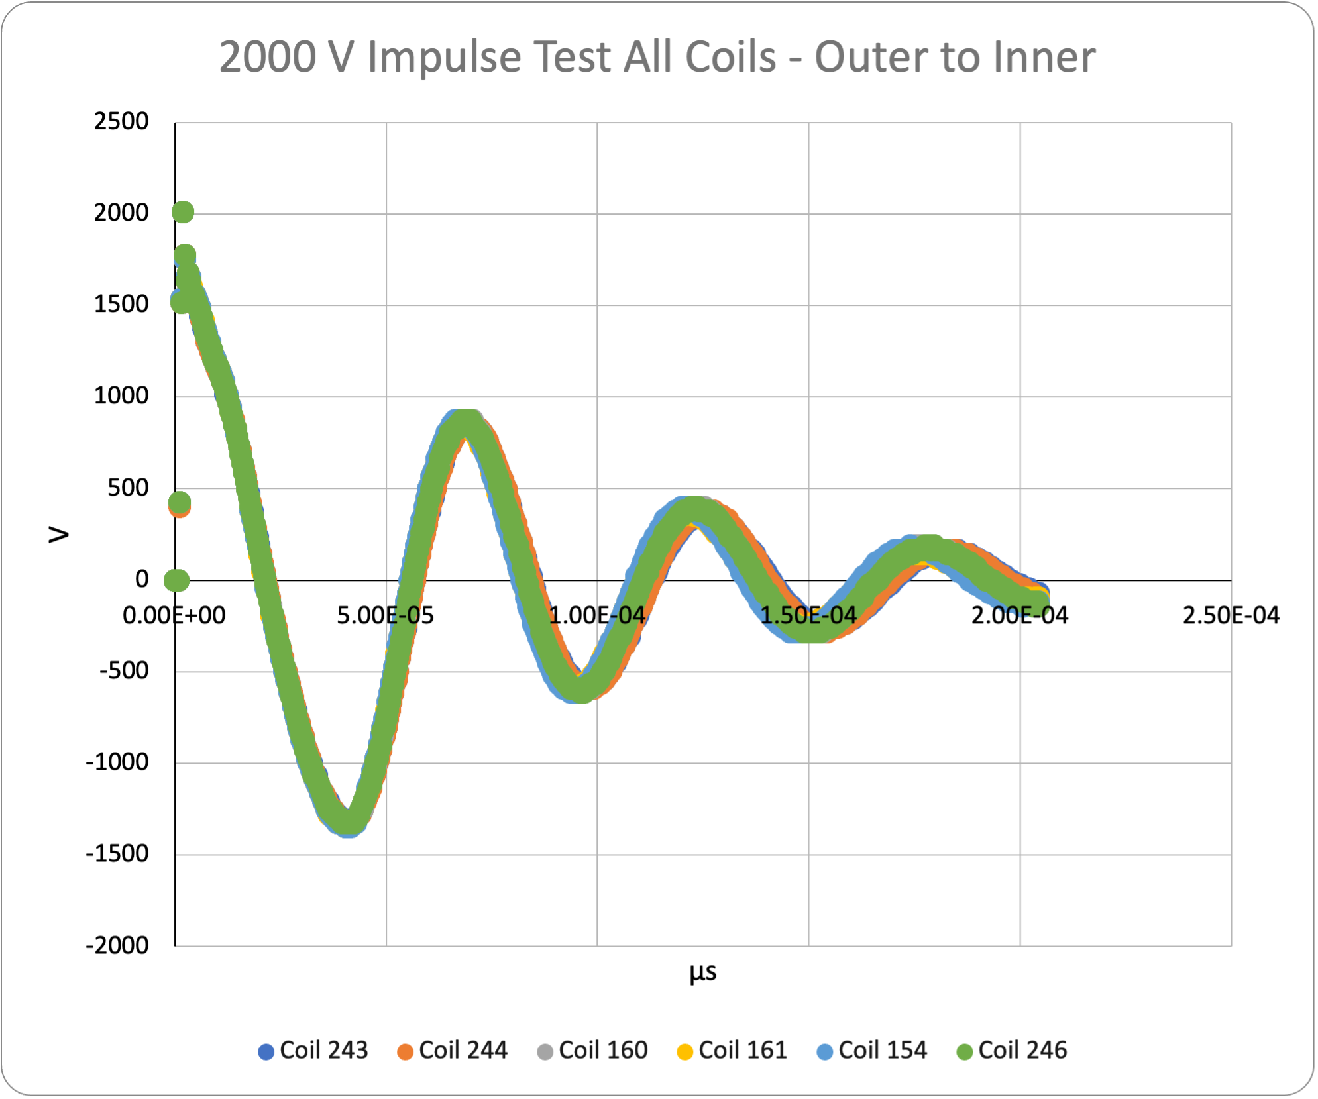
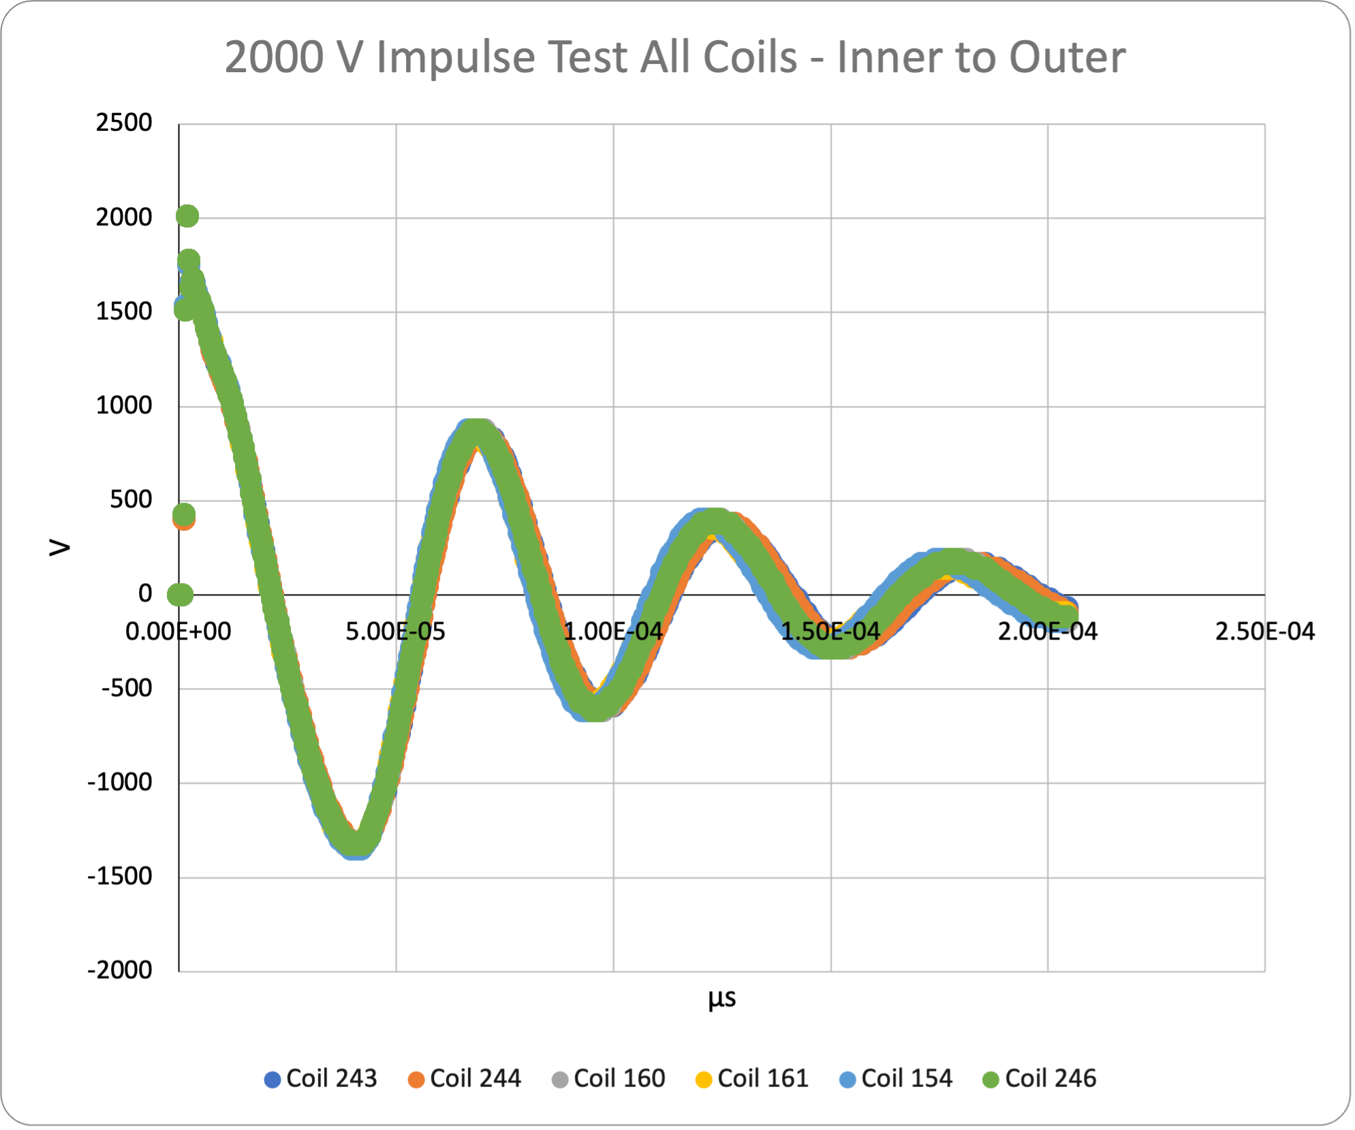
Hipot and Impulse tests
Hipot tests passed for all coils
See Coil EQC data workbook on Indico Page
Impulse tests at 2000V shown below

Slide 5
Summary
Coil acceptance EQC tests are complete
All measurements passed
No other issues observed

Slide 6
Appendix

