Slide 1
Coil ordering in MQXFA18 based on conductor properties
Maria Baldini, Vittorio Marinozzi

Slide 2
MQXFA18 cables: RRR estimations
Maximum coil to ground voltage at quench with ordering: 353 V (EDMS 1963398, Us-HiLumi Docdb 879)
COIL | CABLE
154 | P43OL1196
160 | P43OL1203
161 | P43OL1209
243 | P43OL1191
244 | P43OL1195
246 | P43OL1199
Rolled and minor edge extracted samples used to estimate RRR of the coil
Each cable: 40 strands in parallels coming from several spools
Spools come from different billets.
There is one rolled sample value per billet.
If the Cu/NCu value of the spool used for the cable is not present, the Cu/NCu of a particular spool is estimated averaging data from spools belonging to the same billet.
A weighted mean (weight= # of strands) is used to estimate cable RRR rolled samples and Cu/NCu values.
Minor and Major edge extracted samples are collected only from the most represented billets. Values are averaged
Witness sample RRR are also collected on representative billets. Data are not measured anymore starting from cable 1134

Slide 3
MQXFA18 coils
COIL | RRR rolled | RRR minor edge | RRR major edge
154 | 228.525 | 261.8 | 300.2
160 | 216.875 | 262.8 | 301.2
161 | 186.25 | 266.2 | 301.8
243 | 215.575 | 305.6 | 309
244 | 202.875 | 252.2 | 308.4
246 | 193.825 | 242.6 | 295.6
COIL | Cu/nCu
154 | 1.172
160 | 1.192
161 | 1.158
243 | 1.1786
244 | 1.184
246 | 1.165

Slide 4
RRR estimate values

Slide 5
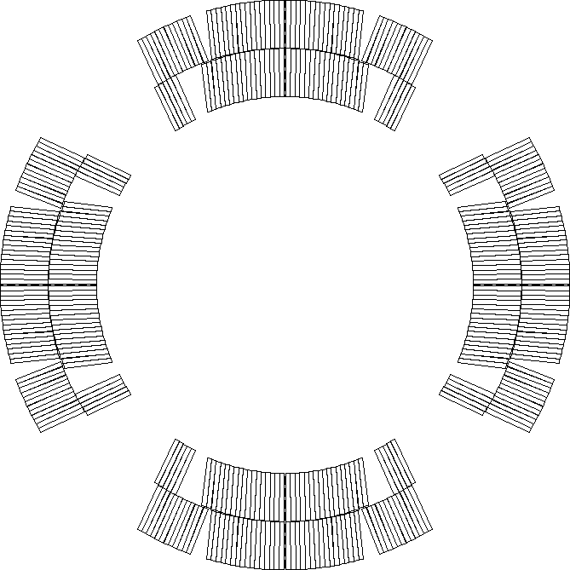
Peak voltages assumptions
Current: 16470
Old nominal, since electrical design criteria are based on old nominal current
Nominal protection (CLIQ 600 V - 40 mF, OL QH 300 V – 7.05 mF)
Coils are reported in mechanical ordering
Peak voltages have been computed using rolled and minor edge RRR values. All coil orderings resulting in peak voltage to ground less than 353 V with both assumptions and for all failure cases have been identified
Peak voltages computed using STEAM-LEDET app provided by CERN
Four Combinations of coils are considered
(160 161 243 244 154)
(160 161 243 244 246)
(160 243 154 246)
(160 243 154 246 161)
For each combination, nominal scenario plus 3 failure scenarios are considered
P2
P1
P3
P4
Notes:
Need to be u

Slide 6
Acceptable coil ordering (154 spare)
Coils are reported in mechanical order
There are 53 (with coil 154) acceptable coil orderings with voltage < 353 V that are common for both rolled and minor edge RRR values (values reported for rolled RRR)
P1 | P2 | P3 | P4 | Volt
244 | 161 | 243 | 160 | 333
244 | 161 | 160 | 243 | 333
244 | 161 | 160 | 154 | 333
244 | 161 | 154 | 160 | 333
243 | 244 | 160 | 154 | 333
244 | 161 | 243 | 154 | 334
244 | 161 | 154 | 243 | 334
243 | 161 | 244 | 160 | 335
243 | 161 | 160 | 154 | 335
243 | 154 | 160 | 244 | 335
154 | 244 | 160 | 243 | 335
243 | 161 | 244 | 154 | 336
243 | 161 | 160 | 244 | 336
243 | 161 | 154 | 244 | 336
244 | 154 | 243 | 160 | 337
243 | 244 | 154 | 161 | 337
243 | 154 | 244 | 161 | 337
160 | 244 | 243 | 161 | 337
160 | 244 | 154 | 161 | 337
160 | 243 | 154 | 161 | 337
P1 | P2 | P3 | P4 | Volt
160 | 154 | 244 | 161 | 337
160 | 154 | 243 | 244 | 337
160 | 154 | 243 | 161 | 337
154 | 161 | 243 | 160 | 337
154 | 161 | 160 | 243 | 337
160 | 243 | 244 | 161 | 338
154 | 244 | 243 | 160 | 338
154 | 244 | 160 | 161 | 338
154 | 161 | 244 | 160 | 338
154 | 161 | 160 | 244 | 338
154 | 160 | 244 | 161 | 338
243 | 244 | 160 | 161 | 339
160 | 244 | 243 | 154 | 339
154 | 161 | 243 | 244 | 339
243 | 160 | 244 | 161 | 340
160 | 161 | 154 | 244 | 340
160 | 161 | 154 | 243 | 340
244 | 154 | 160 | 243 | 341
160 | 161 | 243 | 244 | 342
160 | 161 | 243 | 154 | 342
P1 | P2 | P3 | P4 | Volt
154 | 161 | 244 | 243 | 342
160 | 161 | 244 | 243 | 345
160 | 161 | 244 | 154 | 345
243 | 160 | 244 | 154 | 346
243 | 154 | 244 | 160 | 346
160 | 154 | 244 | 243 | 346
154 | 243 | 244 | 160 | 346
154 | 160 | 244 | 243 | 346
160 | 243 | 244 | 154 | 347
244 | 243 | 154 | 161 | 351
244 | 154 | 243 | 161 | 351
243 | 160 | 154 | 161 | 351
243 | 154 | 160 | 161 | 351

Slide 7
Acceptable coil ordering (246 spare)
Coils are reported in mechanical order
There are 51 (with coil 246) acceptable coil orderings with voltage < 353 V that are common for both rolled and minor edge RRR values (values reported for rolled RRR)
P1 | P2 | P3 | P4 | Volt
246 | 161 | 244 | 160 | 332
246 | 161 | 243 | 160 | 332
246 | 161 | 160 | 244 | 332
246 | 161 | 160 | 243 | 332
244 | 161 | 243 | 160 | 333
244 | 246 | 243 | 160 | 333
244 | 246 | 160 | 243 | 333
243 | 244 | 160 | 246 | 335
243 | 161 | 244 | 160 | 335
243 | 160 | 244 | 246 | 335
243 | 246 | 244 | 160 | 335
243 | 246 | 160 | 244 | 335
244 | 246 | 160 | 161 | 336
243 | 161 | 160 | 244 | 336
160 | 243 | 244 | 246 | 336
243 | 161 | 160 | 246 | 337
160 | 244 | 243 | 161 | 337
160 | 246 | 243 | 244 | 337
243 | 246 | 160 | 161 | 338
161 | 246 | 243 | 160 | 338
P1 | P2 | P3 | P4 | Volt
160 | 243 | 244 | 161 | 338
243 | 244 | 160 | 161 | 339
243 | 246 | 244 | 161 | 339
243 | 160 | 244 | 161 | 340
160 | 246 | 244 | 243 | 340
246 | 244 | 243 | 160 | 341
246 | 243 | 244 | 160 | 341
160 | 161 | 243 | 244 | 342
244 | 243 | 246 | 161 | 345
161 | 244 | 246 | 243 | 345
161 | 246 | 243 | 244 | 345
160 | 161 | 244 | 243 | 345
243 | 244 | 246 | 161 | 346
244 | 161 | 246 | 243 | 348
244 | 160 | 243 | 246 | 348
244 | 160 | 246 | 161 | 348
243 | 161 | 246 | 244 | 348
160 | 161 | 243 | 246 | 348
161 | 246 | 160 | 243 | 350
161 | 243 | 246 | 160 | 351
P1 | P2 | P3 | P4 | Volt
161 | 246 | 160 | 244 | 351
160 | 244 | 246 | 161 | 351
160 | 161 | 244 | 246 | 351
244 | 161 | 246 | 160 | 352
243 | 160 | 246 | 161 | 352
161 | 160 | 246 | 243 | 352
160 | 243 | 246 | 161 | 352
244 | 243 | 160 | 161 | 353
161 | 160 | 246 | 244 | 353
246 | 244 | 160 | 243 | 353

Slide 8
Acceptable coil ordering (154 and 246 non-spare)
There are 10 acceptable coil orderings with voltage < 353 V that are common for both rolled and minor edge RRR values (values reported for rolled RRR) for coils 243 – 246 – 154 – 160
Coils are reported in mechanical order
P1 | P2 | P3 | P4 | Volt
243 | 246 | 154 | 160 | 334
243 | 246 | 160 | 154 | 335
160 | 246 | 154 | 243 | 335
160 | 243 | 154 | 246 | 336
160 | 154 | 243 | 246 | 336
154 | 246 | 243 | 160 | 336
160 | 246 | 243 | 154 | 337
154 | 246 | 160 | 243 | 337
243 | 154 | 160 | 246 | 345
243 | 160 | 154 | 246 | 346

Slide 9
Acceptable coil ordering (154 and 246 non-spare, 161 spare)
There are 40 acceptable coil orderings with voltage < 353 V that are common for both rolled and minor edge RRR values (values reported for rolled RRR)
P1 | P2 | P3 | P4 | Volt
246 | 161 | 243 | 160 | 332
246 | 161 | 160 | 243 | 332
246 | 161 | 160 | 154 | 332
246 | 161 | 154 | 243 | 332
246 | 161 | 154 | 160 | 332
243 | 246 | 154 | 160 | 334
243 | 161 | 160 | 154 | 335
243 | 246 | 160 | 154 | 335
160 | 246 | 154 | 243 | 335
160 | 243 | 154 | 246 | 336
160 | 154 | 243 | 246 | 336
154 | 246 | 243 | 160 | 336
243 | 161 | 160 | 246 | 337
160 | 243 | 154 | 161 | 337
160 | 246 | 243 | 154 | 337
160 | 154 | 243 | 161 | 337
154 | 161 | 243 | 160 | 337
154 | 161 | 160 | 243 | 337
154 | 246 | 160 | 243 | 337
161 | 246 | 243 | 160 | 338
P1 | P2 | P3 | P4 | Volt
243 | 246 | 160 | 161 | 338
160 | 161 | 154 | 243 | 340
154 | 161 | 160 | 246 | 340
154 | 246 | 160 | 161 | 340
161 | 246 | 243 | 154 | 342
160 | 161 | 243 | 154 | 342
161 | 246 | 154 | 160 | 343
154 | 246 | 243 | 161 | 343
160 | 246 | 154 | 161 | 344
243 | 154 | 160 | 246 | 345
154 | 161 | 243 | 246 | 345
243 | 160 | 154 | 246 | 346
160 | 161 | 154 | 246 | 346
160 | 246 | 243 | 161 | 346
161 | 246 | 154 | 243 | 348
160 | 161 | 243 | 246 | 348
161 | 246 | 160 | 154 | 349
161 | 246 | 160 | 243 | 350
243 | 160 | 154 | 161 | 351
243 | 154 | 160 | 161 | 351
Coils are reported in mechanical order

Slide 10
Backup slides

