Slide 1
MQXFA18 AUP 302.2.02 and 302.2.03 – • Strand Procurement & Testing • Cable Fabrication & Testing
Lance Cooley – NHMFL/ASC (302.2.02 L3)
Vito Lombardo – FNAL (302.2.02 CAM)
Ian Pong – LBNL (302.2.03 L3 & CAM)
Mike Naus – LBNL (302.2.03 L3 Deputy & CAM Deputy)
Elizabeth Lee – LBNL, Manufacturing Engineer (now at LBNL ALS)
Jonathan Lee – LBNL Intern Student (now Grad Student at NHMFL)

Slide 2
Cable & Coil Overview
Coil # | Cable #
154 | P43OL1196
160 | P43OL1203
161 | P43OL1209
243 | P43OL1191
244 | P43OL1195
246 | P43OL1199
All cables are 2nd generation QXF cables produced under AUP

Slide 3
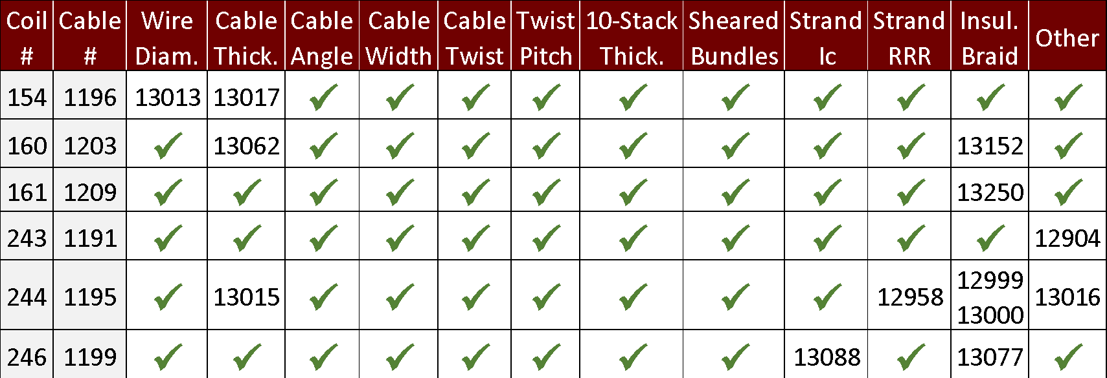
Cable QC Summary
All cables passed the required quality control testing per US-HiLumi-Doc 74
There were No Critical DRs

Slide 4
Cable 1196 (Coil 154) DR Detail: 2 DRs

Slide 5
QXFA-154 / P43OL1196: Wire Diameter
DR #13013 (1 of 2)
Issue: 1.5% diameter measurements ≥ 0.854 mm (≥ 1µm above USL) from one spool
Internal Spec: <1%
Spool: PO08S00694A01U
AUP Spec: 0.850 mm ± 0.003 mm
Cause: Unknown.
Possibly incoming product issue (e.g., drawing die wear)
Spool 03 from same billet had same issue (in Cable 1197)
Acceptance Justification
Small number of high values should not affect cable viability

Slide 6
QXFA-154 / P43OL1196: Cable Thickness
DR #13017 (2 of 2)
Issue: Single CME cable thickness point was OOS-Low at 275 m
Cause:
Below target average thickness, plus process & measurement variation
Acceptance Justification:
Single point, < 1 µm below LSL should not affect cable viability

Slide 7
Cable 1203 (Coil 160) DR Detail: 2 DRs

Slide 8
QXFA-160 / P43OL1203: Cable Thickness
DR #13062 (1 of 2)
Issue: 3 cable thickness points were OOS-High at cabling start
Cause:
Thickness is started higher than target so that it is on target in steady state. Puts thickness close to USL at start, which sometimes goes over
Acceptance Justification: Will be part of cut-off section at coiling

Slide 9
QXFA-160 / P43OL1203: Insulation Thickness
DR #13152 (2 of 2)
Issue: LBNL insulation verification measurement 2 µm above spec
152 µm actual vs. 150 µm spec
Cause:
Insulation at USL (149.8 µm) as measured by vendor (i.e. braided at upper end of spec window)
Measurement variation between sites
Acceptance Justification:
Previously accepted coils with similar insulation thickness have been coiled successfully
When factoring cable thickness (below target) & tolerance, this thicker insulation should be acceptable

Slide 10
Cable 1209 (Coil 161) DR Detail: 1 DR

Slide 11
QXFA-161 / P43OL1209: Insulation Thickness
DR #13250 (1 of 1)
Issue: LBNL insulation verification measurement 0.5 µm below spec
139.5 µm actual vs. 140 µm spec
Cause:
Braided at lower end of spec window
Measurement differences between sites
NEWT: 140.3 µm
Acceptance Justification:
Not expected to cause issue at coiling

Slide 12
Cable 1191 (Coil 243) DR Detail: 1 DR

Slide 13
QXFA-243 / P43OL1191: Shipment Accelerometers
DR #12904 (1 of 1)
Issue: Shipping accelerometers had data integrity issues
Accelerometer-1: Only recorded data LBNL-NEWT, not NEWT‑FNAL
Accelerometer-1: Higher than normal tilt & vibration instances
Accelerometer-2: No data recorded
Cause: Uncertain, but believed to be…
Memories not cleared before shipment
Rough handling from shipping company
Acceptance Justification:
Low probability of quality issues with cables
Cables will be inspected during winding
[Same issue as Coils 151 & 242 reviewed for MQXFA17]

Slide 14
Cable 1195 (Coil 244) DR Detail: 5 DRs

Slide 15
QXFA-244 / P43OL1195: RRR HT Temperature Range
DR #12958 (1 of 5)
Issue:
Range of TC values along sample length at 210°C plateau was >2°C
Cause:
Temperature was slightly high at one end of horizontal tube furnace
One of seven TCs caused range to go out
Acceptance Justification:
Furnace witness wires were within historical norms
Average temperature on target (209.9°C)
210°C is least impactful plateau for RRR

Slide 16
QXFA-244 / P43OL1195: Braiding Data Logger
DR #12999 (2 of 5)
Issue: Automated data logger at braiding vendor only recorded first 34 m of data.
Cause: Improper data logger set-up by braiding operator
Acceptance Justification:
Vision system operational for full length, catching “one faint oil spot”
Rest of log retroactively filled-in based on notes from operator
After this, interlock implemented preventing braiding operation without data logger being on

Slide 17
QXFA-244 / P43OL1195: Insulation Thickness
DR #13000 (3 of 5)
Issue: Insulation thickness verification 1 µm above specification (151 µm)
Cause: Vendor’s measurement was lower and in spec (148 µm)
Acceptance Justification:
Previously accepted coils with similar insulation thickness have been coiled successfully
When factoring cable thickness tolerance, this thicker insulation should be acceptable

Slide 18
QXFA-244 / P43OL1195: Initial Cable Thickness
DR #13015 (4 of 5)
Issue: 3 cable thickness points were OOS-High at cabling start
Cause:
Thickness is started higher than target so that it is on target in steady state. Puts thickness close to USL at start, which sometimes goes over
Acceptance Justification: Will be part of cut-off section at coiling

Slide 19
QXFA-244 / P43OL1195: Core Detector
DR #13016 (5 of 5)
Issue: Core detector inoperable during cable manufacturing
Cause: Dead battery. No time to charge or change before run
Acceptance Justification:
Core spool weighed before and after run to ensure proper amount was incorporated into cable
Core sporadically monitored during run to ensure it was being incorporated into cable

Slide 20
Cable 1199 (Coil 246) DR Detail: 2 DRs

Slide 21
QXFA-246 / P43OL1199: Shipment Accelerometers
DR #13077 (1 of 2)
Issue: Insulation thickness verification 1 µm above spec (151 µm)
Cause: Unknown. Possible measurement differences between sites
Measurement in spec at vendor (147 µm)
Acceptance Justification:
Previously accepted coils with similar insulation thickness have been coiled successfully
When factoring cable thickness & tolerance, this thicker insulation should be acceptable

Slide 22
QXFA-246 / P43OL1199: Ic Measurement
DR #13088 (2 of 2)
Issue: One of three strands was unable to be measured, requiring measurement of back-up strand
Cause: Believed to be sample handling damage, per FNAL
Acceptance Justification:
Backup sample successfully measured with passing results

Slide 23
END [Back-Up Slides Below]

Slide 24
Strand Summary
All strands ordered per the “HiLumi” specification under the AUP program, per the following POs:
FNAL PO 655175 Shipment B
FNAL PO 667037 Shipments D, E, and F
FNAL PO 683525 Shipment A
CERN Exchange
Conductor Description:
Ø0.85 mm, 108/127 stack, Ti-doped, Reduced-Sn core

Slide 25
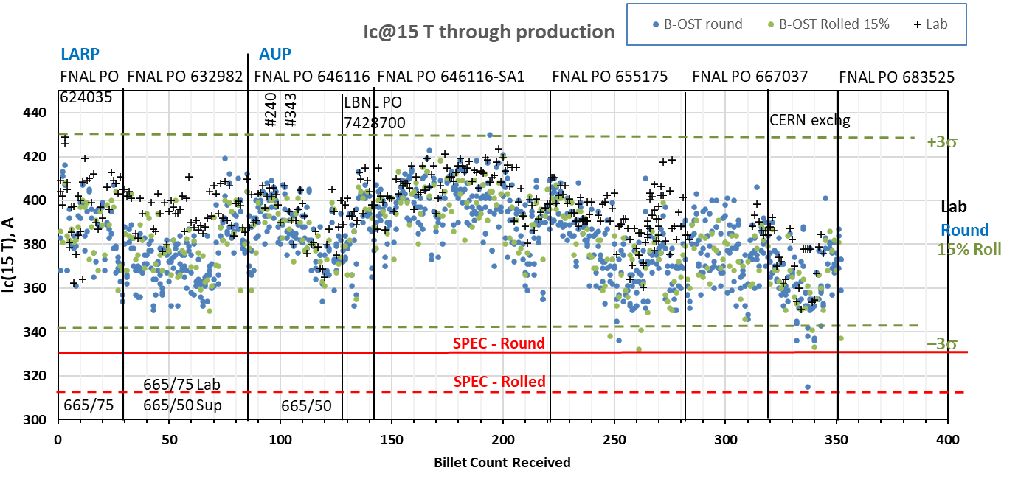
Strand Production Data – I_{c, 15T}
Yellow bands indicate strand data for these cables
Both 665°C/75h
S: 665°C/50h
V: 665°/75h
Both 665°C/50h

Slide 26
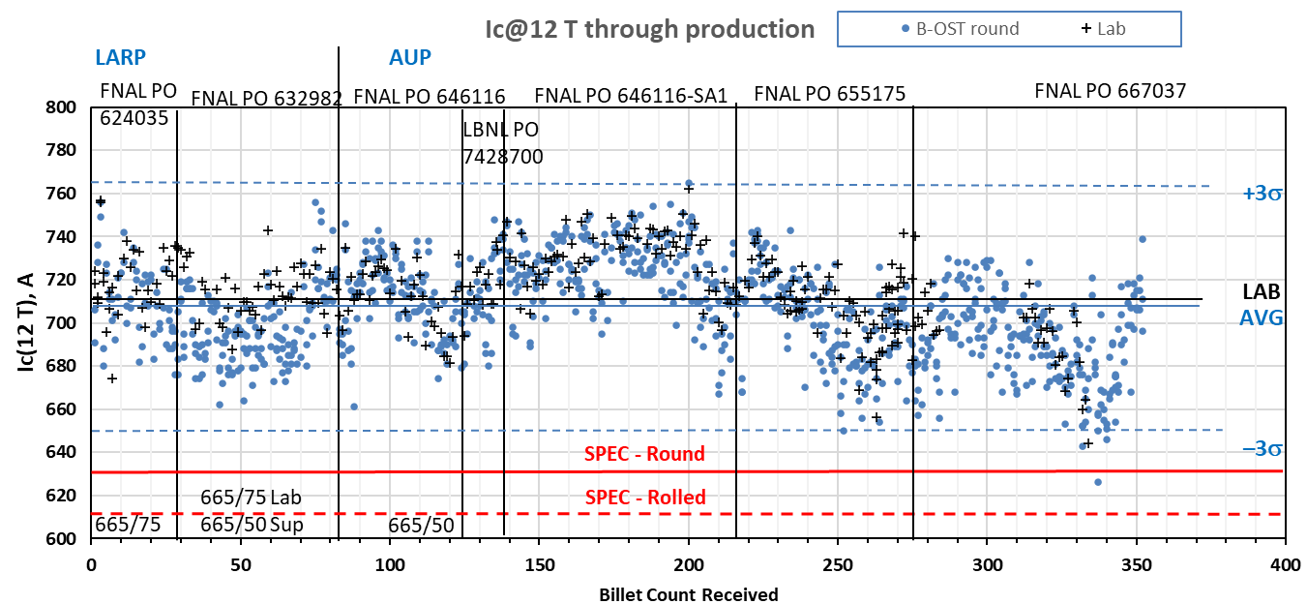
Strand Production Data – I_{c, 12T}
Yellow bands indicate strand data for these cables
Both 665°C/50h
Both 665°C/75h
S: 665°C/50h
V: 665°/75h

Slide 27
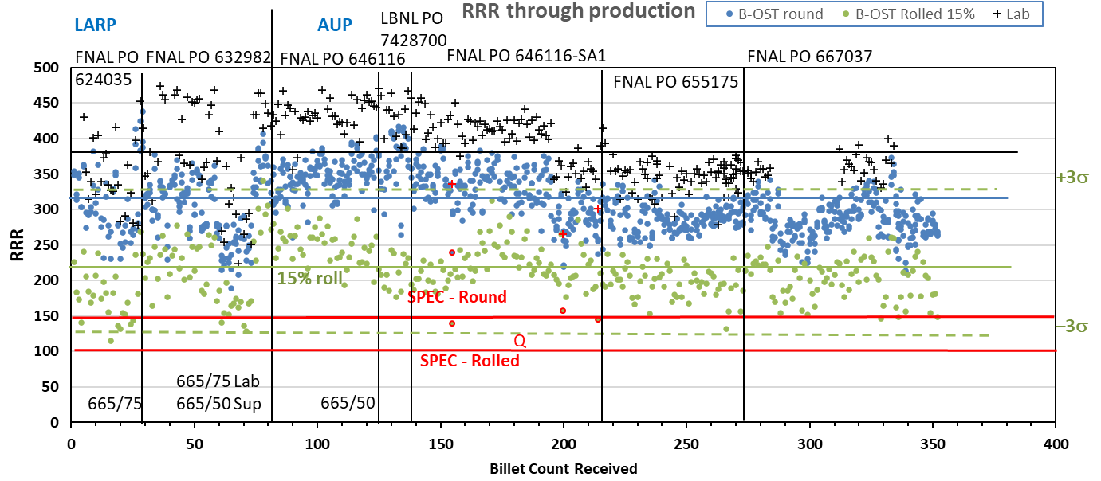
Strand Production Data - RRR
Data for 15% rolled strand predicts the RRR at cable sharp bend
Lab: IEC method, Supplier: 20K method
Inter-lab comparisons have validated approaches (see QP)
Yellow bands indicate strand data for these cables

Slide 28
QXFA-243 / P43OL1191

Slide 29
P43OL1191 – Cable Date, Lengths
Cable Manufacture Date
12 Apr 2022 (Production run)
Cable Length:
467 m (LBNL, fabricated, including LBNL samples)

Slide 30
P43OL1191 – Strand and SS Core ID
Spool: 40 spools from 35 different billets.
Each spool provided one unit length.
Core:
120L42A7400804
Heat: 850858. Lot: 17-521
Material: 316L
Chemical Properties CoT/CoC #172660-1: 0.16 wt% Co
Core width: 12.0 mm
AO08S00092A02U | AO08S00253A01U | AO08S00299A05U | AO08S00384A01U
AO08S00169A02U | AO08S00254A03U | AO08S00301A03U | AO08S00391A03U
AO08S00169A03U | AO08S00256A01U | AO08S00304A02U | AO08S00391A07U
AO08S00226A02U | AO08S00271A04U | AO08S00308A02U | AO08S00392A04U
AO08S00241A04U | AO08S00272A02U | AO08S00309A02U | AO08S00403A04U
AO08S00246A02U | AO08S00282A04U | AO08S00311A03U | AO08S00405A01U
AO08S00246A06U | AO08S00284A03U | AO08S00316A02U | AO08S00437A02U
AO08S00248A05U | AO08S00292A03U | AO08S00321A01U | AO08S00468A02U
AO08S00249A05U | AO08S00297A02U | AO08S00321A03U | AO08S00468A04U
AO08S00250A02U | AO08S00298A03U | AO08S00342A05U | AO08S00570A04U

Slide 31
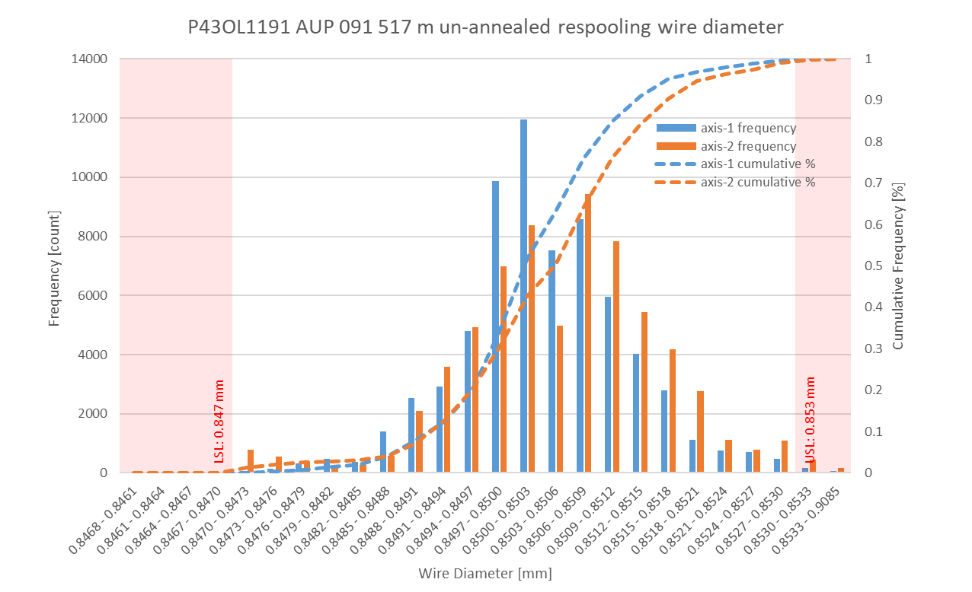
P43OL1191 Respooling Wire Diameter
Below LSL: 0.025%
Above USL: 0.175%

Slide 32
P43OL1191 – Cable QC Data Summary
CME:
Residual Twist: 135°
10-stack:
Qualification: 1.535 mm
Production tail end: 1.526 mm
 | Pressure (MPa) | Angle (°) | Width (mm) | Thickness (mm)
Maximum | 17.0 | 0.392 | 18.165 | 1.532
Average | 16.8 | 0.350 | 18.145 | 1.524
Minimum | 16.7 | 0.322 | 18.141 | 1.517
Sigma | 0.04 | 0.009 | 0.002 | 0.002

Slide 33
Rollers: P-93 (2021-08-09) & P-94 (2021-08-09)

Slide 34
Rollers: P-93 (2021-08-09) & P-94 (2021-08-09)

Slide 35
Rollers: P-93 (2021-08-09) & P-94 (2021-08-09)

Slide 36
P43OL1191 – Braiding
Fiberglass Lot: #RCV0011562
P/I: 18.9
Spool tension: 10 lbs. @ payoff. 20 lbs. @ takeup (12 lbs min)
Bobbin payoff tension: 0.125 lbs. ≤ T ≤ 0.250 lbs.
Insulation Thickness (at 5 MPa)
Site | Cycle #1 (mm) | Cycle #2 (mm) | Cycle #3 (mm) | Average (mm)
NEWT | 0.151 | 0.149 | 0.148 | 0.149
LBNL Verification | 0.148 | 0.146 | 0.144 | 0.146

Slide 37
P43OL1191 – Wire Parameters
Properties | Inspected Average
Wire Diameter | 0.8504 ± 0.001 mm (LBNL)¹
Cu ratio ª | 54.11% (BOST)
Strand twist pitch ª | 18.6 mm (BOST)
RRR (RW) ª | 313 (BOST)
RRR (15% rolled) ª | 216 (BOST)
I_{C} (4.2 K, 15 T) ª | 380 A (BOST)
I_{C} (4.2 K, 14 T) ª | 474 A (BOST)
I_{C} (4.2 K, 13 T) ª | 583 A (BOST)
I_{C} (4.2 K, 12 T) ª | 705 A (BOST)
ª First billet averaged, then weighted average according to the spool distribution in the cable
¹ As-received. LBNL respooling data. Mean ± 1 sigma

Slide 38
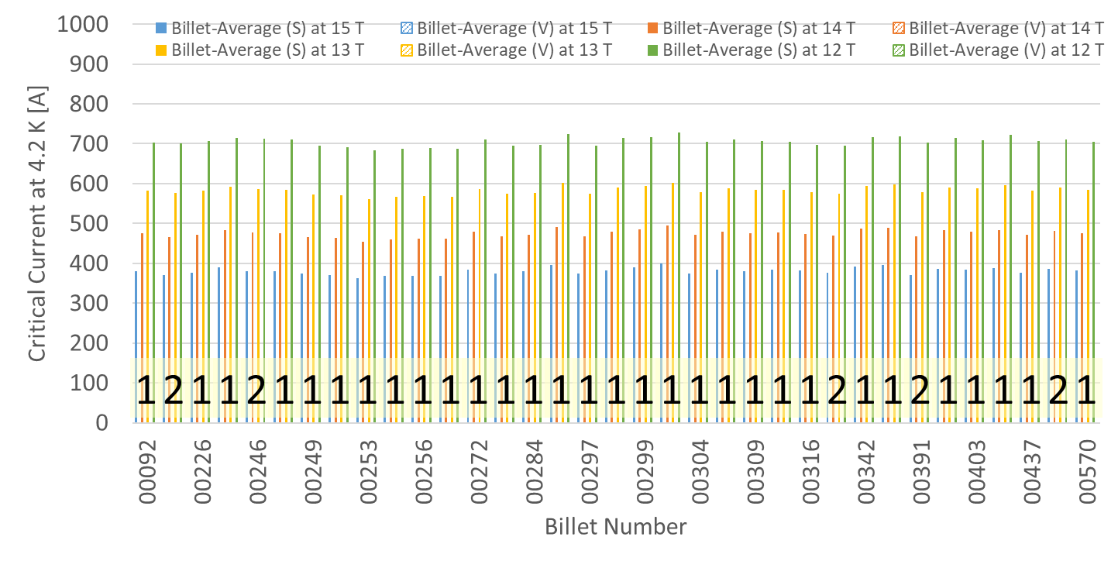
P43OL1191 – Wire Parameters Supplier (S) and Verification (V) I_{C} Data
Due to the fact that the source wire came from exchange with CERN, verification data are not available.

Slide 39
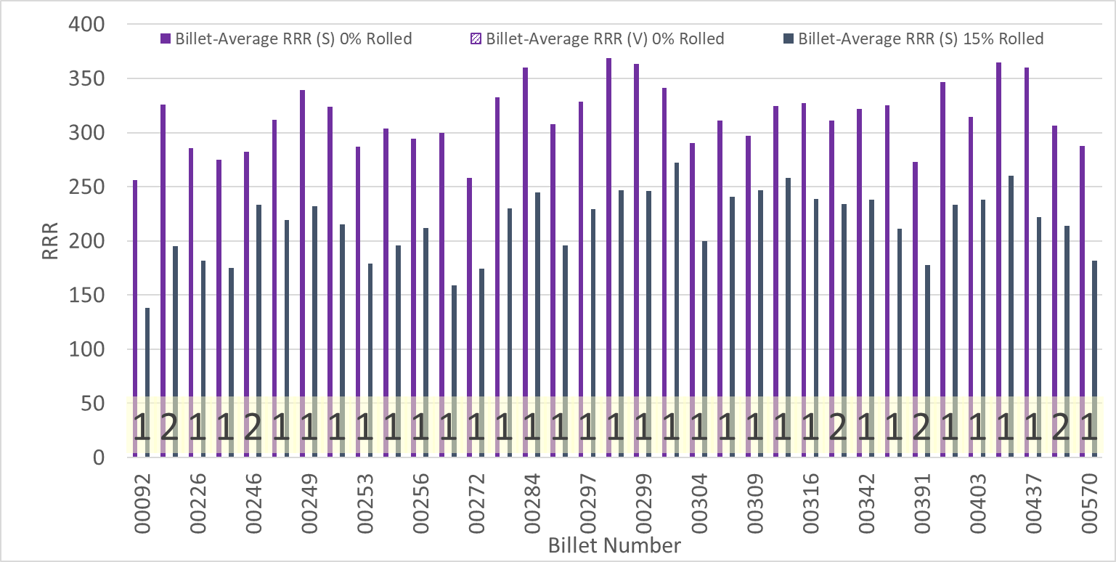
P43OL1191 – Wire Parameters Supplier (S) and Verification (V) RRR Data
Due to the fact that the source wire came from exchange with CERN, verification data are not available.

Slide 40
P43OL1191 – Extracted Strand RRR
Cable ID | No. of Units from Billet (spool) | Heat Treat/ Sample ID | Major Edge RRR | Minor Edge RRR | Straight 1 RRR | Straight 2 RRR
AO08S00392A04U P43OL1191AE03E | 1 (1) | LRLK220420ALC1 | 283 | 306 | 371 | 401
AO08S00308A02U P43OL1191AE06E | 1 (1) | LRLK220420ALC1 | 327 | 334 | 386 | 408
AO08S00246A02U P43OL1191AE09E | 2 (1) | LRLK220420ALC1 | 319 | 306 | 376 | 400
AO08S00169A03U P43OL1191AE11E | 2 (1) | LRLK220420ALC1 | 263 | 244 | 328 | 353
AO08S00321A03U P43OL1191AE24E | 2 (1) | LRLK220420ALC1 | 353 | 338 | 389 | 409

Slide 41
P43OL1191 – I_{c}, Cable Qual Samples
Wire/ Cable Strand | I_{c}(A) at Field (T)
 | 12 T | 13 T | 14 T | 15 T
AO08S00246A02U P43OL1191AE09E | 667 | 552 | 448 | 357
AO08S00169A02U P43OL1191AE11E | 674 | 554 | 451 | 359
AO08S00321A03U P43OL1191AE24E | 666 | 555 | 454 | 365

Slide 42
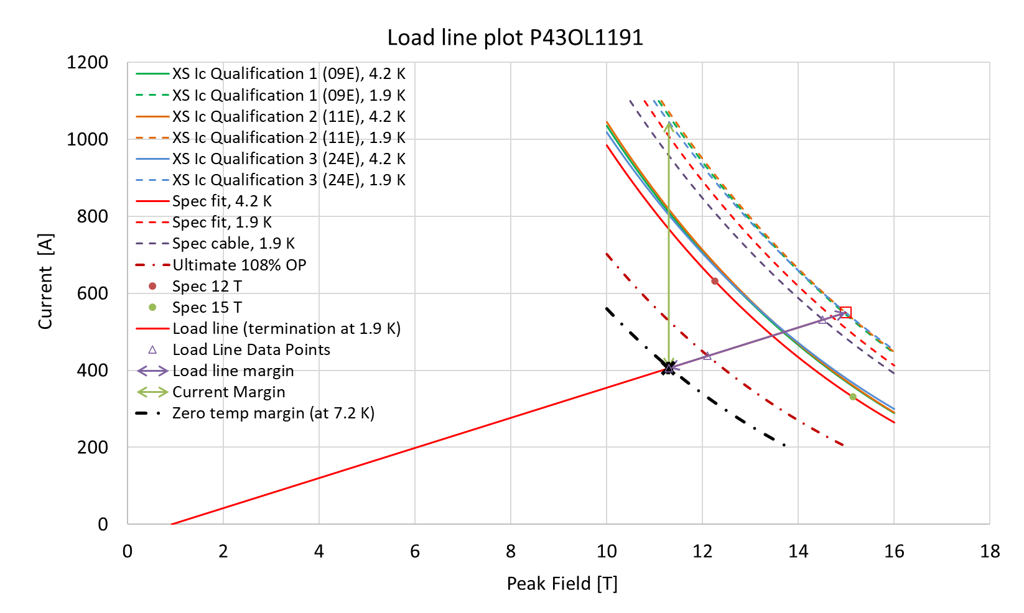
P43OL1191 – SSL Plot, Cable Qual Samples

Slide 43
P43OL1191 – SSL Margins, Qual Samples
Strand from which Margin is Calculated: | Strand # 24E @ 1.9 K
Margins | Margin | Operating Point (X)
Load Line Margin (Purple Arrow) | 26.2% | 73.8%
Current Margin (Green Arrow) | 61.2% | 38.8%
Temperature Margin (K) | 5.3 | 7.2
Limits | Strand | Strand x 40
Selected Strand’s Current (A) at Margin-Calculation Field | 1045 | 41819
Selected Strand’s Current (A) at 100% SSL | 550 | 22001
Selected Strand’s Field (T) at 100% SSL | 15.0

Slide 44
QXFA-244 / P43OL1195

Slide 45
P43OL1195 – Cable Date, Lengths
Cable Manufacture Date
07 July 2022 (Production run)
Cable Length:
469 m (LBNL, fabricated, including LBNL samples)

Slide 46
P43OL1195 – Strand and SS Core ID
Spool:
PO08S00685A03U x 13 ULs
PO08S00686A02U x 5 ULs
PO08S00687A01U x 18 ULs
PO08S00688A03U x 4 ULs
Core:
120L46A7400804
Heat: 850858. Lot: 17-521
Material: 316L
Chemical Properties CoT/CoC #187781-1: 0.16 wt% Co
Core width: 12.0 mm
From 4 billets

Slide 47
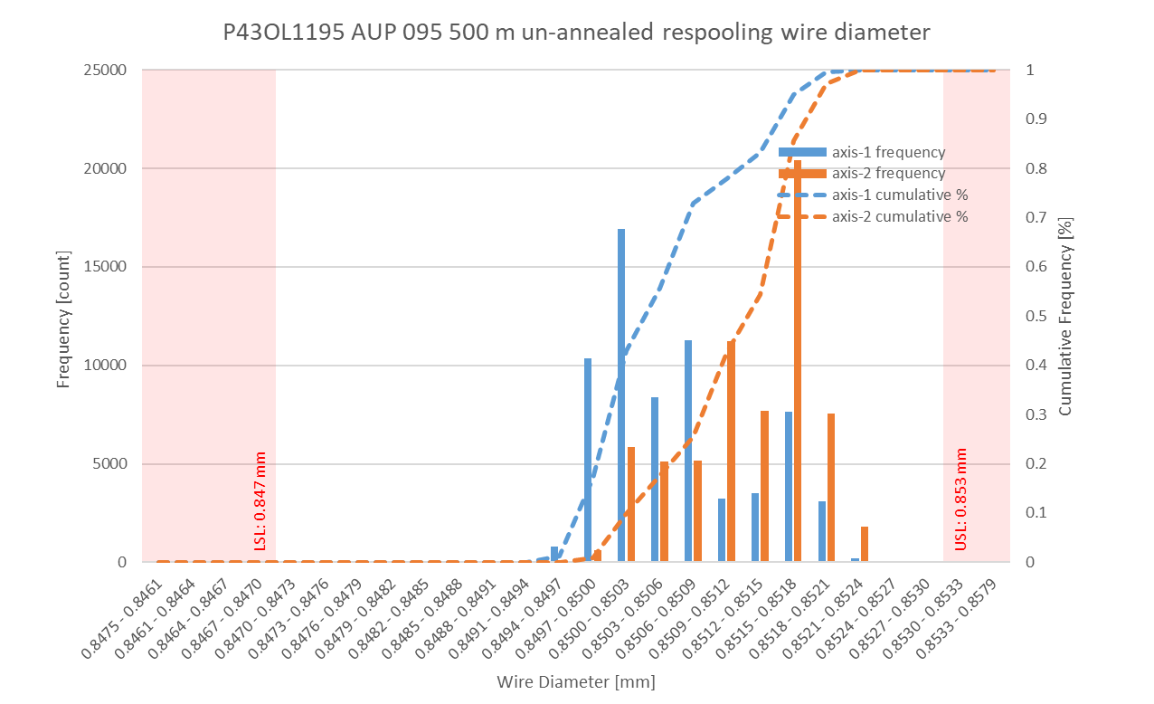
P43OL1195 Respooling Wire Diameter
Below LSL: 0.000%
Above USL: 0.021%

Slide 48
P43OL1195 – Cable QC Data Summary
CME:
Residual Twist: 130°
10-stack:
Qualification: 1.538 mm
Production tail end: 1.529 mm
 | Pressure (MPa) | Angle (°) | Width (mm) | Thickness (mm)
Maximum | 17.1 | 0.393 | 18.154 | 1.536
Average | 16.9 | 0.365 | 18.139 | 1.526
Minimum | 16.6 | 0.327 | 18.133 | 1.522
Sigma | 0.03 | 0.012 | 0.003 | 0.002

Slide 49
Rollers: P-93 (2021-08-09) & P-94 (2021-08-09)

Slide 50
Rollers: P-93 (2021-08-09) & P-94 (2021-08-09)

Slide 51
Rollers: P-93 (2021-08-09) & P-94 (2021-08-09)

Slide 52
P43OL1195 – Braiding
Fiberglass Lot: #RCV00011562
P/I: 18.9
Spool tension: 10 lbs. @ payoff. 20 lbs. @ takeup (12 lbs min)
Bobbin payoff tension: 0.125 lbs. ≤ T ≤ 0.250 lbs.
Insulation Thickness (at 5 MPa)
Site | Cycle #1 (mm) | Cycle #2 (mm) | Cycle #3 (mm) | Average (mm)
NEWT | 0.149 | 0.148 | 0.147 | 0.148
LBNL Verification | 0.154 | 0.151 | 0.150 | 0.151

Slide 53
P43OL1195 – Wire Parameters
Properties | Inspected Average
Wire Diameter | 0.8509 ± 0.001 mm (LBNL)¹
Cu ratio ª | 53.97% (BOST)
Strand twist pitch ª | 19.4mm (BOST)
RRR (RW) ª | 296 (BOST)
RRR (15% rolled) ª | 229 (BOST)
I_{C} (4.2 K, 15 T) ª | 374 A (BOST)
I_{C} (4.2 K, 14 T) ª | 468 A (BOST)
I_{C} (4.2 K, 13 T) ª | 576 A (BOST)
I_{C} (4.2 K, 12 T) ª | 697 A (BOST)
ª First billet averaged, then weighted average according to the spool distribution in the cable
¹ As-received. LBNL respooling data. Mean ± 1 sigma

Slide 54
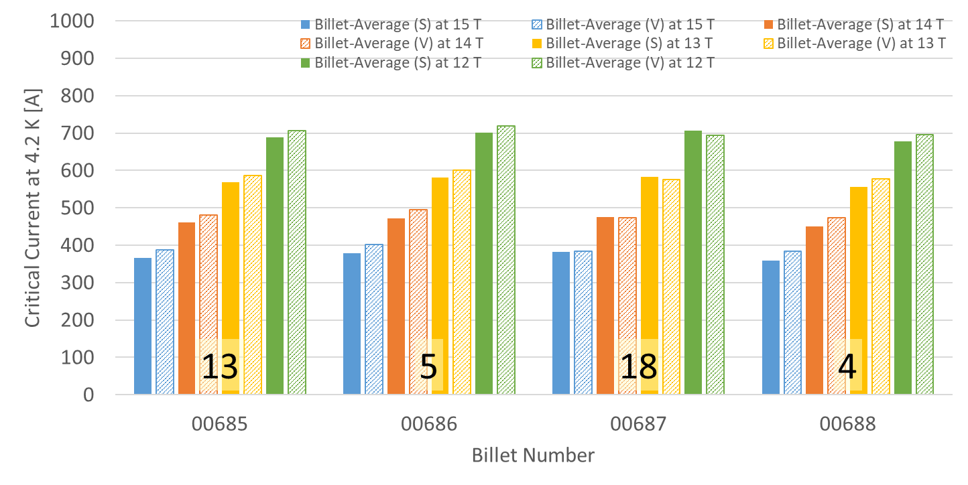
P43OL1195 – Wire Parameters Supplier (S) and Verification (V) I_{C} Data
Number of spools from that billet used in the cable

Slide 55
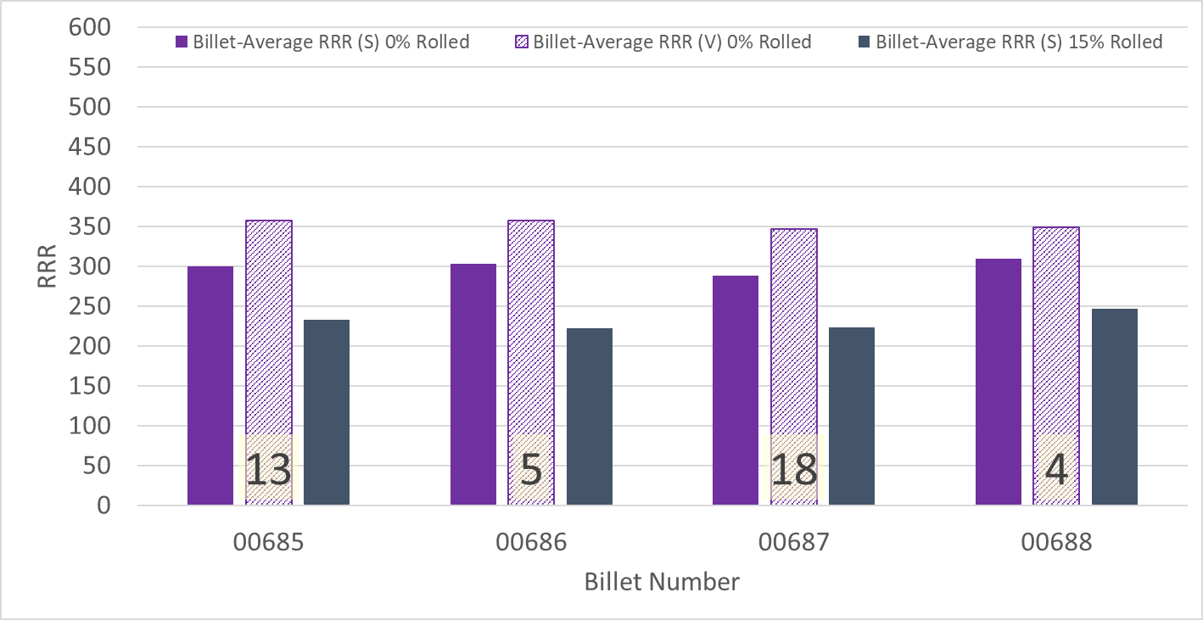
P43OL1195 – Wire Parameters Supplier (S) and Verification (V) RRR Data
Number of spools from that billet used in the cable

Slide 56
P43OL1195 – Extracted Strand RRR
Cable ID | No. of Units from Billet (spool) | Heat Treat/ Sample ID | Major Edge RRR | Minor Edge RRR | Straight 1 RRR | Straight 2 RRR
PO08S00685A03U P43OL1195AE03E | 13 (13) | LRLK220804ALC1 | 326 | 273 | 348 | 349
PO08S00685A03U P43OL1195AE06E | 13 (13) | LRLK220804ALC1 | 336 | 264 | 349 | 355
PO08S00686A02U P43OL1195AE21E | 5 (5) | LRLK220804ALC1 | 272 | 240 | 311 | 298
PO08S00687A01U P43OL1195AE29E | 18 (18) | LRLK220804ALC1 | 282 | 231 | 307 | 318
PO08S00687A01U P43OL1195AE30E | 18 (18) | LRLK220804ALC1 | 326 | 253 | 330 | 343

Slide 57
P43OL1195 – I_{c}, Cable Qual Samples
Wire/ Cable Strand | I_{c}(A) at Field (T)
 | 12 T | 13 T | 14 T | 15 T
PO08S00687A01U P43OL1195AE29E | 671 | 553 | 451 | 359
PO08S00685A03U P43OL1195AE01E | 666 | 552 | 449 | 359
PO08S00686A02U P43OL1195AE21E | 676 | 560 | 458 | 367

Slide 58
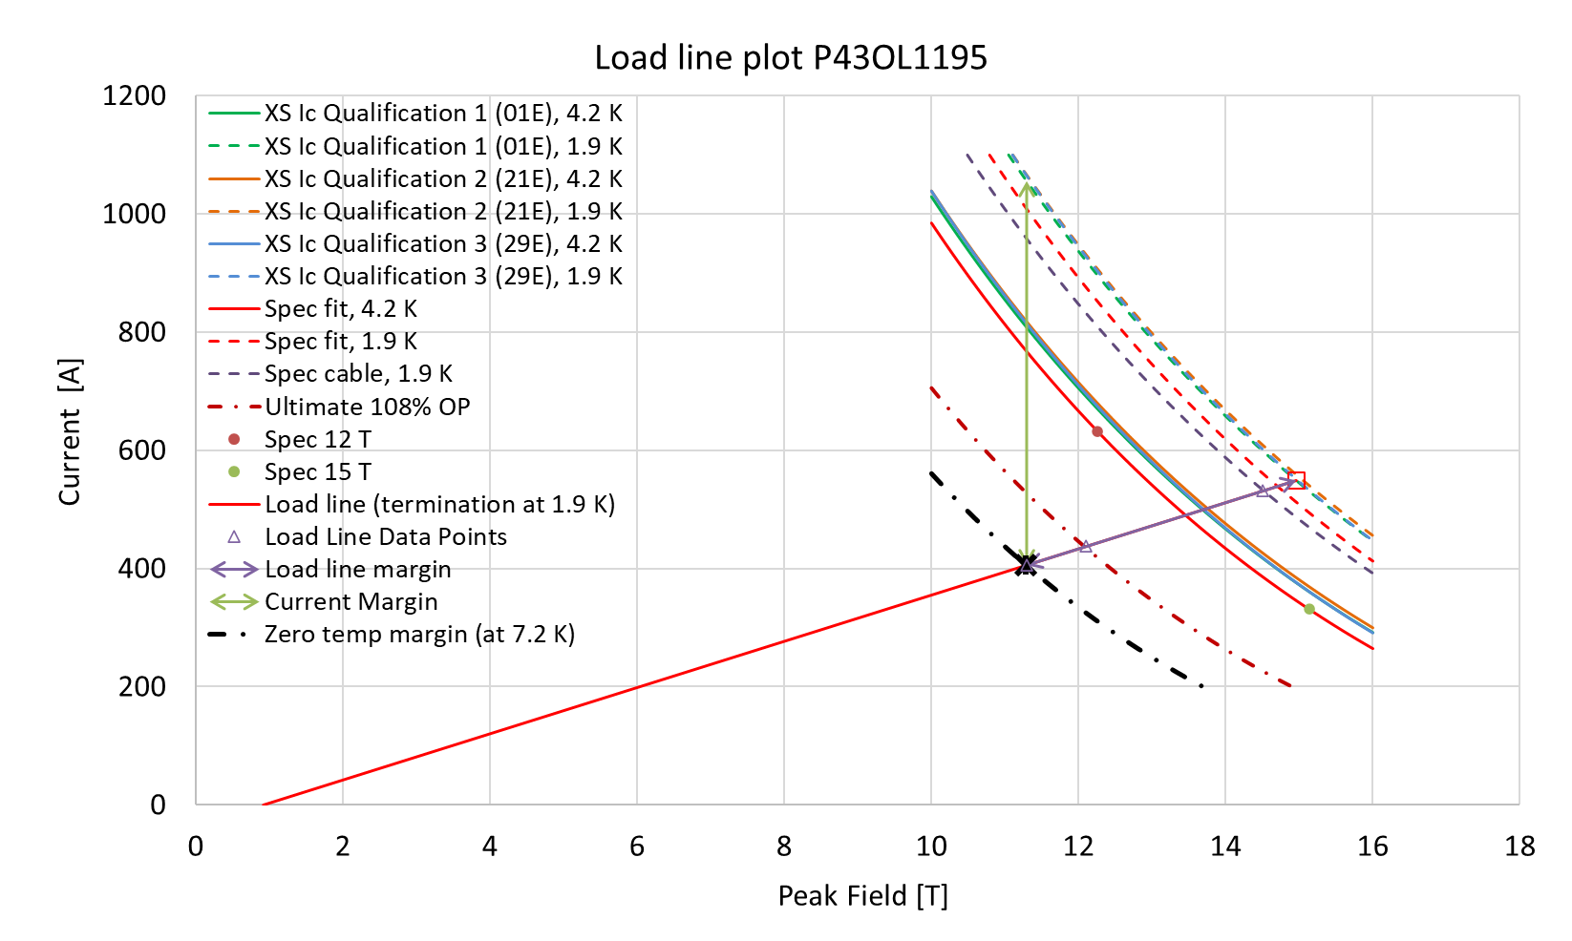
P43OL1195 – SSL Plot, Cable Qual Samples

Slide 59
P43OL1195 – SSL Margins, Qual Samples
Strand from which Margin is Calculated: | Strand # 01E @ 1.9 K
Margins | Margin | Operating Point (X)
Load Line Margin (Purple Arrow) | 26.1% | 73.9%
Current Margin (Green Arrow) | 61.6% | 38.4%
Temperature Margin (K) | 5.3 | 7.2
Limits | Strand | Strand x 40
Selected Strand’s Current (A) at Margin-Calculation Field | 1056 | 42221
Selected Strand’s Current (A) at 100% SSL | 549 | 21964
Selected Strand’s Field (T) at 100% SSL | 15.0

Slide 60
QXFA-154 / P43OL1196

Slide 61
P43OL1196 – Cable Date, Lengths
Cable Manufacture Date
11 Aug 2022 (Production run)
Cable Length:
470 m (LBNL, fabricated, including LBNL samples)

Slide 62
P43OL1196 – Strand and SS Core ID
Spool:
Core:
120L47A7400804
Heat: 850858 Lot: 17-521
Material: 316L
Chemical Properties CoT/CoC #187781-1: 0.16 wt% Co
Core width: 12.0 mm
PO08S00596A01U x 1 ULs | PO08S00631A07U x 3 ULs
PO08S00598A02U x 1 ULs | PO08S00632A01U x 1 ULs
PO08S00602A03U x 1 ULs | PO08S00632A02U x 1 ULs
PO08S00621A05U x 1 ULs | PO08S00636A02U x 1 ULs
PO08S00622A01U x 1 ULs | PO08S00638A05U x 1 ULs
PO08S00622A03U x 1 ULs | PO08S00685A01U x 2 ULs
PO08S00625A01U x 1 ULs | PO08S00685A02U x 2 ULs
PO08S00625A03U x 1 ULs | PO08S00689A01U x 6 ULs
PO08S00630A03U x 1 ULs | PO08S00689A02U x 1 ULs
PO08S00631A01U x 1 ULs | PO08S00689A05U x 2 ULs
PO08S00631A02U x 3 ULs | PO08S00690A02U x 2 ULs
PO08S00631A03U x 1 ULs | PO08S00694A01U x 1 ULs
PO08S00631A06U x 3 ULs
From 15 billets

Slide 63
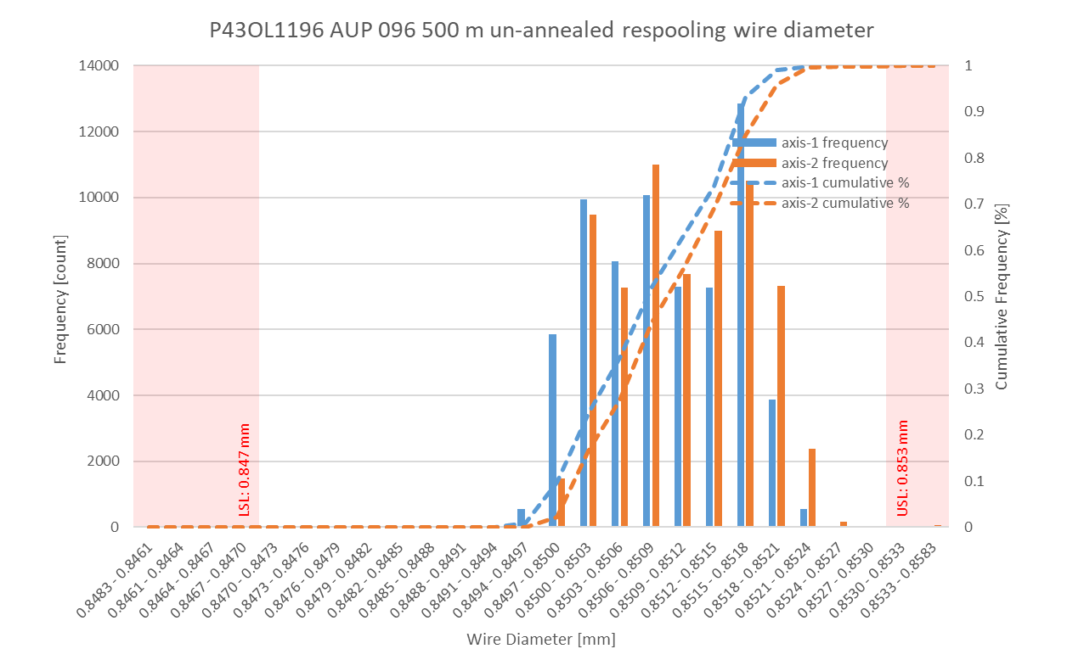
P43OL1196 Respooling Wire Diameter
Below LSL: 0.000%
Above USL: 0.075%

Slide 64
P43OL1196 – Cable QC Data Summary
CME:
Residual Twist: 145°
10-stack:
Qualification: 1.534 mm
Production tail end: 1.527 mm
 | Pressure (MPa) | Angle (°) | Width (mm) | Thickness (mm)
Maximum | 17.0 | 0.394 | 18.142 | 1.531
Average | 16.9 | 0.368 | 18.131 | 1.519
Minimum | 16.8 | 0.343 | 18.126 | 1.514
Sigma | 0.02 | 0.009 | 0.002 | 0.002

Slide 65
Rollers: P-93 (2021-08-09) & P-94 (2021-08-09)

Slide 66
Rollers: P-93 (2021-08-09) & P-94 (2021-08-09)

Slide 67
Rollers: P-93 (2021-08-09) & P-94 (2021-08-09)

Slide 68
P43OL1196 – Braiding
Fiberglass Lot: #RCV00011562
P/I: 18.9
Spool tension: 10 lbs. @ payoff. 20 lbs. @ takeup (12 lbs min)
Bobbin payoff tension: 0.125 lbs. ≤ T ≤ 0.250 lbs.
Insulation Thickness (at 5 MPa)
Site | Cycle #1 (mm) | Cycle #2 (mm) | Cycle #3 (mm) | Average (mm)
NEWT | 0.149 | 0.147 | 0.146 | 0.147
LBNL Verification | 0.149 | 0.146 | 0.146 | 0.147

Slide 69
P43OL1196 – Wire Parameters
Properties | Inspected Average
Wire Diameter | 0.8510 ± 0.001 mm (LBNL)¹
Cu ratio ª | 54.27% (BOST)
Strand twist pitch ª | 19.4mm (BOST)
RRR (RW) ª | 288 (BOST)
RRR (15% rolled) ª | 203 (BOST)
I_{C} (4.2 K, 15 T) ª | 375 A (BOST)
I_{C} (4.2 K, 14 T) ª | 469 A (BOST)
I_{C} (4.2 K, 13 T) ª | 575 A (BOST)
I_{C} (4.2 K, 12 T) ª | 697 A (BOST)
ª First billet averaged, then weighted average according to the spool distribution in the cable
¹ As-received. LBNL respooling data. Mean ± 1 sigma

Slide 70
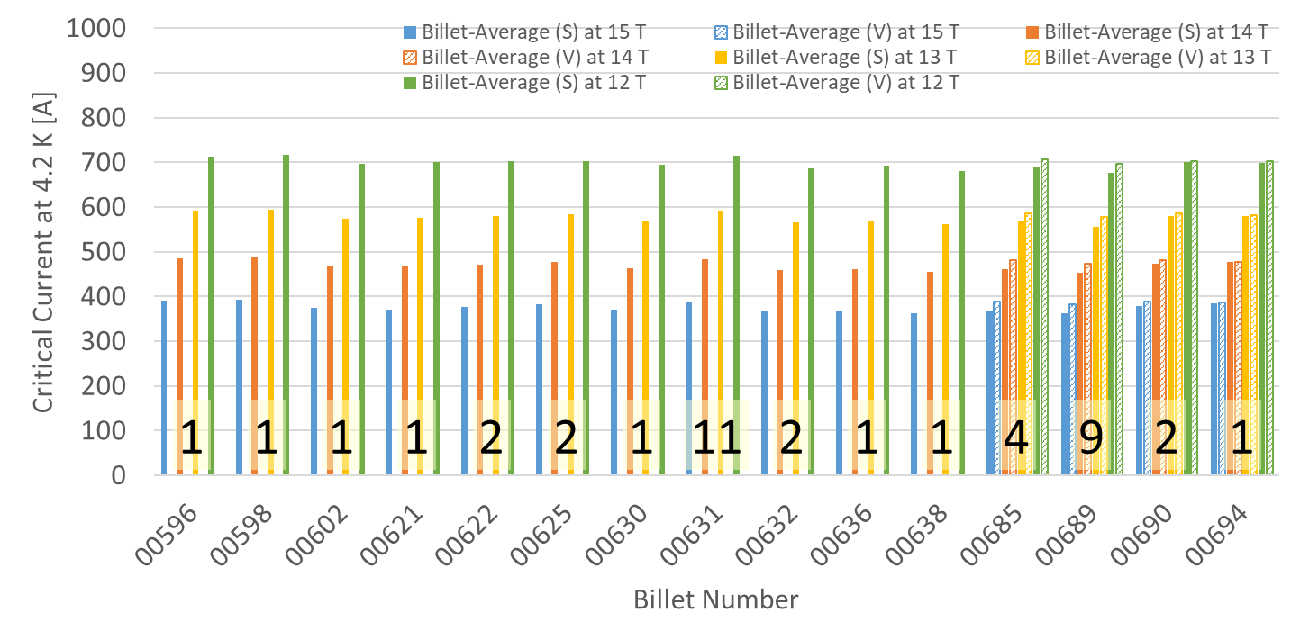
P43OL1196 – Wire Parameters Supplier (S) and Verification (V) I_{C} Data
Number of spools from that billet used in the cable
Verification samples only sent to CERN, so Verification data is not available for several billets

Slide 71
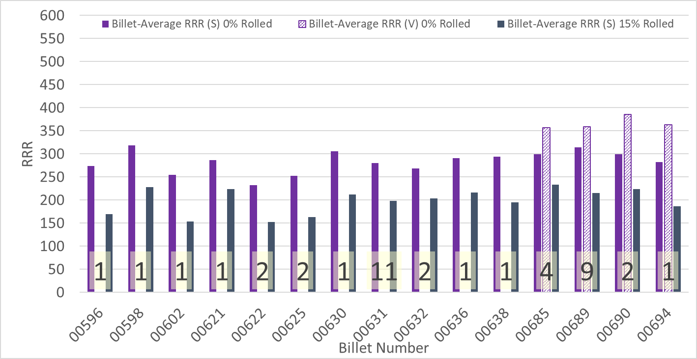
P43OL1196 – Wire Parameters Supplier (S) and Verification (V) RRR Data
Number of spools from that billet used in the cable
Verification samples only sent to CERN, so Verification data is not available for several billets

Slide 72
P43OL1196 – Extracted Strand RRR
Cable ID | No. of Units from Billet (spool) | Heat Treat/ Sample ID | Major Edge RRR | Minor Edge RRR | Straight 1 RRR | Straight 2 RRR
PO08S00689A01U P43OL1196AE03E | 9 (6) | LRLK220825ALC1 | 332 | 275 | 338 | 337
PO08S00685A02U P43OL1196AE11E | 4 (2) | LRLK220825ALC1 | 259 | 218 | 286 | 279
PO08S00631A02U P43OL1196AE19E | 11 (3) | LRLK220825ALC1 | 303 | 275 | 353 | 360
PO08S00631A06U P43OL1196AE30E | 11 (3) | LRLK220825ALC1 | 303 | 271 | 335 | 344
PO08S00631A07U P43OL1196AE48E | 11 (3) | LRLK220825ALC1 | 304 | 270 | 339 | 350

Slide 73
P43OL1196 – I_{c}, Cable Qual Samples
Wire/ Cable Strand | I_{c}(A) at Field (T)
 | 12 T | 13 T | 14 T | 15 T
PO08S00689A01U P43OL1196AE01E | 662 | 549 | 448 | 362
PO08S00631A02U P43OL1196AE19E | 690 | 575 | 470 | 378
PO08S00631A06U P43OL1196AE30E | 669 | 565 | 460 | 361

Slide 74
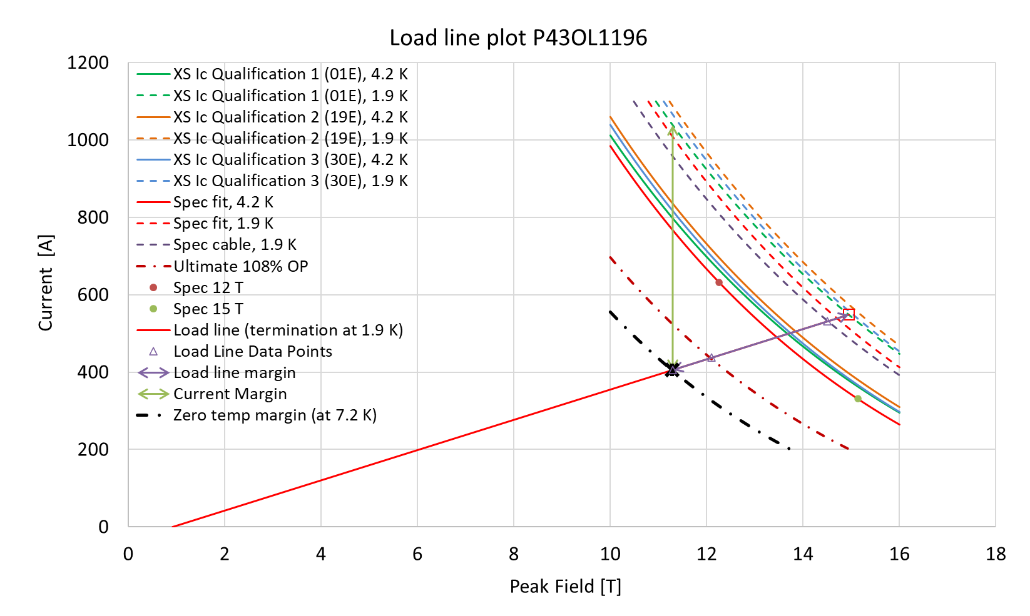
P43OL1196 – SSL Plot, Cable Qual Samples

Slide 75
P43OL1196 – SSL Margins, Qual Samples
Strand from which Margin is Calculated: | Strand # 01E @ 1.9 K
Margins | Margin | Operating Point (X)
Load Line Margin (Purple Arrow) | 26.0% | 74.0%
Current Margin (Green Arrow) | 60.9% | 39.1%
Temperature Margin (K) | 5.3 | 7.2
Limits | Strand | Strand x 40
Selected Strand’s Current (A) at Margin-Calculation Field | 1039 | 41544
Selected Strand’s Current (A) at 100% SSL | 549 | 21942
Selected Strand’s Field (T) at 100% SSL | 14.9

Slide 76
QXFA-246 / P43OL1199

Slide 77
P43OL1199 – Cable Date, Lengths
Cable Manufacture Date
10 Nov 2022 (Production run)
Cable Length:
471 m (LBNL, fabricated, including LBNL samples)

Slide 78
P43OL1199 – Strand and SS Core ID
Spool:
PO08S00538A01U x 2 ULs
PO08S00538A02U x 8 ULs
PO08S00538A03U x 3 ULs
PO08S00538A04U x 3 ULs
PO08S00690A01U x 11 ULs
PO08S00690A03U x 4 ULs
PO08S00692A01U x 7 ULs
PO08S00695A01U x 2 ULs
Core:
120L50A7400804
Heat: 850858 Lot: 17-521
Material: 316L
Chemical Properties CoT/CoC #187781-1: 0.16 wt% Co
Core width: 12.0 mm
From 4 billets

Slide 79
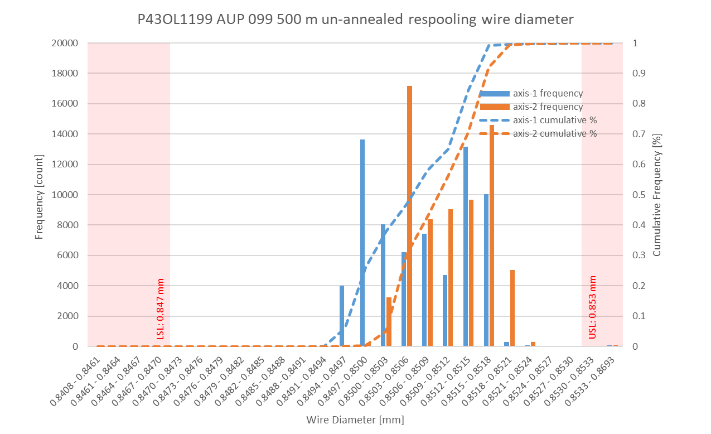
P43OL1199 Respooling Wire Diameter
Below LSL: 0.005%
Above USL: 0.105%

Slide 80
P43OL1199 – Cable QC Data Summary
CME:
Residual Twist: 145°
10-stack:
Qualification: 1.532 mm
Production tail end: 1.527 mm
 | Pressure (MPa) | Angle (°) | Width (mm) | Thickness (mm)
Maximum | 17.1 | 0.406 | 18.159 | 1.531
Average | 17.0 | 0.386 | 18.134 | 1.521
Minimum | 16.9 | 0.349 | 18.129 | 1.517
Sigma | 0.03 | 0.008 | 0.003 | 0.002

Slide 81
Rollers: P-93 (2021-08-09) & P-94 (2021-08-09)

Slide 82
Rollers: P-93 (2021-08-09) & P-94 (2021-08-09)

Slide 83
Rollers: P-93 (2021-08-09) & P-94 (2021-08-09)

Slide 84
P43OL1199 – Braiding
Fiberglass Lot: #RCV00011562
P/I: 18.9
Spool tension: 10 lbs. @ payoff. 20 lbs. @ takeup (12 lbs min)
Bobbin payoff tension: 0.125 lbs. ≤ T ≤ 0.250 lbs.
Insulation Thickness (at 5 MPa)
Site | Cycle #1 (mm) | Cycle #2 (mm) | Cycle #3 (mm) | Average (mm)
NEWT | 0.151 | 0.148 | 0.147 | 0.149
LBNL Verification | 0.153 | 0.151 | 0.150 | 0.151

Slide 85
P43OL1199 – Wire Parameters
Properties | Inspected Average
Wire Diameter | 0.8509 ± 0.001 mm (LBNL)¹
Cu ratio ª | 53.86% (BOST)
Strand twist pitch ª | 19.4mm (BOST)
RRR (RW) ª | 275 (BOST)
RRR (15% rolled) ª | 188 (BOST)
I_{C} (4.2 K, 15 T) ª | 392 A (BOST)
I_{C} (4.2 K, 14 T) ª | 487 A (BOST)
I_{C} (4.2 K, 13 T) ª | 596 A (BOST)
I_{C} (4.2 K, 12 T) ª | 719 A (BOST)
ª First billet averaged, then weighted average according to the spool distribution in the cable
¹ As-received. LBNL respooling data. Mean ± 1 sigma

Slide 86
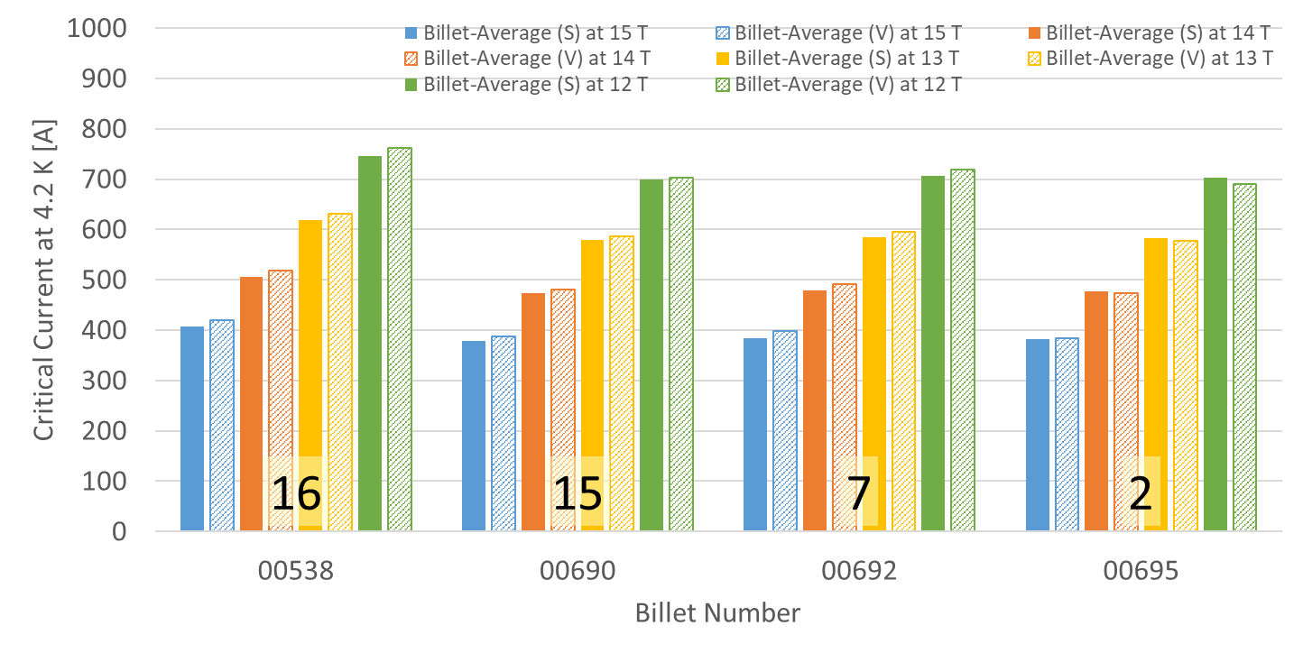
P43OL1199 – Wire Parameters Supplier (S) and Verification (V) I_{C} Data
Number of spools from that billet used in the cable

Slide 87
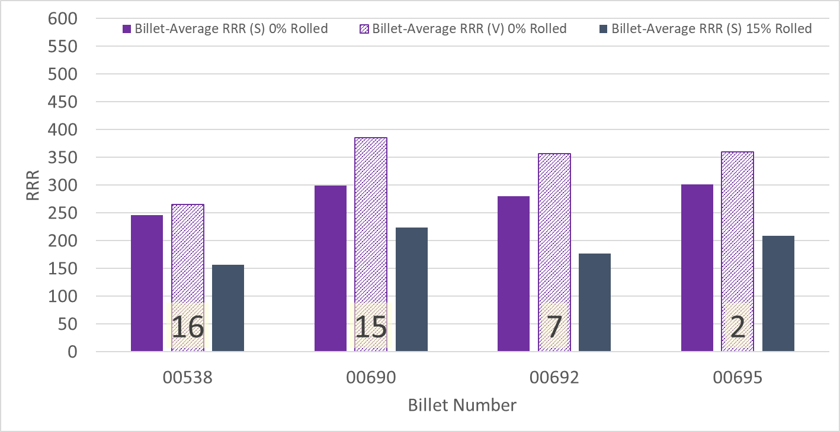
P43OL1199 – Wire Parameters Supplier (S) and Verification (V) RRR Data
Number of spools from that billet used in the cable

Slide 88
P43OL1199 – Extracted Strand RRR
Cable ID | No. of Units from Billet (spool) | Heat Treat/ Sample ID | Major Edge RRR | Minor Edge RRR | Straight 1 RRR | Straight 2 RRR
PO08S00690A01U P43OL1199AE03E | 15 (11) | LRLK221212ALC1 | 342 | 283 | 363 | 363
PO08S00538A02U P43OL1199AE07E | 16 (8) | LRLK221212ALC1 | 244 | 212 | 298 | 300
PO08S00538A03U P43OL1199AE31E | 16 (3) | LRLK221212ALC1 | 323 | 262 | 348 | 352
PO08S00692A01U P43OL1199AE36E | 7 (7) | LRLK221212ALC1 | 266 | 210 | 291 | 310
PO08S00690A03U P43OL1199AE55E | 15 (4) | LRLK221212ALC1 | 303 | 246 | 323 | 328

Slide 89
P43OL1199 – I_{c}, Cable Qual Samples
Wire/ Cable Strand | I_{c}(A) at Field (T)
 | 12 T | 13 T | 14 T | 15 T
PO08S00538A02U P43OL1199AE07E | 731 | 612 | 503 | 409
PO08S00692A01U P43OL1199AE36E | 679 | 565 | 463 | 375
PO08S00538A03U P43OL1199AE31E | 734 | 610 | 501 | 404

Slide 90
P43OL1199 – SSL Plot, Cable Qual Samples

Slide 91
P43OL1199 – SSL Margins, Qual Samples
Strand from which Margin is Calculated: | Strand # 36E @ 1.9 K
Margins | Margin | Operating Point (X)
Load Line Margin (Purple Arrow) | 26.7% | 73.3%
Current Margin (Green Arrow) | 61.8% | 38.2%
Temperature Margin (K) | 5.4 | 7.3
Limits | Strand | Strand x 40
Selected Strand’s Current (A) at Margin-Calculation Field | 1062 | 42495
Selected Strand’s Current (A) at 100% SSL | 553 | 22136
Selected Strand’s Field (T) at 100% SSL | 15.1

Slide 92
QXFA-260 / P43OL1203

Slide 93
P43OL1203 – Cable Date, Lengths
Cable Manufacture Date
12 Dec 2022 (Production run)
Cable Length:
469 m (LBNL, fabricated, including LBNL samples)

Slide 94
P43OL1203 – Strand and SS Core ID
Spool:
PO08S00078A04U x 1 ULs
PO08S00697A01U x 1 ULs
PO08S00700A01U x 7 ULs
PO08S00701A01U x 8 ULs
PO08S00705A03U x 7 ULs
PO08S00706A03U x 4 ULs
PO08S00710A04U x 11 ULs
PO08S00712A03U x 2 ULs
Core:
120L54A7400804
Heat: 850858 Lot: 17-521
Material: 316L
Chemical Properties CoT/CoC #187781-1: 0.16 wt% Co
Core width: 12.0 mm
From 8 billets

Slide 95
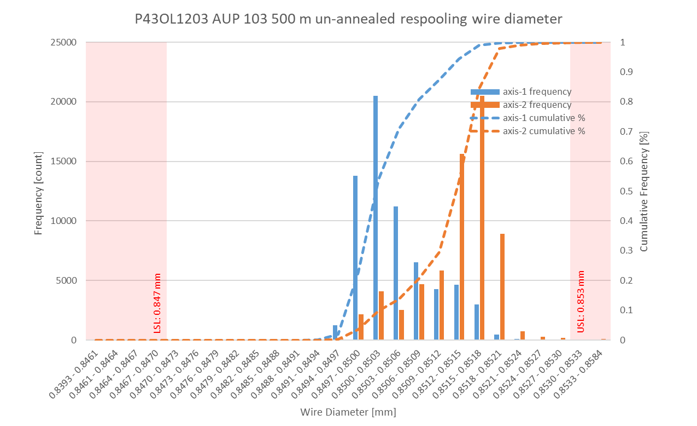
P43OL1203 Respooling Wire Diameter
Below LSL: 0.002%
Above USL: 0.103%

Slide 96
P43OL1203 – Cable QC Data Summary
CME:
Residual Twist: 135°
10-stack:
Qualification: 1.539 mm
Production tail end: 1.528 mm
 | Pressure (MPa) | Angle (°) | Width (mm) | Thickness (mm)
Maximum | 16.9 | 0.413 | 18.165 | 1.537
Average | 16.9 | 0.379 | 18.135 | 1.523
Minimum | 16.8 | 0.345 | 18.128 | 1.518
Sigma | 0.01 | 0.012 | 0.006 | 0.004

Slide 97
Rollers: P-93 (2021-08-09) & P-94 (2021-08-09)

Slide 98
Rollers: P-93 (2021-08-09) & P-94 (2021-08-09)

Slide 99
Rollers: P-93 (2021-08-09) & P-94 (2021-08-09)

Slide 100
P43OL1203 – Braiding
Fiberglass Lot: #RCV00011562
P/I: 18.9
Spool tension: 10 lbs. @ payoff. 20 lbs. @ takeup (12 lbs min)
Bobbin payoff tension: 0.125 lbs. ≤ T ≤ 0.250 lbs.
Insulation Thickness (at 5 MPa)
Site | Cycle #1 (mm) | Cycle #2 (mm) | Cycle #3 (mm) | Average (mm)
NEWT | 0.152 | 0.149 | 0.148 | 0.150
LBNL Verification | 0.154 | 0.151 | 0.150 | 0.152

Slide 101
P43OL1203 – Wire Parameters
Properties | Inspected Average
Wire Diameter | 0.8509 ± 0.001 mm (LBNL)¹
Cu ratio ª | 54.33% (BOST)
Strand twist pitch ª | 20.0 mm (BOST)
RRR (RW) ª | 315 (BOST)
RRR (15% rolled) ª | 217 (BOST)
I_{C} (4.2 K, 15 T) ª | 368 A (BOST)
I_{C} (4.2 K, 14 T) ª | 458 A (BOST)
I_{C} (4.2 K, 13 T) ª | 563 A (BOST)
I_{C} (4.2 K, 12 T) ª | 680 A (BOST)
ª First billet averaged, then weighted average according to the spool distribution in the cable
¹ As-received. LBNL respooling data. Mean ± 1 sigma

Slide 102
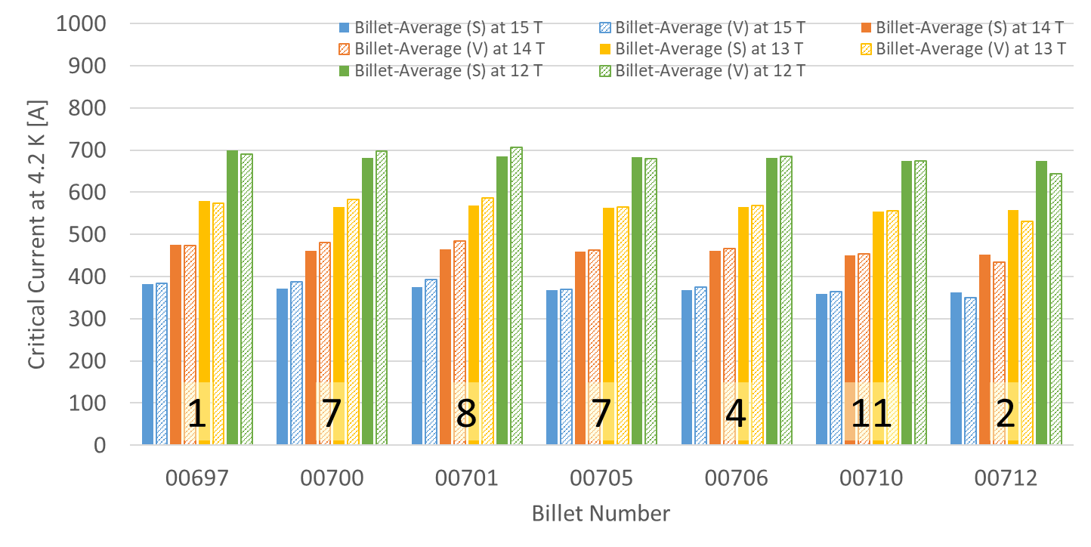
P43OL1203 – Wire Parameters Supplier (S) and Verification (V) I_{C} Data
Number of spools from that billet used in the cable

Slide 103
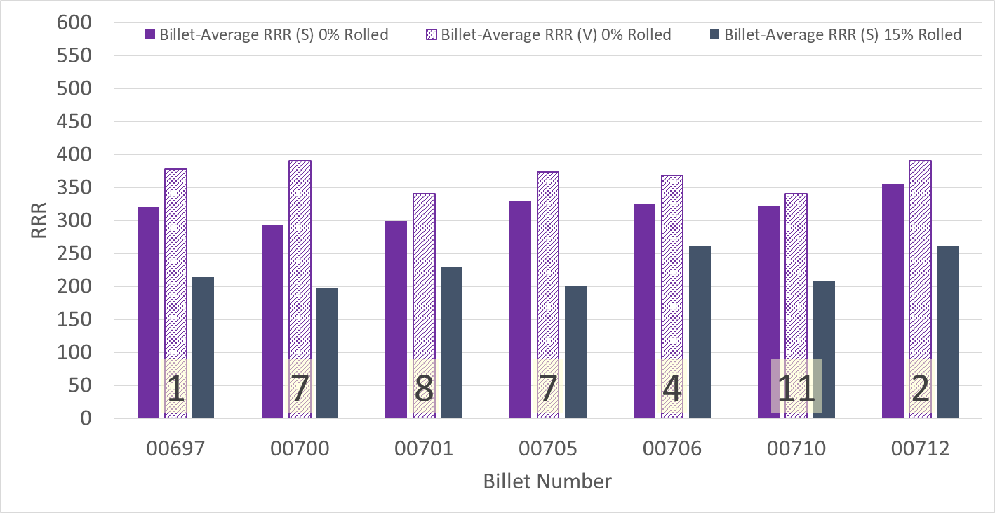
P43OL1203 – Wire Parameters Supplier (S) and Verification (V) RRR Data
Number of spools from that billet used in the cable

Slide 104
P43OL1203 – Extracted Strand RRR
Cable ID | No. of Units from Billet (spool) | Heat Treat/ Sample ID | Major Edge RRR | Minor Edge RRR | Straight 1 RRR | Straight 2 RRR
PO08S00710A04U P43OL1203AE05E | 11 (11) | LRLK230109ALC1 | 294 | 262 | 325 | 324
PO08S00706A03U P43OL1203AE18E | 4 (4) | LRLK230109ALC1 | 299 | 252 | 330 | 333
PO08S00705A03U P43OL1203AE24E | 7 (7) | LRLK230109ALC1 | 287 | 228 | 312 | 309
PO08S00700A01U P43OL1203AE35E | 7 (7) | LRLK230109ALC1 | 297 | 269 | 333 | 348
PO08S00701A01U P43OL1203AE45E | 8 (8) | LRLK230109ALC1 | 329 | 303 | 359 | 365

Slide 105
P43OL1203 – I_{c}, Cable Qual Samples
Wire/ Cable Strand | I_{c}(A) at Field (T)
 | 12 T | 13 T | 14 T | 15 T
PO08S00710A04U P43OL1203AE01E | 642 | 526 | 430 | 340
PO08S00701A01U P43OL1203AE45E | 659 | 544 | 448 | 362
PO08S00705A03U P43OL1203AE24E | 651 | 541 | 437 | 349

Slide 106
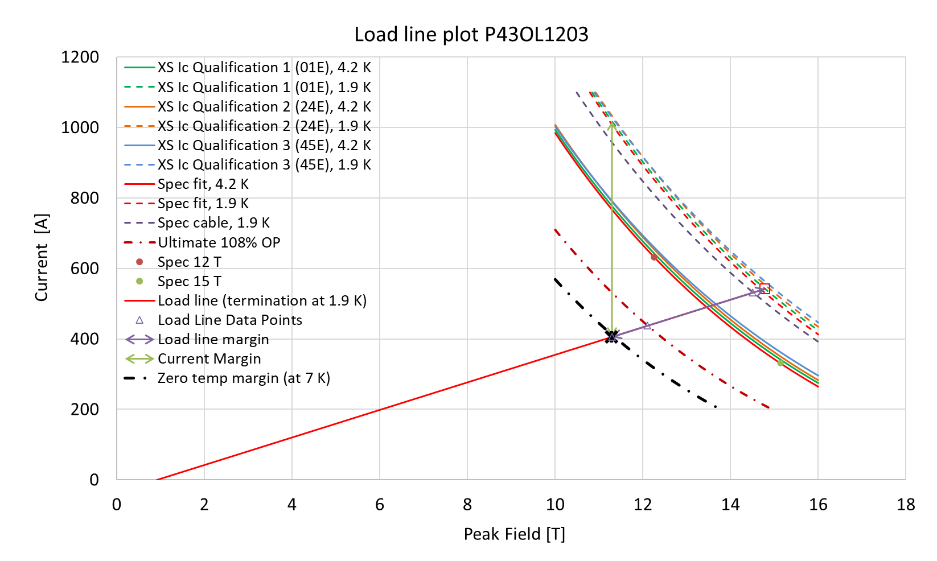
P43OL1203 – SSL Plot, Cable Qual Samples

Slide 107
P43OL1203 – SSL Margins, Qual Samples
Strand from which Margin is Calculated: | Strand # 01E @ 1.9 K
Margins | Margin | Operating Point (X)
Load Line Margin (Purple Arrow) | 25.2% | 74.8%
Current Margin (Green Arrow) | 60.2% | 39.8%
Temperature Margin (K) | 5.1 | 7.0
Limits | Strand | Strand x 40
Selected Strand’s Current (A) at Margin-Calculation Field | 1018 | 40731
Selected Strand’s Current (A) at 100% SSL | 542 | 21688
Selected Strand’s Field (T) at 100% SSL | 14.8

Slide 108
QXFA-161 / P43OL1209

Slide 109
P43OL1209 – Cable Date, Lengths
Cable Manufacture Date
02 Mar 2023 (Production run)
Cable Length:
469 m (LBNL, fabricated, including LBNL samples)

Slide 110
P43OL1209 – Strand and SS Core ID
Spool:
PO08S00665A01U x 19 ULs
PO08S00667A02U x 3 ULs
PO08S00667A04U x 2 ULs
PO08S00696A02U x 16 ULs
Core:
120L60A7400804
Heat: 850858 Lot: 17-521
Material: 316L
Chemical Properties CoT/CoC #187781-1: 0.16 wt% Co
Core width: 12.0 mm
From 3 billets

Slide 111
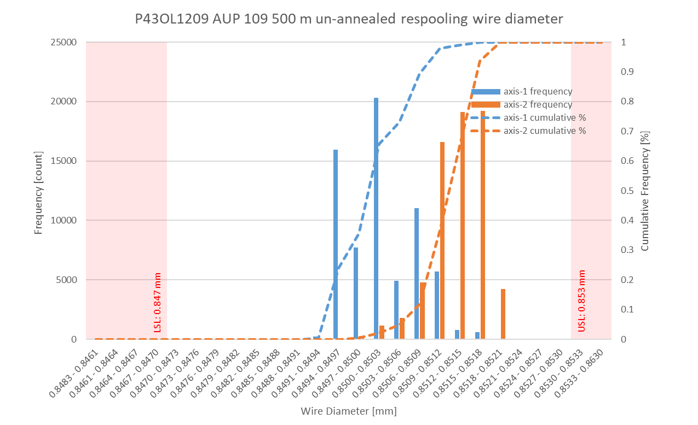
P43OL1209 Respooling Wire Diameter
Below LSL: 0.000%
Above USL: 0.013%

Slide 112
P43OL1209 – Cable QC Data Summary
CME:
Residual Twist: 140°
10-stack:
Qualification: 1.533 mm
Production tail end: 1.525 mm
 | Pressure (MPa) | Angle (°) | Width (mm) | Thickness (mm)
Maximum | 17.1 | 0.427 | 18.148 | 1.531
Average | 17.0 | 0.388 | 18.140 | 1.522
Minimum | 16.7 | 0.358 | 18.134 | 1.518
Sigma | 0.03 | 0.013 | 0.003 | 0.002

Slide 113
Rollers: P-93 (2021-08-09) & P-94 (2021-08-09)

Slide 114
Rollers: P-93 (2021-08-09) & P-94 (2021-08-09)

Slide 115
Rollers: P-93 (2021-08-09) & P-94 (2021-08-09)

Slide 116
P43OL1209 – Braiding
Fiberglass Lot: #RCV00011562
P/I: 18.9
Spool tension: 10 lbs. @ payoff. 20 lbs. @ takeup (12 lbs min)
Bobbin payoff tension: 0.125 lbs. ≤ T ≤ 0.250 lbs.
Insulation Thickness (at 5 MPa)
Site | Cycle #1 (mm) | Cycle #2 (mm) | Cycle #3 (mm) | Average (mm)
NEWT | 0.142 | 0.140 | 0.139 | 0.140
LBNL Verification | 0.142 | 0.139 | 0.138 | 0.140

Slide 117
P43OL1209 – Wire Parameters
Properties | Inspected Average
Wire Diameter | 0.8507 ± 0.001 mm (LBNL)¹
Cu ratio ª | 53.74% (BOST)
Strand twist pitch ª | 18.9 mm (BOST)
RRR (RW) ª | 293 (BOST)
RRR (15% rolled) ª | 186 (BOST)
I_{C} (4.2 K, 15 T) ª | 379 A (BOST)
I_{C} (4.2 K, 14 T) ª | 473 A (BOST)
I_{C} (4.2 K, 13 T) ª | 579 A (BOST)
I_{C} (4.2 K, 12 T) ª | 700 A (BOST)
ª First billet averaged, then weighted average according to the spool distribution in the cable
¹ As-received. LBNL respooling data. Mean ± 1 sigma

Slide 118
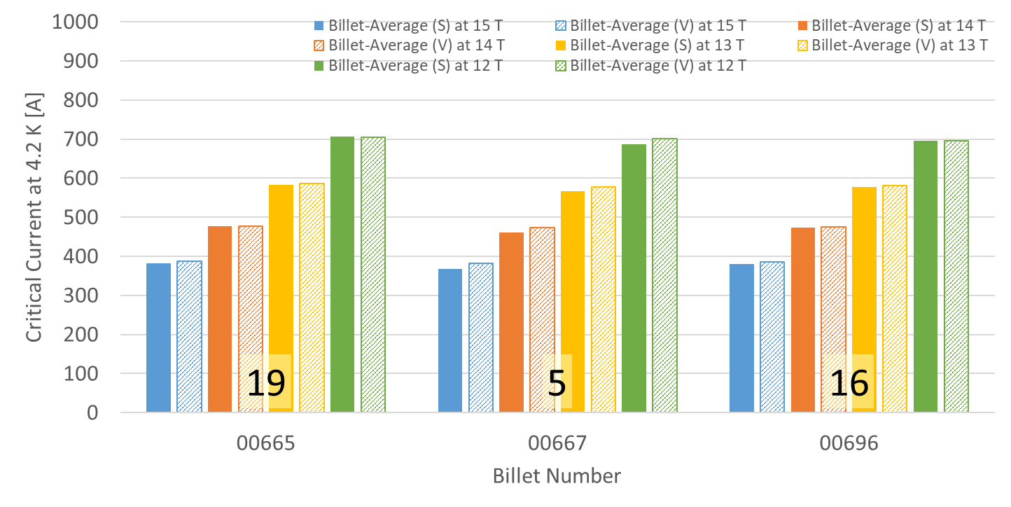
P43OL1209 – Wire Parameters Supplier (S) and Verification (V) I_{C} Data
Number of spools from that billet used in the cable

Slide 119
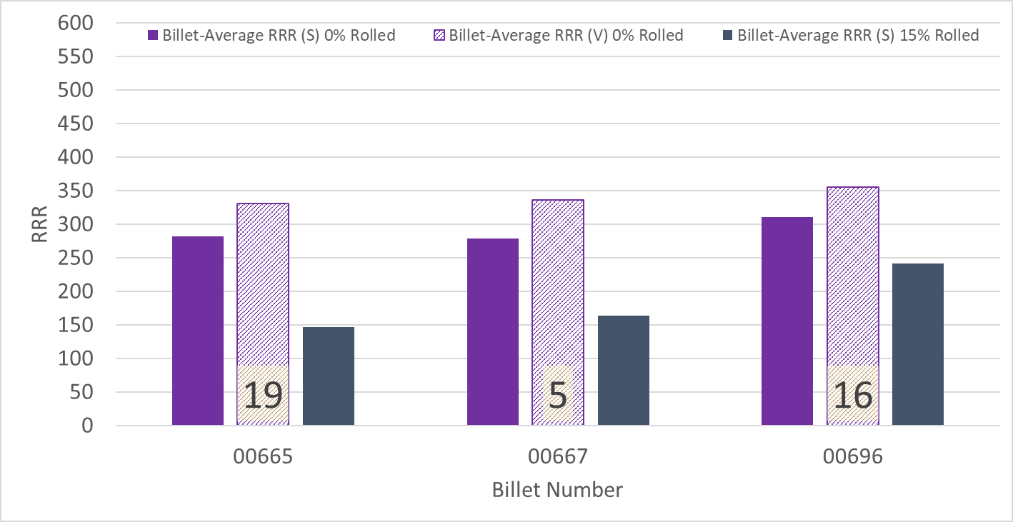
P43OL1209 – Wire Parameters Supplier (S) and Verification (V) RRR Data
Number of spools from that billet used in the cable

Slide 120
P43OL1209 – Extracted Strand RRR
Cable ID | No. of Units from Billet (spool) | Heat Treat/ Sample ID | Major Edge RRR | Minor Edge RRR | Straight 1 RRR | Straight 2 RRR
PO08S00667A02U P43OL1209AE05E | #N/A | LRLK230411ALC1 | 296 | 257 | 335 | 339
PO08S00696A02U P43OL1209AE09E | #N/A | LRLK230411ALC1 | 316 | 282 | 344 | 347
PO08S00696A02U P43OL1209AE11E | #N/A | LRLK230411ALC1 | 337 | 291 | 357 | 361
PO08S00665A01U P43OL1209AE33E | #N/A | LRLK230411ALC1 | 274 | 235 | 282 | 295
PO08S00665A01U P43OL1209AE35E | #N/A | LRLK230411ALC1 | 286 | 266 | 324 | 333

Slide 121
P43OL1209 – I_{c}, Cable Qual Samples
Wire/ Cable Strand | I_{c}(A) at Field (T)
 | 12 T | 13 T | 14 T | 15 T
PO08S00665A01U P43OL1209AE33E | 679 | 562 | 459 | 370
PO08S00696A02U P43OL1209AE09E | 664 | 552 | 457 | 366
PO08S00667A02U P43OL1209AE05E | 653 | 539 | 439 | 351

Slide 122
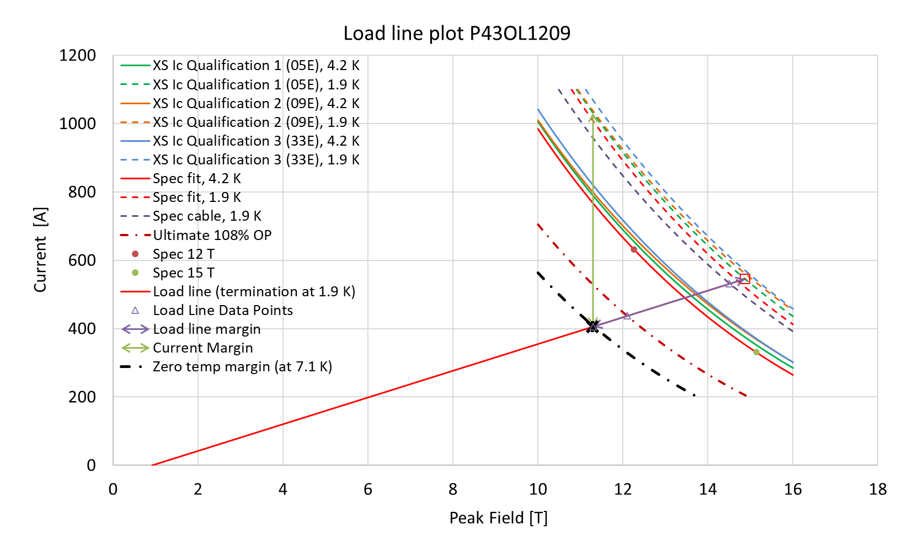
P43OL1209 – SSL Plot, Cable Qual Samples

Slide 123
P43OL1209 – SSL Margins, Qual Samples
Strand from which Margin is Calculated: | Strand # 05E @ 1.9 K
Margins | Margin | Operating Point (X)
Load Line Margin (Purple Arrow) | 25.6% | 74.4%
Current Margin (Green Arrow) | 60.7% | 39.3%
Temperature Margin (K) | 5.2 | 7.1
Limits | Strand | Strand x 40
Selected Strand’s Current (A) at Margin-Calculation Field | 1031 | 41254
Selected Strand’s Current (A) at 100% SSL | 546 | 21826
Selected Strand’s Field (T) at 100% SSL | 14.9

