Slide 1
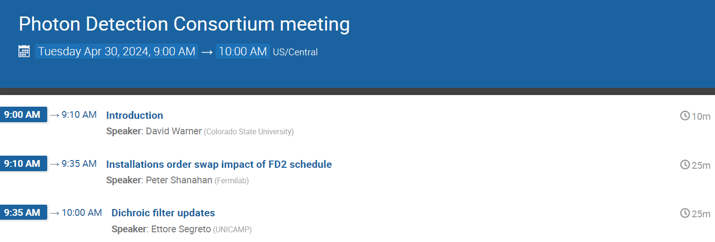
This agenda can be found at the link:
https://indico.fnal.gov/event/64541/
Zoom connection:
https://zoom.us/j/97903450029?pwd=cXE1YTBkdnpLNEVJODMxWS9RcWhWUT09

Slide 2

Technical Update
David Warner
Photon Detector Consortium Meeting
April 30, 2024

Slide 3
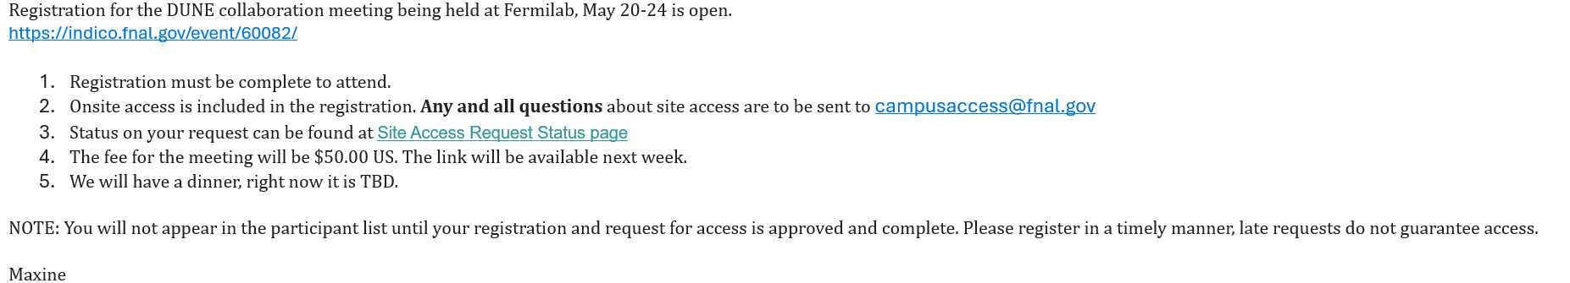
Collaboration Meeting Parallel Sessions
The collaboration meeting will be held at Fermilab May 20 - 24:
Registration available at https://indico.fnal.gov/event/60082/
4 PDS parallel sessions are proposed for the meeting:
-PDS General
-PDS SiPM and Electronics
-PDS Analysis & Simulation
-PDS ProtoDUNE Status and Plans
There are limited slots available for presentations in these sessions. If you would like to make a presentation please contact Ettore, Dave or Francesco and we will try to accommodate you.

Slide 4
Scope/Project Schedule Update Workshop
A workshop discussing PDS schedule and scope will be held at Northern Illinois University in DeKalb (~45 minutes drive from Fermilab) prior to the collaboration meeting.
  Meeting held Sunday May 19, 2024 (09:00 - ?).
  A representative from each institution/national group has been contacted by Peter or me requesting their presence.
    RSVP if you have been contacted!
    If you feel you have been accidentally omitted and should attend please contact Peter and/or Dave and we can adjust the list.
We plan to step through new schedule in P6 reflecting the detector installation order swap, and to confirm commitments to detector procurement, assembly, and installation as represented in the project schedule.
An agenda is being developed and will be circulated soon.
Logistical details including Zoom link are being settled and will be emailed (along with the agenda) to invitees shortly.

Slide 5
Upcoming Events Calendar
Physics/performance validation runs:
  Cold box runs:
    HD PDS August/September 2024.
    VD PDS (Module 1 run) April 2024 (completed!), June/July 2024, ~September 2024
  ProtoDUNEs
    NP04 (Ongoing through ~August 2024
    NP02 Fall/Winter 2024
Collaboration meeting:
  May 20-24 (Fermilab).
  May 19: PDS Institutional scope confirmation/Schedule swap workshop at NIU. It will be available on Zoom for those unable to attend in person.

