Slide 1
Manager Talking points
Lab-wide Pause to Focus on a Culture of Excellence
April 2024

Slide 2
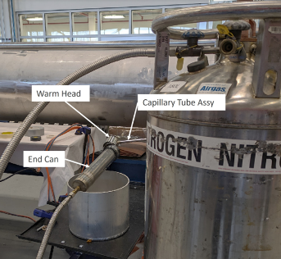
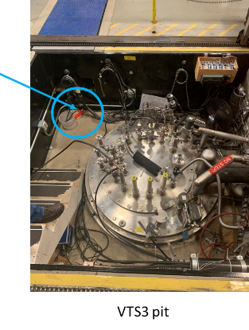
Safety Observations/Opportunities for Improvement
Recent safety incidents:
An electrician placed their hand within the restricted boundary of an energized 120/480-volt panel to operate a switch without an Electrical Hazards Analysis, workplan, and appropriate personal protection equipment (PPE).
An employee’s hand and personal clothing became contaminated while working with experimental equipment.
A lab area experienced an uncontrolled release of nitrogen.
A helium release and corresponding ODH event due to an installation error.
Location of the ODH sensor
Notes:
Manager opens discussions with the following talking points:
Recent months have brought several operational challenges to our attention at Fermilab, underscoring the importance of vigilance and adherence to safety protocols.
We've observed a few instances which suggest the need for further reinforcement of our commitment to a disciplined and consistent approach to our operational procedures.
During this discussion please speak up if there are elements of your day to day operations that could benefit from the discussion points. This exercise will be most beneficial to all if it is interactive.
There are details about the operational events in the backup slides. Manager should review the backup slides prior to this discussion and include details from those events that may be germane to their group.

Slide 3
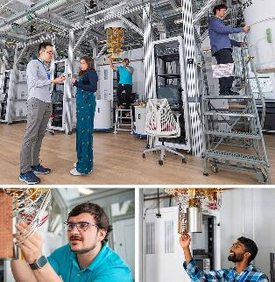
Embracing a Culture of Collaborative Excellence at Fermilab
We are committed to fulfilling our mission with an emphasis on safety, security, and unparalleled quality… a Culture of Excellence.
In the spirit of meticulous care and preparation, our Science, Business and Operational protocols are designed to be comprehensive and inclusive, ensuring that all involved in any given task are well-prepared, informed and engaged from the outset.
Our methodology involves a thorough integration of risk assessment and hazard identification/mitigation and team collaboration to guarantee management and staff are present and engaged in the disciplined execution of work at the point of action.
Beyond the completion of tasks, we value the process of gathering, sharing, and examining work-related experiences as a means for continuous learning and enhancement of our operational practices.
Notes:
Manager: At Fermilab, we are on a collective path to enhance and refine our culture, one that embodies the principles of scientific and operational excellence. We aim to create an environment that is as disciplined as it is compliant.

Slide 4
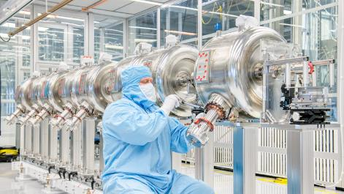
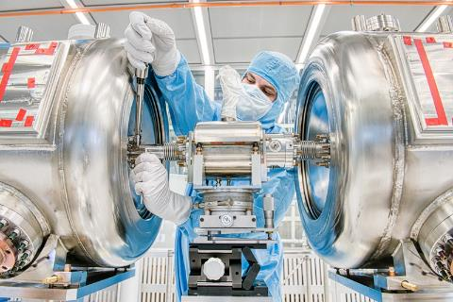
Our Culture of Excellence
Applies to the pursuit of excellence in science, business and operations.
Is defined by our deliberate actions in all lab activities to maintain excellence and scientific achievement.
Involves detailed documentation, established practices, and adherence to standards that underpin a consistent and structured approach to work. This supports our scientific, business, and operational objectives while safeguarding our workforce, the public, and the environment.
Aims to significantly reduce the possibility and impact of human error as well as potential technical and organizational mishaps.
The goal is to minimize the likelihood and consequences of human fallibility or technical and organizational system failures.
Notes:
Manager: Simply stated discipline of operations and the goal of operational excellence can be simply stated as performing the right task, the right way, at the right time, every time.
Manager then goes through the bullets and asks for feedback on how their group is achieving these things in their day to day operations.

Slide 5
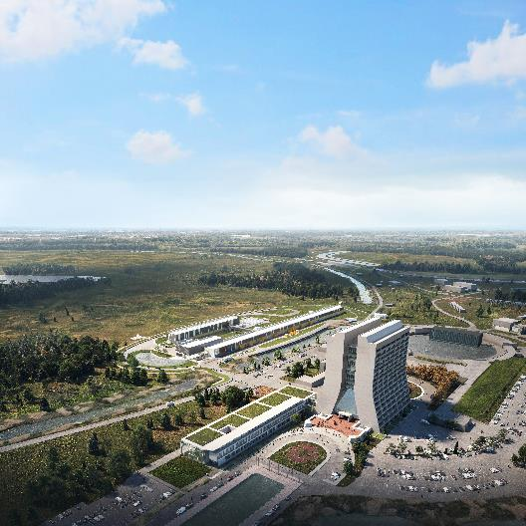
Fermilab Culture of Excellence
Embracing a mindset that focuses on the discipline of how we approach all operations.
Ensure the well-being of all members of our team, allowing everyone to conclude their day safely.
Conduct the appropriate task efficiently, correctly, and on-time, consistently.
Reduce, and potentially eliminate, negative outcomes in our operations.
Fulfill our mission objectives with integrity and reliability.
Reinforce our dedication to a unified approach that brings together our lab, our mission, and our team.
We are ALL on the same team and must commit to support each other and collectively hold ourselves accountable to safely, effectively and efficiently achieve mission success
Notes:
Manager: The concept of disciplined operations needs further integration into our daily conversations and activities. Our goal is to weave this principle seamlessly into our routine discussions, work planning, processes, and actions.
Manager then discusses with their team what a mindset of focusing on disciplined operations enables them to do.

Slide 6
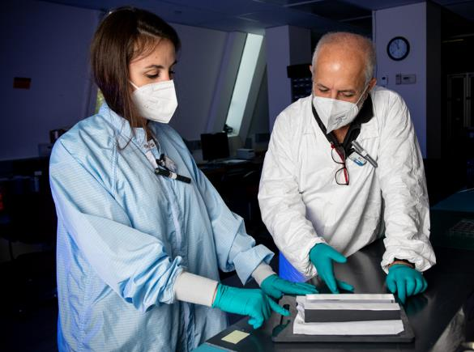
We All Have a Role in Enabling Our Culture of Excellence
Team members: Embracing and advocating for our collective standards is vital. Your actions and leadership serve as a model for the embodiment of our goals.
Managers and Supervisors: Lead by example! You play an instrumental role, with your hands-on approach and involvement being key to championing our culture and the discipline with which we conduct our operations. Ongoing interactions with your team is crucial for our rigorous operational standards.
Fermilab team: Together, we can drive Fermilab to become the scientific, business and operational model of success for other DOE sites to follow.
“Leadership is not about titles, positions, or flowcharts. It is about one life influencing another.”
—John C. Maxwell
Notes:
Manager: Every member of the Fermilab community is a valued contributor to our shared vision of disciplined operations. It is essential that each of us actively participates in nurturing this environment by disseminating these principles among peers and leading by example to put these initiatives into practice.
Manager then talks about the various roles and their importance at Fermi.

Slide 7
Fundamental Tenets of Disciplined Operations
One lab
One mission
One team
Verify…
Line management authorizes work start
Relevant support organizations are informed and ready to assist with the planned activities.
All guidelines and documentation—such as work plans, procedures, manuals—are up-to-date, validated for use, available, and used.
Necessary tools, equipment, and personal protective equipment (PPE) are always being used in accordance with requirements.
Ensure…
Information about the task's progress is effectively communicated to all workers and management at shift handovers.
All team members understand and adhere to relevant safety, security and quality procedures and guidelines.
Safety documents are in place, and risk and/or hazard mitigation measures are comprehensively understood by the entire team and validated to be in place before work starts.
Workers are thoroughly briefed before tasks commence, encouraged to engage in dialogue, understand the intended outcomes, are prepared to halt operations if change is encountered or safety is compromised, and actively engage in mutual monitoring during the task execution.
Notes:
Manager: Adhering to the tenets of disciplined operations systematically mitigates hazards, diminishes risks, and amplifies the likelihood of success across our scientific, business, and operational endeavors.
Consistently doing the right thing, in the right way, at the right time enhances our ability to identify and manage risks and hazards. It ensures that all processes are efficiently carried out and clearly understood by everyone involved.
By minimizing or altogether avoiding the need for rework, additional training, or event investigations, we streamline our work and reduce unnecessary impacts.
Living the principles of disciplined operations and rigorously applying required standards in our job planning empowers us to work with greater assurance, knowing that any issues that arise will be promptly and effectively resolved.
Manager talks about and solicits feedback on how their team verify and ensure work as it relates to these tenets of disciplined operations

Slide 8
What Does a Culture of Excellence Look Like?
We Observe…
There is evidence of a questioning attitude among all (manager and workers) involved in the activity.
We Perform…
All Fermilab staff adhere to our safety policies and requirements and our work plans and stop/pause work when changes or unexpected conditions are encountered during work
Managers and supervisors are regularly on-site reviewing the performance of work to ensure alignment with the work plan.
If an adverse event occurs, line management, with necessary support, uses the leadership chain to promptly notify Fermi leadership as soon as possible, but no later than an hour following the occurrence.
We Communicate…
Managers and supervisors facilitate open post-job dialogue to acknowledge positive actions, identify best practices, and highlight areas for enhancement.
We Assure…
Line management and safety programs confirm the effective implementation of our Culture of Excellence efforts (using assessment and issues management for example) and commit to ongoing refinement. Lessons learned from our reviews are applied across the laboratory
Notes:
Manager talks about and solicits feedback on how their team observes, performs, communicates and assures work as it relates to these tenets of disciplined operations

Slide 9
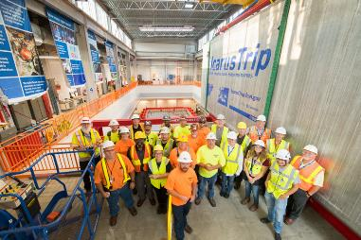
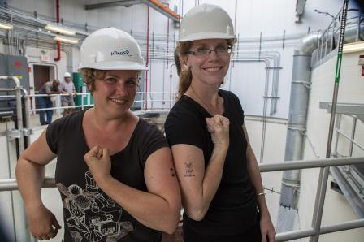
Key Messages
Each member of our Fermilab team contributes to the laboratory's success in their unique capacity – Every team member is valued as a practical expert, and we rely on them to help identify and solve issues within their work processes. We routinely recognize them for their efforts, involvement, and ideas.
Management and supervision have important roles - When management actively demonstrates visible and engaged leadership, employees receive the support and direction necessary for their work to flourish.
We each recognize that the success of our mission is linked to how we fulfill our roles and responsibilities – we are accountable to each other to ensure our safety and the achievement of our mission and operations objectives.
Notes:
Manager: Establishing a Culture of Excellence is fundamental to fostering a strong team spirit, instilling a sense of pride and ownership among all employees engaged in their tasks.
Manager discusses the Key Messages

Slide 10
Path Forward
Our journey to a achieve a strong culture of excellence will involve all employees, with the active engagement of line management, the facilitation of our Office of Contractor Assurance and the collaboration of all members of our mission support team.
Expect regular communications that will cover lab-wide updates, offer implementation guidance and provide consistent messaging to ensure the continuous engagement and support of the initiative.
For those teams seeking further insights on adopting these principles, disciplined operations speakers will be made available to provide tailored guidance and support.
“We are what we repeatedly do. Excellence, then, is not an act, but a habit.”
- Aristotle
Notes:
Manager reads the first bullet then details that OCA will be responsible for the collection and presentation of performance data, which will be reviewed and discussed across a variety of forums for transparency and collective learning.
Manager: To reinforce the importance of the tenets of disciplined operations (we are in the process of creating lanyard cards that encapsulate the tenets of disciplined operations, which will be distributed to all teams to serve as a convenient reference.
Manager then discuss the last 2 bullets with their team and solicits feedback on how their group; can help the lab move forward with implementing what they have been discussing.

Slide 11
Back up

Slide 12
Recent Events
Lab-wide Pause to Focus on Culture of Excellence
April 2024

Slide 13
MI-40 event
Uncontrolled release of nitrogen
Skin contamination
ODH alarm response

Slide 14
Event: MI-40 Electrical Panel
April 3, 2024, ISD personnel were investigating the cause of flooding in the MI-40 Abort Tunnel. The electricians sought to manually operate each of the two pumps operated by the MI-40 Abort Tunnel sump pump controller. Because the manual controls for this sump pump controller were located inside the controller’s electrical controller, an electrician opened the enclosure and manually operated the auto-off-hand switch for each pump.
Initial findings (event still under review):
Task was performed without an Electrical Hazard Analysis and Work Plan.
Task was performed without donning shock or arc-flash protective gear.
These switches were located on a small panel spaced in front of the other electrical components but were within the 1-foot Restricted Approach Boundary (RAB) for 480 volt equipment.
Pre-job briefing reportedly discussed not opening the panel.
Task was reported to DSO through RCTs, but action was not taken to stop work in the field.
Poor unconventional design of the equipment having the controls within the panel and not accessible.
Was identified as being an issue 2 years ago.
Delays in reporting

Slide 15
Event: Skin Contamination
March 19,2024, an employee’s hand became contaminated during an access to fill an experiment with liquid argon at MTA/ITA.
The employee used a spare glove as a rag to clean the inside of the experiment container of debris prior to filling. When exiting the enclosure, it was identified that the glove the employee was wearing was contaminated. The employee went back into the enclosure to place the glove on a table and report to another employee within the enclosure. The second employee instructed the employee to notify the RSO.
Initial findings (event still under review):
Newer employees/lack of experience among RSO, RCT and mployees

Slide 16
Event: Uncontrolled Release of Nitrogen Gas
March 4, 2024, there was an unexpected sudden release of nitrogen gas. There were no injuries.
Personnel were attempting to test a hypothesis that moisture was trapped within a capillary tube assembly and was causing the failures of hi-pot tests at room temperature. They were instructed to obtain a liquid nitrogen (LN2) dewar but were not told of the specific pressure rating that was expected for the test. The personnel set up the test using a flex line from the LN2 dewar to an end can. The dewar had a pressure gauge and dewar relief device. The warm head and end can were secured together with fiberglass tape and duct tape. A thin rubber strip and stainless steel sheet metal strip were placed around the tape and tightened with a hose clamp. A quick clamp was used to clamp the two pipes together. No pressure relief device was used on the set up as the capillary tube is open on one end. As the LN2 dewar valve was opened slowly, a loud “pop” occurred due to the sudden release of nitrogen gas from the test set up.
Initial findings (event still under review):
A verbal (informal) WPC/HA completed including a walk-through of the final setup before turning on the pressure. There was NO written Hazard Analysis or Work Plan in place, NO written standard operating procedure. This was off-normal work that was not part of a traveler/procedure.
Personnel involved were not experienced in this type of work.
The expected dewar pressure rating was not communicated.
It was assumed there was no danger in over pressurizing the system since it was not closed and a fail point (duct tape) was installed.

Slide 17
Event: ODH Alarm at IB1
SRF group completed their typical VTS installation procedure per traveler 464240 for cavity B9AS-AES-003 then posted in the IB1 e-log for cryo to proceed. Cryo pumped and backfilled VTS-3 with gaseous helium without issue. There was no rise in pressure when the cryo operators did the standard rate of rise test at close to full vacuum conditions. Cryo connected VTS-3 to compressor suction. Shortly thereafter the VTS-3 O2 monitor dropped below 18.0% and initiated the ODH siren and strobe. The alarm message also went out to cryo experts via Win-911. At the lowest point the O2 sensor read ~14.5%. The cryo operator valved out compressor suction and the alarm cleared approximately 45 seconds later. The Fermilab fire department was not notified by dialing 3131x as required by FESHM 4240 for ODH alarms/events with oxygen concentration less than 18%.
The cryo operator made a short e-log summary about the ODH event and contacted the VTS Supervisor. Cryo operator and VTS supervisor assessed the situation and discovered the bolts which affix the top plate to the dewar had not been tightened. The VTS supervisor assessed the situation and asked the cryo operator to tighten the bolts (they were still aligned with the holes); they would redo the leak check. The leak check failed, and the decision was made to open the top plate the next day and address whatever the cause was determined to be. SRF technicians replaced the O-rings and properly tightened the bolts the following day. Subsequent cryo and testing work proceeded normally.
Findings:
The direct cause was that the bolts on the VTS-3 top flange had not been tightened. The O-ring released pressure, and helium escaped. Weight and vacuum forces held the seal tight during pump & backfill, but switching to low positive pressure resulted in a leak past the O-ring.
The traveler/procedure was updated to include a verification step for the installation and torquing of the assembly fasteners.

