Slide 1
What do we know about Recycler 302?
2 Nov 1947
1974
Phil Adamson
29th April 2024
1947

Slide 2
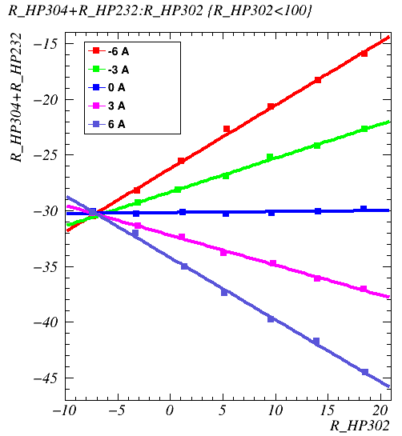
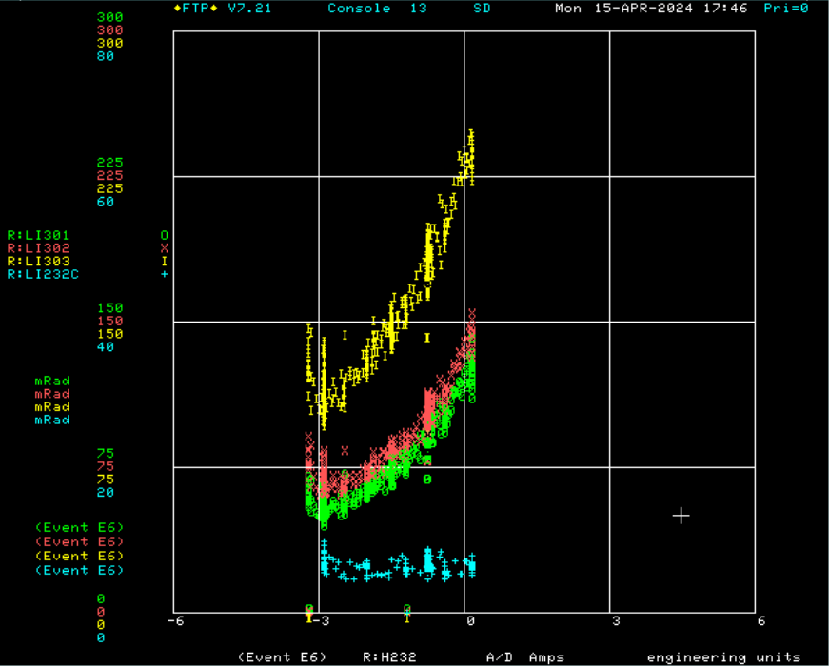
Horizontal scans at 302
Scan through 302 quad trims at different currents finds magnetic center of quad at -7mm on R:HP302.
Aperture scans don’t agree. Beam loss prefers 302 at +4mm.

Slide 3
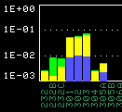
Some notes
301, 302 and 303 loss monitors consistently show losses that track each other. They do not track 232C.
See the same effect on the aperture scan:
So assume that these loss monitors are all seeing the same loss

Slide 4
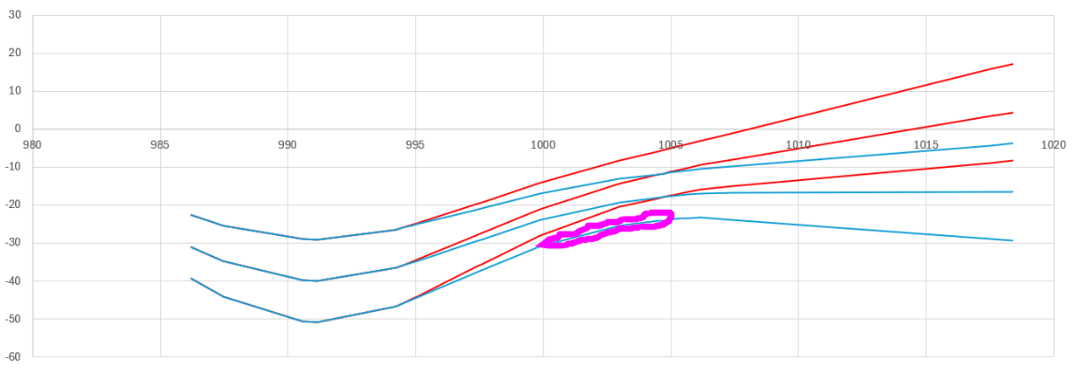
Here’s a cheap cartoon showing the beam horizontally between 232 and 302.
The red trajectory sees less loss; the blue one is the quad trim centre and sees significantly more loss.
Purple speculative loss area is upstream of 301.

Slide 5
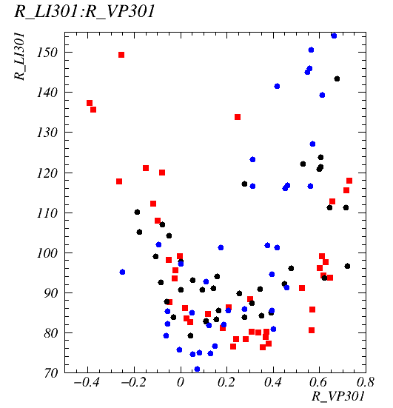
Vertical
Doing a vertical scan at 301 for different values of the 231 vertical position seems to show a shift in the upper edge, and no shift in the lower edge.
Red: VP231 = -3.5mm
Black: VP321 = 0mm
Blue: VP321 = +2mm.
This would lead one to conclude that the upper aperture was upstream of the V301 trim, and the lower aperture was downstream of it.

Slide 6
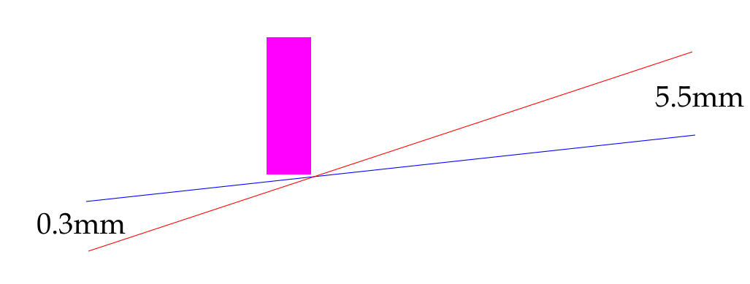
Vertical
Rough scaling from the plot shows that moving the position at 231 by +5.5mm moves the position of the upper aperture edge down by about 0.3mm at 301.
In a linear world, this would put the obstruction 95% of the way between 231 and 301. We’re not in a linear world, because there are quads in the way, but to the accuracy of the plot, this looks like downstream of G301A, and perhaps the red ring on the next page

Slide 7
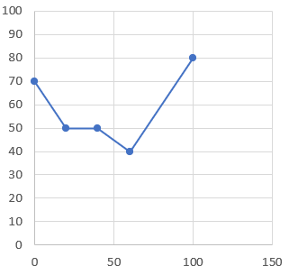
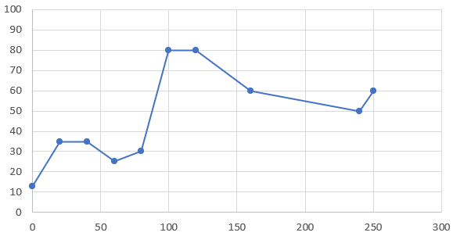
Machine layout
Residual Activation
LM232C
LM301
Red circle: possible loss spot from pre-startup rad survey. V301 is immediately downstream of this.
Blue circle: also possible loss spot from rad survey.

Slide 8
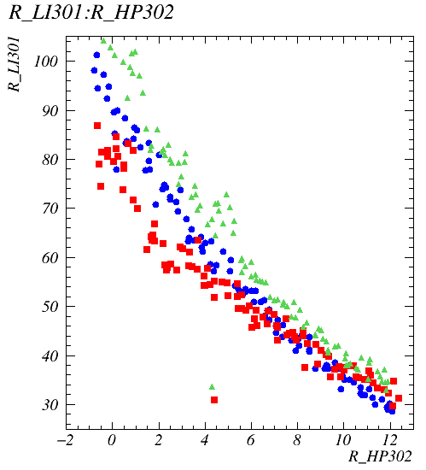
Horizontal again
Horizontal scan at 302 for HP232 = -32mm (green), -31mm (blue) and -29mm (red)
Points at horizontal edge being roughly half way between 232 and 302.
See loss on LI301, so upstream of LI301!
Consistent with location of vertical scan loss on previous pages

Slide 9
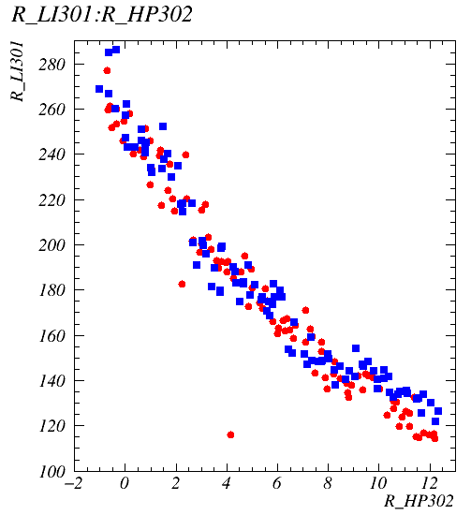
Changing VP301 by +/- 1mm looks the same
Moving position at 301 up or down 1mm creates higher loss at 301, but in a completely symmetric way.
Can’t avoid a horizontal edge by changing height by a small amount

Slide 10
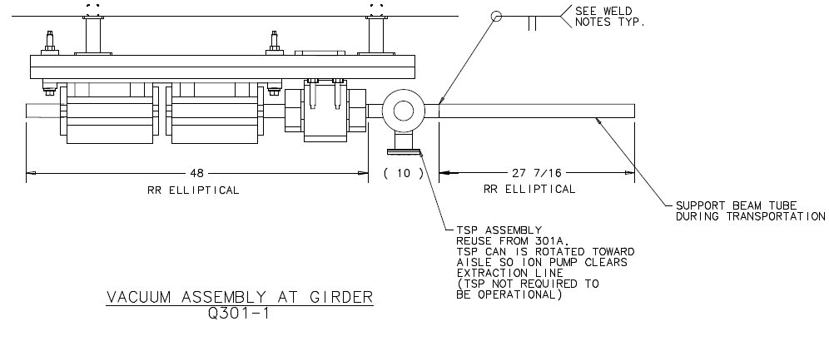
How was it built?
301: V301 and QT301 share a girder

Slide 11
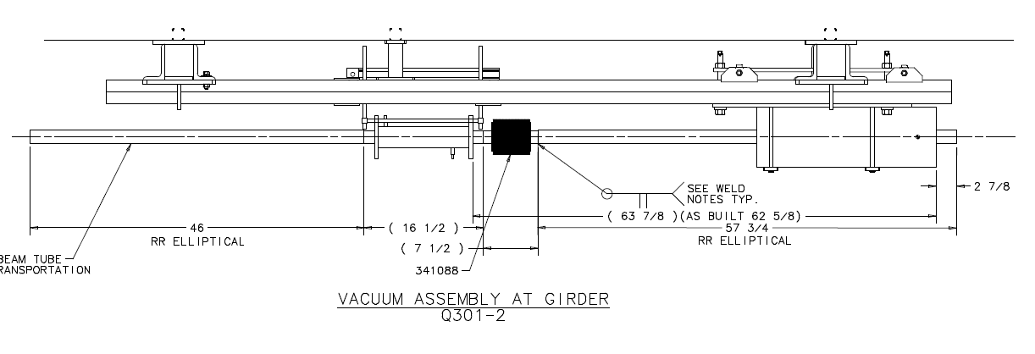
301: Q301B and VP301 share a girder

Slide 12
302
QT302 -1
Q302A
H302
HP302
Q302B
QT302 -2
VP302

