Slide 1
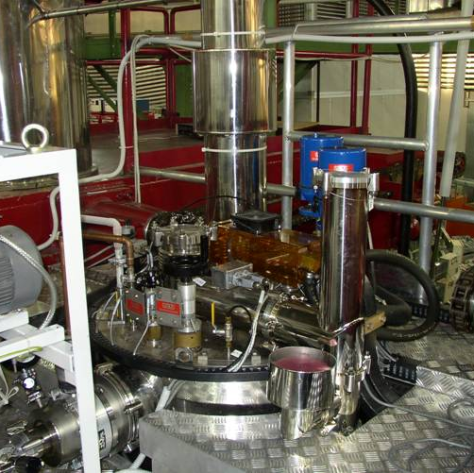


KLOE to SAND: magnet activities @ LNF and FNAL

Slide 2
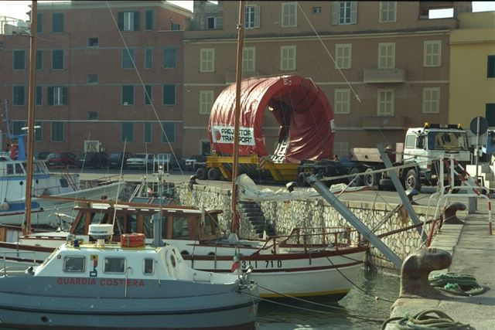
KLOE Magnet: 20 years of operation
The magnet was designed, in conjunction with its iron yoke, to produce 0.6 T over a 4.3 m long 4.8 m diameter volume.
The magnet specifications are below.
KLOE magnet in numbers
Central magnetic field | 0.6 T
Vacuum case length | 4.4 m
Vacuum case inner diameter | 4.86 m
Vacuum case outer diameter | 5.76 m
Coil shell inner diameter | 5.19 m
Cold mass | 10 tonnes
Vacuum case mass | 26 tonnes

Slide 3
KLOE to SAND: Superconducting magnet activities
Scope:
Revamping of aged subsystems in order to provide to the Collaboration a reliable detector that guarantees years of efficient operation
Test the magnet before the shipment in order to guarantee a proper hand-off of the system including the compliance with FNAL internal regulation on Pressure Vessels
Preparing the magnet for the handling and the shipment
Test the magnet before its re-insertion in the yoke at FNAL, in order to check for any damage possibly suffered during the travel from Italy

Slide 4
KLOE Magnet Revamping
KLOE has been operated almost continuously from 1998 to 2018 at LNF showing excellent performance in terms of the reliability of the magnet and its subsystems.
Nonetheless, in the last years of operations, the hydraulic circuit of the PS showed signs of “natural” aging. For this reason, the procurement of a new PS is in progress
The original control system (developed on LabView platform) must be migrated to a more recent version of the software for obvious reasons (compliance with present OS and integration with FNAL supervisor). A reconfiguration of the CS HW architecture will be evaluated to increase the robustness of the subsystem
All the consumable parts will be serviced as well as the vacuum pumps

Slide 5

KLOE Magnet test @ LNF and FNAL
Test of the magnet will be performed to put it back to service. Tests can be divided in two sections
Warm test
Cold test
Warm test - will check the electrical, mechanical, fluidic and control operational status of all the subsystems at 300 K: vacuum, temperature sensors, pressure sensors, valve leaks, actuators, PS interlocks, heaters, CS etc.
Cold test – will check the previous list at 4.4 K in addition to all the test that must be performed on the PS and the quench detector with the coil energized to a limited current
Tests at LNF will be repeated at FNAL, and both performed in presence of
FNAL representatives as part of training program and compliant hand-off

Slide 6
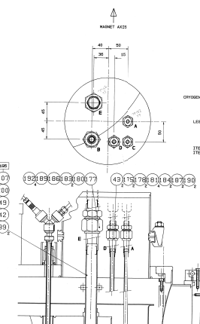
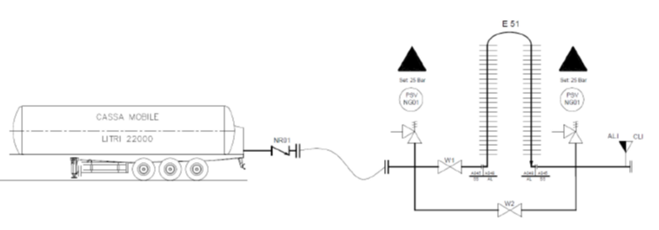
KLOE Magnet test @ LNF
Cryo interface
Existing LN2 flexible TL
Existing LN2 tank 3000 lt
LN2 mobile tank + vaporizer
Atm vent
KLOE
Existing LHe dewars 3 x 1000 lt

Slide 7
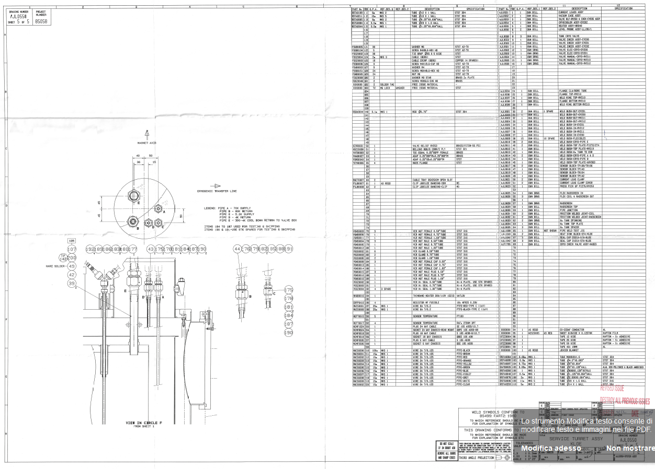
KLOE Magnet test @ LNF and FNAL

Slide 8
Magnet Cool Down with LN2 and LHe
Requires very limited re-installation of the original fluidic subsystems
LN2 flexible TL already in place (with 3000 lt LN2 tank for preliminary test)
LHe dewars available in house (3x1000 lt) already PED re-qualified
Requires the manufacturing of noncomplex cryogenic interfaces
The HW is self consistent to repeat the test “keys in hand” @ FNAL before magnet re-integration in the yoke

Slide 9
Procurement and costs estimate
                PO for most part of the HW and services for the cold test has been emitted to the suppliers, in details:
                All the cryo components connecting the LN2 and LHe lines to the magnet turret + exhaust He and N2 lines
                36.000 liters of LN2 + 4/6 weeks of renting LN2 mobile thank + manufacturing of evaporator to control the LN2 T inlet to the magnet
                Interface for the connection of the DAFNE compensator TL to the mobile thank + its redeployment
                LHe will be procured near the test date for commercial reasons.

Slide 10
KLOE Magnet Compliance
KLOE is provided with 180 liters of LHe reservoir aimed to limit its temperature below 20 K in case of a quench, so it must comply FNAL internal regulation.
Cryogenic tanks at FNAL must be designed, fabricated, tested, and operated according to “FESHM 5031: PRESSURE VESSELS” internal standard.
Since the magnet has been built almost 30 years ago (posing issue about different design & manufacturing standards and lack of records like material certificates and test reports) the point 4 of the procedure “Exceptional Vessels / Director's Exception” shall be applied:

Slide 11
KLOE Magnet Compliance
Exceptional vessels is a process that requires the approval of the Laboratory Director or his/her designee. An Extended Engineering Note shall be prepared
A new pressure test (possibly at down graded level with respect to the original design limits) will be performed with FNAL representative supervision
At present we have started a periodical meeting with Michael Geynisman from FNAL to maximize the efficiency of the process in terms of documentation set up

Slide 12
KLOE Magnet handling: Service Turret Removal
After the tests before the shipment FNAL the service turret must be removed because of the interference with the hall door. The reverse process has been performed by OI in 1997 at magnet delivery. The main operations can be summarized as in the following:
Disconnection of the signal sensors cable (air side)
Removing of the cylindrical shell of the vacuum case
Removing of the MLI
Disconnection of the signal sensors cable (vacuum side)
Disconnection of the coil terminals
Cutting of the 4 cryogenic lines

Slide 13
KLOE Magnet handling: Service Turret Removal
The turret will be reconnected at FNAL and the procedure (to be used in the reverse sequence for the turret removal) is described in the drawing from Oxford Instrument AJL0550 "Service Turret Assy KLOE sheet 1 to 5.
Working Instructions (OI internal procedures) obviously are not available, for this reason due to the nature of this operation INFN will award a contract to ASG Superconductors to perform the entire process of removal and reconnection at FNAL of the service turret.
G. Delle Monache TDR 21th July 2024

Slide 14
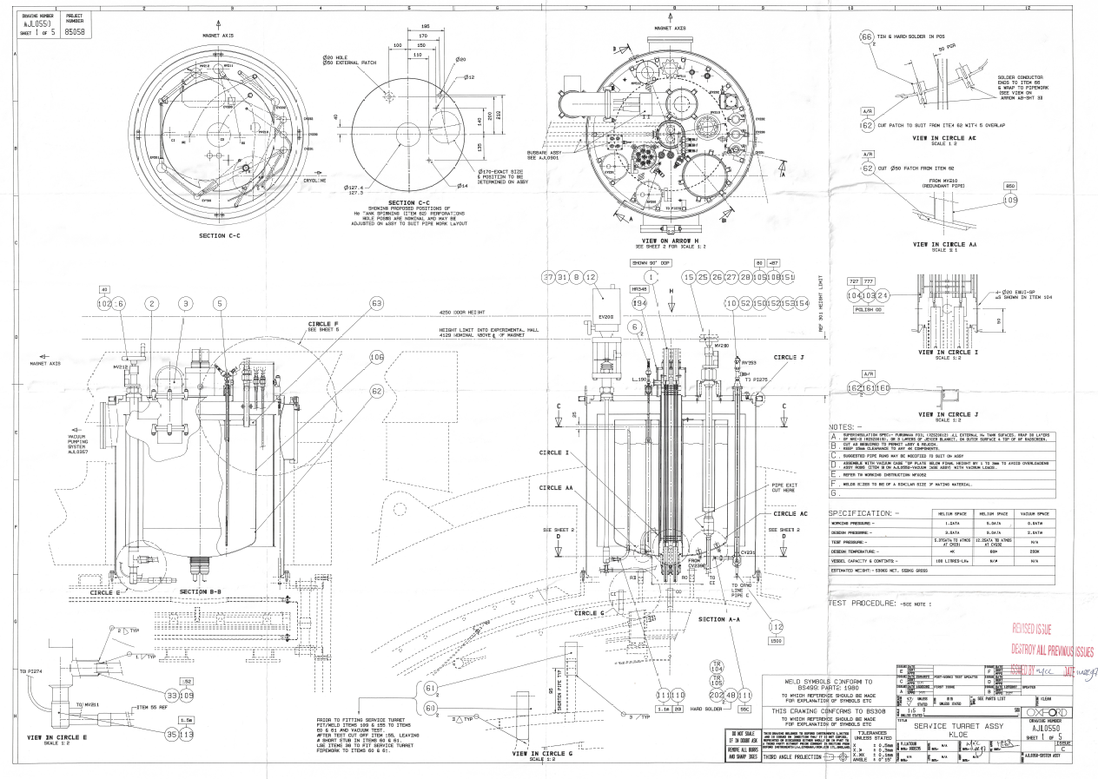
KLOE Magnet handling: Service Turret Removal

Slide 15
KLOE Magnet handling: Service Turret Removal

Slide 16
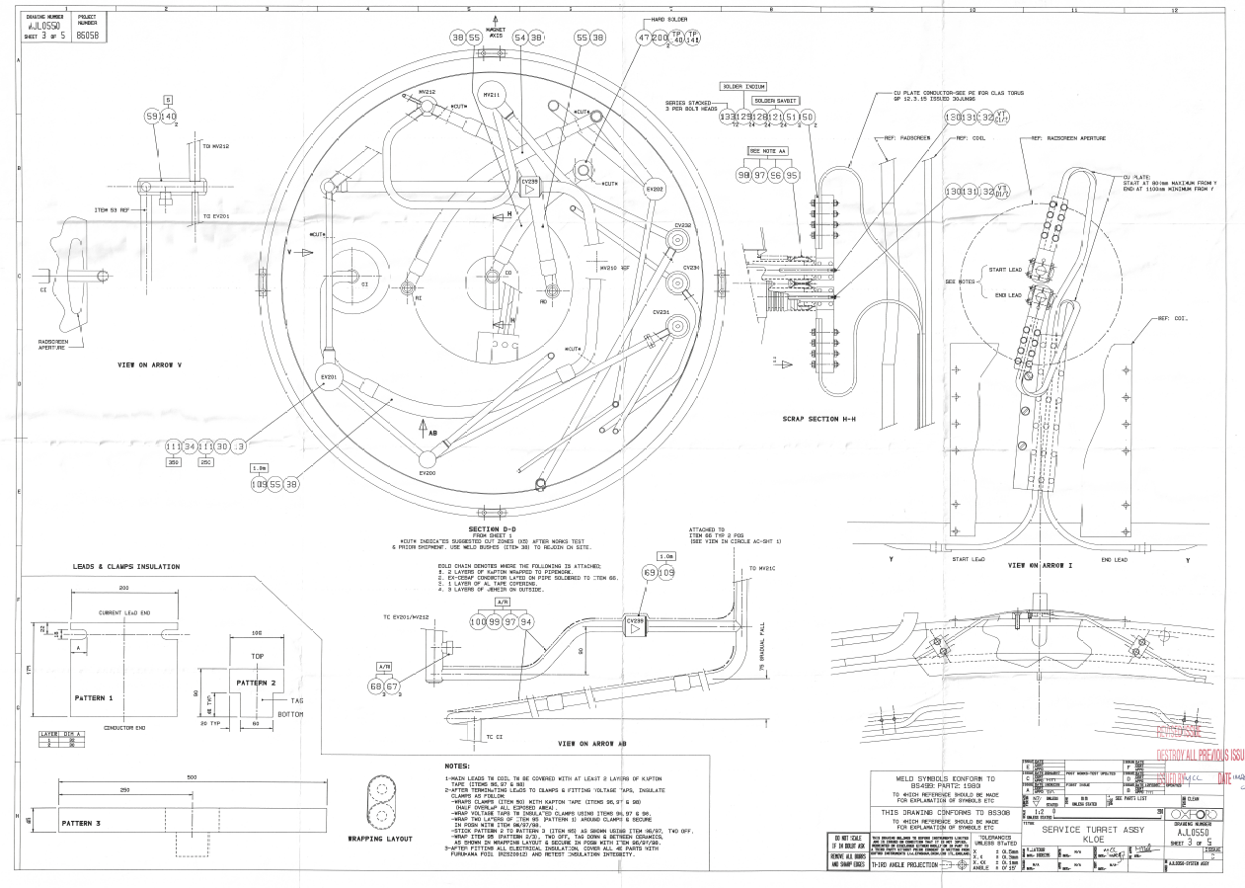
KLOE Magnet handling: Service Turret Removal

Slide 17

KLOE Magnet handling: Service Turret Removal

Slide 18
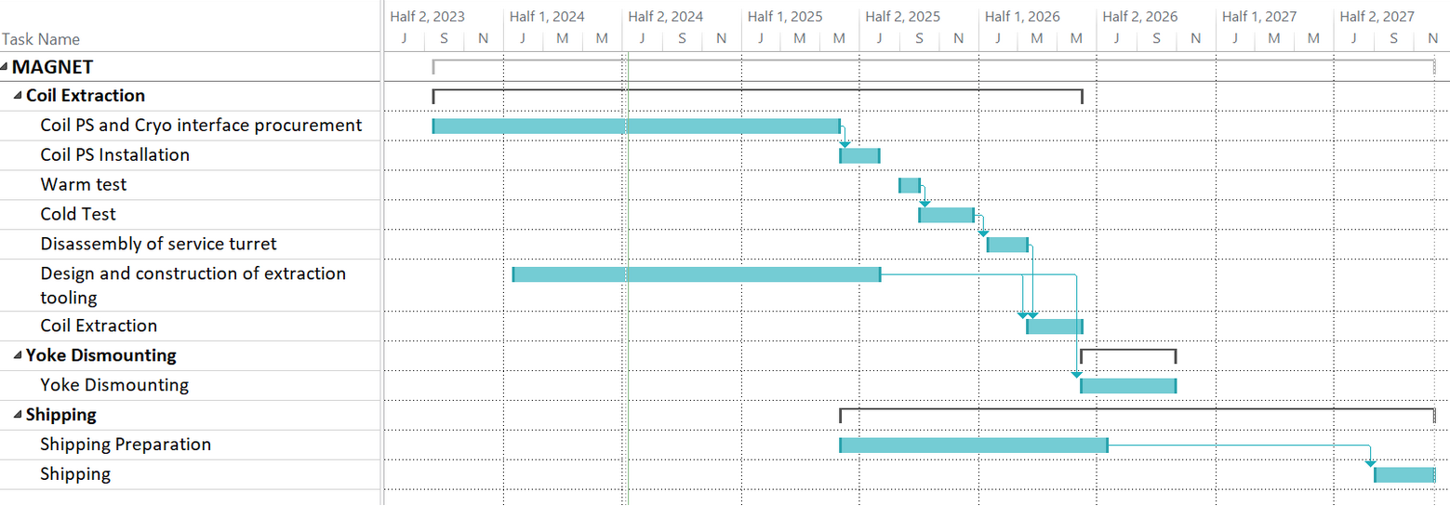
KLOE Magnet schedule

