Slide 1
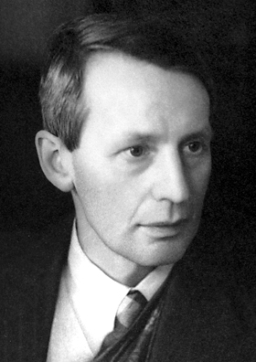
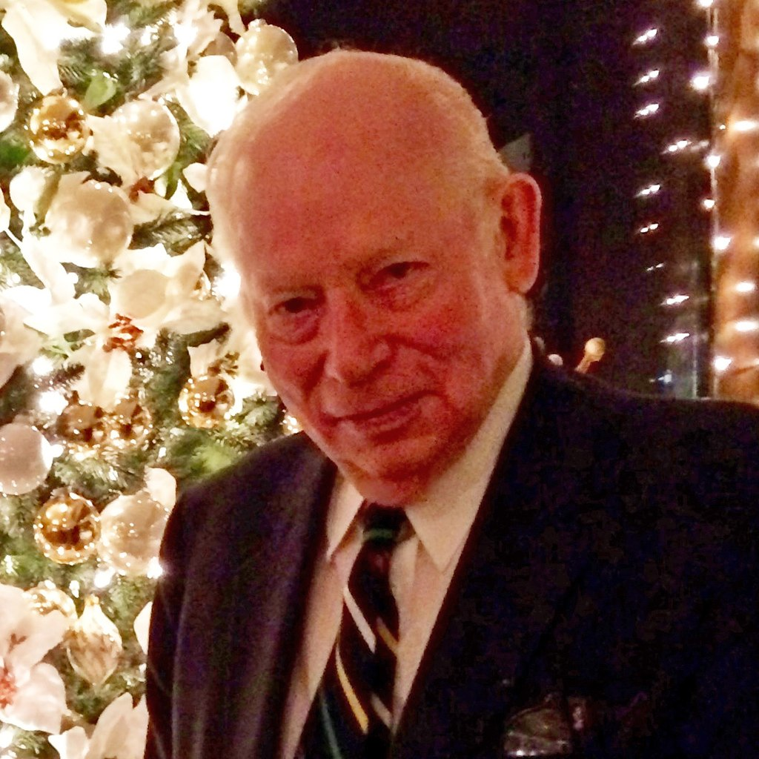
Main Injector / Recycler
Phil Adamson
3rd May 2024
1974
1933: Steven Weinberg
1892: G P Thomson
1947

Slide 2
Steady 800-900 kW to NuMI, lots of tuning.

Slide 3
Status
LAM41/LAM42 weren’t following their reference as they completed the downramp
PESD replaced and tuned regulator cards. Now much better.
Switchyard is coming!
Found EOB event after $E2 was disabled. This was causing the RR LLRF state 5 warnings.
R:EOBE2 timer card returned to proper configuration.
Some tension between setting that are best for booster losses, and those that are best for beam quality to recycler.
Continue to work with Booster to find a good compromise.

Slide 4
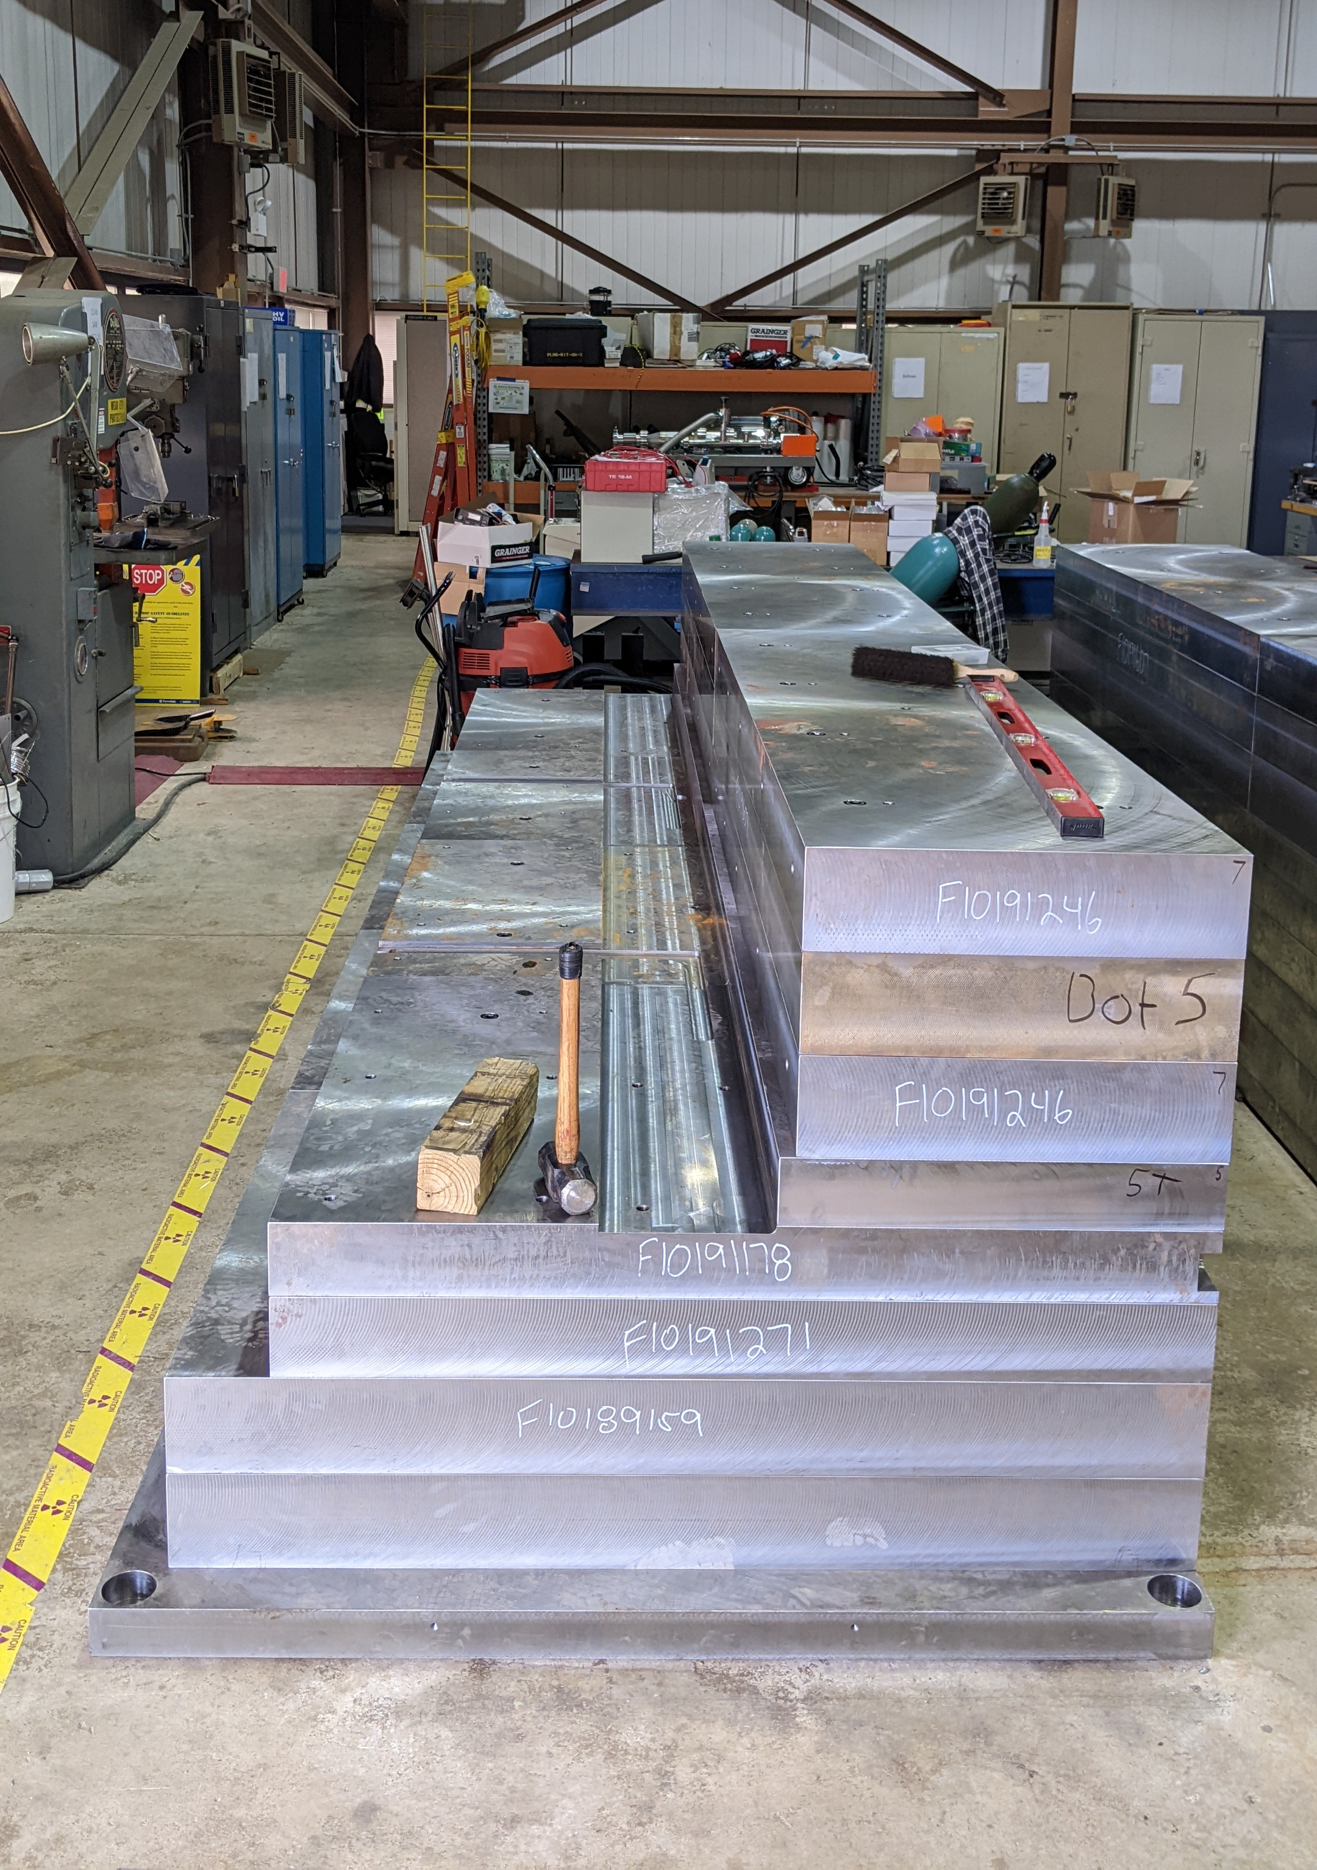
Shutdown preparation
New MI-8 collimator steel being stacked.
What you see in the picture here is all the steel that goes beneath the vacuum tube assembly.

