Slide 1
Tianlai Data Products
Shifan Zuo
2024/04/06

Slide 2
Data Products
Visibility
RFI flagged and calibrated visibilities, shape=(ntime, nfreq, npol, nbl), nfreq = 576, npol = 4
20160927/output_full_data/data/path/to/vis.hdf5 ~11TB
20180322/output_full_data/data/path/to/vis.hdf5 ~13TB
Map
/home/sharedir/zuoshifan/20160927_products/map_full.hdf5 nfreq = 144, nside=512, 4.5GB
/home/sharedir/zuoshifan/20180322_products/map_full.hdf5 nfreq = 144, nside=512, 4.5GB
/home/sharedir/zuoshifan/20160927_20180322_synthesis_products/map_full.hdf5 nfreq = 144, nside=512, 4.5GB
/home/sharedir/zuoshifan/20180322_576freqs_products/map_full.hdf5 nfreq = 576, nside=512, all baselines, 18GB
/home/sharedir/zuoshifan/20180322_576freqs_xcyl_products/map_full.hdf5 nfreq = 576, nside=512, cross-cyliner baselines only, 18GB
Multi-frequency Angular Power Spectrum $C_{ℓ}(ν, ν^{′})$
/home/sharedir/zuoshifan/20160927_products/cl.hdf5 and cl_from_map_full.hdf5 nfreq = 144, nl = 718
/home/sharedir/zuoshifan/20180322_products/cl.hdf5 and cl_from_map_full.hdf5 nfreq = 144, nl = 718
/home/sharedir/zuoshifan/20160927_20180322_synthesis_products/cl.hdf5 and cl_from_map_full.hdf5 nfreq = 144, nl = 718
/home/sharedir/zuoshifan/20180322_576freqs_products/cl.hdf5 and cl_from_map_full.hdf5 nfreq = 576, nl = 718
Power Spectrum P(k)
/home/sharedir/zuoshifan/20160927_20180322_synthesis_products/fisher.hdf5 and ps_full.hdf5
Other products
gain
mmodes
beam transfer matrices

Slide 3
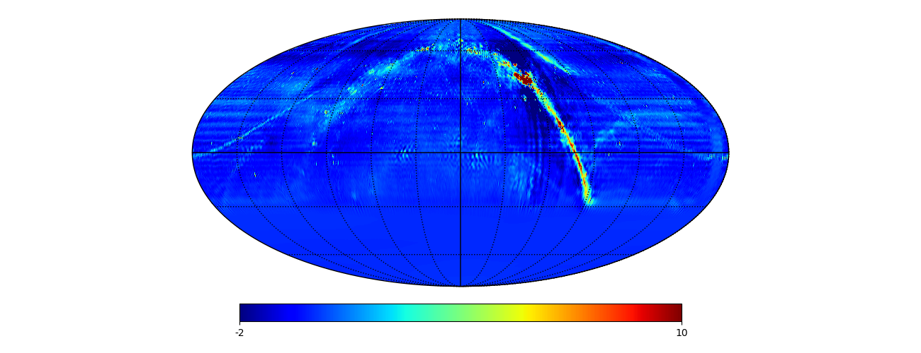
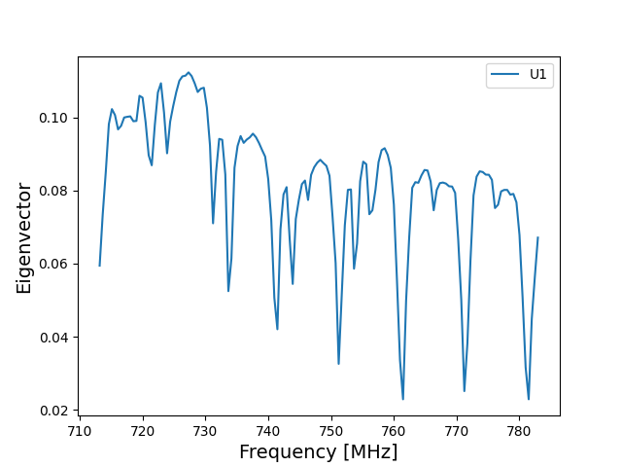
Maps
20160927, nfreq = 144, nside=512

Slide 4
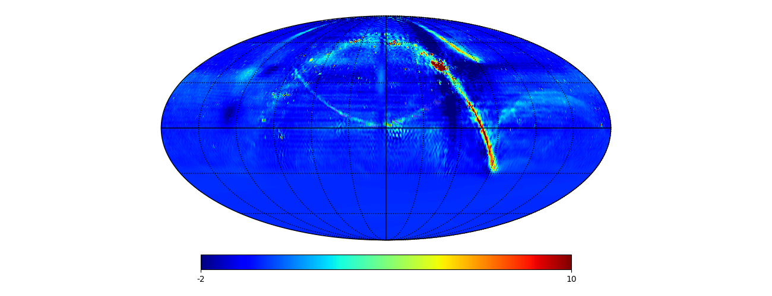
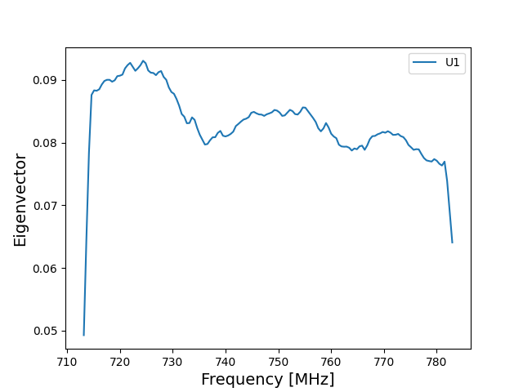
Maps
20180322 , nfreq = 144, nside=512

Slide 5
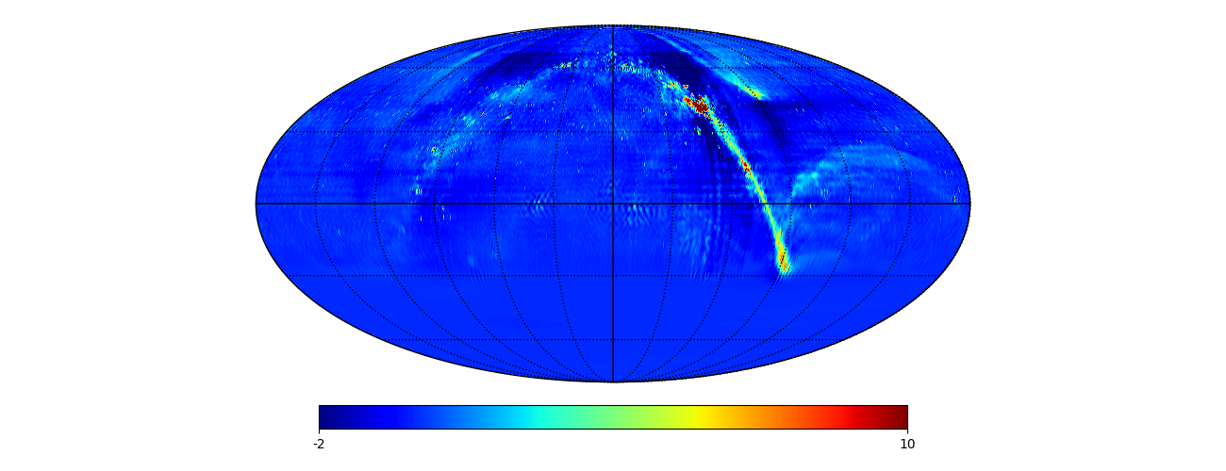
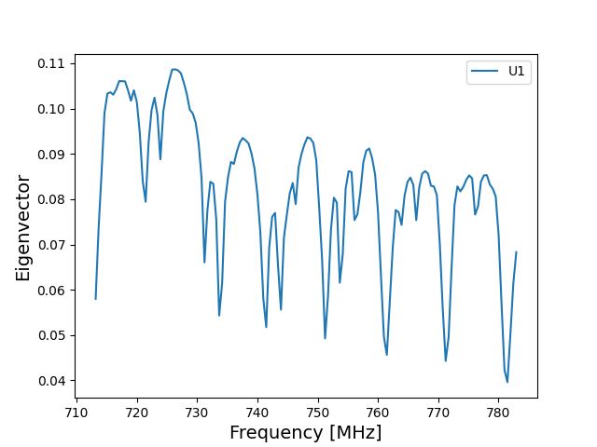
Maps
20160927 + 20180322 , nfreq = 144, nside=512

Slide 6
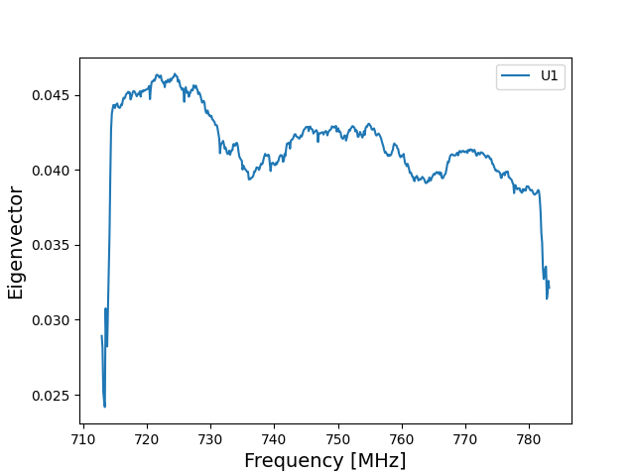
Maps
20180322 , nfreq = 576, nside=512, with all baselines

Slide 7
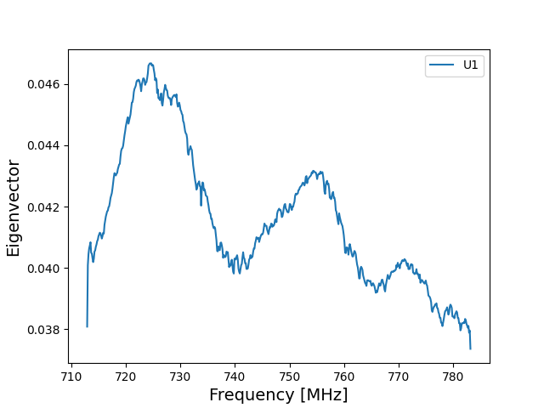
Maps
20180322 , nfreq = 576, nside=512, with only cross-cylinder baselines

Slide 8
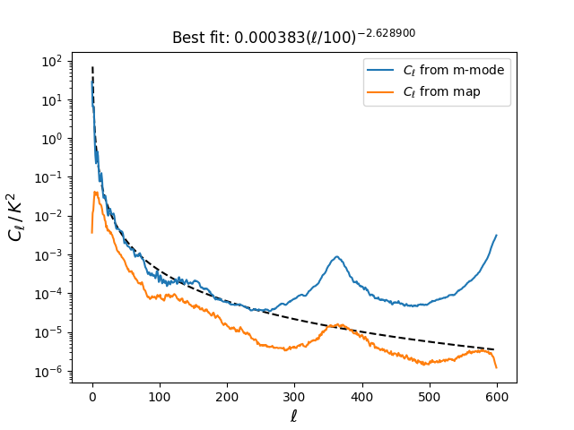
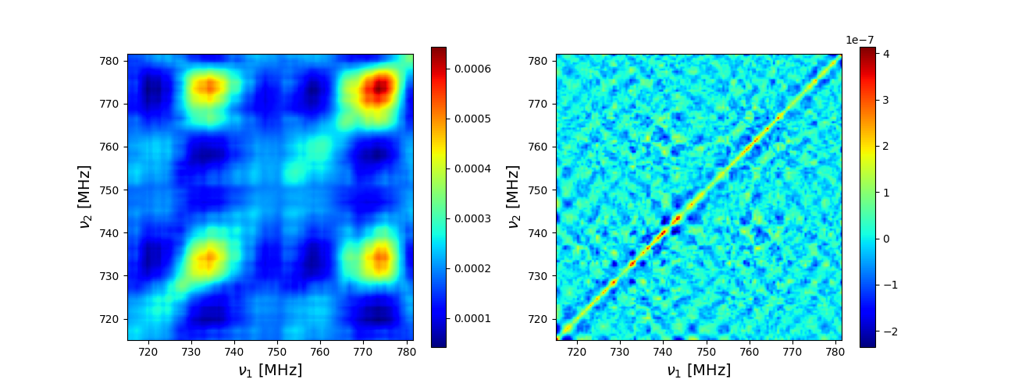
Multi-frequency Angular Power Spectrum $C_{ℓ}(ν, ν^{′})$
$C_{ℓ=100}\left(ν, ν^{′}\right)$, 20160927, PCA modes = 20
$$C_{ℓ}\left(ν\right)=A{(\frac{ℓ}{ℓ_{0}})}^{−α}{(\frac{ν}{ν_{0}})}^{−2β}$$
$C_{ℓ}\left(ν, ν\right)$ with $ν=750$ MHz
$C_{ℓ=100}\left(ν, ν^{′}\right)$, 20180322, PCA modes = 20

Slide 9
Power Spectrum
$Δ^{2}\left(k\right)=k^{3}P(k)/2π^{2}$ from 20160927 + 20180322

Slide 10
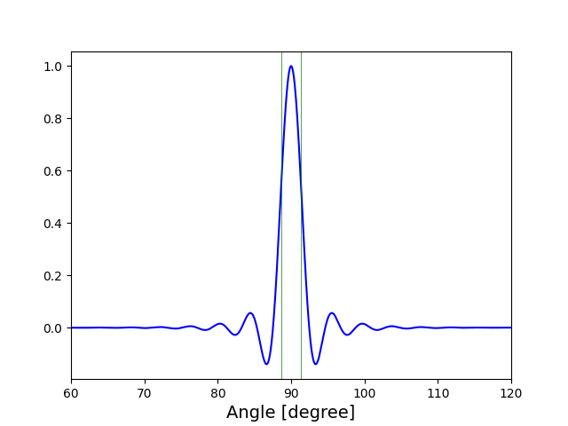
Beam
Model beam at 750 MHz

Slide 11
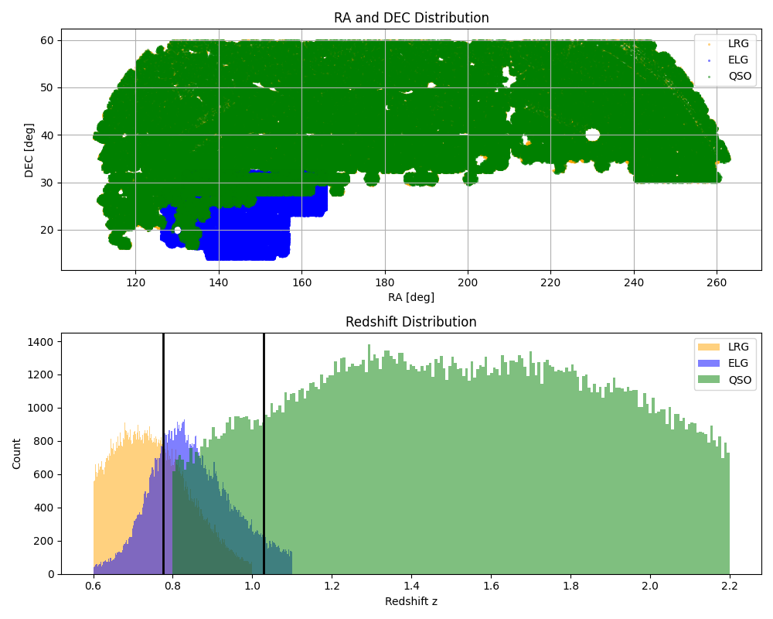
Stacking Analysis
LRG: luminous red galaxies
ELG: emission line galaxies
QSO: quasars
eBOSS catalogs

Slide 12
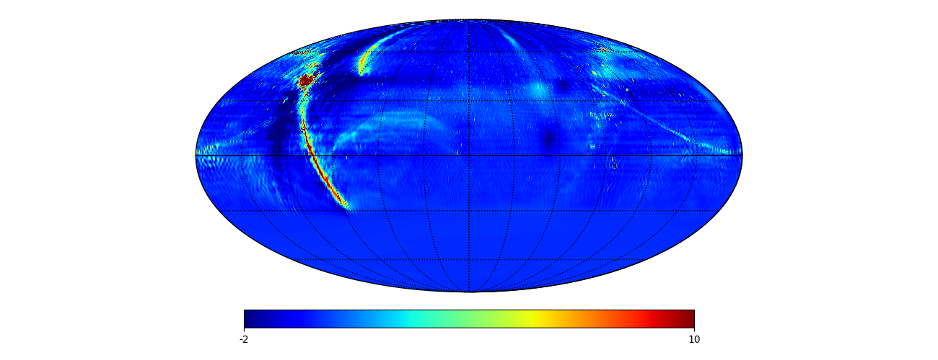
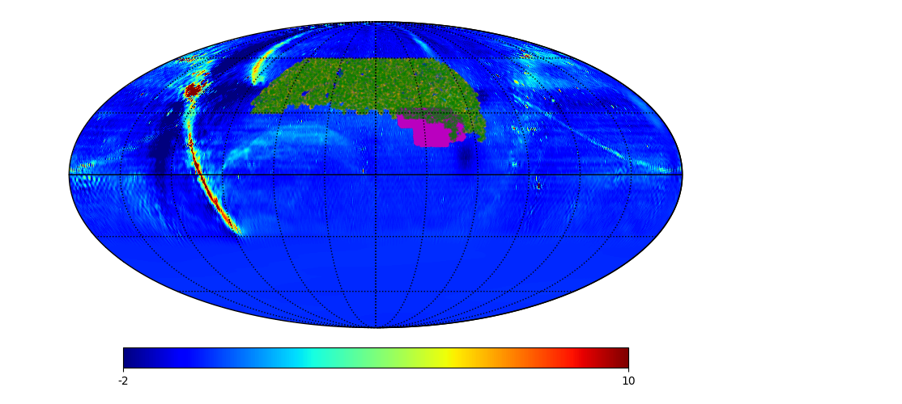
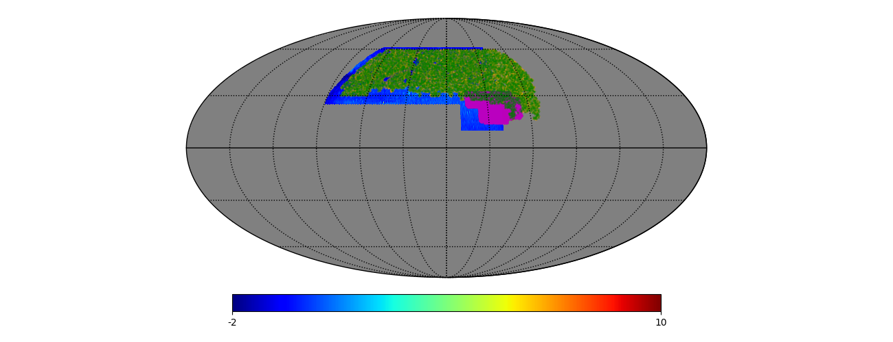
Stacking Analysis

Slide 13
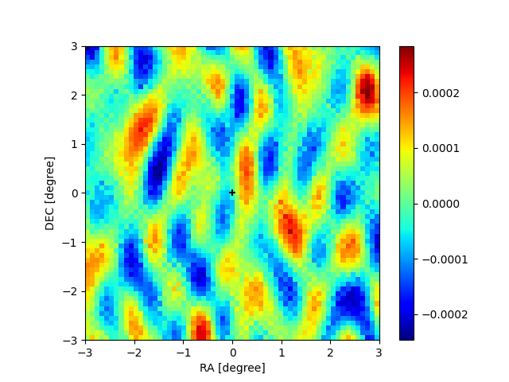
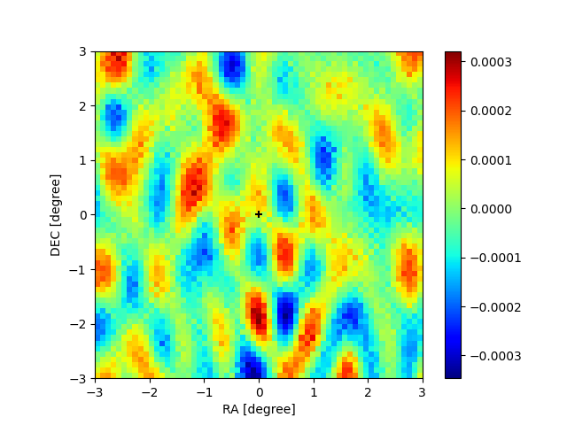
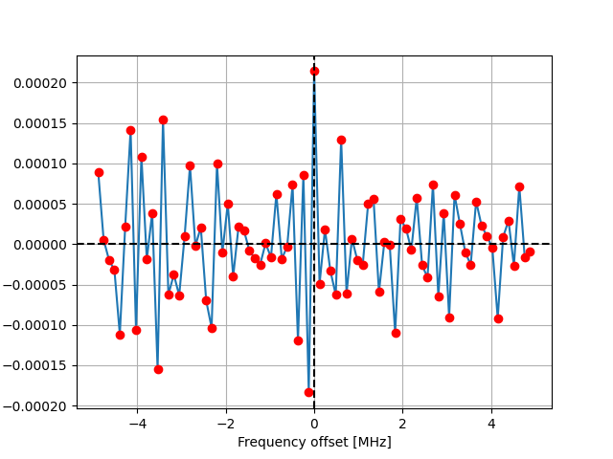
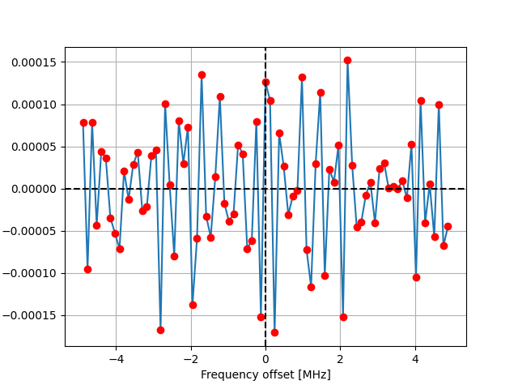
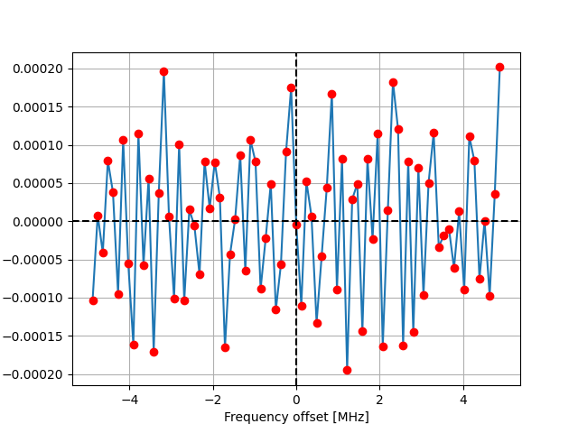
Stacking Analysis
ELG LRG QSO

Slide 14
Stacking Analysis --- CHIME Results

Slide 15
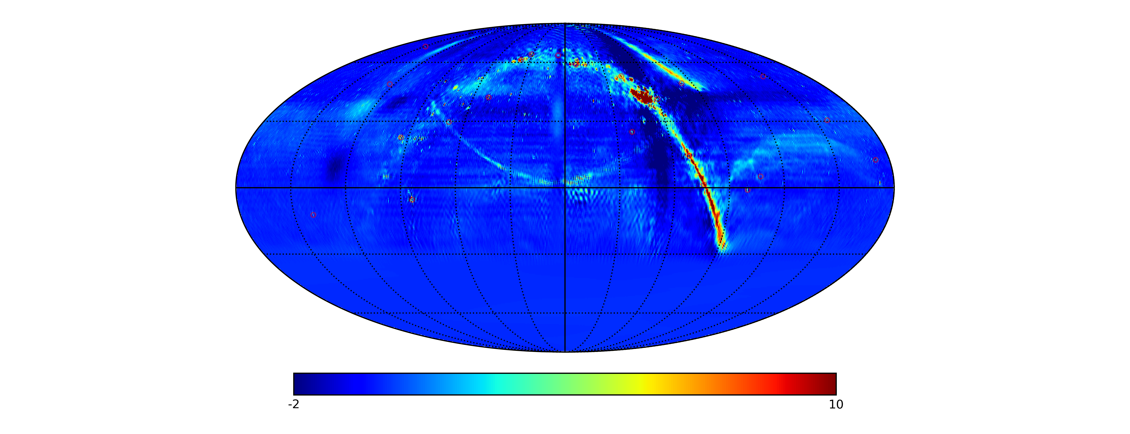
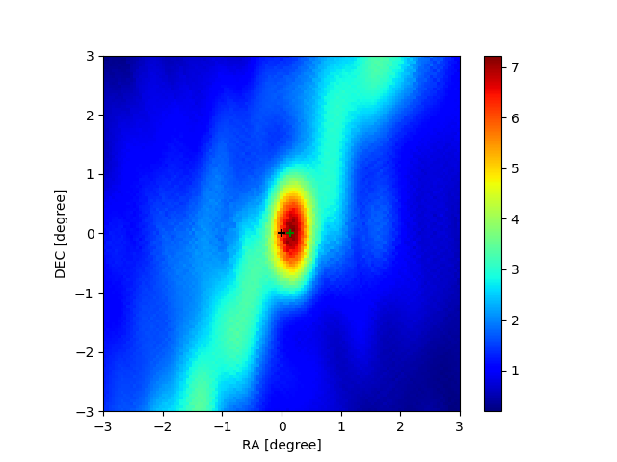
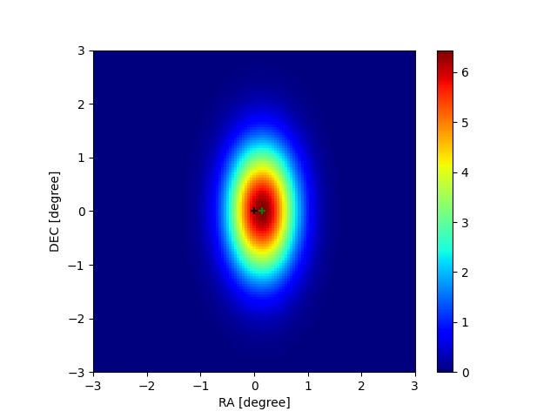
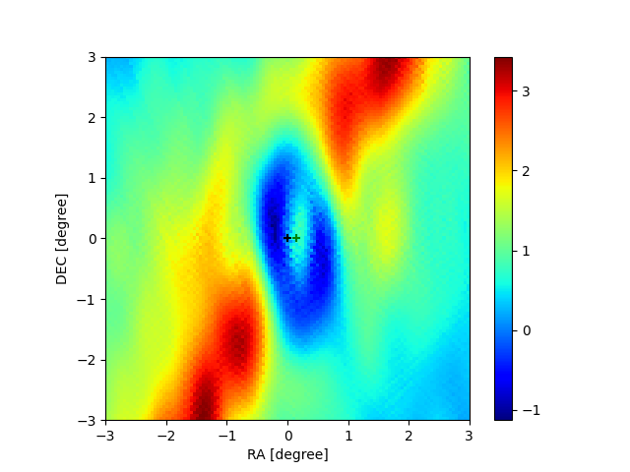
Stacking Analysis on Strong Sources
Stacked image 2D Gaussian fit Residue

