Slide 1
Tooth strip to board step measurements
Nelson, Dar
13-may-2024

Slide 2
outline
Production procedures update
Status to step measurements
Production status and schedule projection

Slide 3
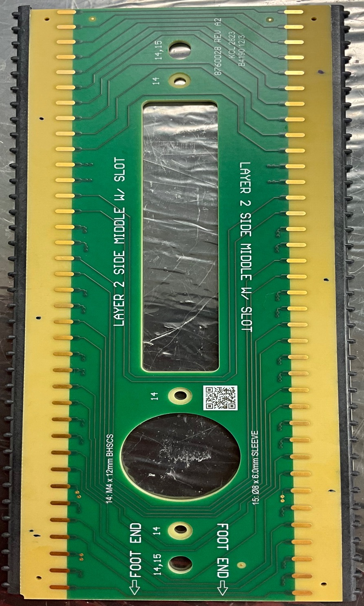
Procedures update
The US (W&M) group had been using a version of the UK’s geometry board assembly procedures based on last summer
We make a version of that procedure updated for local conditions
Different tooth strip trimming – we do ours on a fixture on a CNC mill
Different epoxy application method
All other aspects meant to be the same
They have made a number proc’s updates in the UK over the last year
We knew of some by not other of these
Cleaning was done the same, for example
Measurements of step between board and strip was developed in parallel
Using a Dremel brush to remove excess epoxy was new to us
Had a couple productive sessions reviewing the UK proc’s in detail
Led by Brian and Justin with QA office participating
When we get revised UK proc note will insert the US specific areas
Then we will again be working on a common procedure

Slide 4
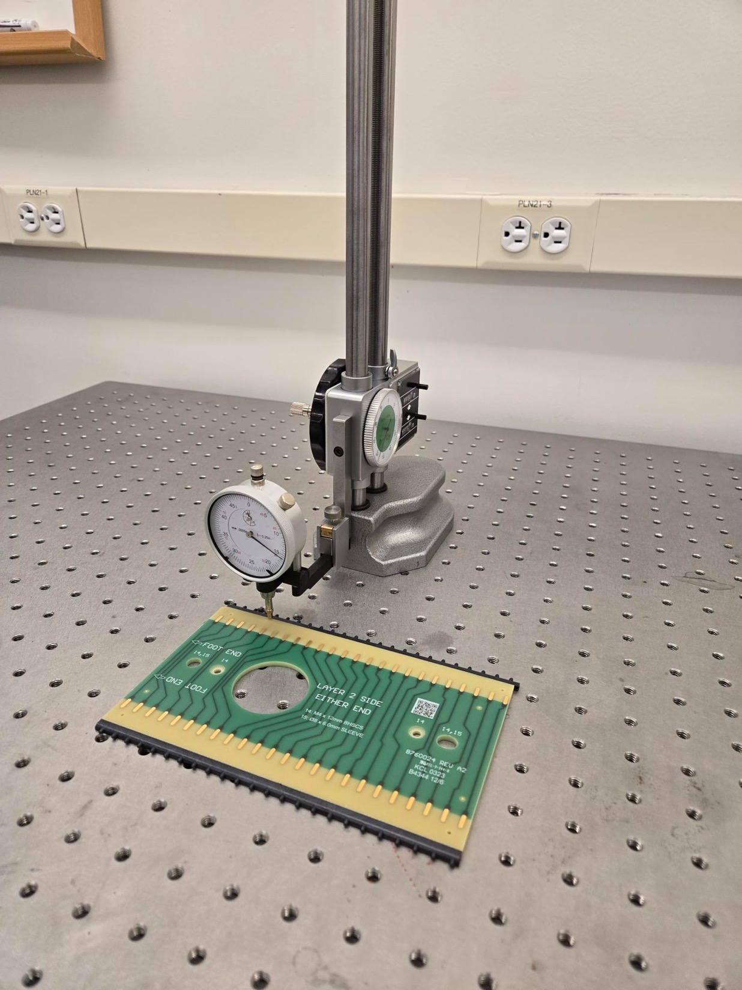
Step between board and tooth strip
Specification of +/- 200 um (0.2mm) between top surface of the board and the top of the tooth strip
Two measurement techniques
A machinist’s dial indicator – for production (right)
Currently https://www.mcmaster.com/20715A81/ with a 4mm tip
Moving to the UK’s tip indicator with 1mm tip https://www.zoro.co.uk/shop/measuring-and-test-equipment/dial-test-indicators-lever-type/dial-test-indicator-513-424-10t/p/ZT1025781P
Moving from a lab bench to an optical table for production measurements
A precision profilometer – for testing precision of method
https://www.bruker.com/en/products-and-solutions/test-and-measurement/stylus-profilometers/dektakxt.html
10s of nm precision, available for (shared) use in W&M’s core labs
Cross calibration in progress

Slide 5
Preliminary tests of 6 boards
Dial indicator in a work bench
All 36 measurements were within the 200um
All but one point with the strip above the board

Slide 6
Profilometer in action

Slide 7
Assembled board foot step
8760040 | Board is higher (microns)
1 | 112
2 | 129
3 | 117
4 | 47
5 | 104
3
4
2
5
1
1

Slide 8
Assembled board foot step
4
5
8760038 | Board is higher (microns)
1 | 82
2 | 103
3 | 83
4 | 32
5 | 83
6 | 130
7 | 55
8 | 60
3
6
2
7
1
1
8

Slide 9
Assembled board foot step
4
5
8760038 | Board is higher (microns)
1 | 137
2 | 180
3 | 176
4 | 167
5 | 123
6 | 125
7 | 124
8 | 132
3
6
2
7
1
1
8

Slide 10
Assembled board foot step
4
8760038 | Board is higher (microns)
1 | 85
2 | 57
3 | 35
4 | 62
5 | 46
6 | 114
3
5
2
6
1
1

Slide 11
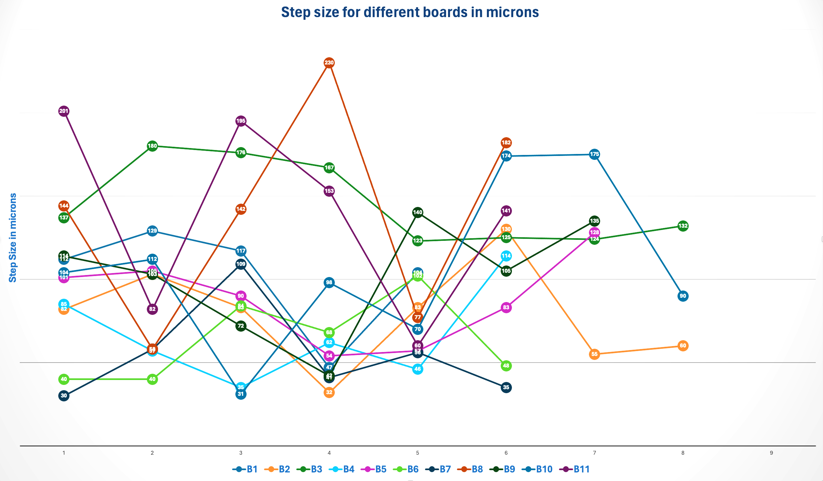
Profilometer data
200 $μ$ tolerance line
All are “board taller than strip” in this sample

Slide 12
Observations
We see larger variations in step away from the center of the board
UK’s plan for adding 4 extra clamps near the corners is a good idea
When the updated drawings are ready, we will update the fixtures accordingly

Slide 13
Precision?
Initial cross check (1 board, 6 points) shows 20-30um RMS on the comparison of the two devices
More correlated data on the way
This will be w/ new dial indicator + smaller ball + optical table
Will work through the current inventory to test and develop statistics
Note time-motion test on these measurement add about 25% to the effort to produce a board

Slide 14
Notes on status

Slide 15
Status
On a work stop
Pending plans, review, and (possible) site visit to W&M to address issues seen in delivered boards
Recent issues
Main - older boards (before ~ Sept 2023) have adhesions problems at least in part due epoxy loading near the ends of the ends of the strips
Do not plan to use these boards unless there is an approved remediation method; not pursuing at this point
Epoxy on tooth strips and surface of some recent boards
New UK proc with Dremel tool will fix the issues on the strips
Actions
Adding new QC checks at the end of production accordingly
Sent video of our assembly process for comment from the UK
Got useful feedback
After we have added the W&M-specific steps in the proc’s to reshoot for feedback

Slide 16
After reauthorization to start production, we could produce an APA’s work each two weeks
Worked with Brian on a set of deliverable documentation
It is important to get the reject boards (their IDs too) from UC to track their status and make sure we understand the origin on these issues
Plan needs approval
Hope for this in early June

Slide 17
Production status/schedule
Have delivered acceptable boards for
APA 1 all layers
APA 2 x, v layers
Currently we only have received U long side boards for 2.7 APAs
Some of those were in the bad-board era
Last delivery in January
Do not have enough currently to complete APA 2 u layer
These boards are the critical path – other board types assembled do no advance our completion date

Slide 18
Backup slides

Slide 19
Assembled board foot step
4
8760038 | Board is higher (microns)
1 | 101
2 | 105
3 | 90
4 | 54
5 | 57
6 | 83
7 | 128
3
5
2
6
1
1
7

Slide 20
Assembled board foot step
4
8760054 | Board is higher (microns)
1 | 40
2 | 40
3 | 84
4 | 68
5 | 102
6 | 48
3
5
2
6
1
1

Slide 21
Assembled board foot step
4
8760054 | Board is higher (microns)
1 | 30
2 | 58
3 | 109
4 | 41
5 | 56
6 | 35
3
5
2
6
1
1

Slide 22
Assembled board foot step
4
8760057 | Board is higher (microns)
1 | 144
2 | 58
3 | 142
4 | 230
5 | 77
6 | 182
3
5
2
6
1
1

Slide 23
Assembled board foot step
4
8760038 | Board is higher (microns)
1 | 114
2 | 103
3 | 72
4 | 42
5 | 140
6 | 105
7 | 135
3
5
2
6
1
1
7

Slide 24
Assembled board foot step
4
5
8760057 | Board is higher (microns)
1 | 104
2 | 112
3 | 31
4 | 98
5 | 70
6 | 174
7 | 175
8 | 90
3
6
2
7
1
8

Slide 25
Assembled board foot step
4
8760040 | Board is higher (microns)
1 | 201
2 | 82
3 | 195
4 | 153
5 | 60
6 | 141
3
5
2
6
1
1

