Slide 1
Signal discrimination for neutron-antineutron oscillation sensitivity study at DUNE
Justin Wheeler
Fermilab/Carthage College
Mentor: Linyan Wan Fermilab

Slide 2
DUNE overview
Goals:
Measure $ν$ oscillation parameters, especially CP violation
BSM physics (Neutron-antineutron oscillation)
DUNE as a $ν$detector:
$ν_{μ}$ beam
Known direction
Atmospheric $ν$
Unknown direction
Dominant background
for BNV processes
Liquid Argon Time Projection Chamber (LArTPC)
Atmospheric $ν$
from unknown directions
$$ν$$
$$ν$$
$$ν$$
$$ν$$
$$ν$$
$$ν$$
$$ν$$
$$ν$$
Source: DUNE Collaboration
Notes:
Mention atmospherics

Slide 3
Neutron-antineutron oscillation $(n→\overline{n})$
Baryon number violation ($ΔB=2$)
Beyond Standard Model
Could explain Baryon asymmetry universe
DUNE searching for $n→\overline{n}$ in Ar nuclei
Place limits on $n→\overline{n}$ lifetime
Post-oscillation the antineutron annihilates with a proton or neutron in the nucleus
Source: B. Dev, et al., J. Phys. G (2024)
Notes:
BNV According to Sakharov conditions
Transition not oscillation????

Slide 4
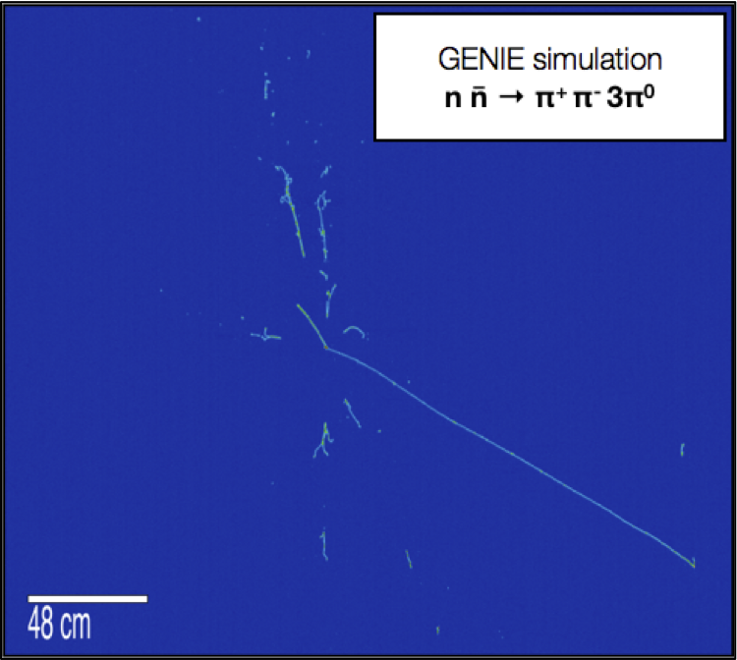
Antineutron annihilation in nucleus
Branching ratios:
Determined by experiments investigating $\overline{p}p$ and $\overline{p}n$ annihilation
Outcoming particles:
Mostly pions (charged and neutral)
Final state interactions:
Affect pion kinematics
Include intranuclear scattering, absorption, charge exchange, and pion production
GENIE simulation
$$n\overline{n}→π^{+}π^{−}3π^{0}$$
DUNE Far Detector Horizontal Drift (FDHD) Simulation
Notes:
Higher res figure
Verify FSI bullet points – elastic
antineutron annihilation title (ignore)
Label tracks and showers not the pi0 and pi+ pi-

Slide 5
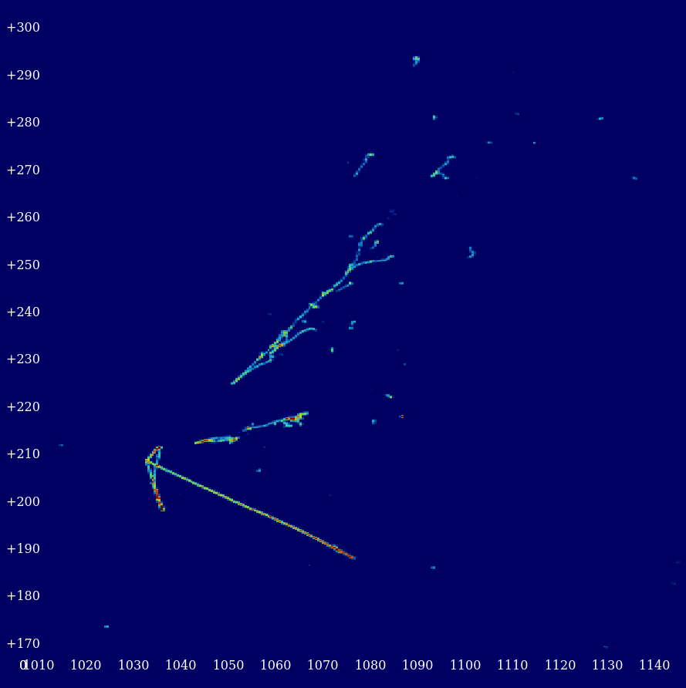
Background signal: atmospheric neutrinos
$$ν_{μ}+Ar40→μpπ^{+}π^{0}$$
Dominant background to the $n→\overline{n}$ search
Interaction products:
Muons, electrons, and hadrons
Generally exhibit preferential direction
Identify differences between background and potential signal events
Momentum and energy distributions
DUNE FDHD Simulation
Notes:
Make sure CC and NC.
Highlight no charged leptons in signal more.
Linyan will email simulated atm nu interaction

Slide 6
Constructing Feature Variables
Compared to background we generally expect signal events to
Be more isotropic
Have higher multiplicity
Have no long muon track
…
Notes:
Highlight kinematic variables.
Clarify these are not all the features of nnbar

Slide 7
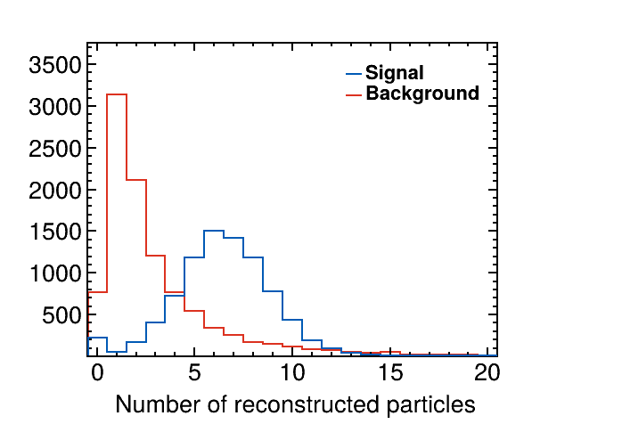
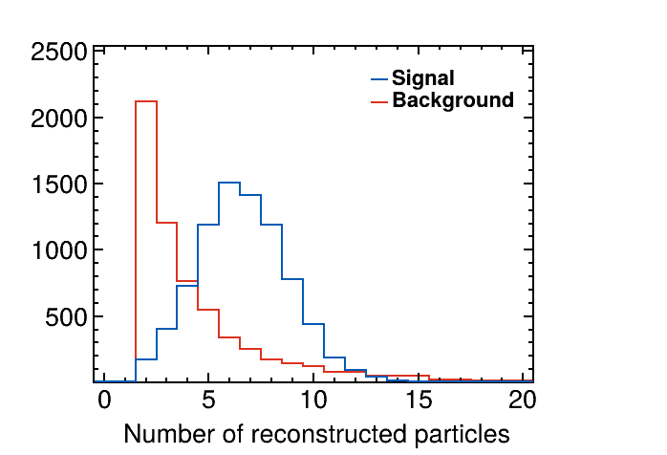
Multiplicity and precuts
FDHD Simulation
FDHD Simulation
DUNE Work In Progress
DUNE Work In Progress
# particles > 1
Background not flux weighted
Background not flux weighted
Apply precut of number of reconstructed particles > 1
Signal efficiency: 96.7%
Cut out 39.0% background
Signal events have higher multiplicity

Slide 8
Isotropy and kinematics
FDHD Simulation
FDHD Simulation
DUNE Work In Progress
DUNE Work In Progress
Background not flux weighted
Background not flux weighted
Signal events are more isotropic
Background exhibits directionality
Background events have wider kinematic range
Signal events have total momentum around fermi momentum

Slide 9
Classification of Signals
Check correlation between variables
Optimize cuts based on sample size
Optimize an estimator
Final signal efficiencies can be calculated
Can be applied to calculate DUNE far detector sensitivity
Example decision tree

Slide 10
Summary
Sensitivity of DUNE FD to $n→\overline{n}$ oscillation in bound nuclei
Place limits on oscillation time for neutrons
Sensitivity determined by
Signal/background efficiency
Detector operational time
Number of available neutrons
SK, Phys.Rev.D 103 (2021) 1, 012008
DUNE?
Source: Babu, et al.

