Slide 1
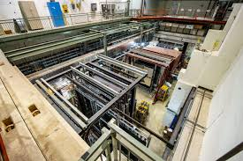


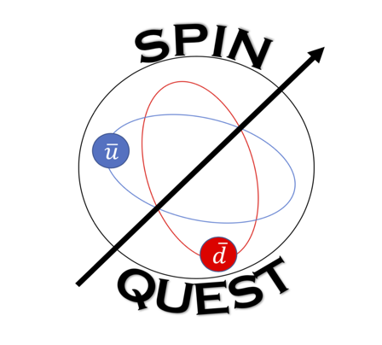

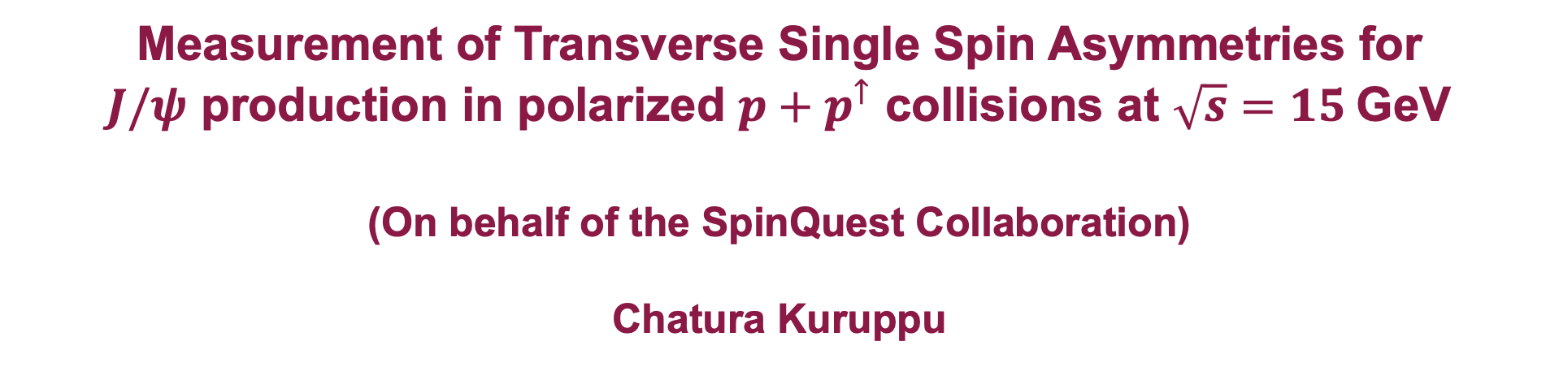
Measurement of Transverse Single Spin Asymmetries for
$J/ψ$ production in polarized $p+p^{↑}$ collisions at $\sqrt{s}=15$GeV
(On behalf of the SpinQuest Collaboration)
Chatura Kuruppu
Notes:
Hi everyone.!
I am Chatura Kuruppu. I am a postdoctoral researcher from the New Mexico State University.
Today, Im gonna be talking about the preliminary studies made to measure TSSA for J/psi production using SpinQuest experiment. On behalf of the spinquest collaboration.

Slide 2

Outline
Introduction
Motivation
Existing results (PHENIX)
SpinQuest Experiment
Analysis Procedure:
  Generated Monte-Carlo
  Background estimation using GPR (Gaussian Process Regression)
  Bayesian Unfolding (Using RooUnfold)
Simulation Results
Conclusions
Next Steps and Discussion
Notes:
In this talk, I would like to ouline:
A brief introduction
The motivation of such measurement
Existing results published by other collaborations like PHENIX
A brief intro for spinquest experiment
The analysis strategy
simulation results
finally conclusions and the next steps

Slide 3
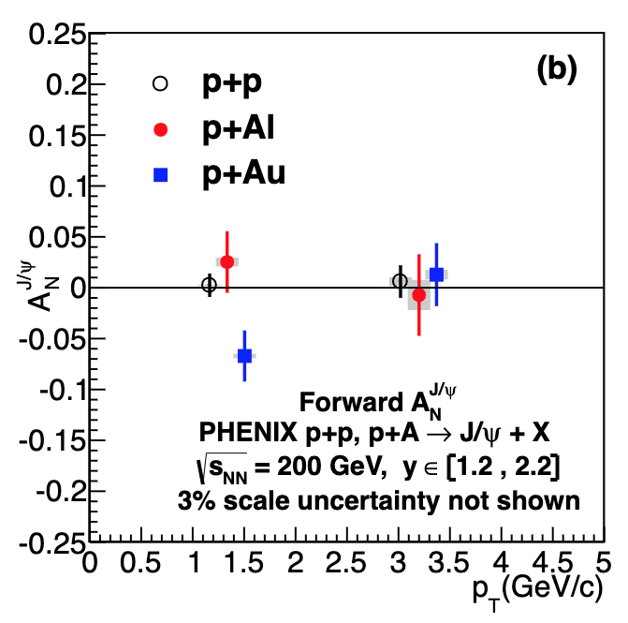
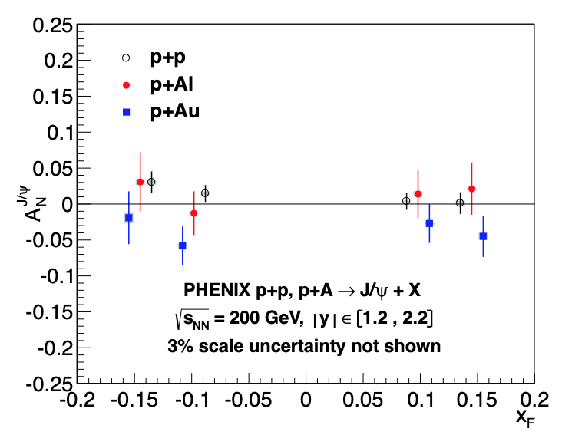
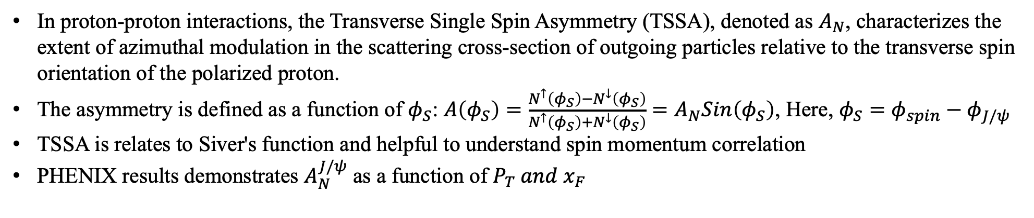
Transverse Single Spin Asymmetry in $J/ψ$ Production
In proton-proton interactions, the Transverse Single Spin Asymmetry (TSSA), denoted as $A_{N}$, characterizes the extent of azimuthal modulation in the scattering cross-section of outgoing particles relative to the transverse spin orientation of the polarized proton.
The asymmetry is defined as a function of $φ_{S}$: $A\left(φ_{S}\right)=\frac{N^{↑}\left(φ_{S}\right)−N^{↓}\left(φ_{S}\right)}{N^{↑}\left(φ_{S}\right)+N^{↓}\left(φ_{S}\right)}=A_{N}Sin\left(φ_{S}\right)$, Here, $φ_{S}=φ_{spin}−φ_{J/ψ}$
TSSA is relates to Siver's function and helpful to understand spin momentum correlation
PHENIX results demonstrates $A_{N}^{J/ψ}$ as a function of ${P_{T} and x}_{F}$
19%
618 files
81%
2587 files
Aidala et al., Phys. Rev. D 98, 012006, arXiv: 1805.01491 (hep-ex) (2018)
Notes:
In pp⃗ interactions, the transverse single spin asymmetry (TSSA), is defined as the amplitude of the azimuthal angular modulation AN of the outgoing particle’s scattering cross section with respect to the transverse spin direction of the polarized proton.
The asymmetry can be written as function of angle φS which is defined as the difference between Azimuthal angle of spin and the azimuthal angle of J/psi momentum
The physics significance is TSSA is it relates to Siver's function and helpful to understand spin momentum correlation
There are many experiment like Phenix, COMPASS already measured TSSA in different Kinematic regions.
As you can see these TSSA measurements using JPsi events are made by using different transverse momentum and Xf bins. The white color points denote TSSA measurements on p-p interactions

Slide 4
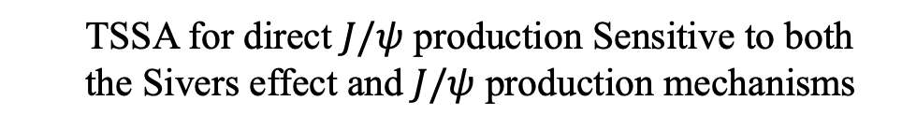
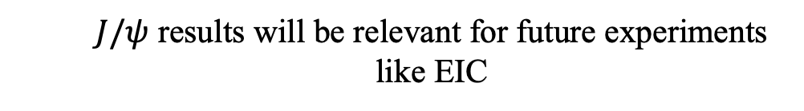
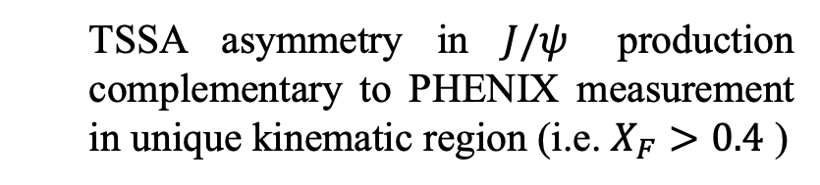
Motivation
Theoretical Interests:
Experimental Interests:
  TSSA for direct $J/ψ$ production Sensitive to both the Sivers effect and $J/ψ$ production mechanisms
Role of gluons in creating A_{N} is not well understood,
while quarks relatively well understood (only the Sivers effect is responsible for any TSSA)
  TSSA asymmetry in $J/ψ$ production complementary to PHENIX measurement in unique kinematic region (i.e. $X_{F}>0.4$ )
  Spectrometer is well tested and calibrated to detect physics events with final-state di-muons
  $J/ψ$ results will be relevant for future experiments like EIC
Notes:
The motivation to pursue analysis on this topic can be classified under two sub sections:
1. Theoritical interests
2. Experimental interests
Speaking of Theoritical interests:
1. transverse single spin asymmetry (SSA) for direct J/ψ production is sensitive to both the Sivers effect and the J/ψ production mechanism
2. Since J/psi production dominantly involves g-g interactions in initial state,, and only the Sivers effect can be responsible for any transverse SSA.
Speaking of Experimental interests:
1. SpinQuest will conduct the first measurement of the Sivers asymmetry in J/psi production in a unique kinematic region.
2. Also, our spectrometer is well-calibrated and well tested to detect final-state di-muons from physics events with the final state di-muons.
3. Speaking of the kinematic region, we probe a very differnt kinematic region compared to other experiments.
4. J/psi production results will be relevant to future experiments like EIC (diffractive J/psi production)

Slide 5
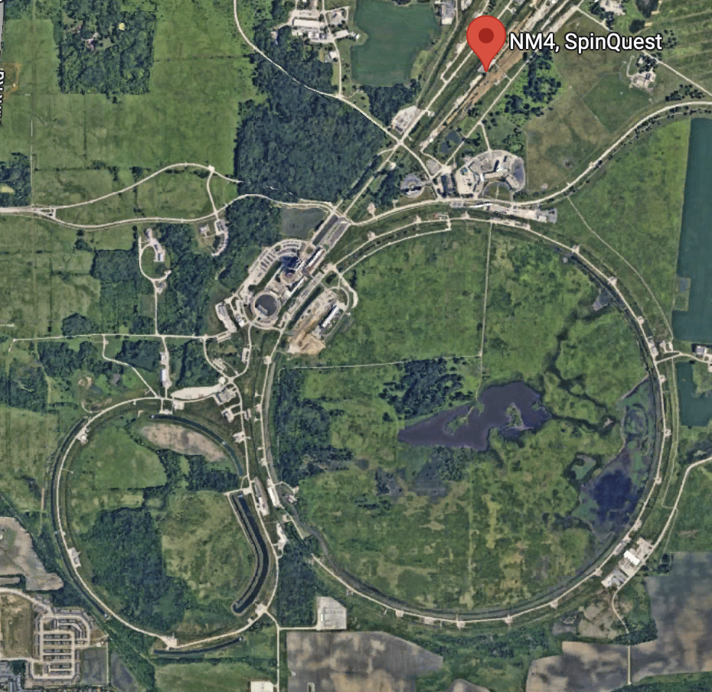
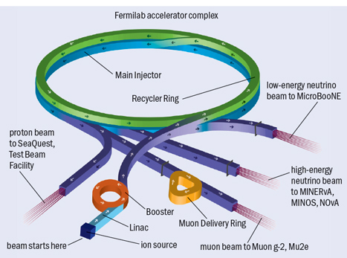

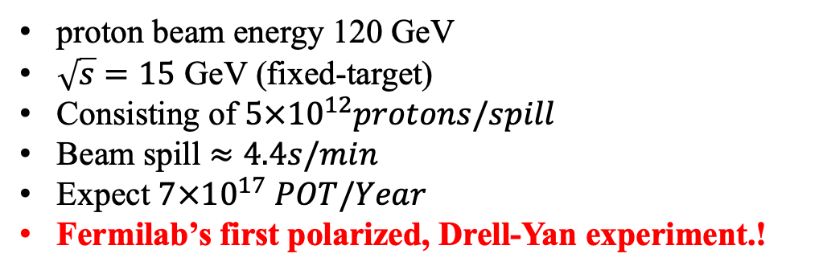
SpinQuest Experiment (Beamline)
You are here
proton beam energy 120 GeV
$\sqrt{s}=15$ GeV (fixed-target)
Consisting of $5×{10}^{12}protons/spill$
Beam spill $≈4.4s/min$
Expect $7×{10}^{17} POT/Year$
Fermilab’s first polarized, Drell-Yan experiment.!
19%
618 files
81%
2587 files
Notes:
Our experiment is located at the NM4 facility.
As you can see the beam is projected from the main injector ring with proton beam with 120GeV
Since our target is fixed, the center of mass energy is 15GeV
Beam spill last 4.4s and we expect 7x10^17 POT/year
Fun fact about spinquest experiment, it is the first polarized Drell-Yan experiment

Slide 6
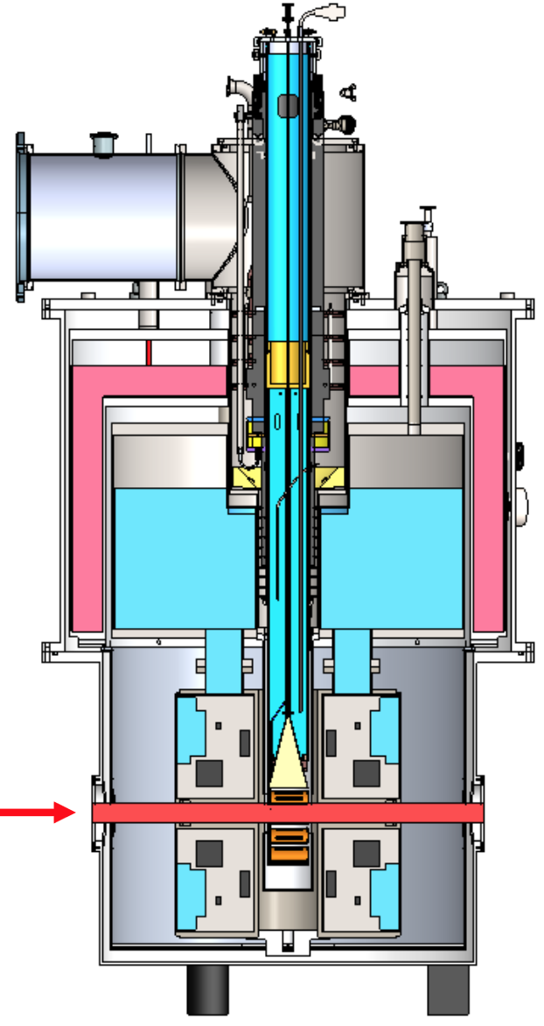
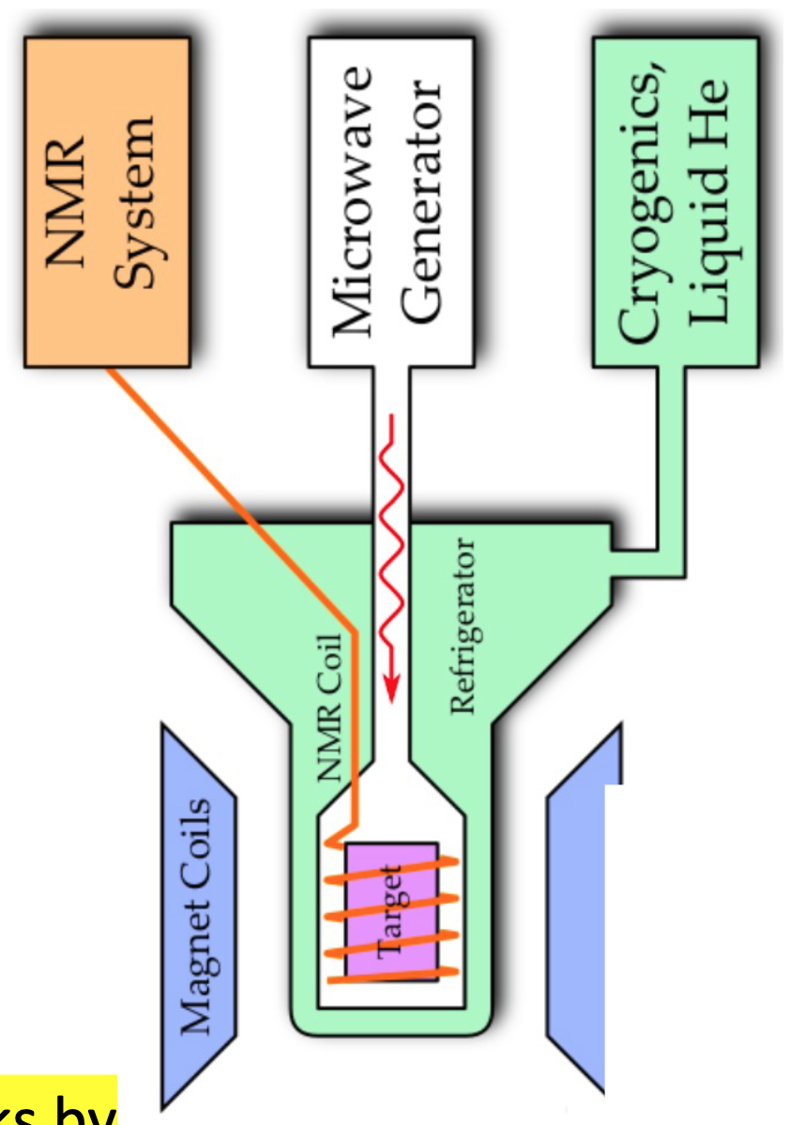
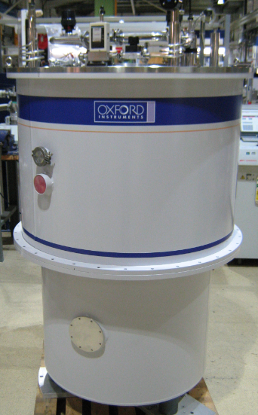
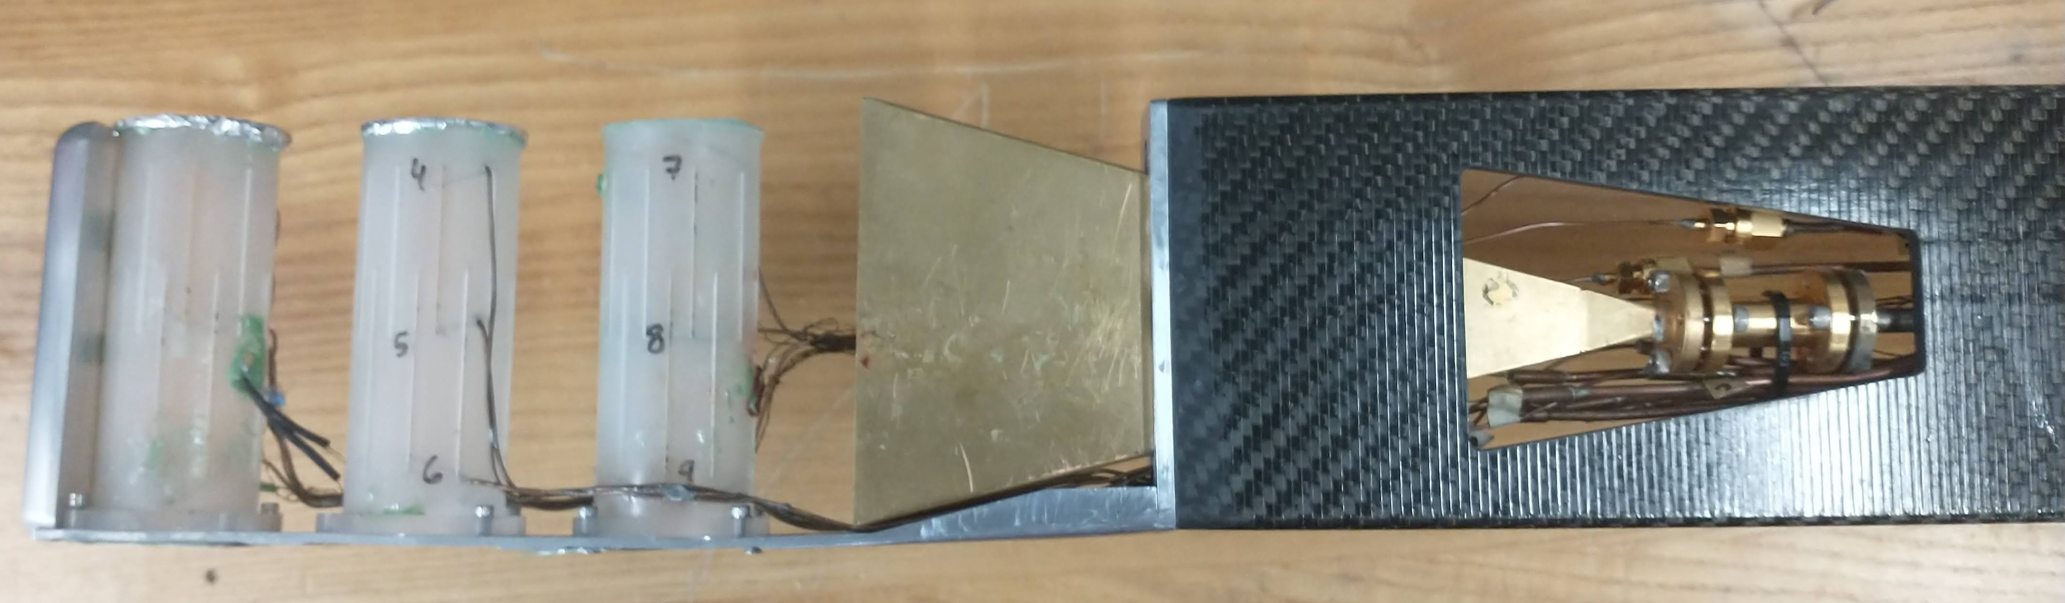
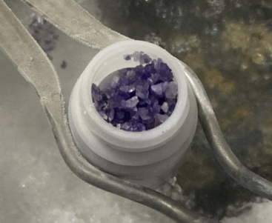
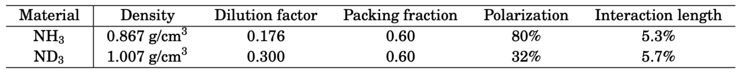
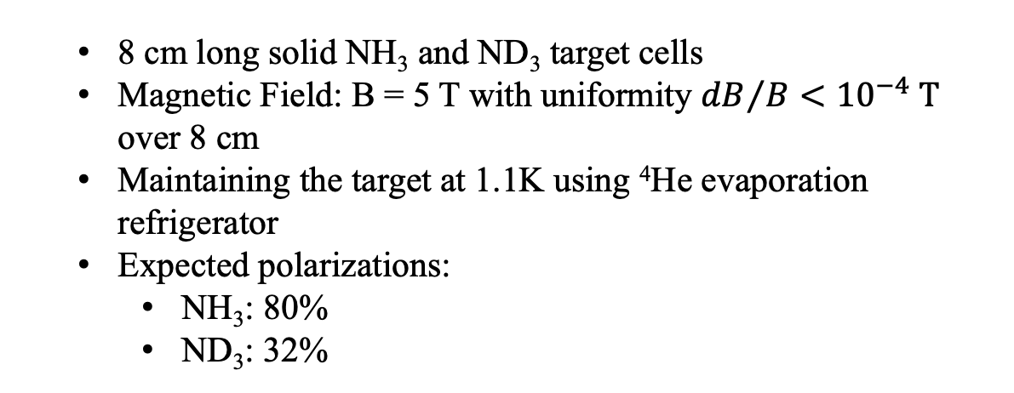
SpinQuest Experiment (Cryogenic Polarized Target)
  8 cm long solid NH₃ and ND₃ target cells
  Magnetic Field: B = 5 T with uniformity ${dB}/B<{10}^{−4} T$ over 8 cm
  Maintaining the target at 1.1K using ⁴He evaporation refrigerator
  Expected polarizations:
    NH₃: 80%
    ND₃: 32%
19%
618 files
81%
2587 files
Notes:
The plot on the left is a sideview of the criogenic target. As you can see it contains:
LN2 outer shield,
inside LHe is used to maintain criogenic conditions to make sure our solid target materials sustainably kept at 1.1K.
In between, there is an insulated vaccum chamber.
Expected polarizations for:
NH3 is 80%
ND3 is 32%

Slide 7
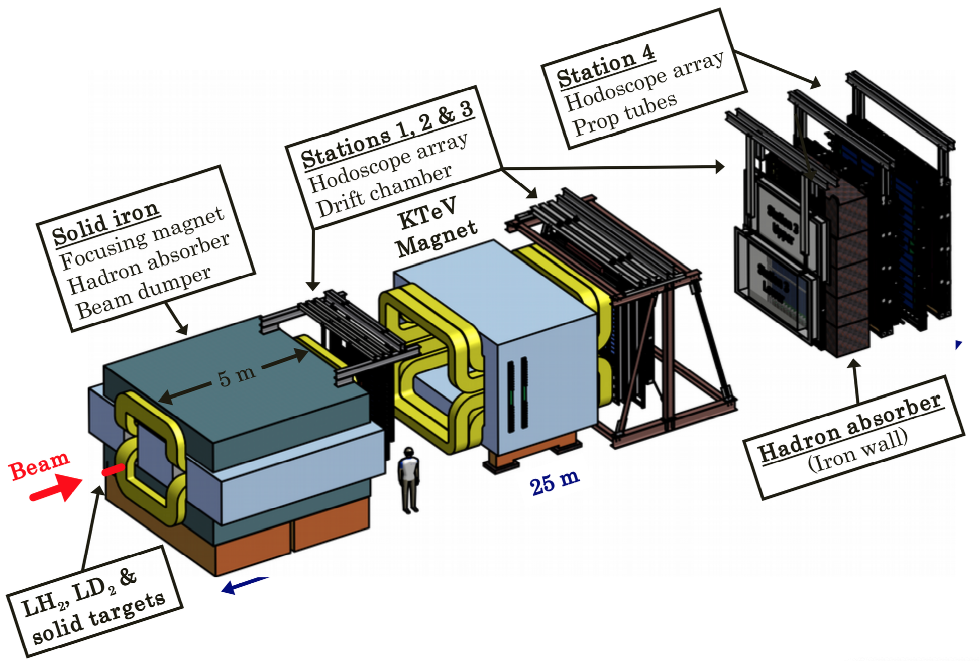
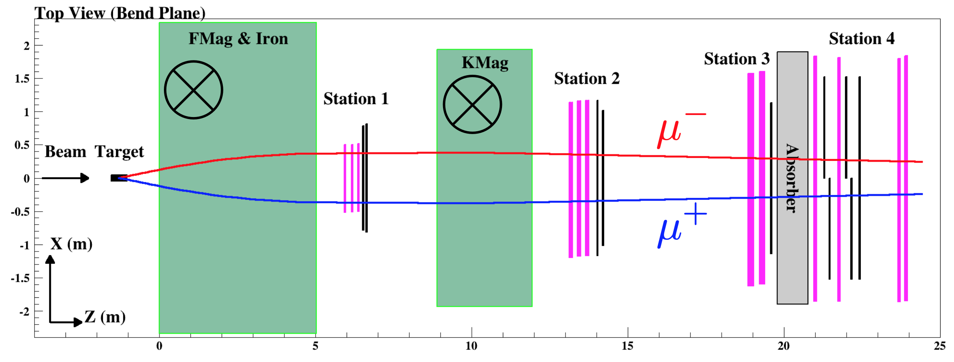
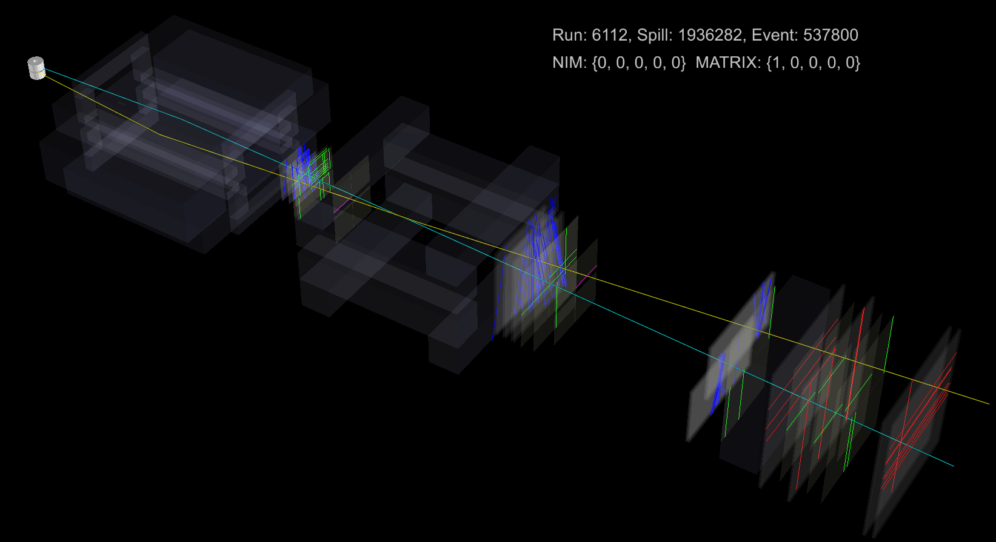
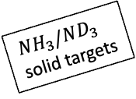
SpinQuest Experiment (Spectrometer Setup)
$NH_{3}/ND_{3}$
solid targets
    Taking the advantage of the spectrometer used by SeaQuest experiment
    Made by 24 wire chamber planes, 16 hodoscope planes and 8 planes with proportional tubes
    FMag generates magnetic field of 1.8T to select muons in appropriate momentum region
    KMag generates magnetic field of 0.4T and useful to evaluate momenta of muon candidates
19%
618 files
81%
2587 files
Event display view of di-muon event recorded during the beam commissioning period
Notes:
We take the advantage of using the same spectrometer setup designed for the predesessor experiment: seaquest and it was well-tested and calibrated to detect final state dimuons of the J/psi and its combinatory backgrounds
It contains 24 wire chamber planes, 16 hodoscope planes and 8 planes made of proportional tubes
Addition to criogenic magnet inside target, there are 2 diopole magnets operates in the spectrometer.
FMag
KMag

Slide 8
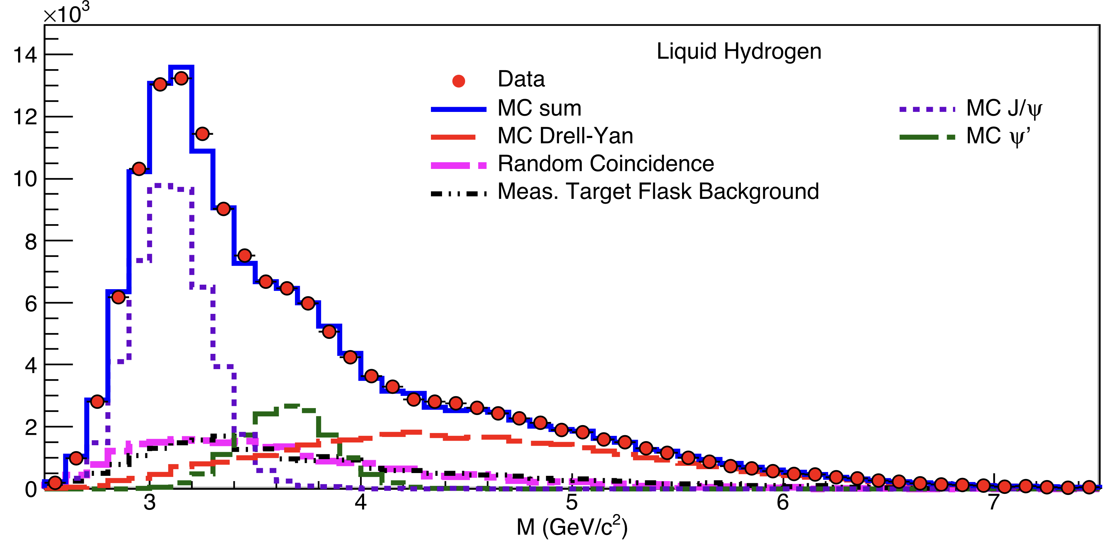


Commissioning Status
SpinQuest Semi-Online-Reconstruction
SeaQuest Data
We observed $J/ψ$ mass peak using limited beam commissioning data
(extremely preliminary result).!
Wider acceptance range (compared to SeaQuest) below 2 GeV to better understand backgrounds with sideband studies
Projected event selection/reconstruction is expected to be the same for SpinQuest from SeaQuest
$δσ_{M}$(𝐽/𝜓) ~ 220 MeV
Already collected data during the beam commissioning and analyzed invariant mass spectrum with the limited data collected for online reconstruction (not a full reconstruction)
We expect better efficiency and resolution from offline analysis
Notes:
As you already know, we are in the final stages of beam commisioning.
Since the J/psi production is heavily involved with gluons from the initial state, we can observe mass peak due to the J/psi events with our fast online monitoring data.
Looking at seaquest data and MC plots, it is evident that there is a good agreement between data and MC
the resolution of the reconstructed J/psi invariant mass peak was 220MeV for SeaQuest
We expect better efficiency and resolution from offline analysis
I also want to point out that compared to SeaQuest experiment our detector acceptance at the low mass region is very good, this helps us to better understand backgrounds present in low mass region

Slide 9

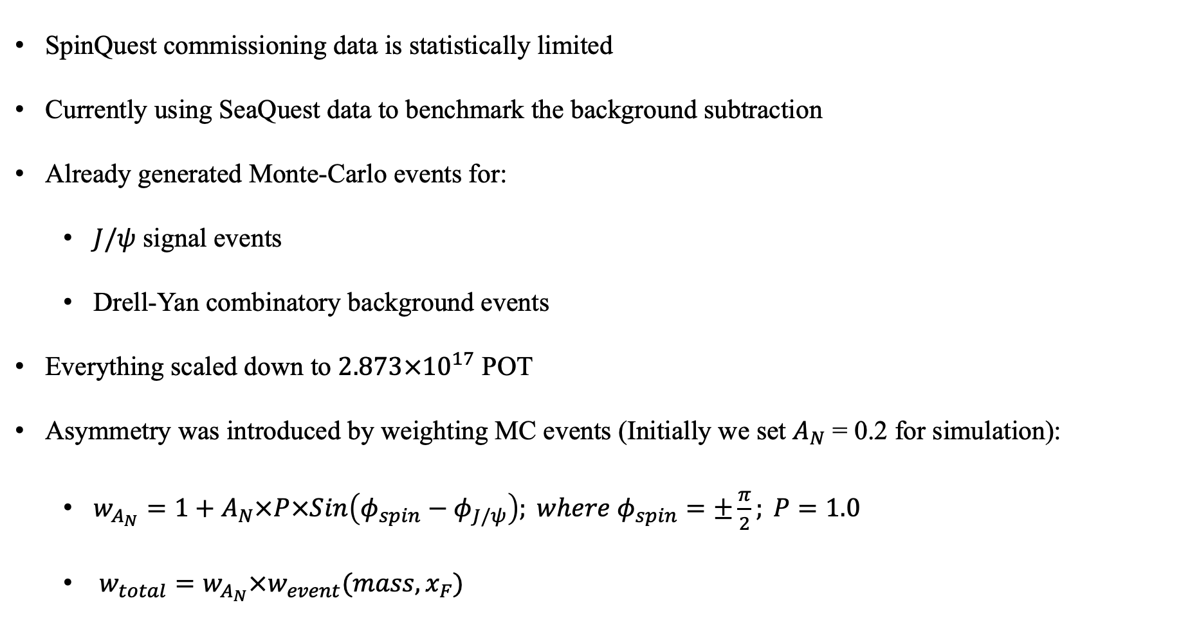
Simulation Studies for $A_{N}^{J/ψ}$ Determination
SpinQuest commissioning data is statistically limited
Currently using SeaQuest data to benchmark the background subtraction
Already generated Monte-Carlo events for:
  $J/ψ$ signal events
  Drell-Yan combinatory background events
Everything scaled down to $2.873×{10}^{17}$ POT
Asymmetry was introduced by weighting MC events (Initially we set $A_{N}$ = 0.2 for simulation):
  $w_{A_{N}}=1+A_{N}×P×Sin\left(φ_{spin}−φ_{J/ψ}\right); where{ φ}_{spin}=±\frac{π}{2}; P=1.0$
  $w_{total}=w_{A_{N}}×w_{event}(mass, x_{F})$
Notes:
We are at the last stages of the beam commissioning and limited by statistics
Currently I conduct my study using Data/MC events generated by SeaQuest experiment
My signal is J/Psi and at the moment dominant background is Drell-Yan.
For my study, I assume the detector is perfect i.e. P=1
I introduce assymetry by weights

Slide 10

Current Strategy
Fake Data Studies
Background Subtraction
Using GPR
$φ$Distributions
𝜙 Distributions
Unfolding $φ$Distributions
Unfolding 𝜙 Distributions
Using iterative Bayesian unfolding by RooUnfold
Binned Data
($J/ψ$ Signal+ Drell-Yan background)
(𝐽/𝜓 Signal+ Drell-Yan background)
Defining Sidebands
Spin up/down cases
Simulated Events
No Asymmetry Introduced
Response Matrix
using RooUnfold
Extracting $A_{N}^{J/ψ}$
Notes:
1. So the current procedure is to treat MC events i.e. signal+background and use data to test the robustness of the data-driven background subtraction
2. Fill the event for kinematic bins such as Transverse momentum or Feynman X
3. Using invariant mass distribution, define sidband regions that dominate background and training regression model to predict backgrounds and interpolate in-between.
4. Applying background subtraction
5. Create Histograms of azimuthal angle
6. Using RooUnfold to correct detecor in-efficiencies
7. Finally fitting a function to extract assymetry

Slide 11
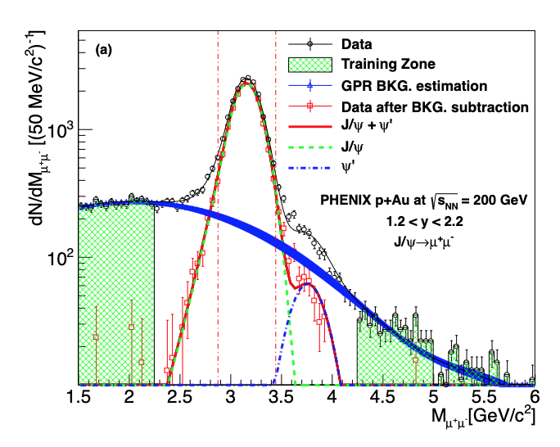
Background Subtraction using GPR
SeaQuest Data
95% confidence interval
For background prediction
Sideband regions: 0-2.4GeV and 4.2-8GeV
We selected GPR (Matern Kernel) among other regression techniques based on hyper parameter optimizations
Aidala et al., Phys. Rev. D 98, 012006, arXiv: 1805.01491 (hep-ex) (2018)
Notes:
The plot on the left explains the background subtraction done by defining sideband regions in the invariant mass spectum by PHENIX experiment.
We follow the same procedure and the plot on the right demonstrates the background subtraction by defining sidebands within the regions 0-2.4GeV and 4.2-8GeV
I would also want to point out the existing tail due to psi prime background events.

Slide 12
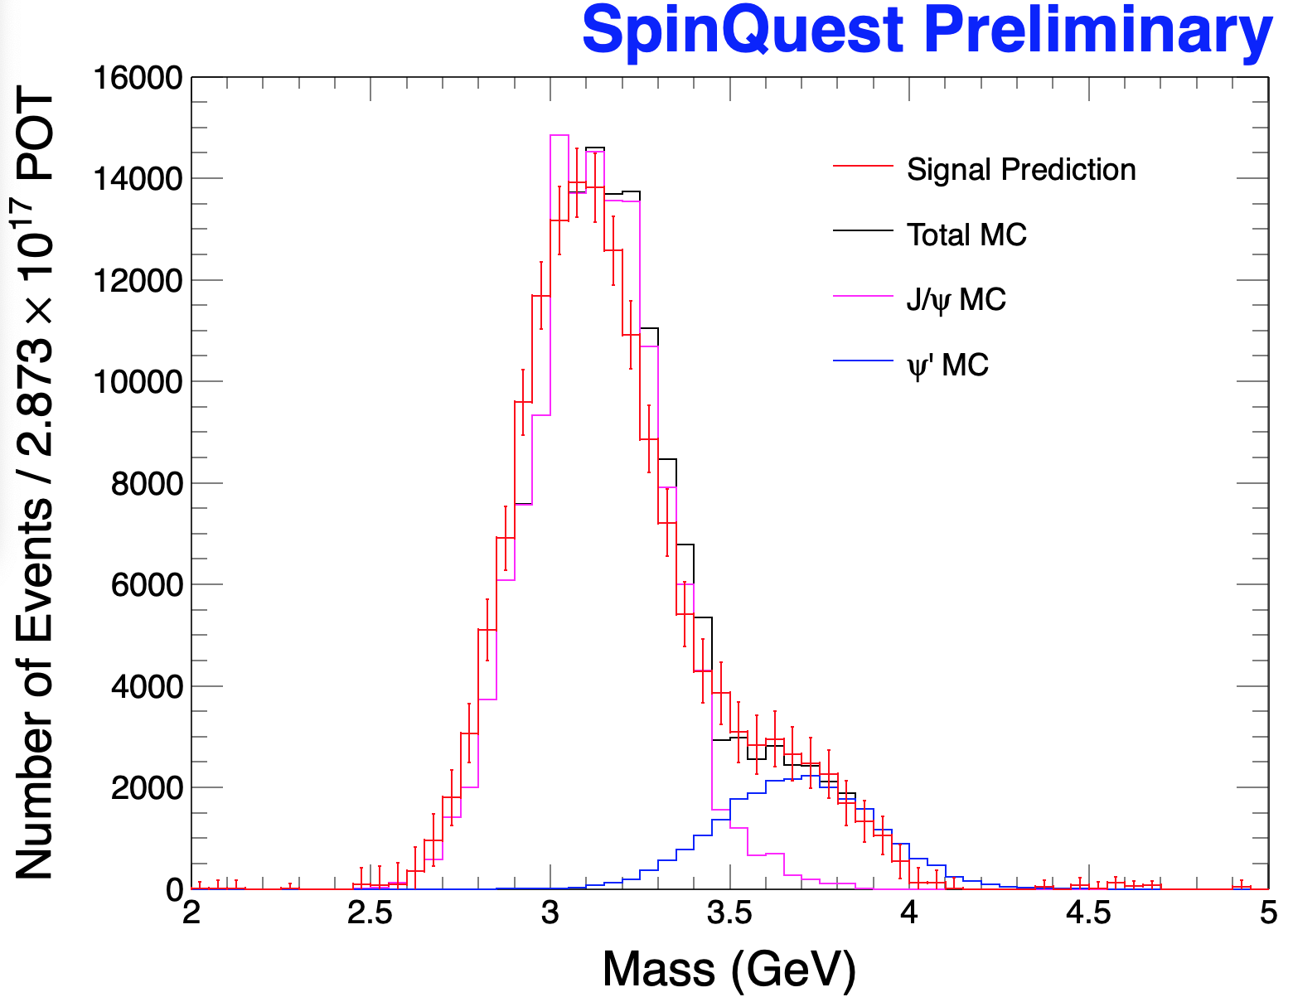
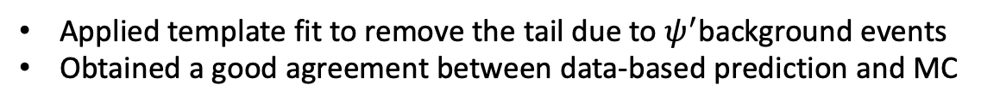
Comparing Background-Subtracted Spectrum to Monte Carlo
Applied template fit to remove the tail due to $ψ^{′}$background events
Obtained a good agreement between data-based prediction and MC
Notes:
In order to remove the tail due to psi prime events, I fit template using MC by minimizing chi squared.
The plot on the right demonstrates the agreement between the database Jpsi prediction to the Jpsi MC prediction.

Slide 13
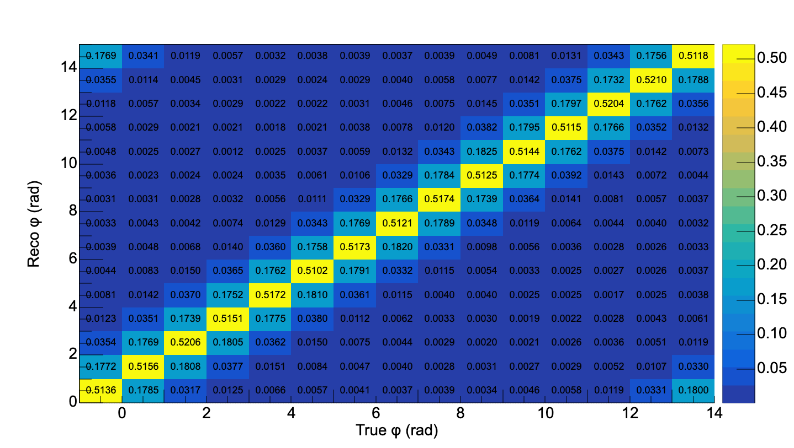
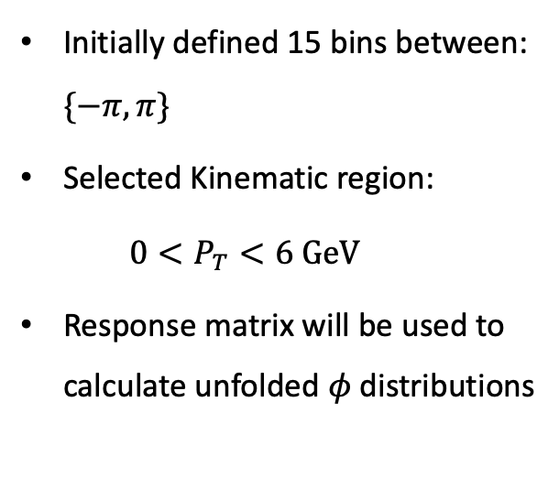
Iterative Bayesian Unfolding using RooUnfold
Initially defined 15 bins between: $\{−π,π\}$
Selected Kinematic region:
  $$0<P_{T}<6 GeV$$
Response matrix will be used to calculate unfolded $φ$distributions
Notes:
As I explained earlier we have to apply correction of measured spectra in data for the finite detector efficiency, acceptance, and resolution from the detector to particle level. .
We calculate the response matrix with Drell-Yan events without any asymmetry included. We used the iterative Bayesian method in ROOUnfold library to unfold the φ distributions
Our next goal is to correct the bin-by-bin migration using the iterative Bayesian unfolding.

Slide 14
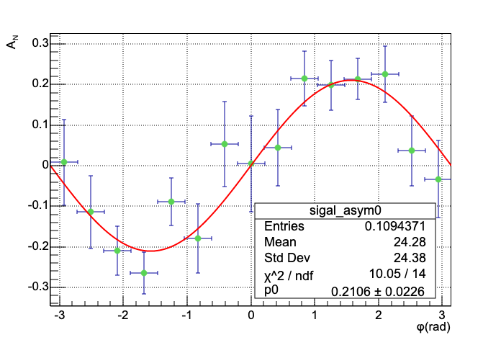
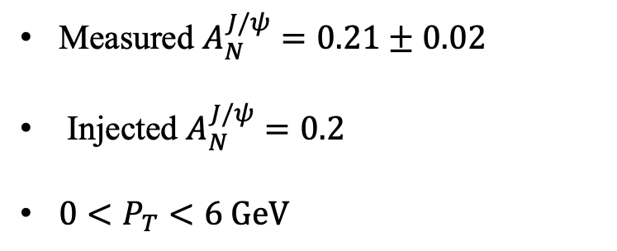

Unfolded $A_{N}^{J/ψ}$for selected $P_{T}$ bin
Measured $A_{N}^{J/ψ}=0.21±0.02$
Injected $A_{N}^{J/ψ}=0.2$
$0<P_{T}<6 GeV$

Slide 15
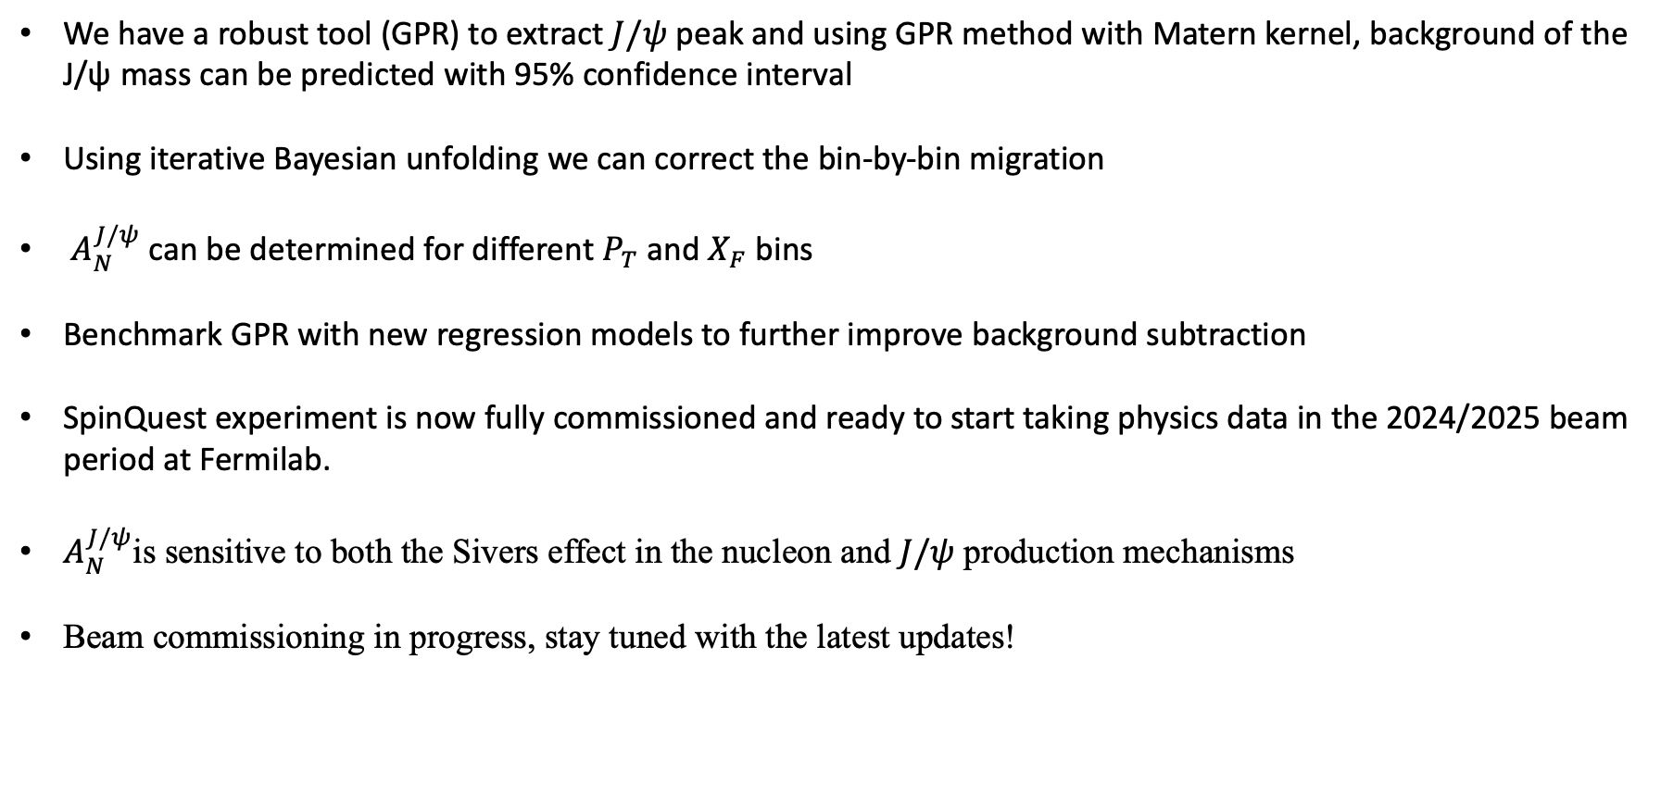
Conclusions and next steps
We have a robust tool (GPR) to extract $J/ψ$ peak and using GPR method with Matern kernel, background of the J/ψ mass can be predicted with 95% confidence interval
Using iterative Bayesian unfolding we can correct the bin-by-bin migration
$A_{N}^{J/ψ}$ can be determined for different $P_{T}$ and $X_{F}$ bins
Benchmark GPR with new regression models to further improve background subtraction
SpinQuest experiment is now fully commissioned and ready to start taking physics data in the 2024/2025 beam period at Fermilab.
$A_{N}^{J/ψ}$is sensitive to both the Sivers effect in the nucleon and $J/ψ$ production mechanisms
Beam commissioning in progress, stay tuned with the latest updates!
Notes:
Let me briefly explain what the existing code does.
First, we run a cron job to update token for every 4 days
Then we run our first script to get token information.
Check database for reconstruction status of each run. I would like to introduce a parameter reco_status:
if reco_status == 0 that means the run was never reconstructed
if reco_status == 1 that means the run was partially reconstructed but not complete
if reco_status == 2 that means the run was fully reconstructed
Then we create a runlist
We iterate through each run by checking number of files saved per run > 1
If the number of files for that particlar run is greater than 1 then assign gridjob to run standard RecoE1039Data.C else, we skip to the next run.
This process plans to run once every 3hours using crontab
We have very similar script to resubmit failled jobs sheduled to be run once every 4 hours.

Slide 16
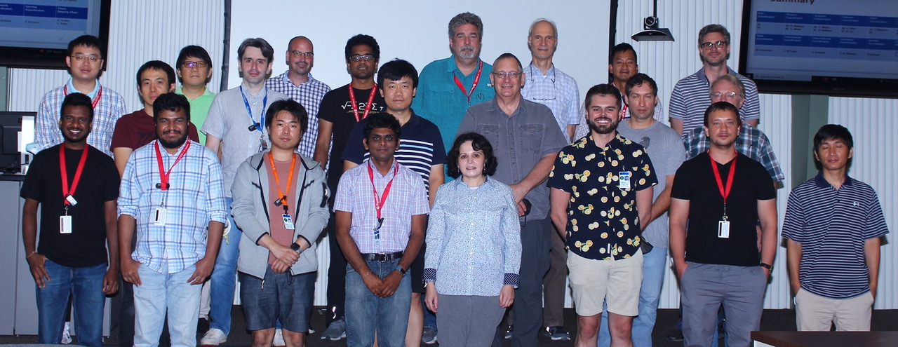

Thank you.!
Notes:
Let me briefly explain what the existing code does.
First, we run a cron job to update token for every 4 days
Then we run our first script to get token information.
Check database for reconstruction status of each run. I would like to introduce a parameter reco_status:
if reco_status == 0 that means the run was never reconstructed
if reco_status == 1 that means the run was partially reconstructed but not complete
if reco_status == 2 that means the run was fully reconstructed
Then we create a runlist
We iterate through each run by checking number of files saved per run > 1
If the number of files for that particlar run is greater than 1 then assign gridjob to run standard RecoE1039Data.C else, we skip to the next run.
This process plans to run once every 3hours using crontab
We have very similar script to resubmit failled jobs sheduled to be run once every 4 hours.

Slide 17
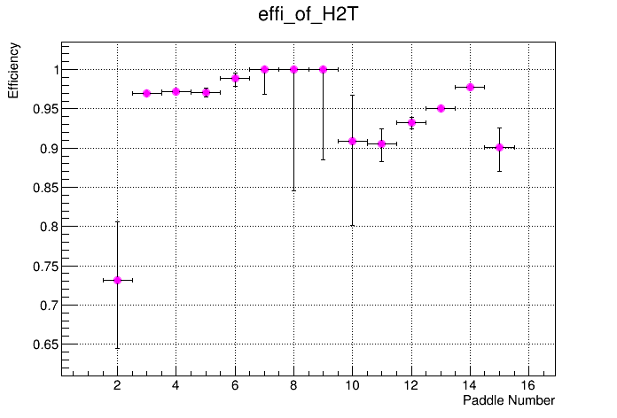
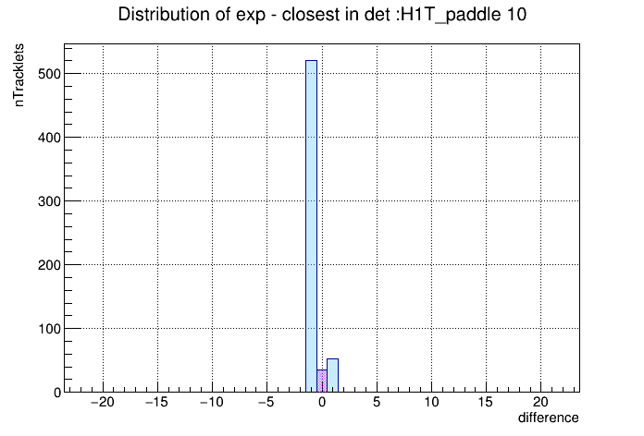
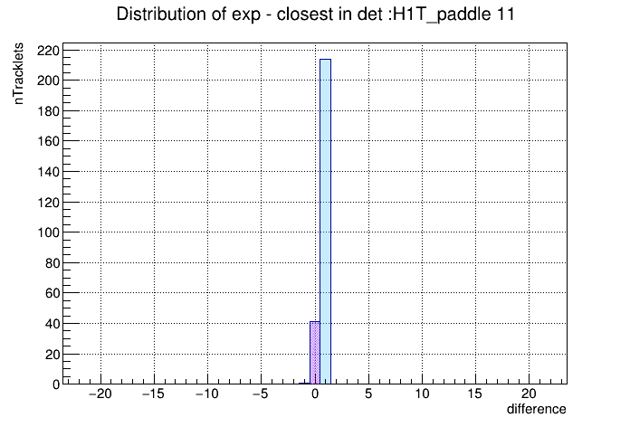
Online Reconstruction Updates
Two different reconstructions working together to process decoded files:
  Online reconstruction (local, fast, limited by occupancy)
  Semi-Online reconstruction (Fermigrid, time consuming, no occupancy constraints)
  Already completed reconstructing goodruns (853 spills).!
Provides data quality and online monitoring (track-level information event-by-event basis)
Monitor the impact on Physics when introducing constraints (invariant mass spectrum when K-Mag runs half of the current to reduce heat load )
Wire chamber and hodoscope efficiency calculations
Troubleshooting spectrometer by using online reconstruction:
  Beam gate malfunctioning identified (Elog 5599)
  Swapped cables found at hodoscope stations (Elog 5666)
  Chamber connections mistakenly swapped found
  Correcting wire-chamber alignment by studying residual plots (work on progress!)
Stay tuned to receive more exciting news.!
SpinQuest Semi-Online-Reconstruction

Slide 18
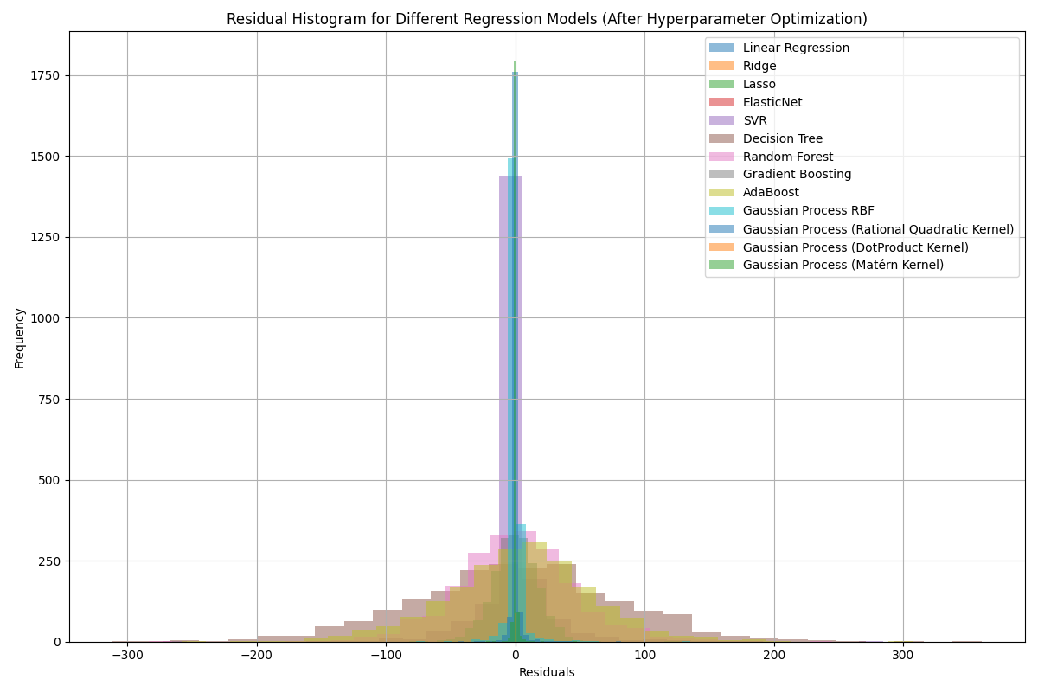
Benchmarking Regression Models
Notes:
Probability density function (PDF) of a multivariate normal distribution (MVN) with dimension D is;
1 􏰁1 T−1 􏰂 N(x|μ,Σ)= (2π)D/2|Σ1/2|exp −2(x−μ) σ (x−μ)
where D is the number of dimensions, x is the variable, μ is the mean vector and Σ is the covariance matrix.
Gaussian processes are distributions over functions f(x) of which the distribution is defined by a mean function m(x) and positive definite covariance function k(x,x′), with x the function values and x, x′ all possible pairs in the input domain;
f(x) ∼ GP(m(x), k(x, x′))
where for any finite subset X = x1 , ......, xn of the domain of x, the marginal
distribution is a multivariate Gaussian distribution;
f(X) ∼ N(m(X),k(X,X))
with mean vector μ = m(X) and covariance matrix Σ = k(X, X).
21 / 22

