Slide 1
Oscura in 10 Minutes
On behalf of the Oscura Collaboration
Edgar Marrufo
New Perspectives 2024

Slide 2
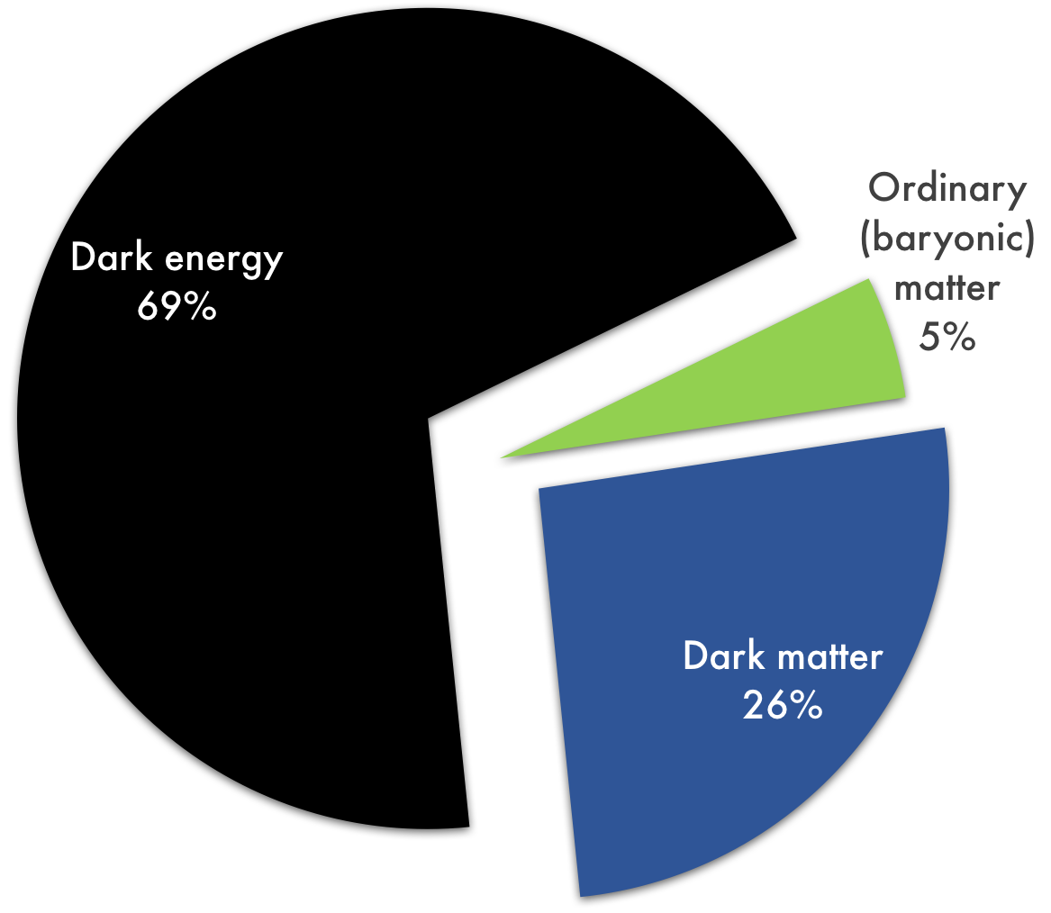
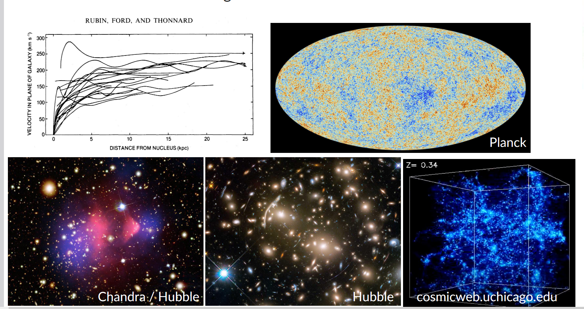
Dark Matter Evidence
  Evidence for the existence of dark matter from Astronomy/Cosmology
  Astrophysical Probes
  Rotation curves, cluster collisions, gravitational lensing
  Cosmological Probes
  CMB anisotropies
  Structure formation
SIFS bench spectrograph
Planck Collaboration 2008

Slide 3
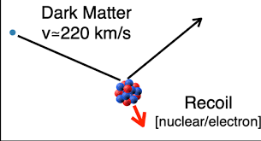
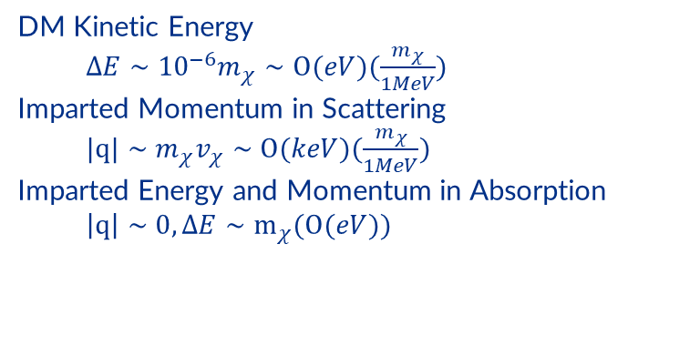






Direct Dark Matter Detection
$${10}^{−22}eV$$
1 $eV$
1 $keV$
1 $GeV$
1 $TeV$
$$M_{PL}={10}^{19}GeV$$
SOAR Telescope
eV-scale Bosons and Sub-GeV DM:
Absorption and Inelastic scattering as interaction mechanisms (feeble interactions)
DM Kinetic Energy
$ΔE∼{10}^{−6}m_{χ}∼Ο(eV)(\frac{m_{χ}}{1MeV})$
Imparted Momentum in Scattering
$|q|∼m_{χ}v_{χ}∼Ο(keV)(\frac{m_{χ}}{1MeV})$
Imparted Energy and Momentum in Absorption
$\left|q\right|∼0,ΔE∼m_{χ}(Ο(eV))$
SIFS bench spectrograph

Slide 4
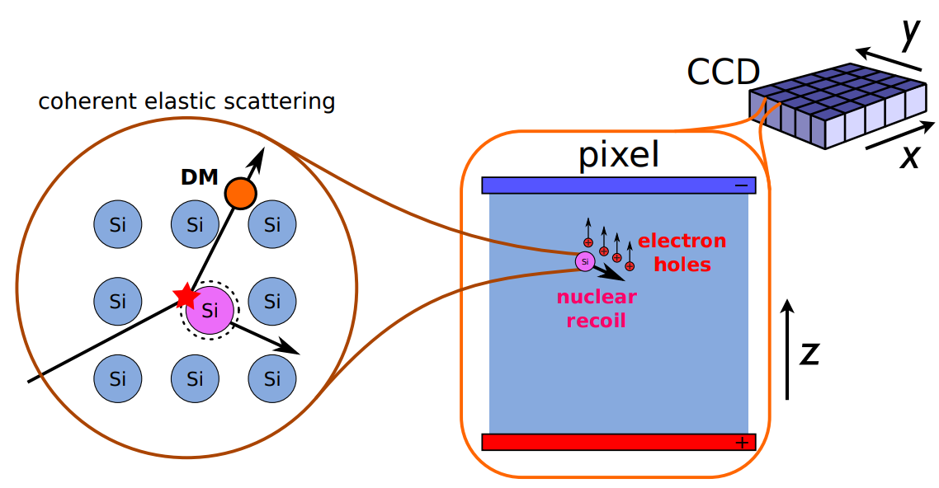
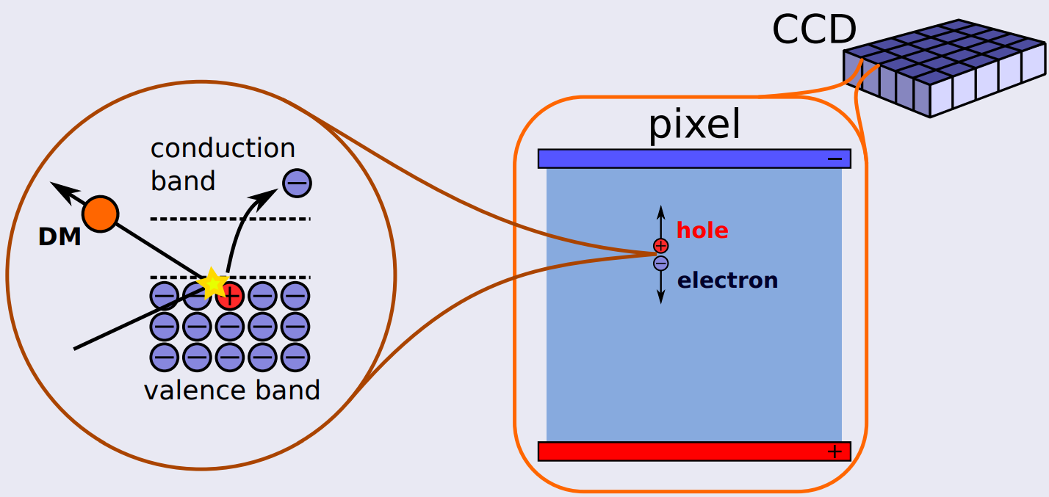
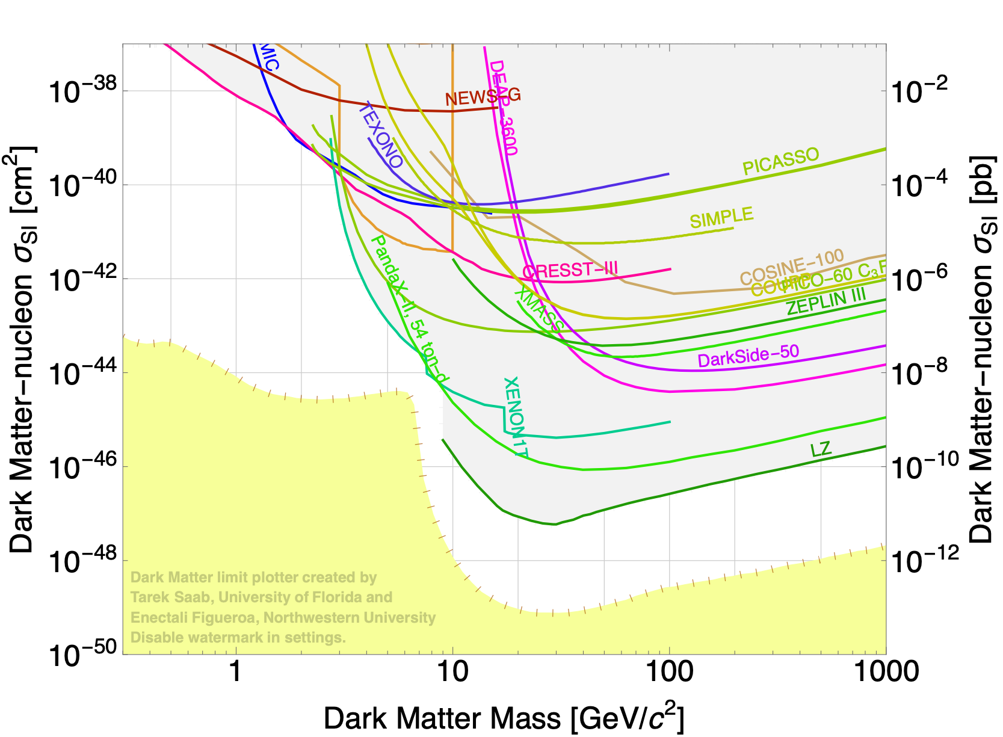
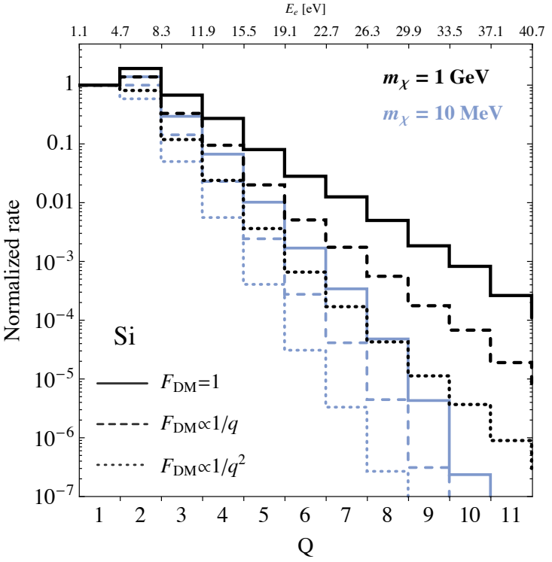
DM direct detection with CCDs
DM-nucleus scattering
Sub-GeV DM needs other detection channels
m_{χ} ~ GeV → energy transfer is a few keV
DM-electron scattering
m_{χ} ~ MeV-GeV
→ energy transfer is a few eV
DM absorption
Bosonic DM at the eV scale
→ energy transfer equals m_{χ}
[JHEP 05 (2016) 046]

Slide 5
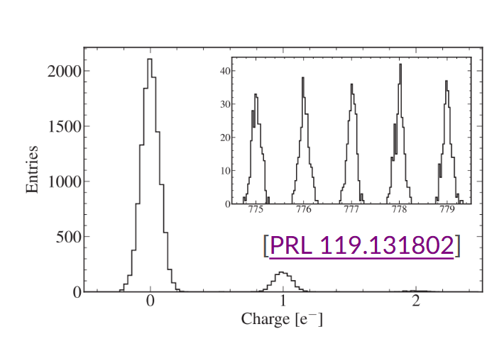
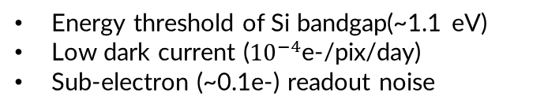
Skipper-CCDs for direct DM search
Skipper CCD qualities for direct detection:
  Energy threshold of Si bandgap(~1.1 eV)
  Low dark current (${10}^{−4}$e-/pix/day)
  Sub-electron (~0.1e-) readout noise
  Low Threshold enables low-mass searches:
  Electron scattering of 1-1000 MeV DM
  Absorption of 1-1000 eV DM

Slide 6
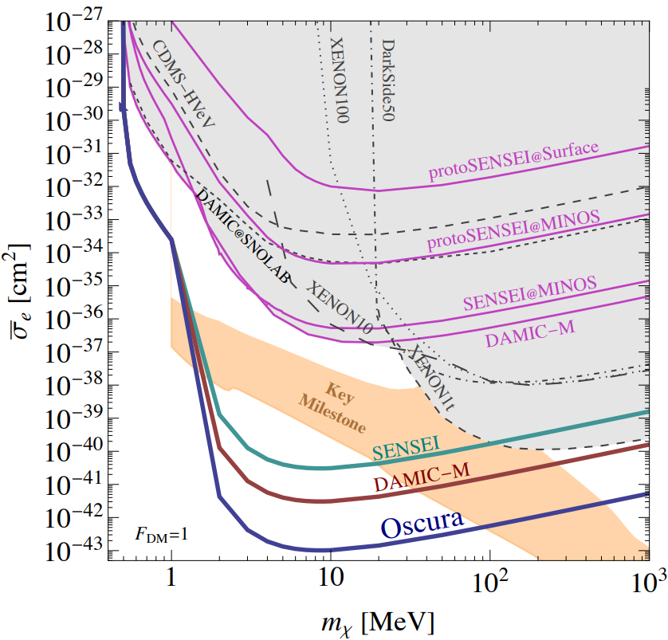
Skipper-CCDs for direct DM search
World best limits for sub-GeV DM candidates with this technology
Ongoing program
Experiment | Mass [kg] | #CCDs | Radiation bkgd [dru] | Instrumental bkgd [e-/pix/day] | Commissioning
SENSEI @ MINOS | ~0.002 | 1 | 3400 | 1.6 x 10⁻⁴ | late-2019
DAMIC @ SNOLAB | ~0.02 | 2 | ~10 (exp*) | ~3 x 10⁻⁴ (exp*) | late-2021
DAMIC-M LBC | ~0.02 | 2 | 10 | 3 x 10⁻³ | late-2021
SENSEI-100 | ~0.1 | 50 | 10 (goal) |  | mid-2022
DAMIC-M | ~1 | 200 | 0.1 (goal) |  | ~2023
OSCURA | ~10 | 20,000 | 0.01 (goal) | 1 x 10⁻⁶ (goal) | ~2028
* expected from DAMIC with standard CCDs [PRL 123, 181802/PRL 125, 241803]
Oscura builds on existing efforts
The challenges are to increase mass (from 10s to 10,000s CCDs) and to reduce the backgrounds (2 orders of magnitude)
Major R&D

Slide 7
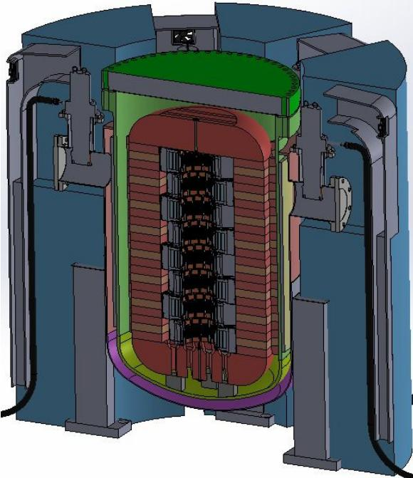
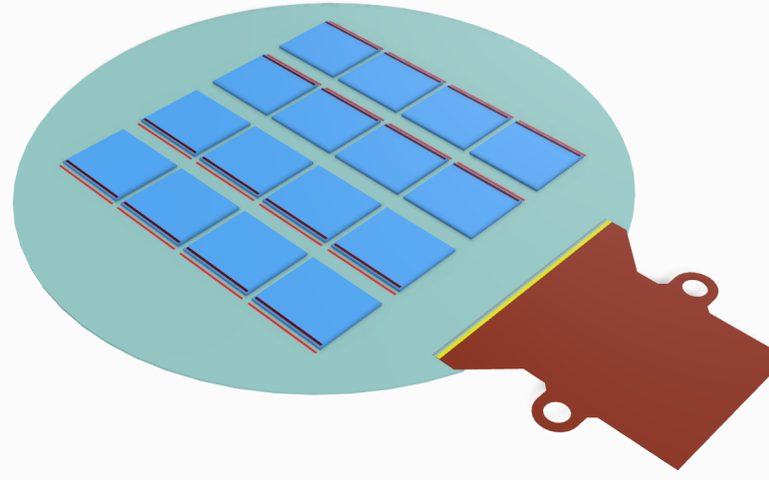
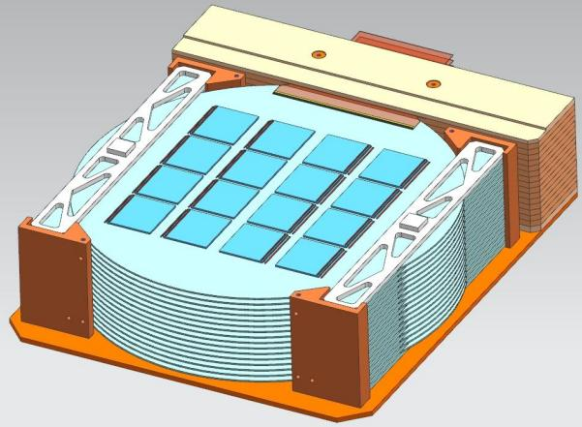
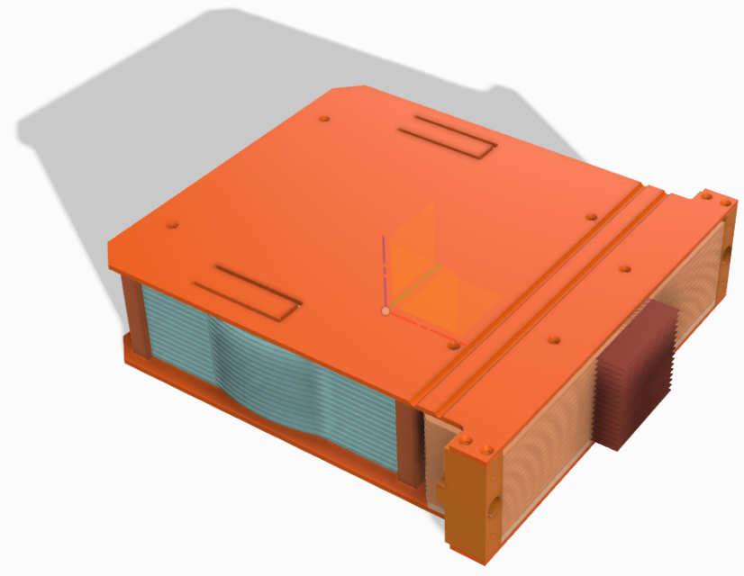
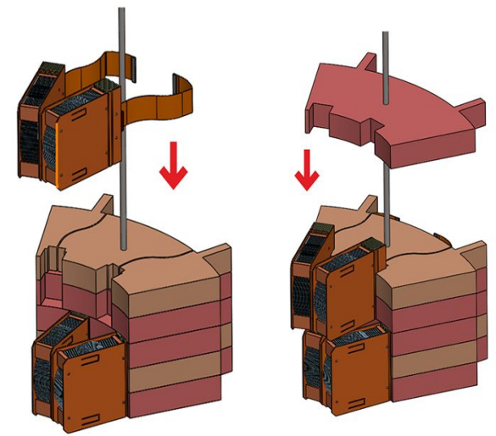
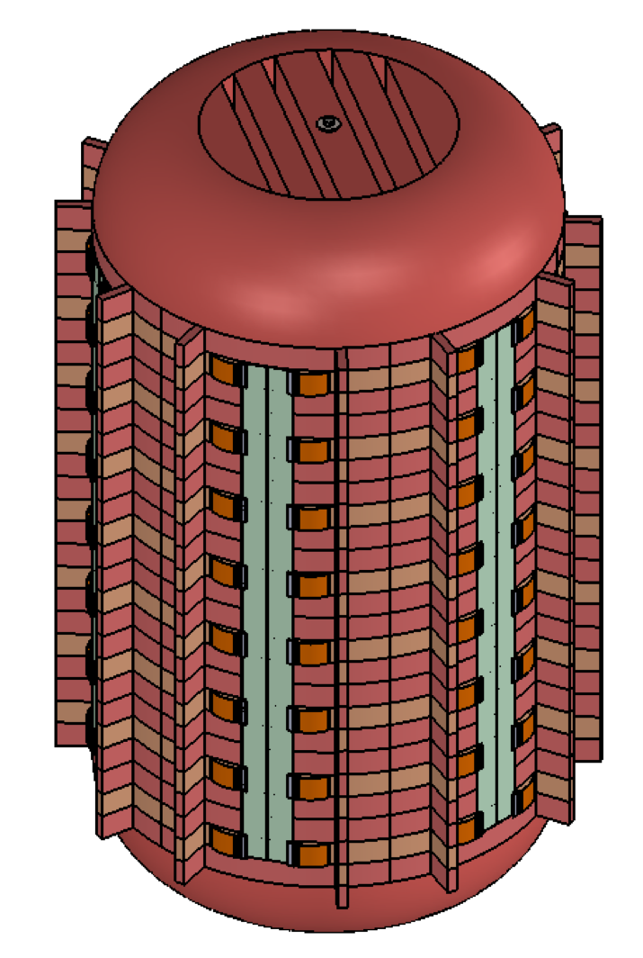
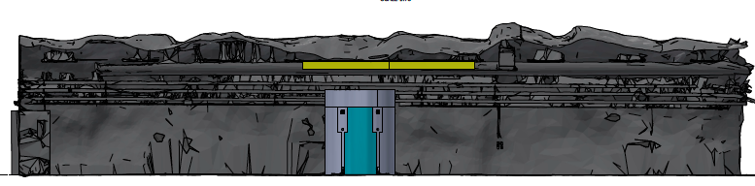

Oscura: 10-kg skipper-CCD experiment
[arXiv:2202.10518]
Multi-Chip Module
(16 skipper-CCDs)
Super Module
(16 MCMs)
LN₂ pressure vessel @ 450 psi
3 m
Detector payload in 6 columnar slices (96 SMs)

Slide 8
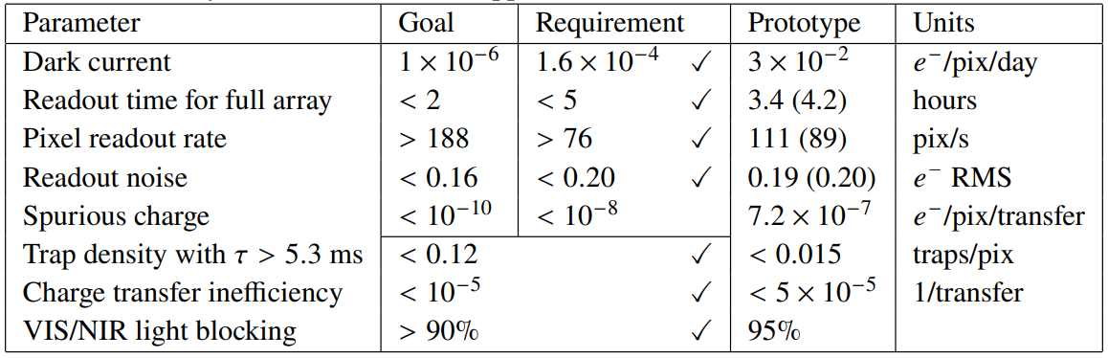
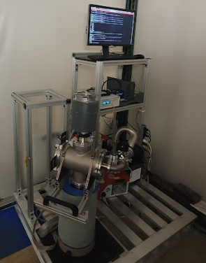
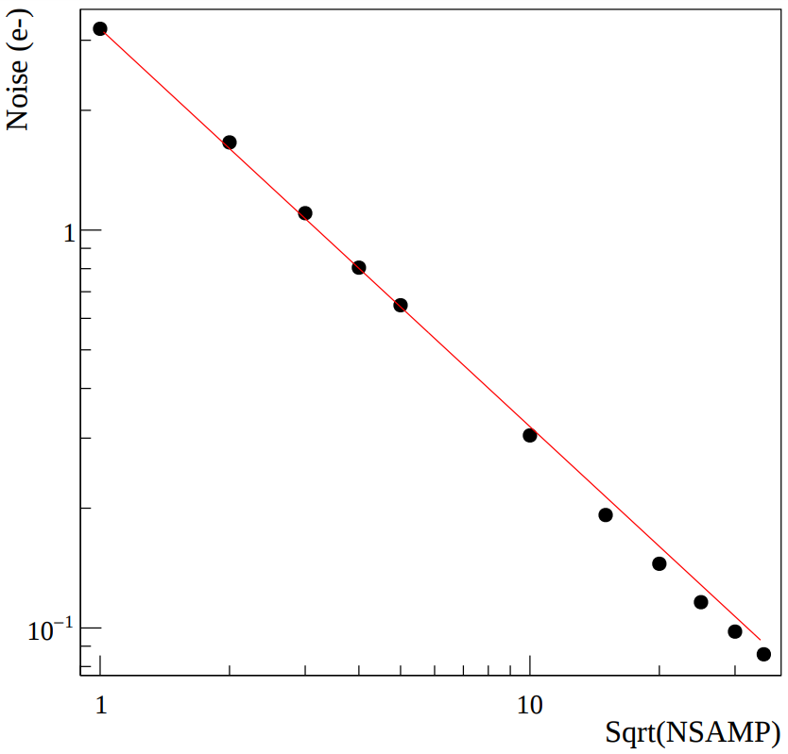
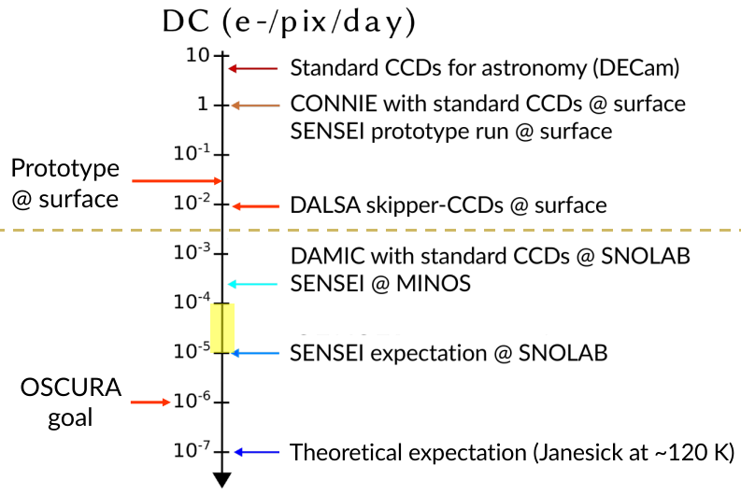
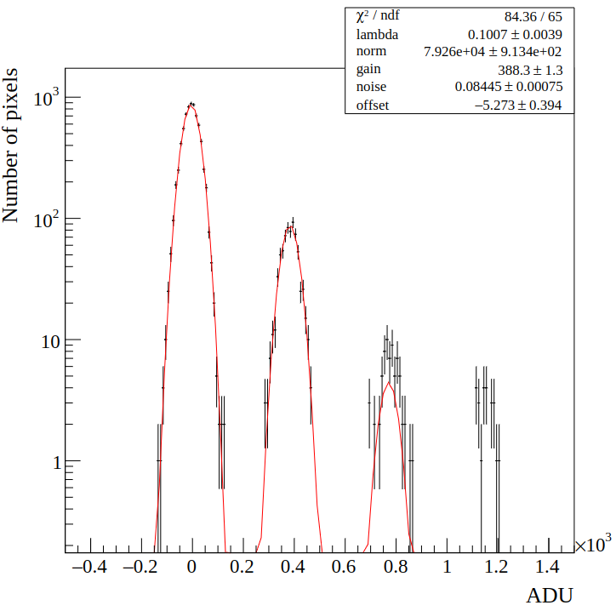
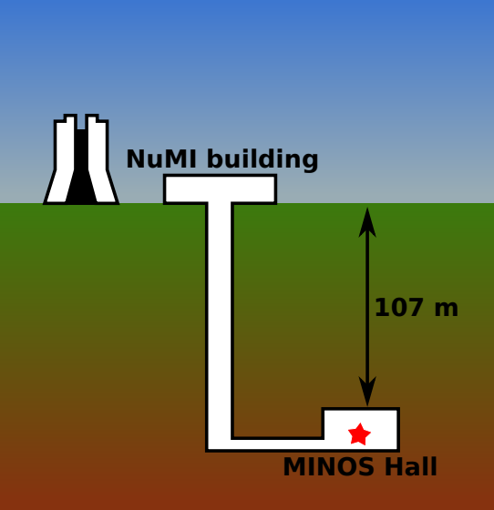
Oscura: Sensors performance
No events with >1e-
No events with 3e- or more
Sensors reach sub-electron noise and meet almost all constraints to reach desired instrumental background
Spurious charge is under study and new approaches are being implemented
Installed underground setup at MINOS (MOSKITA) to measure the ultimate DC

Slide 9
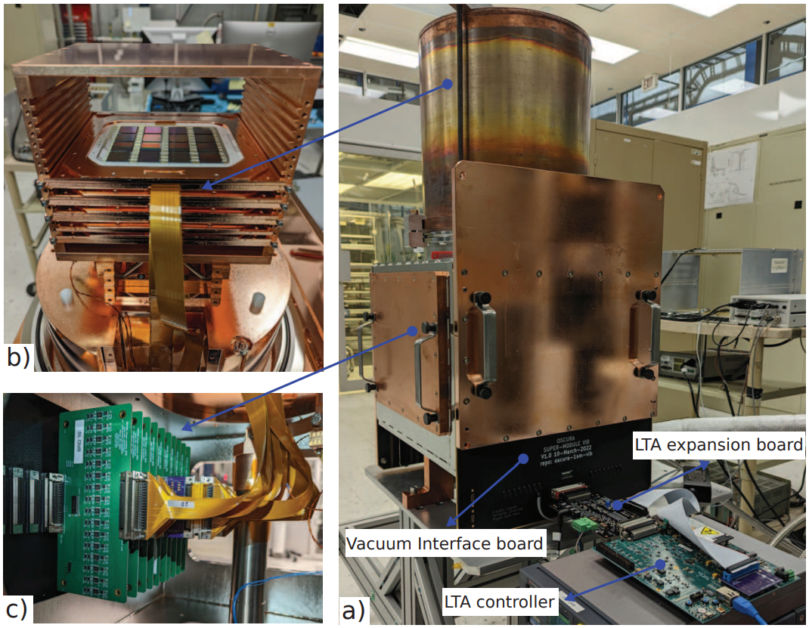
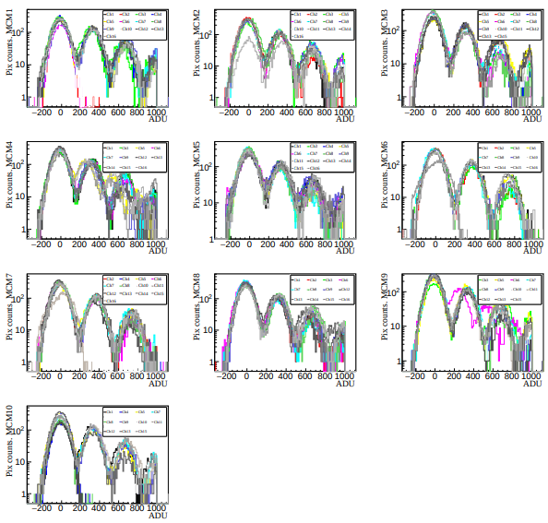
Oscura: Massive testing setup with 10 MCMs (160 sensors)
[JINST 18 P01040]
Copy of SENSEI-100 vessel with 10 prototype ceramic MCMs and the discrete readout electronics
Largest ever built instrument with skipper-CCDs controlled by 1 LTA → Demonstrates electronics solution
~90% of the sensors working without a preselection! This is a BIG deal!*
*LSST, the largest “astronomical camera” has 189 CCDs!
Setup is being used to develop analysis software and could be used for early science

Slide 10
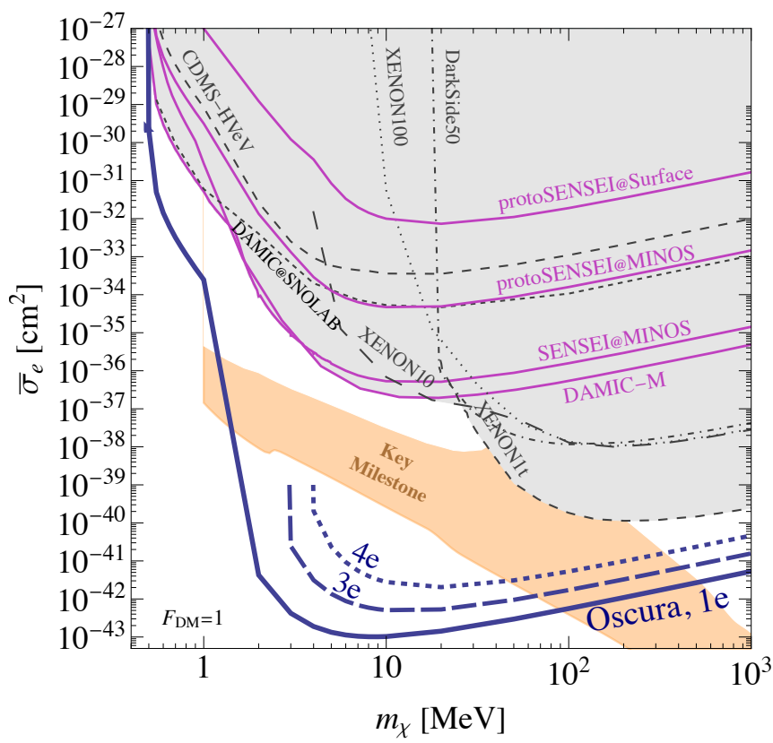
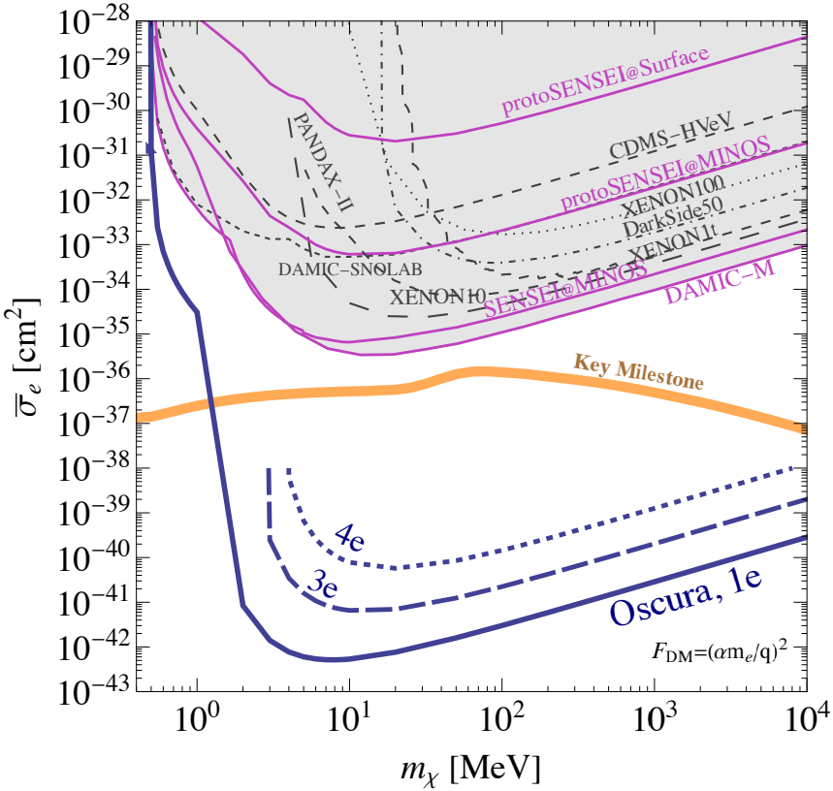
Oscura: Projected sensitivities for 30 kg-year
With the current sensors performance, we have zero background events with 4e⁻ or more (4e curve)
DM-electron scattering mediated by a heavy (left) or light (right) mediator

Slide 11

Oscura: Timeline and goals per period
Evaluation of new sensors
Demonstration of MCM readout
Decision on cold-end electronics
SM full backgrounds simulation
Sensors, cryostat and electronics at SNOLAB for assembly
Sensor packaging facility
Integration test (10%)
R&D
Design
Construction
Operation
2021
2022
2023
2024
2025
2026
2027
2028
2029
Sensor preproduction
Operation of SM in LN2
Project Execution Plan
Full DAQ
Shield at Snolab
- Achieved
* Technically driven Oscura timeline

Slide 12
Take-home messages
Oscura is the next step in skipper-CCD DM searches (10 kg)
It will provide unprecedented sensitivity to sub-GeV DM interacting with electrons
R&D work has been successfully completed and main risks have been addressed
Oscura is moving into design phase, with plan to begin construction in FY25 and operations at SNOLAB in FY29
With a partial load, Oscura can do early science producing very competitive results
Stay tuned!

Slide 13
THANK YOU!

