Slide 1
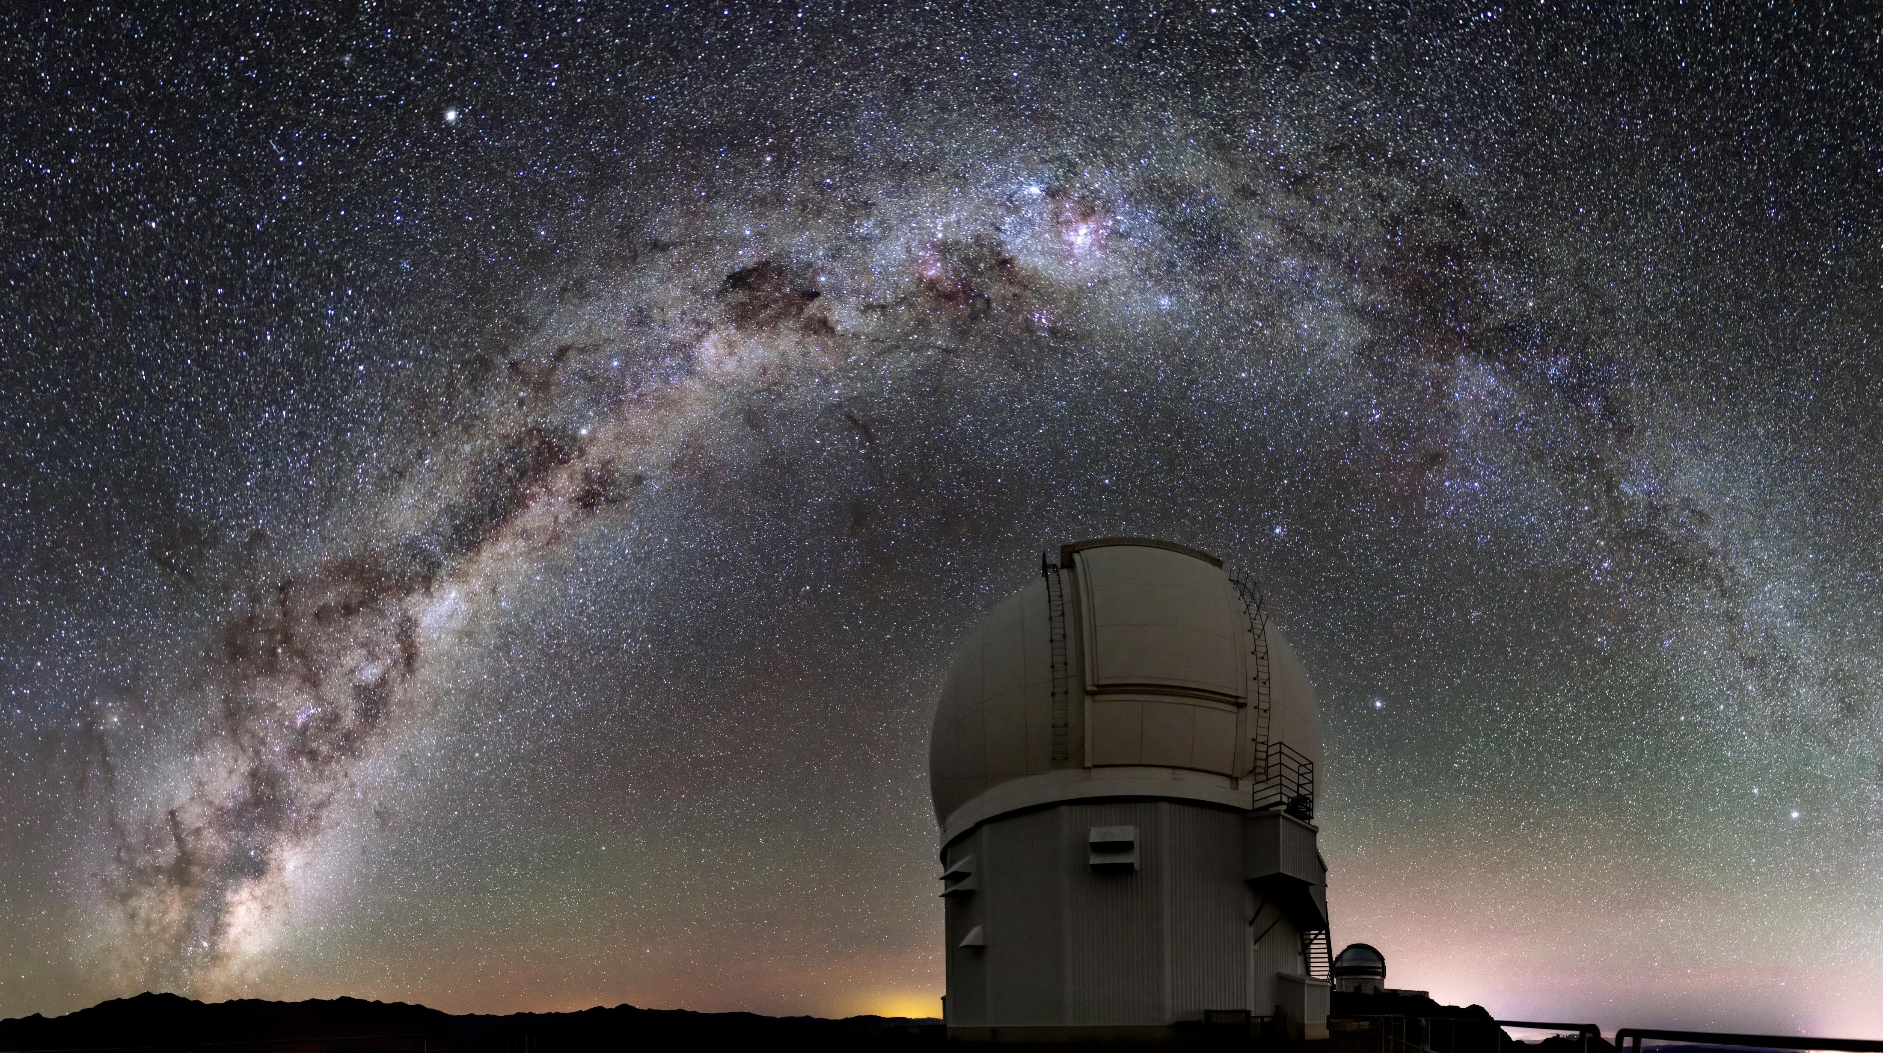
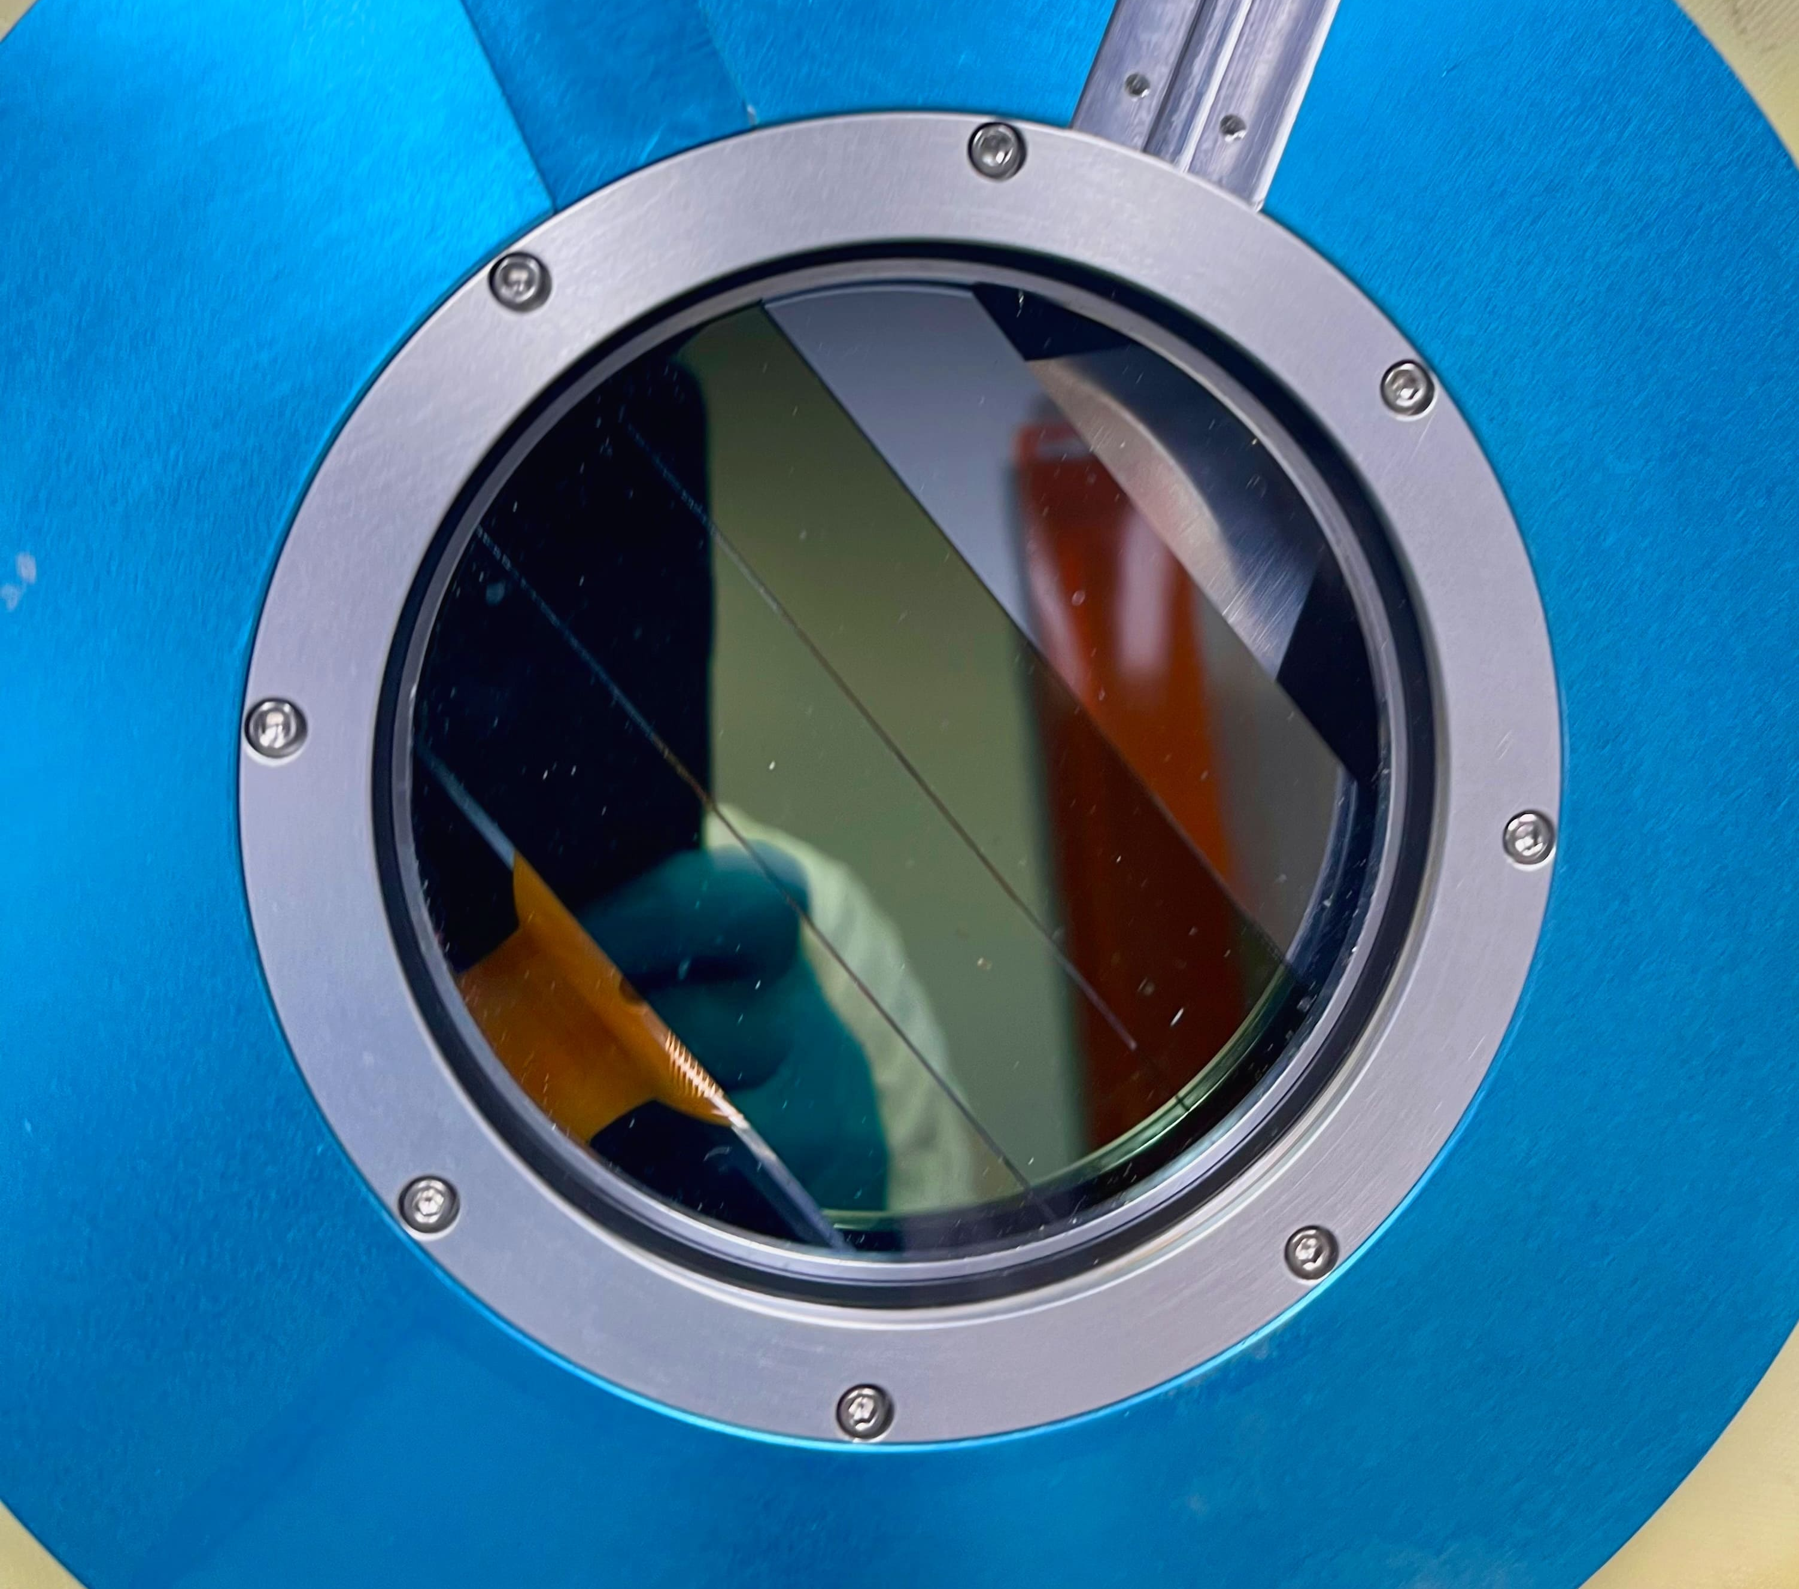


Astronomical Spectroscopy with Skipper CCDs: First Results from a Skipper CCD Focal Plane Prototype at SIFS
Edgar Marrufo
New Perspectives 2024
09 July 2024

Slide 2
Cosmological Surveys

Slide 3
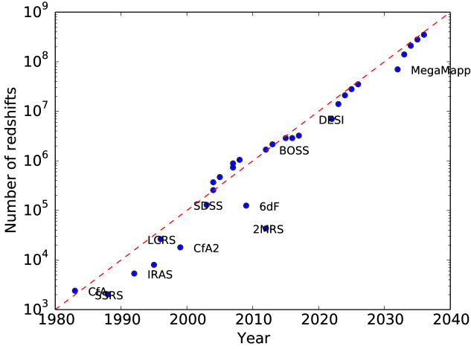
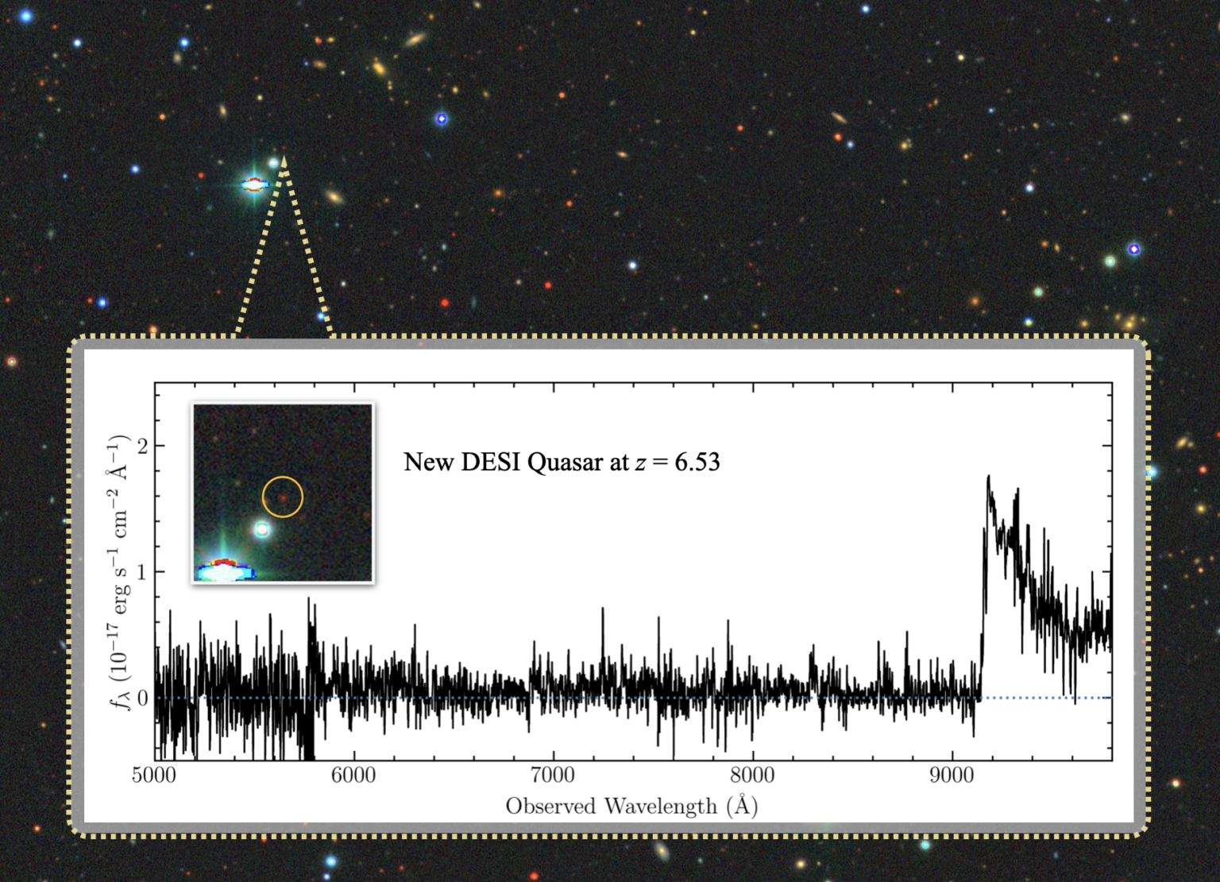
Improved Detector Technology for Cosmic Surveys
Spectroscopic survey speed has increased by a factor of 10 each decade.
Stage-V
arXiv:2209.04322
Future spectroscopic surveys (e.g., DESI-2 and a Stage-5 Spectroscopic Survey) need to be sensitive to fainter objects, particularly at blue wavelengths (Lyman-break galaxies and Lyman-alpha emitters at redshift 2 < z < 5).
Credit: Jinyi Yang, Steward Observatory/University of Arizona

Slide 4
Skipper CCDs

Slide 5
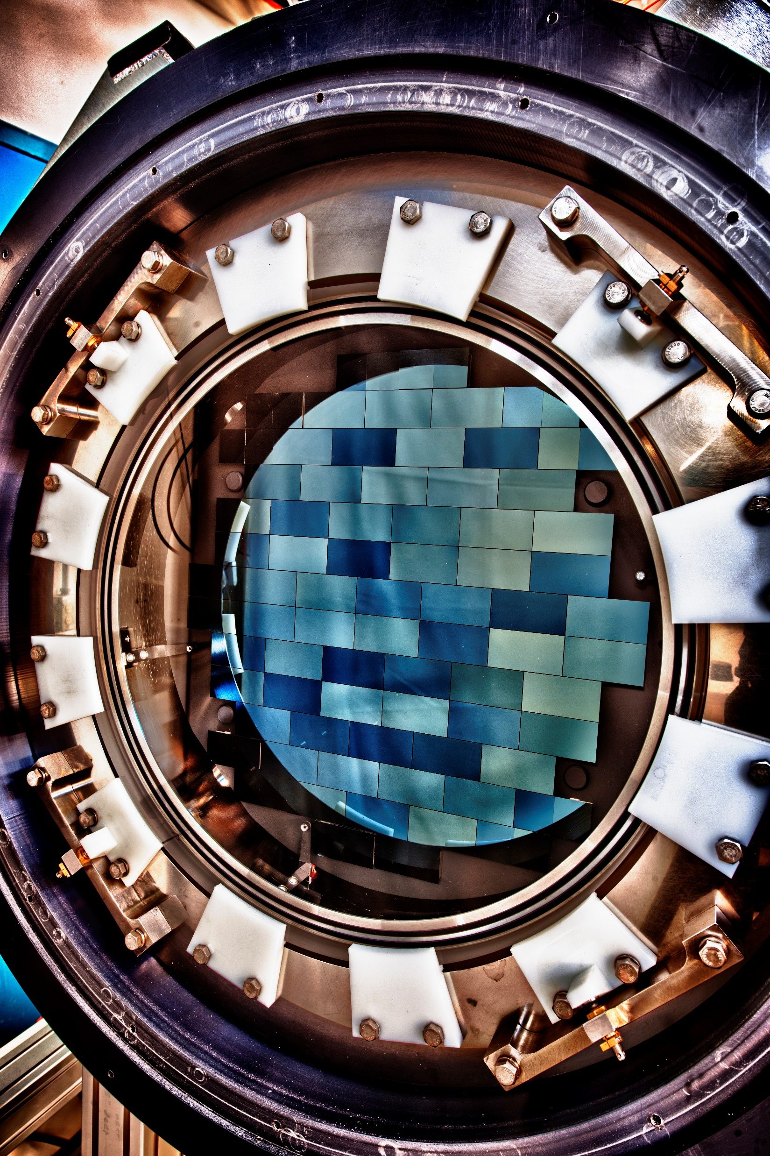
Charge-Coupled Devices (CCDs)
  CCDs: Metal-Oxide-Semiconductor capacitors.
  Radiation interacting in the Si substrate (photoelectric effect) produces electron-hole pairs
  Charge is collected near the surface by applying V_{Sub}

Slide 6
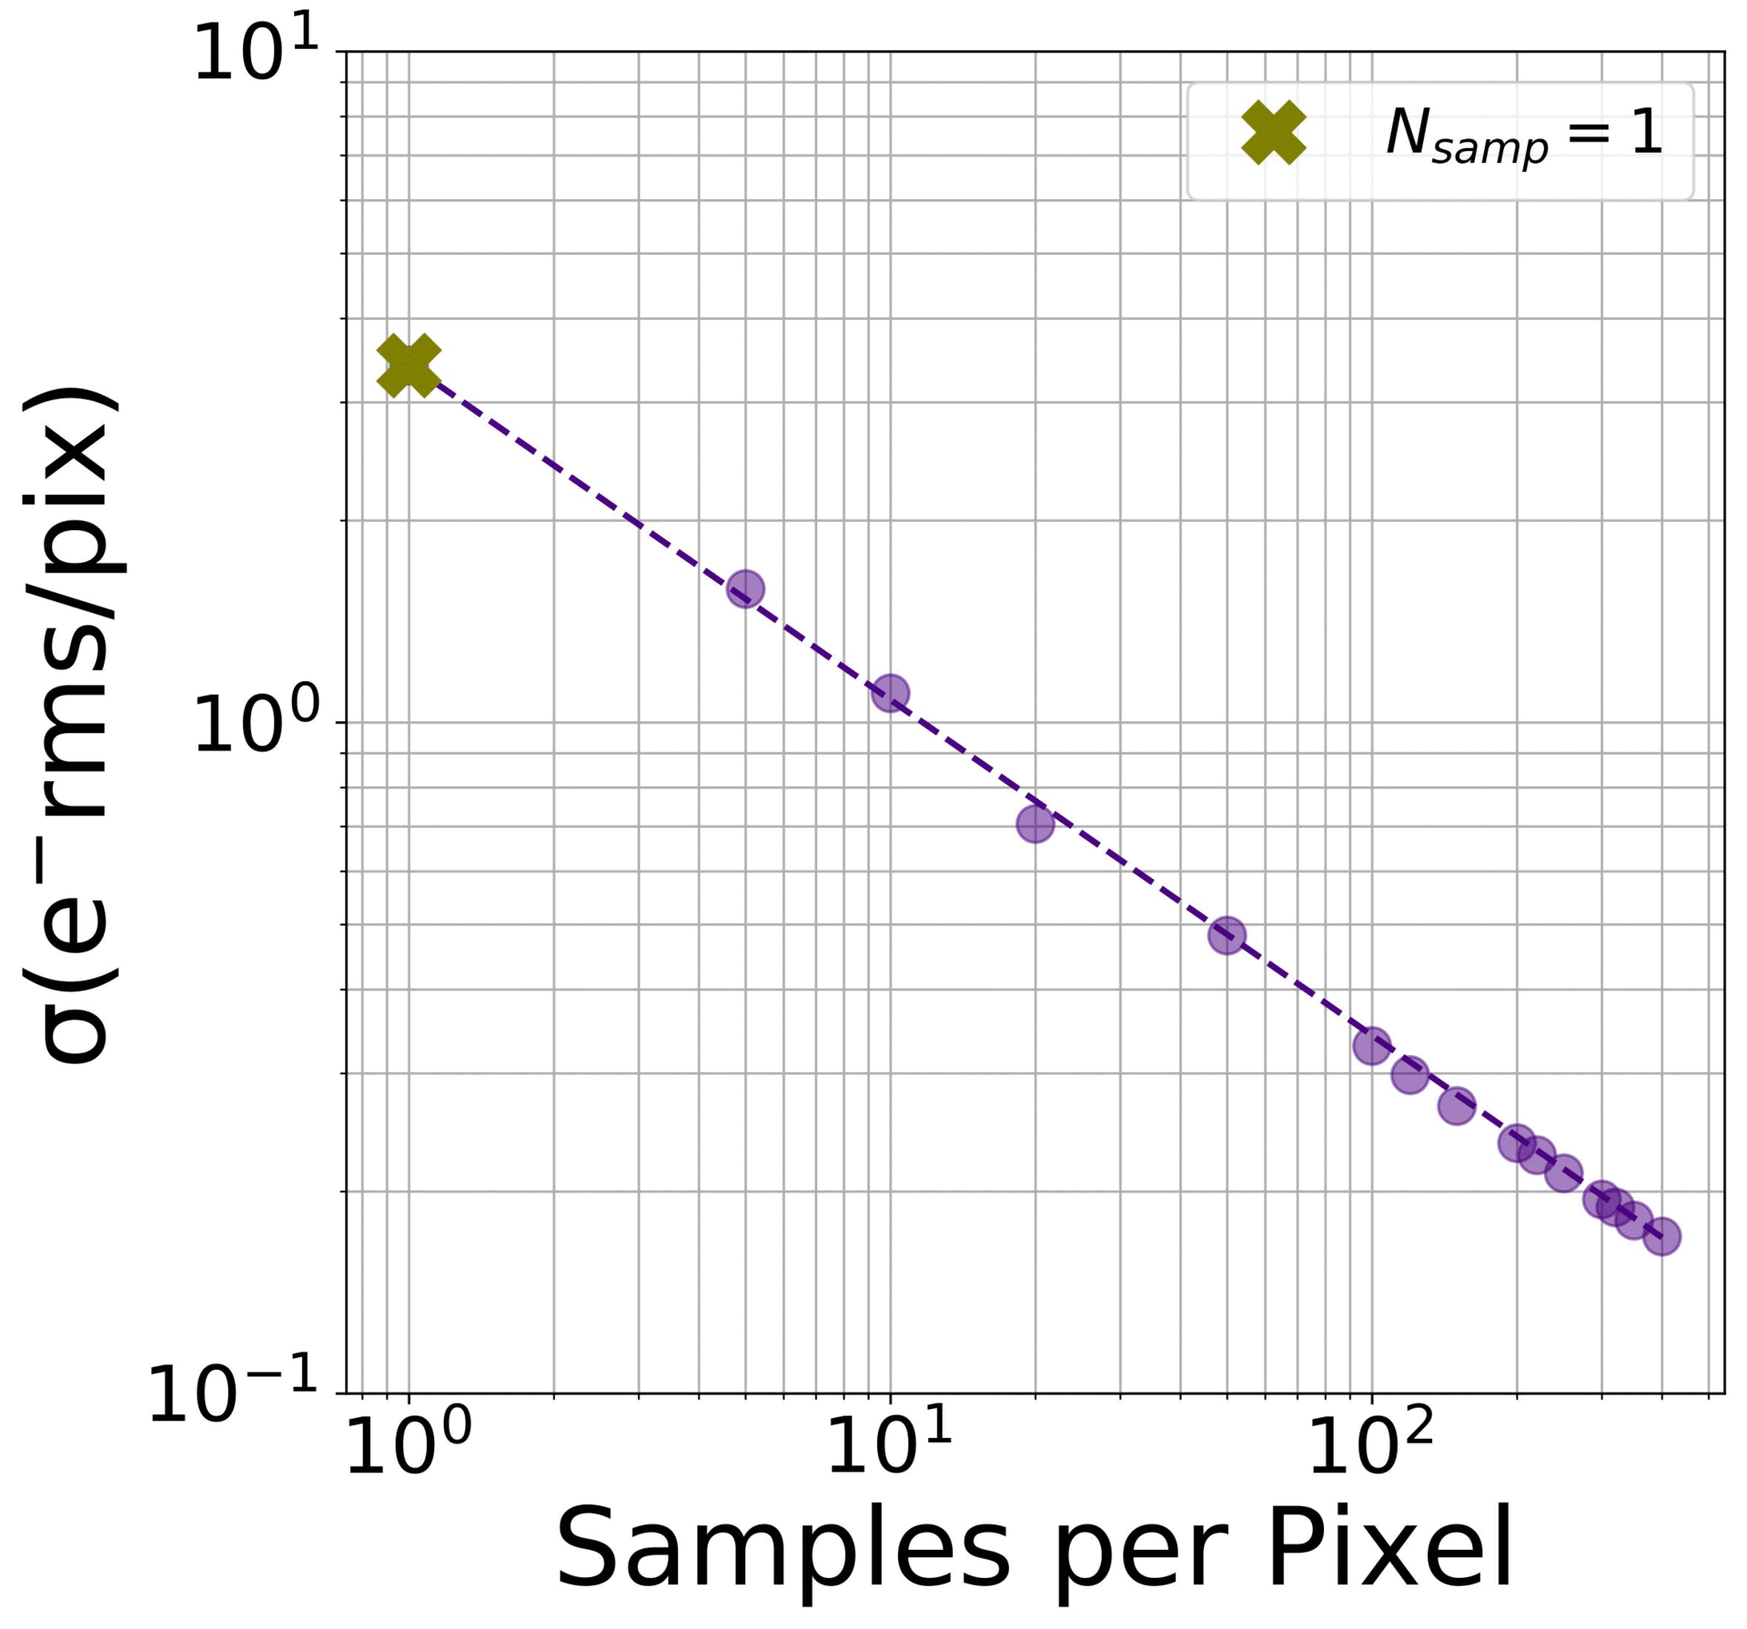
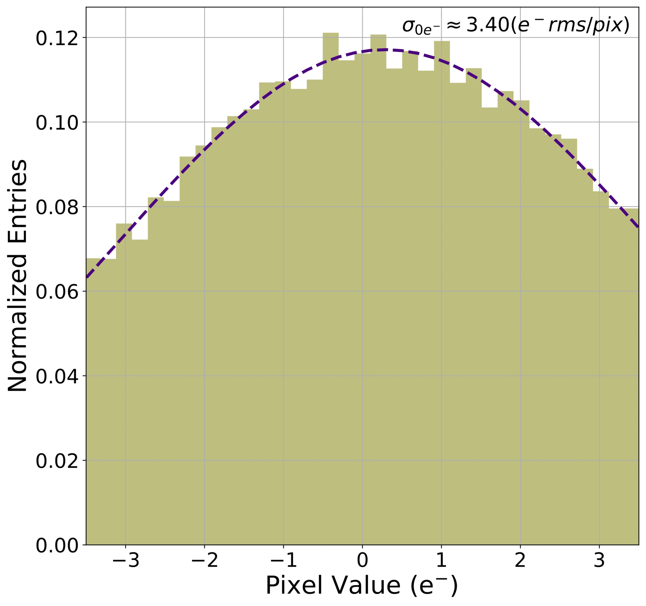

Skipper CCD Readout
$$σ_{N}=\frac{σ_{1}}{\sqrt{N}}$$

Slide 7
Astronomy-optimized Skipper CCDs

Slide 8
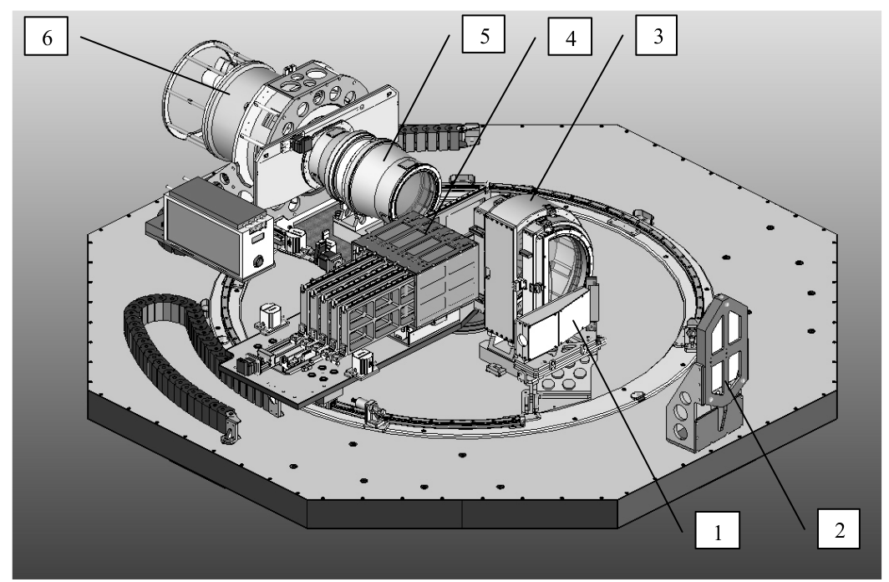
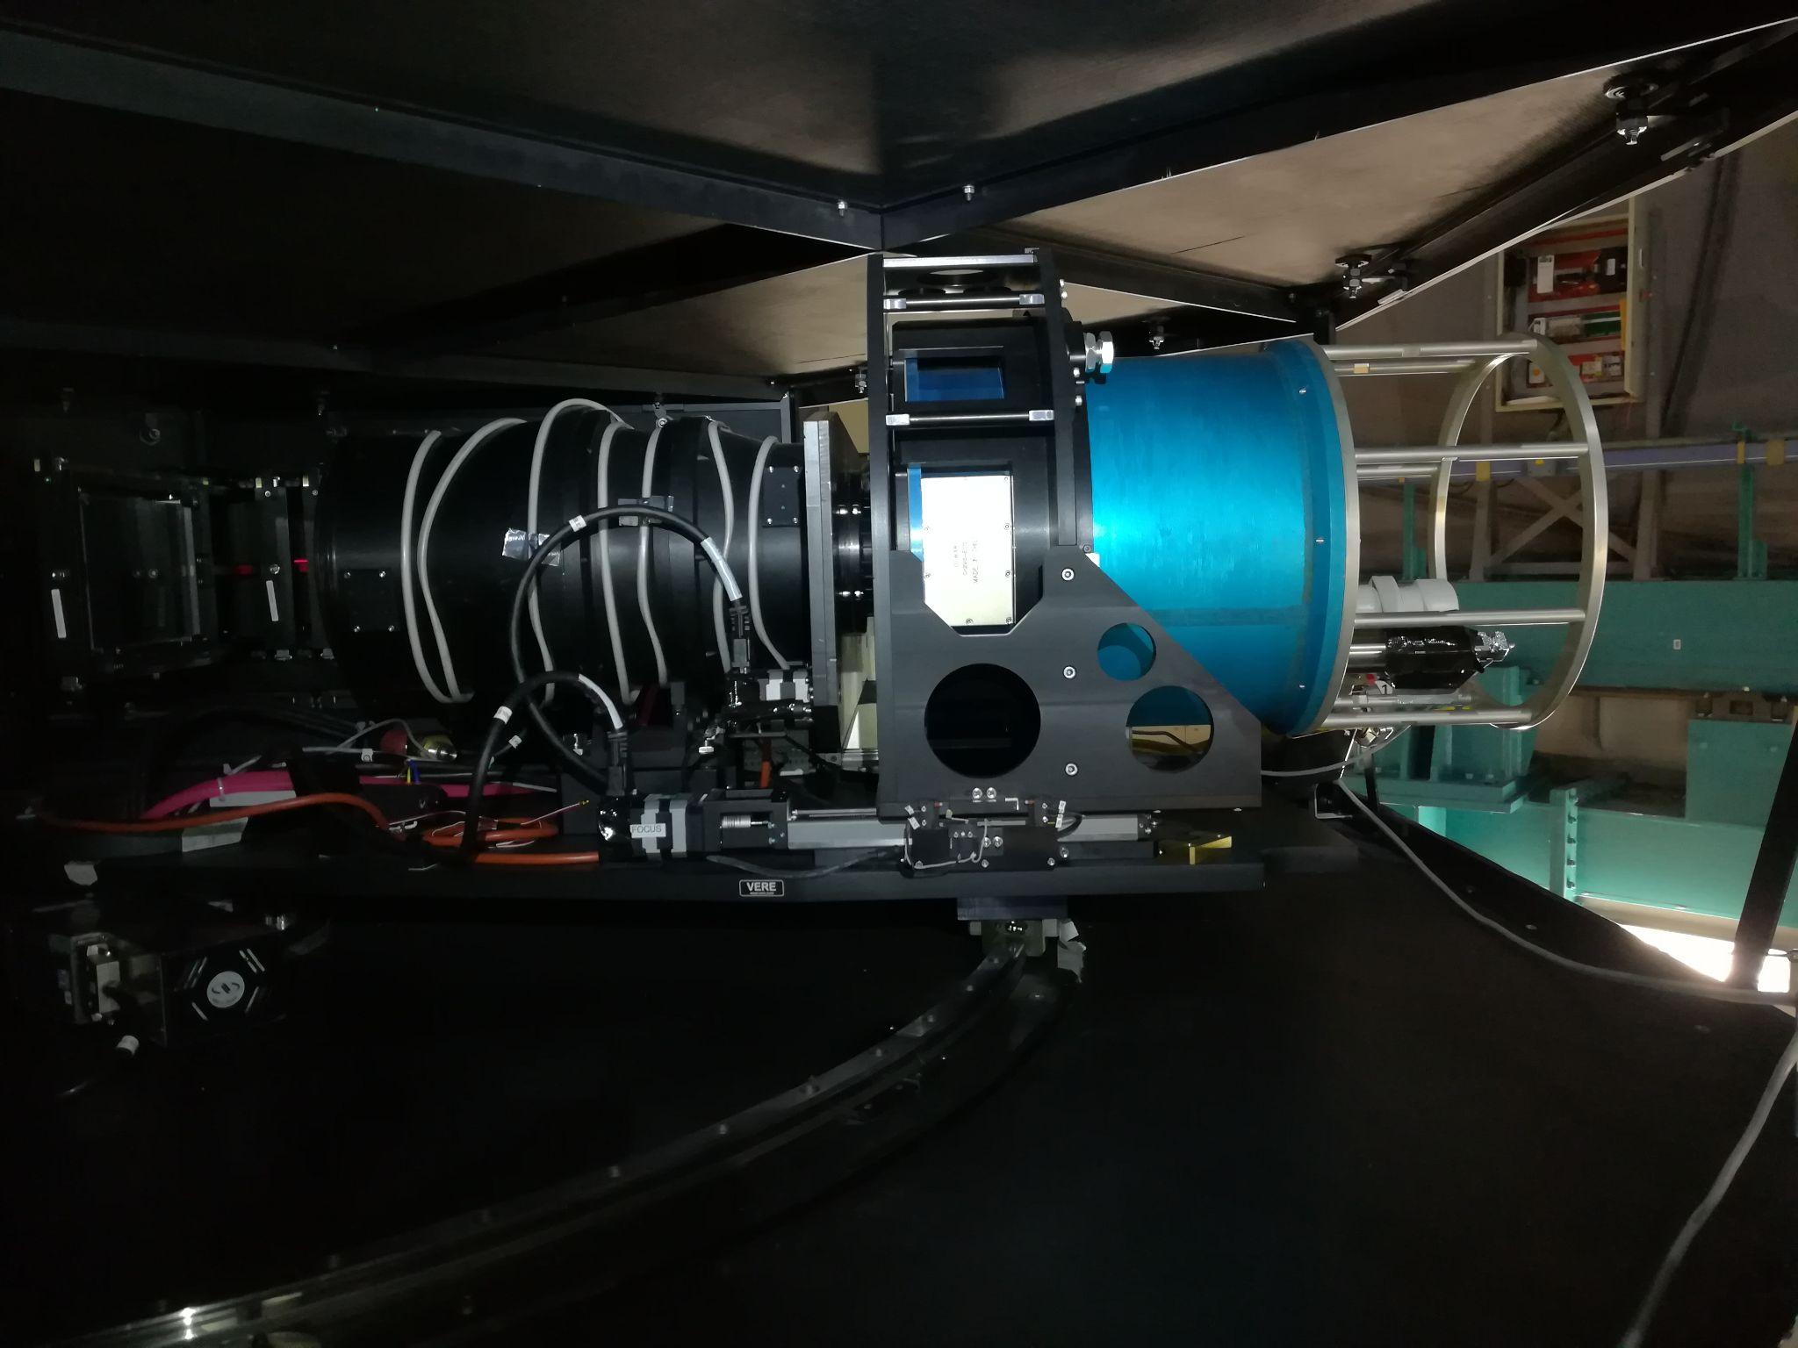
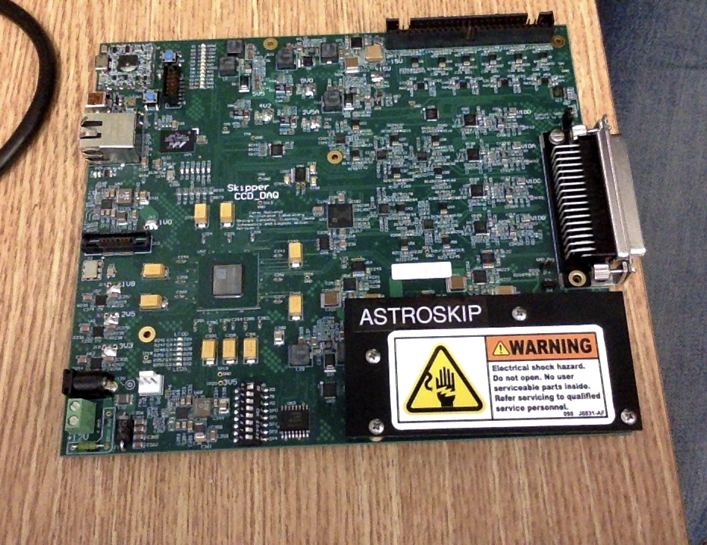
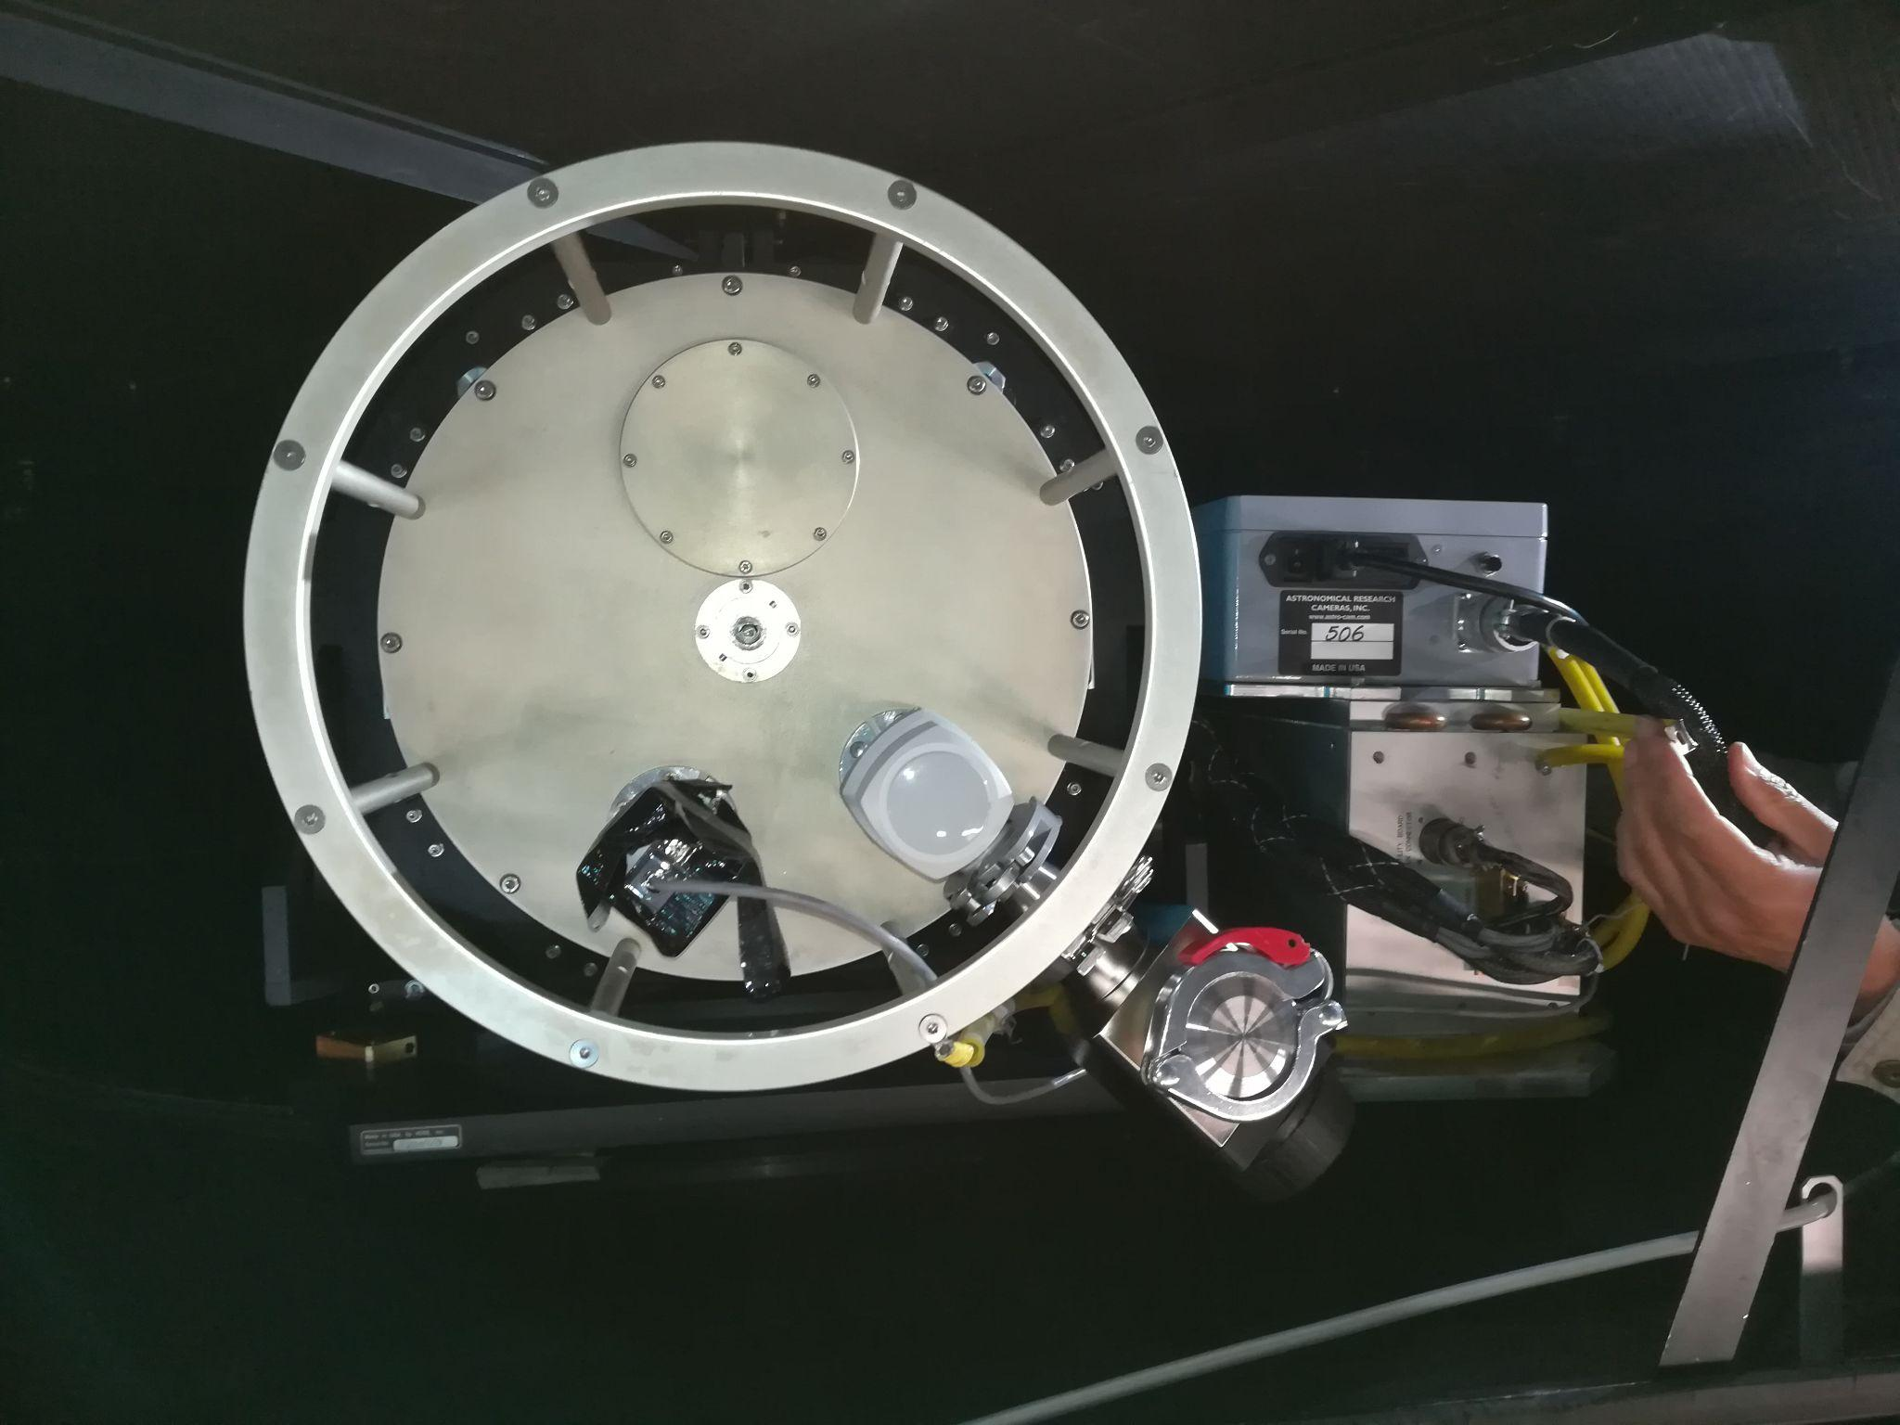
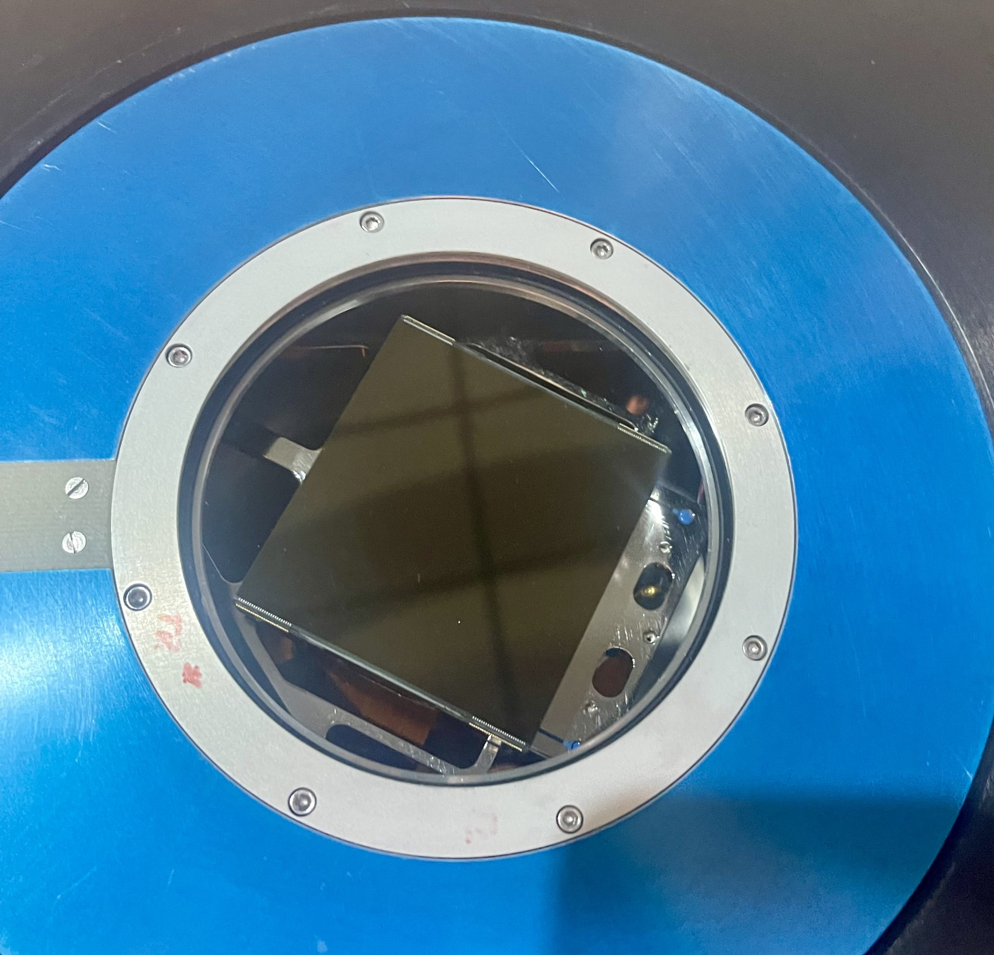
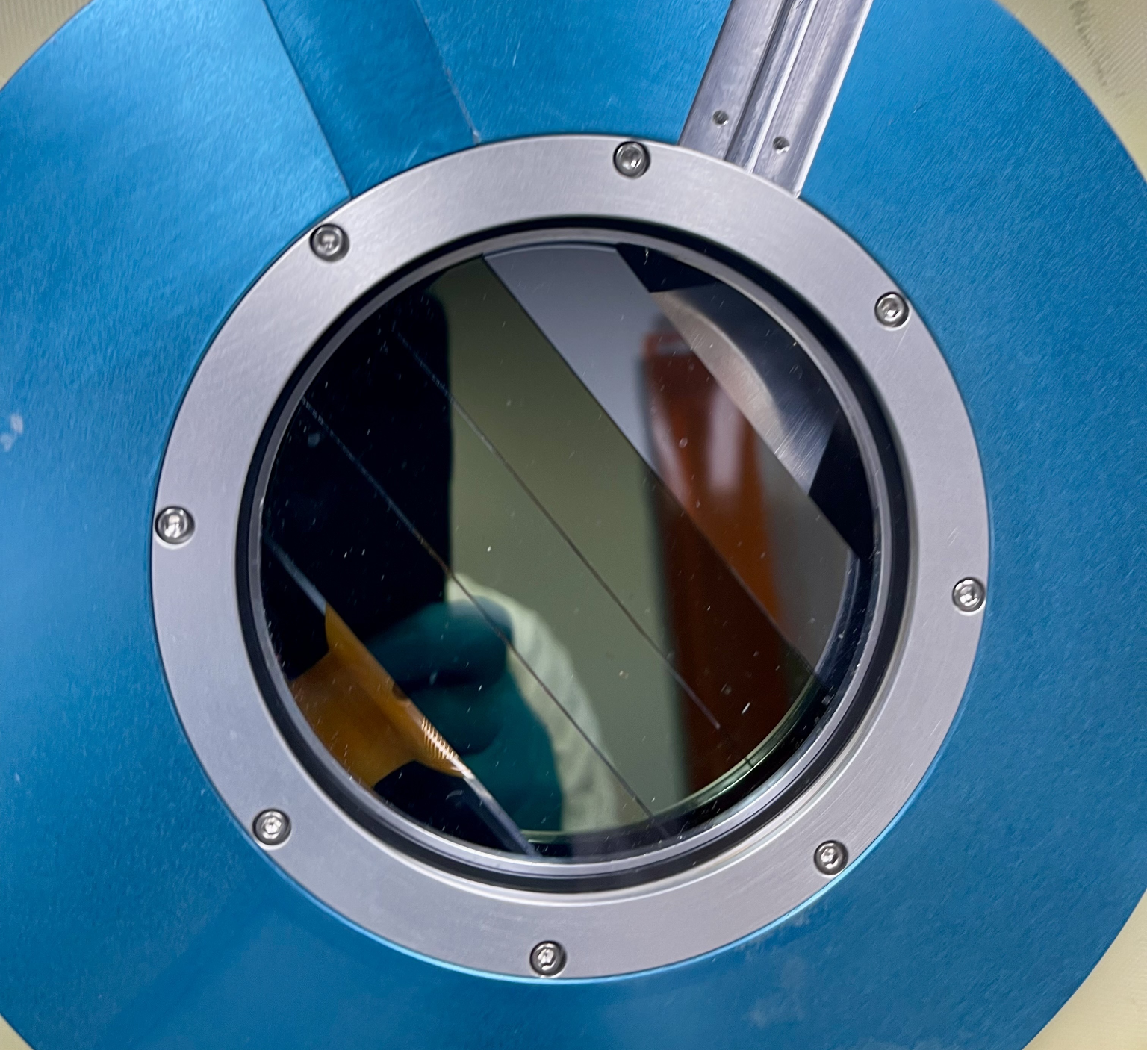
Skipper CCD Focal Plane for SIFS
Dewar
Macanhan, V.B.P, et al.
Science Skipper CCD
4k x 4k e2V

Slide 9
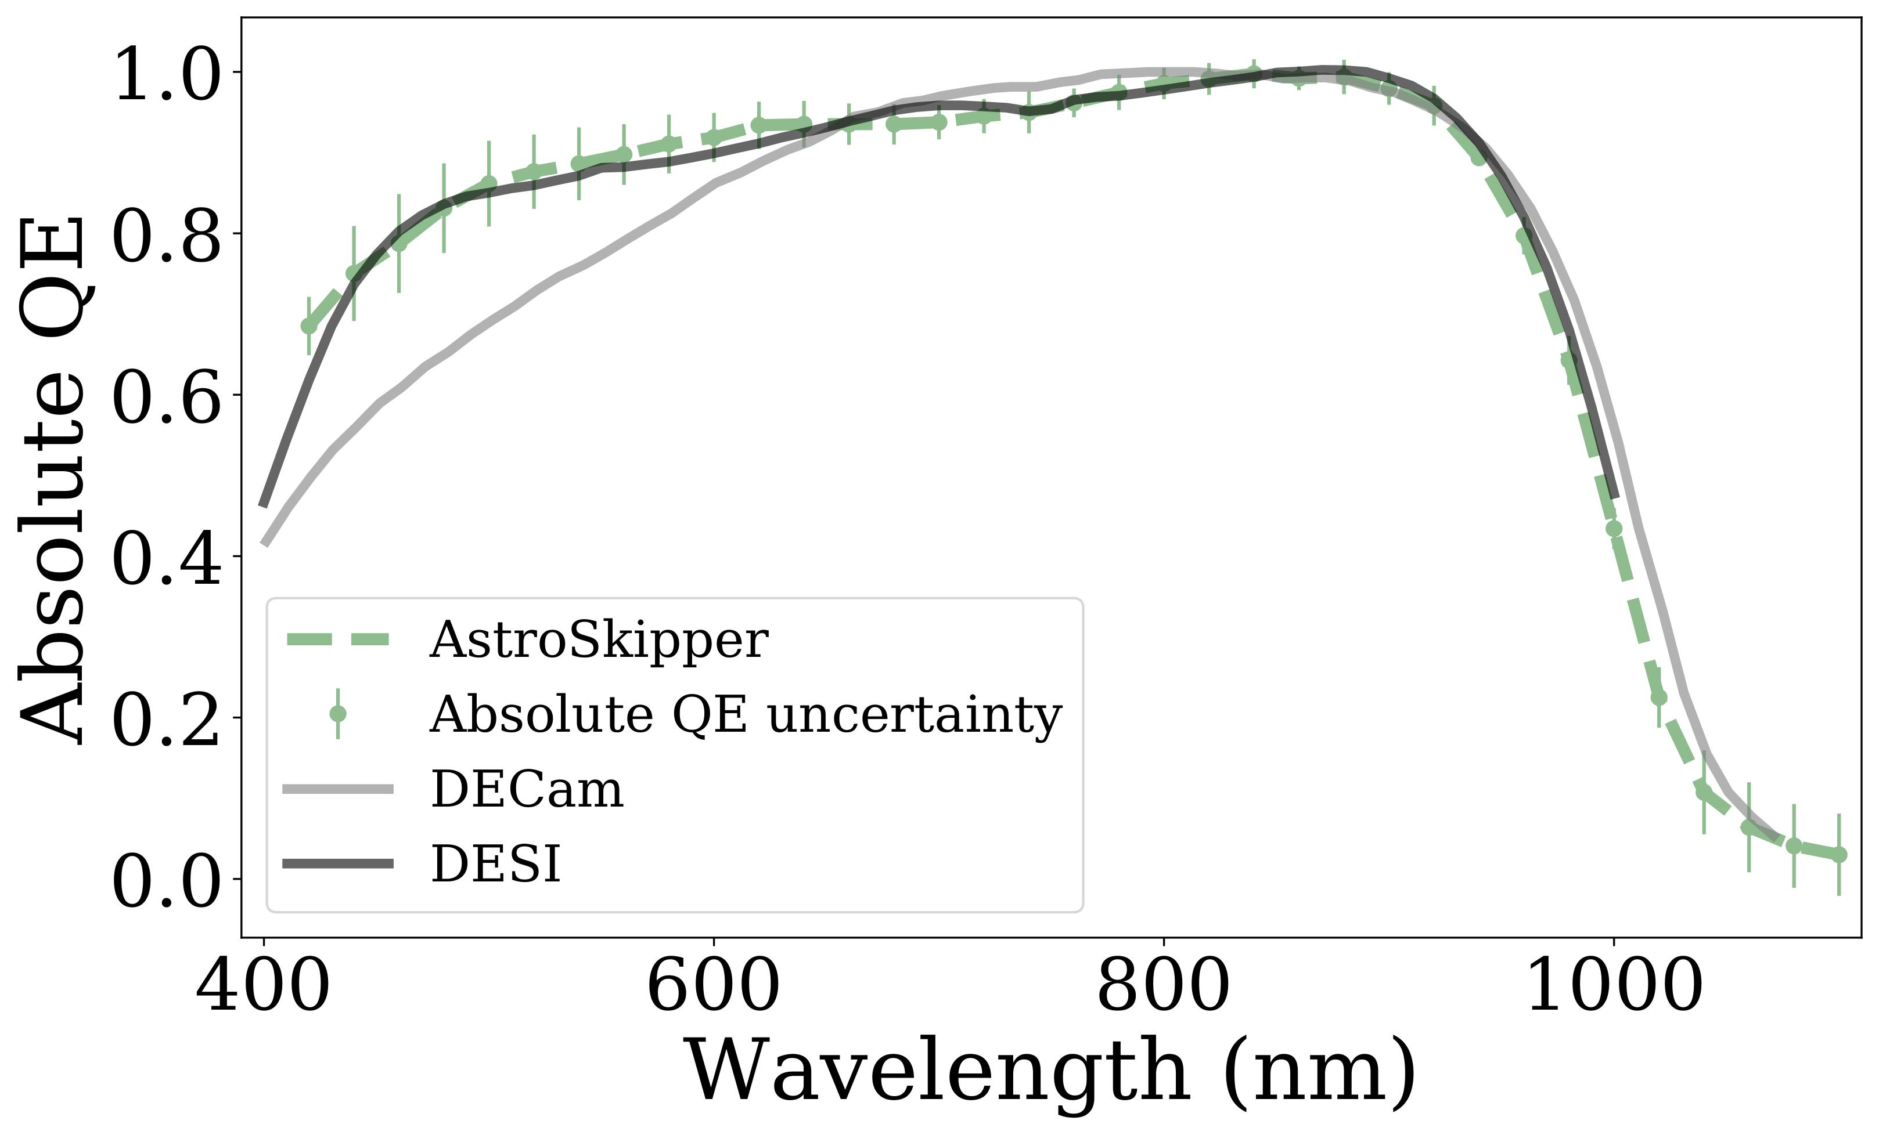
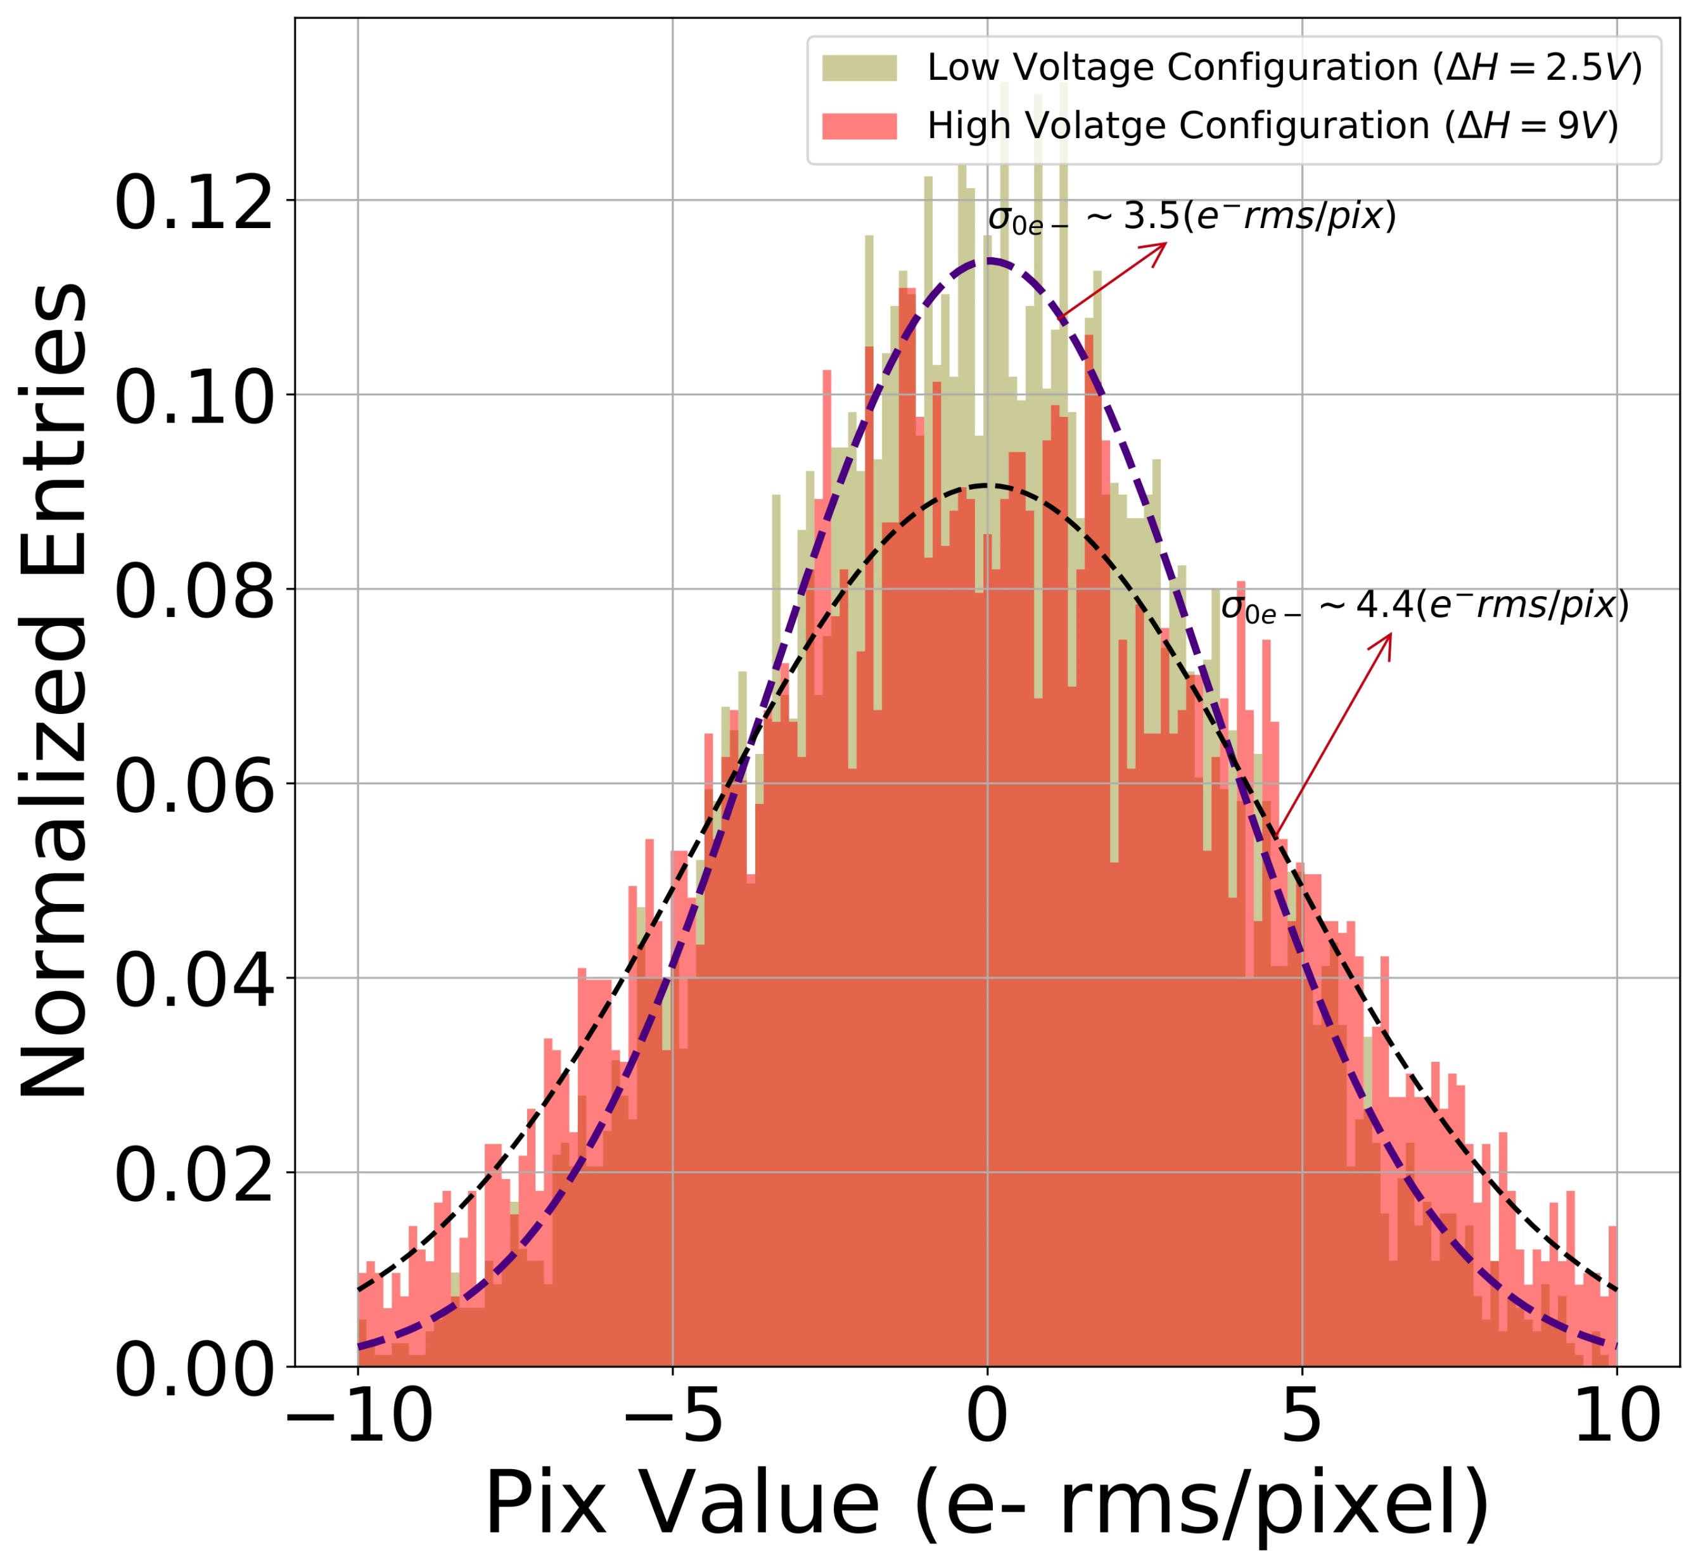
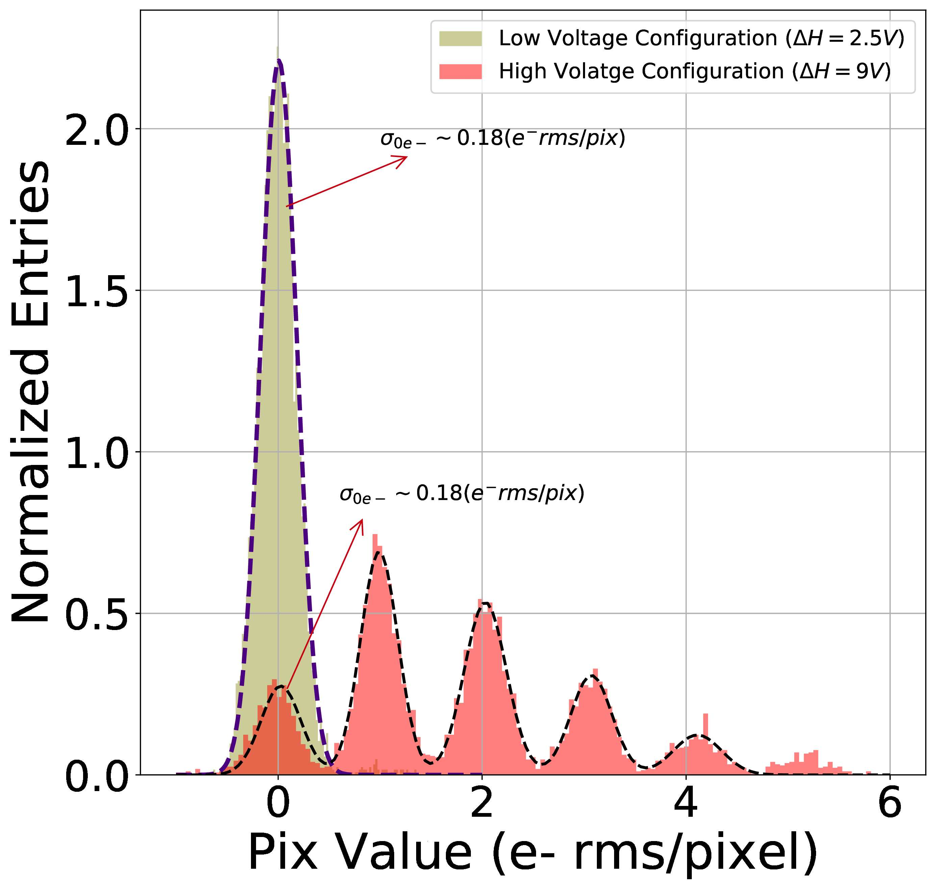
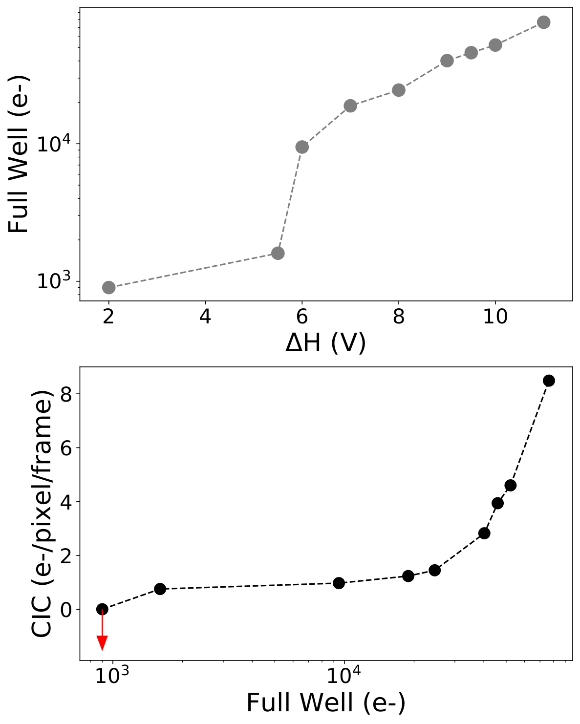
Skipper CCDs: Astronomy-Optimized
AstroSkippers retain the high QE of the thick, fully depleted DESI detectors from LBNL
Skipper CCDs need to be optimized for large full-well capacities and low backgrounds

Slide 10
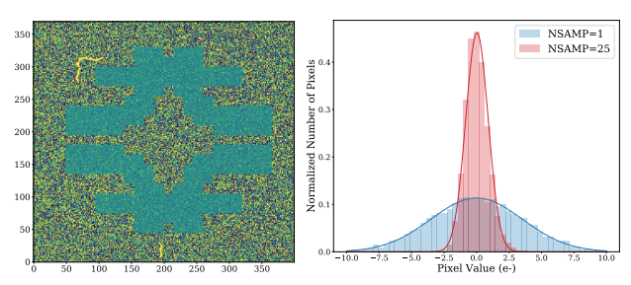
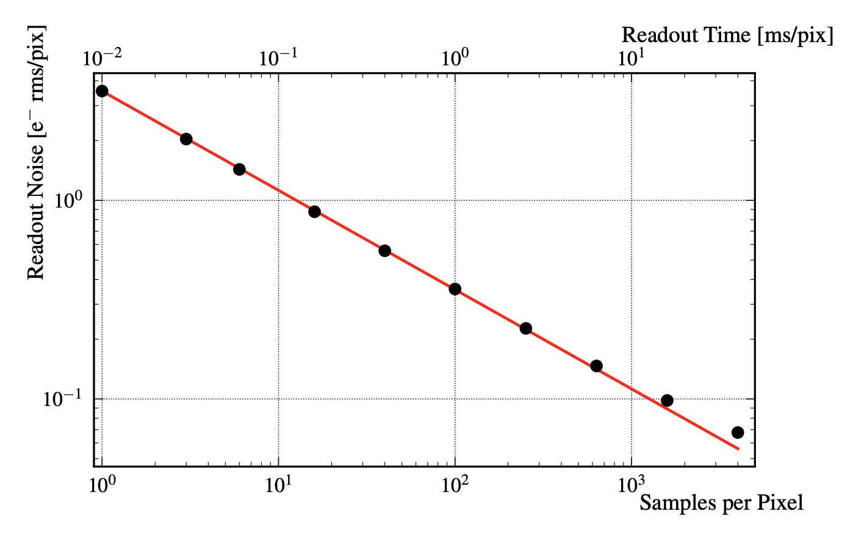
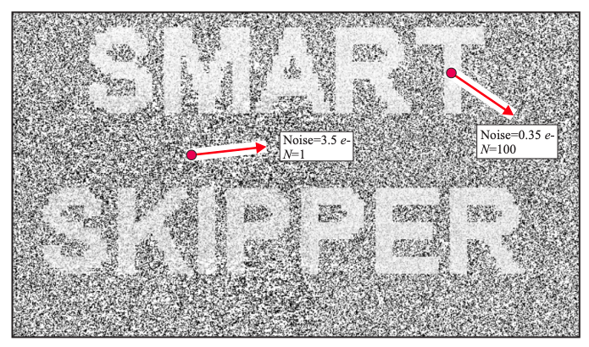
Skipper CCDs: Observation Optimization (Regions of Interest)
Takes a few hours to read full AstroSkipper with single photon counting
arXiv:1706.00028
arXiv:2012.10414

Slide 11
Results

Slide 12
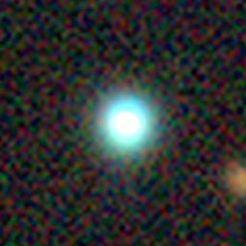
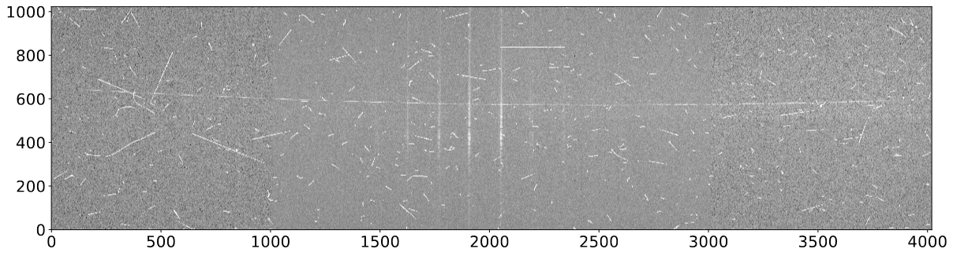
Skipper CCDs: First On-Sky Demonstration (Sub-electron Noise)
ROI
QSO HB89 1159+123
0.5 e- rms/pixel
Achieved sub-electron readout noise (0.5 e- rms/pixel) in science frames for an area 2k x 4k pixels. ROI minimizes readout time from ~55 min to ~15 min.
4.2 e- rms/pixel

Slide 13
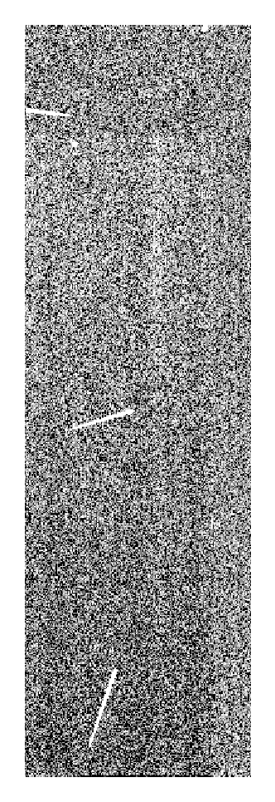
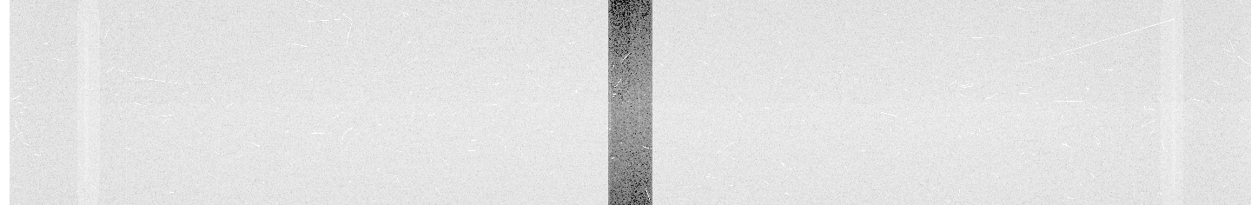
Skipper CCDs: First On-Sky Demonstration (Photon-Counting)
Photon-counting was achieved for the first time for astronomical observations with a Skipper CCD (charge quantizing read out noise on a CCD).

Slide 14
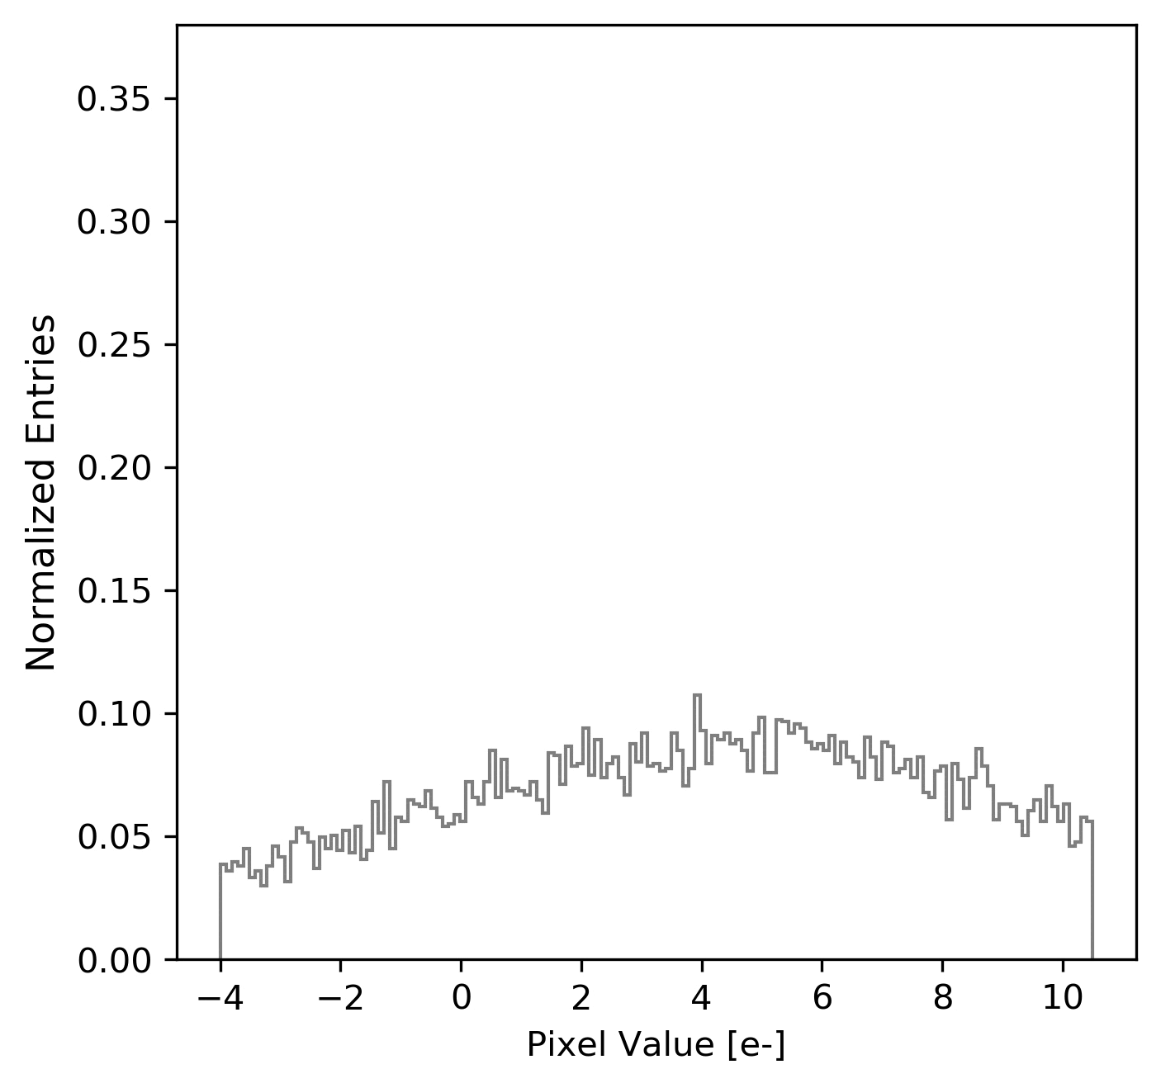
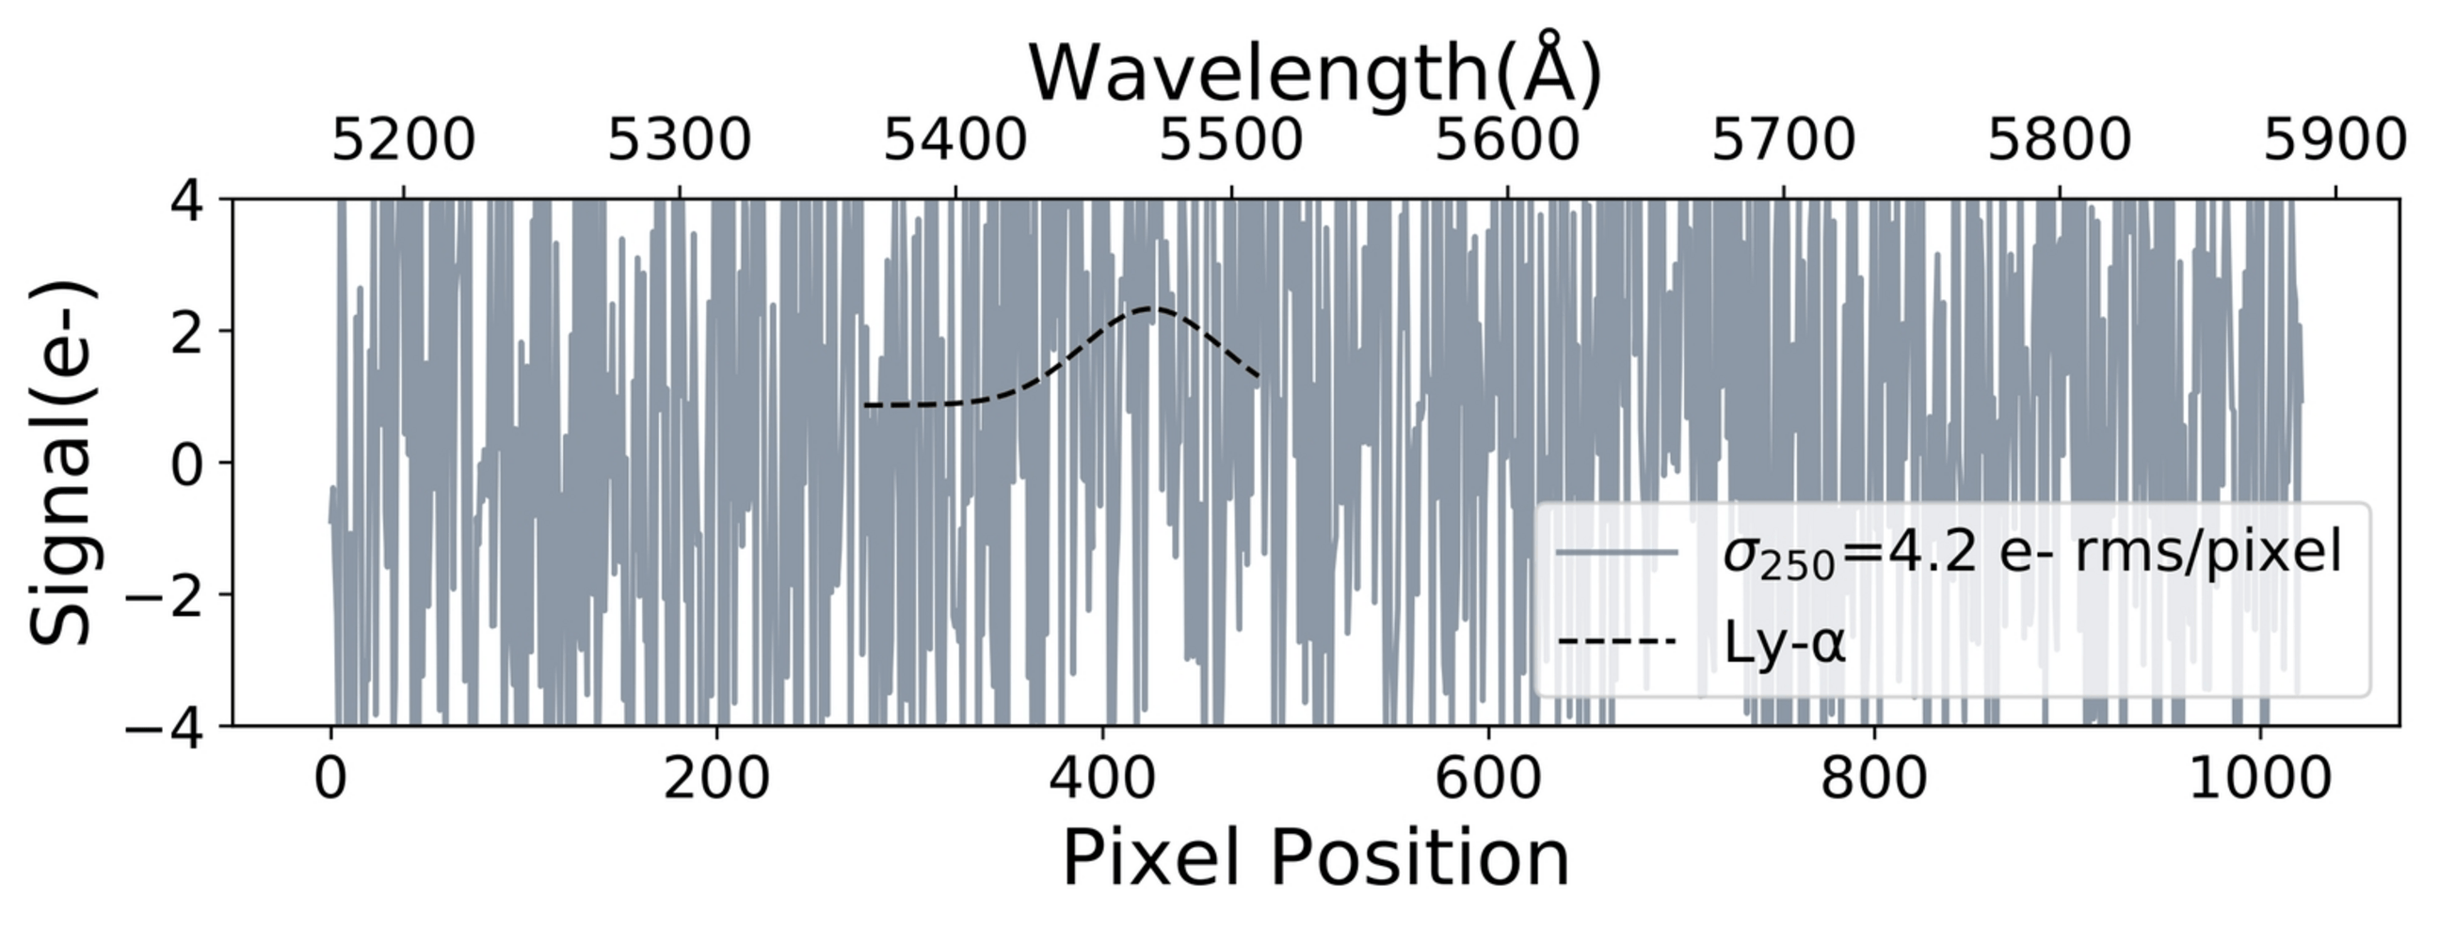
Skipper CCDs: First On-Sky Demonstration (Photon-Counting)

Slide 15
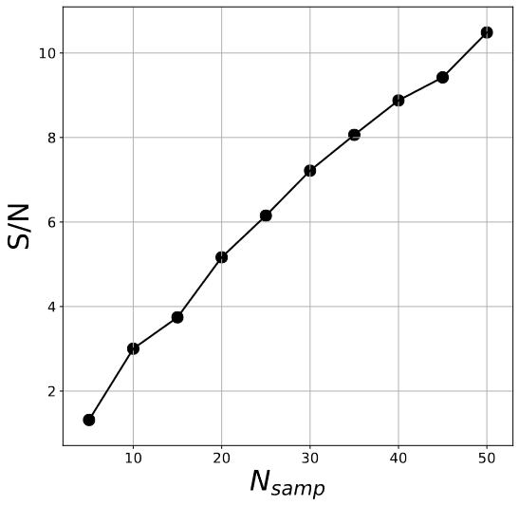
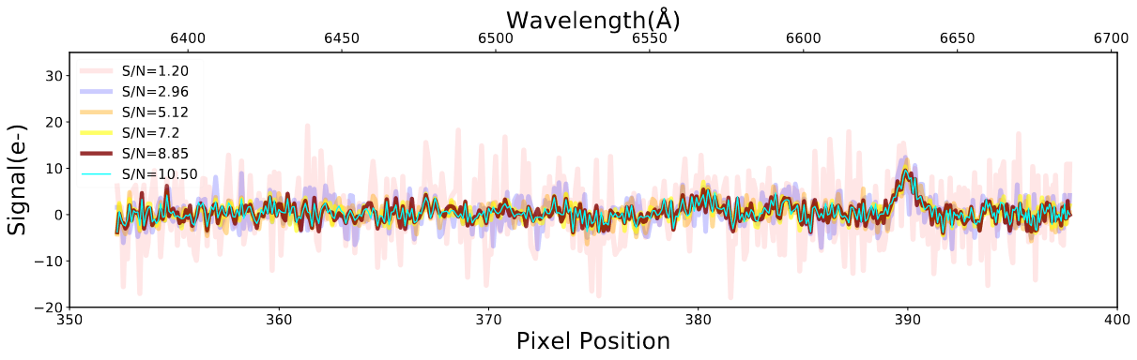
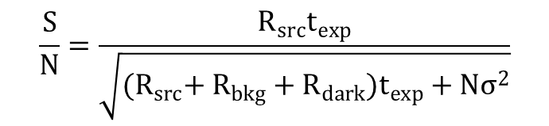
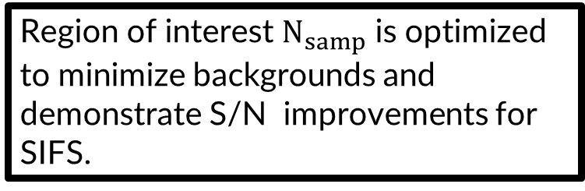
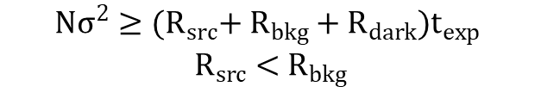
Signal-to-Noise (Read Noise Dominated Regime)
Region of interest $N_{samp}$ is optimized to minimize backgrounds and demonstrate S/N improvements for SIFS.
SOAR Telescope
$$\frac{S}{N}=\frac{R_{src}t_{exp}}{\sqrt{{(R}_{src}{+ R}_{bkg}+R_{dark})t_{exp}+Nσ^{2}}}$$
$$Nσ^{2}≥{(R}_{src}{+ R}_{bkg}+R_{dark})t_{exp}$$
$$R_{src}<{ R}_{bkg}$$
O III
SIFS bench spectrograph

Slide 16
Extra Slides

Slide 17
Planned Science

Slide 18
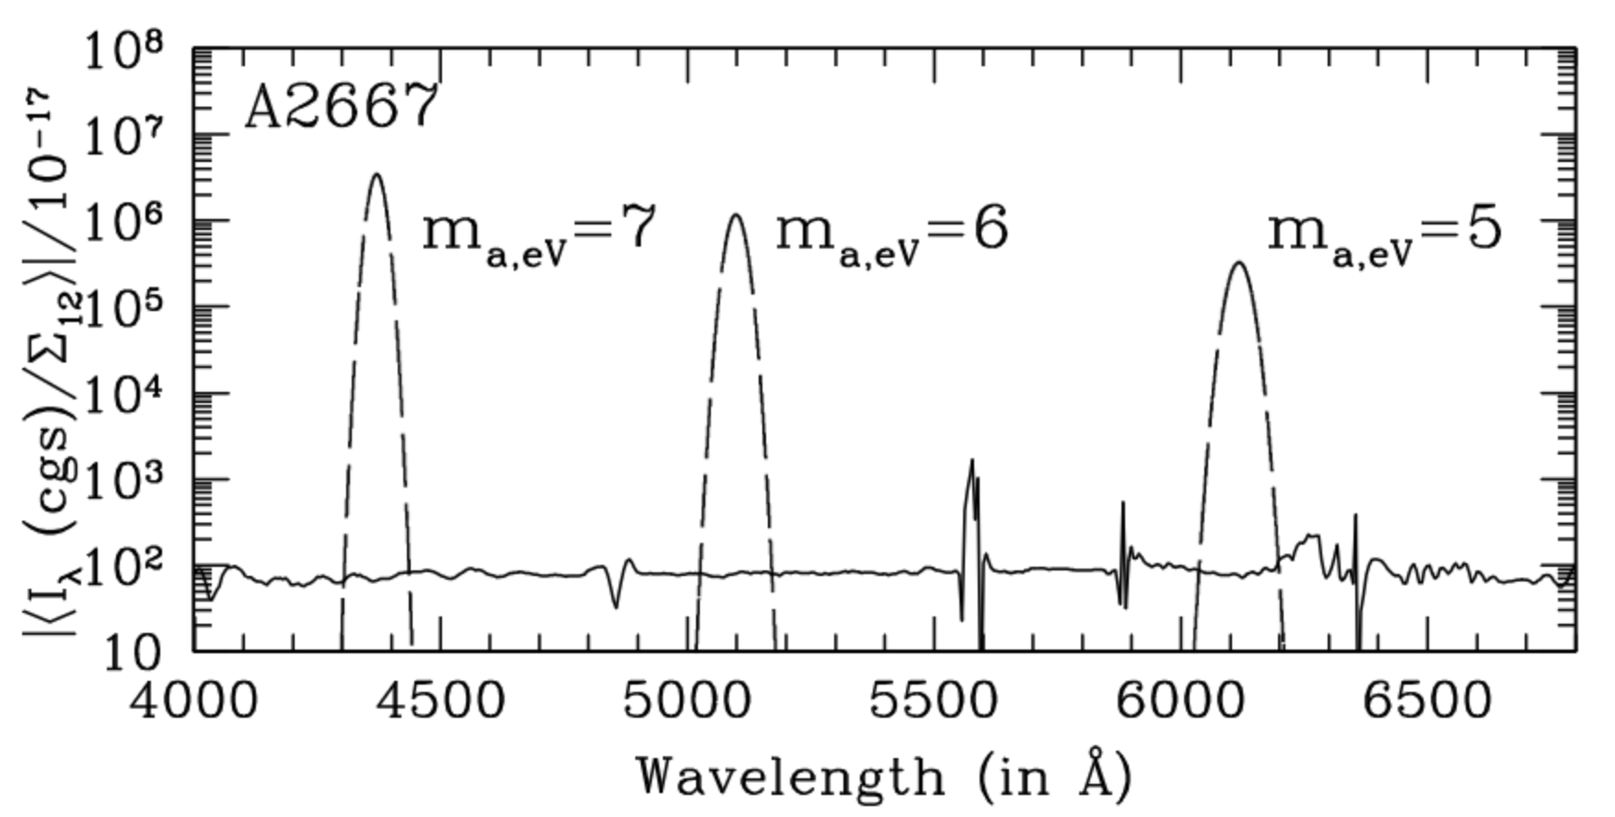
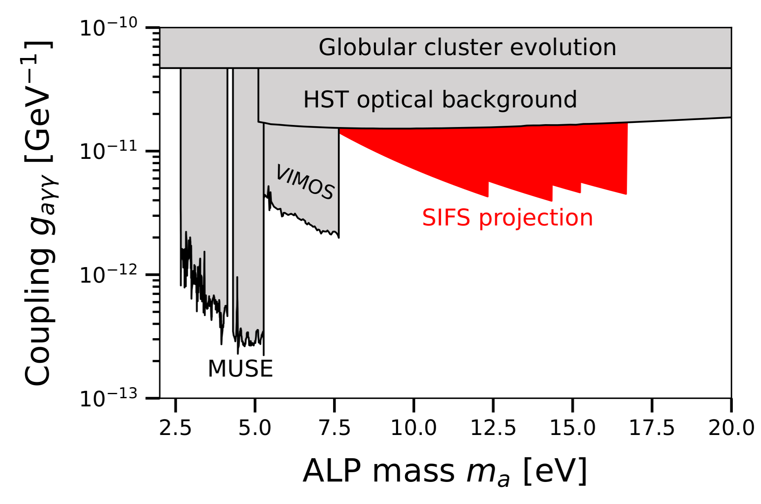
Axion-like-Particle Dark Matter in Galaxy Clusters
SOAR Telescope
ALPs or other eV-scale DM may decay into mono- energetic photons, producing a spectral line.
For two-photon decays, each photon has observed wavelength λ = 2480 Å * (10 eV) * (1+z).
Moderate-redshift (z ~ 1–2) galaxy clusters have several advantages for ALP searches:
Large DM masses constrained by SZ observations (e.g., ACT or SPT)
Increases ALP mass reach for a given wavelength bandpass by a factor (1+z).
SIFS bench spectrograph

Slide 19
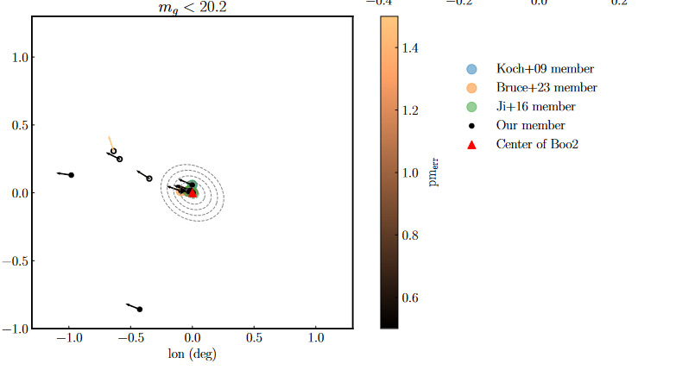
Ultra-faint-Dwarf Galaxy Candidate Member Star
SOAR Telescope
UFD candidate star member confirmation (radial velocity calculations).
Extend the mapping of stellar population of UFDs to larger distances (galaxy evolution and their small dark matter halos).

Slide 20
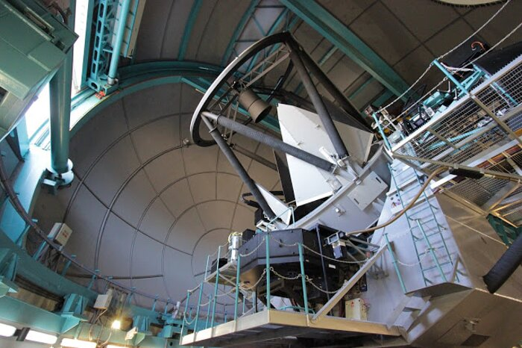
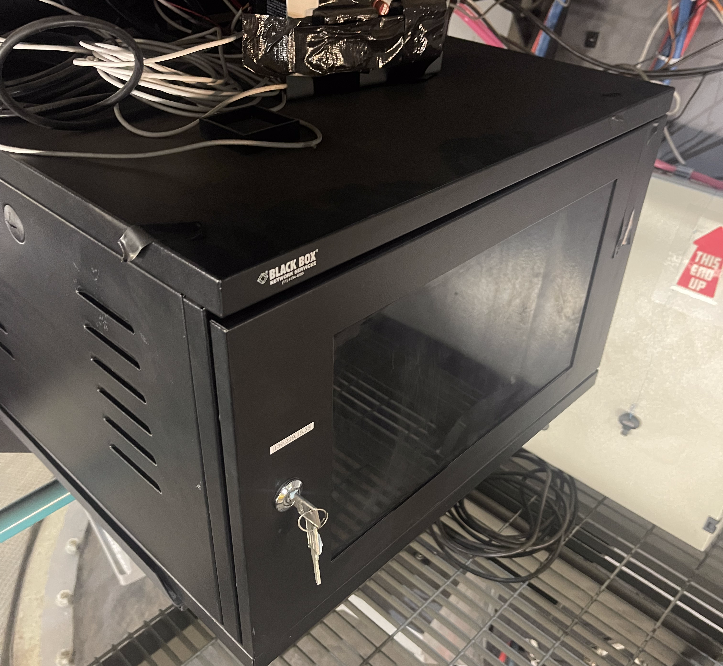
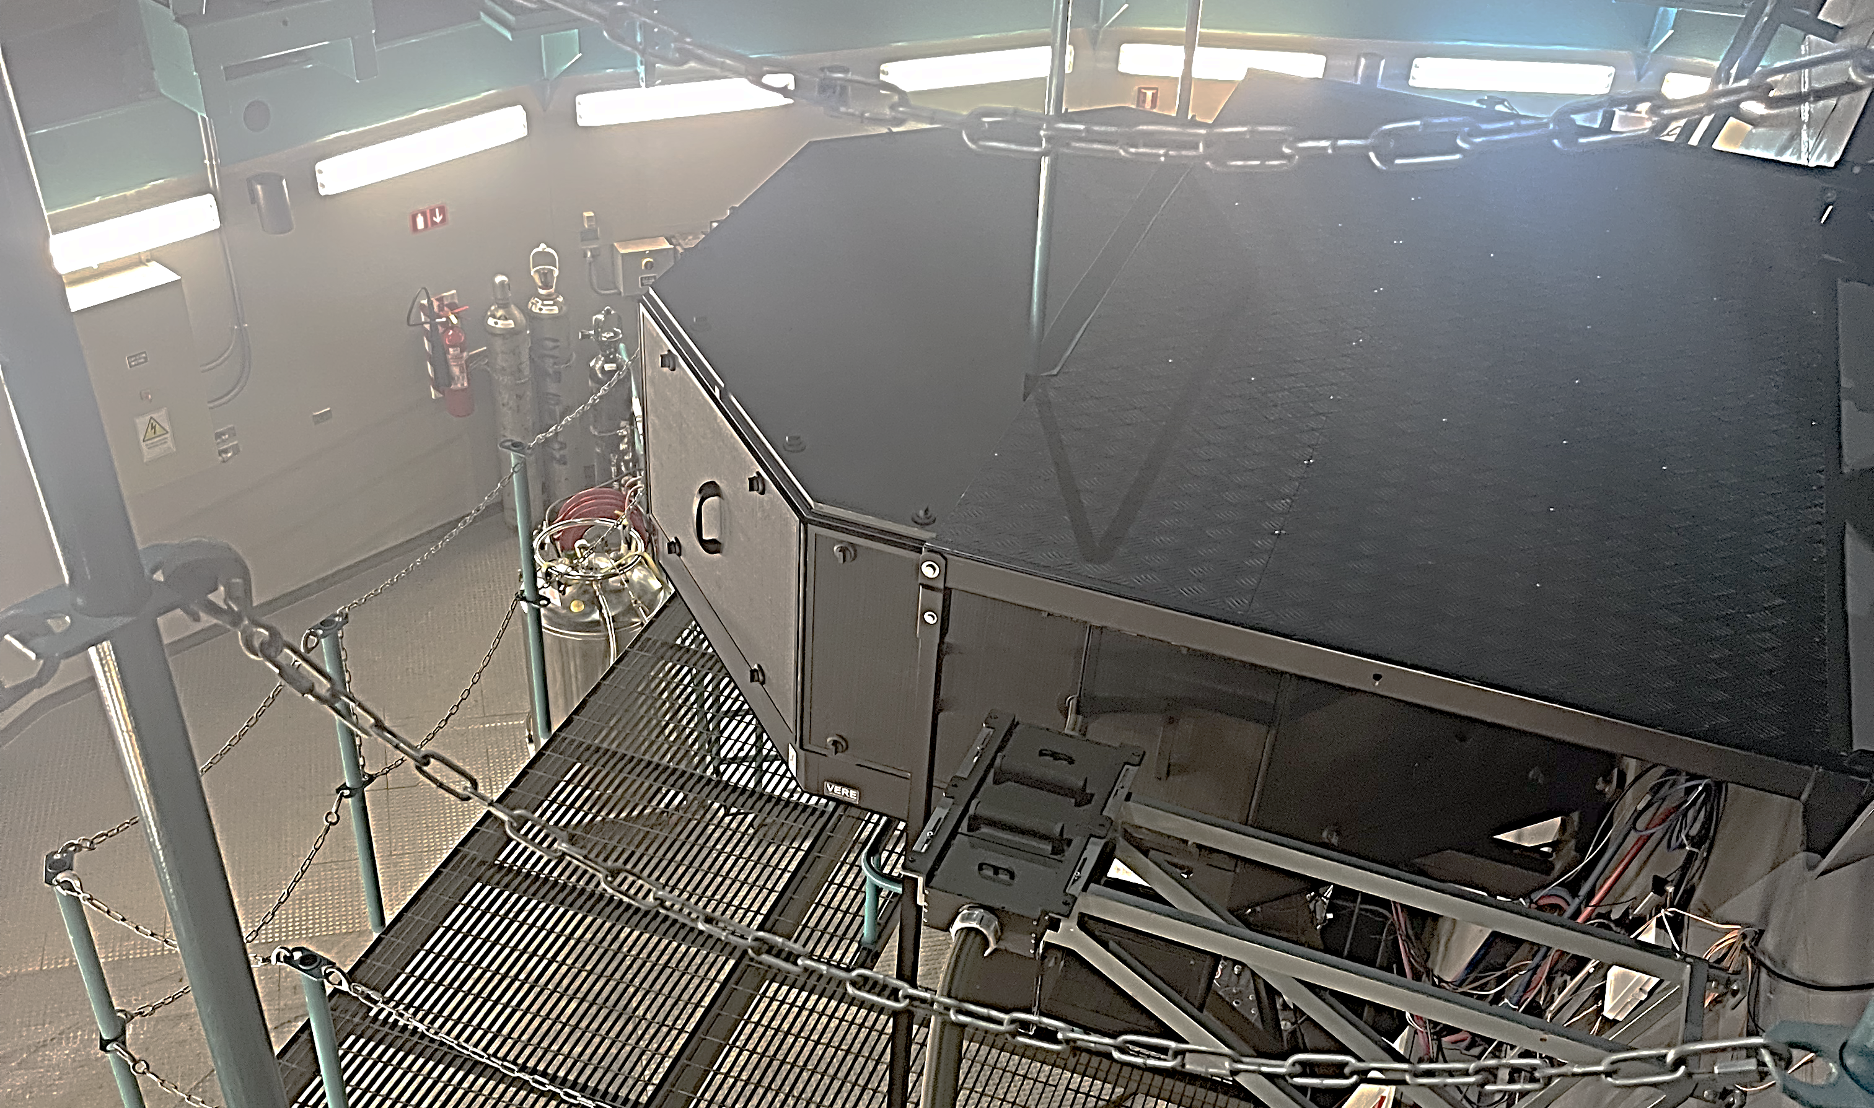
SIFS
SOAR Telescope
Readout boards (SDSU-III controller)
SIFS bench spectrograph

