Slide 1
Studying Galaxy Mergers Using Domain Adaptation
By Rohan Venkat (UChicago) and Dr. Aleksandra Ciprijanovic (UChicago,Fermilab)
rvenkat@uchicago.edu
Notes:
Add email and name of the conference, uchicago logo, add fermilab,uchicago for Dr. Ciprijanovic and Dr. Nord

Slide 2
Key Problem in Astrophysics
There are too many images and not enough astrophysicists
Deep learning is an up and coming resolution to this problem
Can we make a deep learning model which is trained on simulated galaxy merger images that accurately outputs the stellar mass of real galaxy merger images?
https://in.pinterest.com/pin/724375921303803440/
Notes:
Introduce the problem: there are so many images from so many telescopes of galaxy mergers that being able to manually classify them is impossible
Deep learning is a solution to this problem: if we can train a neural network to understand how to extract important features from images of galaxy mergers than it would significantly aid astronomers/astrophysicists
If we choose as the specific feature of interest to be the stellar mass of a galaxy and we can construct a deep learning model which trains on simulated galaxy images and still gives accurate results on real galaxy images then this would be significant because we would have a model which gives results on real galaxies without every needing to have been trained on a real galaxy!

Slide 3
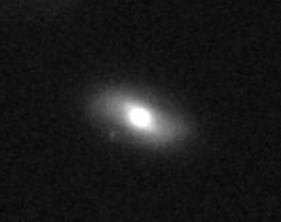
Our Data
We will use simulated merger images from the Illustris TNG simulation which is a cosmological simulation that will provide us with 2698 simulated galaxy merger images of stellar masses ranging from 10⁸ to 10¹⁴ solar masses
The real images are from the CANDELS survey (Hubble space telescope images in WFC3) in which we have around 3000 images: until now, we have worked with noisy versions of the simulated images
Via the CANDELS interactive display
https://hla.stsci.edu/cgi-bin/display?image=hlsp_candels_hst_acs_cos-tot_f814w_v1.0&autoscale=99.8&title=CANDELS+cos-tot+ACS+f814w

Slide 4
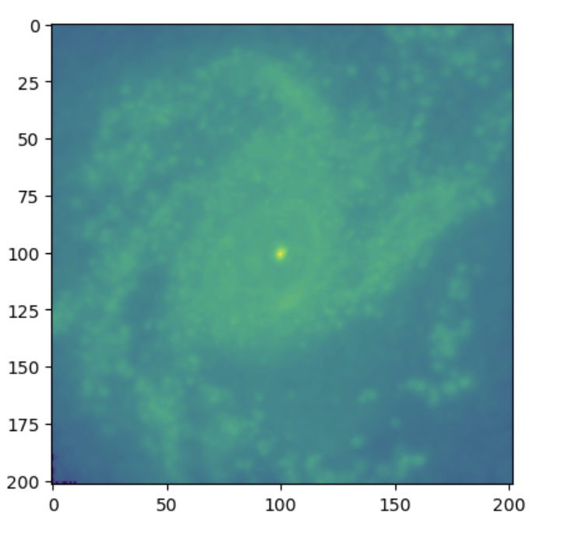
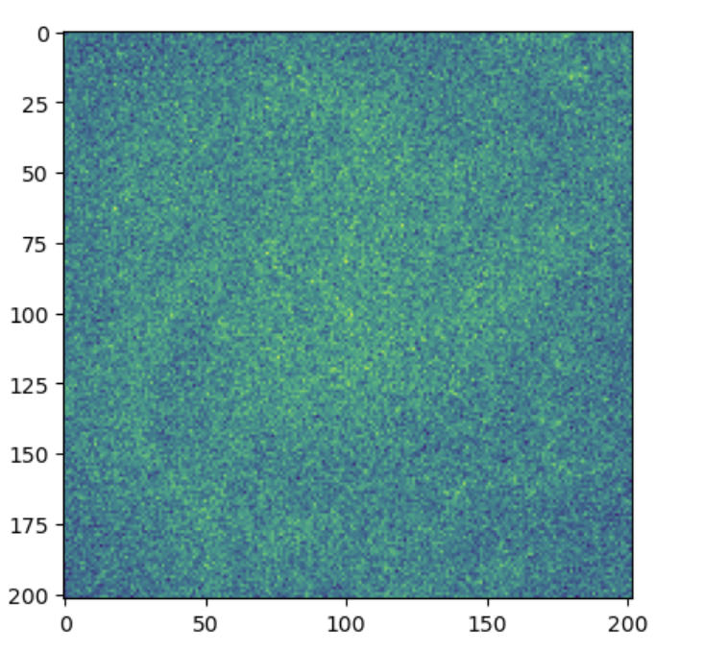
What is Domain Adaptation
A traditional CNN model trains on one domain and tests its performance on images from the same domain
Just because a model performs well on one domain does NOT mean it will perform well on a similar domain
E.g Let us test a model which trained on the simulated galaxy images on a new dataset: the same simulated images with added noise

Slide 5
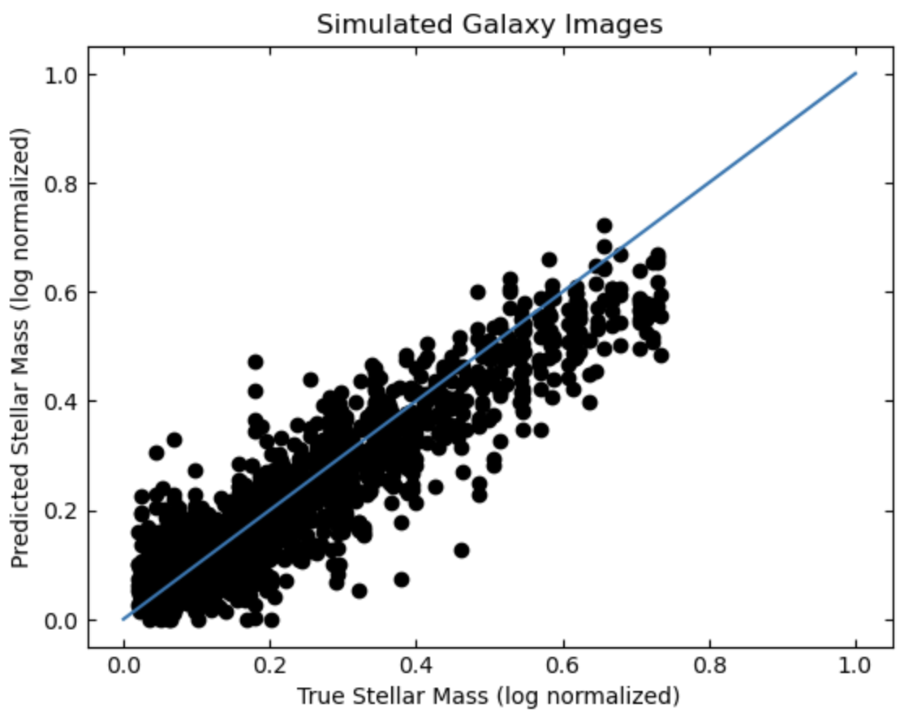
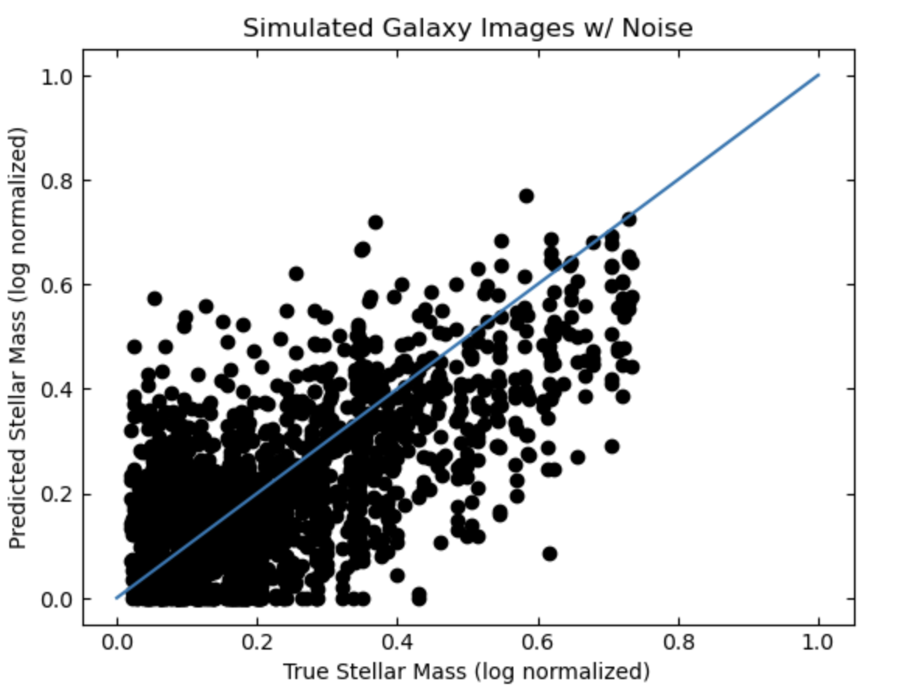
What is Domain Adaptation (cont.)
82% Accuracy
25% Accuracy

Slide 6
Implementing Domain Adaptation
To implement Domain Adaptation, our loss function is as follows:
The parameter 𝛼 tells us how important Domain adaptation is, since if 𝛼 = 0 we are left with a normal MSE loss
We used MMD (maximum mean discrepancy) as our domain adaptation loss

Slide 7
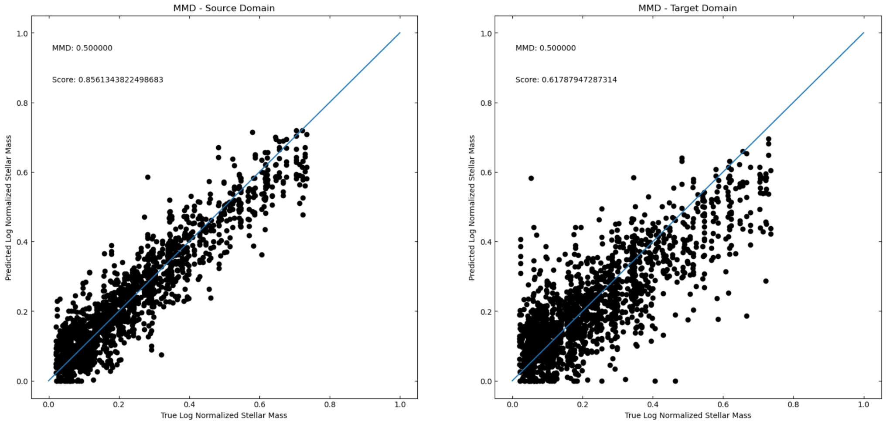
Our Results
86% Accuracy
61% Accuracy

Slide 8
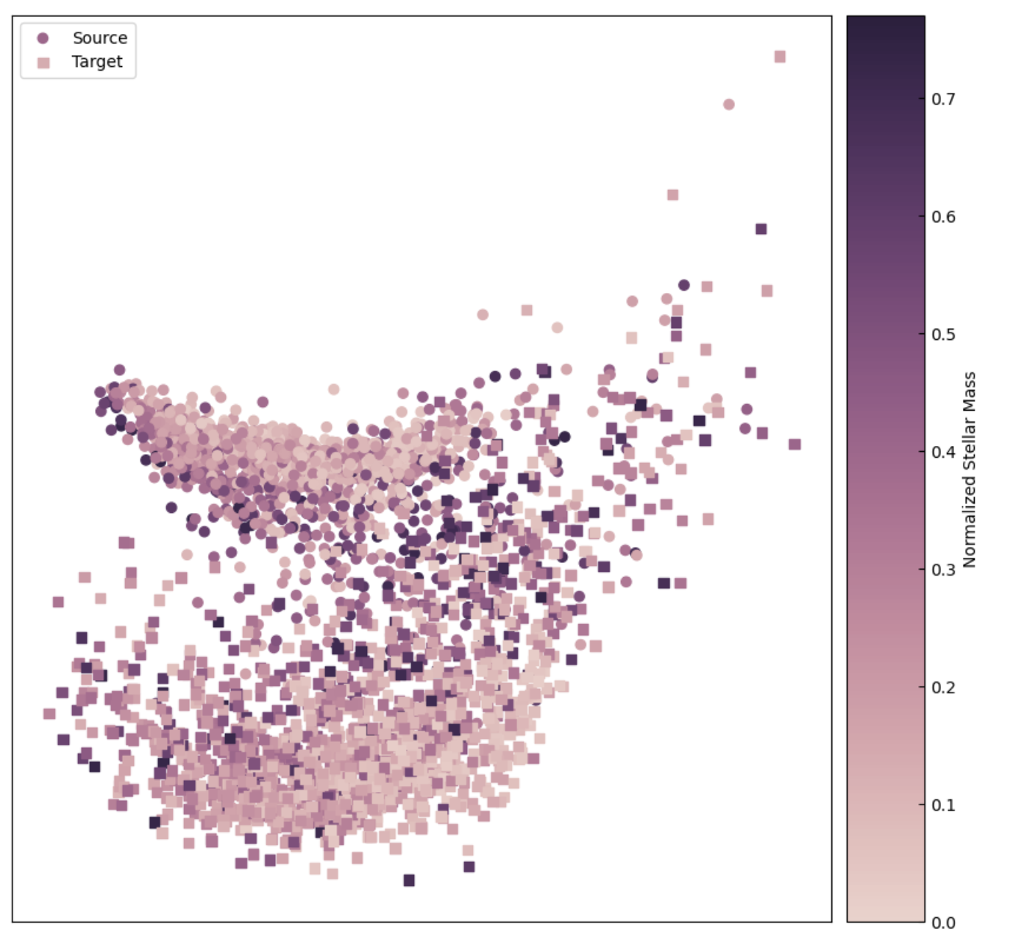
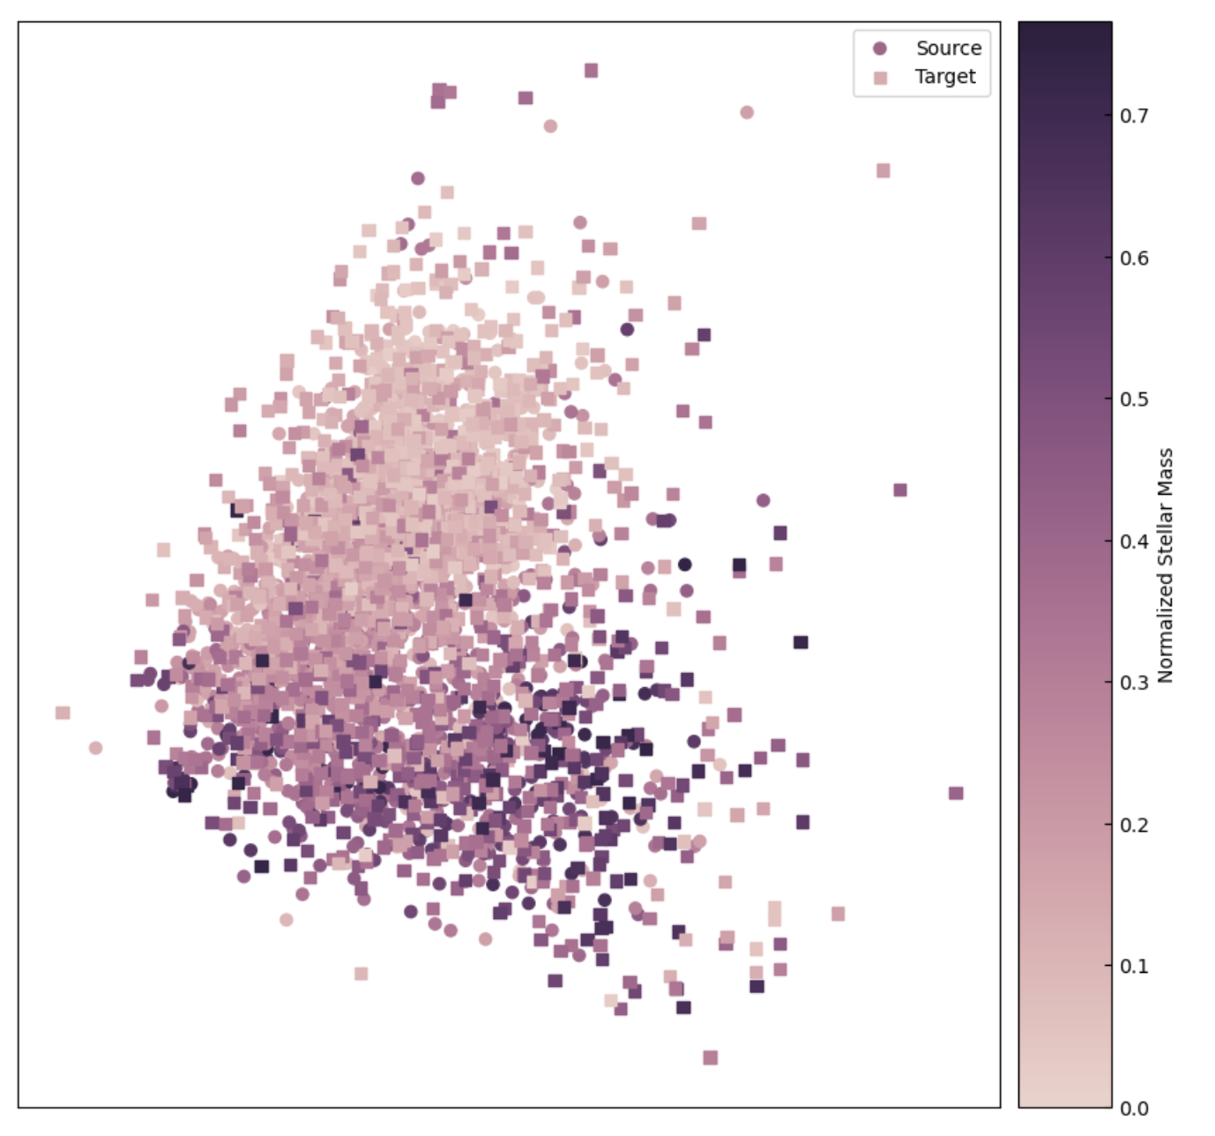
Our Results (cont.)
Notes:
While we are waiting for real data, we have toyed around with adding artificial noise and show that our model fails on the noisy images to show that this is something domain adaptation can help us with - in the previous slides also mention that the real data is in preperation but for now we are playing around with adding extra noise as the real data set; also, make sure to say that this is in logscale and is normalized; in reality, these masses are from ___ to ____ give them actual mass ranges

Slide 9
Thanks for Listening!
Special Thanks to Dr. Aleksandra Ciprijanovic and Dr. Brian Nord from Fermilab!

Slide 10
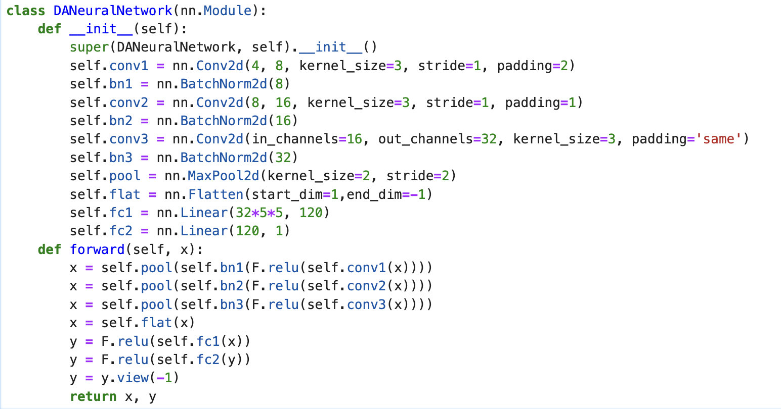
Appendix 1: Model Architecture

Slide 11
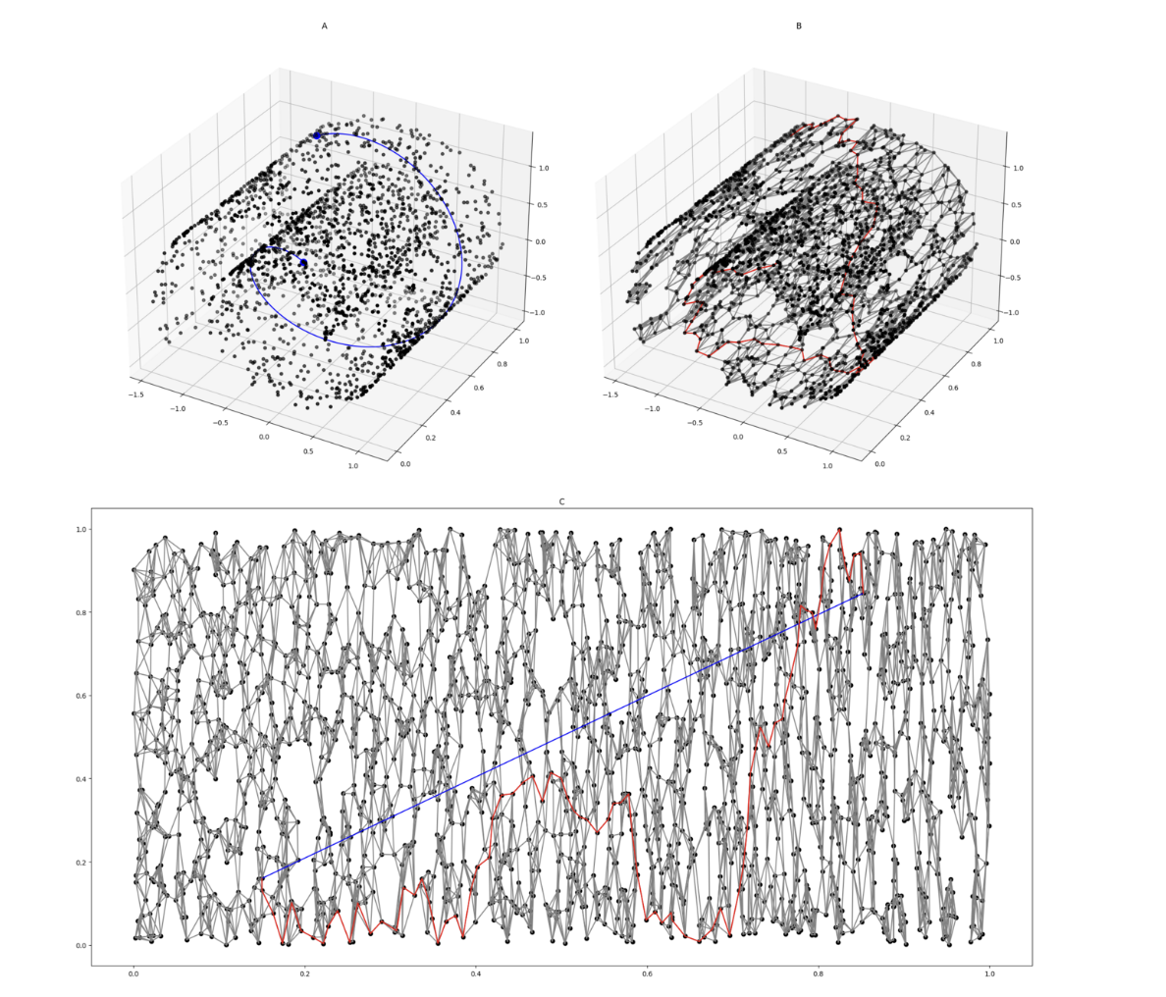
Appendix 2: Isomaps
Takes high dimensional data and creates a low dimensional representation of the data
https://www.wikiwand.com/en/Isomap

Slide 12
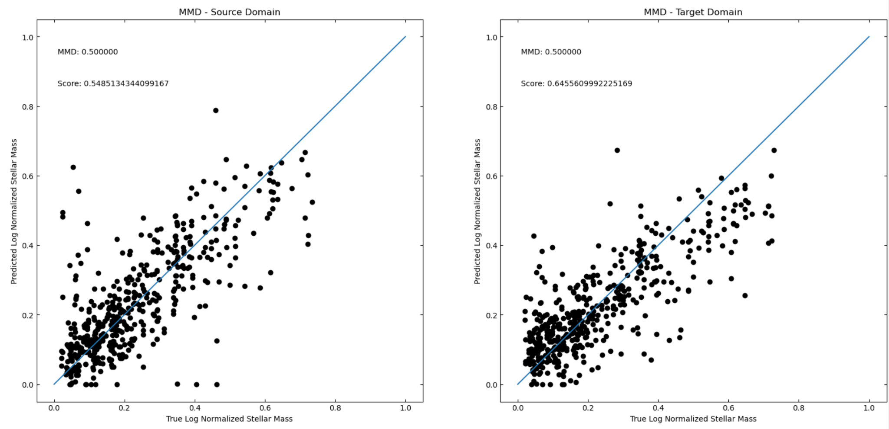
Appendix 3: Testing Dataset

