Slide 1
Computational Exploration of High Entropy Alloys as Promising Materials for Future Beam Windows
Gaurav Arora
Postdoc Research Associate (HPT R&D group), Accelerator Division
New Perspective 2024
FERMILAB-SLIDES-24-0165-AD

Slide 2
What is high-power targetry research and development (HPT R&D), and why is it necessary?

Slide 3
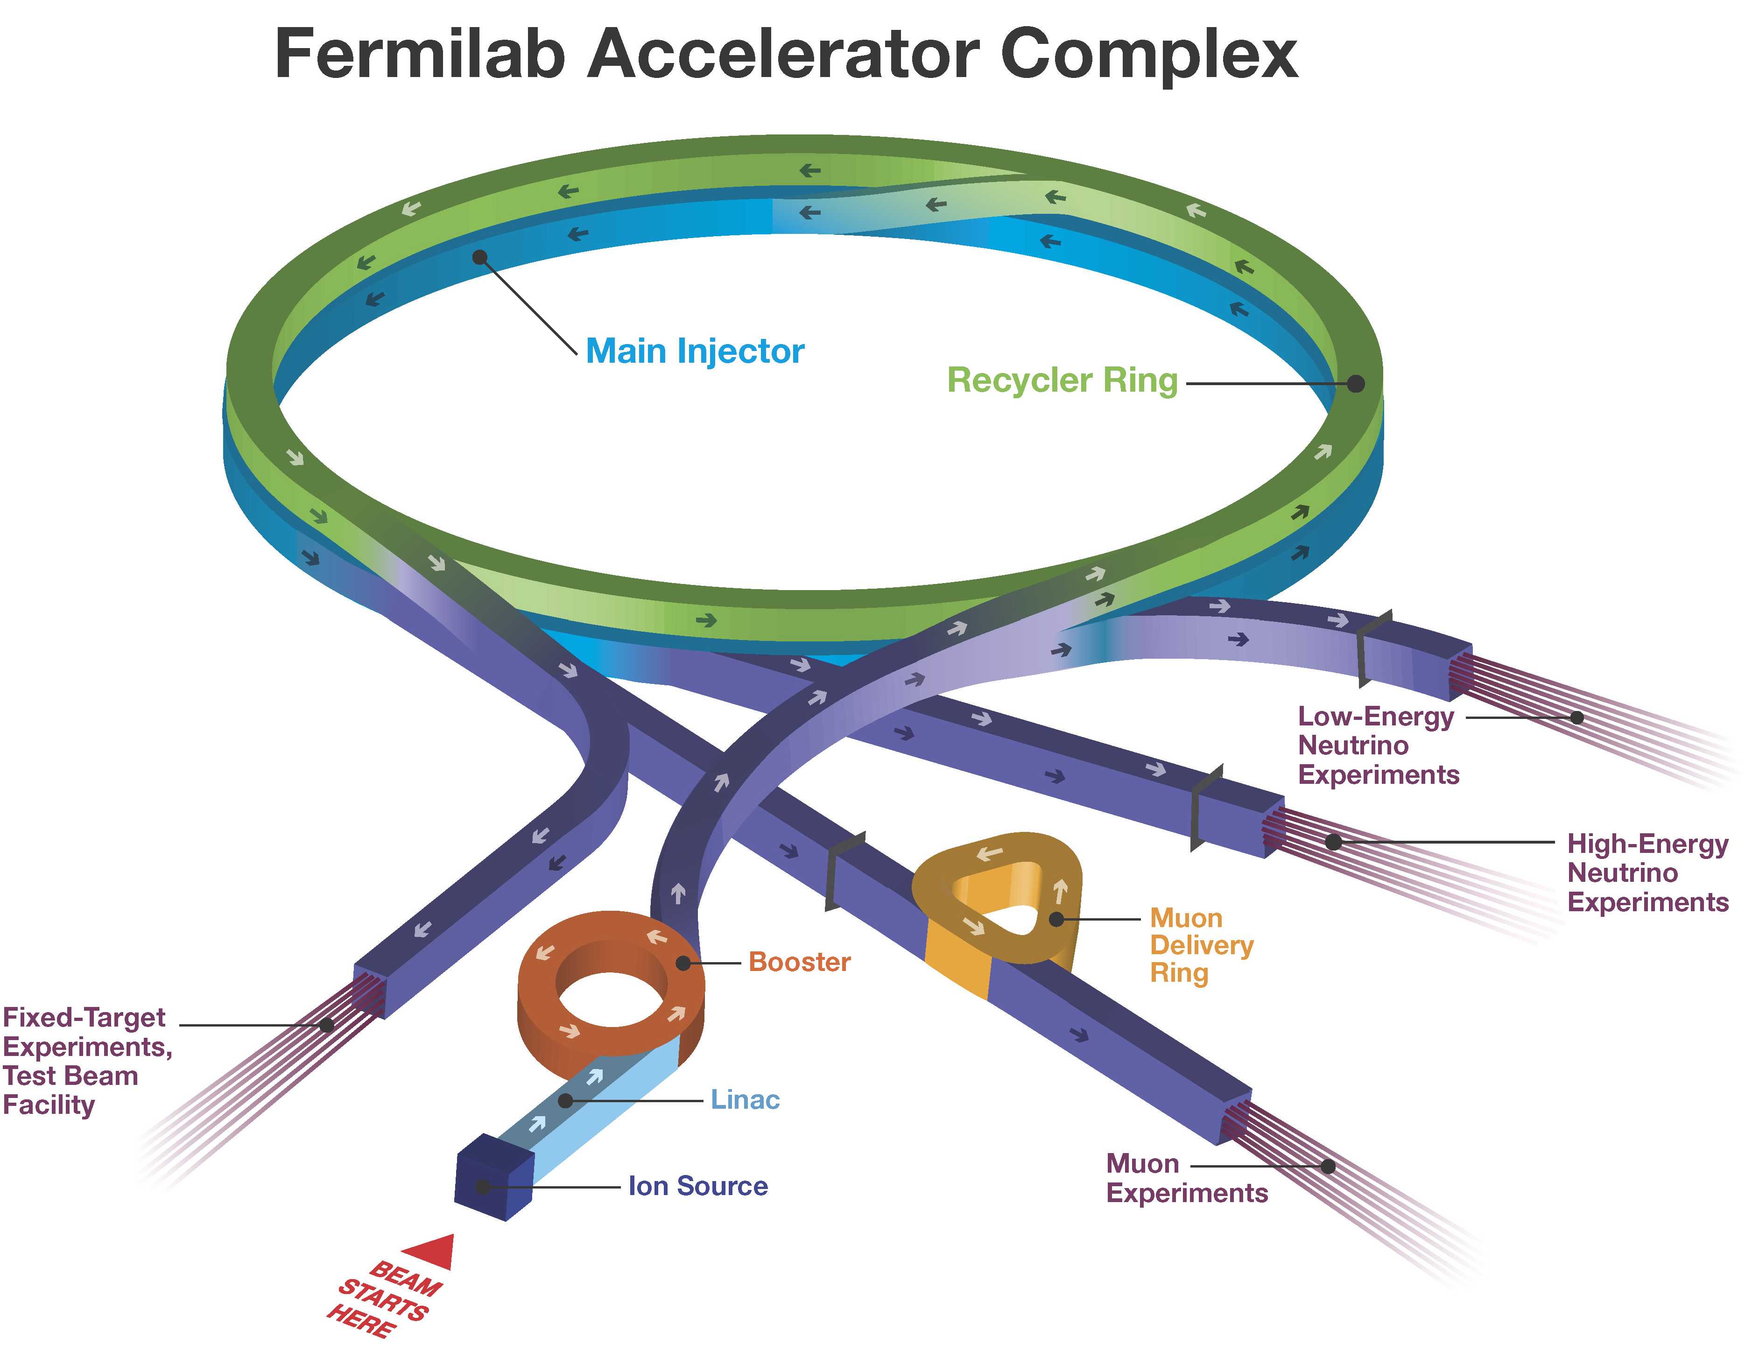
Need for high power accelerators
Everyone needs high power accelerators for fundamental research in physics
  Discovery of new particles
  Testing theories
  Neutrino physics
  Replicating big-bang conditions
Not my cup of tea
Viewpoints from colleagues/friends on increasing power of accelerators
NoVA
More beam power means more protons on target in smaller time which means more neutrinos and indeed more interactions in detectors
MINERvA
Increasing beam intensity increases our probing power and potential to discover new physics
Mu2e
With higher beam power you will be able to discover unknown particles with good significance
High power accelerators are required to discover unknown particle, test theories, and understand nature better at the quantum level
Notes:
When a beam hit a target bunch of secondary particles are produced and physisct do their things.

Slide 4
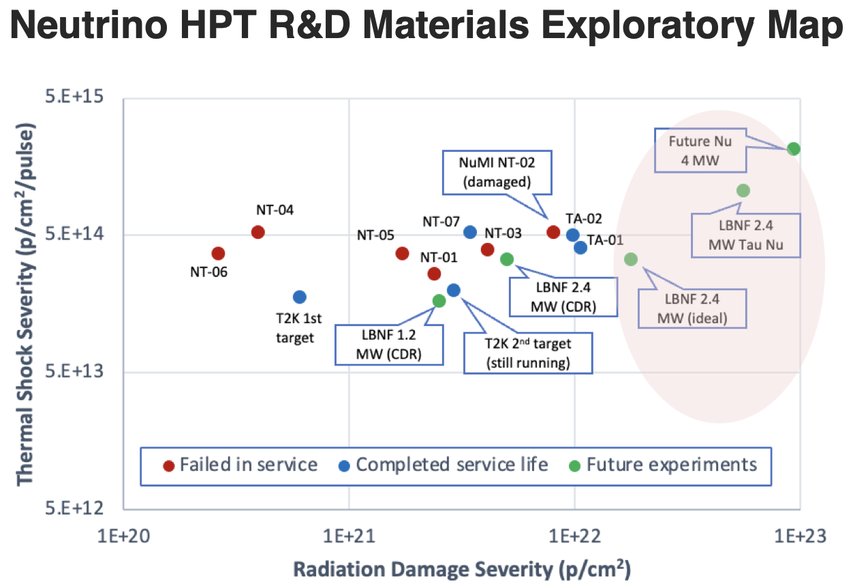

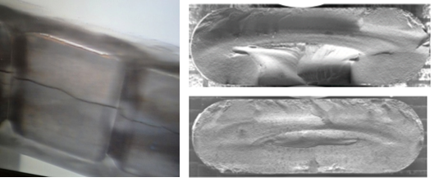
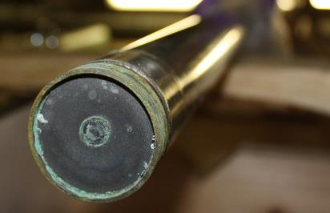
What is HPT R&D and why we need it!
HPT R&D involves the study and creation of materials and systems that can withstand and operate effectively under extremely high-power conditions and is required to make next generation accelerator work. BUT!
Failures of materials under current power
MINOS NT-02 target failure: radiation-induced swelling (FNAL)
Primary Be window embrittlement (FNAL)
As beam power increases, operating conditions becomes more severe and thus we need materials that could withstand such conditions for longer duration.
Materials HPT R&D is absolutely required for future accelerators
Notes:
When a beam hit a target bunch of secondary particles are produced and physisct do their things.
Before hitting the target, beam has to pass through a component called beam window
We have seen failures of materials before their designed lifetime which is scary and we don’t know what will happen once we increase the power.

Slide 5
Quote from Head of Accelerator Directorate (Alexander Valishev)
Achieving 1 MW power for continuous 3 hours on 26th June 2024 from NuMI
The journey to achieve true megawatt performance was far from easy and this achievement merely marks the beginning of a long path to sustained operations at the power exceeding one megawatt, ultimately doubling that for the LBNF/DUNE. Yet I am sure we will get there!
Materials HPT R&D is absolutely required for future accelerators

Slide 6
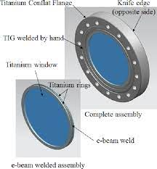
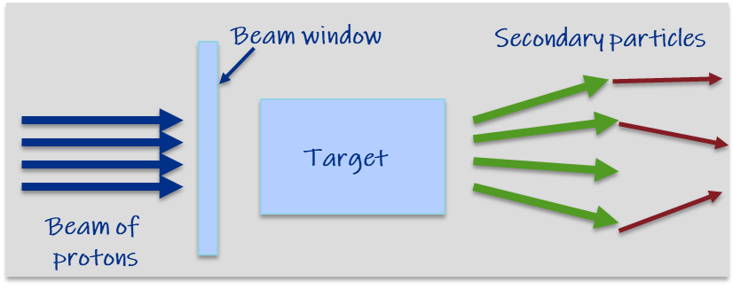
Basic working of an accelerator
Zoomed view
Beam window and target are known as beam intercepting devices (BIDs) and are key components to an accelerator
Physics can not be done if materials being used in accelerator cannot handle high power
This talk, focus will be on material being researched for beam window

Slide 7
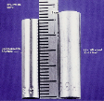

Key challenges: Radiation damage and Thermal shock
Radiation Damage: Displacements in crystal lattice expressed as Displacements Per Atom (DPA)
Hardening and embrittlement
Creep and swelling
Fracture toughness reduction
Thermal/electrical conductivity reduction
Coefficient of thermal expansion
Modulus of elasticity
Transmutation products (H, He gas production can cause void formation and embrittlement)
Thermal Shock: Sudden energy deposition from pulsed beam
Fast expansion of the material surrounded by cooler material generates localized area of compressive stress
  1 MW target: ~250 K in 10 µs pulse (2.5 x 10⁷ K/s)
Stress waves move through the material at sonic velocities
Plastic deformation, cracking and fatigue failure can occur
Thermal Fatigue: Cycling loading environment
  Cycling loading progressively damage material’s microstructure such that it can ultimately fail at stress levels that are actually lower than its failure strength
    Fatigue Stress Cycle Amplitude x2 at 2.4 MW
D.L. Porter and F. A. Garner, J. Nuclear Materials, 159, p. 114 (1988)
Iridium target tested at CERN’s HiRadMat facility

Slide 8
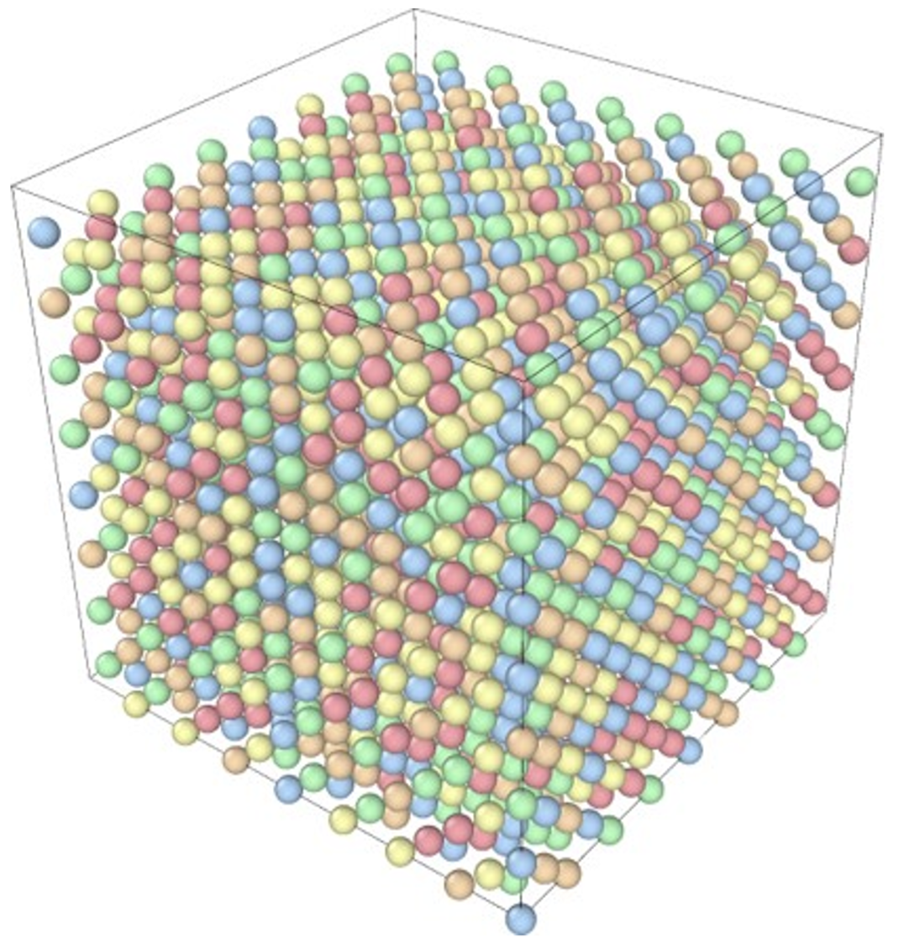
High entropy alloys (HEAs) to the rescue
Conventional alloy: Steel
HEA
1 principal element
Small designing space
Multiple principal elements
Large designing space
Ye et al., Materials today 19, 6 (2016)
Large number of HEAs can be designed by changing the chemistry and composition of principal elements
Multi-principal elemental alloys
Random solid-solution
Equi-atomic or near equi-atomic composition
FCC, BCC or HCP crystal structures
Distorted lattice
Notes:
HEAs offer promising solution for this problem as they have been researched actively in nuclear science community

Slide 9
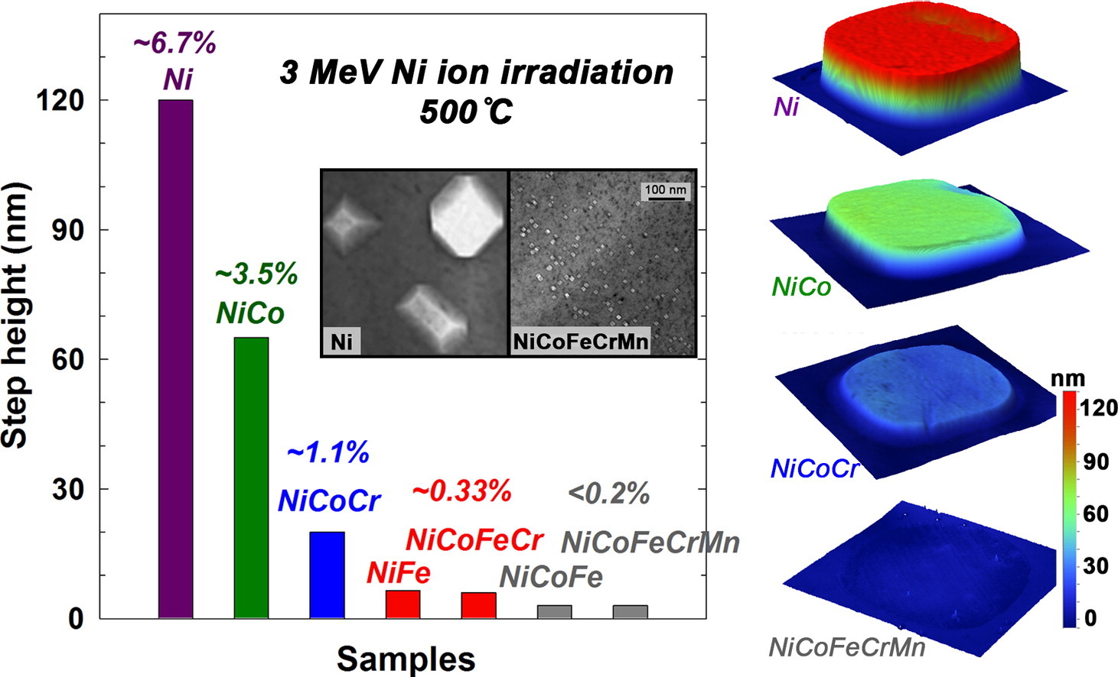
Properties of high entropy alloys (HEAs)
Mechanical properties
Irradiation tolerant properties
Swelling of increasingly complex alloys under ion irradiation, Jin et al., Scripta Materialia 119 (2016)
HEAs have shown higher radiation resistance and better mechanical properties compared to conventional alloys
Youssef et al., Materials Research Letters, 95-99 (2015)

Slide 10
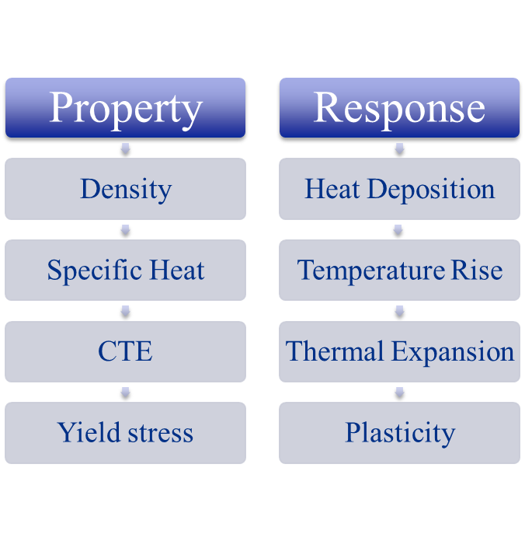
Design goals for HEAs for beam windows
Desired properties
High radiation resistance
Low density
High specific heat
Low coefficient of thermal expansion
High yield strength
Currently we are working to design materials with high radiation resistance
In collaboration with UM-Madison Materials Degradation under Corrosion and Radiation (MADCOR, Dr. Couet)

Slide 11
Computational tools/techniques used for designing HEAs
Goal: Predict material behavior under different temperature and irradiation conditions before doing any experiment to save time and money.
CALculation of PHAse Diagrams (CALPHAD) | Density functional theory (DFT) | Molecular dynamics (MD)
CALPHAD: Used to explore vast design space for HEAs efficiently and down select compositions of interest based on phase diagram
Used this tool to scan over ~120,000 different alloys (Very fast)
Chose alloys with single phase BCC
DFT: Used to collect data with high accuracy and can be thought of as a ground truth for a computational researcher
Highly accurate as it is based on quantum mechanical theory
Computationally expensive thus limited to ~200-300 atoms, cannot model complex phenomena
MD: Used to run simulations depicting radiation damage at different temperatures
Accuracy depends upon the quality of force-field where Newtonian physics is used to study the kinetics of the system
Millions of atoms can be modeled using LAMMPS package, helping in understanding complex phenomena

Slide 12
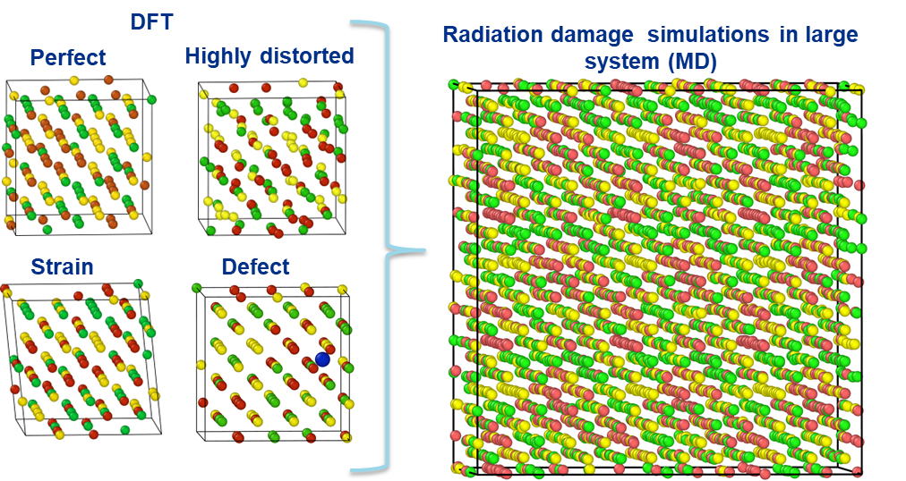
Short term goal: Making force field for MD simulations
Run thousands of DFT simulations to generate high quality data from smaller system
Collect position, forces and energies from the data
Required accuracy not reached
Train machine learning model to generate force field file
Validate machine learning model against DFT
Reached required accuracy
Training ML model is an iterative process and accuracy of MD simulations depends upon accuracy of force field
Use generated force field for running MD simulations over millions of atoms and study defect energetics

Slide 13
Selected HEAs for further exploration
Study the effect of Ti concentration
Al10-Co4-Cr25-Mn26-Ti1-V34
Al10-Co4-Cr27-Mn21-Ti4-V34
2. Study the effect of Co concentration
Al16-Co2-Cr25-Mn30-Ti1-V26
Al16-Co4-Cr25-Mn30-Ti1-V24
3. Study the effect of Al and removing Cr
Al20-Co1-Mn27-Ti2-V50
Al12-Co3-Cr6-Mn27-Ti2-V50
4. Study the effect of removing Co
Al18-Mn30-Ti2-V50
Al20-Co2-Mn26-Ti2-V50
CALPHAD was used to scan over 120,000 unique compositions for further study with CrMnV as base alloy
In collaboration with UM-Madison Materials Degradation under Corrosion and Radiation (MADCOR, Dr. Couet)

Slide 14
Status on DFT simulations and machine learned force field
Ran 14680 DFT simulations
Trained the machine learning model with 80-20 split
True data refers to DFT values and predicted data refers to LAMMPS values
LAMMPS values were calculated using force fields developed using DFT data
MAE: 5.06 meV/atom
Correl. coeff: 0.99
MAE: 5.41 meV/atom
Correl. coeff: 0.99
LAMMPS predicts system energies with high accuracy

Slide 15
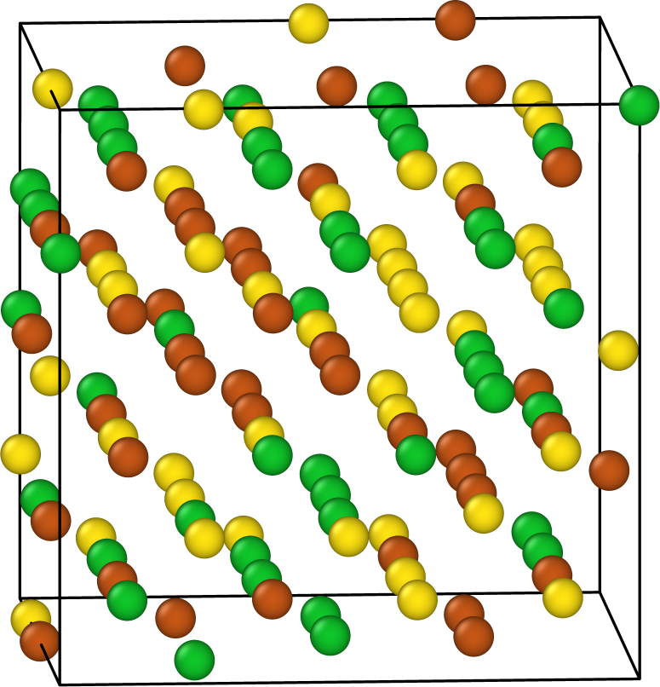
Predicting single vacancy formation energy
Required for studying radiation damage
Refers to energy required to extract a single atom from a system
Higher the energy, harder it is to form vacancies thus better would be the radiation resistance
LAMMPS values were calculated using force fields developed using DFT data
LAMMPS overpredicts the vacancy formation energies
Next step: Run more defect DFT simulations and fix the issue
Due to different nearest neighbor environment, range of vacancy formation energies is observed

Slide 16


Conclusions
HPT R&D is very important as we need materials to withstand high power from beam for longer period.
Computational techniques such as CALPHAD, DFT, and MD provide with an alternative approach for designing new materials in more efficient way compared to just doing experiments.
System energies predicted using LAMMPS does match vey well with the true DFT values.
Prediction of defect energies still need work for simulating radiation damage.
Acknowledgement
HPT R&D group at Fermilab
University of Wisconsin-Madison
  Dr. Izabela Szlufarska
  Dr. Dane Morgan
  Dr. Adrien Couet
  Nicholas Crnkovich
Thank you!

