Slide 1
Spacely
Yash Saxena
July 9, 2024

Slide 2
Spacely
Spacely is an open-source, Python based test automation framework
Spacely consists of a core Python repository, supplemented by instrument libraries, firmware, and recommended design flows.
Spacely is targeted toward small ASIC design teams in research/academia, and non-expert (scientific) users.
Notes:
Spacely is a versatile software tool designed for efficient testing of ASICs using Python. It leverages Python's flexibility to create and execute test routines, making the testing process more adaptable and streamlined. Spacely supports various ASIC configurations and integrates seamlessly with FPGA for comprehensive testing. Its modular design allows easy customization and scalability, enabling users to target different ASICs without extensive reconfiguration.
We use Spacely to improve the efficiency and accuracy of ASIC testing. Traditional testing methods can be rigid and time-consuming, whereas Spacely's Python-based approach offers greater flexibility and faster setup times. By automating test routines and integrating with existing FPGA systems, Spacely reduces manual effort and minimizes errors, leading to more reliable testing outcomes. This makes it an invaluable tool in the development and verification of complex integrated circuits.

Slide 3
Why was Spacely needed?
Notes:
Spacely is a versatile software tool designed for efficient testing of ASICs (Application-Specific Integrated Circuits) using Python. It leverages Python's flexibility to create and execute test routines, making the testing process more adaptable and streamlined. Spacely supports various ASIC configurations and integrates seamlessly with FPGA for comprehensive testing. Its modular design allows easy customization and scalability, enabling users to target different ASICs without extensive reconfiguration.
We use Spacely to improve the efficiency and accuracy of ASIC testing. Traditional testing methods can be rigid and time-consuming, whereas Spacely's Python-based approach offers greater flexibility and faster setup times. By automating test routines and integrating with existing FPGA systems, Spacely reduces manual effort and minimizes errors, leading to more reliable testing outcomes. This makes it an invaluable tool in the development and verification of complex integrated circuits.

Slide 4
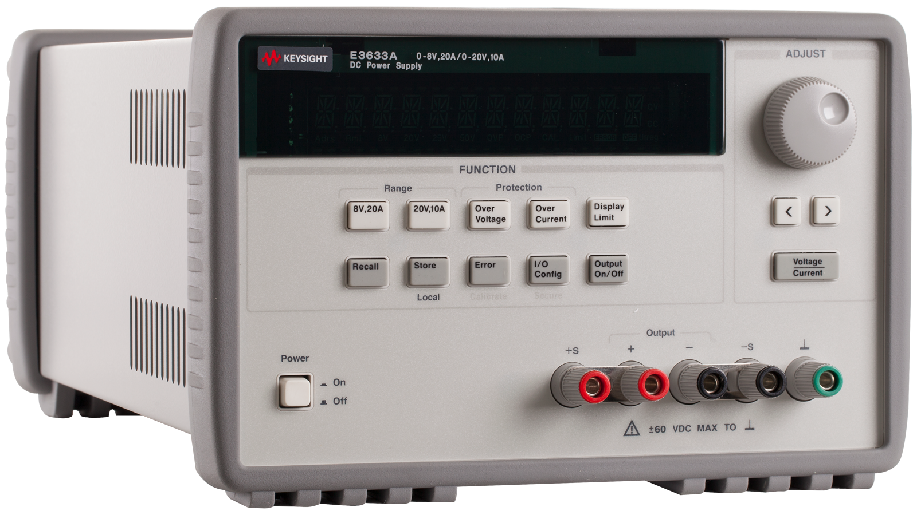
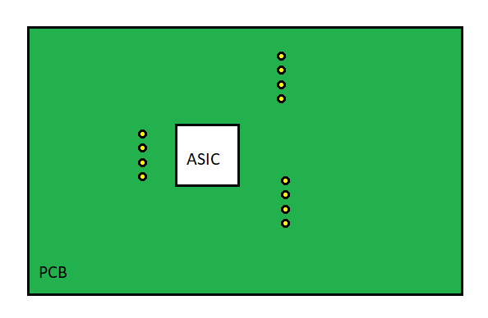
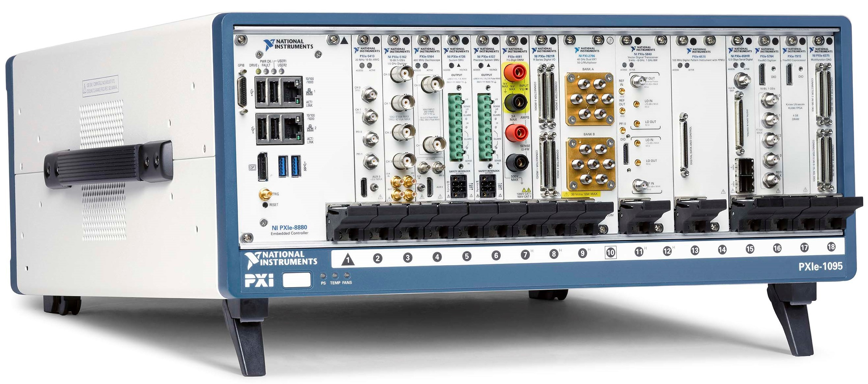
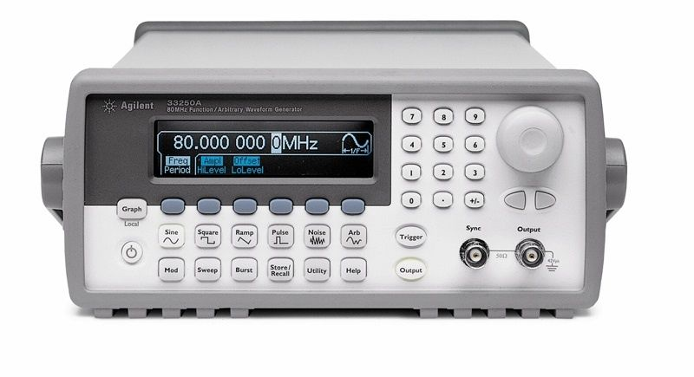
Before Spacely (Using LabVIEW)
Send Instructions for proper test function
Acquires Test Data
Send Test Result
Signals back which are
acquired by FPGA
LabVIEW Test software setup
Send Instructions for proper test function
Notes:
Develop Test Software in LabVIEW:
- Launch LabVIEW and create a new VI (Virtual Instrument).
- Use the NI Instrument Driver Finder to locate and import instrument drivers for your specific NI instruments into your LabVIEW project.
- Design the VI to control the instruments, send commands, and acquire data from the ASIC.
- Implement the test sequences, measurements, and data logging within the VI.
The biggest difference is that in LabView, you have to rewrite custom LabView firmware for every change to the test code (instead of writing Python), which takes both time and expertise in LabView (which is uncommon, meaning not many people can develop test fw)
ASIC Communication:
- If the ASIC communicates via standard protocols (e.g., SPI, I2C, UART), use LabVIEW to send and receive data through these interfaces. NI provides libraries and example code for interfacing with various protocols.
Data Acquisition and Analysis:
- Configure LabVIEW to acquire data from the ASIC through analog or digital channels, depending on the nature of the measurements required.
- Implement algorithms or analysis routines within LabVIEW to process acquired data and determine whether the ASIC meets specified criteria.
Integration and Testing:
- Integrate all components of your test software (instrument control, ASIC communication, data acquisition, and analysis) into a cohesive VI.
- Test the VI to ensure proper functionality and accuracy in measuring the ASIC's performance against the defined specifications.
- Keep room for debugging as well.
Validation and Verification:
- Validate that the ASIC meets all functional and performance requirements through thorough testing using your LabVIEW-based test software

Slide 5
What can Spacely do?

Slide 6
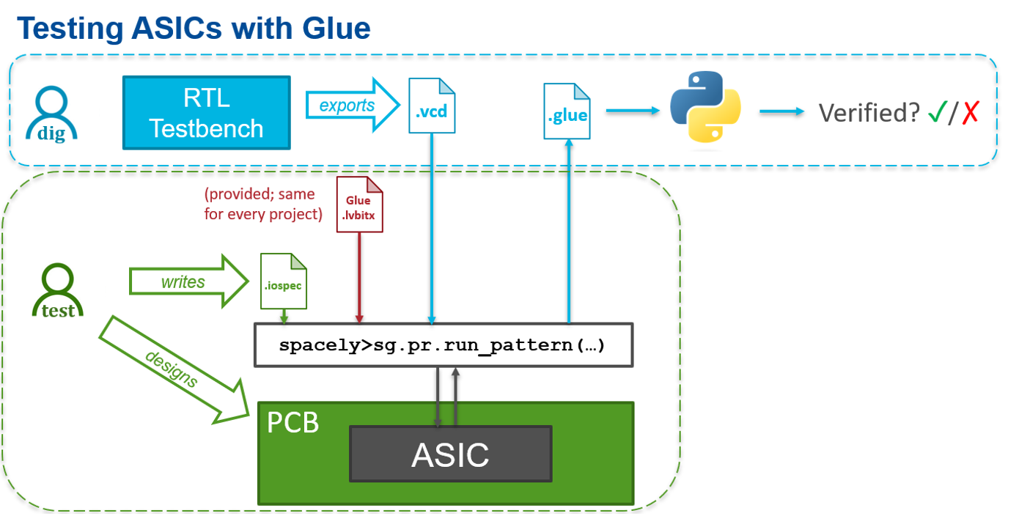
Go from Verilog to the Lab with Spacely
Export VCD waveforms from your verification testbench and use them directly as test stimulus for your ASIC.
Expert digital ASIC and test engineers can both participate directly in test, reducing miscommunication.
Notes:
"Export VCD waveforms from your verification testbench and use them directly as test stimulus for your ASIC."
1. VCD Waveforms:
- Definition: VCD (Value Change Dump) files record the changes in signal values over time during digital circuit simulations. These files capture detailed waveform data, showing how signals in the design change at each simulation step.
- Generation: During the design verification process, simulations are run using a testbench, which is an environment set up to test the functionality of the ASIC design. This process generates VCD files containing the waveform data.
2. Exporting VCD Waveforms:
- Process: Spacely allows you to export these VCD waveforms from your simulation environment. This export process captures the precise stimulus that was used during the simulation.
3. Using VCD Waveforms as Test Stimulus:
- Direct Application: Once exported, these VCD files can be directly used as input stimuli for the physical ASIC. This means that the exact same test conditions used during simulation can be replicated in real hardware testing.
- Consistency: Using the same waveforms ensures that the conditions under which the ASIC was verified in simulation are identical to those during physical testing, leading to consistent and reliable test results.
"Expert digital ASIC and test engineers can both participate directly in test, reducing miscommunication."
1. Collaborative Testing:
- Involvement: Both digital ASIC design engineers and test engineers can be directly involved in the testing process. Digital ASIC engineers bring their deep understanding of the design, while test engineers contribute their expertise in hardware testing and validation.
2. Reducing Miscommunication:
- Unified Test Conditions: By using VCD waveforms as the test stimulus, both sets of engineers work with the same data and test conditions. This shared understanding minimizes the risk of miscommunication about test scenarios and expected outcomes.
- Clear Documentation: The use of VCD files as a standardized format for stimuli ensures that all test parameters are well-documented and reproducible, further reducing misunderstandings.
3. Improved Efficiency:
- Streamlined Workflow: With both sets of engineers working together using the same test data, the workflow becomes more streamlined. Issues can be identified and resolved more quickly, leading to a more efficient testing process.
- Enhanced Verification: The involvement of experts from both domains ensures that the ASIC undergoes thorough testing, from initial design verification to final hardware validation.

Slide 7
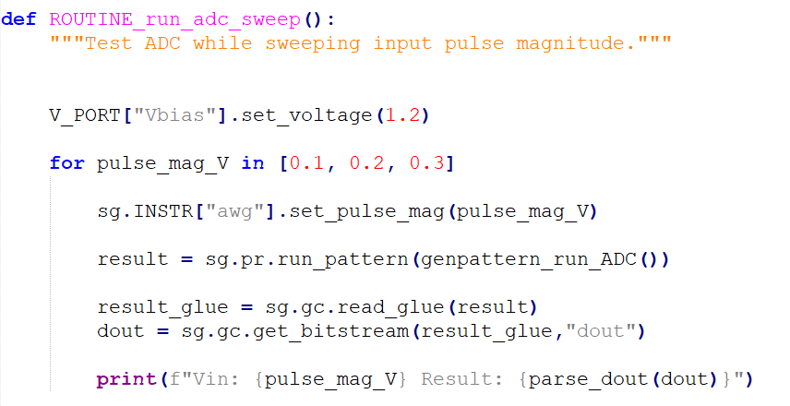
Control Test Instruments with Spacely
Spacely abstracts interfaces to test equipment
Python test routines read like natural language; easy for scientific stakeholders to participate.
VOLT:OFFS 1.2
PULS:MAG 0.1
<i/p vector>
<o/p vector>
Notes:
"Spacely abstracts interfaces to test equipment"
1. Abstracting Interfaces:
- Definition: Abstracting interfaces means simplifying and standardizing the way test equipment is controlled and accessed. Instead of dealing with complex, device-specific commands and protocols, users interact with a higher-level, more intuitive interface.
- Implementation in Spacely: Spacely provides a unified interface for various types of test equipment, such as oscilloscopes, signal generators, and logic analyzers. This abstraction hides the complexity and specifics of each device, allowing users to focus on the testing tasks rather than the intricacies of the equipment.
2. Benefits:
- Ease of Use: Engineers and scientists do not need to learn and manage different control languages and protocols for each piece of equipment. This makes the testing process more straightforward and less error-prone.
- Consistency: Standardized interfaces ensure consistent operation and reduce the likelihood of errors due to miscommunication or misunderstanding of device-specific commands.
"Python test routines read like natural language; easy for scientific stakeholders to participate."
1. Python Test Routines:
- Natural Language-Like Syntax: Spacely allows test routines to be written in Python, a high-level programming language known for its readability and ease of use. Python's syntax is often described as being close to natural language, making it accessible to a broad range of users.
- Intuitive Scripts: The test routines in Spacely are designed to be intuitive and straightforward, enabling users to write and understand them without deep programming expertise.
2. Accessibility for Scientific Stakeholders:
- Participation: Scientific stakeholders, such as researchers and engineers who may not have extensive programming backgrounds, can easily understand and contribute to the test routines. This inclusivity ensures that experts from various domains can participate in the testing process.
- Collaboration: By making test routines easy to read and write, Spacely fosters better collaboration among multidisciplinary teams. Scientists and engineers can work together more effectively, leveraging their combined expertise to design and execute comprehensive tests.

Slide 8
Glue File Generation and Handling with Spacely
Glue files store waveform data or test patterns for FPGA-ASIC interaction.
Functions:
Generating Glue Files: Converts high-level test descriptions or VCD files into glue files.
Running Test Patterns: FPGA applies signals to the ASIC based on glue files; responses are captured.
Reading and Analyzing Data: Captured data is compared with expected results to verify ASIC behavior.
Notes:
Glue files in Spacely facilitate communication and synchronization between the FPGA and ASIC. They store waveform data or test patterns, ensuring accurate timing and control. Spacely generates these files from high-level test descriptions or VCD files, loads them to configure the FPGA, runs tests by applying signals to the ASIC, and analyzes the captured responses to verify the ASIC's functionality. This process enhances the efficiency and accuracy of ASIC testing.

Slide 9
Analyzing Glue Files with Spacely
Loading Glue Files: Reads and interprets glue files, configuring the FPGA with signal data and timing.
Converting files: Spacely can convert Glue files into bitstream values and help us realize the results of our tests.
get_bitstream()
Bitstream
Glue wave
This data was collected while testing XROCKET2 ASIC in Fermilab
Notes:
The Glue wave file is simply a list of integers describing which I/Os are active at each timestep.
Need to use Test Engineer’s iospec to interpret which I/O is which.
Glue files in Spacely facilitate communication and synchronization between the FPGA and ASIC. They store waveform data or test patterns, ensuring accurate timing and control. Spacely generates these files from high-level test descriptions or VCD files, loads them to configure the FPGA, runs tests by applying signals to the ASIC, and analyzes the captured responses to verify the ASIC's functionality. This process enhances the efficiency and accuracy of ASIC testing.

Slide 10
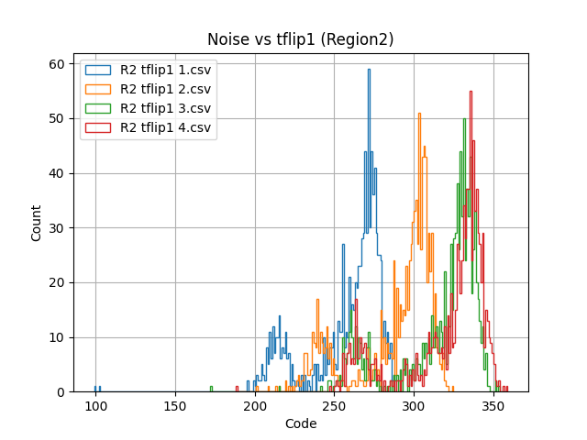
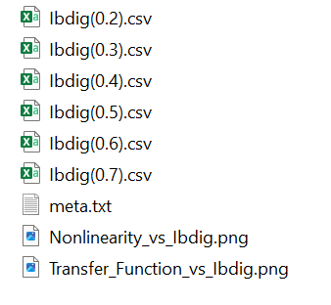
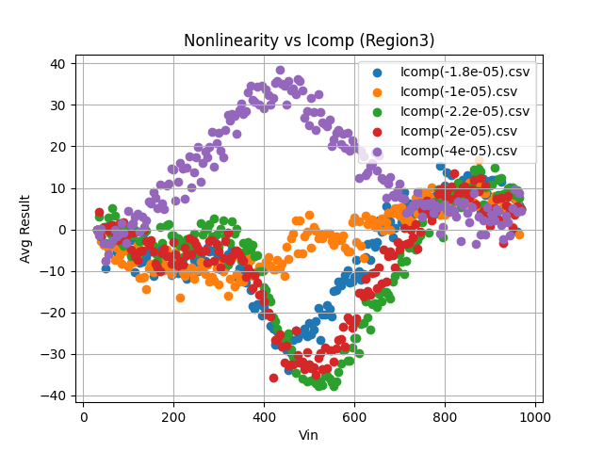
Analyze Data with Spacely
Group data into Experiments and DataFiles, each with tagged Metadata corresponding to the Python variables used in the Spacely routine, which is automatically written to file.
Calculate statistics and generate scatter plots / histograms natively in Spacely.
Notes:
"Group data into Experiments and DataFiles, each with tagged Metadata corresponding to the Python variables used in the Spacely routine, which is automatically written to file."
1. Grouping Data into Experiments and DataFiles:
- Experiments: In Spacely, data can be organized into logical units called Experiments. Each Experiment represents a set of tests or measurements that are related to a specific aspect of the ASIC or FPGA under test.
- DataFiles: Within each Experiment, data is stored in DataFiles. These files contain the actual measurements or simulation results collected during testing.
2. Tagged Metadata:
- Python Variables and Metadata: During testing, Spacely routines use Python variables to control test parameters and record results. These variables are automatically tagged with Metadata, which provides context and descriptions for the data.
- Automatic Writing: Spacely automatically writes this Metadata to the DataFiles, ensuring that each data point is well-documented with relevant information. This tagging includes details like test conditions, variable names, units, and descriptions.
3. Benefits:
- Organization: Grouping data into Experiments and DataFiles with tagged Metadata ensures that all test results are systematically organized and easily accessible.
- Contextual Information: Metadata tagging provides comprehensive context for each data point, making it easier to understand and analyze the results.
"Calculate statistics and generate scatter plots / histograms natively in Spacely."
1. Native Calculation of Statistics:
- Built-in Capabilities: Spacely includes built-in tools for calculating statistical measures such as mean, median, standard deviation, and more. This allows users to perform statistical analysis directly within the Spacely environment without needing external tools.
- Automated Analysis: These statistical calculations can be automated as part of the testing routine, providing immediate insights into the data collected during experiments.
2. Generating Scatter Plots and Histograms:
- Visualization Tools: Spacely provides native support for generating visualizations such as scatter plots and histograms. These visual tools help users to quickly interpret the data and identify trends, outliers, or patterns.
- Customization: Users can customize these plots with labels, colors, and other features to better suit their analysis needs.
- Integrated Analysis: By integrating statistical calculations and visualization tools, Spacely offers a seamless environment for both data collection and analysis.
- Efficiency: Users can quickly move from data acquisition to analysis and visualization within the same platform, enhancing workflow efficiency and reducing the need for external software.

Slide 11
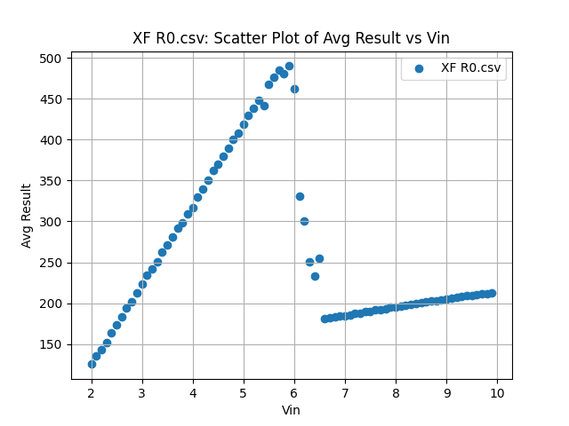
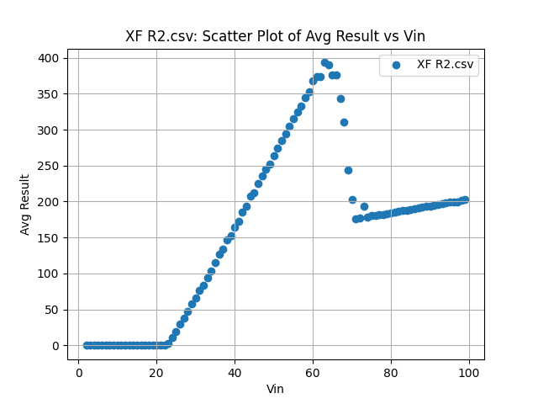
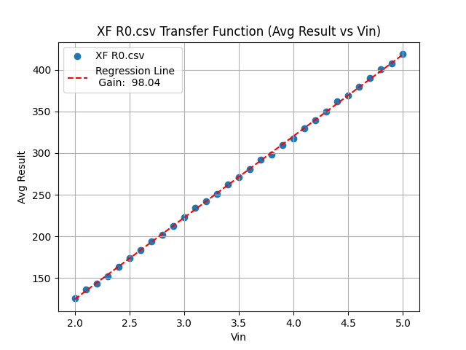
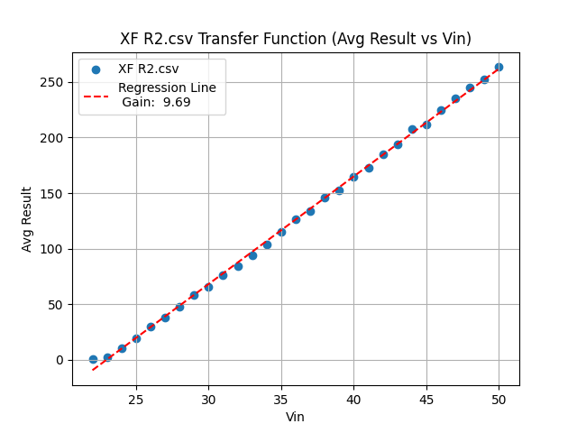
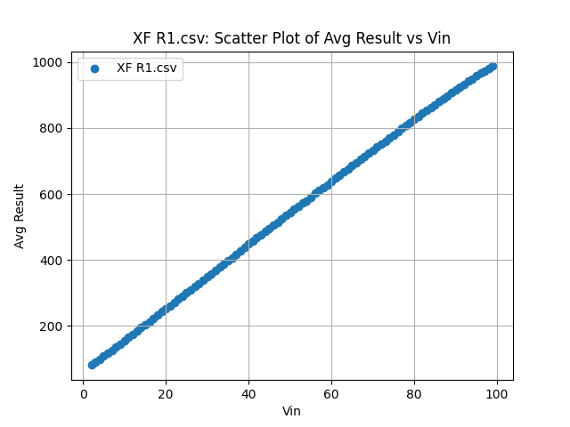
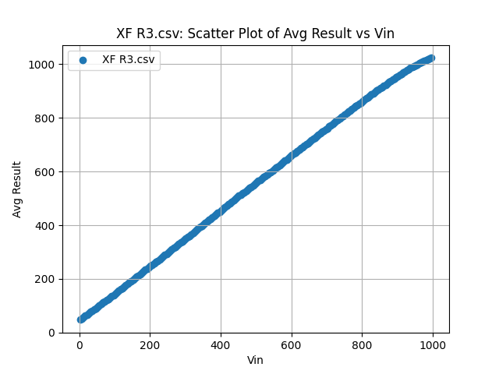
Analyzing Data with Spacely
This data was collected from SPROCKET2 test chip in normal conditions.
Spacely allows comprehensive data logging.
Raw Data: Warm Char with AWG Offset 0 5_10_2024
Notes:
This test data was collected when we Tested SPROCKET2 Test chip in May this year.
Our goal was to understand the linearity of the ADC and its gain.
We had 4 Regions to test the chip, R0 : high gain, input is small, integrates 10 samples.. R1: high gain, input is large, integrates 1 sample. R2: low gain, input is small, integrates 10 samples. R3: low gain, input is large, integrates 1 sample
We have run spacely for around 2 days straight and still got results that are really competitive.

Slide 12
Added Uses of Spacely
During Experimentation on various chips, we need to monitor the power of the test setup.
Spacely gives detailed insights and allows dynamic adjustments to the test setups.
Gives test consistency and precision.
Helps in comprehensive data logging.
Notes:
1. Real-Time Monitoring and Analysis
- Detailed Insights: Spacely enables real-time monitoring of power rails, providing detailed insights into the voltage levels and current consumption of various power domains within the ASIC or FPGA. This real-time feedback helps engineers detect and analyze power-related issues immediately, ensuring that the power rails operate within the specified limits.
- Dynamic Adjustments: With real-time data, engineers can dynamically adjust power settings and configurations during testing. This capability is crucial for identifying transient power issues, such as voltage droops or spikes, which could affect the performance and reliability of the design.
2. Automated Power Integrity Tests
- Consistency and Precision: Spacely allows the automation of power integrity tests, ensuring that each test is conducted consistently and precisely. Automated testing reduces the risk of human error and ensures that all power rails are tested under various conditions, including different load scenarios and environmental variations.
- Comprehensive Data Logging: Spacely logs all power rail data with corresponding metadata, making it easier to track power performance over time and under different test conditions. This comprehensive data logging facilitates in-depth analysis and comparison of power rail behavior across multiple test runs, helping engineers to identify patterns and potential issues more effectively.

Slide 13
Future use of Spacely

Slide 14
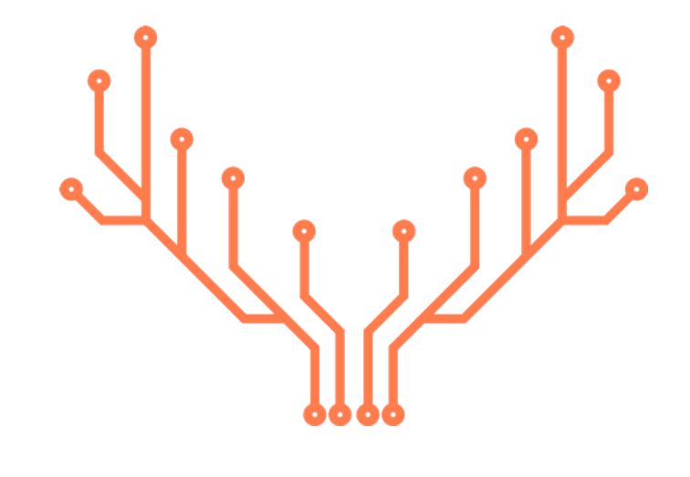
What is Spacely-Caribou?
Spacely-Caribou is a test strategy which uses the Spacely test automation framework to write Python tests which are carried out using Caribou test hardware and firmware.
The primary aim is to leverage Caribou infrastructure, while shifting as much of the ASIC-specific development into the high-productivity Python environment.
+

Slide 15
Impact of Spacely in open-Source Community

Slide 16
Statistics of Spacely Repository
Git Clones
- Total Clones: 11
- Unique Cloners: 8
Visitors
- Total Views: 270
- Unique Visitors: 24
The statistics indicate that Spacely repository saw higher interest and engagement on specific dates, particularly June 13 and June 24.
The spike suggest targeted interest.

Slide 17
Thanks
Yash Saxena
July 9, 2024

