Slide 1
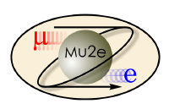
A New Track Trigger for Characterization of the Antiproton-Induced Background in the Mu2e Experiment
Ethan Martinez (Yale University)
New Perspectives
9 July 2024

Slide 2
Overview
Introduction
The Mu2e Experiment
Antiproton Annihilation in Mu2e
Topology of Antiproton-Induced Events
Antiproton (Pbar) Trigger
Trigger Sequences in Mu2e
Definition
Performance
Conclusion and Next Steps
E. Martinez | New Perspectives

Slide 3
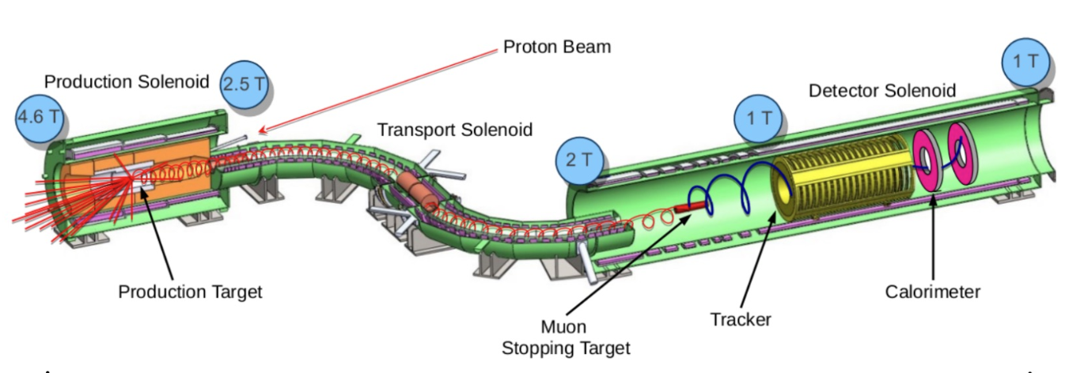
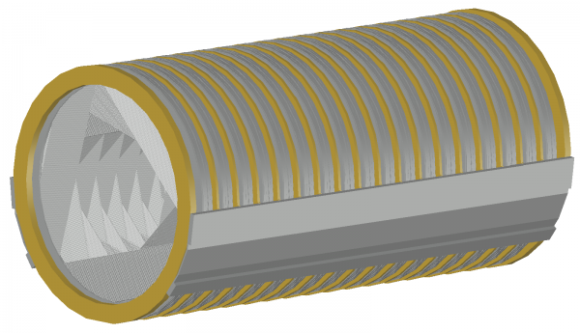
The Mu2e Experiment
Search for neutrinoless muon-to-electron conversion in the field of an Al nucleus
Monochromatic conversion electron signal of ~105 MeV
Sensitivity goal of 3x10⁻¹⁷ (improvement from previous upper limit by 4 orders of magnitude)
Muon beam supplied from pulsed proton beam incident on Tungsten target (~3x10⁷ protons every 1.7 μs)
Tracker composed of hollowed planes consisting of 23,000 straw tubes
Excellent momentum resolution
Calorimeter comprised of two annular disks, each holding 674 CsI crystals
Excellent timing and energy resolution
Mu2e calorimeter (Bernstein 2019)
Mu2e apparatus (Edmonds 2023)
Mu2e tracker (Bernstein 2019)
E. Martinez | New Perspectives

Slide 4
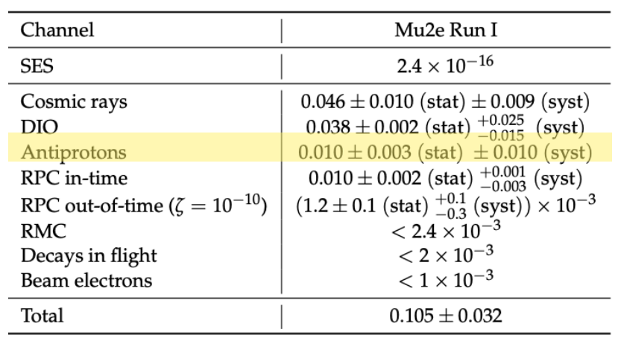
Antiproton Annihilation in Mu2e
Antiprotons are produced from proton beam’s collision with Production Target at a low rate
Some reach Detector Solenoid and annihilate with protons in Al Stopping Target
~2 GeV available in annihilation
Produces pions, muons, and electrons
Expect electrons that mimic conversion electron signal to be produced at a rate of 0.010 ± 0.010
Large systematic uncertainty due to theoretical model of antiproton production cross-section
This process can be better characterized experimentally by developing an efficient antiproton trigger
Projected background rates for Mu2e Run 1
E. Martinez | New Perspectives

Slide 5
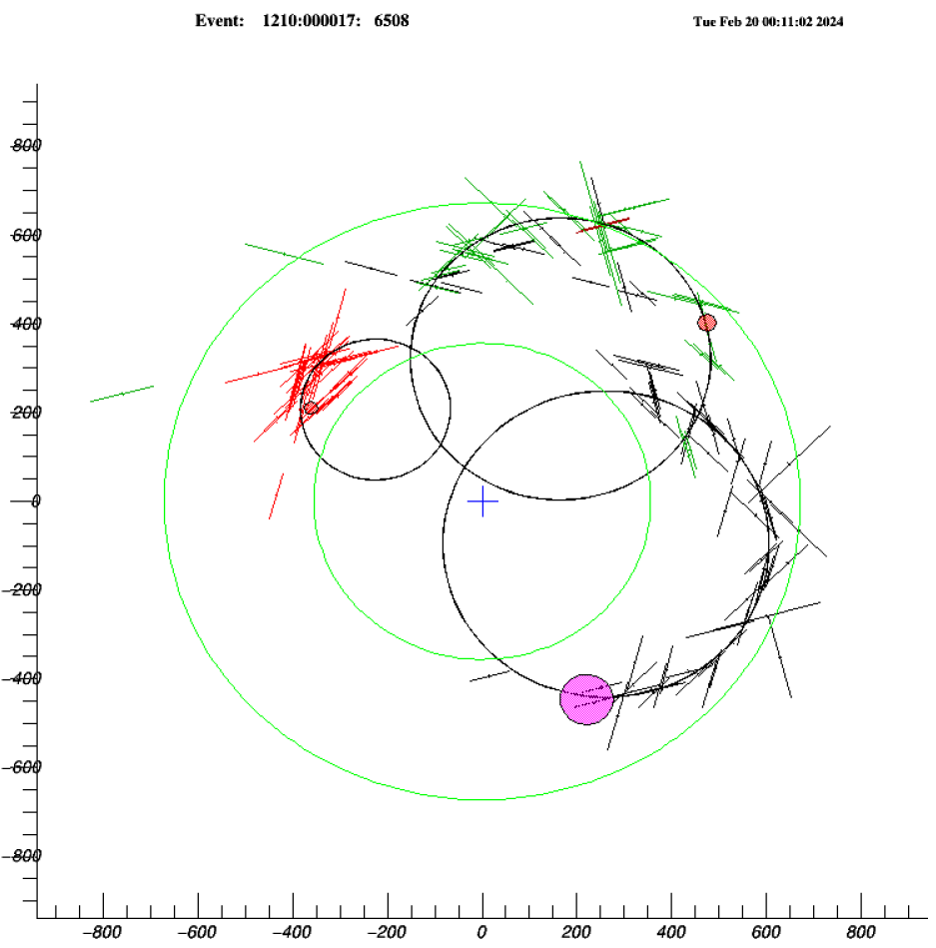
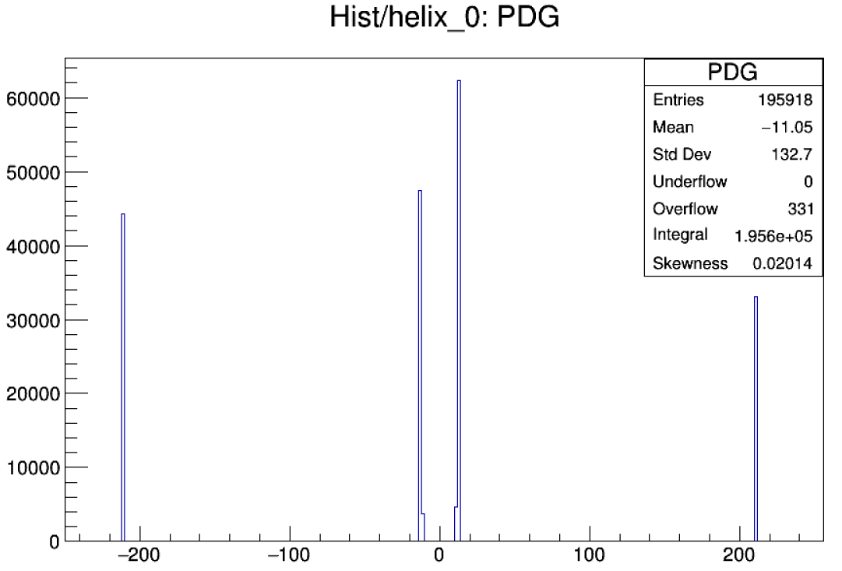
Antiproton Annihilation in Mu2e
Challenging for conversion electron reconstruction algorithm
Non-electron particles
Particles overlapping in space and time
Unproblematic for agnostic reconstruction
Excellent reconstruction of particles close in space and time
Efficient with non-electron particles
No initial assumptions on particle trajectory
y
Muon
Electron
Pion
Muon
Pion
x
Pion
Antiproton-induced event display in the transverse plane of the tracker showing reconstructed particle trajectories.
Electron
Agnostic reconstructed particle PDG of antiproton-induced events.
E. Martinez | New Perspectives

Slide 6
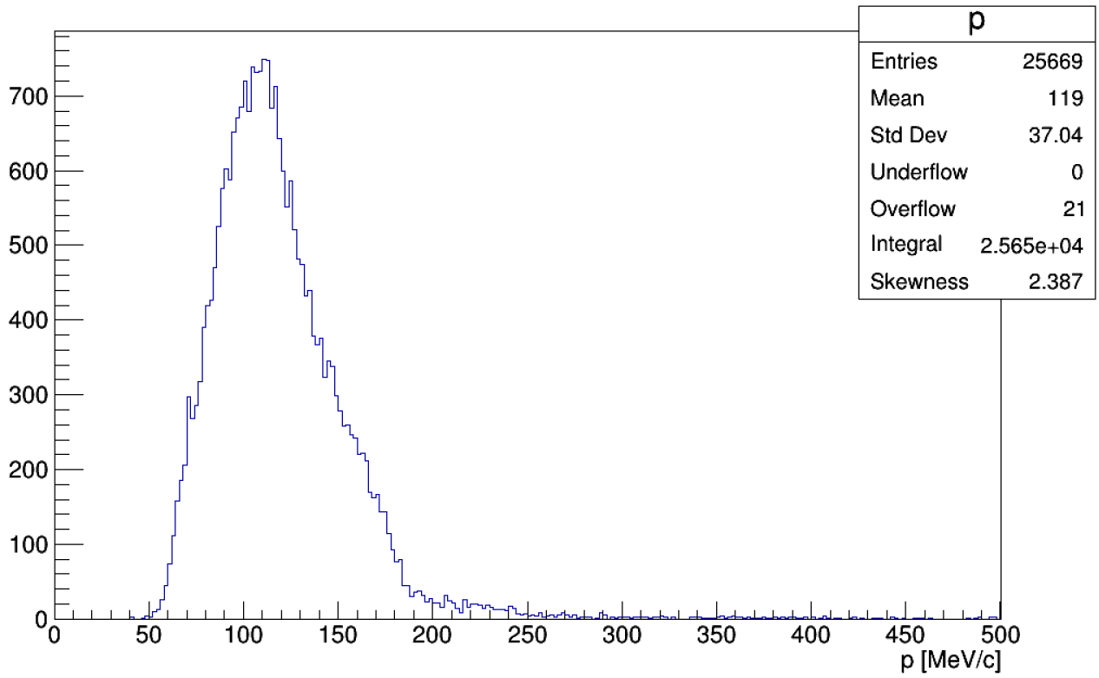
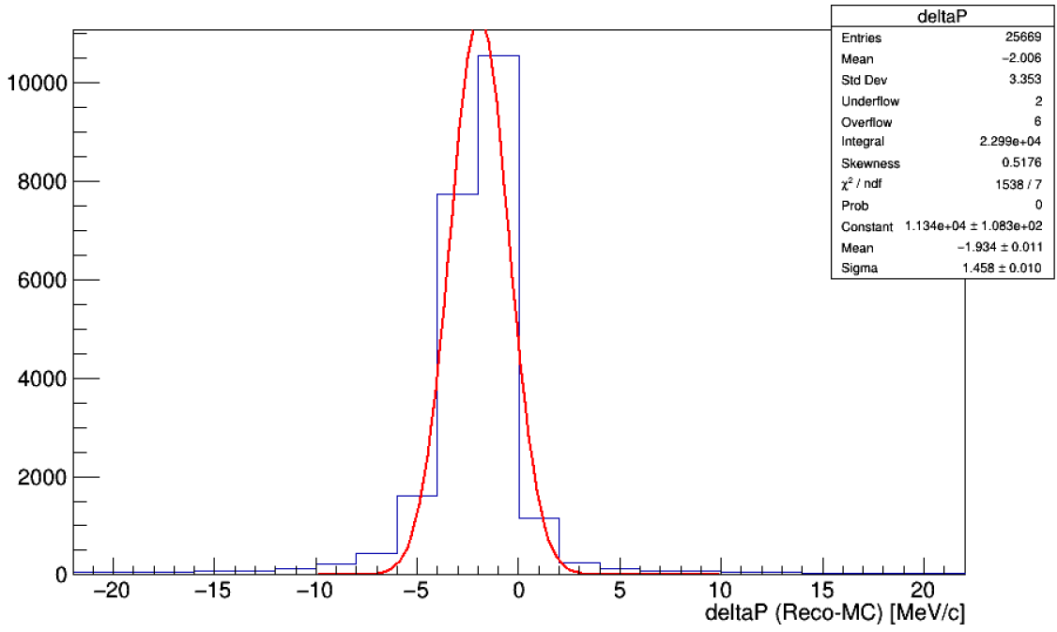
Topology of Antiproton-Induced Events: Momentum
CE Signal
Reconstructed momentum of antiproton-induced events.
Residual momentum (reconstructed – MC) of antiproton-induced events (blue) with Gaussian fit (red).
Large momentum compared to conversion electron signal
Mean of 119 MeV/c
Shape of distribution due to tracker geometry
Efficient reconstruction of antiproton-induced event
Sigma of ~1.5 MeV/c
E. Martinez | New Perspectives

Slide 7
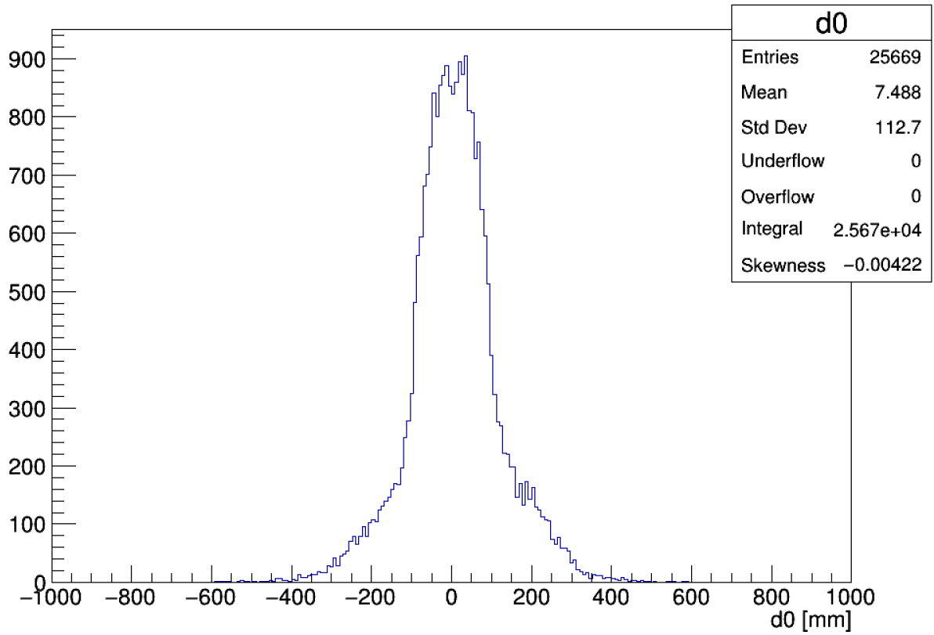
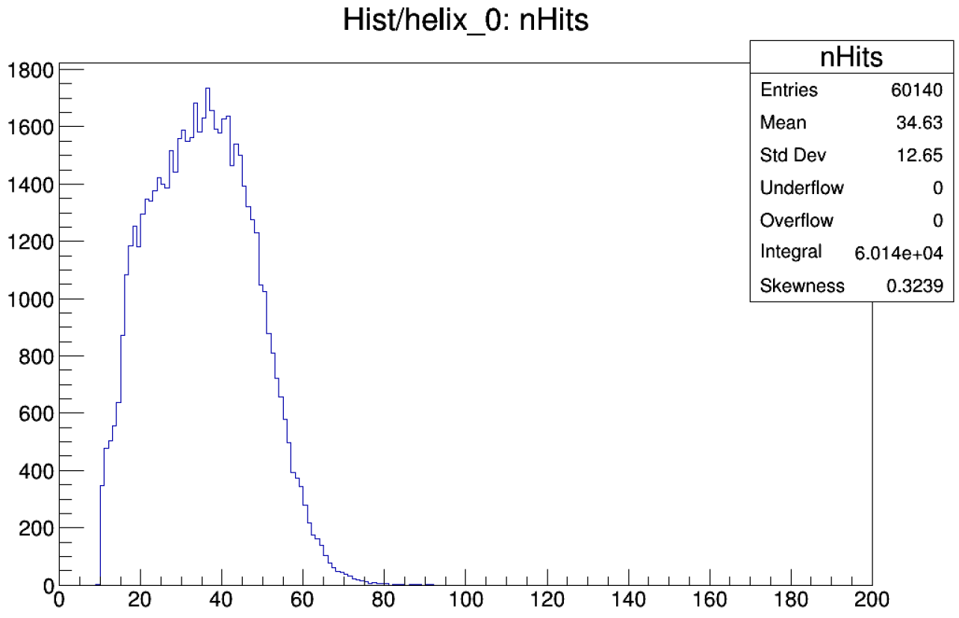
Topology of Antiproton-Induced Events: Impact Parameter and Number of Straw Hits
Stopping Target
Reconstructed impact parameter (d0) of antiproton-induced events.
Number of straw hits of antiproton-induced events.
Smallest distance from particle trajectory to center of tracker
Events originate from Stopping Target
Distribution centered around 0 mm
Large number of straw hits in tracker
Important factor to reduce rate of events with fake tracks
E. Martinez | New Perspectives

Slide 8
Trigger Sequences in Mu2e
Default:
Conversion electron reconstruction
Tracker Pattern Recognition (TPR) + Calorimeter Pattern Recognition (CPR)
Requires charge and upstream vs. downstream assumptions
Antiproton (Pbar):
Agnostic reconstruction
Agnostic Pattern Recognition (APR) + Calorimeter Pattern Recognition (CPR)
Does not require charge or upstream vs downstream assumption
Selects events with multi-track topology using lower momentum cut
Trigger Philosophy:
Maximize signal efficiency
Minimize rate of fake events
Take advantage of signal event topology
E. Martinez | New Perspectives

Slide 9
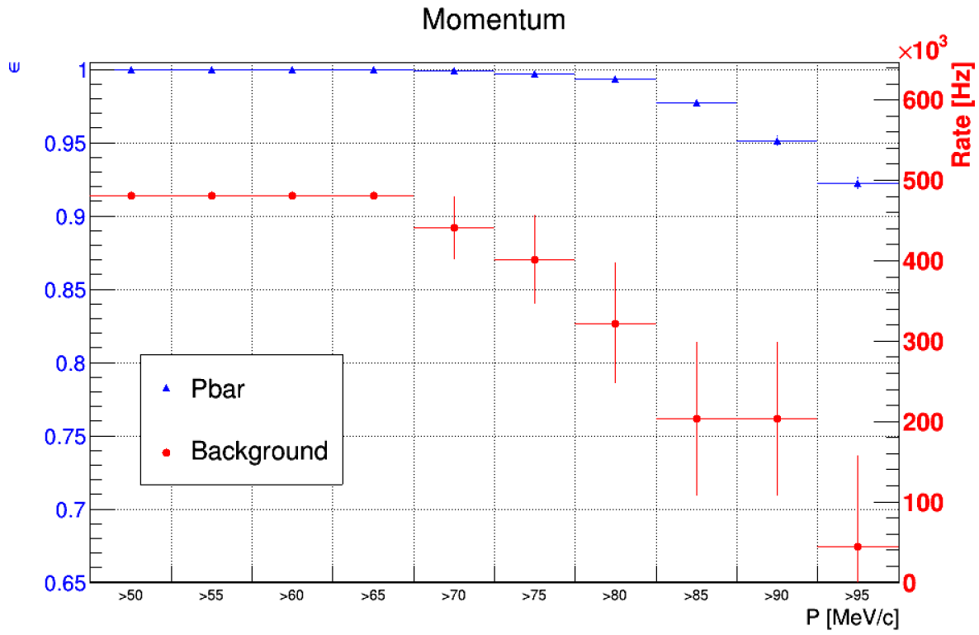
Definition of Pbar Trigger Selection
Take advantage of antiproton-induced event topology
Especially particle multiplicity
Define cuts which reduce rate of fake events by significant fraction
Parameter | Cut
Momentum (MeV/c) | P > 80
Impact Parameter (mm) | -150 < D0 < 150
Number of Hits | N ≥ 15
Number of Tracks | N ≥ 2
$$ϵ=\frac{NumberOfEventsPassed}{TotalNumberOfEvents}$$
$$Rate=InputRate∗\frac{NumberOfEventsPassed}{TotalNumberOfEvents}$$
Antiproton-induced signal efficiency and rate of fake events of pbar trigger at varying momentum cuts.
Efficiency evaluated with antiproton-induced events
Rate evaluated with background events
Rate drops by ~30% with 80 MeV/c momentum cut
Cuts not shown: Transverse momentum, number of loops, hit ratio, helix lambda, and chi2.
E. Martinez | New Perspectives

Slide 10
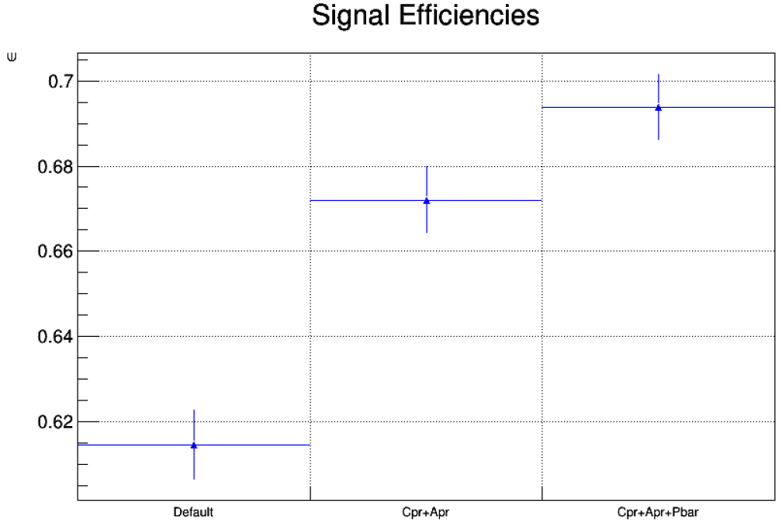
Performance of Pbar Trigger Selection: Efficiency
Efficiency Definition:
$$ϵ=\frac{NumberOfEventsPassed}{TotalNumberOfGoodEvents}$$
Good events have at least 2 tracks with at least 80 MeV/c and 15 straw hits
Evaluated with antiproton-induced events
Performance:
Highest efficiency achieved with antiproton trigger selection
~70% at best
Agnostic (CPR + APR) outperforming conversion electron (default) reconstruction by ~10%
Signal efficiencies of three trigger selection sequences: Default, Agnostic, and Agnostic + Pbar.
E. Martinez | New Perspectives

Slide 11
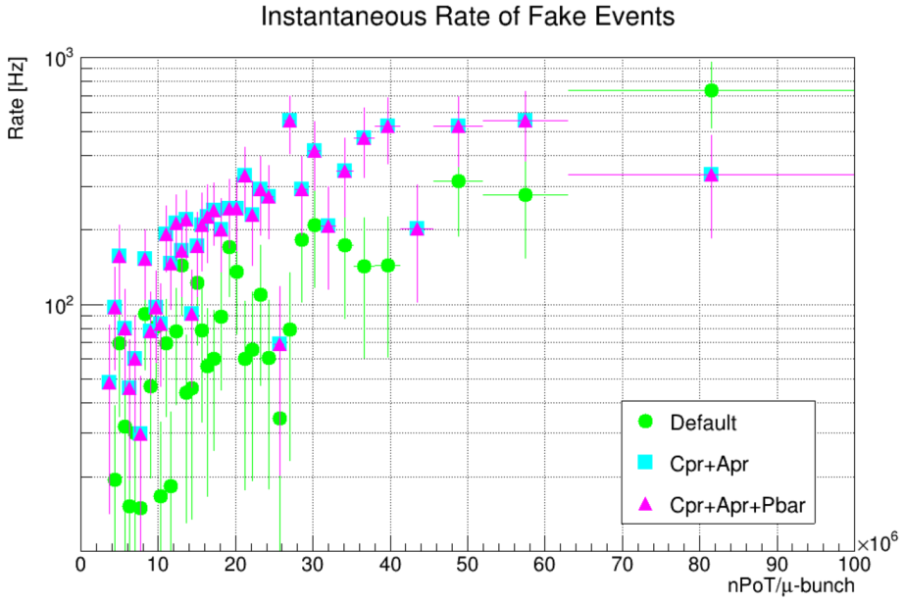
Performance of Pbar Trigger Selection: Rate of Fake Events
Rate Definition:
$$Rate=InputRate∗\frac{NumberOfEventsPassed}{TotalNumberOfEvents}$$
Plotted as a function of number of protons on target
Evaluated with background events
Performance:
Agnostic trigger rate performs within 1kHz limit
Required to limit the total amount of data we store
Additional antiproton-induced selection does not increase rate
Average nPoT/micro-bunch
Instantaneous rate of fake events of three trigger selection sequences: Default, Agnostic, and Agnostic + Pbar.
E. Martinez | New Perspectives

Slide 12
Conclusion and Next Steps
Agnostic reconstruction and multi-track selection are necessary to develop an efficient antiproton trigger to better characterize this process
We will continue to optimize selection cuts to boost signal efficiency
We will further optimize agnostic reconstruction to reduce rate of fake events
Consider introducing new cuts (timing, tracker-related observables)
THANK YOU!
E. Martinez | New Perspectives

Slide 13
Backup
E. Martinez | New Perspectives

Slide 14
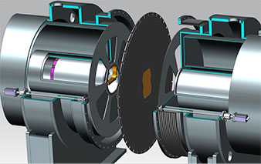
Antiproton Stopping Windows
Thin Beryllium wedge-shaped plate 200-1300 μm thick
Placed in between collimators located in the Transport Solenoid
Designed to absorb antiprotons while avoiding reduction of the muon stopping rate
Antiproton Stopping Window
Preliminary design of the collimators COL3u and COL3d assembly inside the Transport Solenoid cryostat in an assembled cross-section view.
E. Martinez | New Perspectives

Slide 15
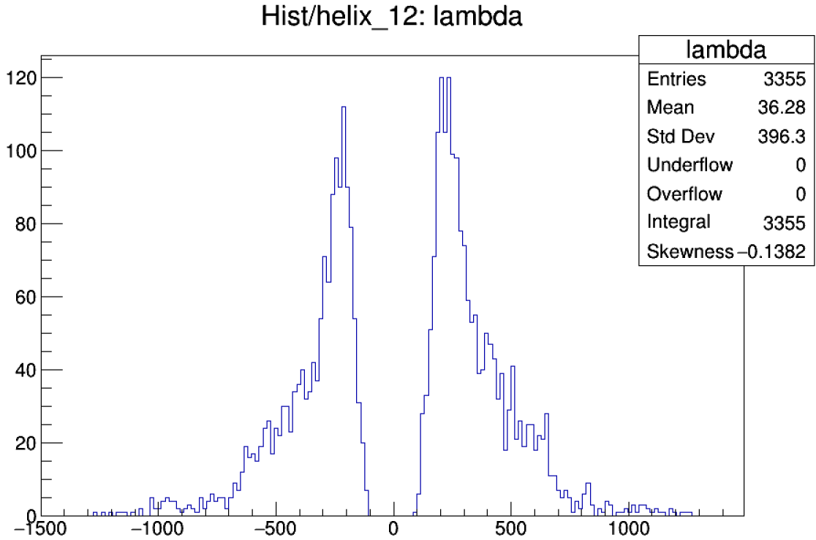
Helix Lambda of Failed Antiproton-Induced Events
Helix lambda of good antiproton-induced events which failed the pbar trigger selection.
Definitions of cuts placed at the helix level of the pbar trigger selection.
E. Martinez | New Perspectives

Slide 16
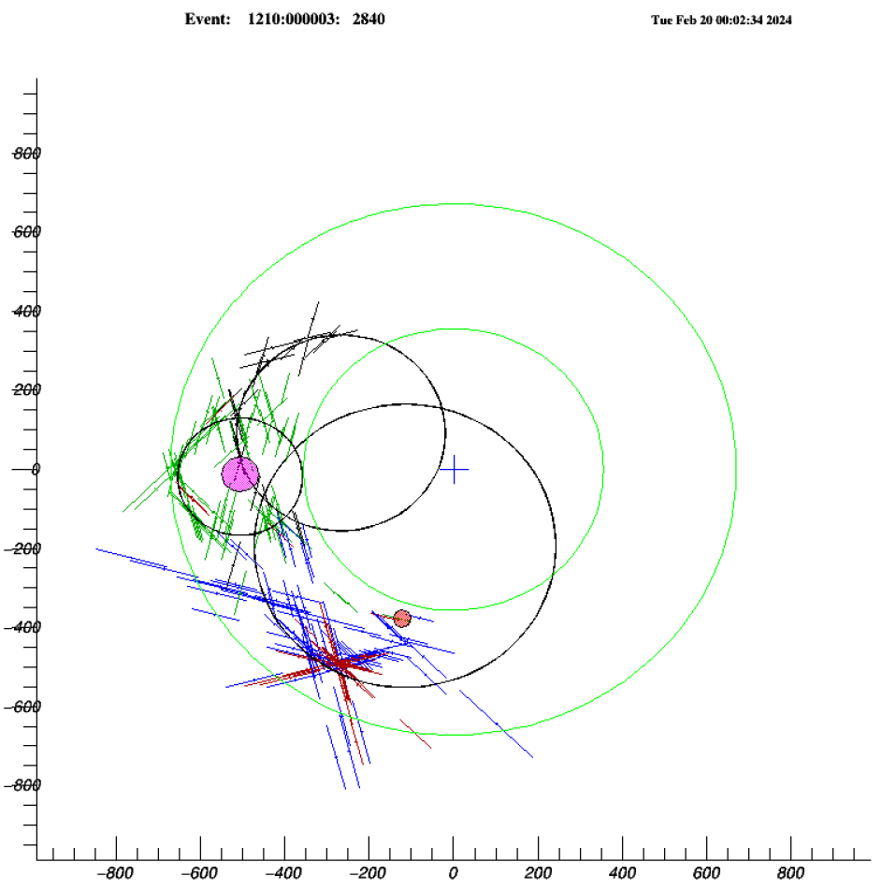
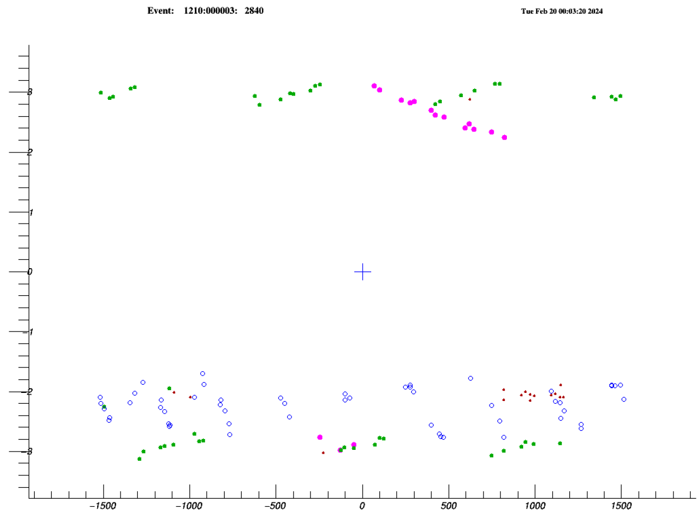
Antiproton-Induced Events with Large NHitsRatio
Positron
Event display in transverse view of antiproton-induced event.
Event display in the Phi-Z view of antiproton-induced event.
Printout of reconstructed helix information.
E. Martinez | New Perspectives

Slide 17
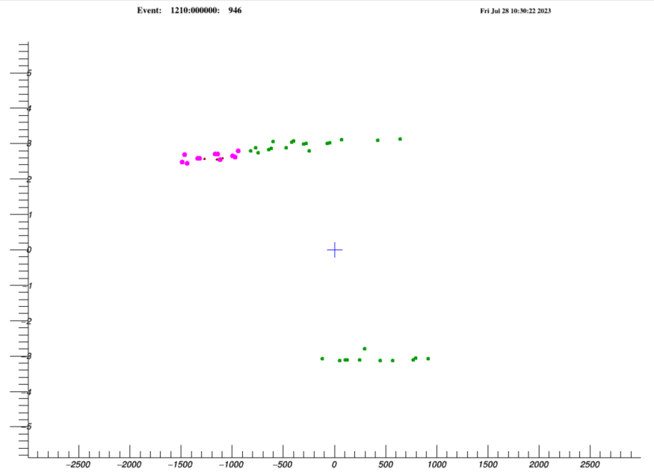
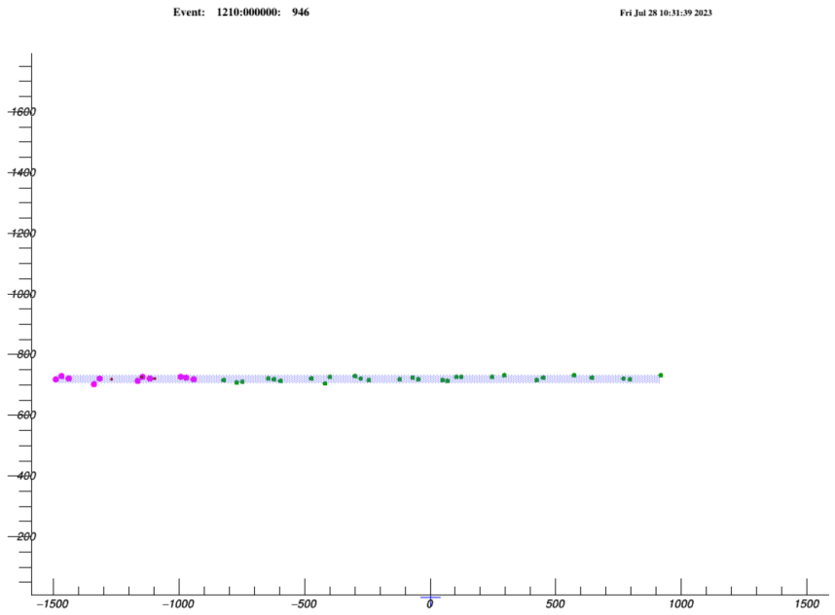
Decay-In-Flight Event
Event display in phi-z view of the tracker.
Event display in the transverse view of the tracker showing trajectory of decay-in-flight particles from antiproton-induced event.
Event display in t-z view of the tracker.
E. Martinez
E. Martinez | New Perspectives

