Slide 1
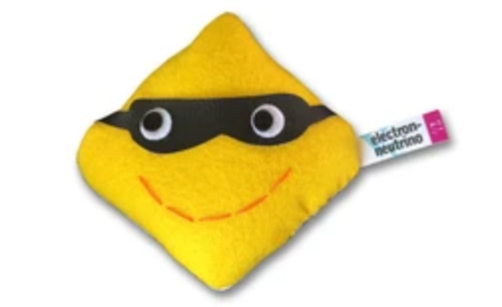
FERMILAB-SLIDES-24-0143-T
How Matter Matters:
The Story of Time Invariance Violation in Neutrino Oscillations
Olivia Meredith Bitter
New Perspectives 2024
Neutrino pictures: https://www.particlezoo.net/

Slide 2
Motivation from the CPT symmetry story
If we follow that CPT is a fundamental symmetry.
C P T
Charge conjugation
Parity
Time reversal
2
New Perspectives, 2024

Slide 3
Motivation from the CPT symmetry story
Charge parity transform (CP) alone is violated in the weak sector.
If we follow that CPT is a fundamental symmetry.
C P T
C P
Charge conjugation
Parity
Time reversal
2
New Perspectives, 2024

Slide 4
Motivation from the CPT symmetry story
Time reversal transforms alone should also be violated in weak interactions, to preserve such an overall symmetry.
Charge parity transform (CP) alone is violated in the weak sector.
If we follow that CPT is a fundamental symmetry.
C P T
T
C P
Charge conjugation
Parity
Time reversal
2
New Perspectives, 2024

Slide 5
Motivation from the CPT symmetry story
Neutrino physics is a well motivated probe for CP violation, but we are limited to an improper test due to living in a
matter dominated universe.
Let us then consider to what extent time invariance violation occurs within the neutrino sector.
Why? New physics may not impact both CP and time reversal in the same way.
3
Source:https://physics.aps.org/articles/v15/120
Credit:APS/Carin Cain
New Perspectives, 2024

Slide 6
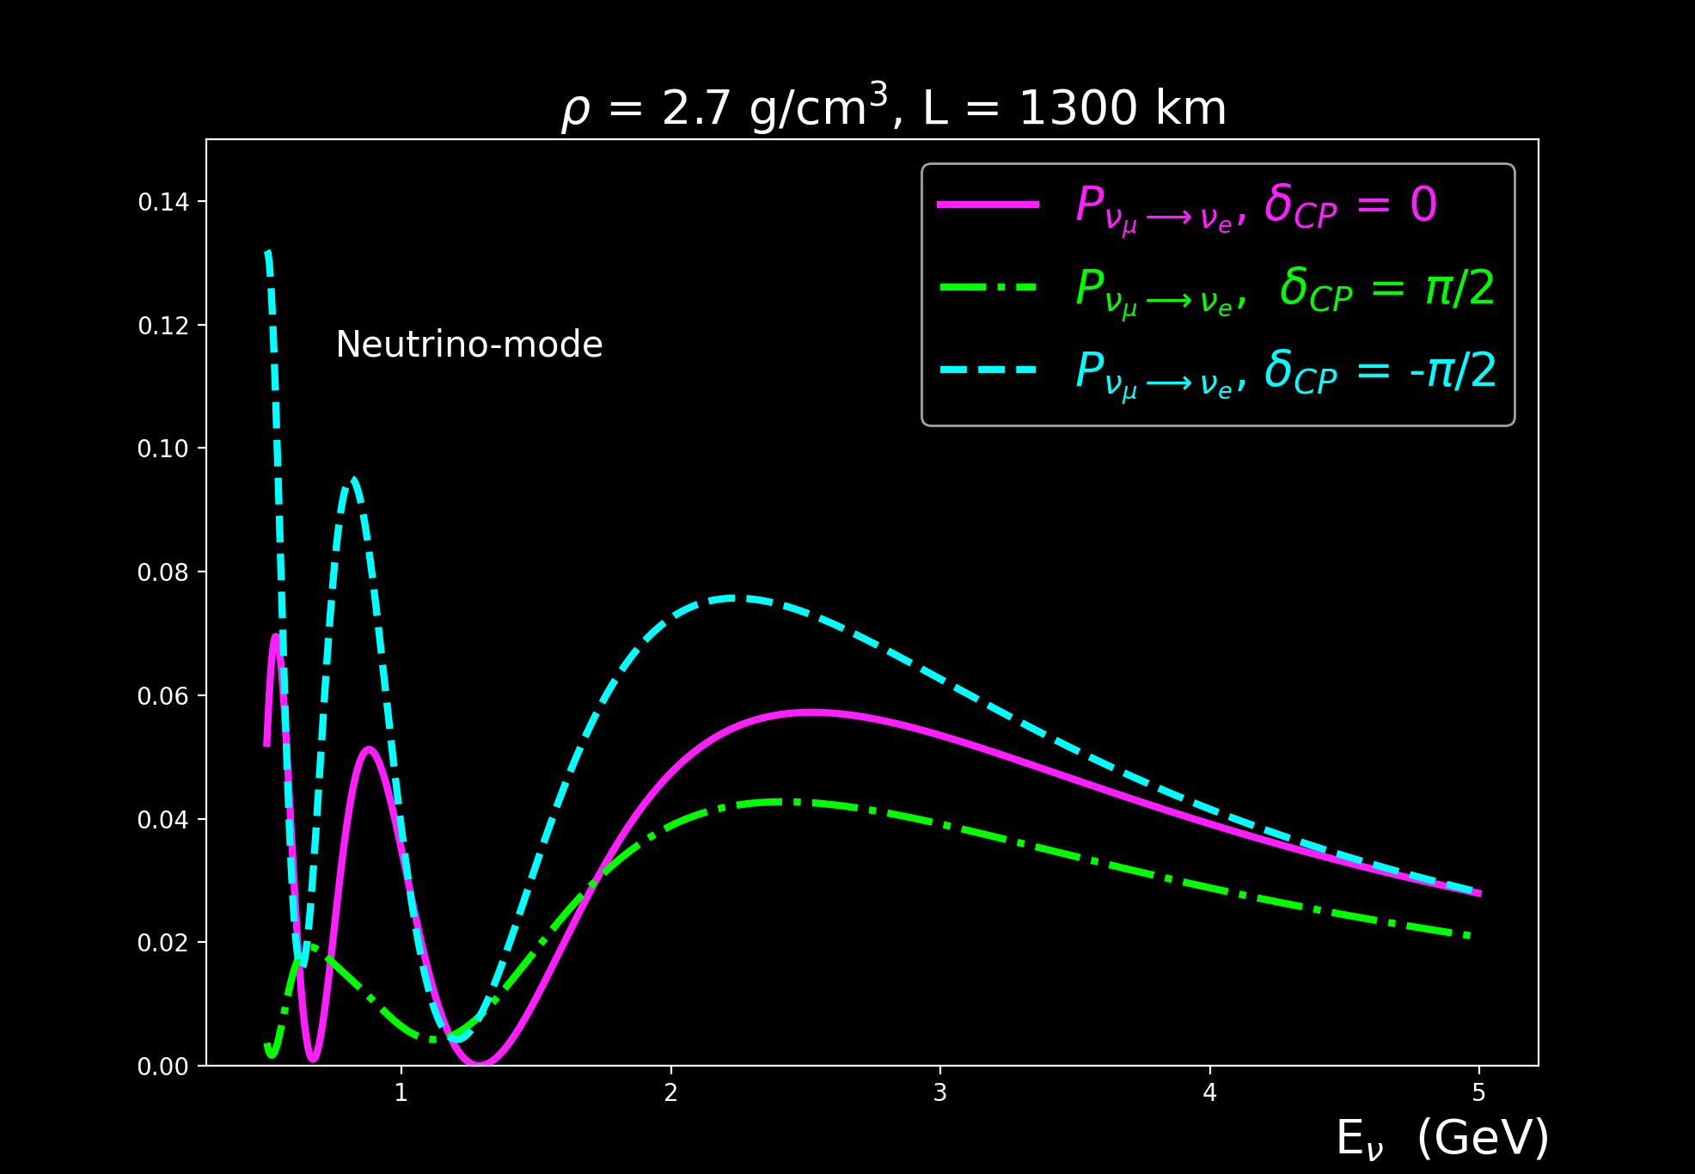
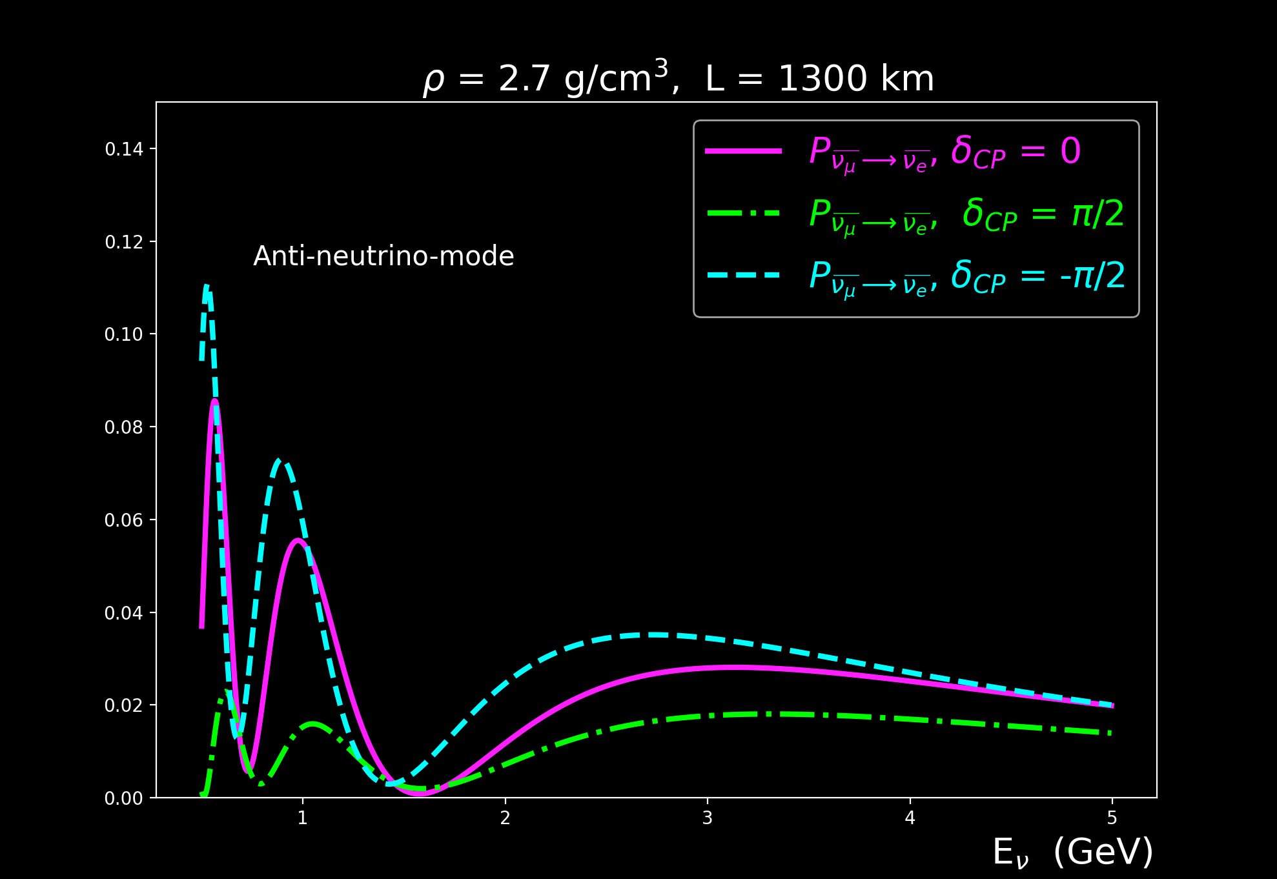
Motivation from experiments story
NO
Neutrino mode
Anti-neutrino mode
density ⟺ Earth’s crust
CP conjugate channels are the most common probes, as they are more accessible to experiments like long baselines.
4
New Perspectives, 2024

Slide 7
Motivation from experiments story
NO
Neutrino mode
Anti-neutrino mode
Warning:
Non-trivial matter effects!
density ⟺ Earth’s crust
CP conjugate channels are the most common probes, as they are more accessible to experiments like long baselines.
4
New Perspectives, 2024

Slide 8
Motivation from experiments story
What else can we do?
5
New Perspectives, 2024

Slide 9
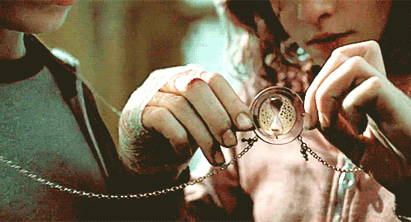
Motivation from experiments story
Time Invariance
Tests
5
New Perspectives, 2024
Source: (Time-turner) https://tenor.com/view/time-turner-harry-potter-moving-spinning-gif-16031036

Slide 10
Motivation from experiments story
Time Invariance
Tests
Time invariance violation tests give relatively clearer ways to aid in our understanding of how different matter profiles can affect neutrino oscillations
(i.e. distinguishing between intrinsic & induced time invariance violation)
5
New Perspectives, 2024
Source: (Time-turner) https://tenor.com/view/time-turner-harry-potter-moving-spinning-gif-16031036

Slide 11
Motivation from experiments story
Time Invariance
Tests
Time invariance violation tests give relatively clearer ways to aid in our understanding of how different matter profiles can affect neutrino oscillations
(i.e. distinguishing between intrinsic & induced time invariance violation)
NOTE: time invariance probability tests require comparing
(or anti-neutrino versions)
We assume that a new beam capable of producing high energy $ν_{e}$’s exists (i.e. muon storage rings).
5
New Perspectives, 2024

Slide 12
Recalling 3-Flavor Neutrino Oscillations with charge-current matter effects
(PMNS matrix)
$$M^{2}= \begin{matrix}0 & 0 & 0 \\ 0 & ∆m_{21}^{2} & 0 \\ 0 & 0 & ∆m_{31}^{2}\end{matrix}$$
$$A= \begin{matrix}\sqrt{2}G_{F}N_{e} & 0 & 0 \\ 0 & 0 & 0 \\ 0 & 0 & 0\end{matrix}$$
Sources: https://neutrino.syr.edu/research/neutrino-oscillations/ & https://neutrino-history.in2p3.fr/neutrino-oscillation/
6
+/- for neutrinos/antineutrinos
New Perspectives, 2024

Slide 13
Defining time invariance measures
To clarify what ”comparison” we are making in looking for time invariance violation effects, we’ve specified two distinct measures:
proper time invariance: (aka: true time invariance violation)
Not a good observable, but certainly no harder to calculate than CP conjugate channels.
Requires comparing probabilities with final states exchanged and swapping the detector with source.
7
New Perspectives, 2024

Slide 14
Defining time invariance measures
To clarify what ”comparison” we are making in looking for time invariance violation effects, we’ve specified two distinct measures:
proper time invariance: (aka: true time invariance violation)
ex: 2-step piece-wise
constant matter profiles
A₀₀ = A(L) = $\sqrt{2}G_{F}N_{e}$
$$P_{v_{e}→v_{μ}} vs P_{v_{μ}→v_{e}}$$
_{(decreasing potential)}
_{(increasing potential)}
N_{e} changes depending on density
7
New Perspectives, 2024

Slide 15
Defining time invariance measures
improper time invariance: (next best thing!)
Compares probabilities with only the final states exchanged.
$$P_{v_{e}→v_{μ}} vs P_{v_{μ}→v_{e}}$$
_{(decreasing potential)}
_{(decreasing potential)}
This is what an experiment can measure!
8
New Perspectives, 2024

Slide 16
Modeling Matter Effects for 3-Flavors
For the purposes of our study, we separately two types of matter potential profiles.
Symmetric: vacuum or single step constant matter potential profile
Non-symmetric: piece-wise matter potential profiles (increasing or decreasing)
9
New Perspectives, 2024

Slide 17
Modeling Matter Effects for 3-Flavors
For the purposes of our study, we separately two types of matter potential profiles.
Symmetric: vacuum or single step constant matter potential profile
Non-symmetric: piece-wise matter potential profiles (increasing or decreasing)
All mixing parameters (apart from $δ_{CP}$) have been drawn from NuFIT 2024 global fits: (arXiv:2007.14792 & NuFIT 5.3 (2024), www.nu-fit.org)
9
New Perspectives, 2024

Slide 18
Disclaimer!
The following preliminary analysis is done with hypothetical/fictious matter effects, to get a general sense of how intrinsic versus induced time invariance violation behave with matter effects in cases that the have stronger oscillation differences.
10
New Perspectives, 2024

Slide 19
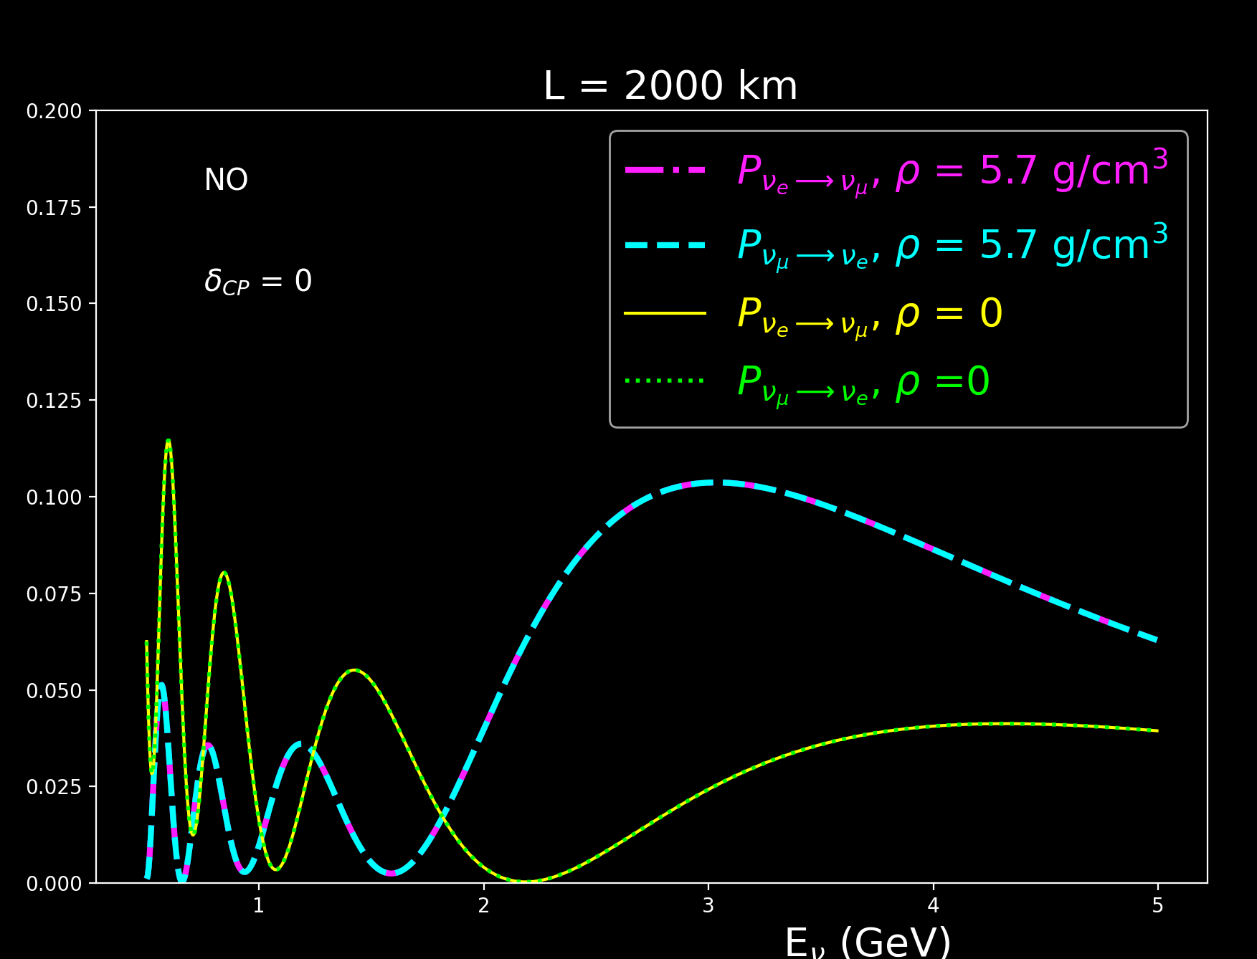
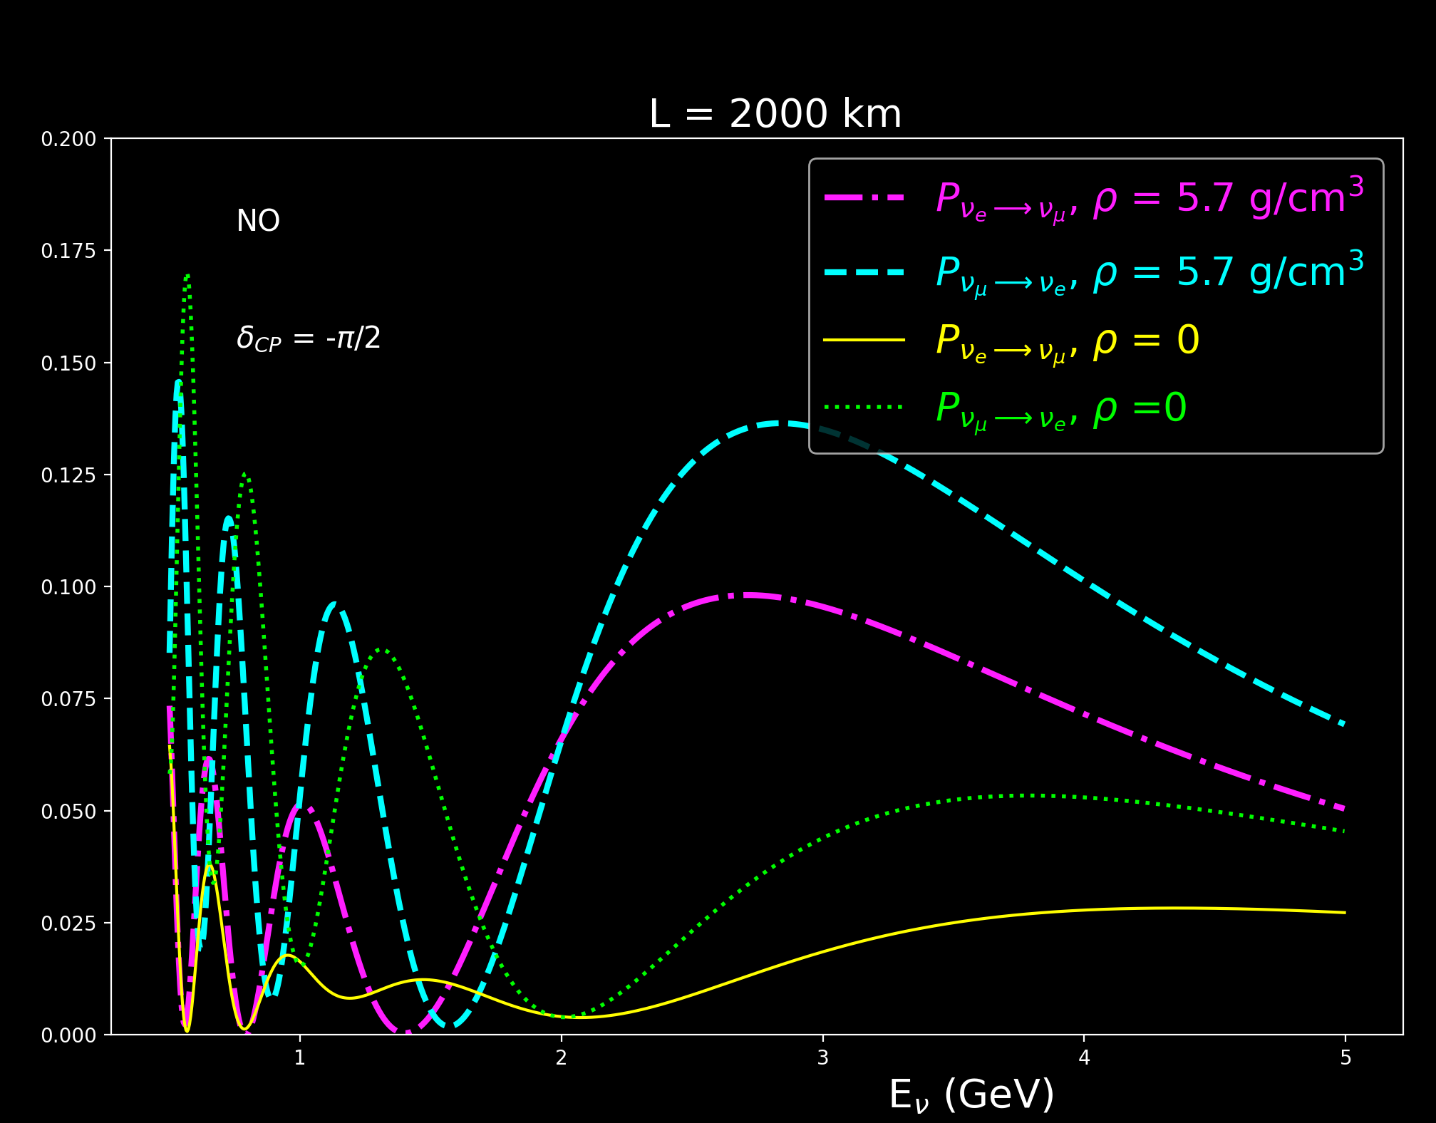
Symmetric matter effects for 3-Flavors
NO
$$δ_{CP}=0$$
NO
$$δ_{CP}=− \frac{π}{2}$$
matter channels
matter channels
vacuum channels
vacuum channels
Constant matter potential:
1.1x10⁻³ eV²/GeV
( 5.7 g/cm³)
11
New Perspectives, 2024

Slide 20
Symmetric matter effects for 3-Flavors
NO
$$δ_{CP}=0$$
NO
$$δ_{CP}=− \frac{π}{2}$$
1. Symmetric matter potentials cannot induce time invariance violation.
2. If there is intrinsic time invariance from $δ_{CP}$, then the matter potential simply changes the degree of the effects.
11
New Perspectives, 2024

Slide 21
Symmetric matter effects for 3-Flavors
NO
$$δ_{CP}=0$$
NO
$$δ_{CP}=− \frac{π}{2}$$
If we exchange final states, same matter potential profile.
3. Improper and proper comparisons are the same if the matter potential is symmetric.
11
New Perspectives, 2024

Slide 22
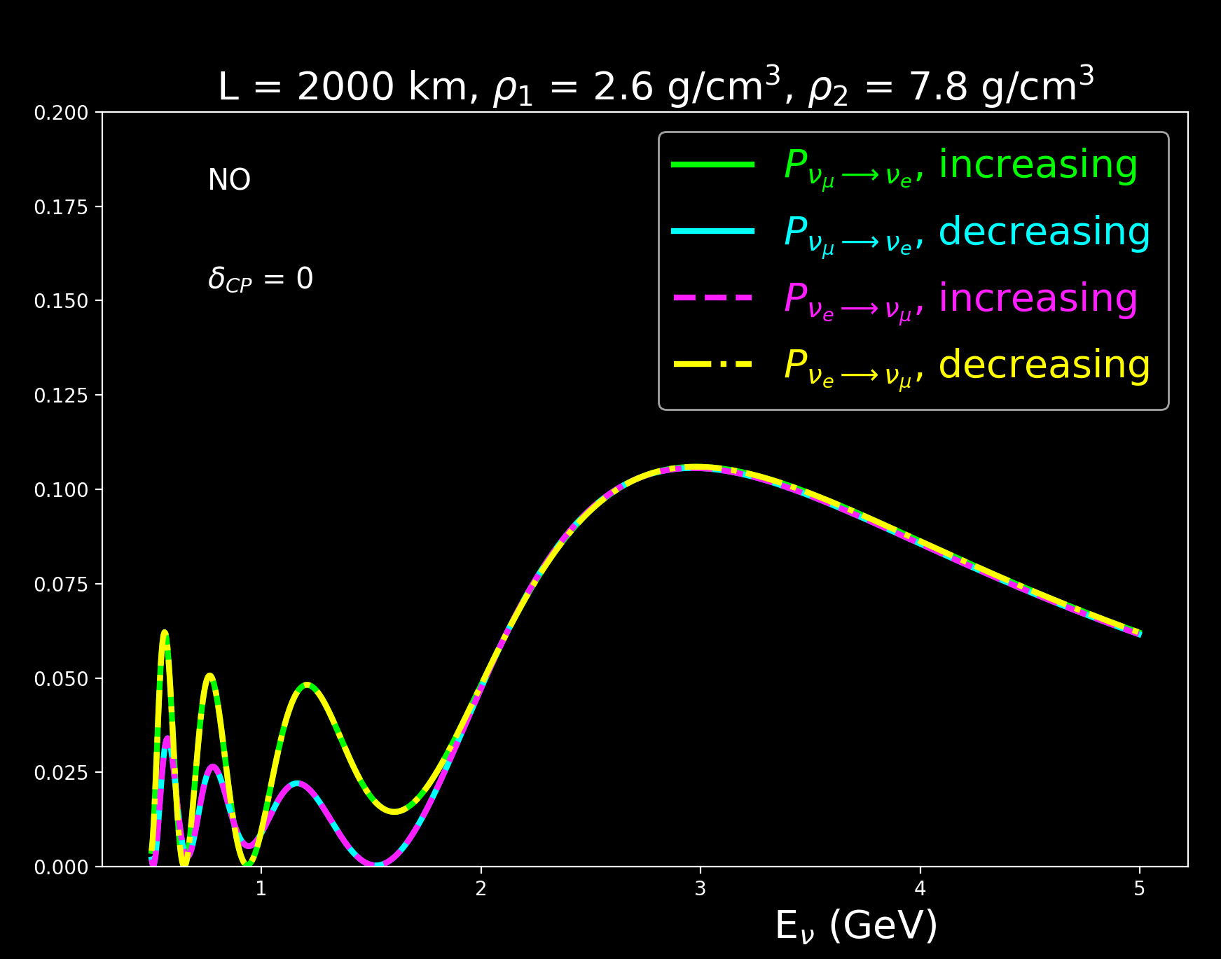
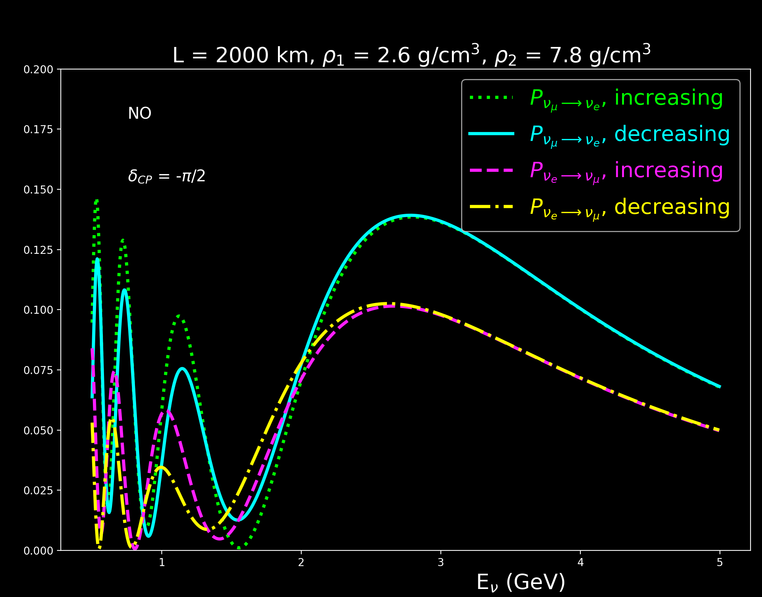
Non-symmetric matter effects for 3-Flavors
NO
$$δ_{CP}=0$$
NO
$$δ_{CP}=− \frac{π}{2}$$
Piecewise matter potential (2 steps):
A₁ =5x10⁻⁴ eV²/GeV (2.6 g/cm³)
A₂ =1.5 x10⁻³ eV²/GeV (7.8 g/cm³)
12
New Perspectives, 2024

Slide 23
Non-symmetric matter effects for 3-Flavors
NO
$$δ_{CP}=0$$
NO
$$δ_{CP}=− \frac{π}{2}$$
Proper
2. Proper time remains invariant, but improper channels are different.
1. Non-symmetric matter effects are pairwise degenerate ($δ_{CP}$: 0)
12
New Perspectives, 2024

Slide 24
Non-symmetric matter effects for 3-Flavors
NO
$$δ_{CP}=0$$
NO
$$δ_{CP}=− \frac{π}{2}$$
Proper
2. Proper time remains invariant, but improper channels are different.
1. Non-symmetric matter effects are pairwise degenerate ($δ_{CP}$: 0)
12
New Perspectives, 2024

Slide 25
Non-symmetric matter effects for 3-Flavors
NO
$$δ_{CP}=0$$
NO
$$δ_{CP}=− \frac{π}{2}$$
Improper
2. Proper time remains invariant, but improper channels are different.
1. Non-symmetric matter effects are pairwise degenerate ($δ_{CP}$: 0)
12
New Perspectives, 2024

Slide 26
Non-symmetric matter effects for 3-Flavors
NO
$$δ_{CP}=0$$
NO
$$δ_{CP}=− \frac{π}{2}$$
Improper
2. Proper time remains invariant, but improper channels are different.
1. Non-symmetric matter effects are pairwise degenerate ($δ_{CP}$: 0)
12
New Perspectives, 2024

Slide 27
Non-symmetric matter effects for 3-Flavors
NO
$$δ_{CP}=0$$
NO
$$δ_{CP}=− \frac{π}{2}$$
2. Proper time remains invariant, but improper channels are different.
3. No intrinsic time invariance violation but matter induced time invariance violation occurs.
1. Non-symmetric matter effects are pairwise degenerate ($δ_{CP}$: 0)
12
New Perspectives, 2024

Slide 28
Non-symmetric matter effects for 3-Flavors
NO
$$δ_{CP}=0$$
NO
$$δ_{CP}=− \frac{π}{2}$$
4. No longer pairwise degenerate if ($δ_{CP}$:- $\frac{π}{2}$).
5. Matter potential choice changes magnitude of oscillations:
All probabilities are different.
12
New Perspectives, 2024

Slide 29
Main Takeaways
This is an ongoing study into how much time invariance violation (if at all) can be observed in neutrino oscillations, and to what extent such observables can be differentiated in simple neutrino matter potential models.
Symmetric potentials cannot induce time violation, but if time invariance is intrinsically non-conserved, the matter potential simply changes the degree of the observed effects.
Symmetric potentials provide probes into checking proper time invariance, which could be accessible in the near future with new beams.
Non-symmetric matter potentials can induce improper time violation, while proper time violation is more protected. More on this to come.
Future studies: 2-flavor/3-flavor NSI and more realistic matter profiles just to name a few!
13
New Perspectives, 2024

Slide 30
Thank you!
14

Slide 31
Backups
15

Slide 32
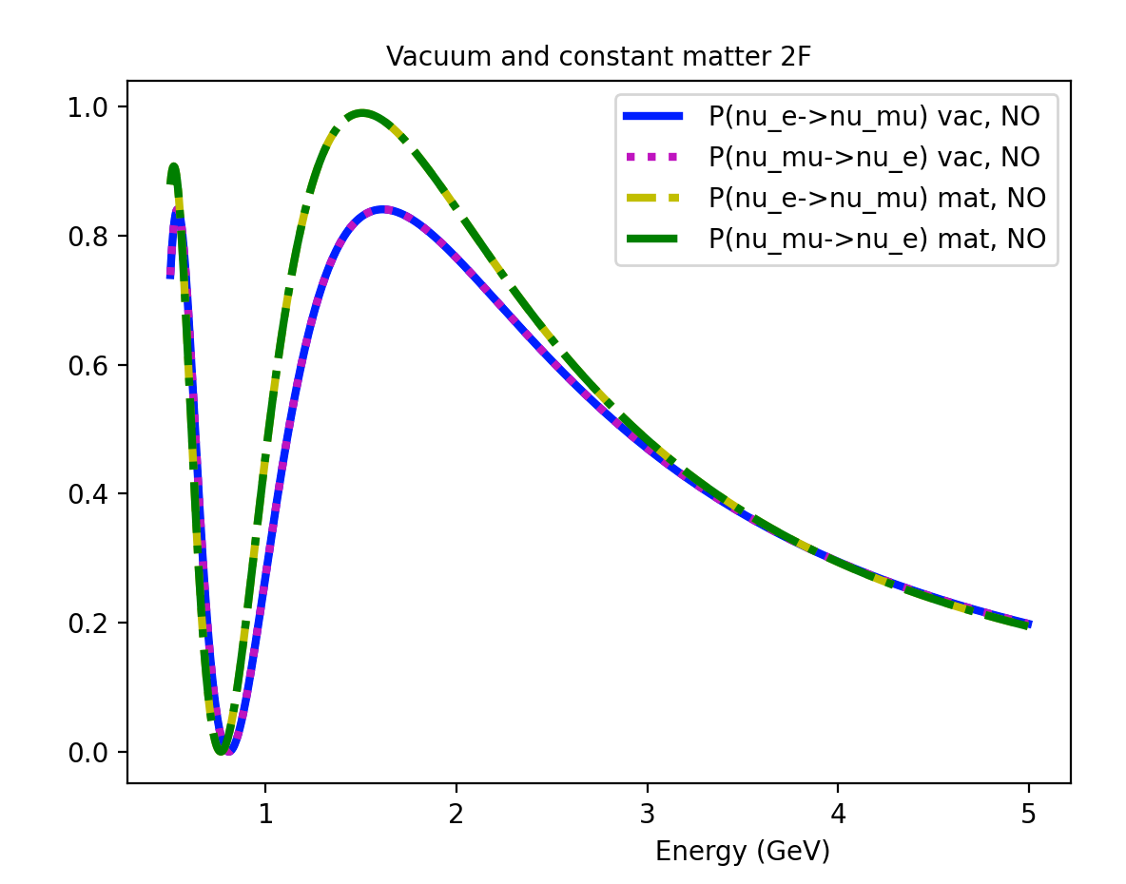
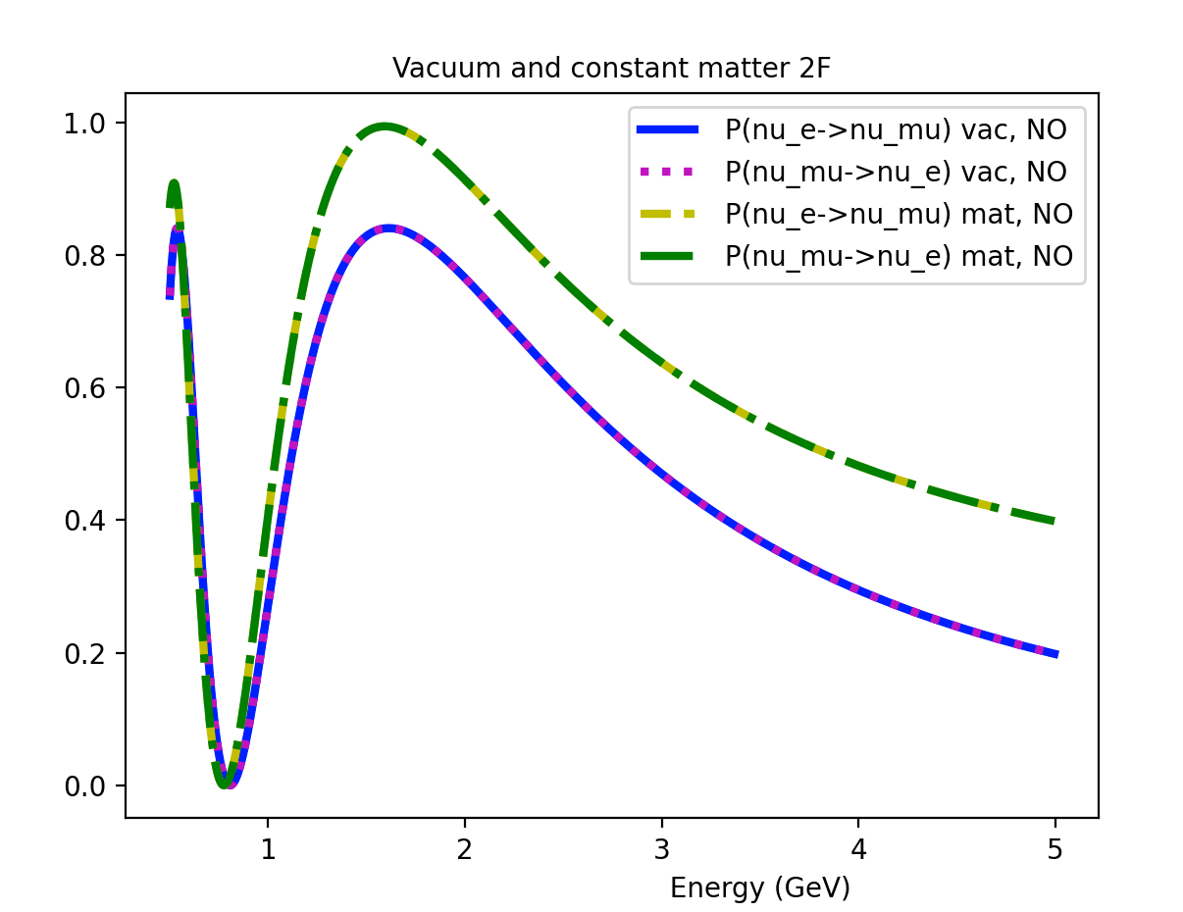
Symmetric matter effects for 2-Flavors (Normal Ordering, Baseline: 2000 km)
constant matter potential:
A $≈$ 5*10⁻⁴ eV²/GeV (2.6 g/cm³)
NSI + constant matter potential:
A $≈$ 5*10⁻⁴ eV²/GeV (2.6 g/cm³)
B $≈$ i * 2.5*10⁻⁴ eV²/GeV (1.3 g/cm³)
Preliminary
Preliminary
$P_{v_{μ}→v_{e}}$ & $P_{{v_{e}→v}_{μ}}$
$P_{v_{μ}→v_{e}}$ & $P_{{v_{e}→v}_{μ}}$
$P_{{v_{e}→v}_{μ}}$ (vacuum, NO)
$P_{v_{μ}→v_{e}}$ (vacuum, NO)
$P_{{v_{e}→v}_{μ}}$ (constant matter, NO)
$P_{v_{μ}→v_{e}}$ (constant matter, NO)
$P_{{v_{e}→v}_{μ}}$ (vacuum, NO)
$P_{v_{μ}→v_{e}}$ (vacuum, NO)
$P_{{v_{e}→v}_{μ}}$ (constant matter, NO)
$P_{v_{μ}→v_{e}}$ (constant matter, NO)
matter channels
matter channels
$$P_{v_{α}→v_{β} }$$
$$P_{v_{α}→v_{β} }$$
vacuum channels
vacuum channels
44
$α$, $β$ -> [$μ, e]$
New Perspectives, 2024

Slide 33
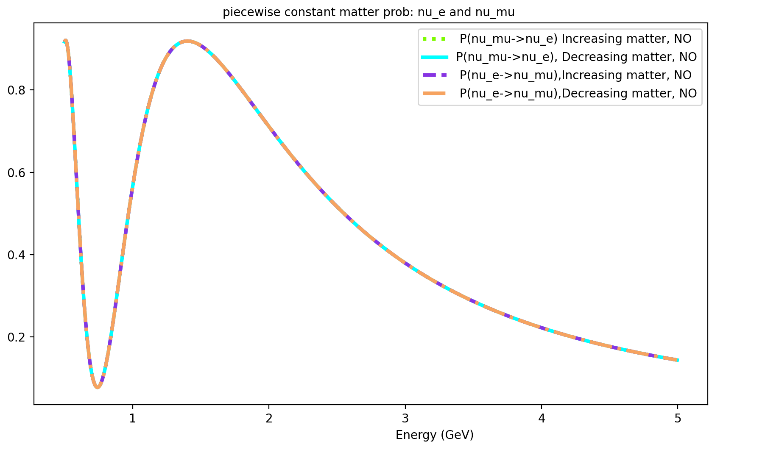
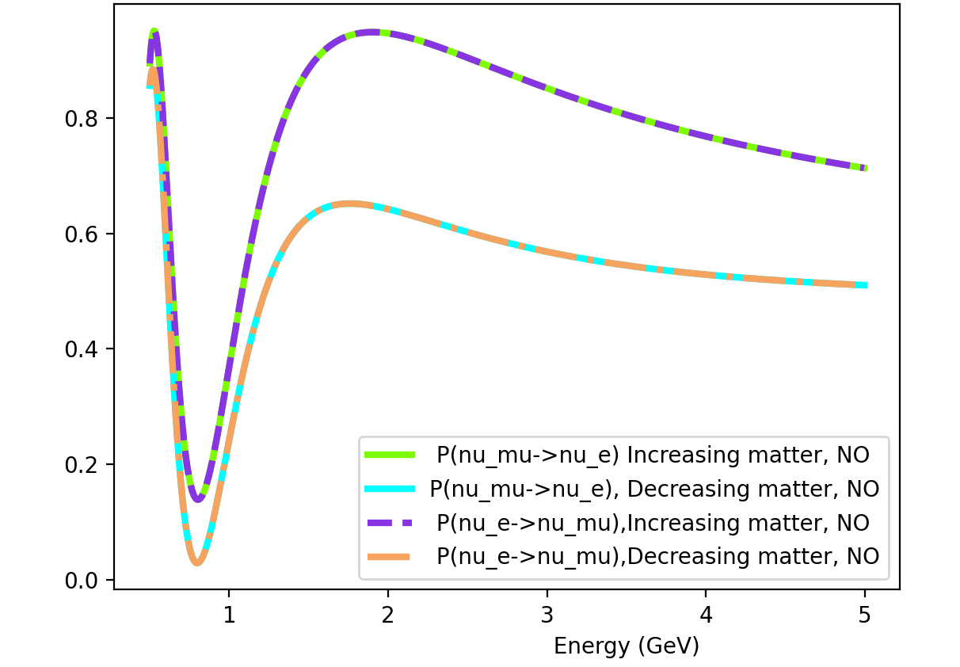
Non-symmetric matter effects for 2-Flavors (Normal Ordering, Baseline: 2000 km)
2 step constant matter potential:
A1 $≈$ 5*10⁻⁴ eV²/GeV (2.6 g/cm³)
A2 $≈$ 1.5*10⁻³ eV²/GeV (7.8 g/cm³)
NSI + 2 step constant matter potential:
A1 $≈$ 5*10⁻⁴ eV²/GeV (2.6 g/cm³)
B1 $≈$ i * 2.5*10⁻⁴ eV²/GeV (1.3 g/cm³)
A2 $≈$ 1.5*10⁻³ eV²/GeV (7.8 g/cm³)
B2 $≈$ i * 7.5*10⁻⁴ eV²/GeV (3.9 g/cm³)
Preliminary
$P_{v_{μ}→v_{e}}$ & $P_{{v_{e}→v}_{μ}}$
$P_{v_{μ}→v_{e}}$ (increasing matter, NO)
$P_{v_{μ}→v_{e}}$ (decreasing matter, NO)
$P_{{v_{e}→v}_{μ}}$ (increasing matter, NO)
$P_{{v_{e}→v}_{μ}}$ (decreasing matter, NO)
Preliminary
$P_{v_{μ}→v_{e}}$ & $P_{{v_{e}→v}_{μ}}$
increasing matter
$$P_{v_{α}→v_{β} }$$
2 flavors (general)
2 step constant matter potential
A1 $≈$ 5*10⁻⁴ eV²/GeV
A2 $≈$ 15*10⁻⁴ eV²/GeV
b1 $≈$ i * 2.5*10⁻⁴ eV²/GeV
b2 $≈$ i * 7.5*10⁻⁴ eV²/GeV
decreasing matter
$$P_{v_{α}→v_{β} }$$
$P_{v_{μ}→v_{e}}$ (increasing matter, NO)
$P_{v_{μ}→v_{e}}$ (decreasing matter, NO)
$P_{{v_{e}→v}_{μ}}$ (increasing matter, NO)
$P_{{v_{e}→v}_{μ}}$ (decreasing matter, NO)
45
$α$, $β$ -> [$μ, e]$
New Perspectives, 2024

Slide 34
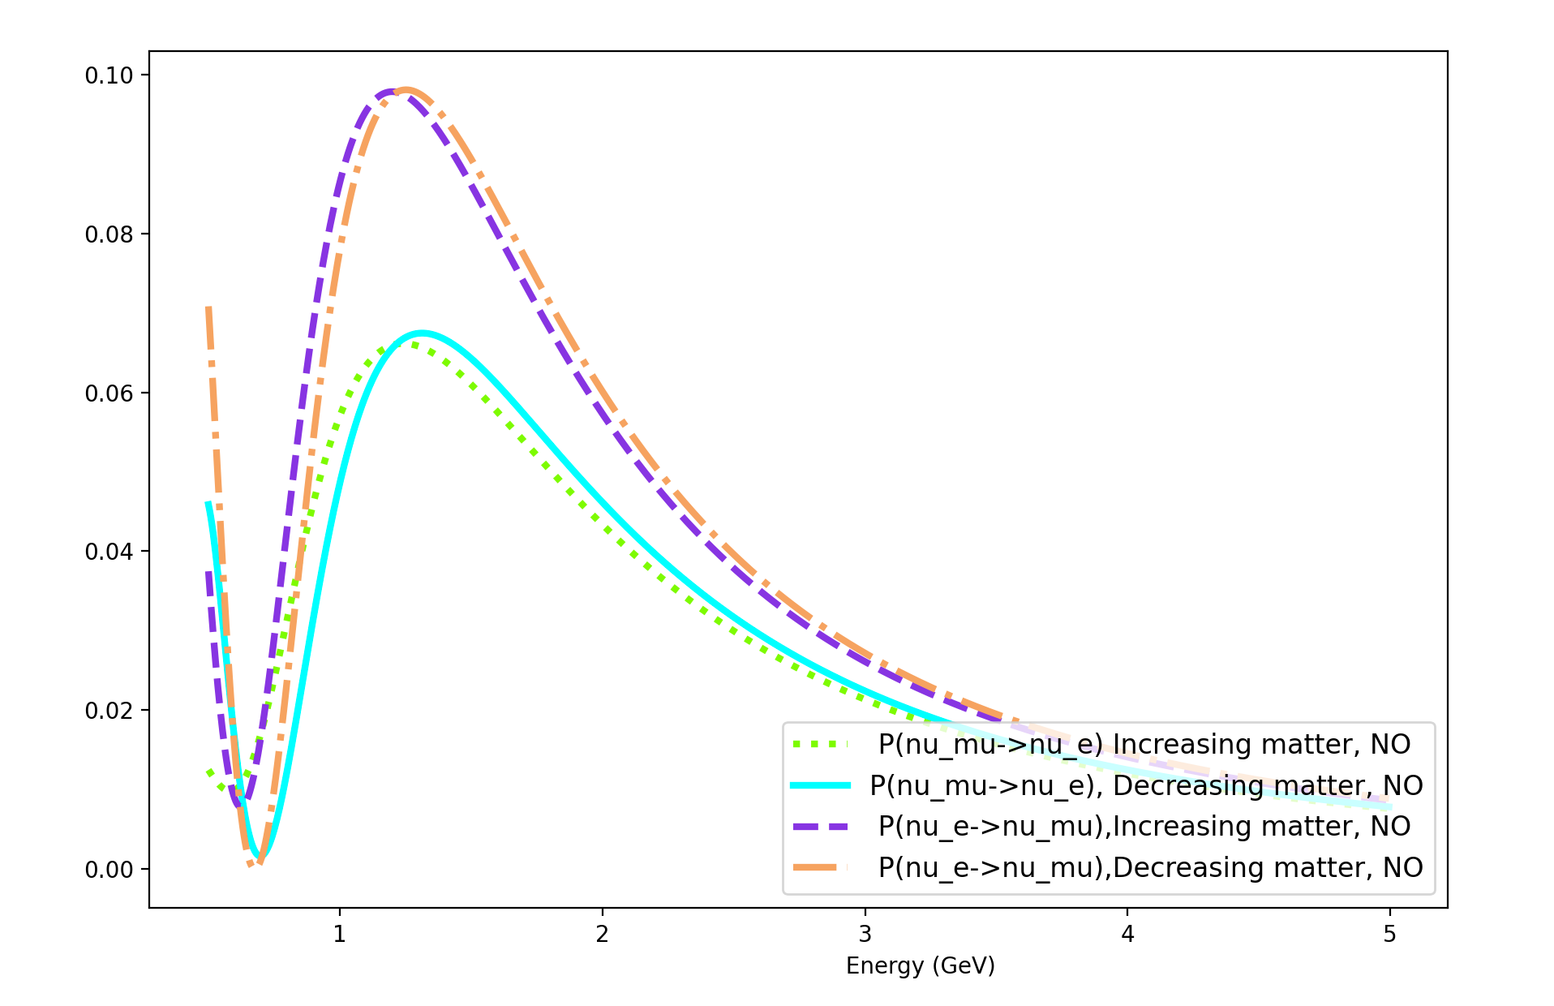
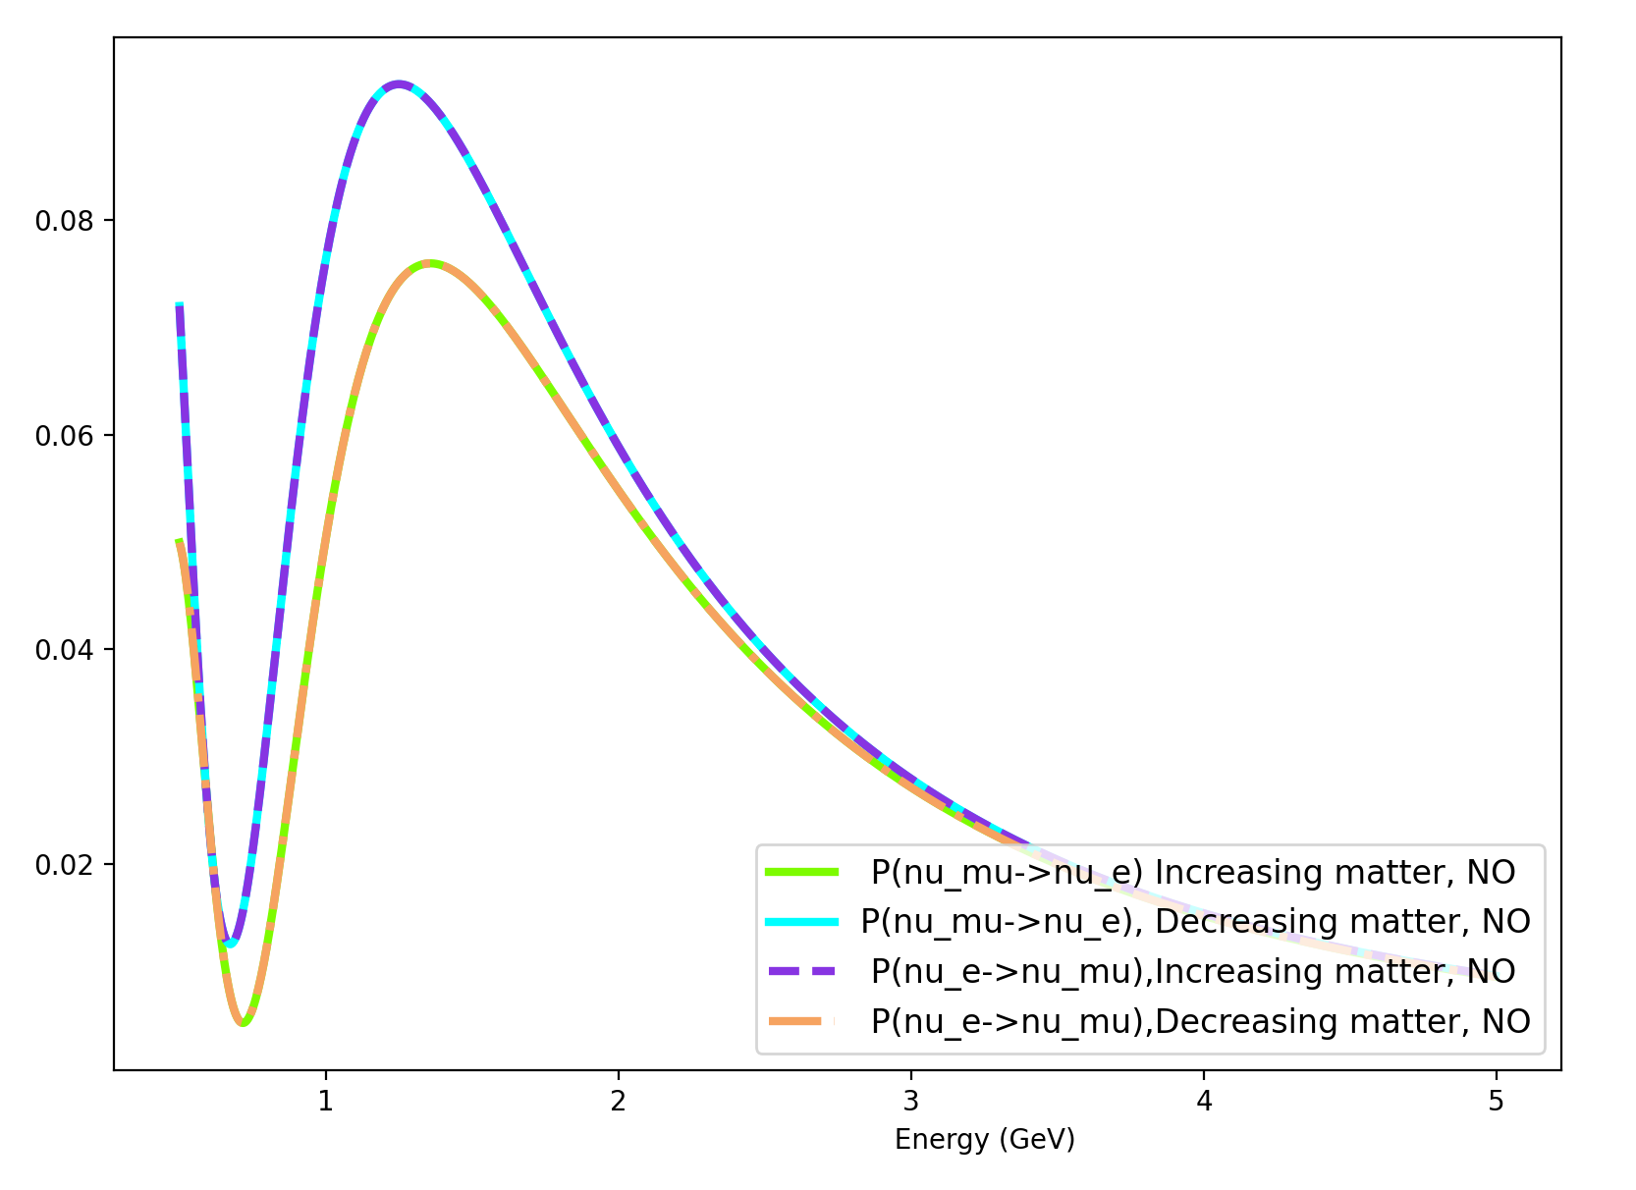
Non-symmetric matter effects for 3-Flavors, 3-Steps (Normal Ordering, Baseline: 2000 km)
3 step constant matter potential:
A1 $≈$ 5.0*10⁻⁴ eV²/GeV (2.6 g/cm³)
A2 $≈$ 1.5*10⁻³ eV²/GeV (7.8 g/cm³)
A3 $≈$ 3.0*10⁻³ eV²/GeV (15.6 g/cm³)
Preliminary
$P_{v_{μ}→v_{e}}$ & $P_{{v_{e}→v}_{μ}}$
$δ_{CP}$ = 90
Preliminary
$P_{v_{μ}→v_{e}}$ & $P_{{v_{e}→v}_{μ}}$
Proper channels are the same
$$P_{v_{α}→v_{β} }$$
$$P_{v_{α}→v_{β} }$$
$P_{v_{μ}→v_{e}}$ (increasing matter, NO)
$P_{v_{μ}→v_{e}}$ (decreasing matter, NO)
$P_{{v_{e}→v}_{μ}}$ (increasing matter, NO)
$P_{{v_{e}→v}_{μ}}$ (decreasing matter, NO)
$P_{v_{μ}→v_{e}}$ (increasing matter, NO)
$P_{v_{μ}→v_{e}}$ (decreasing matter, NO)
$P_{{v_{e}→v}_{μ}}$ (increasing matter, NO)
$P_{{v_{e}→v}_{μ}}$ (decreasing matter, NO)
46
$δ_{CP}$ = 0
$α$, $β$ -> [$μ, e]$
New Perspectives, 2024

Slide 35
Recalling 3-Flavor Neutrino Oscillations with charge-current matter effects
We include matter effects explicitly from the following prescription for the probabilities (useful in the context of this study):
$$P_{v_{α}→v_{β} }={\left|<v_{β}(0)|v_{α}\left(L\right)>\right|}^{2}$$
$|v_{α}\left(L\right)>$ = $U$ $|v_{α}\left(0\right)>$
where
U =$e^{−iLH}$
(H = H_{vacuum} + H_{matter})
with
12
New Perspectives, 2024

Slide 36
Recalling 3-Flavor Neutrino Oscillations with charge-current matter effects
As an example for a Baseline L, let’s break L up into 2 steps: L₁ and L_{2,} where each evolution U(L) will model different matter potentials A₁ and A₂ respectively.
13
New Perspectives, 2024

Slide 37
Recalling 3-Flavor Neutrino Oscillations with charge-current matter effects
As an example for a Baseline L, let’s break L up into 2 steps: L₁ and L_{2,} where each evolution U(L) will model different matter potentials A₁ and A₂ respectively.
U₁ =$e^{−iL_{1}H_{1}}$
&
U₂ =$e^{−iL_{2}H_{2}}$
where H_{i} contain different matter effects in the form:
A_{i} = $\sqrt{2}G_{F}N_{e}$ -> constant
14
New Perspectives, 2024

Slide 38
Recalling 3-Flavor Neutrino Oscillations with charge-current matter effects
In principle, one could consider an n multistep matter potential A = where each step is itself a constant matter potential (piecewise constant).
$$\sum_{i=1}^{n}{A_{i}}$$
n=2
n=1
15
New Perspectives, 2024

Slide 39
Defining time invariance measures
To handle the difficulties of testing for time invariance violation effects in experiments, we’ve specified two distinct measures:
proper time invariance: (aka: true time invariance violation)
Not a good observable, but certainly no harder to calculate than CP conjugate channels.
Requires comparing probabilities with final states exchanged and swapping the detector with source.
16
New Perspectives, 2024

Slide 40
Defining time invariance measures
proper time invariance:
(ex 2 steps)
$$P_{v_{e}→v_{μ}} vs P_{v_{μ}→v_{e}}$$
_{(decreasing potential)}
_{(increasing potential)}
for U = U₁U₂
_{(decreasing potential)}
for U = U₂U₁
_{(increasing potential)}
17
New Perspectives, 2024

Slide 41
Defining time invariance measures
improper time invariance: (next best thing!)
Compares probabilities with only the final states exchanged.
$$P_{v_{e}→v_{μ}} vs P_{v_{μ}→v_{e}}$$
ex 2 steps: (same potential)
U = U₂U₁
_{(increasing potential)}
U = U₂U₁
_{(increasing potential)}
18
New Perspectives, 2024

Slide 42
Defining time invariance measures
improper time invariance: (next best thing!)
Compares probabilities with only the final states exchanged.
Improper time invariance violation has the potential to be observable in experiments.
$$P_{v_{e}→v_{μ}} vs P_{v_{μ}→v_{e}}$$
ex 2 steps: (same potential)
U = U₂U₁
_{(increasing potential)}
U = U₂U₁
_{(increasing potential)}
19
New Perspectives, 2024

Slide 43
Modeling Matter Effects for 3-Flavors
To make reasonable predictions that includes the role matter effects play in time invariance probes, it’s important to keep in mind the characteristics of the matter potentials, as these influence our results.
For the purposes of our study, we separately considered both symmetric and non-symmetric matter potential examples.
20
New Perspectives, 2024

Slide 44
Modeling Matter Effects for 3-Flavors
The type of matter potential (symmetric/non-symmetric) provides a quick way to prove if there is matter induced time violation.
Symmetric: vacuum or single constant matter potential
Non-symmetric: piece-wise matter potentials (increasing or decreasing)
21
New Perspectives, 2024

Slide 45
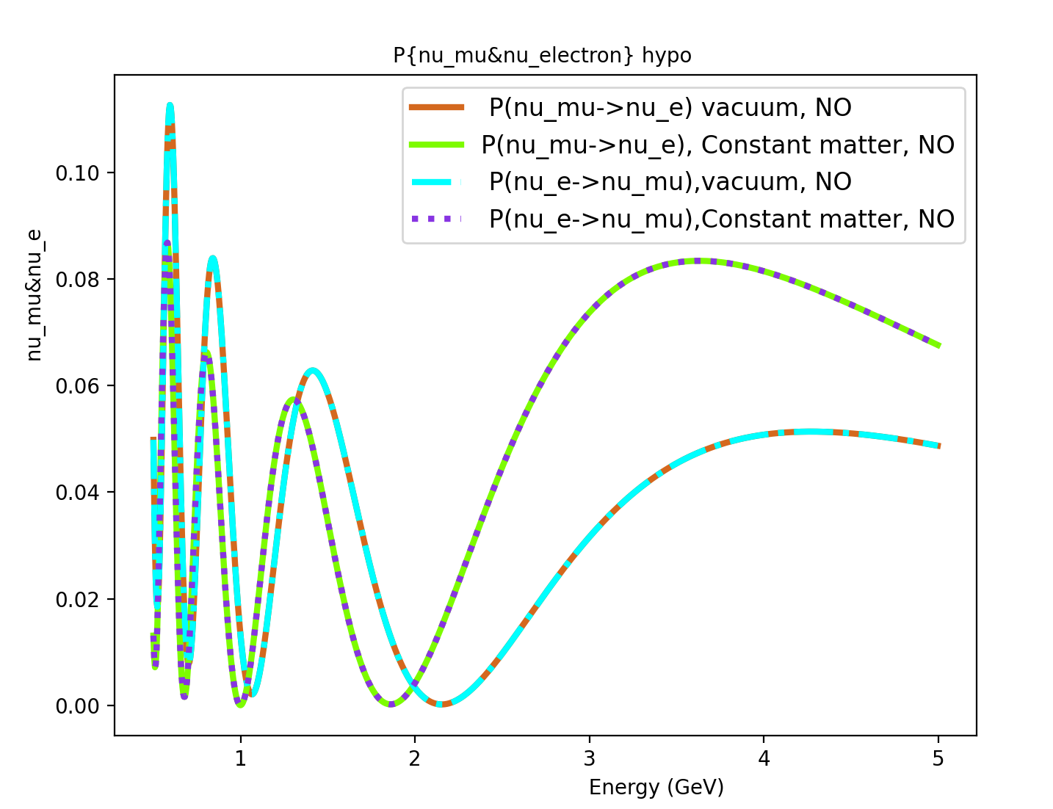
Symmetric matter effects for 3-Flavors
$P_{v_{μ}→v_{e}}$ & $P_{{v_{e}→v}_{μ}}$ channels:
Baseline: 2000 km
Constant matter potential:
5x10⁻⁴ eV²/GeV
(2.6 g/cm³)
$δ_{CP}$: 0
Normal Ordering
Preliminary
$P_{v_{μ}→v_{e}}$ & $P_{{v_{e}→v}_{μ}}$
$P_{v_{μ}→v_{e}}$ (vacuum, NO)
$P_{v_{μ}→v_{e}}$ (constant matter, NO)
$P_{{v_{e}→v}_{μ}}$ (vacuum, NO)
$P_{{v_{e}→v}_{μ}}$ (constant matter, NO)
matter channels
$$P_{v_{α}→v_{β} }$$
vacuum channels
24
$α$, $β$ -> [$μ, e]$
New Perspectives, 2024

Slide 46
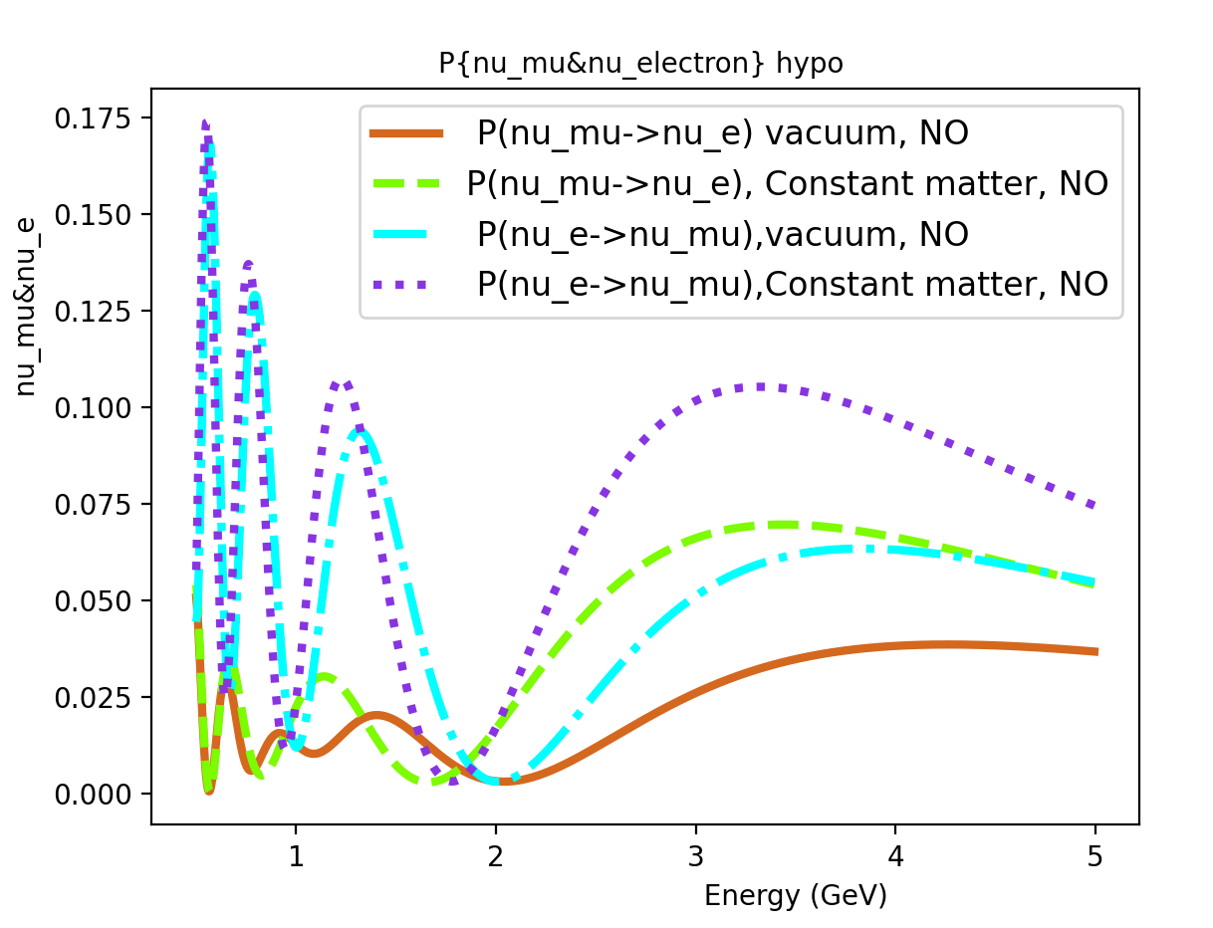
Symmetric matter effects for 3-Flavors
$P_{v_{μ}→v_{e}}$ & $P_{{v_{e}→v}_{μ}}$ channels:
Baseline: 2000 km
Constant matter potential:
5x10⁻⁴ eV²/GeV
(2.6 g/cm³)
$δ_{CP}$: $\frac{π}{2}$
Normal Ordering
Preliminary
$P_{v_{μ}→v_{e}}$ & $P_{{v_{e}→v}_{μ}}$
$P_{v_{μ}→v_{e}}$ (vacuum, NO)
$P_{v_{μ}→v_{e}}$ (constant matter, NO)
$P_{{v_{e}→v}_{μ}}$ (vacuum, NO)
$P_{{v_{e}→v}_{μ}}$ (constant matter, NO)
matter channels
$$P_{v_{α}→v_{β} }$$
vacuum channels
25
$α$, $β$ -> [$μ, e]$
New Perspectives, 2024

Slide 47
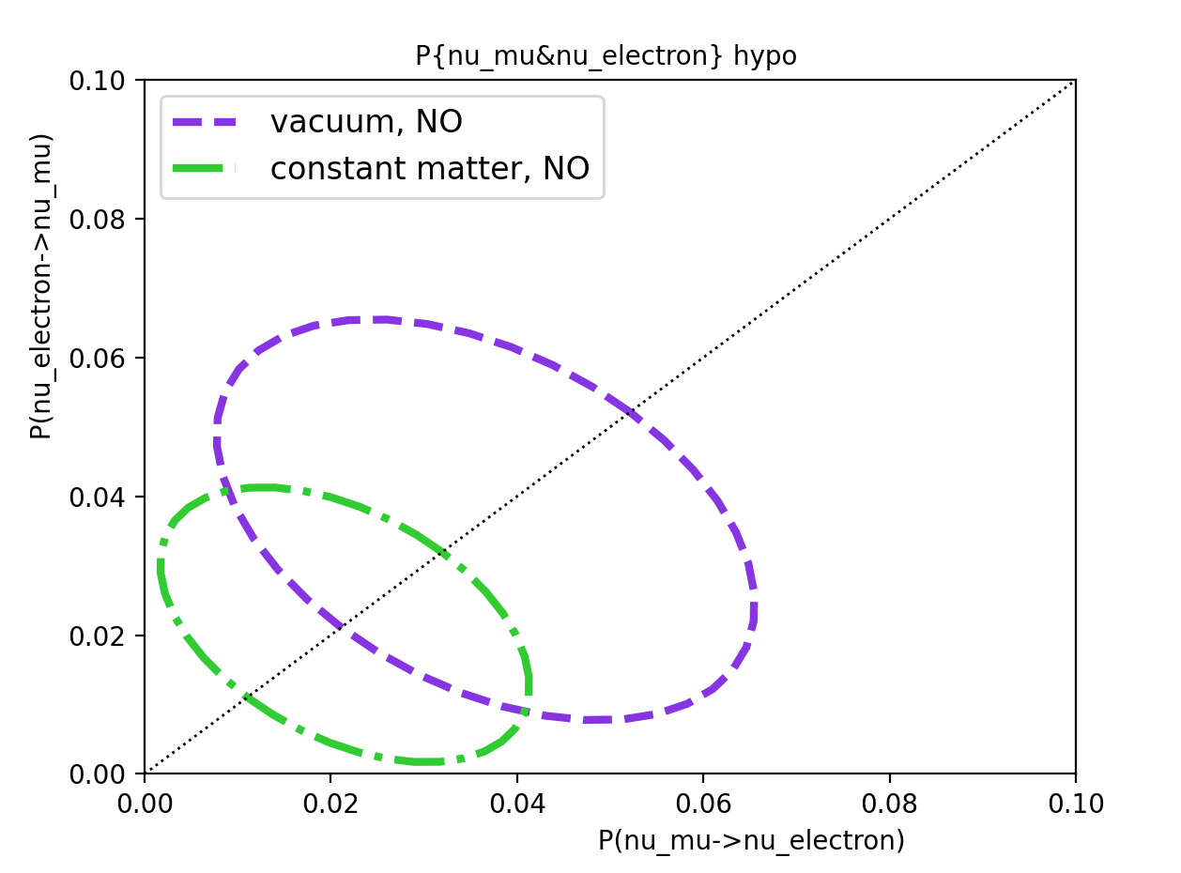
Symmetric matter effects for 3-Flavors
Preliminary
$P_{v_{μ}→v_{e}}$ & $P_{{v_{e}→v}_{μ}}$
Symmetric matter potentials cannot induce time violation.
If there is intrinsic $P_{v_{μ}→v_{e}}$ $≠$ $P_{{v_{e}→v}_{μ}}$
from $δ_{CP}$, then the matter potential
simply changes the degree of the
observed effects.
E = 1.5 GeV
$$P_{{v_{e}→v}_{μ}}$$
$$P_{v_{μ}→v_{e}}$$
26
New Perspectives, 2024

Slide 48
Symmetric matter effects for 3-Flavors
Preliminary
Note: Improper and proper comparisons are the same if the matter potential is symmetric.
Why?
A single constant matter potential is by construction symmetric.
We cannot tell the two measures apart if “exchanging source and detector” gives the same results.
$P_{v_{μ}→v_{e}}$ & $P_{{v_{e}→v}_{μ}}$
E = 1.5 GeV
$$P_{{v_{e}→v}_{μ}}$$
$$P_{v_{μ}→v_{e}}$$
27
New Perspectives, 2024

Slide 49
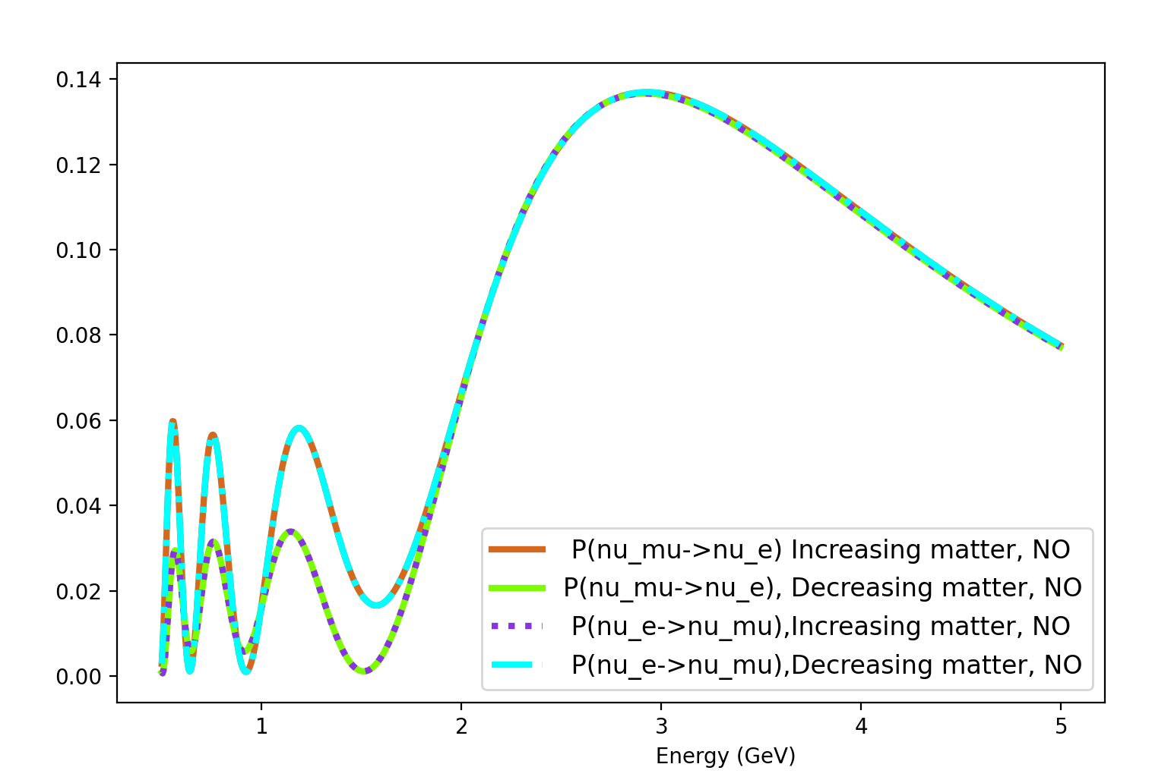
Non-symmetric matter effects for 3-Flavors
$P_{v_{μ}→v_{e}}$ & $P_{{v_{e}→v}_{μ}}$ channels:
Baseline: 2000 km
Piecewise matter potential (2 steps):
A₁ =5x10⁻⁴ eV²/GeV (2.6 g/cm³)
A₂ =1.5 x10⁻³ eV²/GeV (7.8 g/cm³)
$δ_{CP}$: 0
Normal Ordering
Preliminary
$P_{v_{μ}→v_{e}}$ & $P_{{v_{e}→v}_{μ}}$
$$P_{v_{α}→v_{β} }$$
$P_{v_{μ}→v_{e}}$ (increasing matter, NO)
$P_{v_{μ}→v_{e}}$ (decreasing matter, NO)
$P_{{v_{e}→v}_{μ}}$ (increasing matter, NO)
$P_{{v_{e}→v}_{μ}}$ (decreasing matter, NO)
28
$α$, $β$ -> [$μ, e]$
New Perspectives, 2024

Slide 50
Non-symmetric matter effects for 3-Flavors
Non-symmetric matter effects are pairwise degenerate ($δ_{CP}$: 0)
Proper time invariance channels hold
Improper are different
No intrinsic time invariance violation!
But matter induced time invariance violation can occur.
Preliminary
$P_{v_{μ}→v_{e}}$ & $P_{{v_{e}→v}_{μ}}$
$$P_{v_{α}→v_{β} }$$
$P_{v_{μ}→v_{e}}$ (increasing matter, NO)
$P_{v_{μ}→v_{e}}$ (decreasing matter, NO)
$P_{{v_{e}→v}_{μ}}$ (increasing matter, NO)
$P_{{v_{e}→v}_{μ}}$ (decreasing matter, NO)
29
$α$, $β$ -> [$μ, e]$
New Perspectives, 2024

Slide 51
Non-symmetric matter effects for 3-Flavors
Non-symmetric matter effects are pairwise degenerate ($δ_{CP}$: 0)
Proper time invariance channels hold
Improper are different
Preliminary
$P_{v_{μ}→v_{e}}$ & $P_{{v_{e}→v}_{μ}}$
$$P_{v_{α}→v_{β} }$$
Same
$P_{v_{μ}→v_{e}}$ (increasing matter, NO)
$P_{v_{μ}→v_{e}}$ (decreasing matter, NO)
$P_{{v_{e}→v}_{μ}}$ (increasing matter, NO)
$P_{{v_{e}→v}_{μ}}$ (decreasing matter, NO)
30
$α$, $β$ -> [$μ, e]$
New Perspectives, 2024

Slide 52
Non-symmetric matter effects for 3-Flavors
Non-symmetric matter effects are pairwise degenerate ($δ_{CP}$: 0)
Proper time invariance channels hold
Improper are different
Preliminary
$P_{v_{μ}→v_{e}}$ & $P_{{v_{e}→v}_{μ}}$
$$P_{v_{α}→v_{β} }$$
Same
$P_{v_{μ}→v_{e}}$ (increasing matter, NO)
$P_{v_{μ}→v_{e}}$ (decreasing matter, NO)
$P_{{v_{e}→v}_{μ}}$ (increasing matter, NO)
$P_{{v_{e}→v}_{μ}}$ (decreasing matter, NO)
31
$α$, $β$ -> [$μ, e]$
New Perspectives, 2024

Slide 53
Non-symmetric matter effects for 3-Flavors
Non-symmetric matter effects are pairwise degenerate ($δ_{CP}$: 0)
Proper time invariance channels hold
Improper are different
Preliminary
$P_{v_{μ}→v_{e}}$ & $P_{{v_{e}→v}_{μ}}$
$$P_{v_{α}→v_{β} }$$
Different
$P_{v_{μ}→v_{e}}$ (increasing matter, NO)
$P_{v_{μ}→v_{e}}$ (decreasing matter, NO)
$P_{{v_{e}→v}_{μ}}$ (increasing matter, NO)
$P_{{v_{e}→v}_{μ}}$ (decreasing matter, NO)
32
$α$, $β$ -> [$μ, e]$
New Perspectives, 2024

Slide 54
Non-symmetric matter effects for 3-Flavors
Non-symmetric matter effects are pairwise degenerate ($δ_{CP}$: 0)
Proper time invariance channels hold
Improper are different
Preliminary
$P_{v_{μ}→v_{e}}$ & $P_{{v_{e}→v}_{μ}}$
$$P_{v_{α}→v_{β} }$$
Different
$P_{v_{μ}→v_{e}}$ (increasing matter, NO)
$P_{v_{μ}→v_{e}}$ (decreasing matter, NO)
$P_{{v_{e}→v}_{μ}}$ (increasing matter, NO)
$P_{{v_{e}→v}_{μ}}$ (decreasing matter, NO)
33
$α$, $β$ -> [$μ, e]$
New Perspectives, 2024

Slide 55
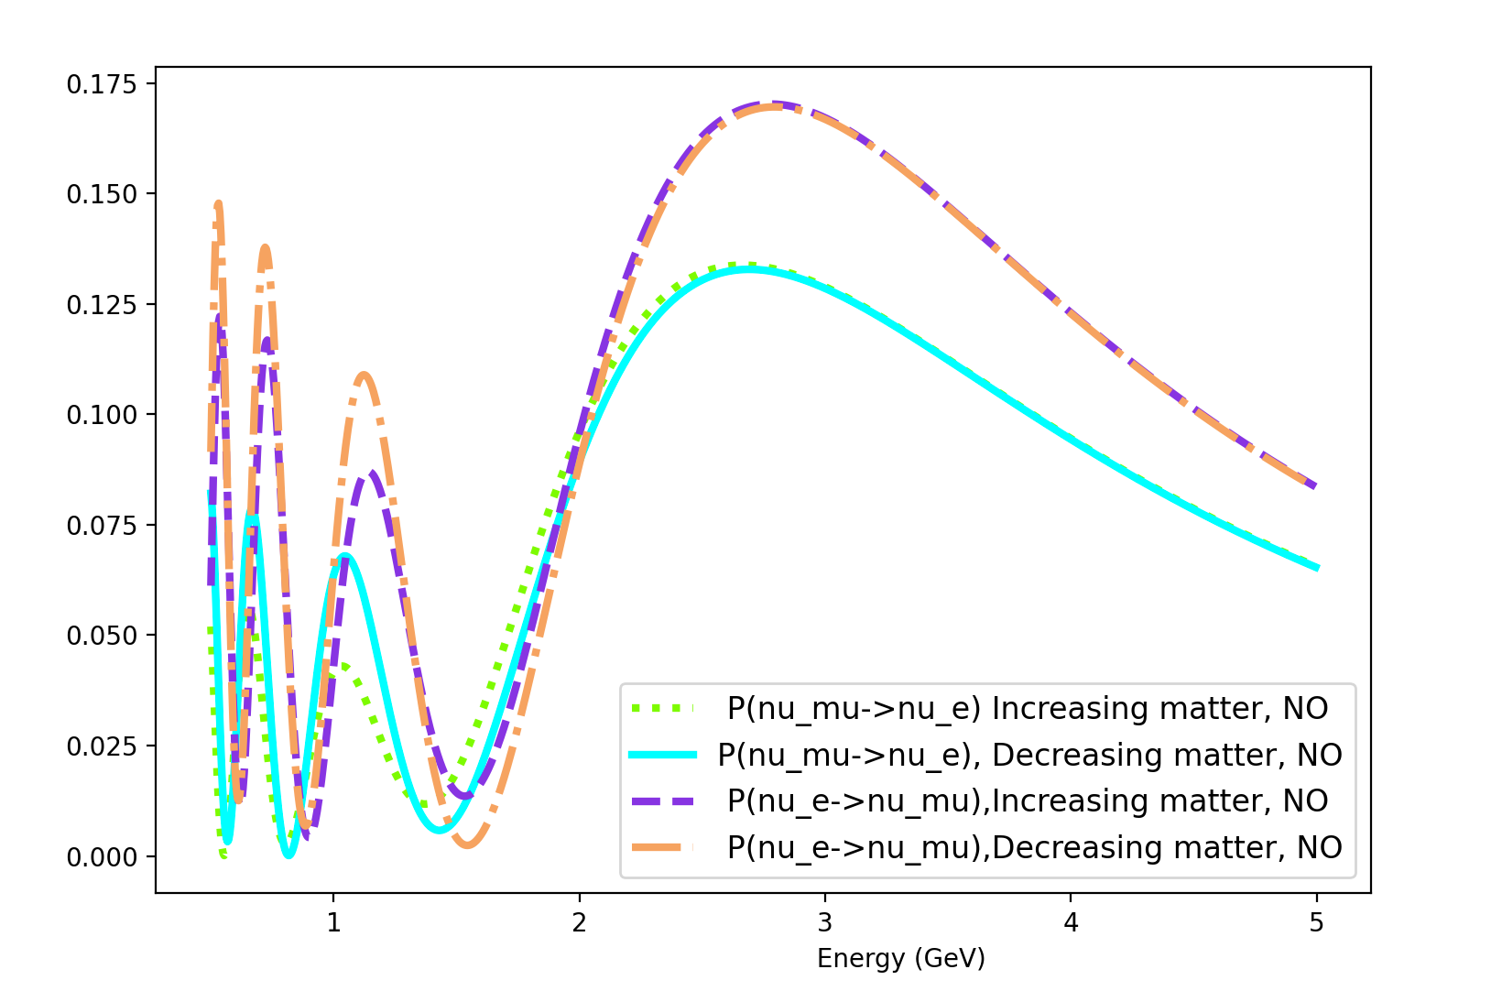
Non-symmetric matter effects for 3-Flavors
$P_{v_{μ}→v_{e}}$ & $P_{{v_{e}→v}_{μ}}$ channels:
Baseline: 2000 km
Piecewise matter potential (2 steps):
A₁ =5x10⁻⁴ eV²/GeV
A₂ =1.5 x10⁻³ eV²/GeV
$δ_{CP}\text{: }\frac{π}{2}$
Normal Ordering
Preliminary
$P_{v_{μ}→v_{e}}$ & $P_{{v_{e}→v}_{μ}}$
$$P_{v_{α}→v_{β} }$$
$P_{v_{μ}→v_{e}}$ (increasing matter, NO)
$P_{v_{μ}→v_{e}}$ (decreasing matter, NO)
$P_{{v_{e}→v}_{μ}}$ (increasing matter, NO)
$P_{{v_{e}→v}_{μ}}$ (decreasing matter, NO)
34
$α$, $β$ -> [$μ, e]$
New Perspectives, 2024

Slide 56
Non-symmetric matter effects for 3-Flavors
Non-symmetric matter effects ($δ_{CP}$: $\frac{π}{2}$)
No longer pair-wise degenerate.
(Intrinsic $P_{v_{μ}→v_{e}}$ $≠$ $P_{{v_{e}→v}_{μ}}$)
Preliminary
$P_{v_{μ}→v_{e}}$ & $P_{{v_{e}→v}_{μ}}$
$$P_{v_{α}→v_{β} }$$
$P_{v_{μ}→v_{e}}$ (increasing matter, NO)
$P_{v_{μ}→v_{e}}$ (decreasing matter, NO)
$P_{{v_{e}→v}_{μ}}$ (increasing matter, NO)
$P_{{v_{e}→v}_{μ}}$ (decreasing matter, NO)
35
$α$, $β$ -> [$μ, e]$
New Perspectives, 2024

Slide 57
Non-symmetric matter effects for 3-Flavors
Non-symmetric matter effects ($δ_{CP}$: $\frac{π}{2}$)
No longer pair-wise degenerate.
(Intrinsic $P_{v_{μ}→v_{e}}$ $≠$ $P_{{v_{e}→v}_{μ}}$)
Matter potential choice changes magnitude of oscillations.
Preliminary
$P_{v_{μ}→v_{e}}$ & $P_{{v_{e}→v}_{μ}}$
$$P_{v_{α}→v_{β} }$$
$P_{v_{μ}→v_{e}}$ (increasing matter, NO)
$P_{v_{μ}→v_{e}}$ (decreasing matter, NO)
$P_{{v_{e}→v}_{μ}}$ (increasing matter, NO)
$P_{{v_{e}→v}_{μ}}$ (decreasing matter, NO)
All probabilities are different.
36
$α$, $β$ -> [$μ, e]$
New Perspectives, 2024

Slide 58
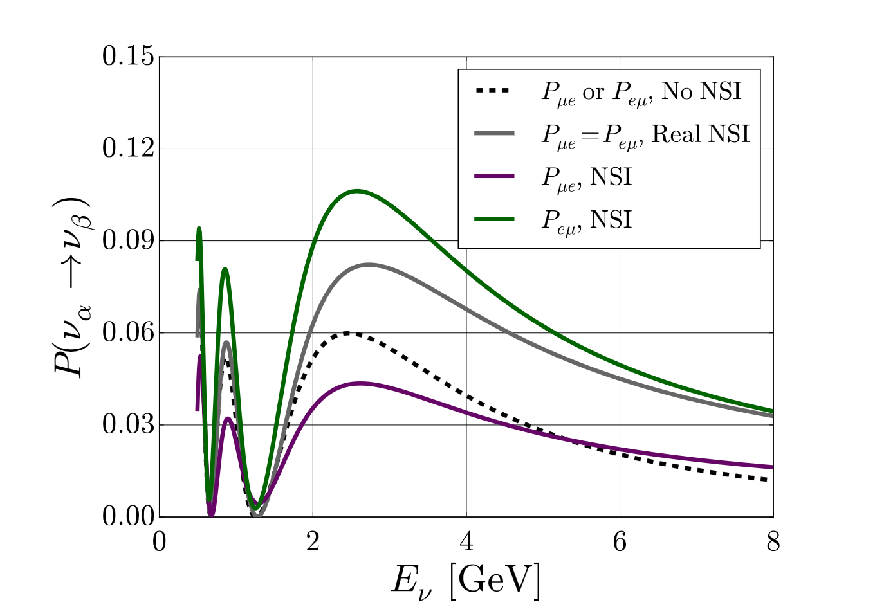
Future Studies
Interesting probes in cases where matter induced time violation occurs and/or realistic models are non-symmetric:
Center of the Earth (annihilating dark matter to neutrinos scenario)
Geo neutrinos (properties/applications)
Next steps include NSI time invariance probes applicable to DUNE, (a follow-up to previous work).
A. de Gouvêa & K. Kelly (2016) arXiv: 1511.05562
39
New Perspectives, 2024

