Slide 1
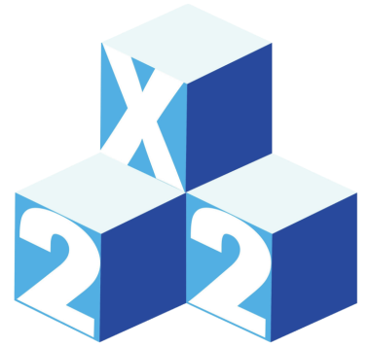
First Physics Studies with DUNE Near Detector Prototype ($2×2$ Demonstrator)
Muhammad bilal azam
Illinois Institute of Technology, Chicago
On behalf of the DUNE Collaboration
July 8, 2024
New Perspectives 2024
Fermi National Accelerator Laboratory

Slide 2
Science goals of dune
Constrain flavor and mass models
Measurement of precise neutrino oscillation parameters
CP violation
Mass hierarchy
Learn more about supernovae and black holes
DUNE alone would detect $>3x$ as many neutrinos as all active detectors did for SN1987A
GUT and beyond SM
Proton decay
Baryon number violation
Sterile neutrinos
Non-standard interactions and more

Slide 3
Deep Underground Neutrino Experiment (DUNE)
Long baseline experiment: $1300 km$ from Fermilab to SURF
Intense neutrino beam: $1.2 MW$ (upgradable to $2.4 MW$)
Two detectors
Near Detector (ND): To measure un-oscillated neutrino flux
Far Detector (FD): A $70−kton total (40−kton fiducial)$ detector to measure oscillated neutrino flux
DUNE detector prototypes
$2×2$ Demonstrator at Fermilab for ND
ProtoDUNE program at CERN for FD
South Dakota
Illinois

Slide 4
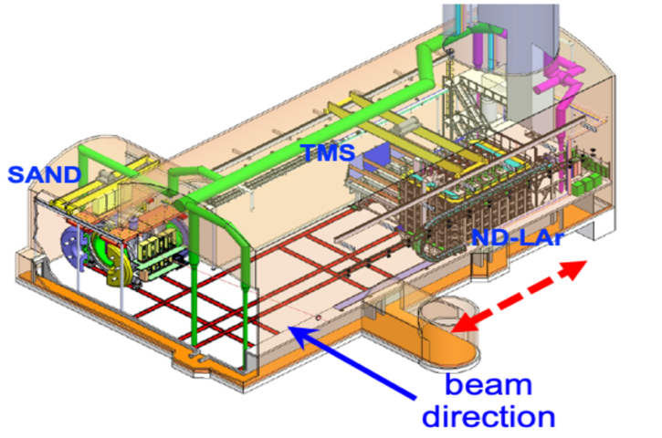
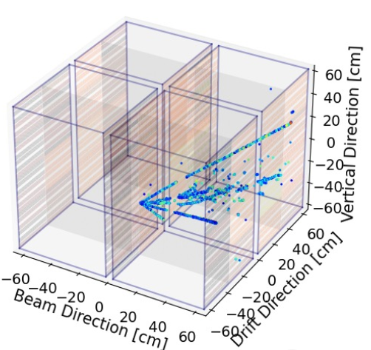
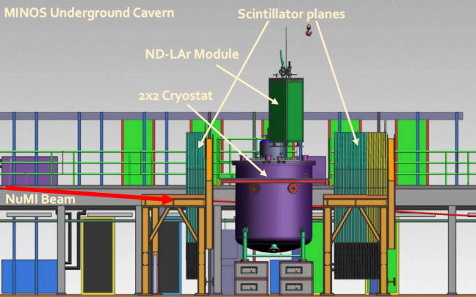
Full Near detector and its prototype
Full Near Detector have:
Near Detector Liquid Argon (ND-LAr)
The Muon Spectrometer (TMS)
System for On-Axis Neutrino Detection (SAND)
Our current effort is with ND-LAr prototype (also known as $2×2$ Demonstrator)
Successfully entered its commissioning phase in June 2024 with antineutrinos from the NuMI Beam
Sketch of Future ND
Modular Design of
$2×2$ Demonstrator
$2×2$ Demonstrator
DUNE:2X2 Demonstrator Simulation (Preliminary)

Slide 5
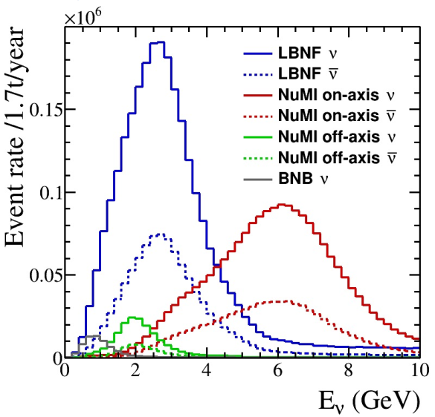
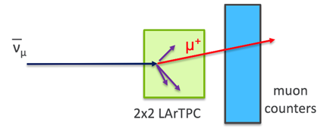
Physics studies with $2×2$ Demonstrator
Perform first physics studies of antineutrino events in NuMI beam using novel pixelated $2×2$ Demonstrator technology
The goal is to help demonstrate DUNE ND-LAr physics capabilities early at the prototype stage
Validate event simulation and reconstruction
Compare measurements to various neutrino generator models (GENIE etc.) to benchmark these models
Identify areas where new systematic uncertainties will need to be implemented in the analysis, before the ND data becomes available $\left(∼2031+\right)$

Slide 6
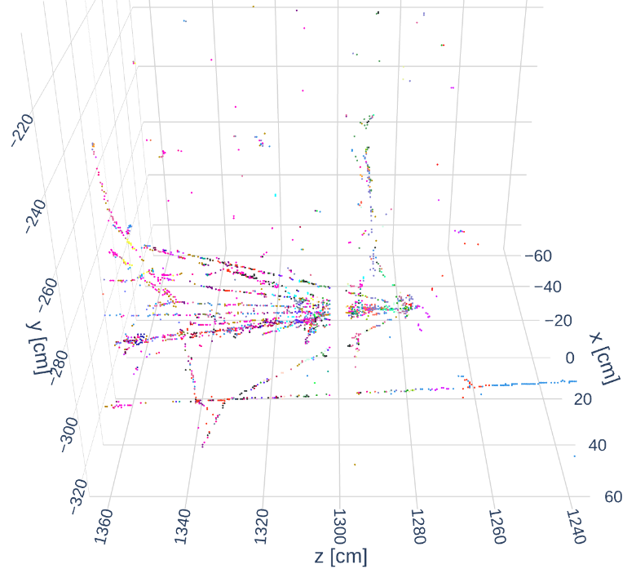
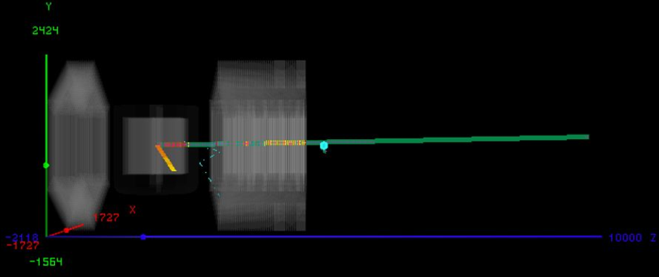
physics analysis efforts
Our current research and analysis efforts are focused on developing simulation, event selection and reconstruction tools.
DUNE:2X2 Demonstrator Simulation (Preliminary)
These are examples of initial physics measurements that we are working on:
charged track multiplicity analysis
mesonless CC antineutrino cross-section

Slide 7
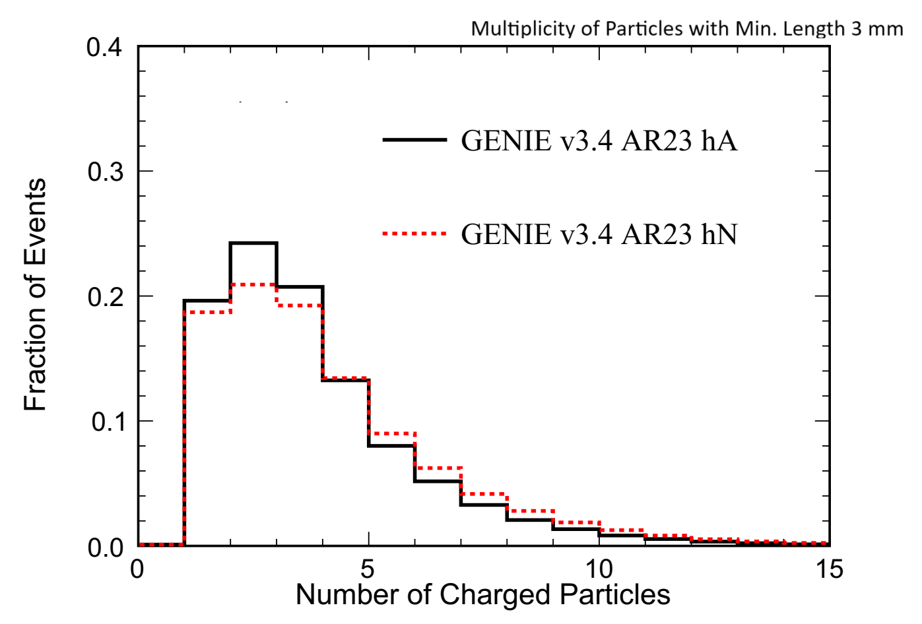
Charged track Multiplicity analysis
Select antineutrino interactions with single muon and associated charged hadrons
Count number of reconstructed tracks
Muon reconstructed in both LArTPC (Liquid Argon Time Projection Chamber) and muon counters (MINERvA planes)
Other charged tracks are reconstructed in LArTPC
Selection Criteria
Require interaction vertex to be within LAr fiducial volume
Require associated particles to have a minimum track length
This exercises tools like track reconstruction and particle identification, which are useful in other analyses (e.g. cross-section measurements)
Signal purity is $>90\%$.
DUNE:2X2 Demonstrator Simulation (Preliminary)

Slide 8
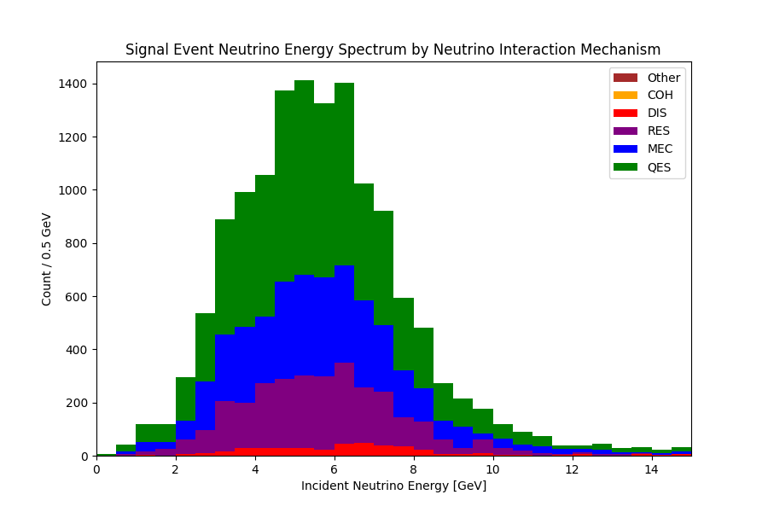
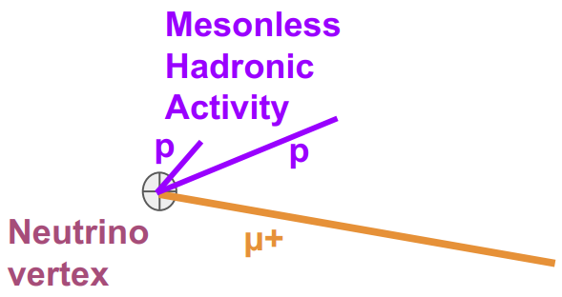
Motivation for mesonless $\overline{ν_{μ}}$-Argon CC Cross Section
Neutrino interaction mis-modeling acts as a major source of systematic uncertainty in neutrino energy reconstruction for DUNE oscillation analyses
Signal: $\overline{ν_{μ}}$ charged-current with zero final state pions over charge tracking threshold
Signal topology encompasses a broad range of physics processes
Includes QE events, 2p2h (MEC), etc.
And cross section measurements help in improving neutrino event generators/neutrino-nucleus interaction modeling
DUNE:2X2 Demonstrator Simulation (Preliminary)

Slide 9
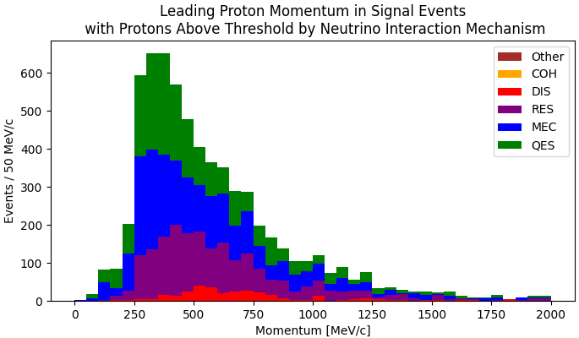
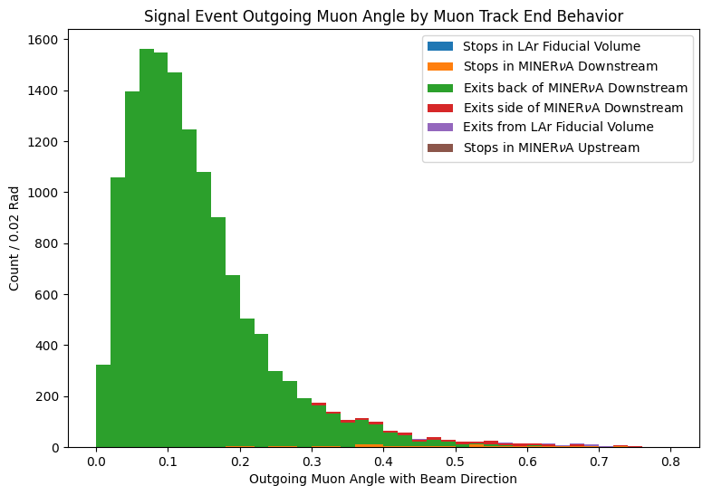
Mesonless$\overline{ν_{μ}}$-Argon CC Cross Section
Signal definition
one muon originating in the LAr fiducial volume and punching through the back of MINERvA downstream planes
no mesonic activity above threshold at the neutrino vertex
(Not required) hadronic activity from protons or heavier baryons
Topology (based on our signal definition) is simple.
We will measure differential cross-sections using events with protons in the final state.
DUNE:2X2 Demonstrator Simulation (Preliminary)
DUNE:2X2 Demonstrator Simulation (Preliminary)

Slide 10
Summary and next steps
DUNE will make neutrino oscillation measurements with cutting-edge precision
DUNE ND will have a critical role in these precise measurements
ND-LAr Prototype $(2×2 Demonstrator)$ is a novel pixelated TPC that will be taking NuMI antineutrino data this summer
Currently, analysis efforts are focused on simulation, event selection and reconstruction.
We are working on the first physics studies with $2×2$ Demonstrator focused on:
charged track multiplicity analysis
mesonless CC antineutrino cross-section
Next steps include detector data collection, analysis and comparison to the antineutrino interaction models.
Acknowledgements

Slide 11
Backup Slides

Slide 12
Protodune at cern
Two $750 ton$ prototypes: $\left(7.2×6.1×7.0\right) m$
Single-Phase Horizontal Drift (HD)
Single-Phase Vertical Drift (HD)
Advantages
Design validation of all components
Characterize detector performance on charged-particle beams
Train and develop reconstruction algorithms
Perform in-depth physics analysis
Provide feedback to AI/ML reconstruction and Monte-Carlo simulations
Each DUNE-FD module will be $20$ times larger than one ProtoDUNE detector.

Slide 13
Near detector complex
Near Detector Liquid Argon (ND-LAr)
A $67−ton$ liquid argon time projection chamber (TPC)
Allows target for neutrino interactions with hadronic activity
Temporary Muon Spectrometer (TMS)
Muon spectrometer for forward muons not contained in ND-LAr
System for On-Axis Neutrino Detection (SAND)
Provides baseline monitoring with a detector and target that enables weekly beam-monitoring

Slide 14
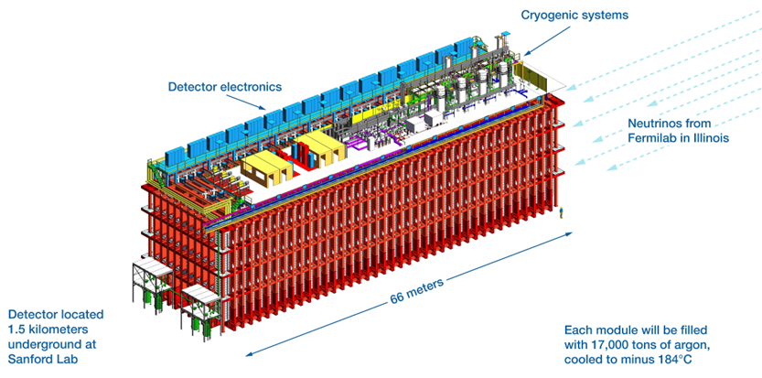
FAR detector complex
4 detector modules, 17 kt total mass each (∼10 kt of FV each)
Construction in stages
2 single-phase (SP) and 2 dual-phase (DP) LArTPCs
Single-Phase LArTPC
FD #1: Horizontal Drift (HD) − Construction starts in mid 2020’s
FD #2: Vertical Drift (VD)
Dual-Phase LArTPC Technologies
FD #3: SP LArTPC enhanced VD concept - Ongoing
FD #4: Ongoing R&D

Slide 15
LBNF Neutrino Beam (Working)
$$π^{+}→μ^{+}+v_{μ} \\ π^{−}→μ^{−}+\overline{v_{μ}} \\ μ^{+}→e^{+}+ν_{e}+\overline{v_{μ}} \\ K^{+}→μ^{+}+ν_{μ} \\ k^{+}→π^{0}+e^{+}+ν_{e} \\ K^{−}→μ^{−}+\overline{v_{μ}} \\ K^{−}→π^{0}+e^{−}+\overline{v_{e}}$$
Start with an intense (MW) proton beam
Point towards South Dakota
Smash high-energy (~80 GeV) protons into a target
Focus positive pions/kaons
Allow them to decay
Absorb remaining charged particles in rock (e.g., $π^{+},π^{−},K^{+},K^{−},K^{0}$)
Left with a “collimated” $ν_{μ}$ beam
$$p$$
ii
$$p$$
$$π,K$$
$$p$$
i
iii
$$μ,ν$$
iv
v
vii
$$ν$$
vi

Slide 16
Neutrino beam flux
Predicted fluxes at FD are shown.
Generated using Geant4-based simulation of the LBNF neutrino beam
Fluxes are available in both modes:
Forward Horn Current (FHC) mode (for neutrinos)
Reverse Horn Current (RHC) mode (for antineutrinos)
DUNE oscillation
Around $3 GeV$
$\overline{ν_{μ}}$ is $3×{10}^{10}$
$\overline{ν_{e}}$is $3×{10}^{8}$
$1\%$ of antineutrinos are electron-antineutrinos.

Slide 17
How will the multiplicity analysis proceed?
Charged Multiplicity Analysis Steps
Collect charge hits vs time
Reconstruct hit clusters $→$ tracks/showers
Reconstruct neutrino slices within each event
Find an event vertex
Loop around vertex to find associated tracks
Use track length in the track selection
Count number of charged particle tracks
Compare data to MC distributions
Account for systematic uncertainties.
Event Example
Thanks to Andrew Mogan!

Slide 18
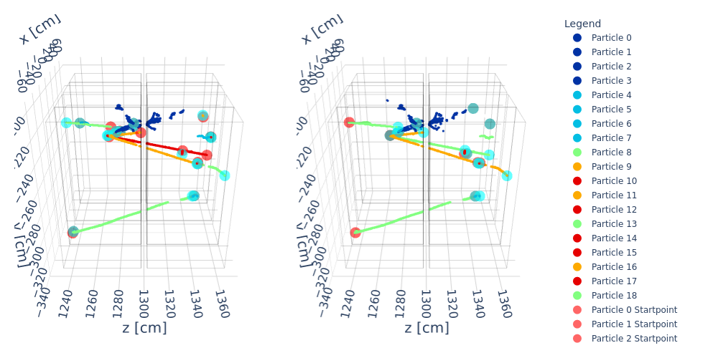
How does an ML-reconstructed event look like?
output_27023276_64-larcv_mlreco_ana.h5 (Event 30)
Reco
Truth
 | $$γ$$ | $$e$$ | $$μ$$ | $$π^{±}$$ | $$p$$
Reco | $$4$$ | $$4$$ | $$3$$ | $$3$$ | $$5$$
Truth | $$4$$ | $$1$$ | $$3$$ | $$3$$ | $$6$$

Slide 19
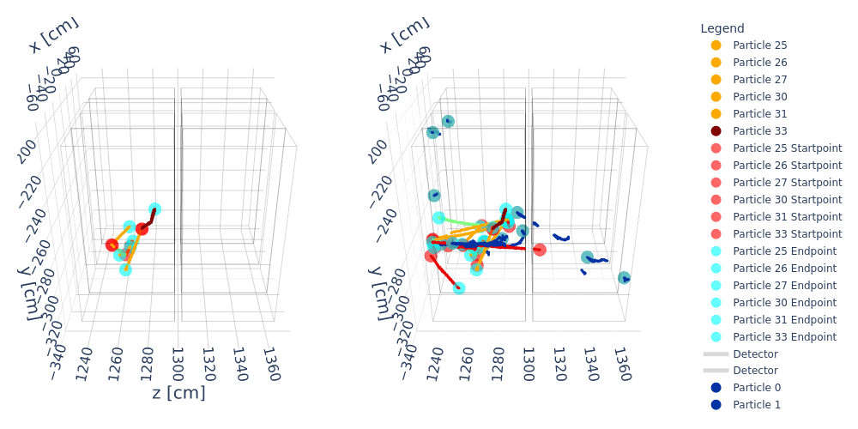
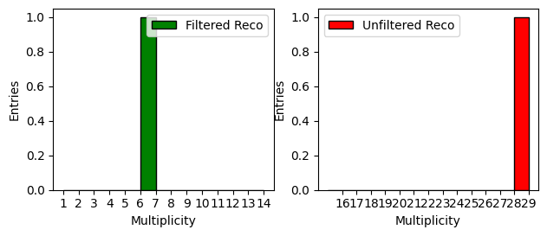
How event looks like?
output_27023276_88-larcv_mlreco_ana.h5 (Event 99, Interaction 6)
 | No Selection | After Selection
$$γ$$ | 10 | 0
$$e$$ | 1 | 0
$$μ$$ | 1 | 5
$$π^{±}$$ | 9 | 0
$$p$$ | 7 | 1
$$K$$ | 1 | 0
Before Selection
After Selection

