Slide 1
LArIAT in 10 Minutes
Liani Silva
Illinois Institute of Technology
On behalf of the LArIAT collaboration
New Perspectives 2024
07/09/2024

Slide 2
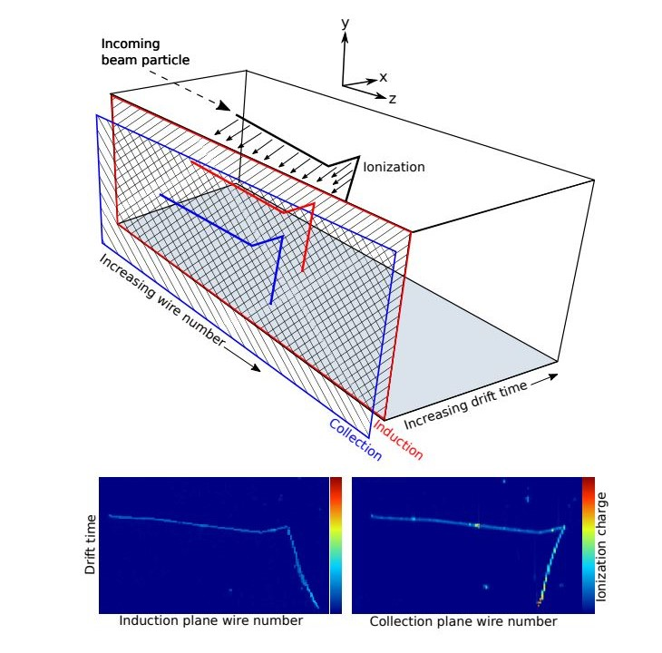
LArIAT: Liquid Argon in a Testbeam
LArIAT is a Liquid Argon Time Projection Chamber (LArTPC) in a test beam of known charged particles (π±, µ±, e±, p, K±) in a momentum range of 300-1400 MeV/c.
As these particles move through the LArTPC, they ionize the argon to produce scintillation light and free electrons that drift through a 484 V/cm electric field towards a dual-plane wire mesh.
The electrons induce current on the induction plane and deposit charge onto the collection plane, together with the eˉ time of flight, a 3D reconstruction is made.
TPC dimensions of 90cm x 47cm x 40cm (length x width x height).
Images: R. Acciarri et al 2020 JINST 15 P04026
New Perspectives 2024
Liani Silva
07/09/2024

Slide 3
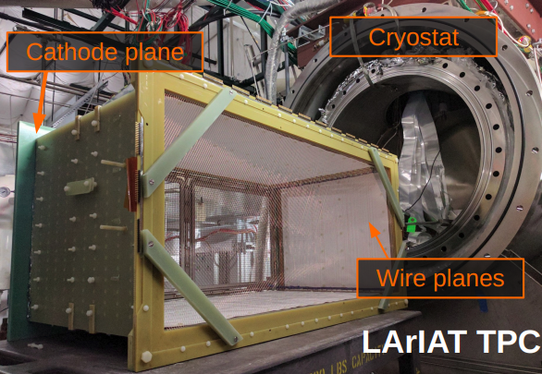
LArIAT: Liquid Argon in a Testbeam
LArIAT is small with an active mass of ~0.24 tons but it provides
improved particle identification
full 3D-imaging
precise calorimetric energy reconstruction
The experiment ran from 2015 to 2017 in the Test Beam Facility.
LArIAT was developed to characterize LArTPC response to particles and energy ranges relevant to both short-baseline (MicroBooNE, SBND, ICARUS) and long-baseline (DUNE) neutrino experiments.
LArIAT is not a direct neutrino detector, it is a detector of the charged particles that can result from neutrino-argon interactions.
Both scintillation light and charge are collected.
The induction and collection plane wires aligned at ±60 degrees with respect to the horizontal z-axis.
Image: R. Acciarri et al 2020 JINST 15 P04026
New Perspectives 2024
Liani Silva
07/09/2024

Slide 5
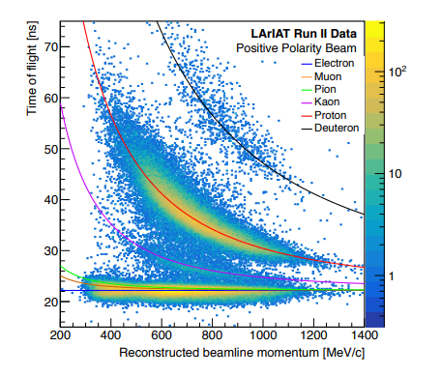
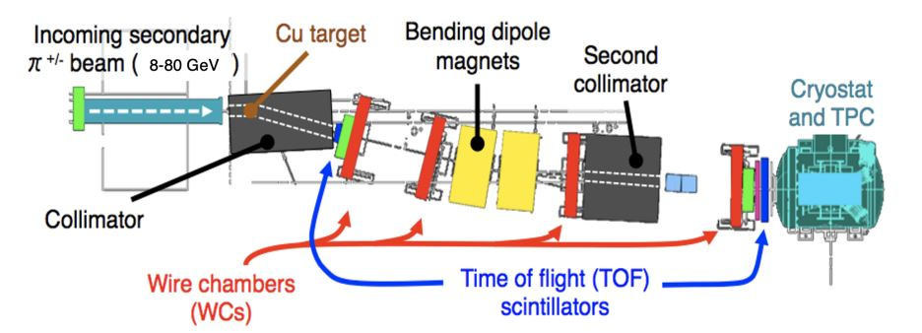
The Testbeam
The secondary pion beam is incident on a copper target.
The four wire chambers measure the momentum and particle composition of the beam.
The TOF scintillation paddles are the beamline’s clock.
The resulting tertiary beam has a momentum of 0.3–1.4 GeV/c at an angle of 13° relative to the secondary beam.
Results in a well-defined calibration beam.
Images: R. Acciarri et al 2020 JINST 15 P04026
New Perspectives 2024
Liani Silva
07/09/2024

Slide 6
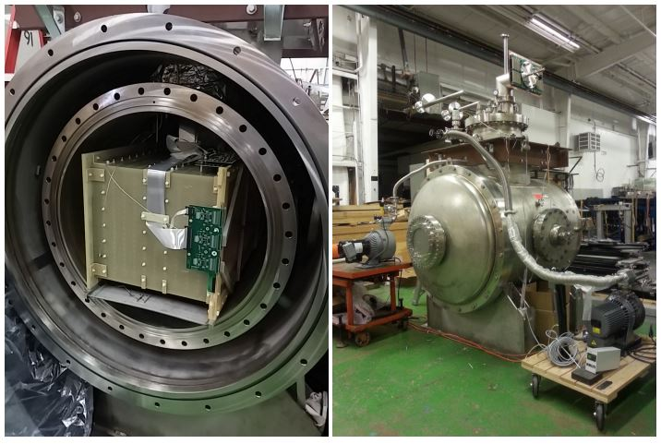
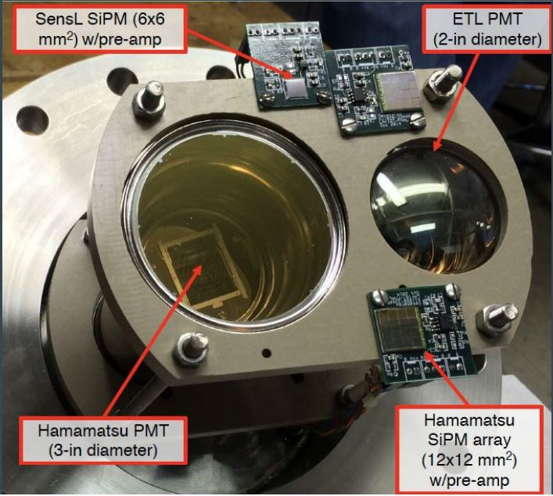
LArIAT Technology
Scintillation light is downshifted from VUV to visible by TPB coated reflector foils and then captured by PMTs and SiPMs.
LArIAT’s cryostat which was inherited and improved from the ArgoNeuT experiment.
Image: R. Acciarri et al 2020 JINST 15 P04026
New Perspectives 2024
Liani Silva
07/09/2024

Slide 7
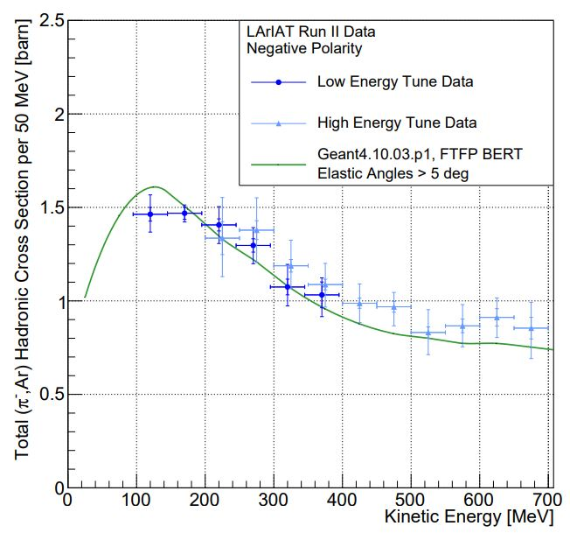
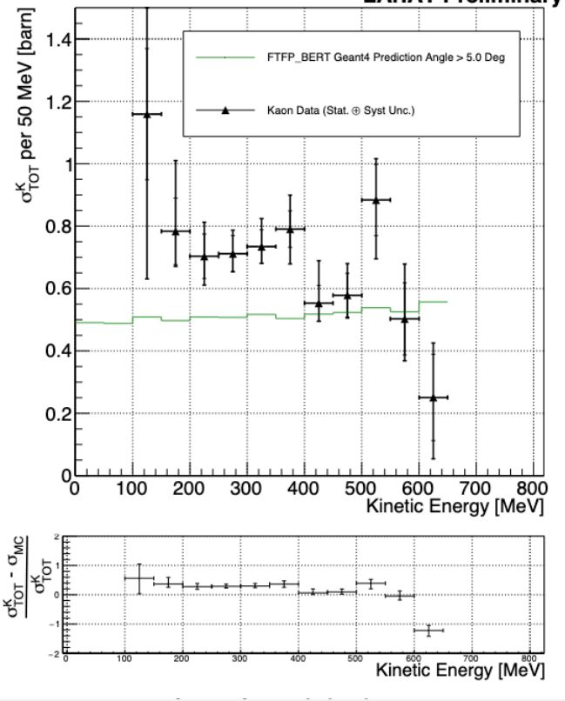
Cross Sections
Pions below 1 Gev are common products of neutrino interactions.
A novel “thin slice” method was created to measure the total hadronic cross section on liquid argon in a mid energy range (100-700 MeV).
These are the first measurements of πˉ and K⁺ total cross sections in a LArTPC
Proton decay is predicted by almost every GUT (violates baryon number)
p → e⁺π⁰
p → K⁺ν
The measured cross section is in good agreement with Geant4 for pions but significantly higher for kaons, on the order of 20%-30% (in bins <400 MeV).
πˉ total cross section on argon
Image: E. Gramellini et al. (LArIAT Collaboration), Phys. Rev. D 106, 052009
K⁺ total cross section on argon
Image: E. Gramellini, Fermilab Thesis
New Perspectives 2024
Liani Silva
07/09/2024

Slide 8
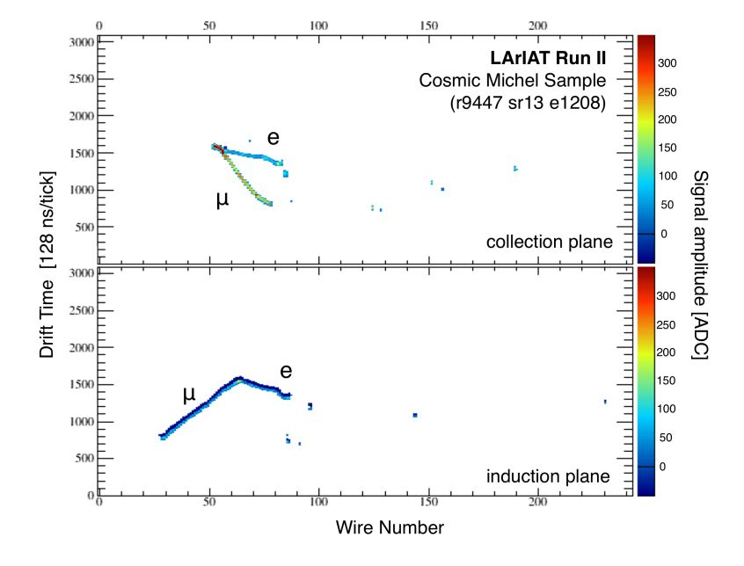
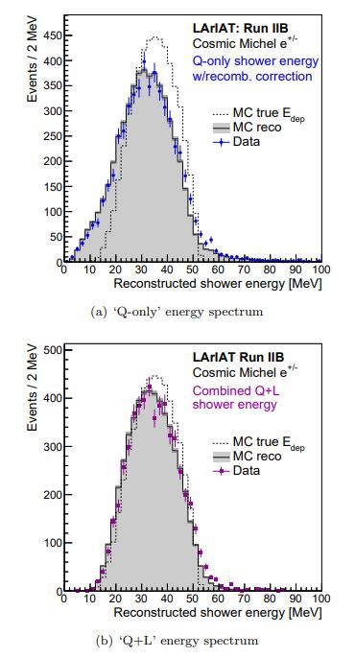
Michel Electrons
Michel electrons are produced when muons decay at rest, they have energies less than 50 MeV.
This analysis designed a real-time trigger on stopping and decaying cosmic muons using PMTs
The energy of Michel electrons was reconstructed using both charge from TPC wires and light from PMTs
Scintillation light was shown to improve energy resolution
Images: W. Foreman et al. (LArIAT Collaboration), PhysRevD.101.012010
New Perspectives 2024
Liani Silva
07/09/2024

Slide 9
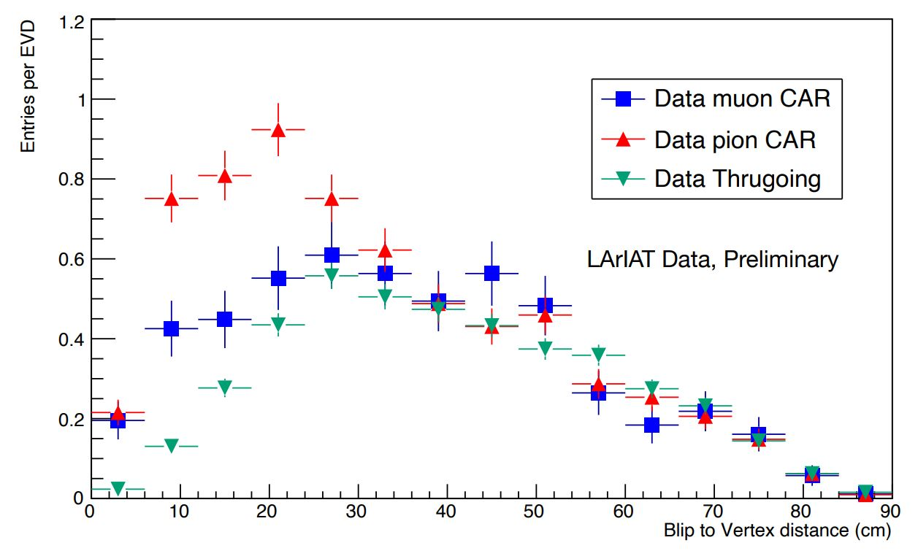
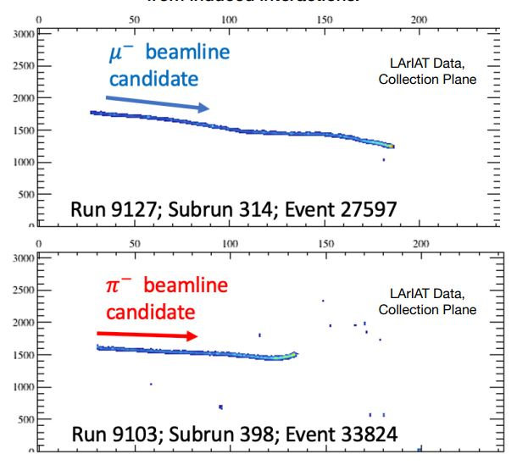
Muon and Pion capture at rest
Blips are small, spatially-isolated energy depositions from MeV scale gamma rays.
Pions and muons captured at rest transfer different amounts of energy to nucleus
With a detailed low-energy blip analysis, MuCAR and PiCAR candidates are clearly identified.
LArIAT is ideal for this analysis as it can measure the low energies needed for capture at rest.
Using beam momentum and track stopping point inside of the TPC, stopping muons are clearly distinguishable from stopping pions.
Credit: Miguel Angel Hernandez Morquecho
New Perspectives 2024
Liani Silva
07/09/2024

Slide 10
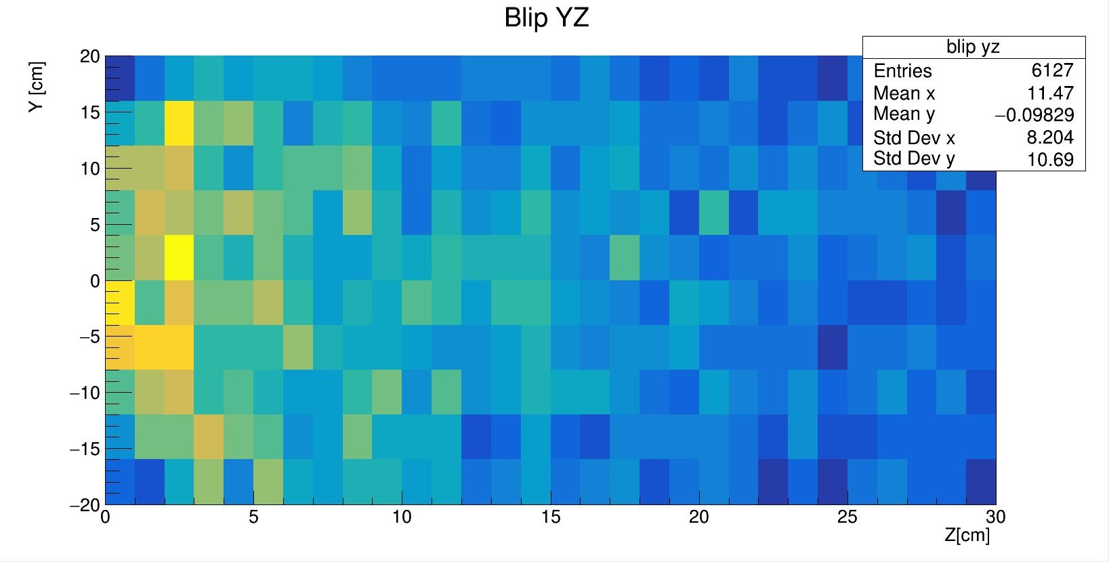
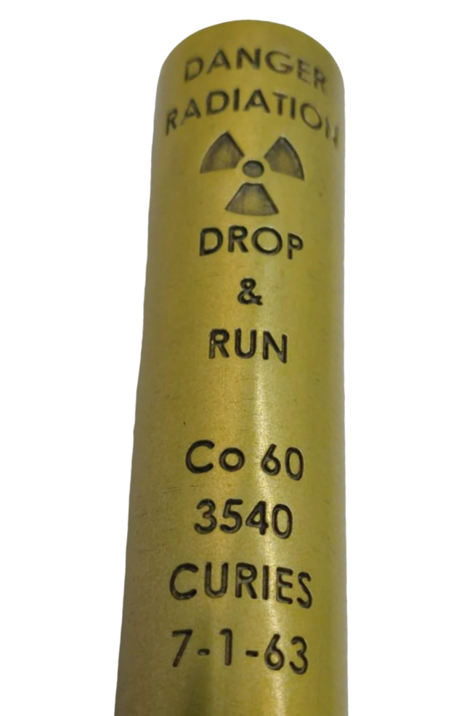
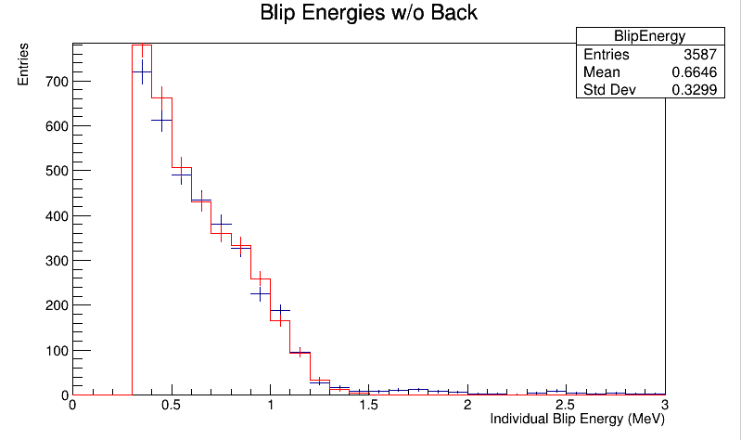
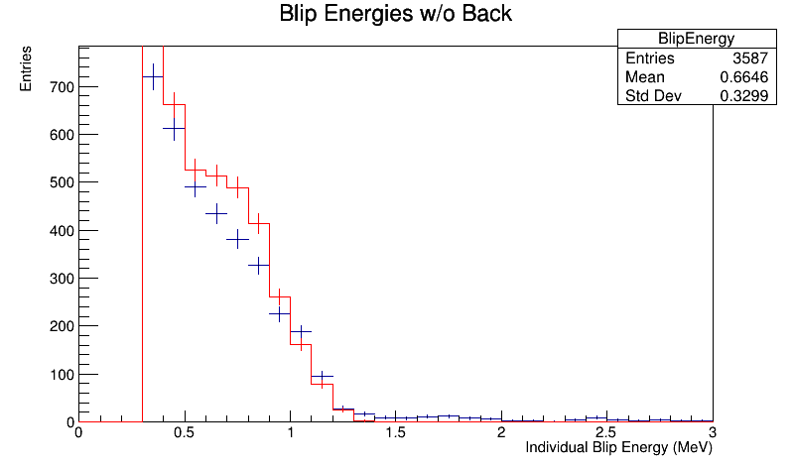
Radioactive Source Runs
A radioactive Co-60 source was placed directly in front of LArIAT, about 10 cm away from the TPC (-z).
We expect to see gammas with energies up to 1.33 MeV as the Co-60 decays, producing an electron and an antineutrino.
The gamma rays ionize Ar electrons which drift towards the wires, depositing blips.
There is a definite energy offset between MC simulation and data which corresponds to a 18.75% energy shift.
Blip energies unshifted
χ² of 58.0
Blip energies optimized and MC shifted by 18.75%
χ² of 7.9
New Perspectives 2024
Liani Silva
07/09/2024

Slide 11
THANK YOU! ☺
New Perspectives 2024
Liani Silva
07/08/2024

