Slide 1
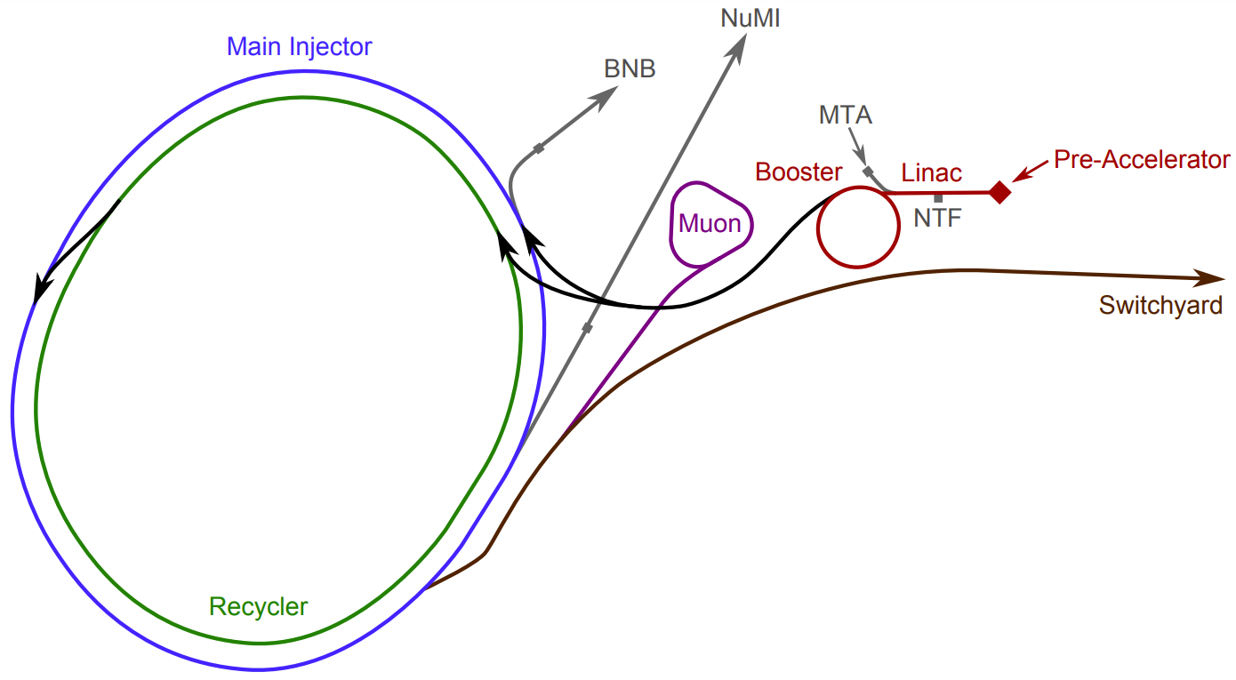
Accelerator Complex Status & Evolution
Jason D. Crnkovic
57th Annual Users Meeting (2024): Inspirations from P5
Wednesday, July 10, 2024
[1]
[1] Accelerator Division - Operations Department, Concepts Rookie Book (2020) https://operations.fnal.gov/rookie_books/concepts.pdf

Slide 2
This talk gives the 10,000-foot view of AD.
There is a lot of current & future accelerator & accelerator dependent work going on at Fermilab!!!
It is not practical for me to acknowledge all the work in this talk.

Slide 3
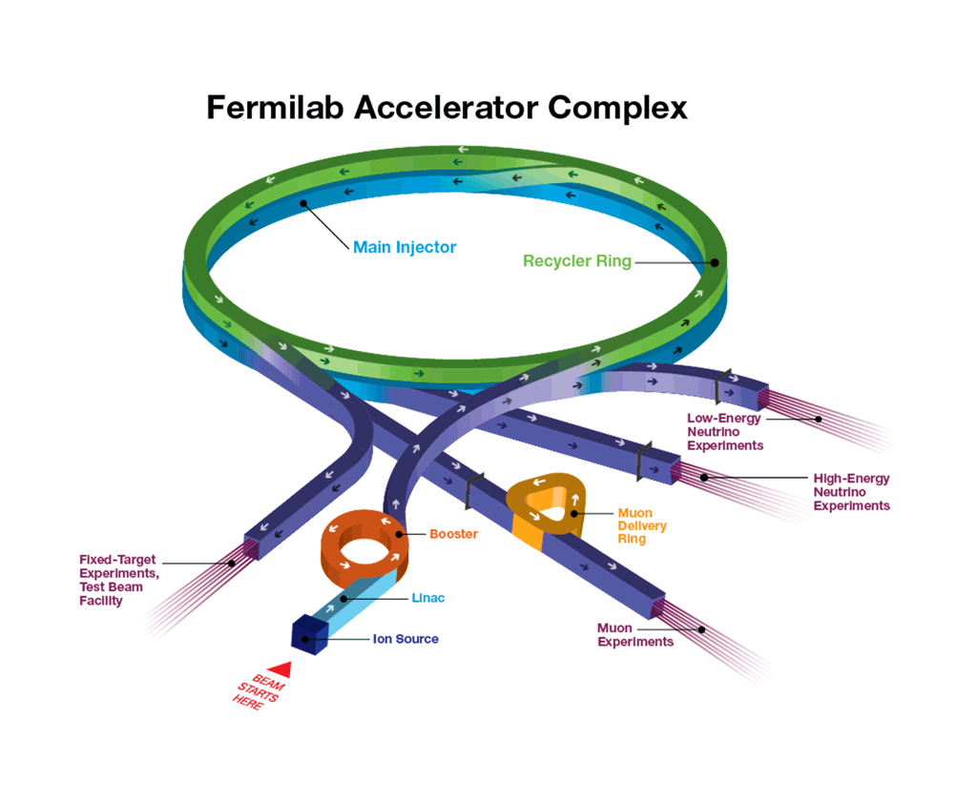
Current Fermilab Accelerator Complex:
[1]
BNB Line to ICARUS, ANNIE, & SBND.
Meson Line to MTest & MCenter
&
Neutrino-Muon Line to SpinQuest
NuMI Line to NOvA
MTA Line to ITA
Muon Campus Line to Mu2e
[1] https://www.fnal.gov/pub/science/particle-accelerators/images/accel-complex-animation.gif

Slide 4
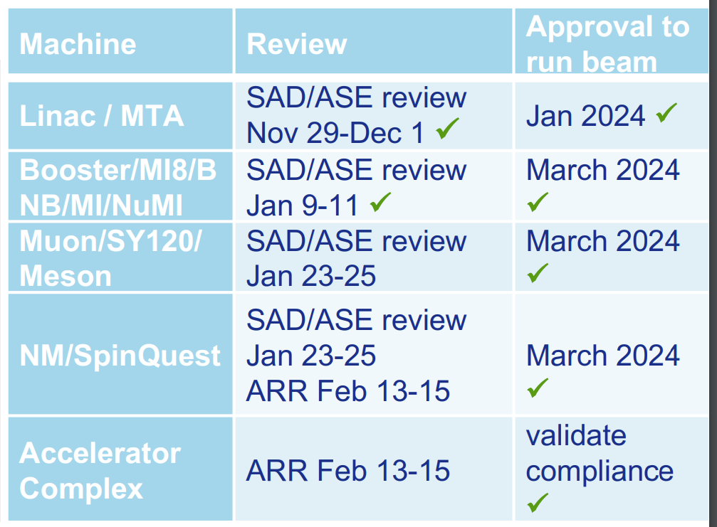
Outline of FY 2024 Run:
Updated Safety Assessment Document (SAD) & Accelerator Safety Envelope (ASE) for compliance with DOE Order 420.2D.
Beam delivery to users started March 8, 2024.
Atypical startup approach this run:
  First, sent beam to both NuMI & BNB as soon as possible.
  Then, worried about tuning up beam intensities.
Sent beam to users on the MTA, BNB, NuMI, Neutrino Muon, & MTest lines.
  Started delivering beam to SpinQuest!
Preparing the Muon Campus for Mu2e operations.
Upgraded the Main Injector cycle time from 1.133 s to 1.067 s.
  One-hour power record of 1.018 MW on June 26, 2024.
See Ievgen Lavrukhin’s talk on Thursday at 11:30 for the SpinQuest/E1039 Report.
Typical startup approach has more of a sequential tune-up of machines.
[1]
✓
✓
✓
[1] A. Valishev, M. Convery, J. Jarvis, R. Zwaska, Accelerator Directorate Update, AD All-Hands Meeting (2024) https://indico.fnal.gov/event/65228/attachments/179063/244360/2024-06-20%20AD%20AllHands.pdf

Slide 5
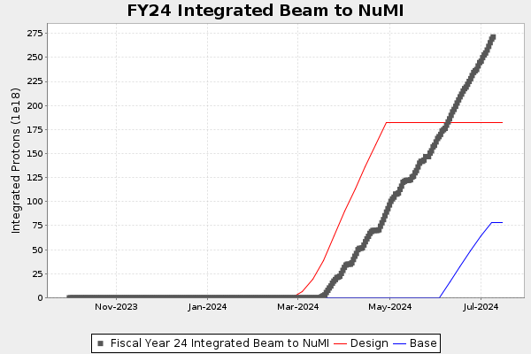
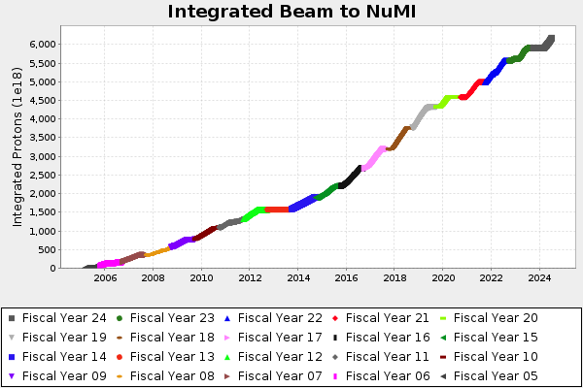
Accelerator complex delivers beam to experiments.
See Mark Messier’s talk on Thursday at 16:20 for the NOvA Report.
More typical turn on period
[1] https://www-bd.fnal.gov/FixedTargetPlots/today/ProtonPlots.html

Slide 6
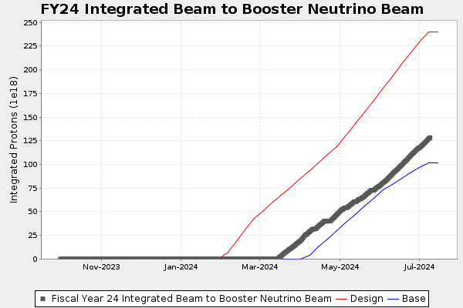
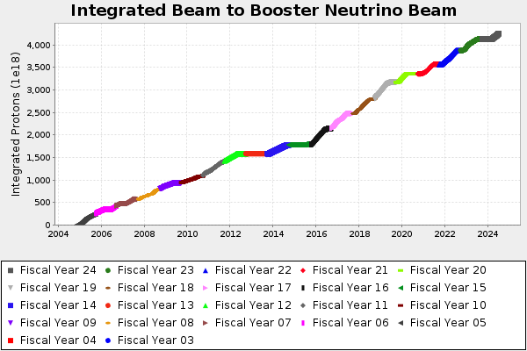
Accelerator complex delivers beam to experiments.
See Amanda Weinstein’s talk on Thursday at 12:10 for the ANNIE Report.
See Michael Mooney’s talk on Thursday at 14:10 for the ICARUS Report.
More typical turn on period
See Daisy Kalra’s talk on Wednesday at 11:10 for the Short-Baseline Near Detector Program.
[1] https://www-bd.fnal.gov/FixedTargetPlots/today/ProtonPlots.html

Slide 7
The P5 Report recommends the completion of existing projects and experiments.
My takeaway from the P5 Recommendation 1:
The highest priority for maximizing science is to complete the construction of projects and support the operations of ongoing experiments and research.
This includes the first phase of DUNE, PIP-II, & Mu2e.
See https://www.usparticlephysics.org/2023-p5-report/full-list-of-recommendations.html

Slide 8
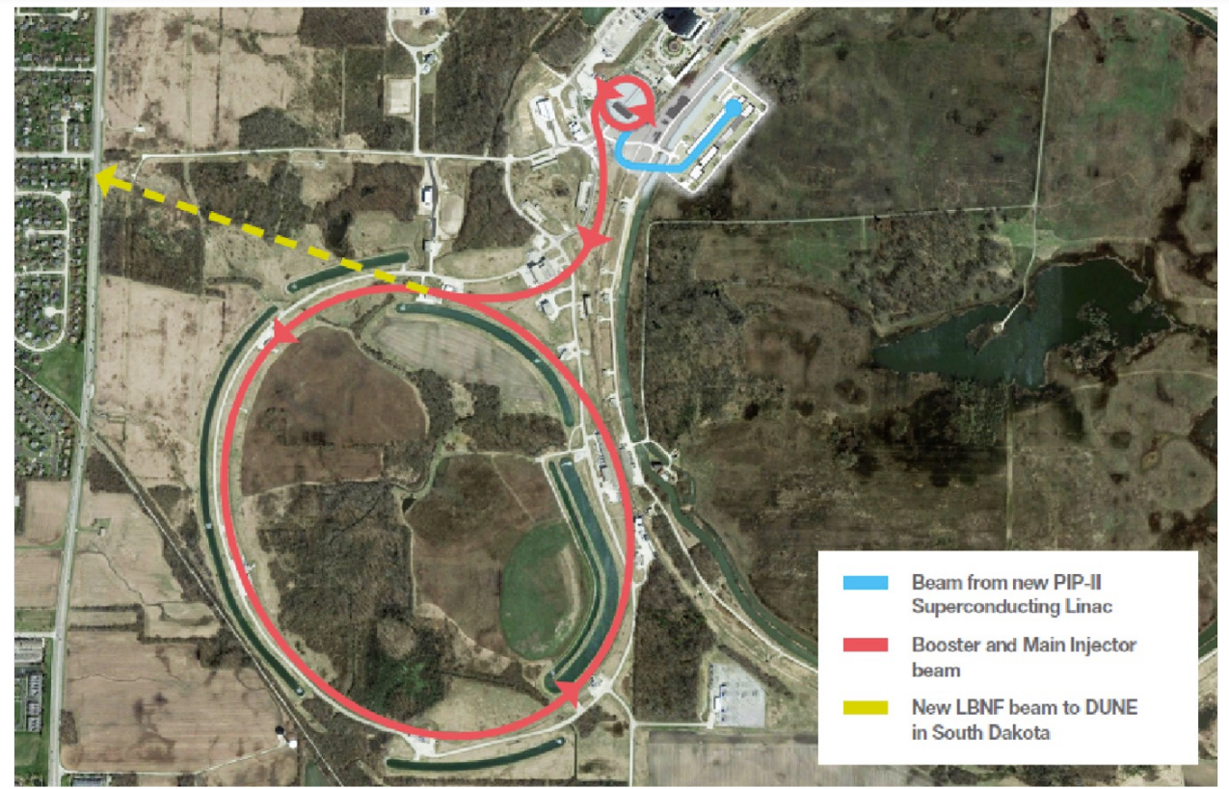
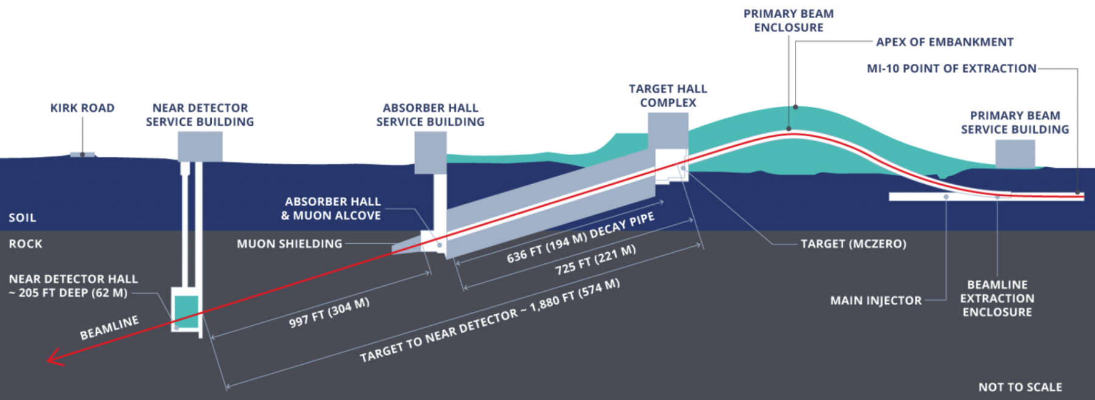
The Deep Underground Neutrino Experiment (DUNE) will provide a neutrino physics program.
[2]
AD focus for DUNE is on the Long-Baseline Neutrino Facility (LBNF).
Build new LBNF beamline and target station.
  Integrate these systems into the Accelerator Complex.
PIP-II Project will upgrade Accelerator Complex for reliable delivery of greater than 1 MW beam power operations.
ACE-MIRT Project will upgrade the Accelerator Complex for reliable delivery of greater than 2 MW beam power operations.
See Sungbin Oh’s talk on Wednesday at 10:30 for the Deep Underground Neutrino Experiment Overview.
[1]
[1] https://lbnf-dune.fnal.gov/
[2] A. Valishev, Fermilab Accelerator Complex Evolution (ACE), Princeton Muon Collider Organizational Workshop (2024) https://lss.fnal.gov/archive/2024/slides/fermilab-slides-24-0021-ad.pdf

Slide 9
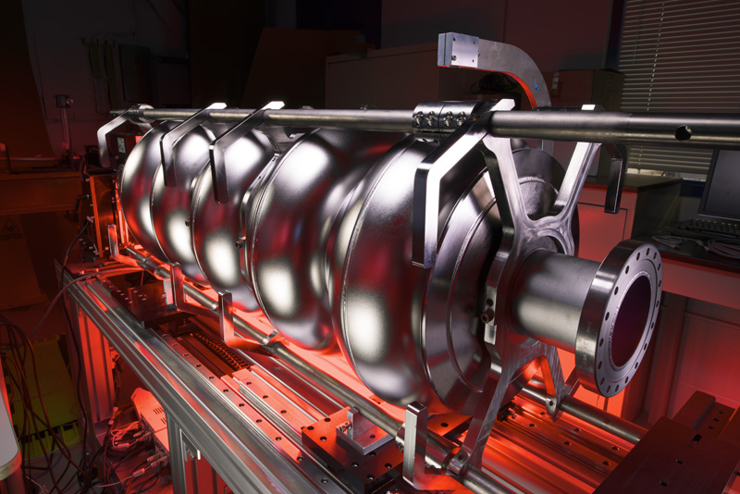
The Proton Improvement Plan-II (PIP-II) will power the world’s most intense neutrino beam.
[2]
PIP-II Project
Replaces the current 400 MeV Linac with an 800 MeV linac that uses superconducting radio-frequency (sRF) technology [1].
  New linac has a 215-meter length.
  New linac will inject beam into the Booster.
Upgrades the Booster cycle rate to 20 Hz from 15 Hz.
Increases 8 GeV p beam intensity to support reliable delivery of greater than 1 MW beam power from the Main Injector.
  New linac will also support reliable delivery of greater than 2 MW beam power upgrade for the Main Injector (ACE-MIRT).
Has Critical Decision 3 (CD-3) approval.
5-cell 650-MHz sRF cavity for PIP-II that is cooled with liquid helium to below -270 ◦C.
[1] https://pip2.fnal.gov/
[2] https://pip2.fnal.gov/about/photos-and-videos/
See Pantaleo Raimondi’s talk on Thursday at 13:30 for the PIP-II Overview & Update.

Slide 10
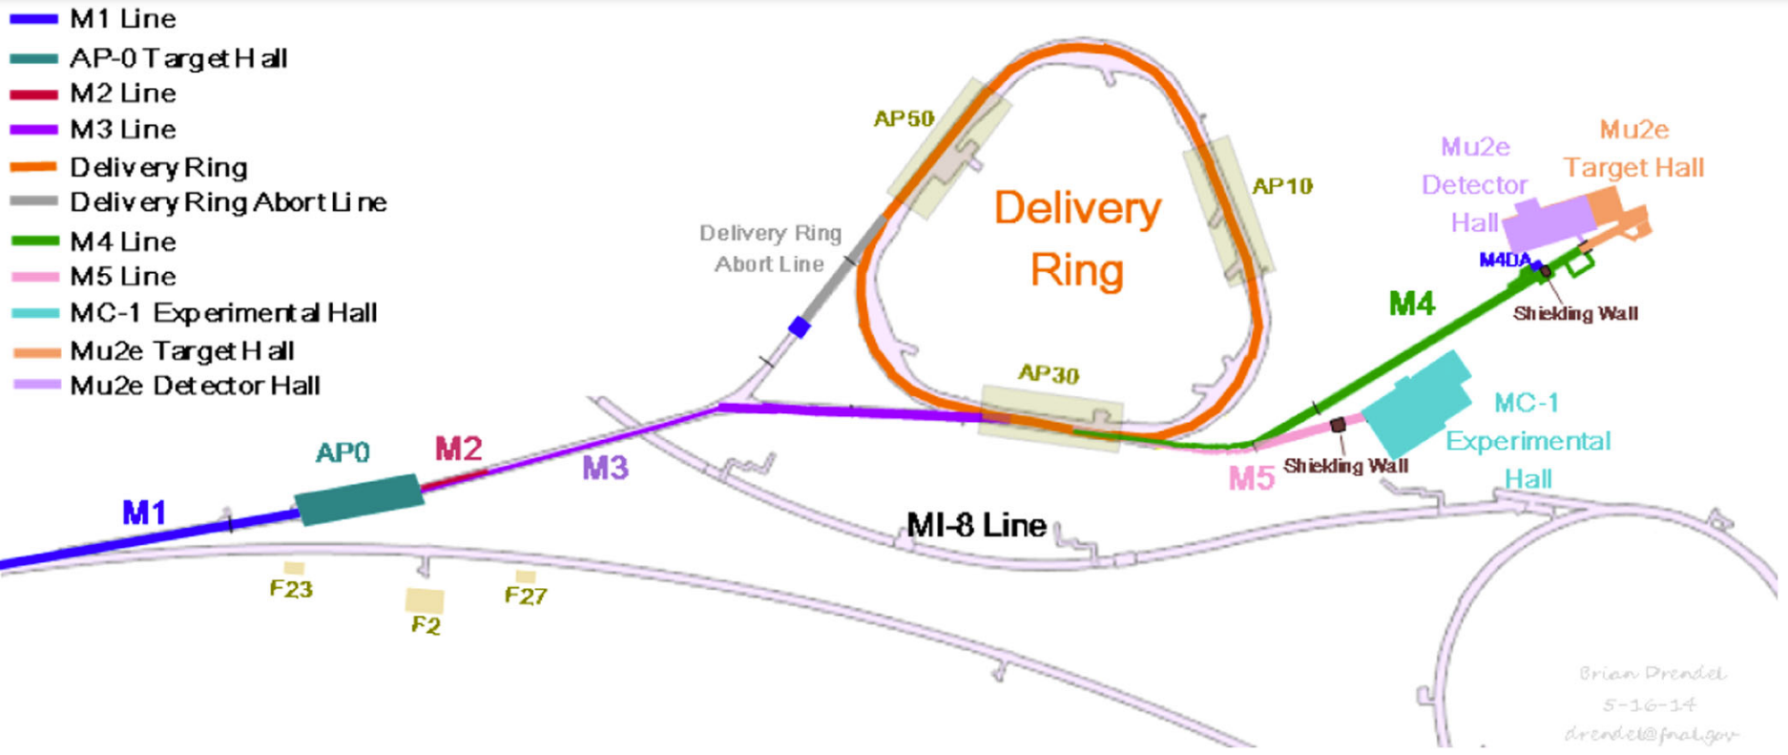
The Muon-to-Electron-Conversion (Mu2e) Experiment will look for charged lepton flavor violation.
AD is preparing the Muon Campus for Mu2e operations.
  Muon g-2 used a muon beam.
  Mu2e will use a proton beam.
AD is working on the production target for the production solenoid.
See Gonzalo Diaz Bautista’s talk on Thursday at 17:00 for Mu2e (+PIP-II Muon Possibilities).
[1]
Mu2e
[1] D. Stratakis et al., Commissioning and First Results of the Fermilab Muon Campus, Phys. Rev. Accel. Beams 22 (2019) no.1, 011001 doi:10.1103/PhysRevAccelBeams.22.011001

Slide 11
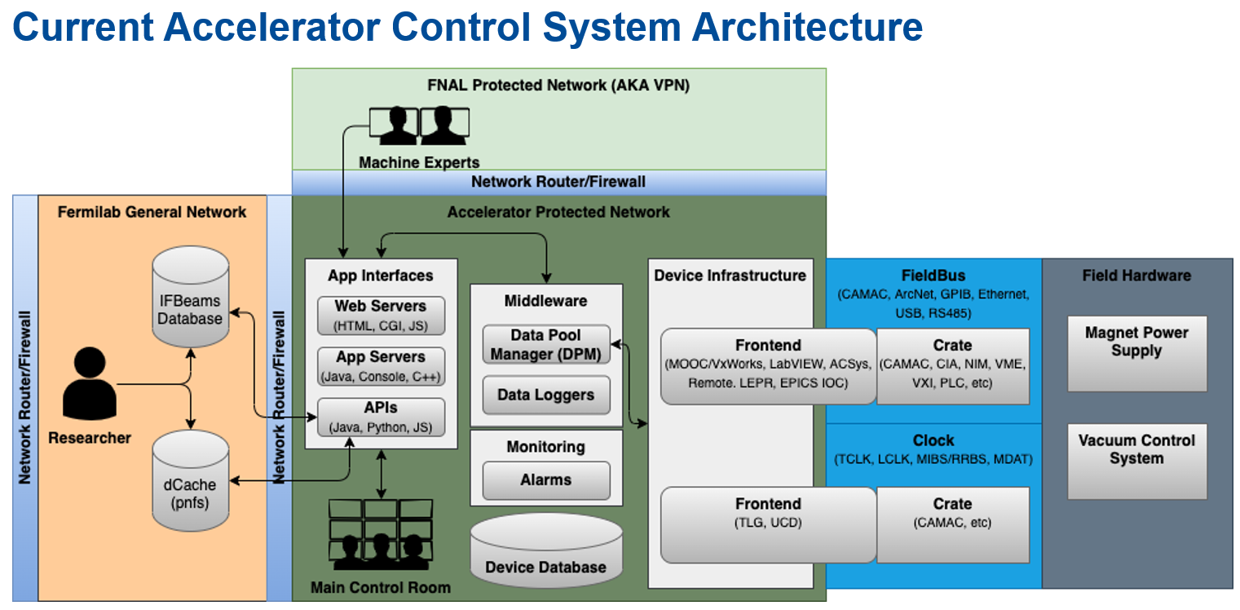
Accelerator Controls Operations Research Network (ACORN) Project will modernize AD control systems:
ACNET control system is currently used for the Accelerator Complex.
  ACNET has been used for decades.
ACORN is developing a modern replacement for ACNET.
Also developing replacements for end-of-life power supplies.
  Working towards megawatt particle beam operations.
Control system must work over 10 miles of equipment and 200,000 devices [1].
Has Critical Decision 0 (CD-0) approval.
  Working on getting Critical Decision 1 (CD-1) approval in September.
[2]
[1] D. Finstrom and E. Gottschalk, Introduction and Status of Fermilab's ACORN Project (2024) arXiv:2401.02291 [physics.acc-ph] https://arxiv.org/abs/2401.02291
[2] A. Watts, Engineering Retreat (2023) https://indico.fnal.gov/event/58491/contributions/260271/attachments/164192/217651/awatts_Eweek2023.pptx

Slide 12
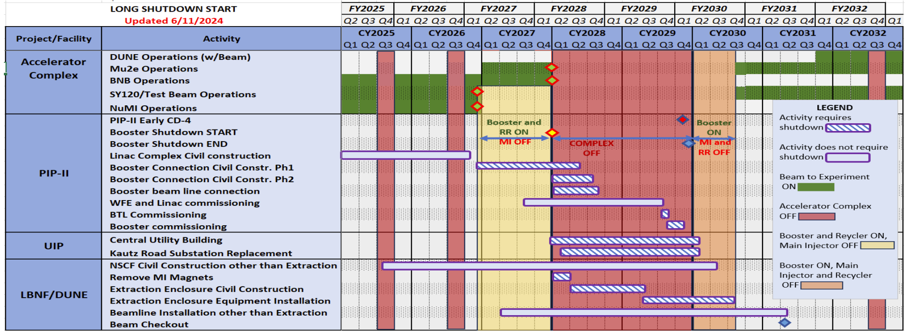
Fermilab Long Range Plan has been recently updated.
[1]
[1] A. Valishev, M. Convery, J. Jarvis, R. Zwaska, Accelerator Directorate Update, AD All-Hands Meeting (2024) https://indico.fnal.gov/event/65228/attachments/179063/244360/2024-06-20%20AD%20AllHands.pdf

Slide 13
P5 Report recommends the study of fundamental constitutes and interaction of the universe.
My takeaway from the P5 Recommendation 2:
Major projects should be constructed that study nearly all fundamental constituents of our universe and their interactions.
The second highest priority for this recomednation includes a re-envisioned second phase of DUNE with an early implementation of an enhanced 2.1 MW beam (ACE-MIRT).
See https://www.usparticlephysics.org/2023-p5-report/full-list-of-recommendations.html

Slide 14
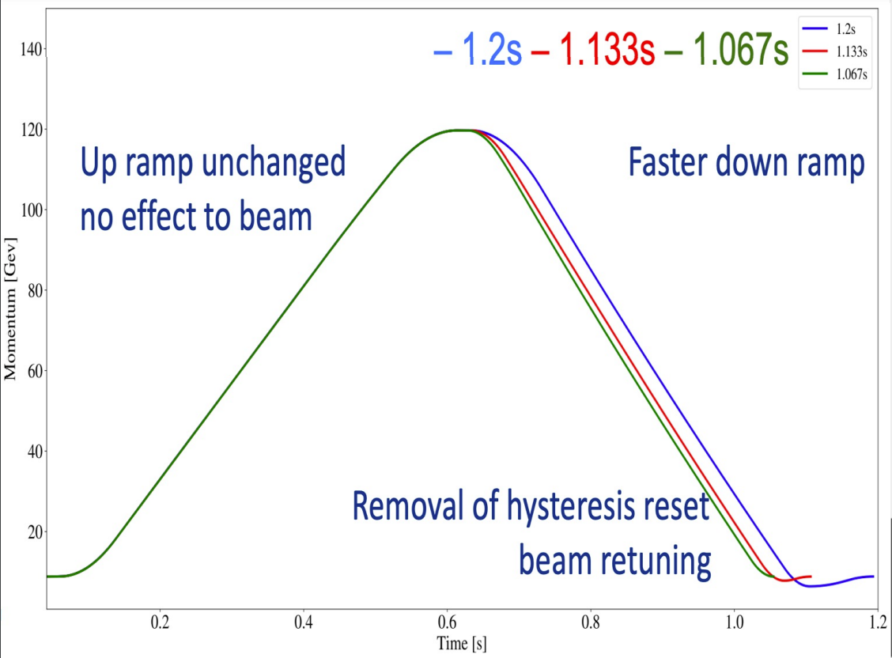
The first phase of the Accelerator Complex Evolution (ACE) plan will provide the Main Injector Ramp & Targetry (ACE-MIRT) upgrade.
Time scale: Now to early 2030s.
Potential motivation: Achieve 5σ mass ordering sensitivity for 100% of δcp values in 3.5 years instead of 5 years.
Capability enhancements.
  Implement 2.1 MW capable LBNF target.
  Upgrade Main Injector to 0.65 s cycle time (~2 × faster than design).
Capacity enhancements.
  Enable use of all 8 GeV beam capacity.
    Maximum LBNF power is currently in tension with any 8 GeV program and Test Beam or SpinQuest.
Reliability enhancements.
[1]
[1] A. Valishev, Fermilab Accelerator Complex Evolution (ACE), Princeton Muon Collider Organizational Workshop (2024) https://lss.fnal.gov/archive/2024/slides/fermilab-slides-24-0021-ad.pdf

Slide 15
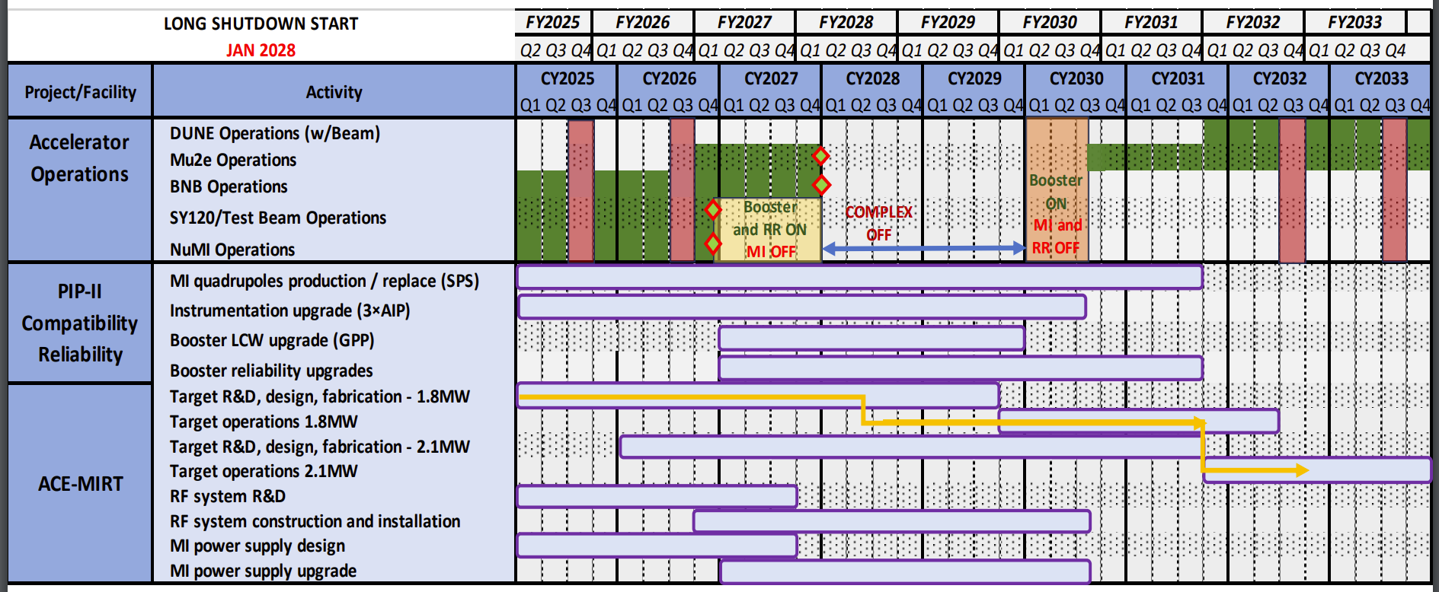
The ACE-MIRT technically limited schedule extends into the early 2030s.
[1]
[1] A. Valishev, M. Convery, J. Jarvis, R. Zwaska, Accelerator Directorate Update, AD All-Hands Meeting (2024) https://indico.fnal.gov/event/65228/attachments/179063/244360/2024-06-20%20AD%20AllHands.pdf

Slide 16
P5 Report recommends long term planning for the Fermilab accelerator complex.
My takeaway from the P5 Recommendation 6:
A targeted panel should be convened later this decade that makes decisions on the US accelerator-based program, where a plan for the Fermilab accelerator complex consistent with the long-term vision in this report should be reviewed.
The panel should consider mid- and large-scale test and demonstrator facilities in the accelerator and collider R&D portfolios, as well as a plan for the evolution of the Fermilab accelerator complex consistent with the long- term vision in this report.
My takeaway from the P5 Area Recommendation 12:
Form a dedicated task force to define a roadmap for upgrade efforts and delivering a strategic 20-year plan for the Fermilab accelerator complex within the next five years for consideration.
Area Recommendation 13:
Assess the booster synchrotron and related systems for reliability risks through the first decade of DUNE operation, and take measures to preemptively address these risks.
See https://www.usparticlephysics.org/2023-p5-report/full-list-of-recommendations.html

Slide 17
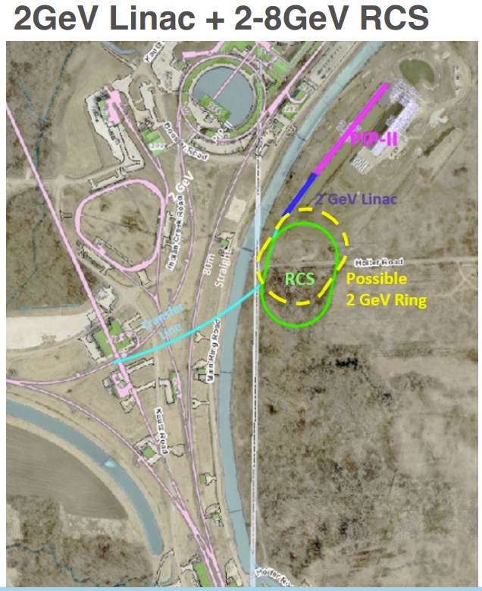
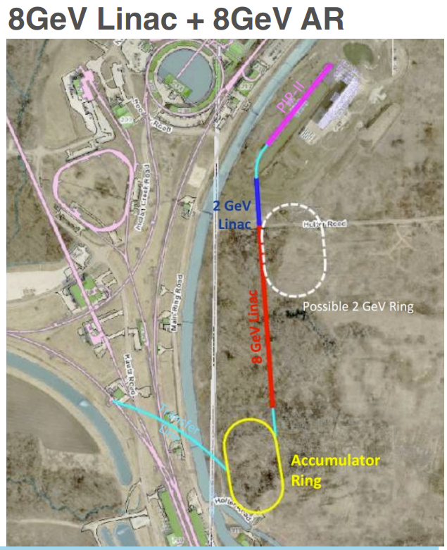
The second phase of the Accelerator Complex Evolution (ACE) plan will provide the Booster Replacement (ACE-BR) upgrade.
New physics capabilities.
Considering different Booster replacement options and configurations.
  High energy linac option needs ~2 GeV beam to take advantage of higher frequency, β = 1, high-gradient cavities that are grouped and fed from a single high-power klystron.
  Rapid-Cycling Synchrotron (RCS) option has reduced space charge at increased energy.
Re-optimize parameters based on future experimental program.
[1]
[1]
[1] A. Valishev, Fermilab Accelerator Complex Evolution (ACE), Princeton Muon Collider Organizational Workshop (2024) https://lss.fnal.gov/archive/2024/slides/fermilab-slides-24-0021-ad.pdf

Slide 18
P5 Report recomends investigating the feasibility of a muon collider.
My takeaway from the P5 Recommendation 4:
Develop an aggressive R&D program that could yield revolutionary accelerator designs to chart a realistic path to a 10 TeV pCM collider. This R&D includes a muon-based collider.
The General Accelerator R&D (GARD) program within HEP should also be expanded, including stewardship.
Plans should be developed for improving the Fermilab accelerator complex that are consistent with the long-term vision of this report including neutrinos and a 10 TeV pCM collider.
See https://www.usparticlephysics.org/2023-p5-report/full-list-of-recommendations.html

Slide 19
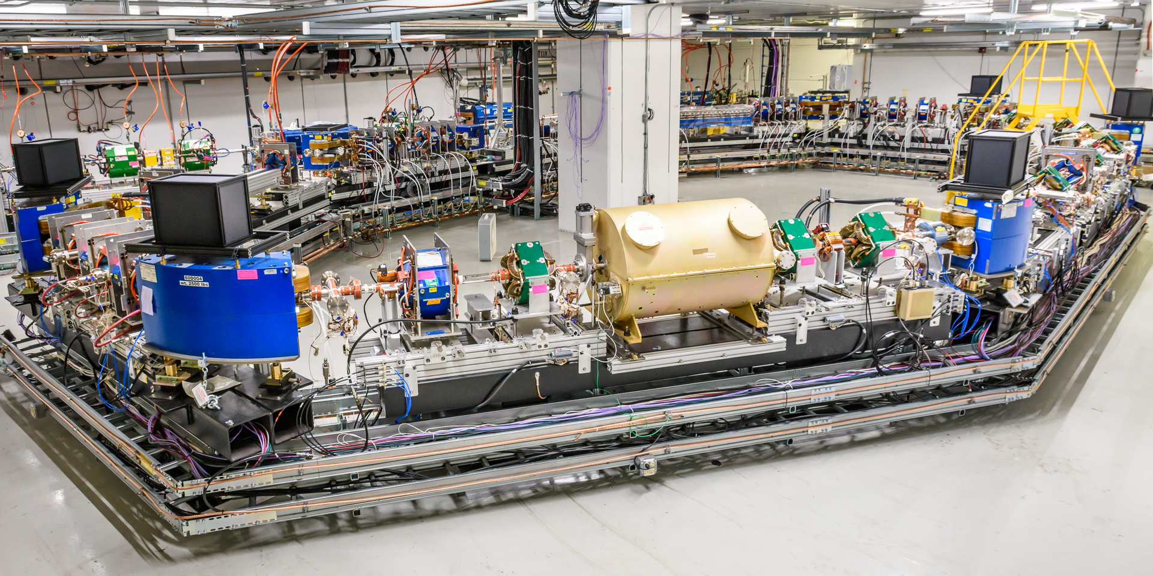
Fermilab Accelerator Science and Technology (FAST) facility and Integrable Optics Test Accelerator (IOTA) ring provide important R&D for future accelerator machines.
[1]
Ongoing Research:
Suppression of coherent instabilities via Landau damping.
Mitigation of space-charge effects (NIO, e-lenses).
Advanced beam cooling: Optical Stochastic Cooling.
Photon and Quantum Science with a single electron.
Development of novel instrumentation and methods.
Carried out 150 MeV electron operations.
Upgrading to 2.5 MeV proton operations.
  Successful commissioning and production of a 50kV proton beam.
IOTA only has a 40 m circumference.
See Michael Wallbank’s talk on Thursday at 11:50 for the IOTA Report.
[1] https://fast.fnal.gov/

Slide 20
A muon collider can provide the 10 TeV pCM collider!
Muon collider science includes:
Advance the understanding of electroweak symmetry breaking (EWSB) and the Higgs boson beyond that which is achievable from using the proposed next generation Higgs factories.
Provide a robust test and potential discovery of weakly interacting massive particles (WIMPs).
Study other beyond Standard Model possibilities.
A 10 TeV muon collider requires significant technological advances.
Detector R&D efforts.
Accelerator R&D efforts.
  Target and Capture.
  Magnets.
  Normal-Conducting RF.
  Super-Conducting RF.
  Ionization Cooling Cell Prototyping & Demonstrator.
  Proton Driver and Synergies with SNS.
See David Neuffer’s talk on Friday at 10:30 for a Muon Collider at Fermilab.
See https://www.muoncollider.us/

Slide 21
Conclusion
FY 2024 Run:
Updated SAD & ASE for compliance with DOE Order 420.2D.
Beam delivery to users started March 8, 2024.
Preparing the Muon Campus for Mu2e operations.
Upgraded the Main Injector cycle time from 1.133 s to 1.067 s.
  One-hour power record of 1.018 MW on June 26, 2024.
AD priorities geared towards future science are consistent with P5 recommendations:
Advancing LBNF, PIP-II, Mu2e, & ACORN projects.
Developing & implementing the ACE-MIRT & ACE-BR projects.
Upgrading FAST/IOTA complex for proton beam operations.
Investigating the feasibility of a 10 TeV pCM muon collider.

Slide 22
Backup Slides:

Slide 23
P5 Report was released at the end of last year.
Recommendation 1: As the highest priority independent of the budget scenarios, complete construction projects and support operations of ongoing experiments and research to enable maximum science. We reaffirm the previous P5 recommendations on major initiatives:
HL-LHC (including the ATLAS and CMS detectors, as well as the Accelerator Upgrade Project) to start addressing why the Higgs boson condensed in the universe (reveal the secrets of the Higgs boson, section 3.2), to search for direct evidence for new particles (section 5.1), to pursue quantum imprints of new phenomena (section 5.2), and to determine the nature of dark matter (section 4.1).
The first phase of DUNE and PIP-II to open an era of precision neutrino measurements that include the determination of the mass ordering among neutrinos. Knowledge of this fundamental property is a crucial input to cosmology and nuclear science (elucidate the mysteries of neutrinos, section 3.1).
The Vera C. Rubin Observatory to carry out the Legacy Survey of Space and Time (LSST), and the LSST Dark Energy Science Collaboration, to understand what drives cosmic evolution (section 4.2). In addition, we recommend continued support for the following ongoing experiments at the medium scale (project costs > $50M for DOE and > $4M for NSF), including completion of construction, operations and research:
NOvA, SBN, T2K, and IceCube (elucidate the mysteries of neutrinos, section 3.1).
DarkSide-20k, LZ, SuperCDMS, and XENONnT (determine the nature of dark matter, section 4.1).
DESI (understand what drives cosmic evolution, section 4.2).
Belle II, LHCb, and Mu2e (pursue quantum imprints of new phenomena, section 5.2).
See https://www.usparticlephysics.org/2023-p5-report/full-list-of-recommendations.html

Slide 24
P5 Report was released at the end of last year.
Recommendation 2: Construct a portfolio of major projects that collectively study nearly all fundamental constituents of our universe and their interactions, as well as how those interactions determine both the cosmic past and future.
These projects have the potential to transcend and transform our current paradigms. They inspire collaboration and international cooperation in advancing the frontiers of human knowledge. Plan and start the following major initiatives in order of priority from highest to lowest:
Plan and start the following major initiatives in order of priority from highest to lowest:
CMB-S4, which looks back at the earliest moments of the universe to probe physics at the highest energy scales. It is critical to install telescopes at and observe from both the South Pole and Chile sites to achieve the science goals (section 4.2).
A re-envisioned second phase of DUNE with an early implementation of an enhanced 2.1 MW beam—ACE-MIRT—a third far detector, and an upgraded near-detector complex as the definitive long-baseline neutrino oscillation experiment of its kind (section 3.1).
An offshore Higgs factory, realized in collaboration with international partners, in order to reveal the secrets of the Higgs boson. The current designs of FCC-ee and ILC meet our scientific requirements. The US should actively engage in feasibility and design studies. Once a specific project is deemed feasible and well-defined (see also Recommendation 6), the US should aim for a contribution at funding levels com- mensurate to that of the US involvement in the LHC and HL-LHC, while maintaining a healthy US onshore program in particle physics (section 3.2).
An ultimate Generation 3 (G3) dark matter direct detection experiment reaching the neutrino fog, in coordination with international partners and preferably sited in the US (section 4.1).
IceCube Gen-2, for study of neutrino properties complementary to DUNE and for indirect detection of dark matter covering higher mass ranges, using non-beam neutrinos as a tool. (section 4.1).
See https://www.usparticlephysics.org/2023-p5-report/full-list-of-recommendations.html

Slide 25
P5 Report was released at the end of last year.
Recommendation 6: Convene a targeted panel with broad membership across particle physics later this decade that makes decisions on the US accelerator-based program at the time when major decisions concerning an offshore Higgs factory are expected, and/or significant adjustments within the accelerator-based R&D portfolio are likely to be needed. A plan for the Fermilab accelerator complex consistent with the long-term vision in this report should also be reviewed.
The panel would consider the following:
The level and nature of US contribution in a specific Higgs factory including an evaluation of the associated schedule, budget, and risks once crucial information becomes available.
Mid- and large-scale test and demonstrator facilities in the accelerator and collider R&D portfolios.
A plan for the evolution of the Fermilab accelerator complex consistent with the long- term vision in this report, which may commence construction in the event of a more favorable budget situation.
Area Recommendation 12: Form a dedicated task force, to be led by Fermilab with broad community membership. This task force is to be charged with defining a roadmap for upgrade efforts and delivering a strategic 20-year plan for the Fermilab accelerator complex within the next five years for consideration (Recommendation 6). Direct task force funding of up to $10M should be provided.
Area Recommendation 13: Assess the booster synchrotron and related systems for reliability risks through the first decade of DUNE operation, and take measures to preemptively address these risks.
See https://www.usparticlephysics.org/2023-p5-report/full-list-of-recommendations.html

Slide 26
P5 Report was released at the end of last year.
Recommendation 4: Support a comprehensive effort to develop the resources—theoretical, computational, and technological—essential to our 20-year vision for the field. This includes an aggressive R&D program that, while technologically challenging, could yield revolutionary accelerator designs that chart a realistic path to a 10 TeV pCM collider.
Investing in the future of the field to fulfill this vision requires the following:
Support vigorous R&D toward a cost-effective 10 TeV pCM collider based on proton, muon, or possible wakefield technologies, including an evaluation of options for US siting of such a machine, with a goal of being ready to build major test facilities and demonstrator facilities within the next 10 years (sections 3.2, 5.1, 6.5, and Recommendation 6).
Enhance research in theory to propel innovation, maximize scientific impact of investments in experiments, and expand our understanding of the universe (section 6.1).
Expand the General Accelerator R&D (GARD) program within HEP, including stewardship (section 6.4).
Invest in R&D in instrumentation to develop innovative scientific tools (section 6.3).
Conduct R&D efforts to define and enable new projects in the next decade, including detectors for an e⁺e⁻ Higgs factory and 10 TeV pCM collider, Spec-S5, DUNE FD4, Mu2e-II, Advanced Muon Facility, and line intensity mapping (sections 3.1, 3.2, 4.2, 5.1, 5.2, and 6.3).
Support key cyberinfrastructure components such as shared software tools and a sustained R&D effort in computing, to fully exploit emerging technologies for projects. Prioritize computing and novel data analysis techniques for maximizing science across the entire field (section 6.7).
Develop plans for improving the Fermilab accelerator complex that are consistent with the long-term vision of this report including neutrinos, flavor, and a 10 TeV pCM collider (section 6.6).
See https://www.usparticlephysics.org/2023-p5-report/full-list-of-recommendations.html

Slide 27
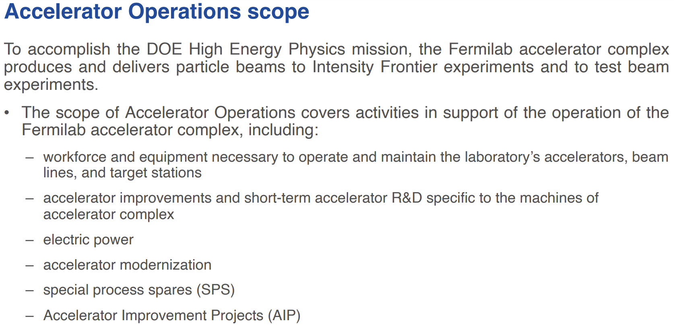
Slide from A. Valishev et al. [1]
[1] A. Valishev, M. Convery, J. Jarvis, R. Zwaska, Accelerator Directorate Update, AD All-Hands Meeting (2024) https://indico.fnal.gov/event/65228/attachments/179063/244360/2024-06-20%20AD%20AllHands.pdf

Slide 28
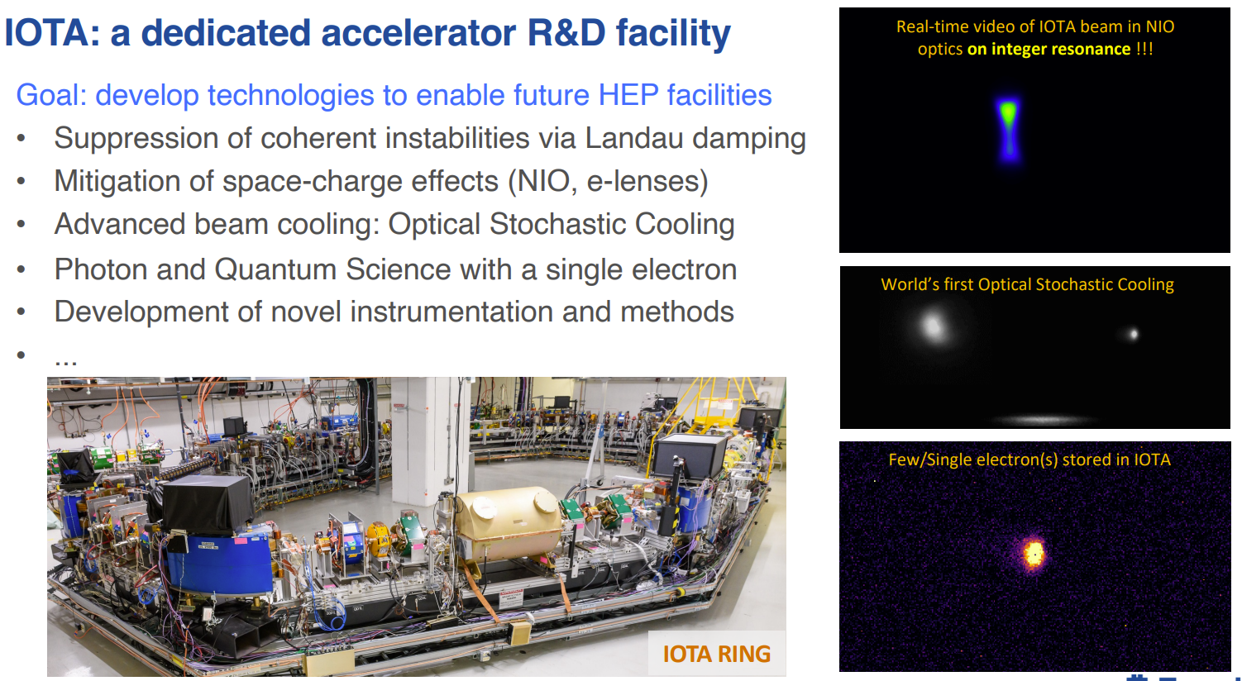
Slide from A. Valishev et al. [1]
[1] A. Valishev, M. Convery, J. Jarvis, R. Zwaska, Accelerator Directorate Update, AD All-Hands Meeting (2024) https://indico.fnal.gov/event/65228/attachments/179063/244360/2024-06-20%20AD%20AllHands.pdf

Slide 29
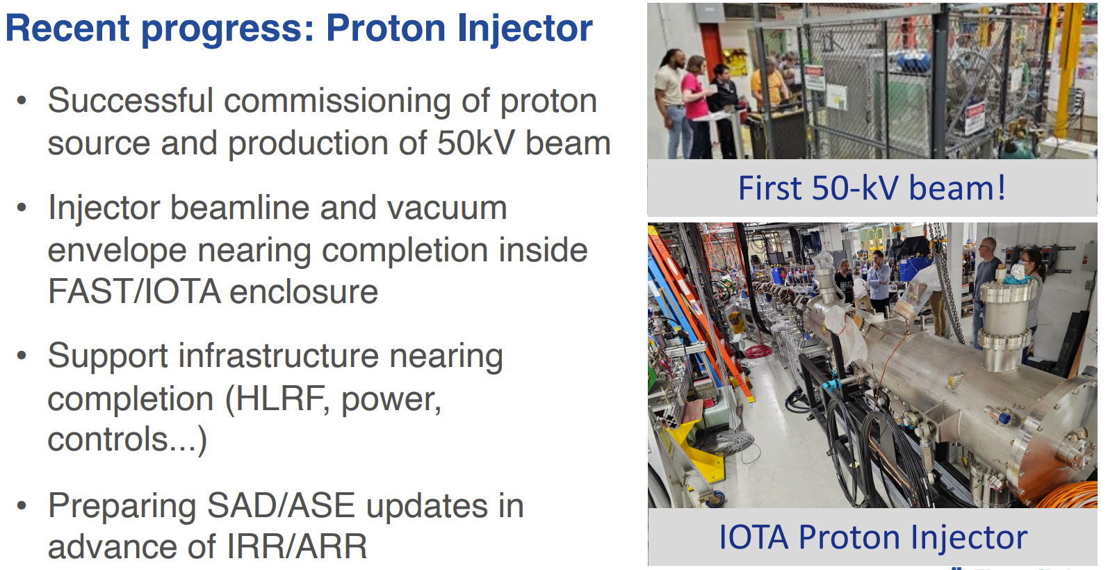
Slide from A. Valishev et al. [1]
[1] A. Valishev, M. Convery, J. Jarvis, R. Zwaska, Accelerator Directorate Update, AD All-Hands Meeting (2024) https://indico.fnal.gov/event/65228/attachments/179063/244360/2024-06-20%20AD%20AllHands.pdf

Slide 30
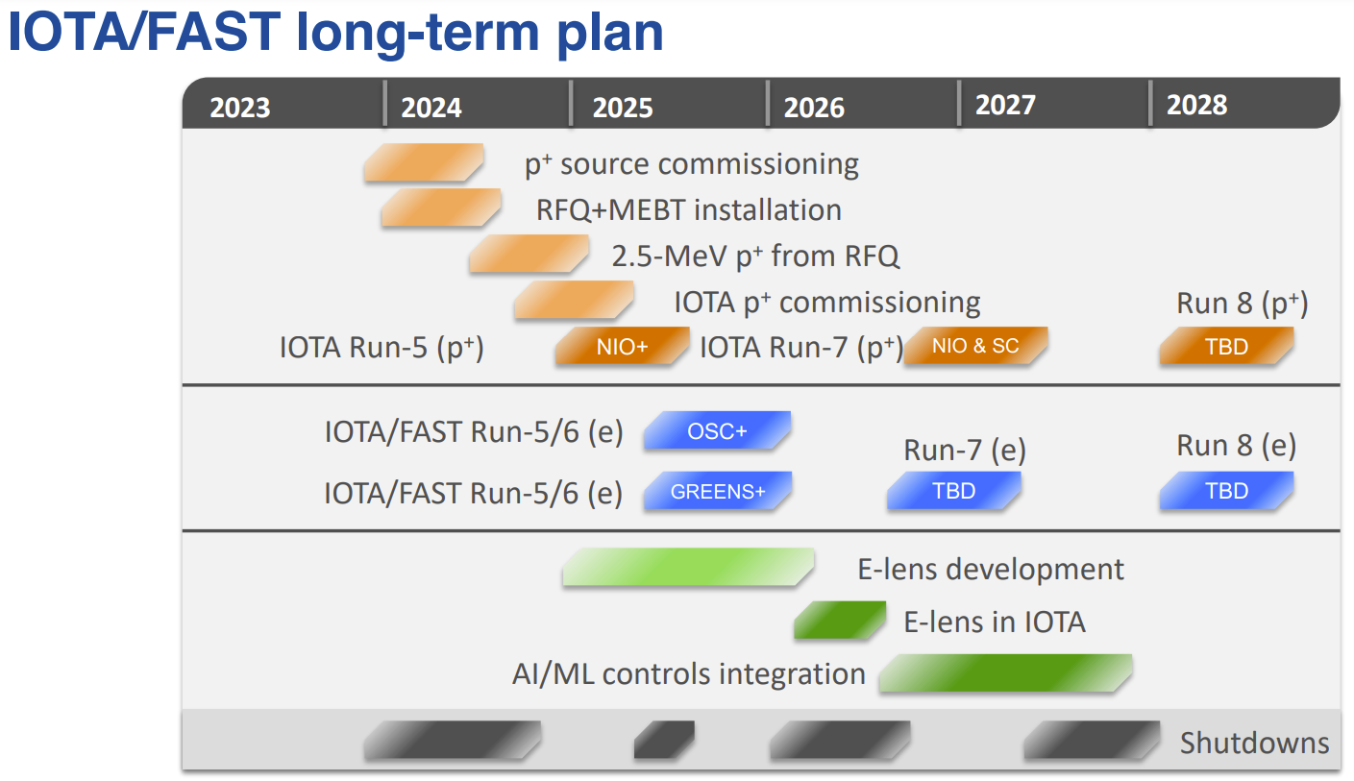
Slide from A. Valishev et al. [1]
[1] A. Valishev, M. Convery, J. Jarvis, R. Zwaska, Accelerator Directorate Update, AD All-Hands Meeting (2024) https://indico.fnal.gov/event/65228/attachments/179063/244360/2024-06-20%20AD%20AllHands.pdf

Slide 31
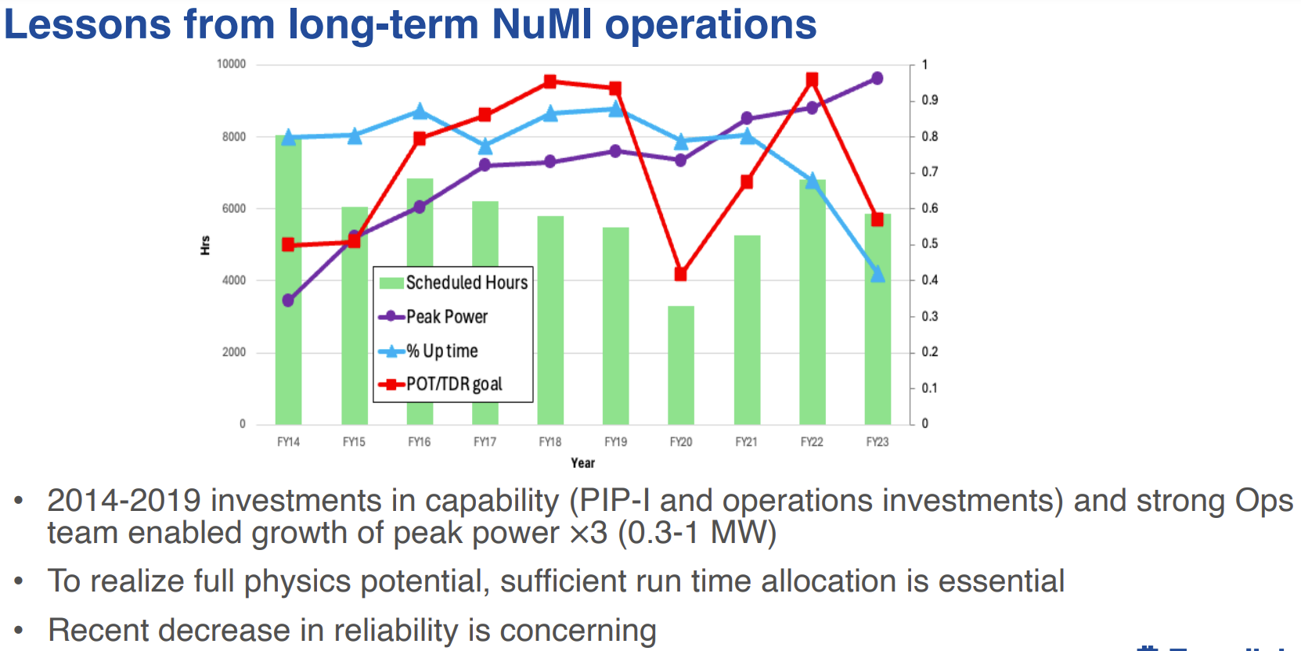
Slide from A. Valishev et al. [1]
[1] A. Valishev, M. Convery, J. Jarvis, R. Zwaska, Accelerator Directorate Update, AD All-Hands Meeting (2024) https://indico.fnal.gov/event/65228/attachments/179063/244360/2024-06-20%20AD%20AllHands.pdf

Slide 32
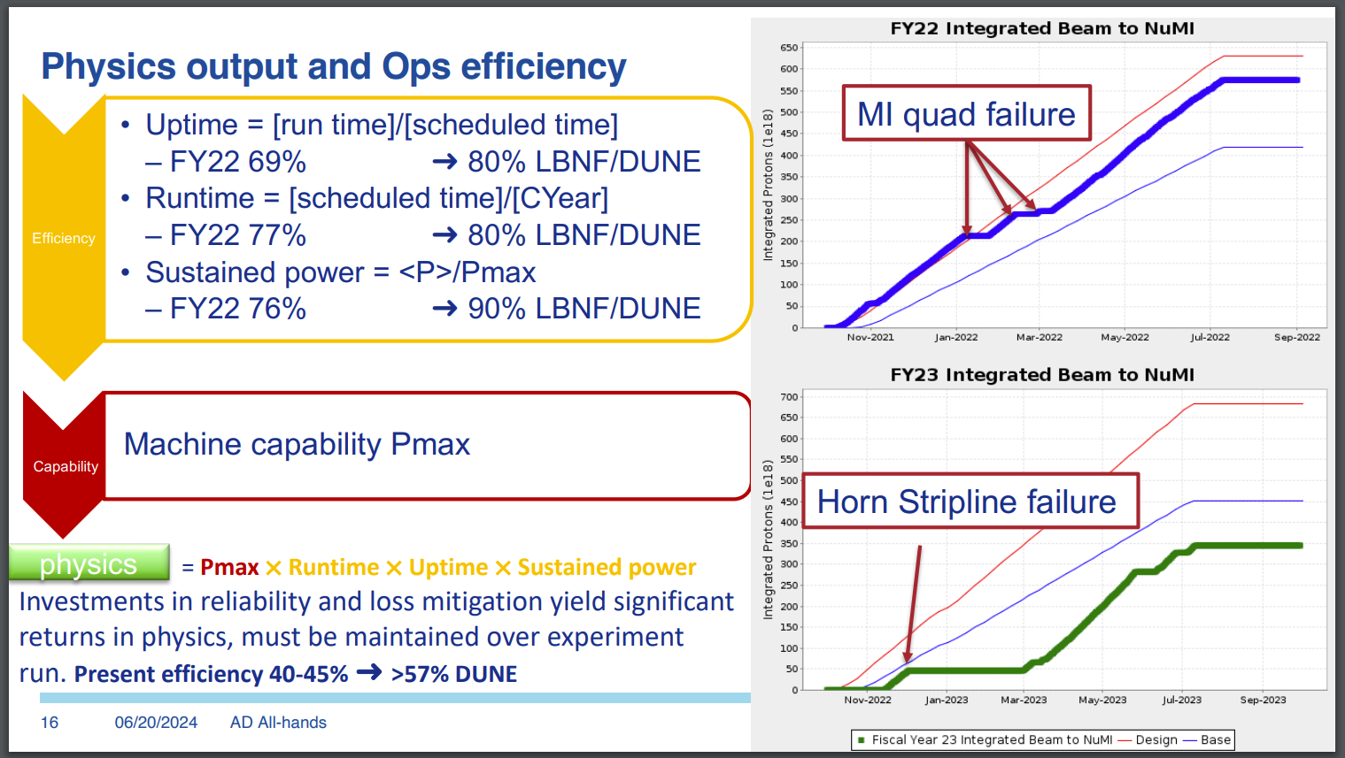
Slide from A. Valishev et al. [1]
[1] A. Valishev, M. Convery, J. Jarvis, R. Zwaska, Accelerator Directorate Update, AD All-Hands Meeting (2024) https://indico.fnal.gov/event/65228/attachments/179063/244360/2024-06-20%20AD%20AllHands.pdf

Slide 33
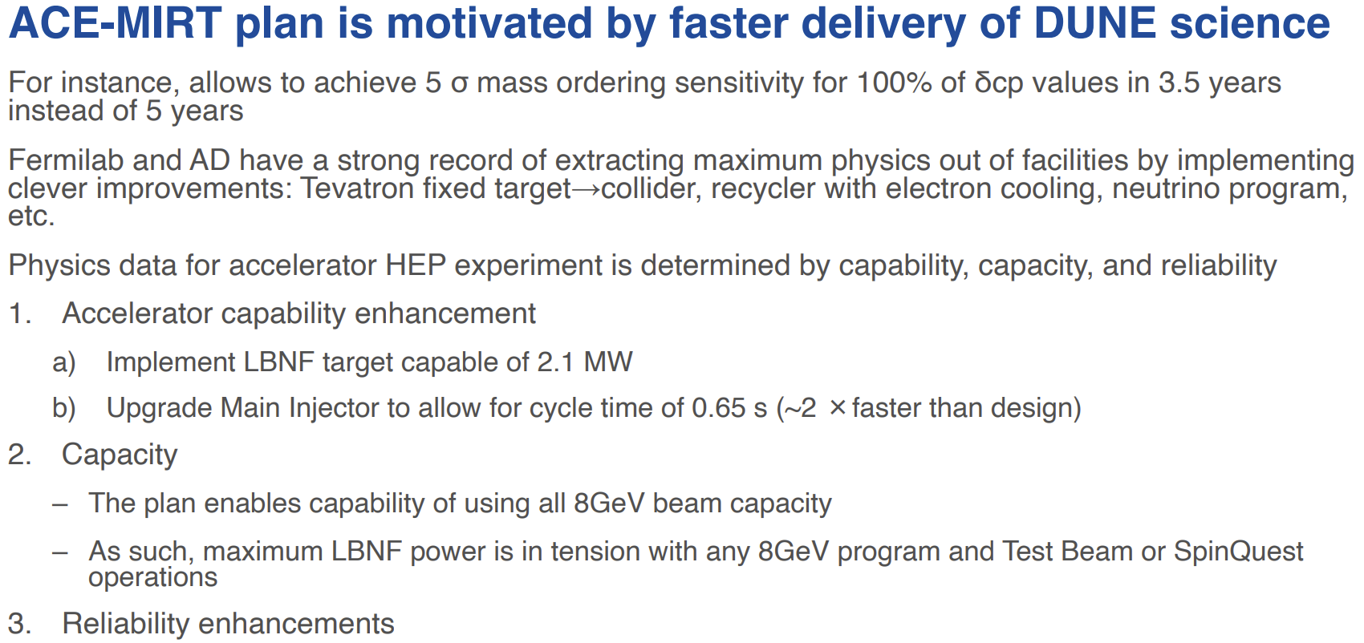
Slide from A. Valishev et al. [1]
[1] A. Valishev, M. Convery, J. Jarvis, R. Zwaska, Accelerator Directorate Update, AD All-Hands Meeting (2024) https://indico.fnal.gov/event/65228/attachments/179063/244360/2024-06-20%20AD%20AllHands.pdf

Slide 34
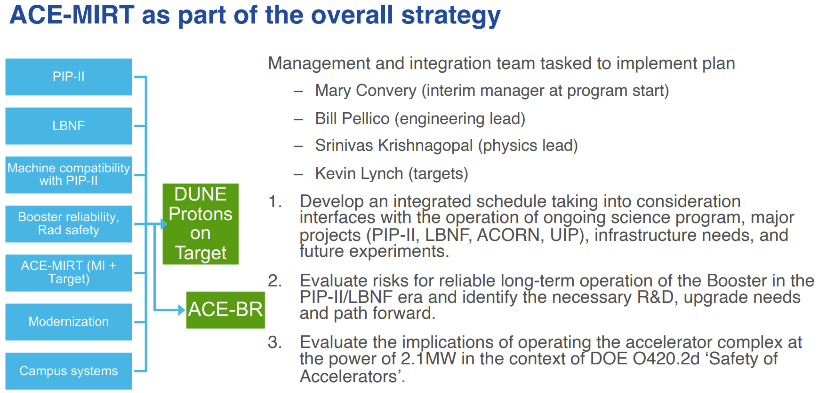
Slide from A. Valishev et al. [1]
[1] A. Valishev, M. Convery, J. Jarvis, R. Zwaska, Accelerator Directorate Update, AD All-Hands Meeting (2024) https://indico.fnal.gov/event/65228/attachments/179063/244360/2024-06-20%20AD%20AllHands.pdf

Slide 35
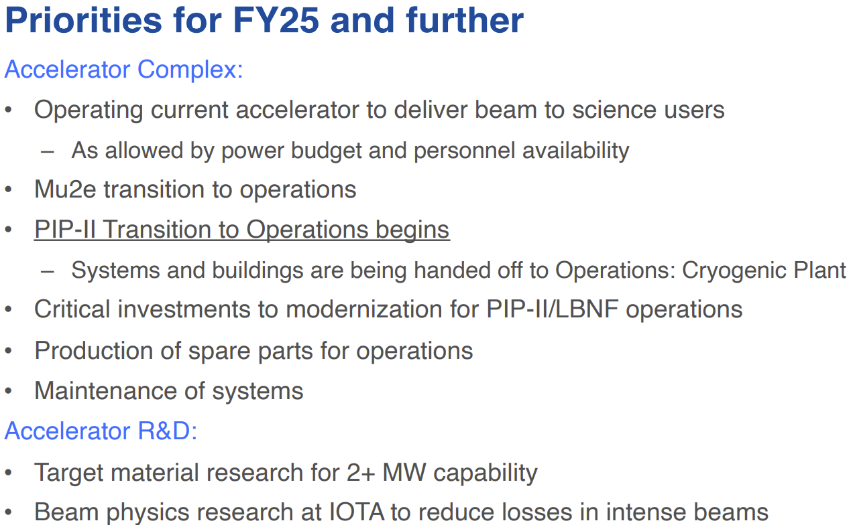
Slide from A. Valishev et al. [1]
[1] A. Valishev, M. Convery, J. Jarvis, R. Zwaska, Accelerator Directorate Update, AD All-Hands Meeting (2024) https://indico.fnal.gov/event/65228/attachments/179063/244360/2024-06-20%20AD%20AllHands.pdf

Slide 36
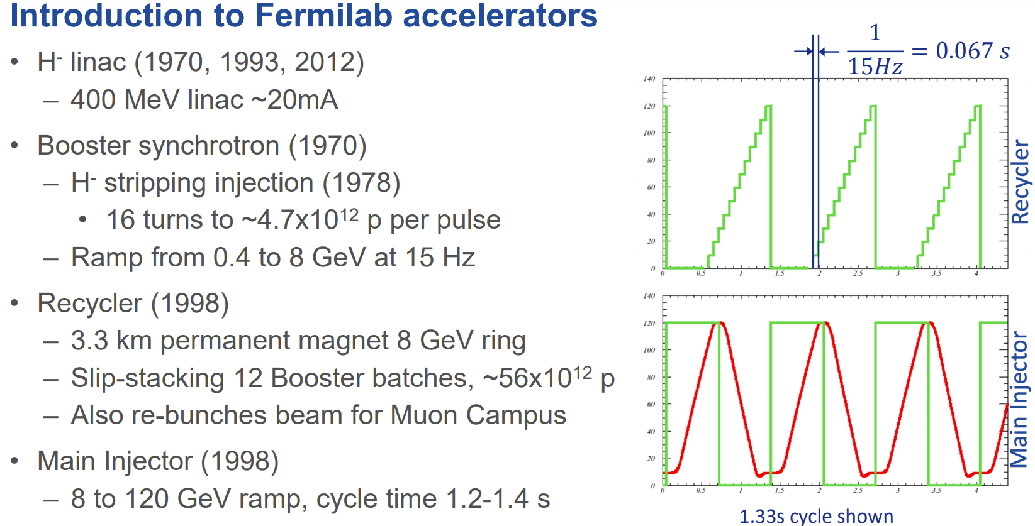
Slide from M. Convery [1]
[1] M. Convery, ACE Overview, Fermilab ACE Science Workshop (2023) https://indico.fnal.gov/event/59663/contributions/268289/attachments/167975/224776/ACEscienceworkshop.pdf

Slide 37
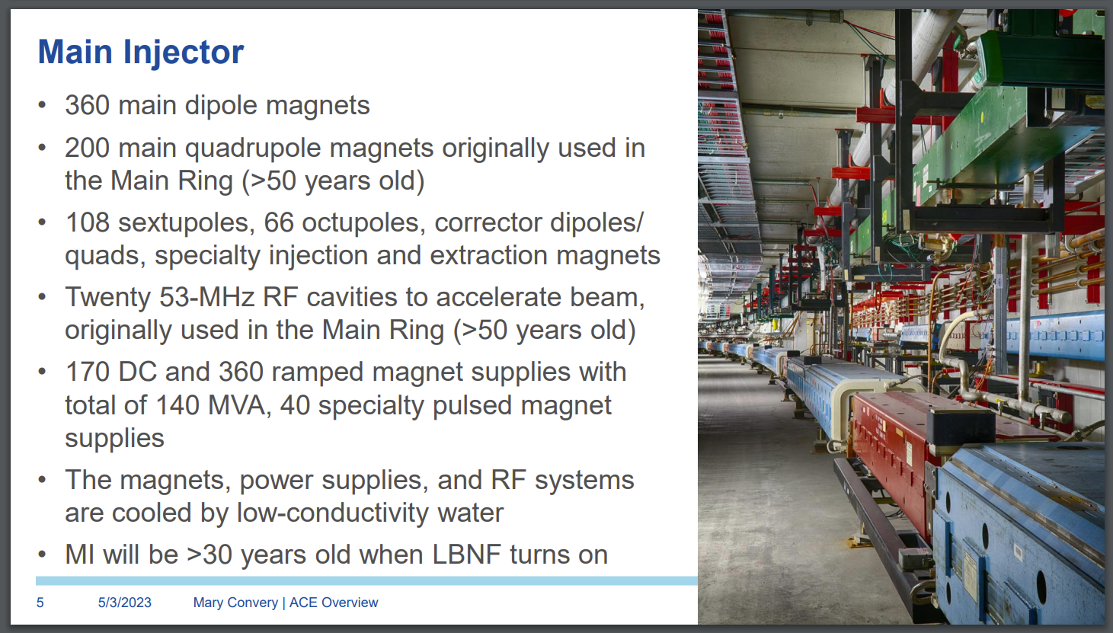
Slide from M. Convery [1]
[1] M. Convery, ACE Overview, Fermilab ACE Science Workshop (2023) https://indico.fnal.gov/event/59663/contributions/268289/attachments/167975/224776/ACEscienceworkshop.pdf

Slide 38
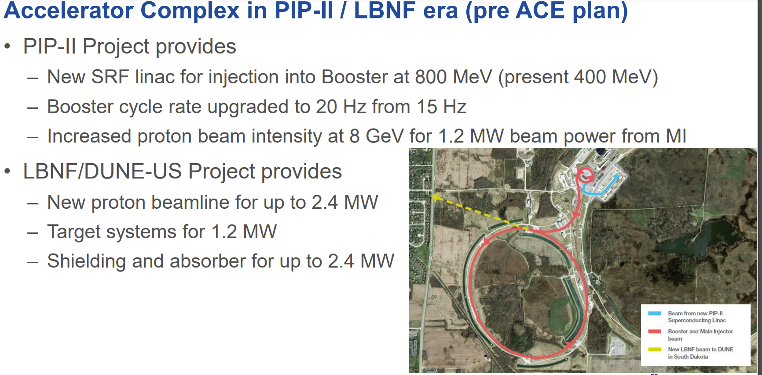
Slide from M. Convery [1]
[1] M. Convery, ACE Overview, Fermilab ACE Science Workshop (2023) https://indico.fnal.gov/event/59663/contributions/268289/attachments/167975/224776/ACEscienceworkshop.pdf

Slide 39
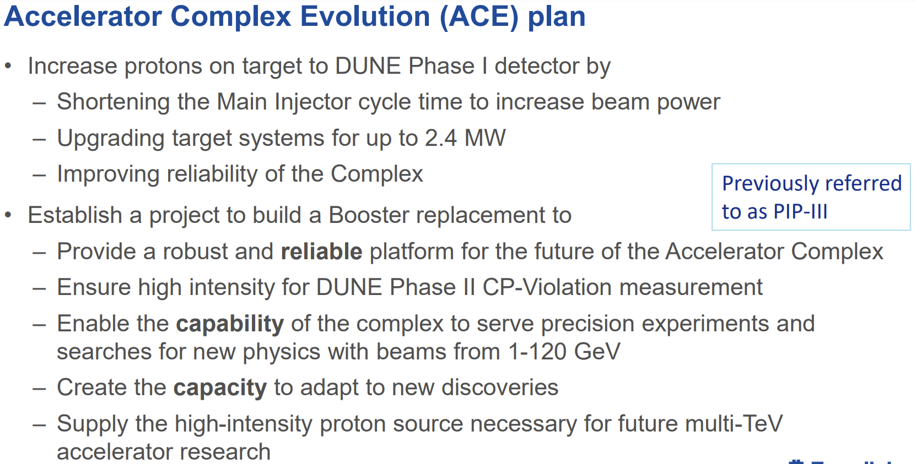
Slide from M. Convery [1]
[1] M. Convery, ACE Overview, Fermilab ACE Science Workshop (2023) https://indico.fnal.gov/event/59663/contributions/268289/attachments/167975/224776/ACEscienceworkshop.pdf

Slide 40
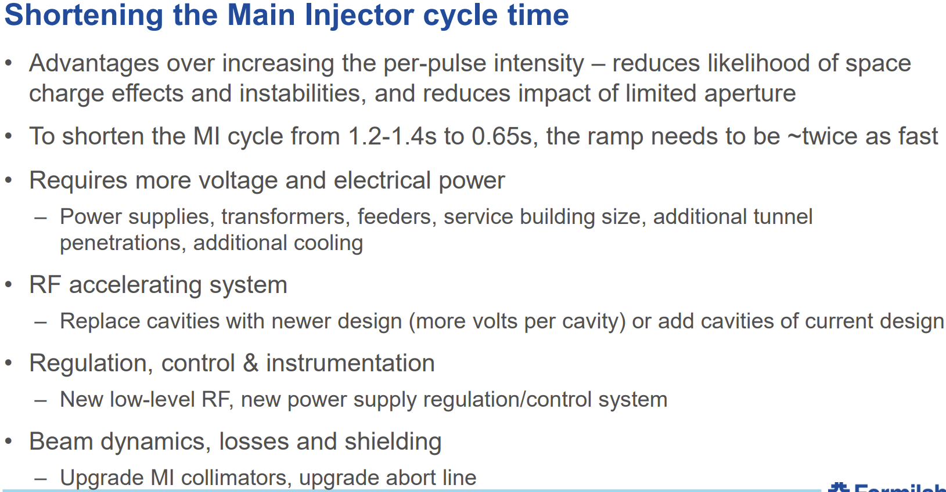
Slide from M. Convery [1]
[1] M. Convery, ACE Overview, Fermilab ACE Science Workshop (2023) https://indico.fnal.gov/event/59663/contributions/268289/attachments/167975/224776/ACEscienceworkshop.pdf

Slide 41
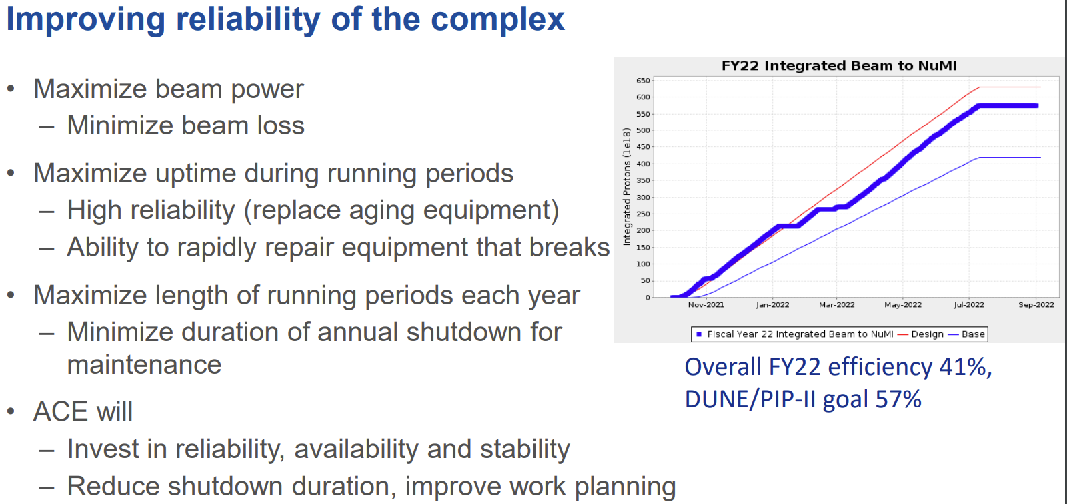
Slide from M. Convery [1]
[1] M. Convery, ACE Overview, Fermilab ACE Science Workshop (2023) https://indico.fnal.gov/event/59663/contributions/268289/attachments/167975/224776/ACEscienceworkshop.pdf

Slide 42
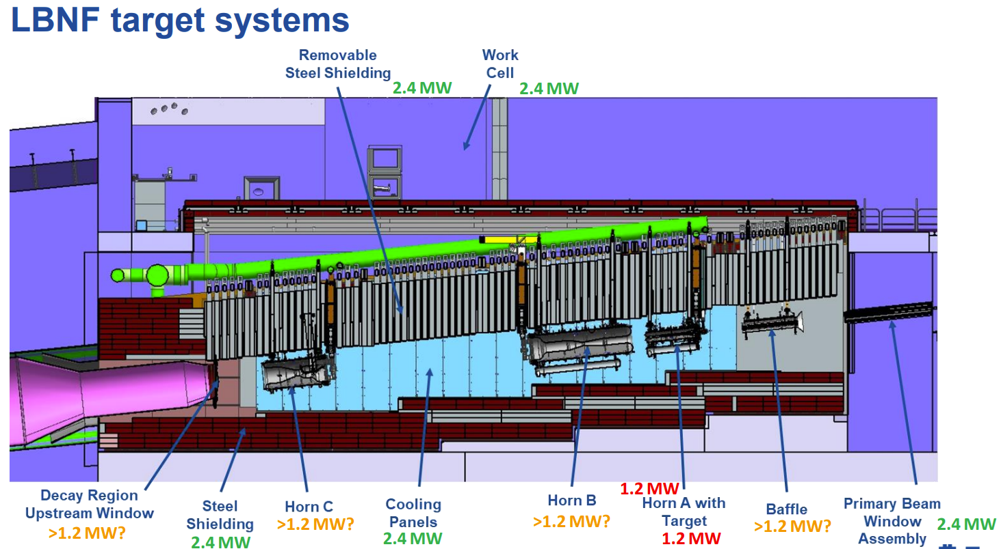
Slide from M. Convery [1]
[1] M. Convery, ACE Overview, Fermilab ACE Science Workshop (2023) https://indico.fnal.gov/event/59663/contributions/268289/attachments/167975/224776/ACEscienceworkshop.pdf

Slide 43
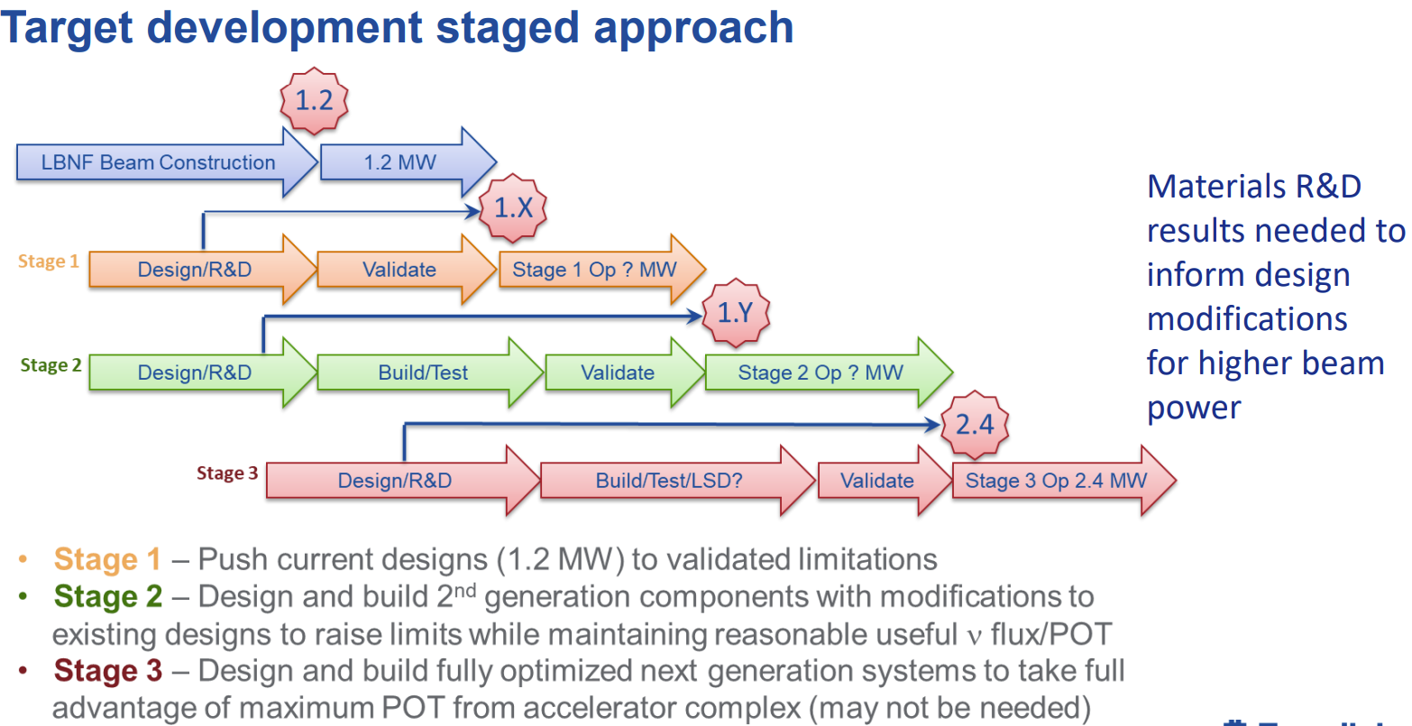
Slide from M. Convery [1]
[1] M. Convery, ACE Overview, Fermilab ACE Science Workshop (2023) https://indico.fnal.gov/event/59663/contributions/268289/attachments/167975/224776/ACEscienceworkshop.pdf

Slide 44
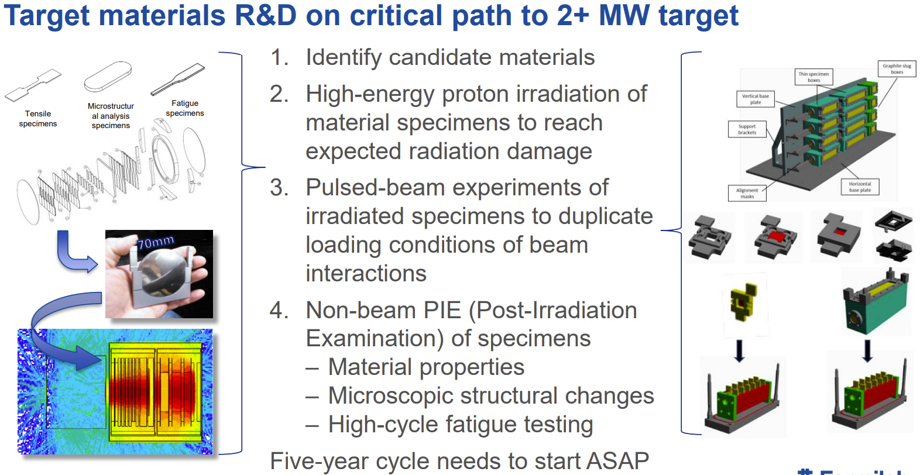
Slide from M. Convery [1]
[1] M. Convery, ACE Overview, Fermilab ACE Science Workshop (2023) https://indico.fnal.gov/event/59663/contributions/268289/attachments/167975/224776/ACEscienceworkshop.pdf

Slide 45
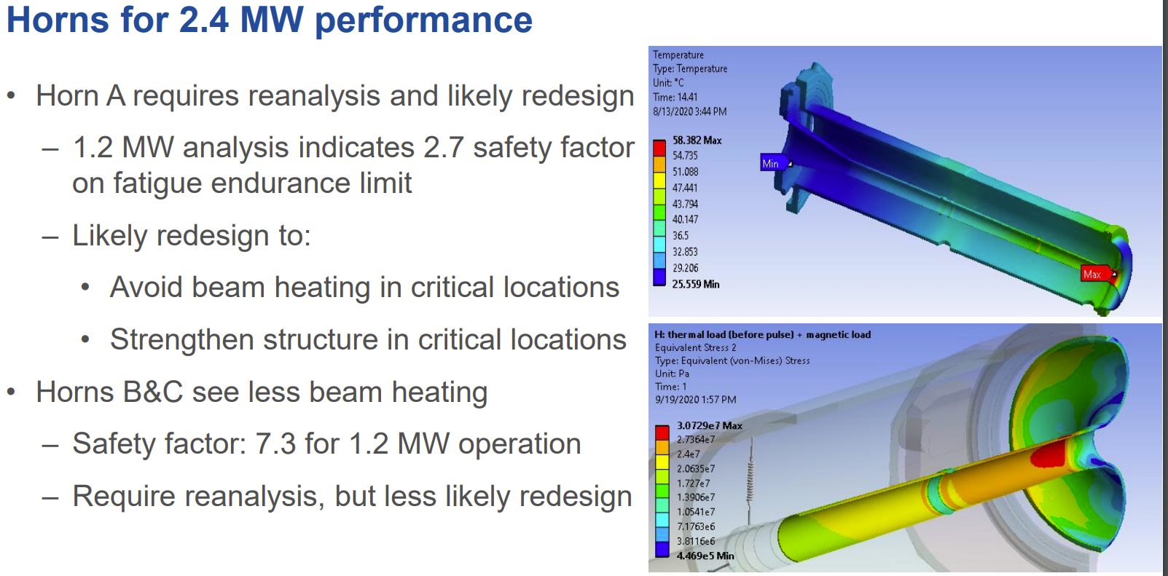
Slide from M. Convery [1]
[1] M. Convery, ACE Overview, Fermilab ACE Science Workshop (2023) https://indico.fnal.gov/event/59663/contributions/268289/attachments/167975/224776/ACEscienceworkshop.pdf

Slide 46
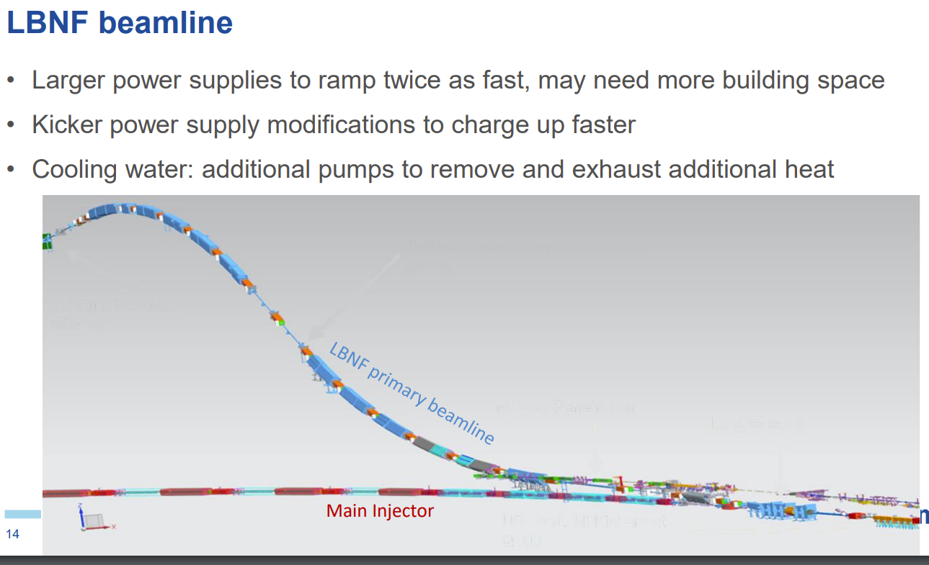
Slide from M. Convery [1]
[1] M. Convery, ACE Overview, Fermilab ACE Science Workshop (2023) https://indico.fnal.gov/event/59663/contributions/268289/attachments/167975/224776/ACEscienceworkshop.pdf

Slide 47
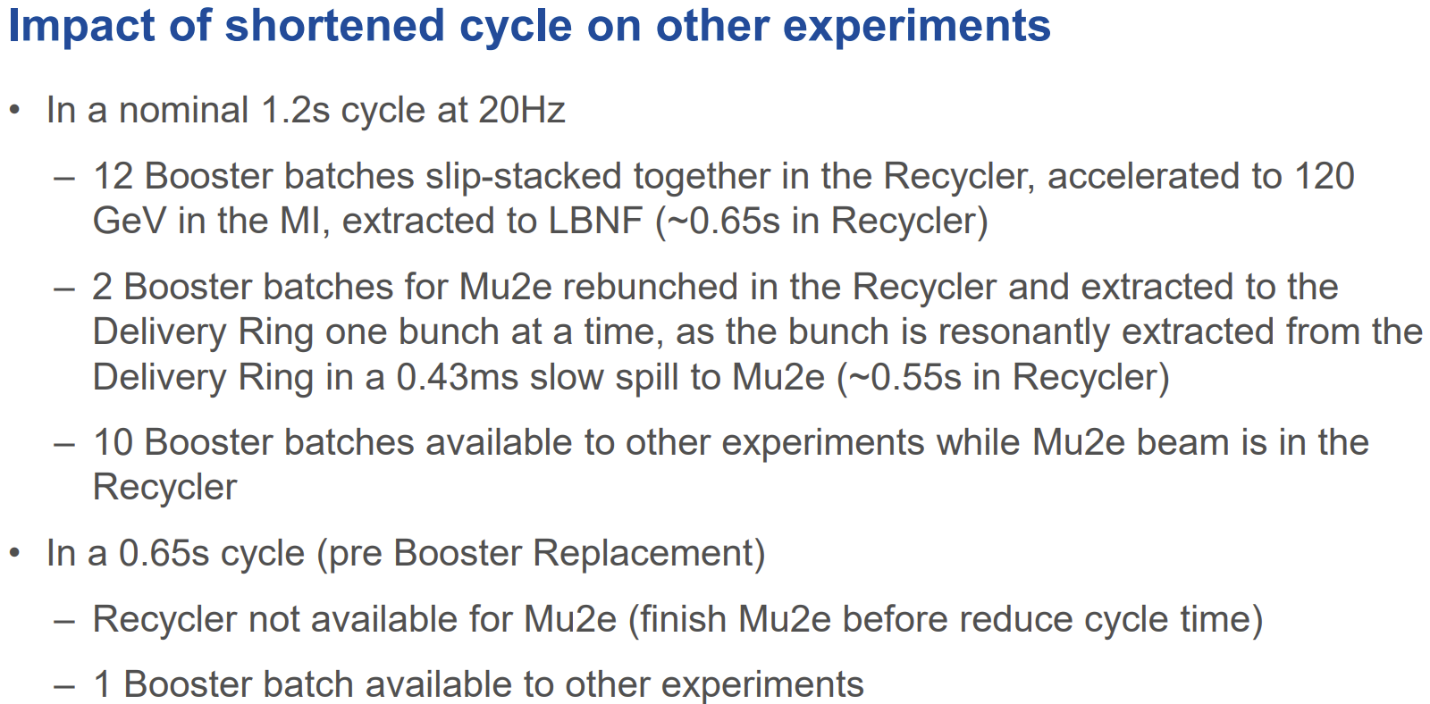
Slide from M. Convery [1]
[1] M. Convery, ACE Overview, Fermilab ACE Science Workshop (2023) https://indico.fnal.gov/event/59663/contributions/268289/attachments/167975/224776/ACEscienceworkshop.pdf

Slide 48
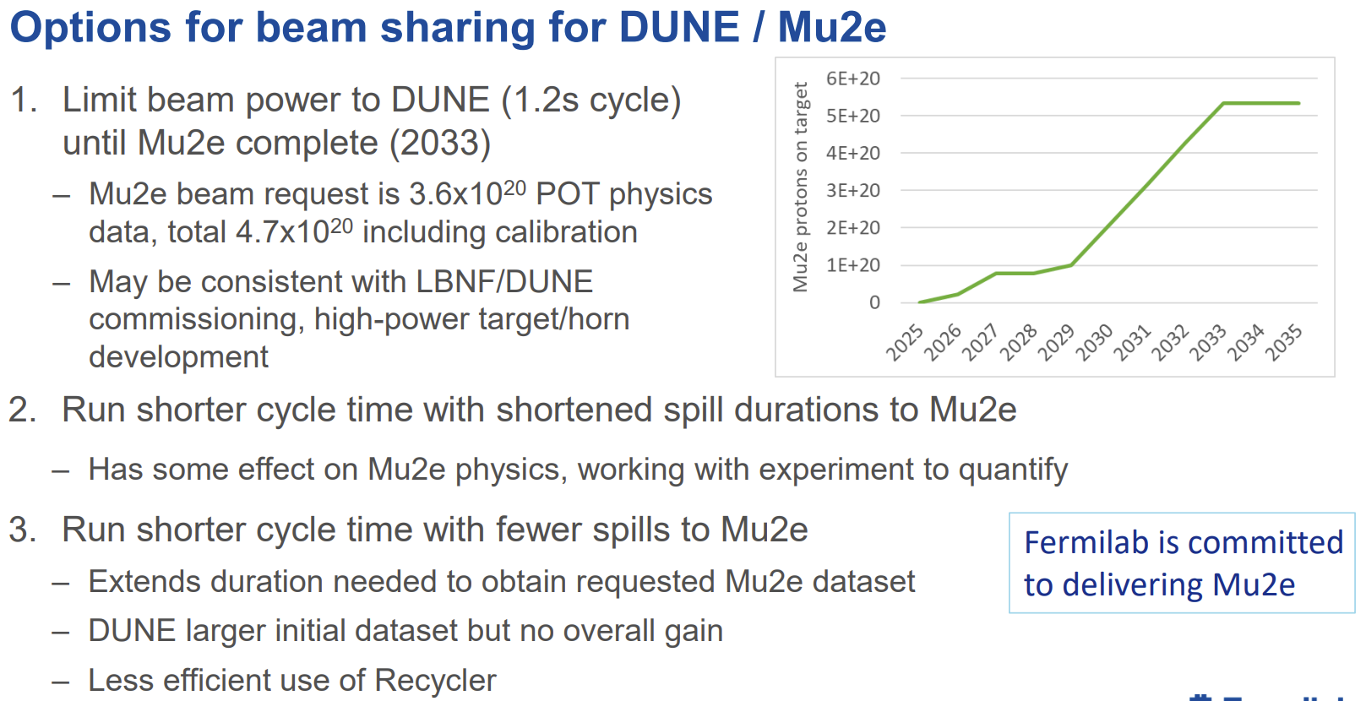
Slide from M. Convery [1]
[1] M. Convery, ACE Overview, Fermilab ACE Science Workshop (2023) https://indico.fnal.gov/event/59663/contributions/268289/attachments/167975/224776/ACEscienceworkshop.pdf

Slide 49
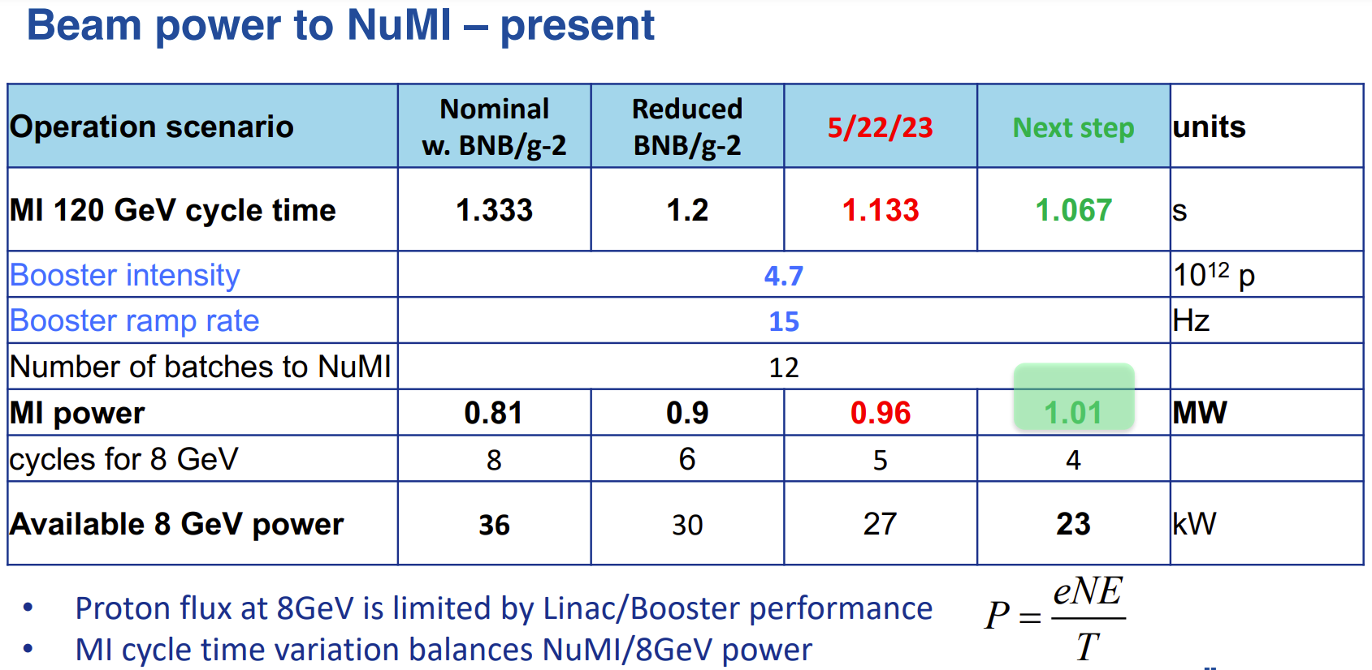
Slide from A. Valishev [1]
[1] A. Valishev, Fermilab Accelerator Complex Evolution (ACE), Princeton Muon Collider Organizational Workshop (2024) https://lss.fnal.gov/archive/2024/slides/fermilab-slides-24-0021-ad.pdf

Slide 50
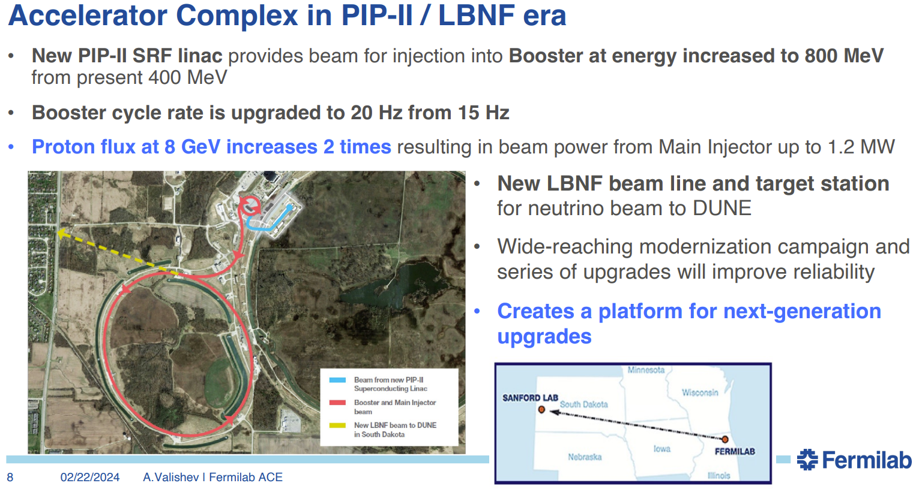
Slide from A. Valishev [1]
[1] A. Valishev, Fermilab Accelerator Complex Evolution (ACE), Princeton Muon Collider Organizational Workshop (2024) https://lss.fnal.gov/archive/2024/slides/fermilab-slides-24-0021-ad.pdf

Slide 51
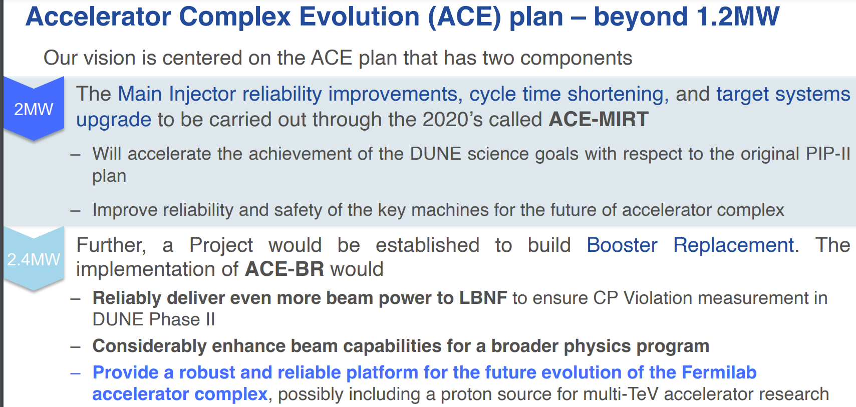
Slide from A. Valishev [1]
[1] A. Valishev, Fermilab Accelerator Complex Evolution (ACE), Princeton Muon Collider Organizational Workshop (2024) https://lss.fnal.gov/archive/2024/slides/fermilab-slides-24-0021-ad.pdf

Slide 52
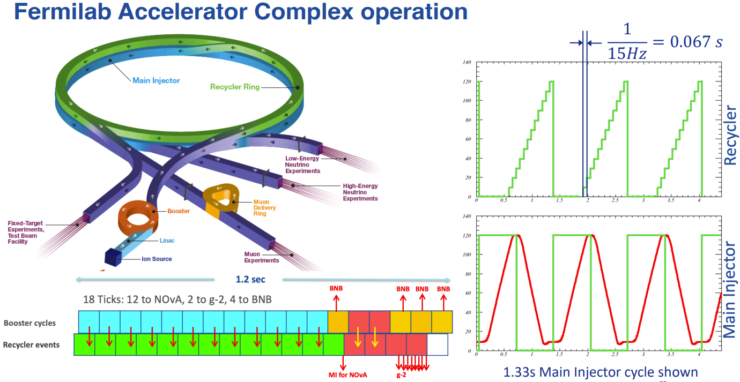
Slide from A. Valishev [1]
[1] A. Valishev, Fermilab Accelerator Complex Evolution (ACE), Princeton Muon Collider Organizational Workshop (2024) https://lss.fnal.gov/archive/2024/slides/fermilab-slides-24-0021-ad.pdf

Slide 53
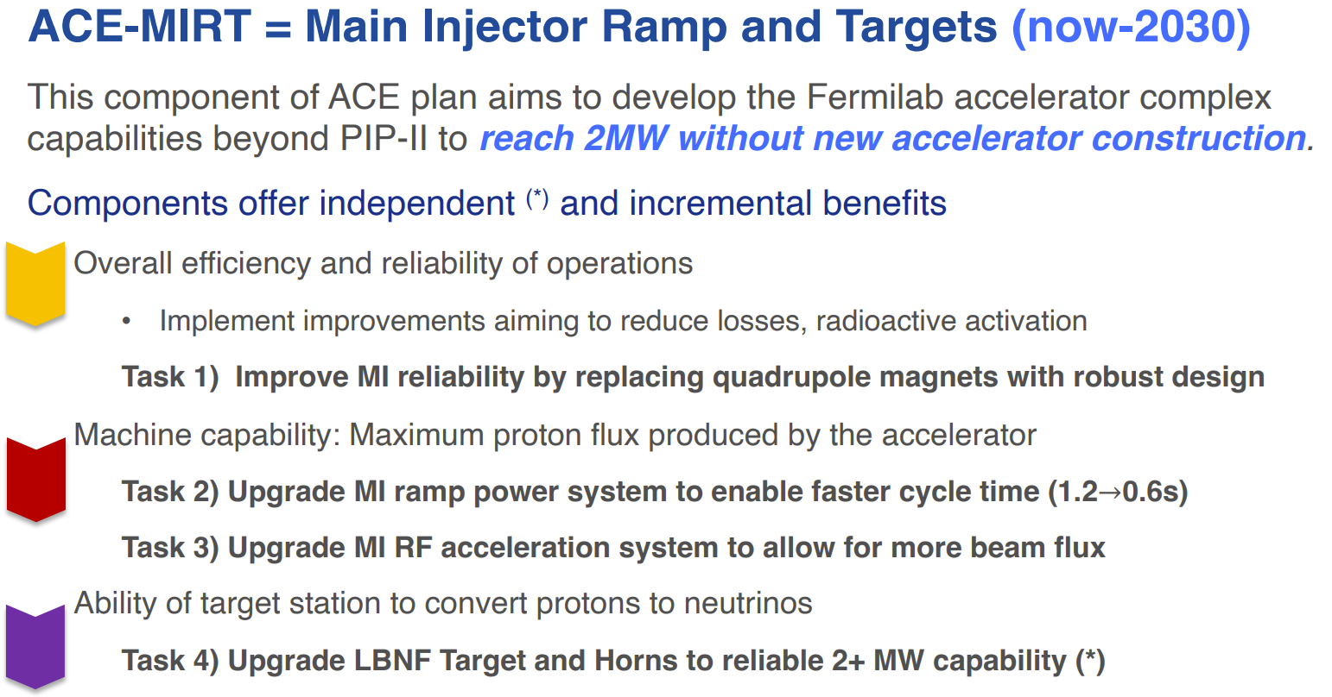
Slide from A. Valishev [1]
[1] A. Valishev, Fermilab Accelerator Complex Evolution (ACE), Princeton Muon Collider Organizational Workshop (2024) https://lss.fnal.gov/archive/2024/slides/fermilab-slides-24-0021-ad.pdf

Slide 54
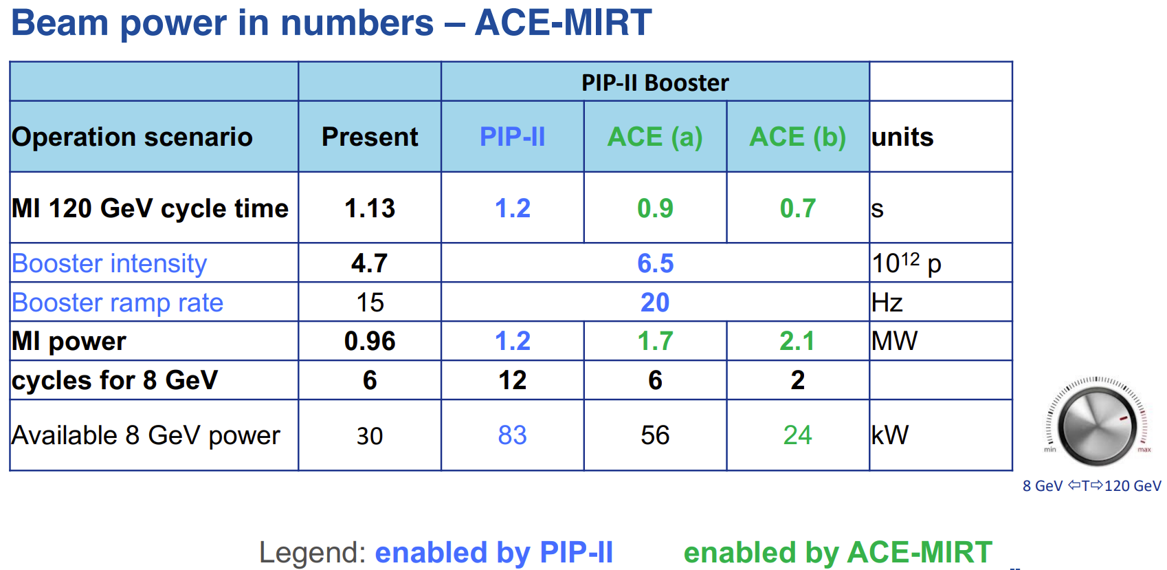
Slide from A. Valishev [1]
[1] A. Valishev, Fermilab Accelerator Complex Evolution (ACE), Princeton Muon Collider Organizational Workshop (2024) https://lss.fnal.gov/archive/2024/slides/fermilab-slides-24-0021-ad.pdf

Slide 55
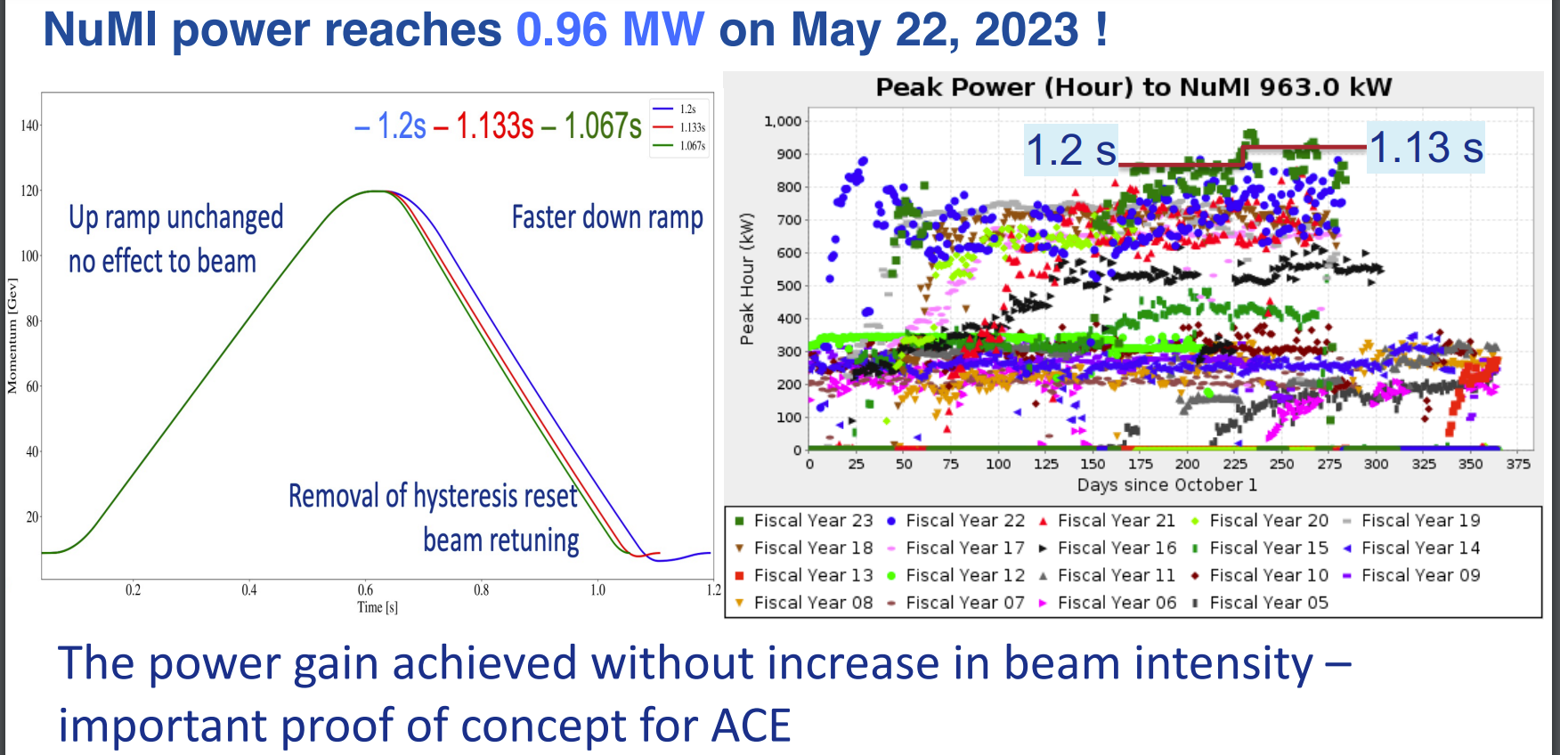
Slide from A. Valishev [1]
[1] A. Valishev, Fermilab Accelerator Complex Evolution (ACE), Princeton Muon Collider Organizational Workshop (2024) https://lss.fnal.gov/archive/2024/slides/fermilab-slides-24-0021-ad.pdf

Slide 56
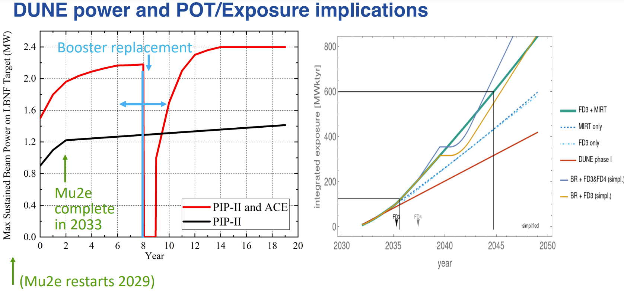
Slide from A. Valishev [1]
[1] A. Valishev, Fermilab Accelerator Complex Evolution (ACE), Princeton Muon Collider Organizational Workshop (2024) https://lss.fnal.gov/archive/2024/slides/fermilab-slides-24-0021-ad.pdf

Slide 57
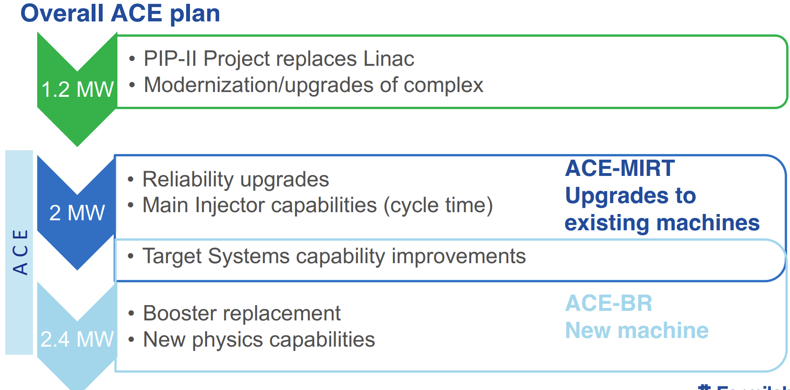
Slide from A. Valishev [1]
[1] A. Valishev, Fermilab Accelerator Complex Evolution (ACE), Princeton Muon Collider Organizational Workshop (2024) https://lss.fnal.gov/archive/2024/slides/fermilab-slides-24-0021-ad.pdf

Slide 58
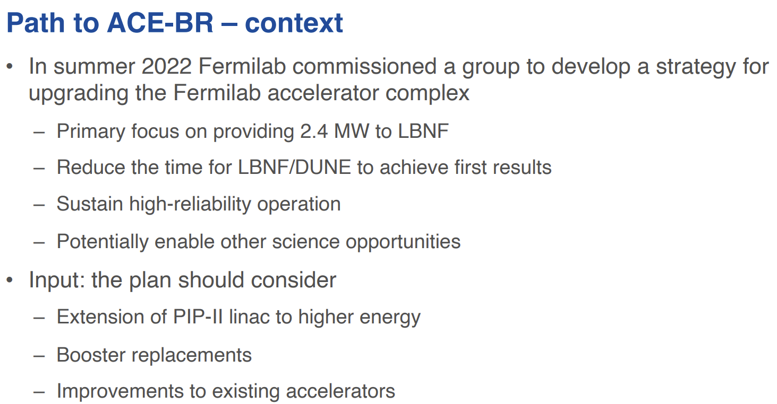
Slide from A. Valishev [1]
[1] A. Valishev, Fermilab Accelerator Complex Evolution (ACE), Princeton Muon Collider Organizational Workshop (2024) https://lss.fnal.gov/archive/2024/slides/fermilab-slides-24-0021-ad.pdf

Slide 59

Slide from A. Valishev [1]
[1] A. Valishev, Fermilab Accelerator Complex Evolution (ACE), Princeton Muon Collider Organizational Workshop (2024) https://lss.fnal.gov/archive/2024/slides/fermilab-slides-24-0021-ad.pdf

Slide 60

Slide from A. Valishev [1]
[1] A. Valishev, Fermilab Accelerator Complex Evolution (ACE), Princeton Muon Collider Organizational Workshop (2024) https://lss.fnal.gov/archive/2024/slides/fermilab-slides-24-0021-ad.pdf

Slide 61

Slide from A. Valishev [1]
[1] A. Valishev, Fermilab Accelerator Complex Evolution (ACE), Princeton Muon Collider Organizational Workshop (2024) https://lss.fnal.gov/archive/2024/slides/fermilab-slides-24-0021-ad.pdf

Slide 62
Current Fermilab Accelerator Complex:
Step 1: Produce 35 keV H⁻ beam & accelerate it to 750 keV.
Step 2: Accelerate 750 keV H⁻ beam to 400 MeV.
Step 3: Remove electrons with stripping foil & accelerate 400 MeV p beam to 8 GeV.
Step 4: MI-8 Line is used to send beam to MI, RR, or BNB Line.
Step 5A: BNB Line sends beam to SBN experiments.
Step 5B: RR is an 8 GeV machine that can perform slip stacking and facilitate injection into MI, as well as send beam to the Muon Campus Line. MI can accelerate 8 GeV p beam to 120 GeV.
Step 6A: NuMI Line sends beam to NoVA.
Step 6B: Muon Campus Line will send beam to Mu2e.
Step 6C: Switchyard Line sends beam to Meson Line (MTest & MCenter) & Neutrino-Muon Line (SpinQuest).
Step 5B:
RR+MI Operations
Or
MI Only Operations
[1]
Step 5A
Step 6C
Step 6A
Step 4
Step 2
Step 6B
Step 3
Step 1
[1] https://www.fnal.gov/pub/science/particle-accelerators/images/accel-complex-animation.gif

Slide 63
The Deep Underground Neutrino Experiment (DUNE) will study neutrino properties.
DUNE science includes:
High precision measurements of neutrino oscillations.
Determining the neutrino mass ordering.
Measure neutrino signals from supernova.
Search for proton decay.
AD focus for DUNE is on the Long-Baseline Neutrino Facility (LBNF).
Build new LBNF beamline and target station.
  Integrate these systems into the Accelerator Complex.
PIP-II Project will upgrade Accelerator Complex for reliable delivery of greater than 1 MW beam power operations.
ACE-MIRT Project will upgrade the Accelerator Complex for reliable delivery of greater than 2 MW beam power operations.
See Sungbin Oh’s talk on Wednesday at 10:30 for the Deep Underground Neutrino Experiment Overview.
[1]
[1] https://lbnf-dune.fnal.gov/

Slide 64


The Deep Underground Neutrino Experiment (DUNE) will study neutrino properties.
[1]
[1]
[1] https://lbnf-dune.fnal.gov/

Slide 65

The Muon-to-Electron-Conversion (Mu2e) Experiment will look for charged lepton flavor violation.
[1]
Mu2e measuring a nonzero signal implies physics beyond the Standard Model.
  Neutrinos undergo flavor oscillations.
AD is preparing the Muon Campus for Mu2e operations.
  Muon g-2 used a muon beam.
  Mu2e will use a proton beam.
AD is working on the production target for the production solenoid.
Mu2e
[2]
See Gonzalo Diaz Bautista’s talk on Thursday at 17:00 for Mu2e (+PIP-II Muon Possibilities).
[1] https://mu2e.fnal.gov/research_goals.shtml
[2] D. Stratakis et al., Commissioning and First Results of the Fermilab Muon Campus, Phys. Rev. Accel. Beams 22 (2019) no.1, 011001 doi:10.1103/PhysRevAccelBeams.22.011001

Slide 66

The Muon-to-Electron-Conversion (Mu2e) Experiment will look for charged lepton flavor violation.
[2]
[1]
Mu2e measuring a nonzero signal implies physics beyond the Standard Model.
  Neutrinos undergo flavor oscillations.
AD is preparing the Muon Campus for Mu2e operations.
  Muon g-2 used a muon beam.
  Mu2e will use a proton beam.
AD is working on the production target for the production solenoid.
See Gonzalo Diaz Bautista’s talk on Thursday at 17:00 for Mu2e (+PIP-II Muon Possibilities).
[1] https://mu2e.fnal.gov/research_goals.shtml
[2] https://www.fnal.gov/pub/today/archive/archive_2014/today14-12-09.html

Slide 67

The Production Solenoid surrounds the Production Target.
See https://mu2ewiki.fnal.gov/wiki/ProductionSolenoidIntro

Slide 68

GUARD funding has been used to support FAST/IOTA.
See https://strategicplan.fnal.gov/accelerator-science-technology/

