Slide 1
Superconducting Quantum Materials and Systems Center
A DOE National Quantum Information Science Research Center
Anna Grassellino, SQMS Center Director
User Meeting
July 2024

Slide 2
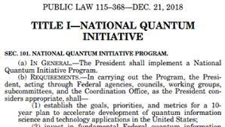
National QIS Research Centers
Build on SC’s long history of stewarding national
initiatives:
National Nanotechnology Initiative, Energy (Bioenergy Research Centers, Energy Innovation Hubs, Energy Frontier Research Centers), Computing (Exascale Computing Project)…
Be an integral (and leading) part of SC QIS portfolio
Represent the “all of SC” strategy
Embody a national imperative – urgency, scale, and impact
Slide from Harriet Kung, DOE SC Director

Slide 3
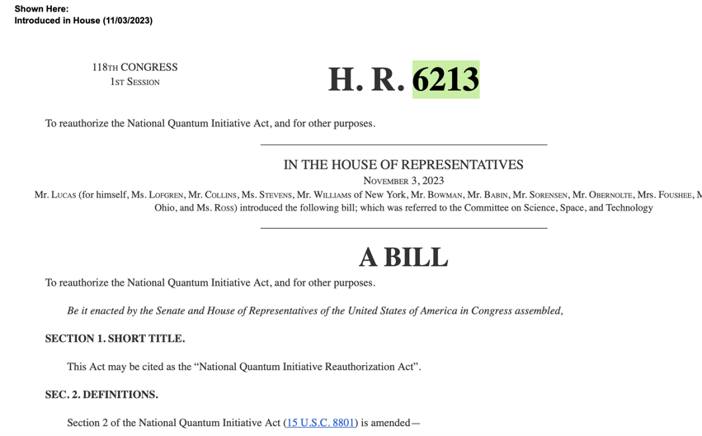
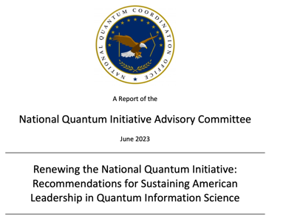
National Quantum Initiative
Authorizes DOE NQI Centers for 10 years
https://www.congress.gov/bill/118th-congress/house-bill/6213/text?s=1&r=1&q=%7B%22search%22%3A%22H.R.+6213%22%7D
https://www.quantum.gov/wp-content/uploads/2023/06/NQIAC-Report-Renewing-the-National-Quantum-Initiative.pdf
NQI reauthorization passed unanimously by House Science committee and to be voted by Congress in next weeks. Contains language on Centers renewal focus and funding levels.

Slide 4
Center Overview

Slide 5

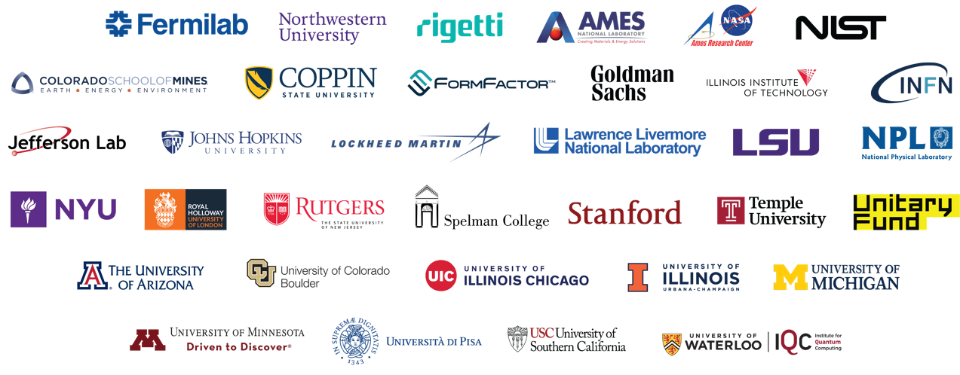
31 Partner Institutions
>535 Collaborators, $112M
A DOE National Quantum Information Science Research Center, led and host by Fermilab
SQMS brings together hundreds of experts from more than 30 DOE national labs, academia, industry and other federal and international entities to bring transformational advances in QIS
*3 MSI pending DOE approval

Slide 6
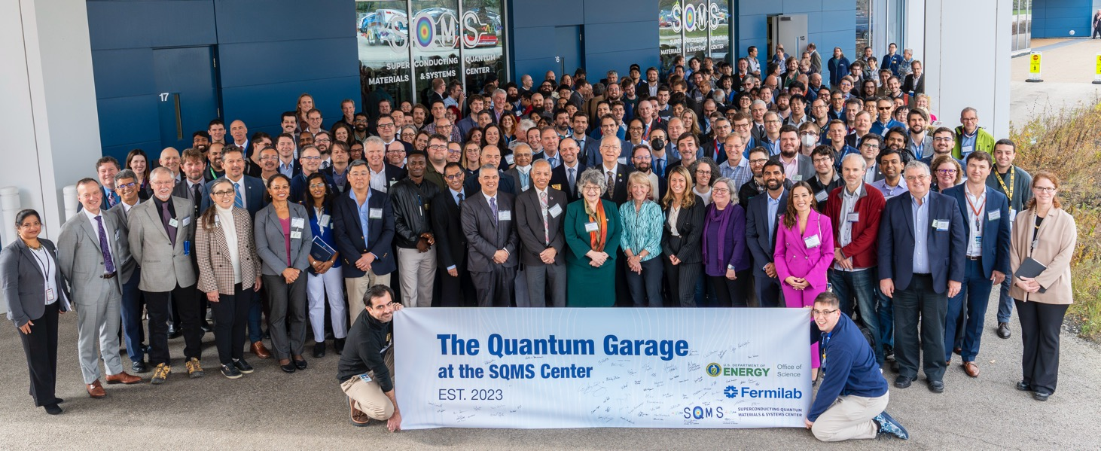
SQMS Collaboration Meeting, November 2023

Slide 7
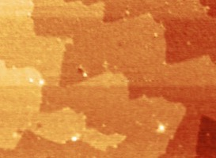
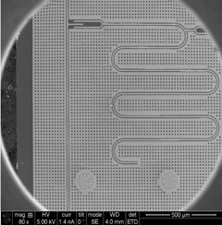
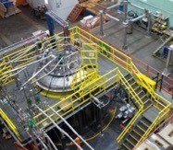
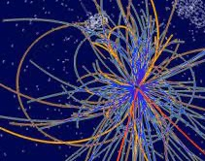
Mission driven collaboration with set goals and milestones
Materials
High-coherence devices
Systems integration
New platforms for
quantum computing & sensing
Quantum advantage
Developing a full understanding of sources of decoherence
Demonstrating devices with systematically higher coherence
Integrating devices into quantum processors
Deploying quantum computing and sensing facilities
Experiments with quantum computing and sensing advantage
Vision: use/achieve unique strengths in quantum technology – be leaders – and employ them for advancing fundamental physics; partner with leading quantum computing industry to jointly advance technology and applications; serve as a ‘gateway’ for FNAL and HEP to broader DOE, national and international ecosystem

Slide 8
SQMS Center Research: Multidisciplinary, Integrated & Synergistic Approach
SRF high Q devices
FNAL
Superconducting qubits
Rigetti, NIST, NU, FNAL, INFN, Colorado Boulder, Rutgers, NPL, RHUL, Livermore
Theory and Applied Superconductivity
FNAL, NU, Temple, IIT, LSU
Scaling & integration
FNAL, Rigetti
Cryogenics
FNAL, NU, Royal Holloway, Form Factor
Material Science
Ames Lab, NU, FNAL
Controls & electronics
Rigetti, NIST, NU, FNAL
Particle Physics
FNAL, UIUC, Stanford, INFN, John Hopkins, Livermore
Computational Science, QIS Theory
NASA Ames, Colorado Mines, Rigetti, NU, Arizona
Condensed Matter Physics
Ames Lab, NU, Nasa Ames, LSU
Industry use cases
Goldman Sachs, Lockheed Martin, Rigetti, NYU

Slide 9
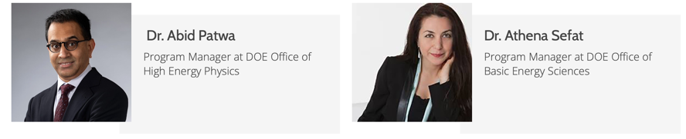
Well-Structured Plan and Metrics
Metrics
Meet/exceed milestones
Proposal appendix 13 - project timetable
  - quarterly updates/refinement JIRA/Confluence
  - boost promising research directions
Number, quality, impact of
peer-reviewed publications,
presentations
- DOE/SQMS as funding source in acknowledgments
- report to FNAL for records
Internal and external evaluations via
- DOE reviews, annual and trimester reports, biweekly meetings
- Advisory Boards and SQMS leadership
PI participation
in center-wide activities and meetings

Slide 10
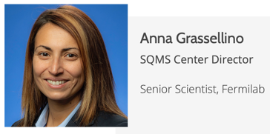
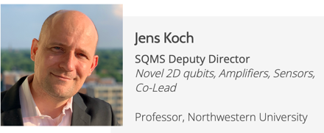
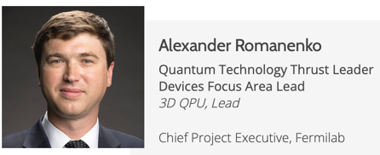
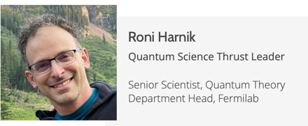
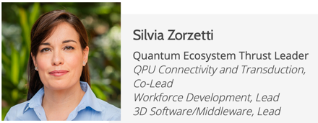
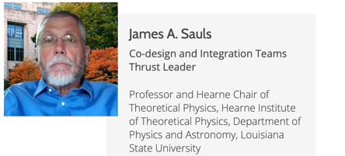
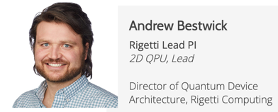
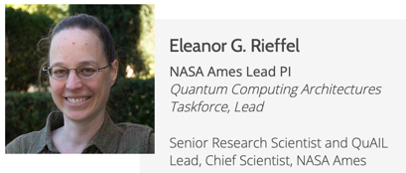
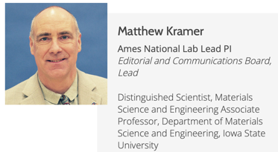
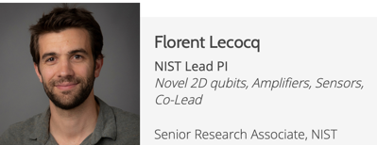
SQMS Center Leadership: Core Management Group
Programmatic and Institutional Leadership of the SQMS Center (Core Partners), has been effective in setting the top scientific directions and priorities for the center, ensuring timely execution towards the center goals, resolving conflicts

Slide 11
SQMS Division at Fermilab
~50 employees plus 11 on-site students establishing quantum competences at FNAL

Slide 12
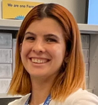
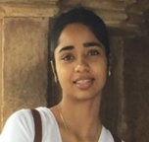
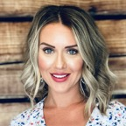

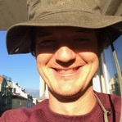
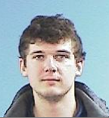
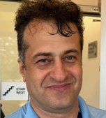
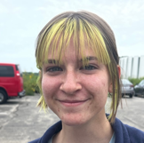
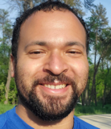
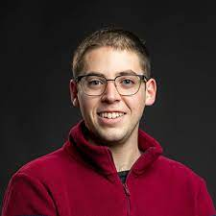
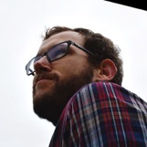
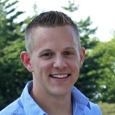
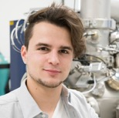
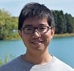

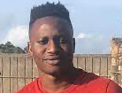

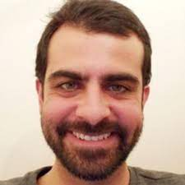
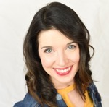
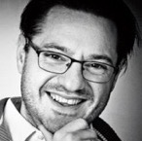
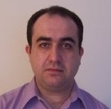
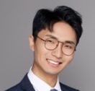
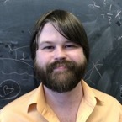
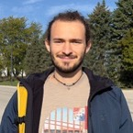
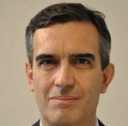
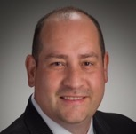
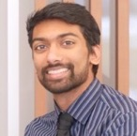
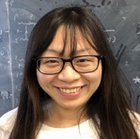
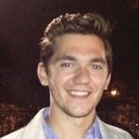
SQMS has attracted to FNAL top and diverse talent
Over 40 excellent new hires since the center inception, early career scientists

Slide 13
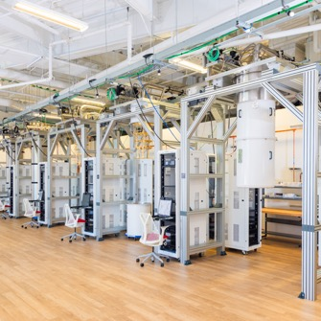
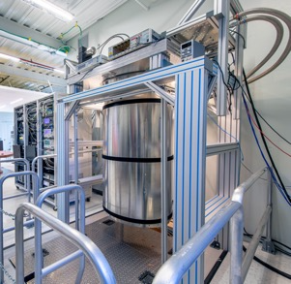
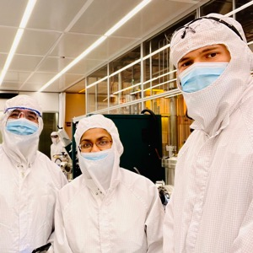
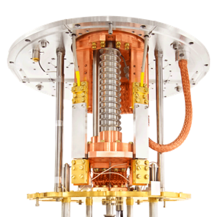


SQMS Core Facilities and Capabilities
https://sqmscenter.fnal.gov/facilities/enabling-labs-and-tools/
Quantum Computing Lab 1 (ICB)–
qubit testing and development, transduction
Quantum Computing Lab 2 (ICBA) –
Superconducting quantum devices nano-fabrication
Quantum Garage (OTE) –qubit characterization,
quantum computing and sensing testbeds
Quantum Computing Lab 4 (HAB) –
High magnetic fields DR qubit testing for sensing
Materials Science Laboratory (ICB) –
Qubit materials advanced characterization
QSET Lab (Northwestern) –
Resonators and qubit characterization

Slide 14




SQMS facilities: deployed fleet of new quantum testbeds and fab capabilities
8 extra large dilution refrigerators, hundreds of qubits and cavities, nanofab tools and materials science capabilities

Slide 15

The Quantum Garage at the SQMS Center, Fermilab
Ribbon Cutting Ceremony, November 2023

Slide 16








SQMS Affiliated Facilities (small subset)
https://sqmscenter.fnal.gov/facilities/enabling-labs-and-tools/
Rigetti Computing Fab-1
NIST Boulder
Microfabrication Facility
Northwestern NUANCE
Facility
Ames Sensitive
Instrument Facility
Boulder Cryogenic
Testbed
Rigetti Computing
Measurement Facility
INFN LNGS Facility
RHUL London Low
Temperature Laboratory

Slide 17
Technical Areas

Slide 18




Technology Thrust - Strategy
Basic Understanding -> Coherence Improvement -> 2D and 3D High Coherence QPUs
Build upon core strengths of partners
  Fermilab world’s best superconducting RF cavities (3D) – seconds of coherence (quality factors Q > 10¹⁰)
    Associated deep structural and superconductivity knowledge of niobium (key part of 2D qubits)
    Microwave, cryogenic, mechanical engineering and large scale integration experience
  Deep 2D superconducting qubit and quantum processor expertise
  Deep basic materials and superconductivity expertise
NbO_{x}
10nm
Nb
7/10/2024
Romanenko | Technology

Slide 19

Goal: identifying all 2D qubit decoherence channels
MS: Metal-Substrate | SA: Substrate-Air | MA: Metal-Air | MM: Metal-Metal
Coherence time ~ 1/γ
Other channels (e.g. radiative decay)
Participation ratio E_{stored} /E_{total}
Total decay rate ^{1,2,3}
1. Koch, J. et al. Physical Review A 76, 042319 (2007)
2. Wenner, J. et al. Applied Physics Letters 99, 113513 (2011)
3. Wang et al. Appl. Phys. Lett. 107, 162601 (2015)
4. Calusine, G. et al. Applied Physics Letters 112, 062601 (2018)
Al
Qubit frequency
Loss tangent
7/10/2024
Romanenko | Technology

Slide 20
Necessary Parts to Advance Coherence
What are all the details of the constituent materials of 2D qubits?
  Substrate, films
    Composition, structure, composition, thicknesses
What is the “hierarchy” of the individual loss contributions?
  Dissipation in oxide(s), substrate, other layers, inclusions, quasiparticles..
7/10/2024
Romanenko | Technology

Slide 21



Material Structure/Properties Understanding approach - coordinated studies of qubit fragments
SQMS 2D qubit chips made at different fabs are dissected and distributed center-wide between partners
  Ames, Fermilab, Northwestern, Temple, IIT
Large scale broad material/properties study with many techniques applied to 2D qubits for the first time
Ensure cross-checking of major findings/embedded redundancy
Akshay Murthy
Materials Focus area leader
Fermilab
Year 1-2: 6 measured Rigetti chips have been sent to Fermilab, Ames, Northwestern (2 each)
Year 2-3: SQMS unified design chips with coherence improvement techniques applied are measured and then dissected/studied center-wide to guide the effort
7/10/2024
Romanenko | Technology

Slide 22













Physical/superconducting characterization
PPMS- AFM/MFM
STM
Point-Contact Tunneling
Study the ‘good vs bad’ performing qubit fragments
THz Spectroscopy
Magneto-optical
β-NMR/μSR
7/10/2024
Romanenko | Technology

Slide 23









Structural/chemical characterization
Electron Microscopy
XRR/XRD
APT
TOF-SIMS
XPS
AFM/MFM
Raman

Slide 24

7/10/2024
Romanenko | Technology

Slide 25




Highlight: Structure and Chemistry of the Oxide
(a)
Nb
O
Multiple institutions studying similar 2D qubit fragments confirm and cross-check the niobium oxide
  Thickness
  Composition
  Mostly amorphous structure - Nb₂O₅
  Is almost identical to SRF cavities
Step forward from prior thinking of Nb oxide having complicated/unclear structure in 2D qubits
NbO_{x}
Cavity
Nb
10nm
(b)
NbO_{x}
Transmon
Nb
10nm
X. Fang et al., Materials Research Letters, 11, 2, 108-116, (2023)
A. A. Murthy et al., ACS Nano 16, 10, 17257–17262 (2022).
7/10/2024
Romanenko | Technology

Slide 26



Highlight: Niobium Hydrides Presence Discovery
First ever cryogenic microscopy (AFM, TEM) studies revealed the presence of hydride precipitates in 2D qubits
  Normal conducting precipitants varying in size and location
  Could be related to cooldown-to-cooldown performance variation
  Detailed impact on decoherence studied
J. Lee, Z. Sung, A. Murthy, M. Reagor, A. Grassellino, and A. Romanenko https://arxiv.org/abs/2108.10385
Torres, Hersam et al https://doi.org/10.1002/adfm.202401365
7/10/2024
Romanenko | Technology

Slide 27


Highlight: Quantifying Impurities in Nb Qubit Films
TOF-SIMS applied for the first time ever to 2D qubits reveal levels of contamination in the Nb pads
Lithography steps during qubit fabrication lead to incorporation of impurity species including O⁻, H⁻, C⁻, Cl⁻, F⁻, Na⁺, Mg⁺, and Ca⁺
Evaluating possible effects of the film purity on the microwave dissipation
Depth Profiles of impurities in Nb film
A. A. Murthy, et al. Appl. Phys. Lett. 120 (4), 044002 (2022) – Editor’s Pick
3D representation of impurity concentrations
7/10/2024
Romanenko | Technology

Slide 28
Directly measuring individual contributions to losses using the high Q 3D SRF cavity as a tool
  Empty cavity (e.g. Niobium oxide or metal loss)
  Bulk substrates (Si, sapphire)
  Studying TLS losses
7/10/2024
Romanenko | Technology

Slide 29



Using high Q SRF Cavities as a Unique Tool for Microwave Dissipation Measurements
SRF Cavity with sample inside
Example: Silicon sample mounted on the cavity flange
  Microwave dissipation inside the very high Q (Q>10⁹) cavity in the quantum regime becomes dominated by the inserted substrate sample
    Parts per billion sensitivity
  Direct measurement, no ambiguity of multiple competing loss mechanisms
7/10/2024
Romanenko | Technology

Slide 30

Saturation of Q decrease in SRF cavities at low fields – TLS signature
1.3 GHz
T=1.5K
Low field Q saturates at Q>3 x 10¹⁰
Field dependence
A. Romanenko and D. I. Schuster, Phys . Rev. Lett. 119, 264801 (2017)
Measured down to <N> ~ 1000 photons

Slide 31

Two level systems in the natural niobium oxide
According to Martinis et al, Phys. Rev. Lett. 95, 210503 (2005) -> electric field effect
Nb
Nb₂O₅
100 nm
5 nm
Nb
Nb₂O₅
A. Romanenko and D. I. Schuster, Phys . Rev. Lett. 119, 264801 (2017)

Slide 32


Cooling down to quantum regime
340-450C vacuum treatments remove amorphous Nb₂O₅ hosting TLS
Depth
TOF-SIMS data on cavity cutouts
A. Romanenko, R. Pilipenko, S. Zorzetti, D. Frolov, M. Awida, S. Belomestnykh, S. Posen, A. Grassellino, Phys. Rev. Appl. 13, 034032 (2020)

Slide 33



Niobium oxide – TLS loss tangent is directly measured
High Q 3D SRF cavities are limited by the two-level-systems in niobium oxide
Possible frequency dependence
A. Romanenko, R. Pilipenko, S. Zorzetti, D. Frolov, M. Awida, S. Belomestnykh, S. Posen, A. Grassellino, Phys. Rev. Appl. 13, 034032 (2020)

Slide 34





Oxygen Vacancies as a Possible Source of TLS Loss
A single 1.3 GHz Nb SRF cavity subjected to sequential rounds of in situ baking without ever breaking interior vacuum: Maintained vacuum level <1e-6 Torr
In situ dissolution of Nb₂O₅ in 3-D cavities drives non-monotonic aggravation of TLS-driven losses
D. Bafia, A. Murthy et al arXiv:2108.13352
f₀ =1.3 GHz
T < 1.5 K
TLS Contribution to RF Loss Post in situ Vacuum Baking Treatments of TE1AES019
f₀ =1.3 GHz
T < 1.5 K

Slide 35


Highlight: Silicon Substrate Dissipation
Si
Direct measurements reveal silicon plays a substantial role in the overall 2D qubit loss budget
M. Checchin et al, Phys. Rev. Applied 18, 034013 (2022) - Editor’s suggestion
7/10/2024
Romanenko | Technology

Slide 36



Measuring Loss Tangents of Sapphire Substrates
Used two niobium SRF cavities to extract out the loss tangent of two different sapphire samples
Ultra high-Q EM resonator
HEMEX c-plane Sapphire
Solvent cleaned
Solvent cleaned
Annealed @1100 C x 3hr
Installed into cavity #1
Solvent cleaned + UV Ozone
Installed into cavity #2
M. Checchin et al. PRAppl 18, 034013 (2022)

Slide 37
Implementing findings to advance coherence
7/10/2024
Romanenko | Technology

Slide 38


















Nanofabrication Taskforce for Coordination
Coordinated study/process flow across FNAL/UChicago, NIST, Rigetti, Northwestern foundries to address material losses
Priorities: Encapsulation strategies & mitigating bulk substrate loss
Mustafa Bal​
Fermilab
Akshay Murthy
Fermilab
Ella Lachman
Rigetti Computing
Shaojiang Zhu​​
Fermilab
​
Francesco Crisa’, Fermilab
7/10/2024
Grassellino - SQMS
Lin Zhou
Ames National Lab
Pete Hopkins,
NIST
Florent Lecoq, NIST
Nik Zhelev, NU
Yuvraj Mohan
Rigetti Computing

Slide 39






Overall approach to improve transmon coherence
Resonators and qubits fab and measurements (> 5 foundries)
Material characterization of devices fragments (> 5 institutions)
Simulation of participation ratios of various materials
Understanding of subsystem losses, choice of subsystem/material to modify
ANSYS HFSS

Slide 40




SQMS FNAL 2D Qubits Chip Layouts version 1 and version 2
R&D Chip v1
R&D Chip v2
    V2 contains big paddle qubits vs smaller pads for v1, and IDC and CC
    8 fixed frequency uncoupled transmons ~ 4 – 5 GHz
    Readout resonators ~ 6 – 8 GHz

Slide 41




Nb surface encapsulation of transmon qubits:
Preserving the low loss of Nb metal while abating Nb oxide losses
Removing oxide → Reduced loss
npj Quantum Information volume 10, Article number: 43 (2024), https://doi.org/10.1038/s41534-024-00840-x
Also explored: full Ta, rhenium and rhenium capping
Nb Baseline
Ta Capped Nb
Al Capped Nb
TiN Capped Nb
Au or Au/Pd Capped Nb
Au
Nb
Sputter deposited Nb film
Surface Oxide: 3 – 5 nm NbOx
Sputter deposited Nb film with in-situ deposited Ta capping layer
Surface Oxide: 3 – 5 nm TaOx
Sputter deposited Nb film with in-situ deposited Al capping layer
Surface Oxide: 2 – 4 nm AlOx
Sputter deposited Nb film with ex-situ ALD grown TiN capping layer (oxide removed chemically)
Surface Oxide: 1 – 2 nm TiOx
Sputter deposited Nb film with ex-situ e-beam deposited Au capping layer (oxide removed by milling)
Surface Oxide: Not Observed
Notes:
The focus of this talk is on the loss due to surface oxide of Nb based superconducting qubits and resonators.
At Fermilab, we are well known for our work on Nb based SRF cavities. During the course of our research, we found out that when we removed the Nb2O5 on the cavity walls , the cavity lifetime reached world record of 2 sec!!!
Similarly, recent work in 2D resonators on Si substrates correleated the surface oxide thickness with loss due to TLS’s.

Slide 42



Measurement results: systematic improvement of coherence in encapsulated small paddle qubits
arXiv:2304.13257
All encapsulation strategies so far lead to the significant systematic coherence advancement
Gold and Tantalum capping lead to similar improvements
No correlation between native oxide thickness and coherence time

Slide 43


Systematic Improvement of Coherence in Ta-Encapsulated Qubits -
Study as a function of qubit geometry
Average values for larger paddle qubits ~0.32 milliseconds
Best T1’s reaching 0.6 milliseconds – record values!

Slide 44


Reproduced by industry: Rigetti-made (Si substrate)
Extraordinary individual T₁ values for Nb qubits
Systematic improvement via the Ta/Nb encapsulation confirmed in the industry fabrication as well
7/10/2024
Romanenko | Technology

Slide 45





Rhenium
TEM image taken by Dr J. Lee
Motivation:
Thin Surface Oxide ̴ 1 nm
1 nm
Various deposition opportunities
Epitaxial growth on sapphire c-plane sapphire
Wide range of tunability
$T_{c}=1.7 K$

Slide 46



Rhenium resonators results for $Q_{i}$ vs Power
Rhenium resonators perform 2 times better than the best encapsulation strategy
Francesco Crisa

Slide 47

First international qubit metrology round robin experiment
SQMS has launched the first, large scale, international experiment to prepare identical quantum testbeds and exchange/measure qubit devices at >10 different test sites around the world
SQMS Qubit Test Sites:
Rigetti Computing
Livermore
NIST
CU Boulder
Fermilab
Northwestern
Waterloo IQC
UK NPL
Royal Holloway
INFN Gran Sasso
University of Pisa
LA
  Effort is key to advance quantum computing and for paving the way to synchronized observatories/experiments

Slide 48





Effect of environmental radiation on qubit performance
Systematic comparative study
FNAL: above-ground
INFN LNGS: deep underground
arXiv:2405.18355
Notes:
We chose two experimental locations with distinct ambient radiation.
The uniqueness of our approach is that we perform systematic comparative study between the two locations using the same qubit chip, same acquisition hardware and the same protocol to avoid unwanted variations and bring stronger conclusions.

Slide 49




Fermilab and INFN Gran Sasso qubit exchange experiments
arXiv:2405.18355

Slide 50



Effect of radiation on transmon qubits (above vs underground)
arXiv:2405.18355

Slide 51
Technology Thrust/Focus Area 2: Devices, Prototypes, QPUs
7/10/2024
Romanenko | Technology

Slide 52
Devices Focus Area - Approach
3D QPUs
  Integrate the world record high Q SRF cavities with the best 2D transmons to achieve qubit and qudit operation
  Utilize existing/develop new techniques to control the high-coherence computational space of SRF cavities to optimize the number of photons/effective dimension of qudits, gate time/fidelity etc
    Number of effective qubits n encoded in a single qudit of up to N stored photons
      n = log₂N
        Eg 4 photons -> 2 qubits, …, 1024 photons -> 10 qubits
2D QPUs
  Harvest the coherence advancement from the Materials effort to implement the multiqubit high-fidelity processors
  Develop device-level techniques to mitigate decoherence
7/10/2024
Romanenko | Technology

Slide 53



Technology Highlight: First 9-qubits quantum processor installed and commissioned at Fermilab SQMS labs
Following our joint developments, Rigetti commercialized the 9 qubit QPU Novera as an affordable QPU for on-premise quantum computing research and development
First commercial superconducting quantum processor (Rigetti Computing) installed and operated at a DOE national laboratory
7/10/2024
Romanenko | Technology

Slide 54
Quantum processor commissioning progress @ Fermilab

Slide 55



Integrating Materials Advancements Into a Full System:
2D SQMS Quantum Processor with Rigetti Computing
9-qubit Rigetti QPU installed and operated at FNAL
9-qubit QPU prototype with higher qubit coherence installed and operated at FNAL
36-qubit QPU with higher qubit coherence preserved into full processor
Installed and operated at FNAL

Slide 56



2D QPU SQMS + Rigetti
Two-qubit gate playground
RIP-ZZ-free
RIP-ZZ-free
RIP-ZZ-free
References:
Huang et al., arXiv:2311.01332
Sete et al., Phys. Rev. Applied 16, 024050 (2021)
Stehlik et al, Phys. Rev. Lett. 127, 080505 (2021)
Roy et al., Phys. Rev. Applied 19, 064024 (2023)
IBM tunable coupler
Rigetti Parametric
Qutrit operations

Slide 57
Converting SRF Cavities to 3D QPUs

Slide 58


Converting to quantum operations: single cell architecture
T. Roy et al, PoS LATTICE2023, 127

Slide 59
Qudit approach
Qubit approach = two states used
In the qudit approach, more than 2 (d > 2) levels are used for quantum computing
Example (let’s take d = N energy levels in a single mode of SRF cavity):
  | qudit state > = a₀ |0> + a₁ |1> + a₂ |2> + … + a_{N} |N> , |a₀|² + … + |a_{N}|² = 1
  Qudits allow fast scale-up and to have the “all-to-all” connectivity
    Open up further options for quantum algorithms and simulations

Slide 60
SRF is the unique platform for qudit implementation
In order to store and manipulate many multiphoton states they must live long enough – coherence is key
  Even if just 1 photon is absorbed, the state is destroyed
  Example: each photon in SRF cavity lives ~τ = Q/ω = 1 sec, then state of precisely 1000 photons |1000 > lives τ/1000 = 1/1000 sec – still long enough
Current 2D and 3D platforms (non-SRF) do not have enough coherence for taking the qudit approach beyond several photon states
With SRF cavities we are targeting to control many photon-states per mode to encode multiple effective qubits

Slide 61


High coherence combined system with strong coupling
χ_{storage-qubit}= 2.9 MHz
T. Roy et al, PoS LATTICE2023, 127
Dielectric losses in the deeply inserted holding chip drag the coherence down from > 30 ms

Slide 62

Cavity photon number-dependent splitting
T. Roy et al, PoS LATTICE2023, 127

Slide 63

Preparation of higher Fock states – basis for qudits
Cavity-2-qubit computational space equivalence:
Cavity Fock state | 2-qubit state
|0> | |0,0>
|1> | |0,1>
|2> | |1,0>
|3> | |1,1>
The highest dimension of the qudit in each mode which can be achieved is subject of the ongoing work
T. Roy et al, PoS LATTICE2023, 127

Slide 64


Qudit gate example – 0-1 subspace rotation

Slide 65


High Q SRF cavity with weakly coupled transmon
χ_{storage-qubit}= 25 kHz
High Q TM01 mode
f_{storage} = 2.994 GHz
Qubit Mode
f_{qubit} = 3.580 GHz

Slide 66

High Q SRF cavity with weakly coupled transmon on lossy Si
Coherent cavity state decay measured using transmon
T1qubit = 10 us
T1~17 milliseconds
Due to weak χ = 25 kHz and low qubit T1 = 10 us conrol is challenging - no SNAP or photon blockade control was possible
NEXT steps:
Transmon with best SQMS technology (currently ~0.6 ms highest T1)
Cavity baked to remove Nb oxide -> seconds T1 empty

Slide 67






Modular architecture
State preparation
Tomography
Provide universal 2-qudit gate set
T. Roy
Swaps $S_{j}↔M_{k}$
Parallel operation
Storage
Manipulator
Coupler
Transmon + Rdt
T. Kim
Multiple high-Q modes
9-cell TESLA (inspired)
RAM
Two moderate-Q modes
2-cell TESLA/Coaxial
Processor
Deal with Cross-Kerr
Y. Lu

Slide 68




3D SQMS Quantum Processor Roadmap
10000
Full-fledged multi-qudit 3D QPU with memory and processor components
1000
Qudit-SWAP between local and remote modules for state-transfer
100
Universal multi-qudit control with many-body entanglement
Estimated Hilbert space dimension
Universal qudit (d-level) control of a single mode
10
Fock states preparation with high-fidelity readout
2
Incorporate 3D transmons into TESLA-shaped cavities
0
0
1
2
3
4
5
Year#

Slide 69


Large Cryogenics Facilities for quantum: Colossus – design milestone completed
Capitalizing on millions of dollars in previous investments in cryogenic infrastructure, we have developed the design of a record size dilution fridge, capable of hosting our SQMS 2D and 3D platforms, and quantum sensors for physics experiments
7/10/2024
Romanenko | Technology

Slide 70


Broader National impact of Colossus development – a Concept for industrial “Quantum Data Center”
The Colossus developments have attracted substantial interest from industry such as IBM, Rigetti, Form Factor, etc. The use of liquid helium rather than mechanical coolers makes the construction of large individual platforms possible but can also support multiple small cryostats from a central plant.
DISTRIBUTION SYSTEM
Central LHe plant
7/10/2024
Romanenko | Technology

Slide 71
Devices - longer term outlook - 5-10 years
Stable Development
  Realization of a larger and larger modular scaled up 3D QPU based on a qudit of low number per each mode in the cavity
  2D QPU incorporating the coherence advances to beyond 1 ms
High risk/high reward
  Many levels controlled per mode in the cavity
    ”Wire-free” scaling of the encoded qubit number
      Requires associated development of optimized gates and algorithms
  Error correction exploration in the 3D architecture
7/10/2024
Romanenko | Technology

Slide 72





SQMS Science
The questions that keep us up:
  What was the viscosity of the Universe when it was young?
  How does the transition quarks → hadrons (e.g. at LHC) happen in “real time”?
  What are the phases of complex quantum materials?
  What the non-equilibrium dynamics of highly entangled systems?
  What is the dark matter?
  Are there new particles that we have not yet discovered?
  Can we detect high frequency gravity waves?
  How well can we study the electron?
Quantum Simulation and Computation
Quantum Sensing
These are long term endeavors.
Our goal is to enable breakthroughs in these question.

Slide 73


Quantum Advantage in Simulation and Sensing
In computing/simulation, quantum advantage is famously “around the corner”. We are in the “NISQ era”.
  SQMS is a strong part of the national technology effort.
  Key efforts (in HEP and other areas):
    Simulation algorithms
    Experimental demonstrations of key components
In sensing, quantum advantage is already here.
  Utilizing quantum technology in classical regime
  Quantum measurement (photon counting, entanglement,…).
  SQMS has a very varied program.

Slide 74















Quantum simulation and computation group
A Multi-institutional, multi disciplinary, enthusiastic team.
Experts from HEP, Condensed matter, QIS.
Labs, Universities, NASA, industry
Focus area leads:
Norm Tubman (NASA) and Hank Lamm (FNAL))
Bi-weekly all-focus-area meetings
+ Working groups: Algorithms for 3D, CM and HEP science, Codesign

Slide 75
Quantum Simulation and Computation
High Energy Physics
Condensed Matter Physics
Roadmap toward QCD
New phases of matter (e.g spin glass)
    Towards Real time HEP simulations
    Dynamics of entangled systems
Algorithms
Identifying Qudit advantage
    Noise models, pulse control, native gate sets, for 2D and 3D.

Slide 76

Quantum Computing for Particle Physics, it’s a need
The world is quantum, and we are lucky anything is amenable to classical computers
  Large-scale quantum computers can tackle computations in HEP otherwise inaccessible
  This opens up new frontiers & extends the reach of LHC, LIGO, EIC & DUNE
While broad, these topics often are formulated as lattice field theories
Quantum Simulation for High-Energy Physics
Bauer, Davoudi et al. - PRX Quantum 4 (2023) 2, 027001
Wonderful survey of physics questions, methods, and outstanding problems in field

Slide 77



Roadmap: Theory Groundwork
Theory work: preparing a ladder of increasingly bigger groups, toward QCD.
What are the gates for the various architectures?
Theory progress:
Hank Lamm (FNAL)
Leveraging DOE investment in Lattice QCD at Fermilab, many challenges are parallel.

Slide 78



What will quantum practicality take?
Reductions thru SQMS
Current computers are usable for testing subroutines
Co-designing future computers specialized to HEP applications

Slide 79


How is SQMS reducing resources?
Scientific Achievement
Derived 3 of 8 discrete group,
Investigated cost of 3d QPU implementations
Significance and impact
Allows benchmarking. Algorithmic
preference for SNAP+DISP over ECD.
Gains in Pulse Optimization.
Details and Next Steps
High “connectivity” devices greatly reduce costs. SQMS 3D!
Need to derive remaining 5 groups (by 2025)
Perform benchmarking on 2d and 3d devices (>6q)
M. S. Alam, S. Hadfield, H. Lamm, A. C.Y. Li - Phys.Rev.D 105 (2022) 11, 114501
E. Gustafson, H. Lamm, F. Lovelace, D. Musk - Phys.Rev.D 106 (2022) 11, 114501
E. Gustafson, H. Lamm, F. Lovelace - arxiv:2312.10285
E. Gustafson, Y. Ji, H. Lamm, E. Murairi, S. Zhu - arxiv:24xx.xxxxx
D. Kurkcuoglu, H. Lamm, Andrea Maestri - arxiv:24xx.xxxx

Slide 80




















Quantum Sensing for fundamental physics group
Focus area co-leads:
Sam Posen and Bianca Giaccone(Fermilab)
Theory and experiment working closely.
Experts in HEP, materials, SRF, sensing, QIS, RF engineering.

Slide 81


Dark Sectors
Snowmass whitepaper on DM Axions
  Dark Matter:
    Axion Dark Matter
      With magnetic field
      multimode
    Dark Photon DM
    Ultra high-Q Cavities
    Single particle trap
Collaborations
+ Quax
Lead
SQMS is demonstrating technologies with prototypes. Enable dedicated campaigns by collaborations.

Slide 82


Dark Sectors
Low hanging fruit: Prototypes already covering large swaths of new parameter space
  New Particles
    Dark SRF – Dark photon search
    Several Axion LSW search concepts. (selected most promising avenues).
Dark SRF: Phys.Rev.Lett. 130 (2023) 26, 261801
Bogorad, et al., PRL, DOI:10.1103/PhysRevLett.123.021801
Gao & Harnik, JHEP, DOI:10.1007/JHEP07 (2021) 053
Berlin, et al., arXiv:2203.12714, Snowmass WP (2022)
Sauls, PTEP, DOI:10.1093/ptep/ptac034 (2022)
Giaccone, et al., arXiv:2207.11346 (2022)

Slide 83

Dark SRF: phase 2 → 2.6GHz cavities in DR
Deploy Dark SRF in dilution refrigerator → reduce thermal background, use quantum technology (JPA) for readout
Modifications of experimental setup for DR:
  2.6GHz cavities at different temperatures
  New tuner system (piezo only!)
  Verify frequency matching & stability
  Reduce crosstalk (in progress)
  Move entire setup to dilution refrigerator
Possible modifications to the measurement protocol/analysis:
  Optimal search duration: several min vs ~1h
  Improved microphonics modeling
  Phase sensitive readout

Slide 84


Deepest sensitivity: Ultrahigh Q for Dark photon DM
Cervantes et al., arXiv:2208.03183v3 (2022) accepted on PRD
DPDM search in DR with 1.3 GHz cavity with $Q_{L}≈{10}^{10}.$
Deepest exclusion to wavelike DPDM by an order of magnitude.

Slide 85




Heterodyne axion DM search: theory to experiment
Nb half cell after 1st calibration. Fabrication is in process at vendor
A. Berlin, et al., Journal of High Energy Physics 2020.7 (2020)
~400 mm
  Design is completed, currently procuring 2 prototype cavities → expected to arrive beginning 2024
  Pump mode: TM₀₂₀, Signal mode: TE₀₁₁
    By design: Δf≈1MHz
    Tuner: same design as Dark SRF 1.3GHz
Schematic of cavity assembled on vertical insert for cold tests and DM search

Slide 86



SRF cavities for high frequency GW: MAGO 1.0
Extensive work necessary before RF cold test (RF and mechanical simulations, heat treatment, plastic tuning, HPR, BCP?)
Theoretical work: coupled oscillators subject to mechanical vibrations (induced by GW vs ambient noise) derive expected growth rate of the signal mode
Overall goal: revive experiment and gain precious experience and lessons learned
  Leverage cavity imperfections to understand effects of cavity design and experimental setup on search sensitivity
  MAGO 1.0: Collaboration between Fermilab, INFN, DESY, UHH to revive MAGO!
TE₀₁₁- 2.1 GHz
Acknowledgements: V. Chouhan, C. Contreras, I. Gonin, T. Khabiboulline, Y. Orlov, O. Pronitchev, Y. Yakovlev

Slide 87



Current State of the Art Axion Searches
Operating haloscopes like ADMX use normal conducting cavities (typically copper)
They have reached desired exclusion limit for a small range of masses, but a very wide mass range remains
Scan rate scales as dν/dt ∝ B⁴V²Q/2T_{sys}
  B (magnetic field), V (cavity volume), Q (cavity quality factor), T_{sys} (system noise temperature)
Q improvement is promising path to improving rate of scanning substantially
Dilution fridge
8 T magnet
Nb₃Sn is well suited due to its very high upper critical field, ~30 T (for comparison: Nb ~0.4 T, NbTi ~15 T)
Copper cavity
From ADMX
https://arxiv.org/pdf/1405.3685.pdf & https://indico.cern.ch/event/606690/contributions/ 2655459/attachments/1498473/2332791/Axion_Overview_TAUP_2017_Final.pdf

Slide 88




Nb₃Sn Cavities in Multi-Tesla Field R&D at Fermilab
Electropolishing Nb Cavity
Nb₃Sn coated on Nb
Up to ~6 T at 4.4 K
Q₀ of 5x10⁵ at 6 T, 4.2 K, 3.9 GHz
Assembled cavity

Slide 89





FNAL Nb₃Sn Cavities for ADMX and INFN
Prototypes sent to Partners
Potential Future Experiments
Initial R&D at Fermilab
Nb₃Sn tuning rod for ADMX Sidecar sent to U. Washington (w/ LLNL)
ADMX-EFR at Fermilab
Hybrid dielectric-Nb₃Sn cavity for INFN QUAX haloscope
9 GHz Nb₃Sn cavity sent to INFN Frascati for testing in 8 T fridge

Slide 94

BSM Physics with One-Electron Qubit
Measure the electron magnetic moment – to 1 part in 10¹⁴
→ most stringent test of SM
(BSM would change make SM theory disagree)
2. Measure the positron magnetic moment – same precision
→ most precise lepton CPT test
3. meV dark matter detection with one-electron qubit
SQMS Connections
→ need loss cryogenic trap cavities
→ unexpected new science opportunities
NU Team

Slide 95

SQMS: Cavities for One-Particle Qubits
Gerald Gabrielse
Director of the Center for Fundamental Physics, Northwestern University
Board of Trustees Professor, Northwestern University
Photo in Gabrielse Lab
at Northwestern
X. Fan, T. Myers, L. Soucy, B. Sukra, G. Gabrielse – CFP at Northwestern
Gonin, T. Khabiboulline, V. Yakovlev, S. Posen – Fermilab
N$F: Lepton moments SQMS: cavities for qubits Templeton: SQUID development
One-quantum detector for dark photons – collaboration with R. Harnik
Optimal control of one-particle anharmonic oscillator – collaboration with J. Koch and S. Joshi
Renormalized calculation of cavity shifts – collaboration with Y. Kahn

Slide 96




Growing an Ecosystem and a Diverse Quantum Workforce
SQMS workshops and events encourage across the DOE office of science collaboration and impact; collaboration across various agencies and internationally;
Exciting mission and international breadth attracts young and diverse talent to the lab

Slide 97




SQMS leads the organization of several international workshops and conference sessions

Slide 98




SQMS Workforce Development
Develop a diverse workforce in STEM
>500
External students trained
(SQMS schools & internships)
Quantum schools
In 2023, SQMS conceived and hosted the largest summer school dedicated to QIS
In 2024 SQMS is collaborating with QSC on the 2024 USQIS (host by ORNL)
K-12 Education
The SQMS’ Fermilab team is hosting a TRAC intern to work on educational quantum kits for K-12 teaching
These efforts add to the past year, when SQMS hosted two TARGET interns who learned how to encode quantum states and program quantum devices
Other selected highlights
Collaboration with the other DOE’s Quantum Research Centers
  Outreach: Quantum Thursdays and Career fair, schools
  Yearly summer internships at SQMS labs

Slide 99







USQIS SCHOOL 2023

Slide 100



SQMS Workforce Development
SQMS Pipeline for students in STEM
From TARGET to Engineer at Fermilab
Julian Delgado was hired as an engineer at Fermilab
Julian was a TARGET intern while attending high-school
In the following years he was selected as a SIST intern and GEM fellow at SQMS
In 2023, he was hired as a Mechanical Engineer at SQMS/Fermilab
SQMS interns to pursue a career in STEM
Jasmin Panthee was an SQMS intern for two years. She is currently continuing her career in STEM as a graduate student at NU under the SQMS collaboration
Naomi Raicu also spent two years with us. She was co-supervised with Rigetti, which paved the way for her current pursuit of a PhD in STEM at the University of Michigan.
Hans Johnson was an Office of Science Graduate Fellow (SCGSR), he is still working with SQMS and is expected to graduate in 2024

Slide 101





HEP-RENEW awarded proposal Fermilab lead institution
Training through research in quantum information science and engineering at the SQMS Center
Leveraging national laboratories and unique facilities to include more MSIs in HEP and QIS research
These efforts add to SQMS workforce development efforts, which led to more than 500 students trained through SQMS schools and internships.
Goals
Students and faculty from MSIs to conduct studies at SQMS
Build capabilities at minority-serving partner institutions
Status update
SQMS requested a change to DOE to include the MSIs as SQMS members
The MSI students will be at Fermilab in the summer
The MSI co-PIs will also be at Fermilab in the summer and teach at the QCIPU school
Silvia Zorzetti, DOE Early career Award, RENEW grant

Slide 102

An exciting future ahead!

