Slide 1
The Discovery on the Prairie Initiative
Jonathan Jarvis for the Discovery on the Prairie Team
Fermilab Users Meeting
10 July 2024

Slide 2
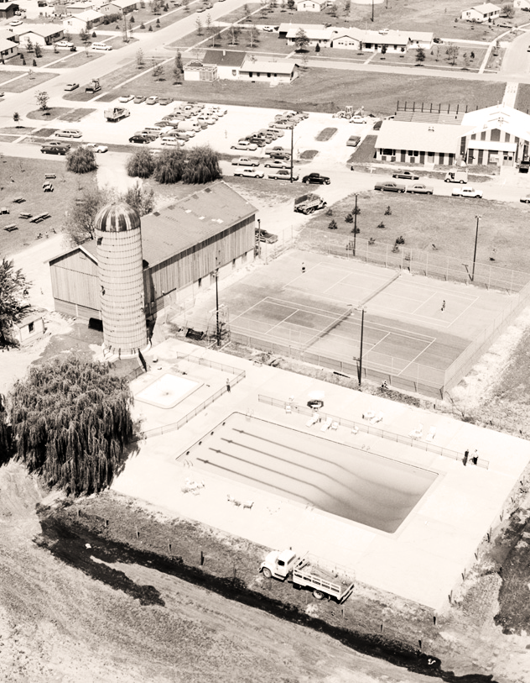
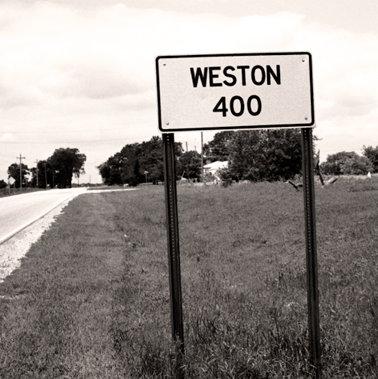
Acknowledgements
Fermilab
Steering Committee:
B. Flemming, R. Goffi, J. Jarvis*, M. Jeffers, L. Merminga, T. Nightengale, V. Shiltsev*, S. Tingey; T. Langford (admin)
Planning Committee:
Stakeholder Engagement Subcommittee: K. Akhobadze, S. Brice, T. Carrol, S. Charles, J. Eacker, N. Johnson*, R. Moss, S. Norberg, N. Parashar, H. Ramamoorthi, K. Reisselman, N. Saffold, H. Sidman, M. Suarez, R. Thompson*,
Technology Park Subcommittee: J. Hoff, J. Jarvis*, B. Pelico, G. Perdue, S. Zorzetti
Project Management: D. Dockery, R. Ortgiesen, B. Rubik,* J. Wills
Implementation Subcommittee: A. Eiffes*, A. Federowicz, C. Hurley, B. Iverson, K. Laureto, B. Lipinski, A. Schmitt
Enablement Subcommittee: A. Dave, B. Fancsali, M. J. Lyke, E. Moss, S. Nelson, C. Schmidt*
A&E Support: A. Federowicz, T. Li
Creative Services Support: S. Koch, R. Postel
StudioGC/Confluence
T. Berkbuegler, C. Brown, S. Delano, Z. Jiang, C. Meadows, M. Miller, M. Strange
Numerous partners from other laboratories: BNL, ORNL, Sandia, CERN
Support from DOE: including HEP, Fermi Site Office, and various other DOE/SC&HQ offices

Slide 3
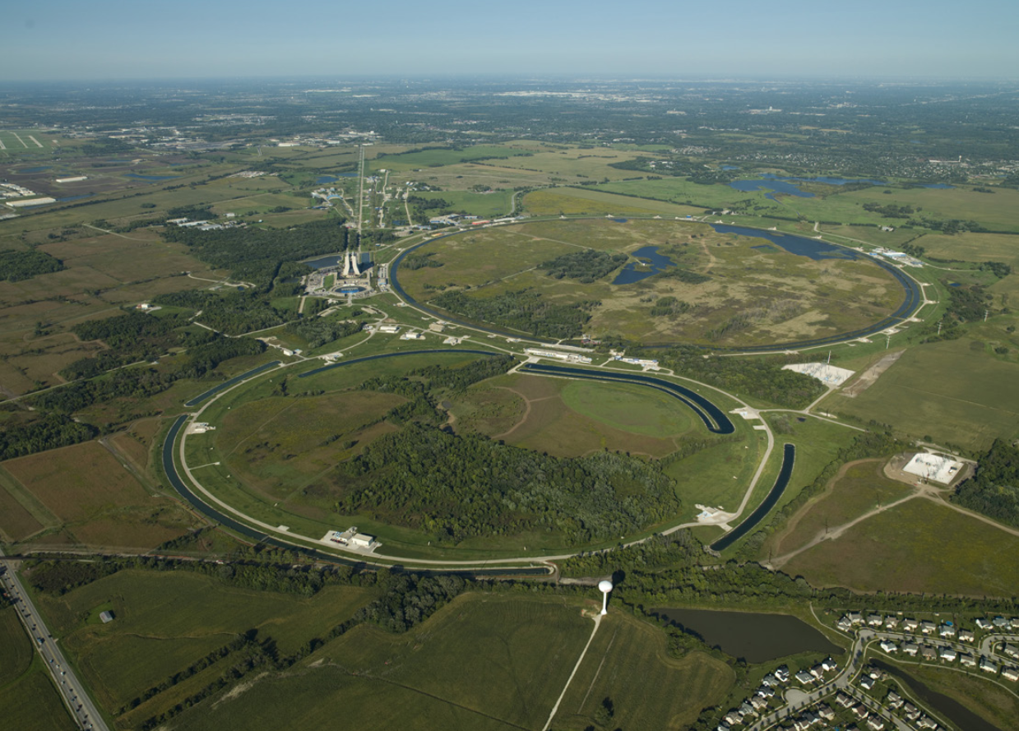
Fermilab is a unique place for Science, Innovation, Community and Inspiration
America’s High-Energy Physics Laboratory
>50-year history rooted in fundamental discovery and technological innovation
Deep and fruitful relationships with local and state communities and govts.
Aggressively expanding capabilities in Critical and Emerging Technologies (Quantum, AI/ML, microelectronics, directed energy…)
6800 acres in the heart of Chicagoland with easy access to ORD, MDW, DPA Metra, Chicago, and all major suburbs

Slide 4
S. Koch

Slide 5
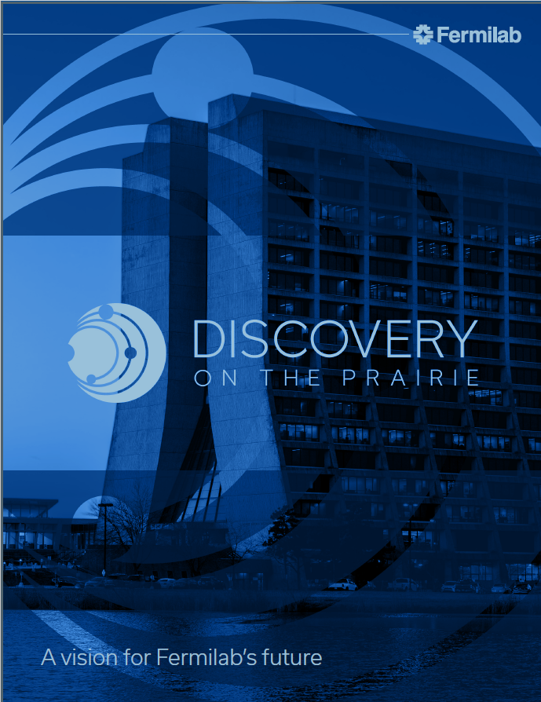
Discovery on the Prairie: an integrated vision for Fermilab’s future
Charged with developing an integrated, long-term vision for Fermilab that dramatically expands our impact for the nation, High-Energy Physics, and our state and local communities
Revitalization of our historic campus and infrastructure driven by community needs in the LBNF/DUNE era and beyond
A new vision and master plan for the Fermilab Village
Phased development of housing; $30M investment from State of Illinois for Phase-I housing construction
Modern daycare, recreational and community amenities
A new, world-class STEM and community-outreach facility
Technology and Innovation Park with university and industrial partners for maximizing Fermilab’s impact in science, society and industry
Near-term operational considerations (e.g. site access and security)
***Overall vision is long term, but with many concrete, near-term actions that will have important benefits
S. Koch

Slide 6
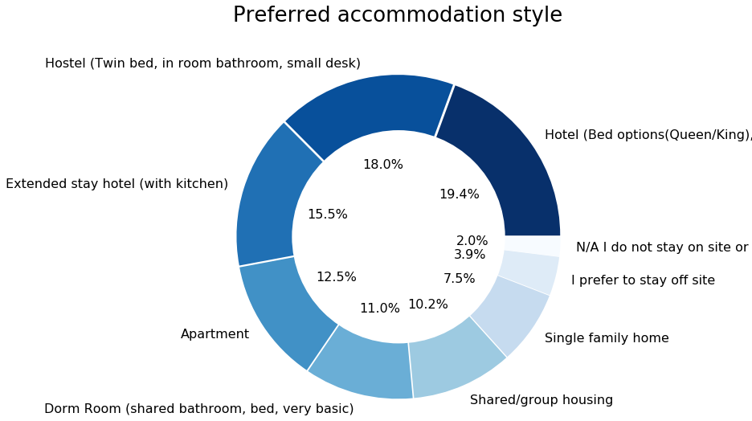
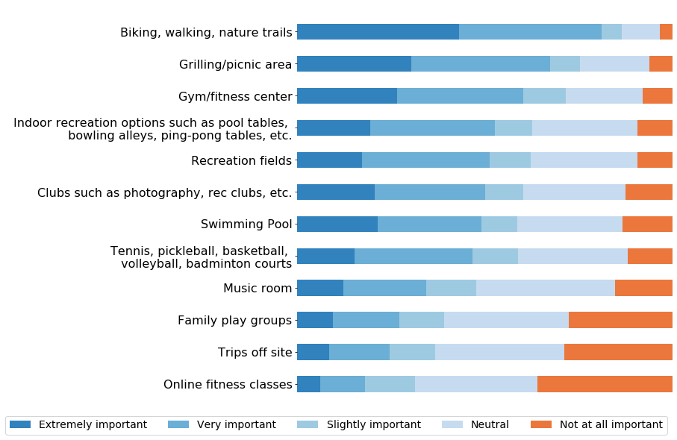
DOTP is driven by data and fieldwork to benefit mission and stakeholders
Village:
DOTP Survey completed in late ’23; >600 respondents (65% employees, 35% users/affiliates)
Focus Groups with representatives from experimental collaborations, user organizations, and other stakeholder groups
Focus on Access/Security, Housing, Amenities (Daycare, Recreation, Food, IT), Transportation
Tech Park:
Site visits to ORNL, BNL and Sandia
Broad discussions with Fermi Site Office, industry, state of IL, academia
STEM Campus:
Focus groups; historic data; internal discussions

Slide 7
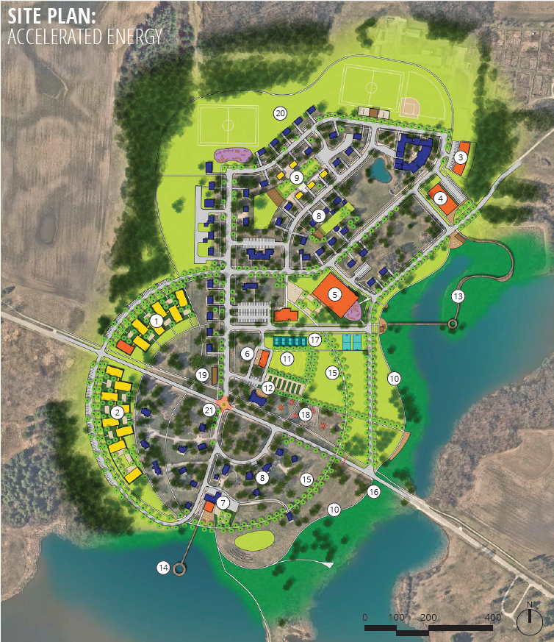
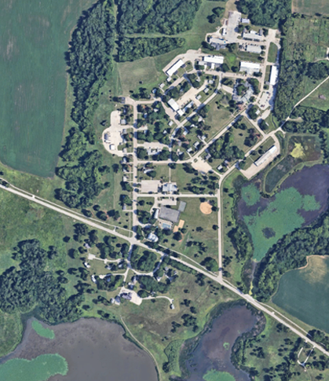
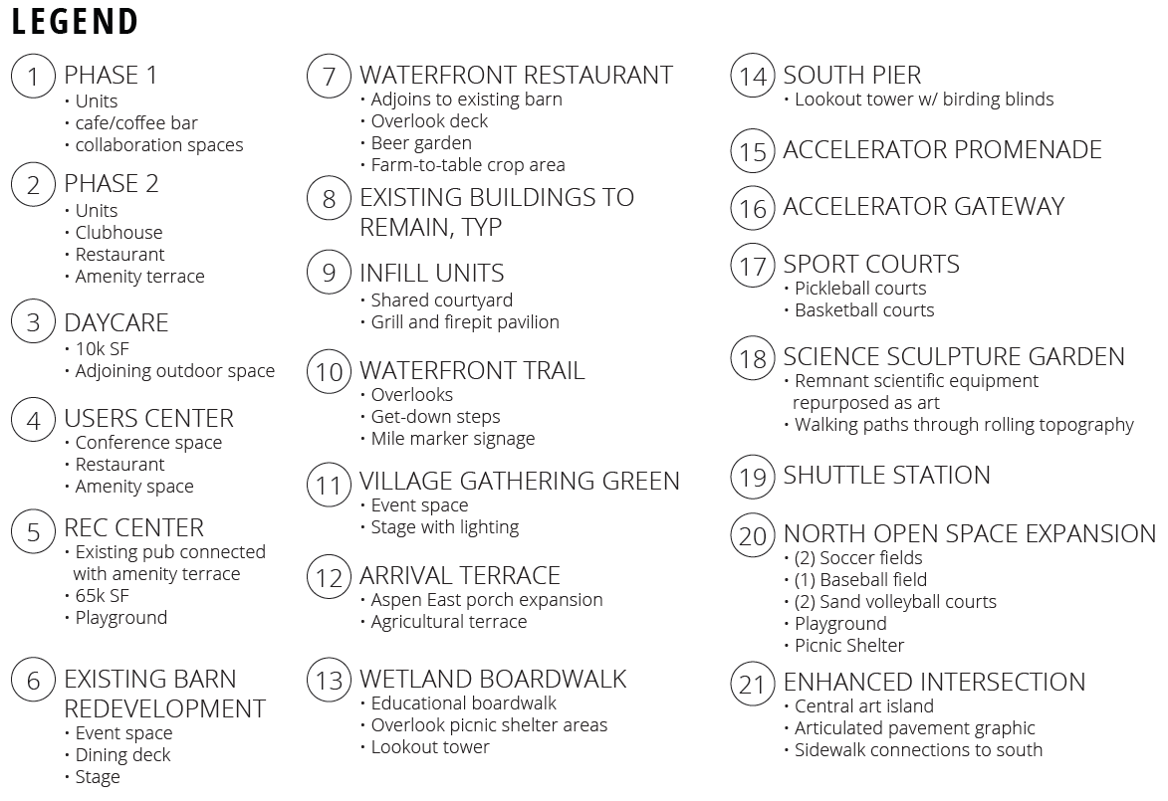
The Fermilab Village

Slide 9
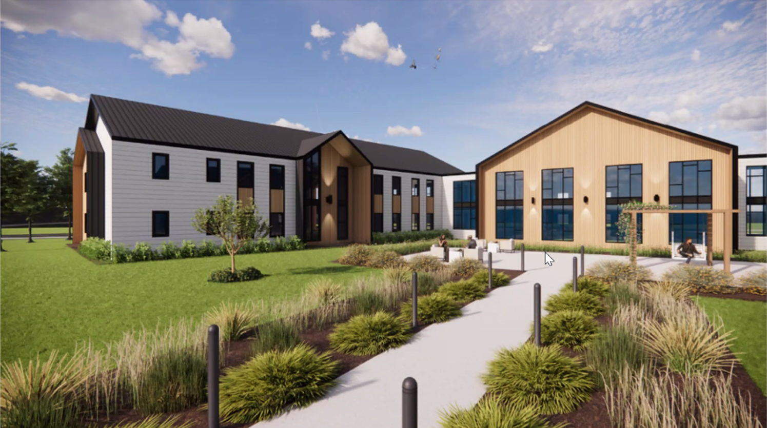
Phase-I housing is a near-term anchor and first step toward the vision
Ph-I housing is motivated by lab’s critical near-term housing needs and expanded activities in the LBNF/DUNE era
Targets modern, affordable accommodations that are comfortable and efficient for short-term and long-term stays
Modular design that can be internally reconfigured as lab needs shift in the future
Total capacity 112 beds; individual bathrooms; a common area and kitchenette per 8 rooms
Envisioned amenities include grab-and-go, café/coffee bar, collaboration spaces, and conference/zoom rooms

Slide 10
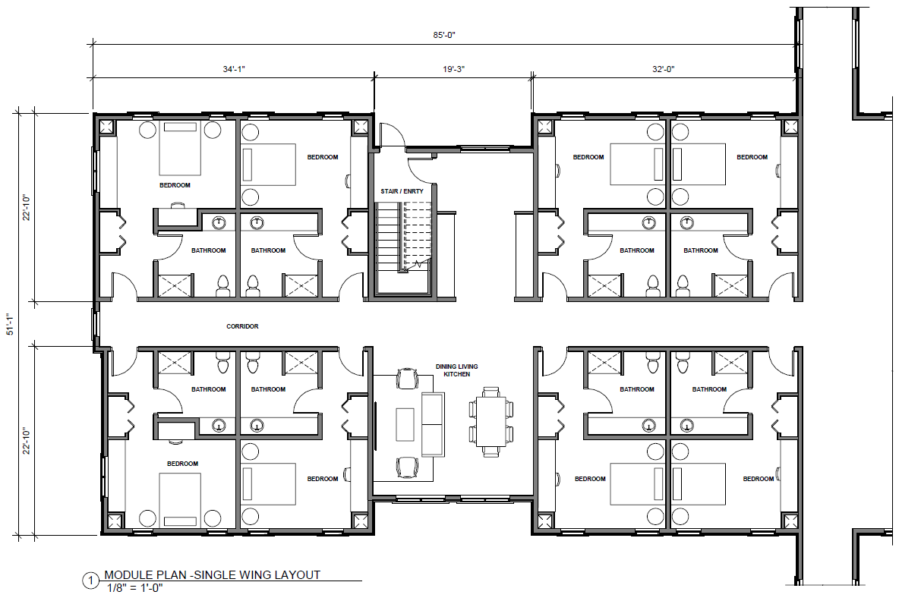
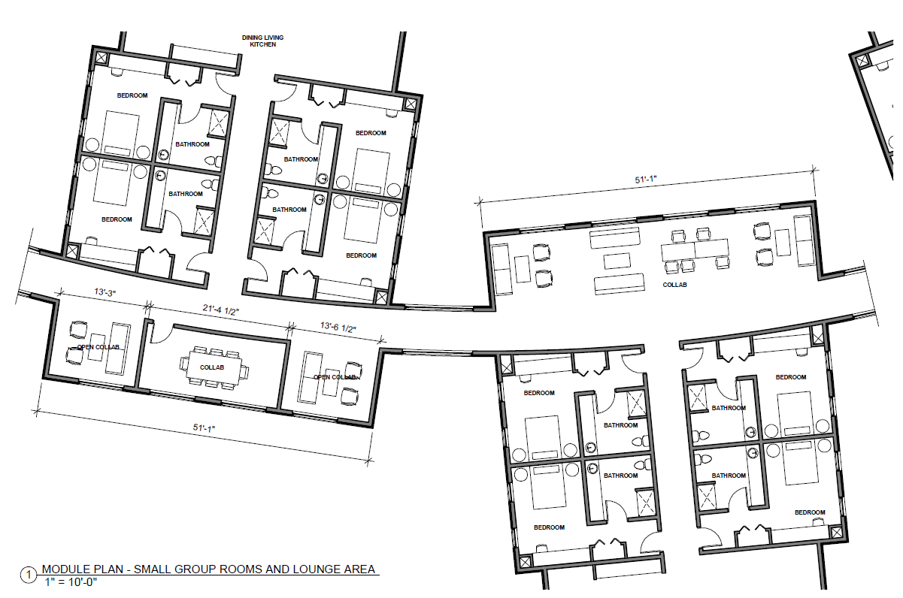
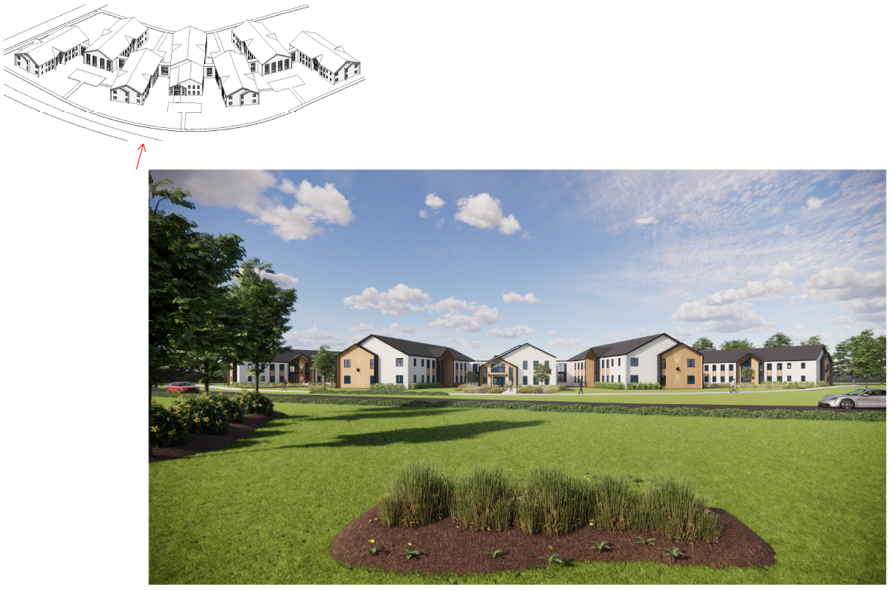
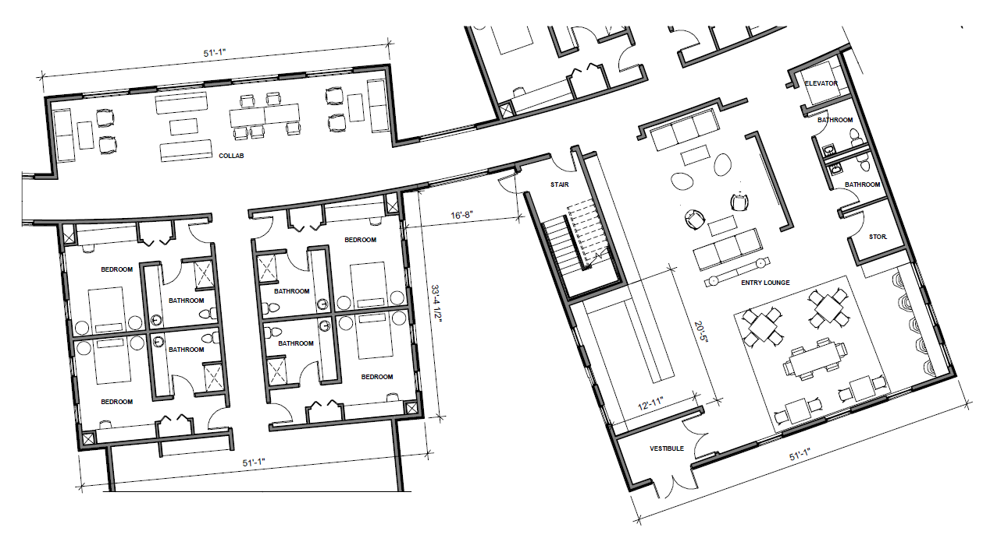

Slide 13
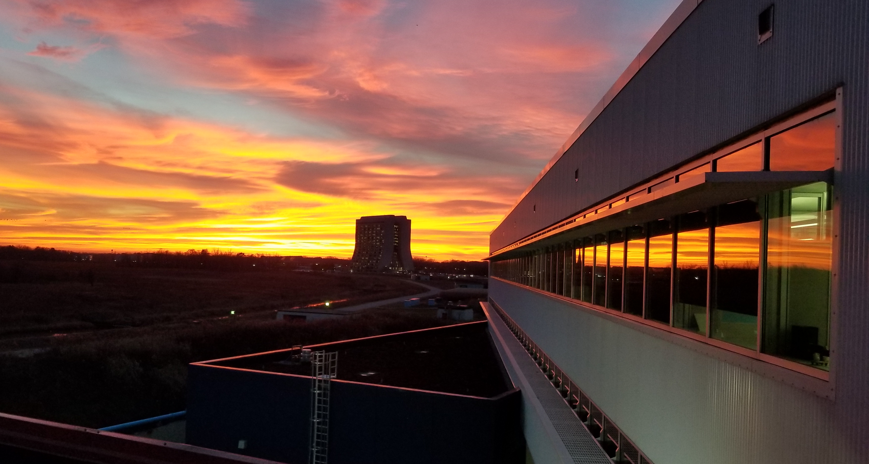
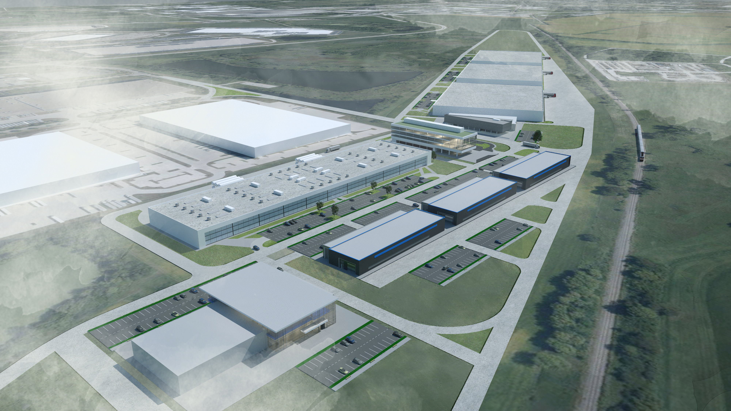
A Technology and Innovation Park is a central long-term element of DOTP
Developing a vision for a technology and innovation Park that empowers a dramatic escalation of Fermilab’s partnerships, innovation, and technology transfer
Major and lasting impacts on National competitiveness in Critical and Emerging Technologies are a core focus (QIST, microelectronics, AI/ML, directed energy…)
Made in-depth site visits to ORNL, BNL and Sandia to understand the promise and pitfalls of different approaches
Fieldwork and discussions point to a combination of on-site and off-site solutions
Will require simultaneous development of people, infrastructure and equipment, programs, and funding
IARC: Illinois Accelerator Research Center
A. Federowicz, T. Li

Slide 14
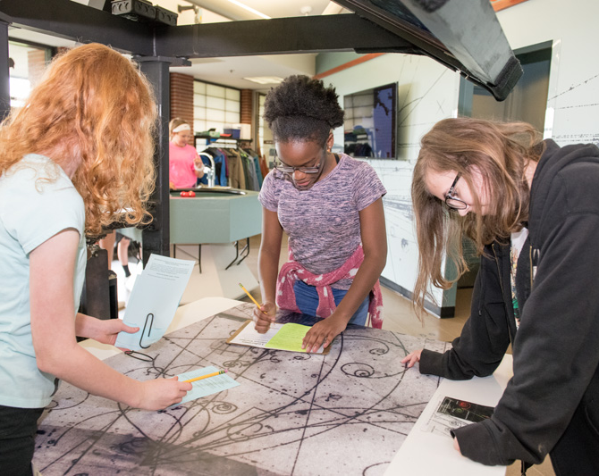
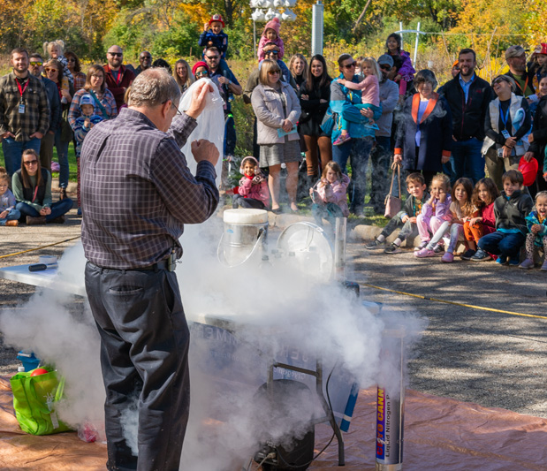
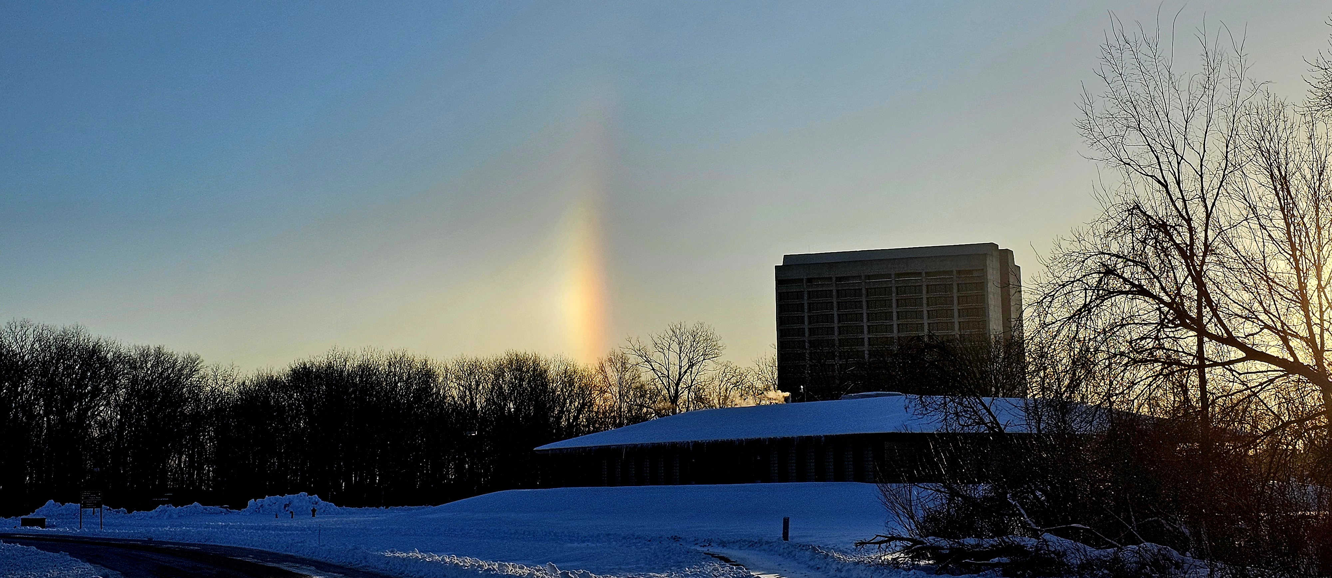
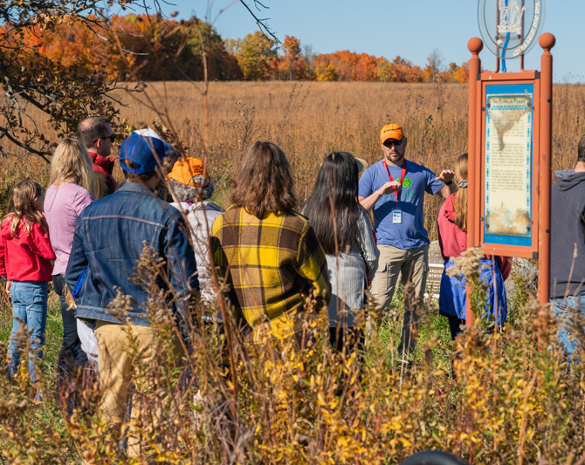
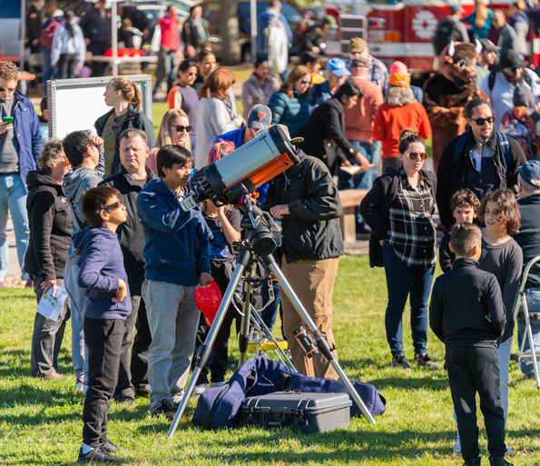
Fermilab has a unique brand and reach in STEM inspiration
Existing STEM programs served by Lederman Center, WH, supporting infrastructure and surrounding ecosystem
Currently ~6000 visitors/year connected to STEM programs and community outreach
Capacity limited with actual demand estimated to be 2-3 times higher

Slide 15
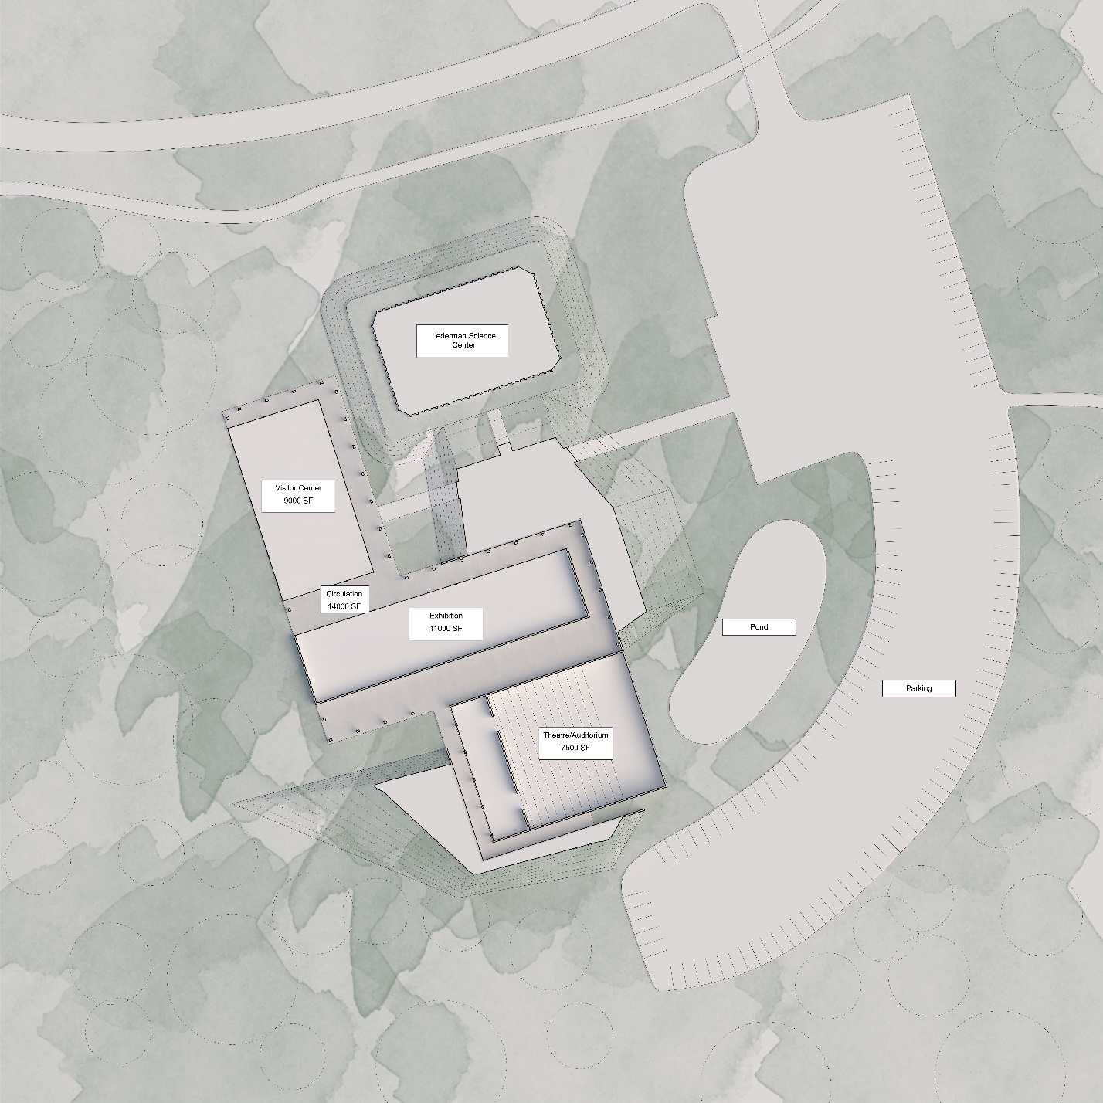
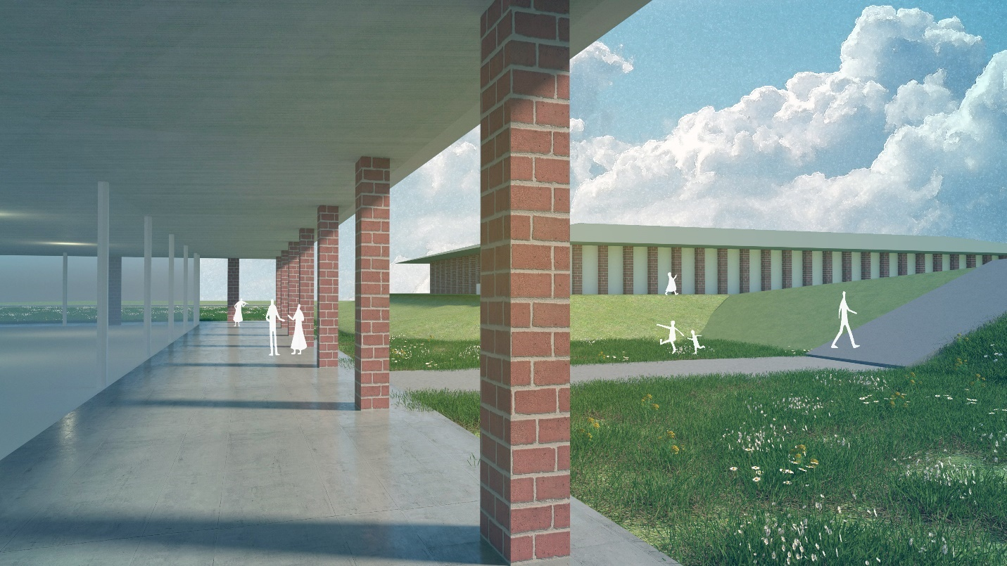
Option 1: Expansion of Lederman Center (preliminary concept)
T. Li
T. Li

Slide 16
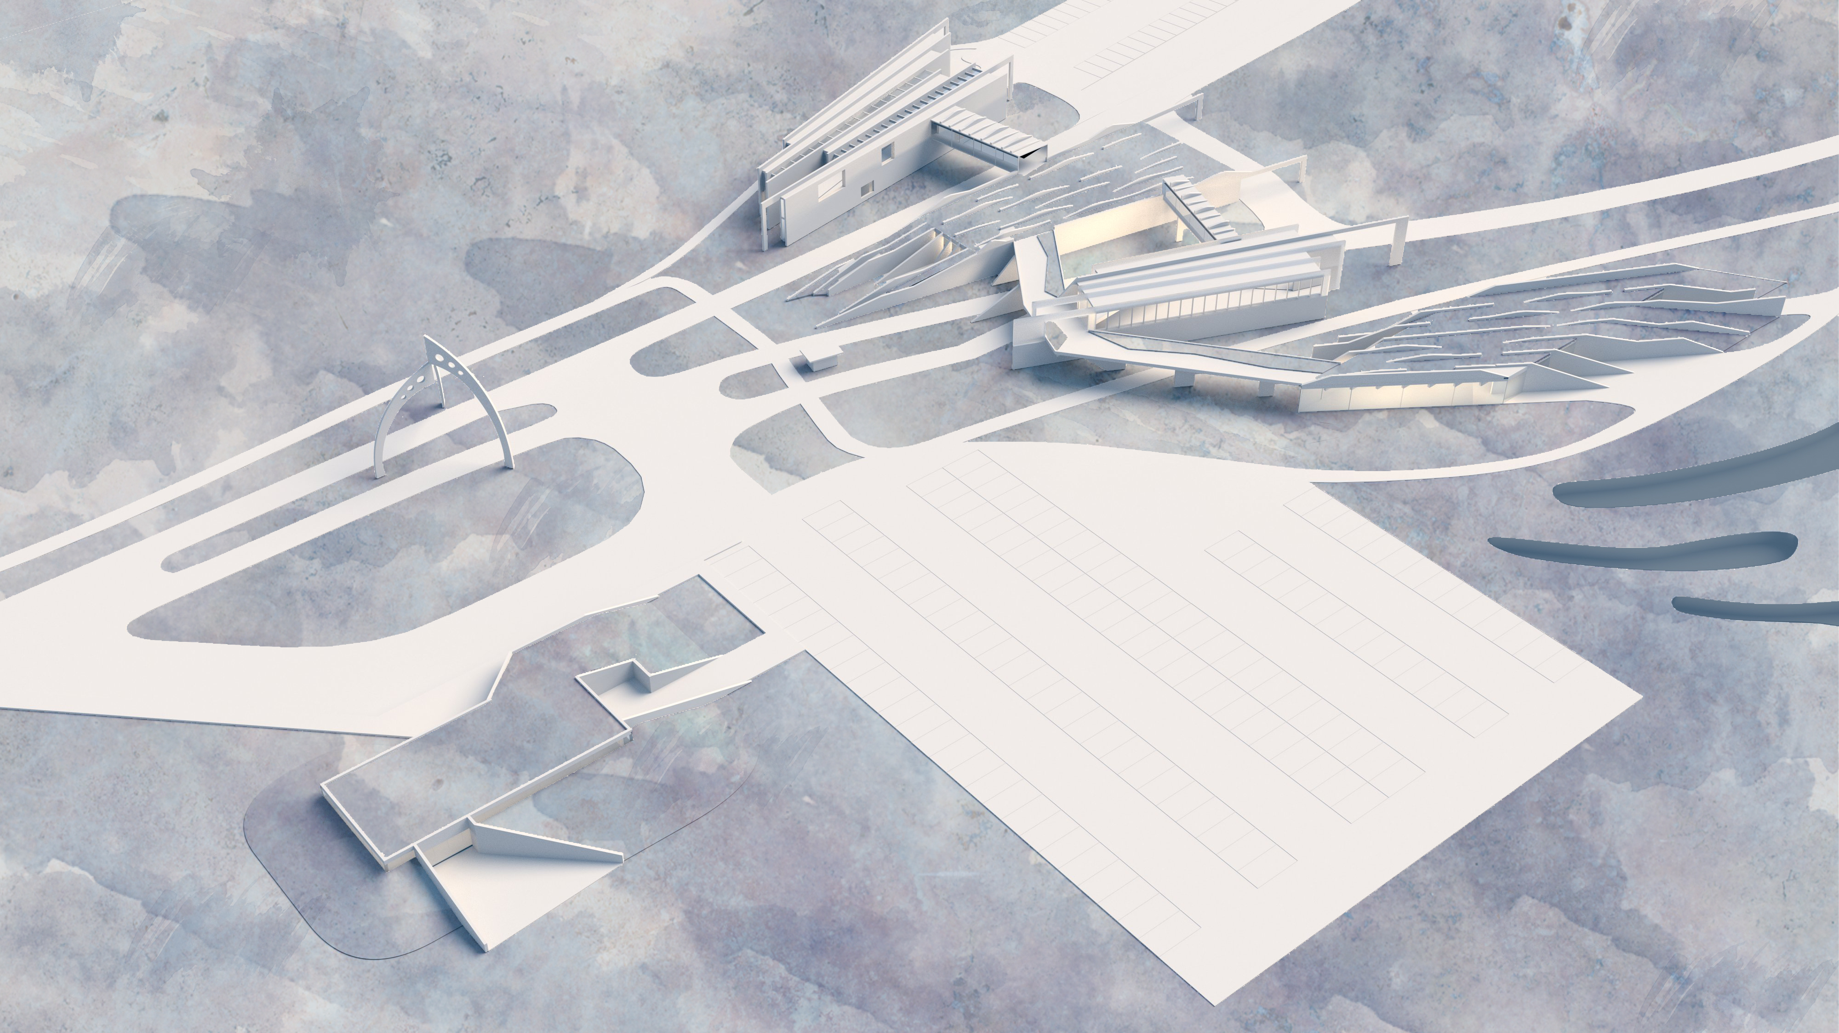
Option 2: Next-generation STEM campus (preliminary concept)
T. Li
T. Li

Slide 17
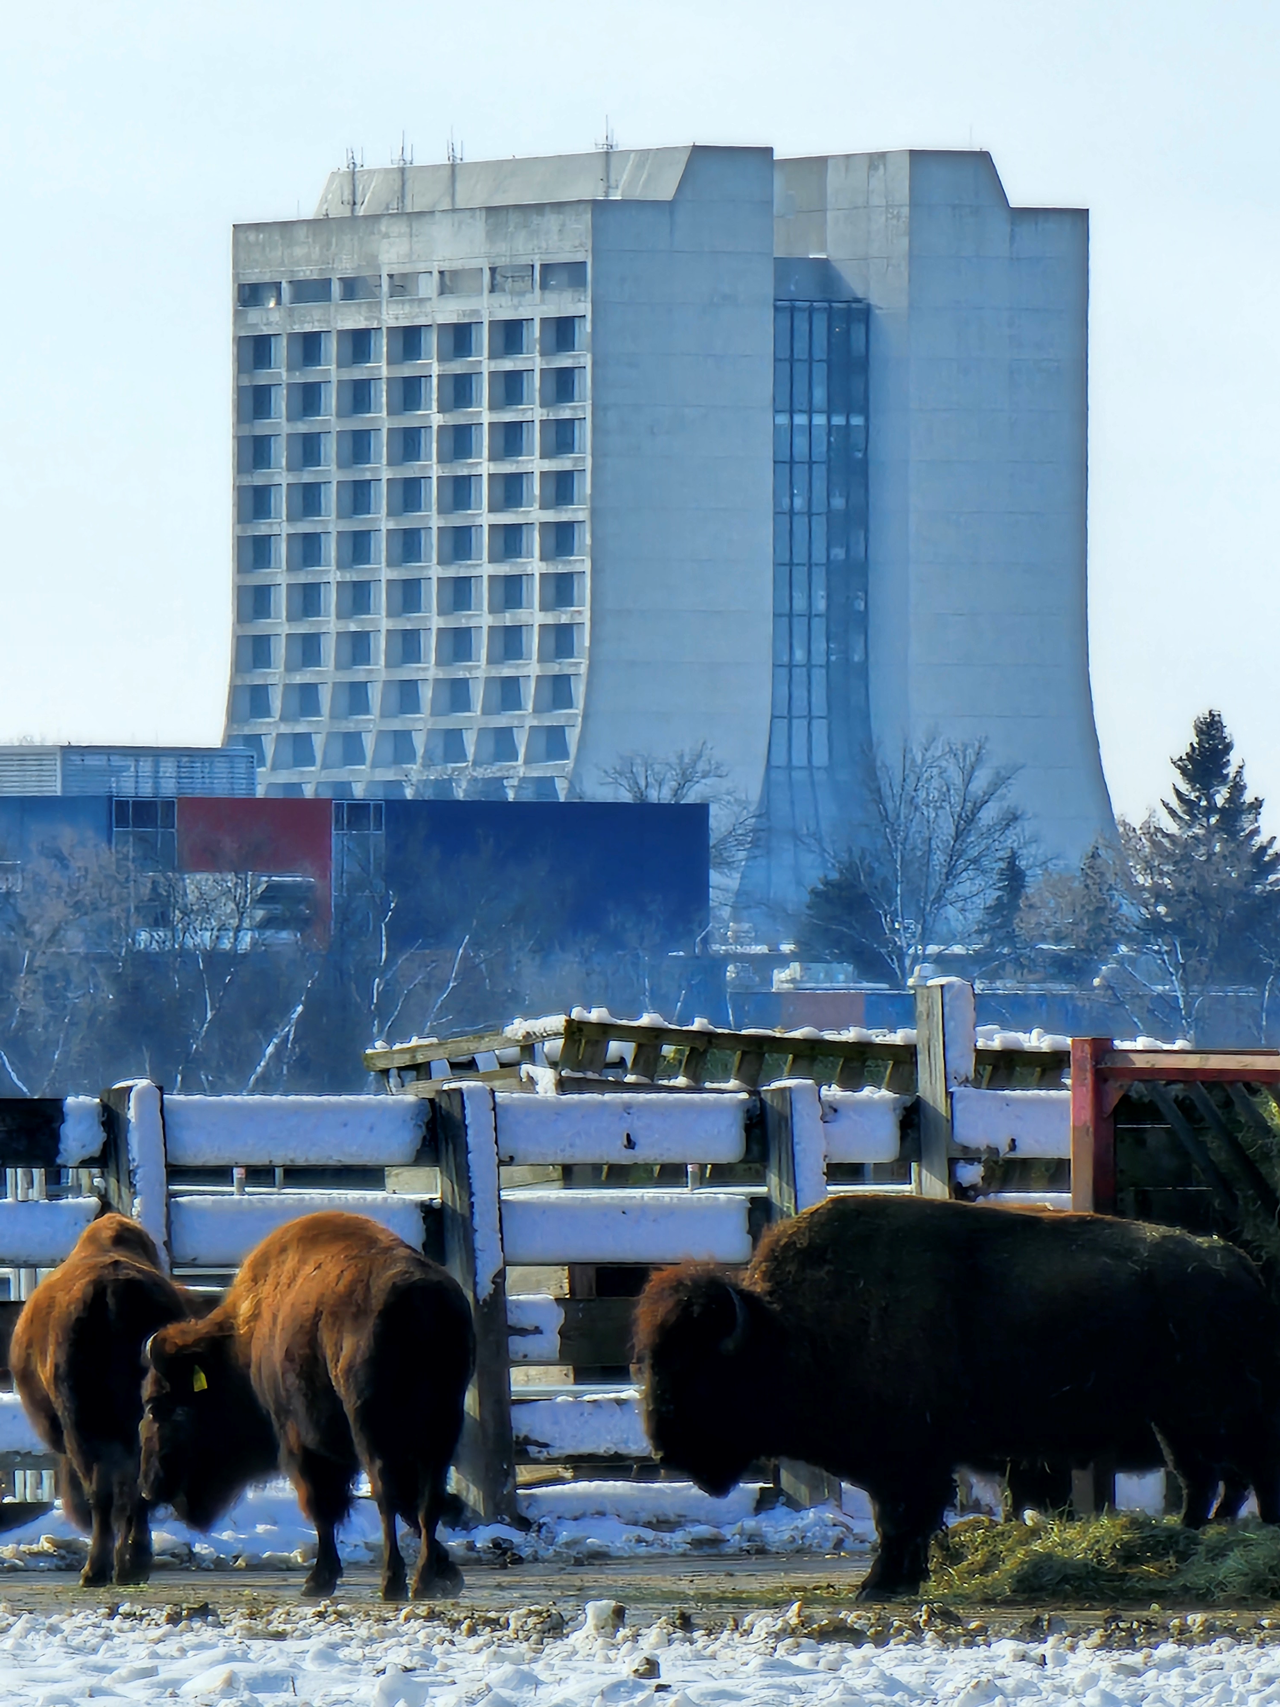
Discovery on the Prairie: Summary
DOTP is a vehicle for realizing an integrated vision for Fermilab and its site
Principal motivation is to ensure that near-term investments and execution are consistent with long-term needs, strategy and vision for the lab
DOTP report coming soon
Near-term priorities:
Release $30M in funding from State of IL to construct the Ph-I housing facility
Remove lab functions from the Village; develop campus infrastructure to support this moveout effort
Long-term focus:
Refine and update Village master plan and explore sequencing and funding approach
Develop STEM campus and Tech Park concepts in more detail and explore funding approach.

Slide 18
EXTRAS

Slide 19
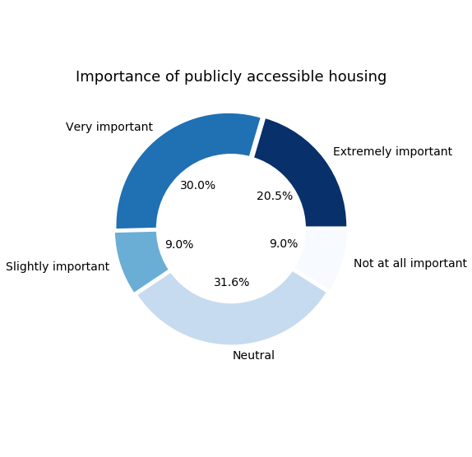
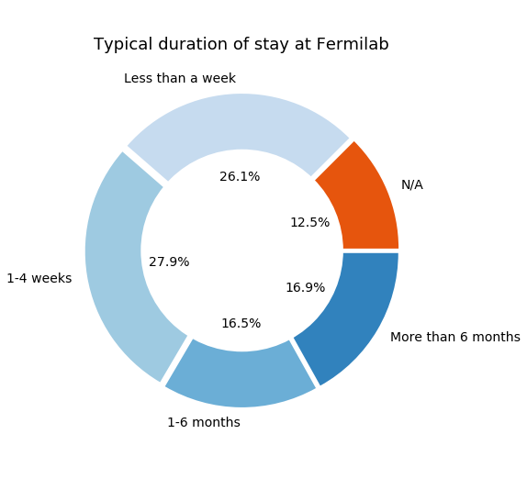

Slide 20
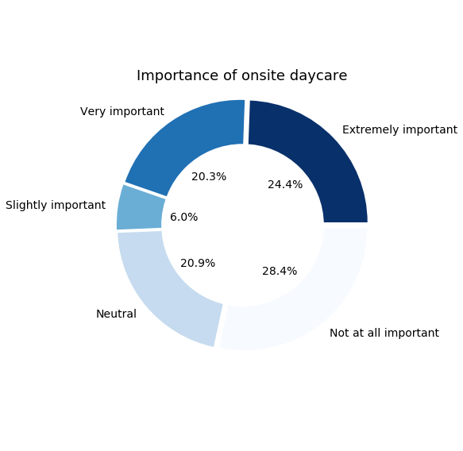
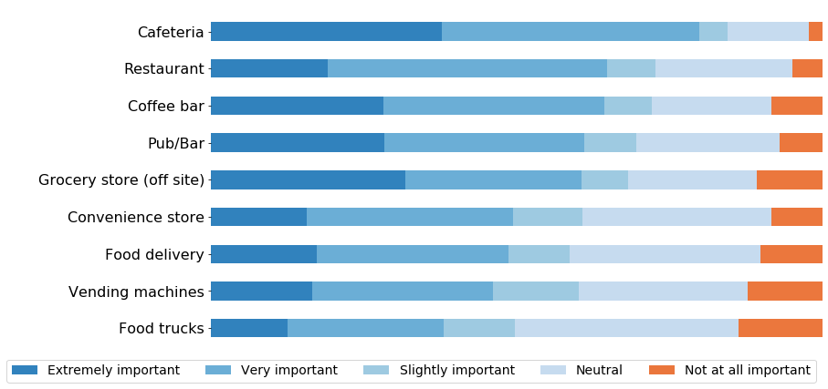
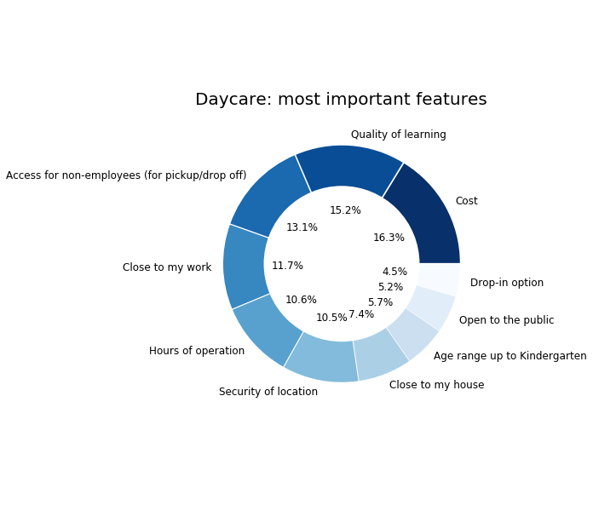
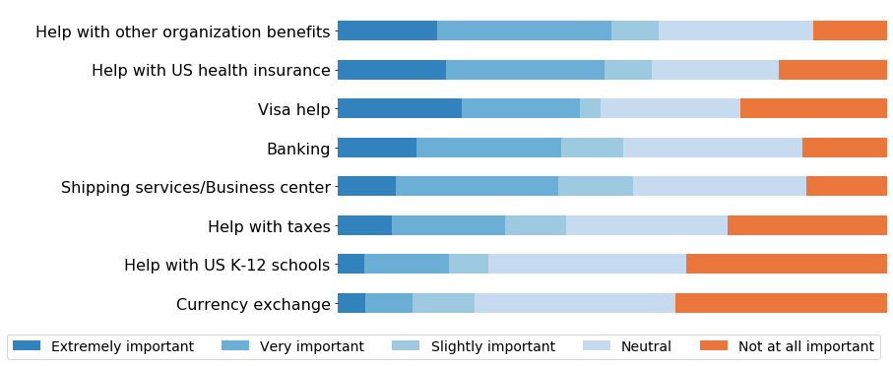
Importance of various food options
Importance of various administrative amenities

Slide 21
Importance of various transportation modes for off-site destinations
Importance of various on-site transportation modes
Adequacy of various conference facilities and amenities

