Slide 1

Fermilab Immigration Q+A
July 10, 2024
Notes:
Please refer to the ABR/QBR User Guide for guidance on how to maximize the value of these reviews and the deck in general (**to be developed**)
This template is designed to be modular, to allow the legal teams to select the slides that are most relevant and will resonate with the particular client.
Where the client's nomenclature differs from the general terminology used in the deck, the client's nomenclature should be used (e.g. how the client refers to the respective regions).
When pulling regional data throughout, ensure you have advised the Reporting Team of the countries to be included in each respective region.
As a general recommendation: consider how you can evoke positive emotions during our presentations, to enable them to feel the connection to the team and the firm and strength of the relationship. If the program review will take place in person, consider bringing something tangible to leave with the client to evoke a positive memory of the meeting in them each time they see/use/touch it.

Slide 2







Fragomen – Who We Are
4,700+ professionals including 625+ immigration lawyers
Strongest global immigration network across 170+ countries
Deep legal expertise in immigration and global mobility
Largest and leading global immigration firm
More than 8,000 corporate clients
More data than any other firm for benchmarking and trends analysis
Pioneer cutting-edge immigration technology solutions
Market-leader in advisory & consulting
Holistic culture of diversity and a focus on sustainable solutions

Slide 3

Updates And Trends
Revamped H-1B lottery system
Increased filing fees
Electronic filing of I-129 and I-907 forms
Domestic Visa Renewal Program
EAD validity period increased to 5 year for AOS applicants
Relief Programs for Undocumented Spouse of US Citizens and Dreamers with US Degrees
New PERM Form and current PERM environment
DOL processing times remain extremely long
Notes:
Include the most significant trends in the environment, that are relevant to the client.
Brief summaries should be used for each bullet point to facilitate the discussion during the review.
It is important to only include trends that will be relevant for the client and their program.

Slide 4

Self-Sponsorship Permanent Residency Categories
EB-1 Extraordinary Ability:
One of the small percentage at the top of field
Sustained national or international acclaim
EB-2 National Interest Waiver:
Proposed endeavor has both substantial merit and national importance
Well positioned to advance the proposed endeavor
Beneficial to the US to waive the job offer and thus permanent labor certification requirements.
Notes:
Specific competitor names should not be used where they are clients of the firm, but this is an opportunity to provide general insight into how the client's industry is handling certain issues, to provide an opportunity for them to consider whether any adjustments to their program, policies, and/or immigration benefits offered to their employees might be appropriate.

Slide 5
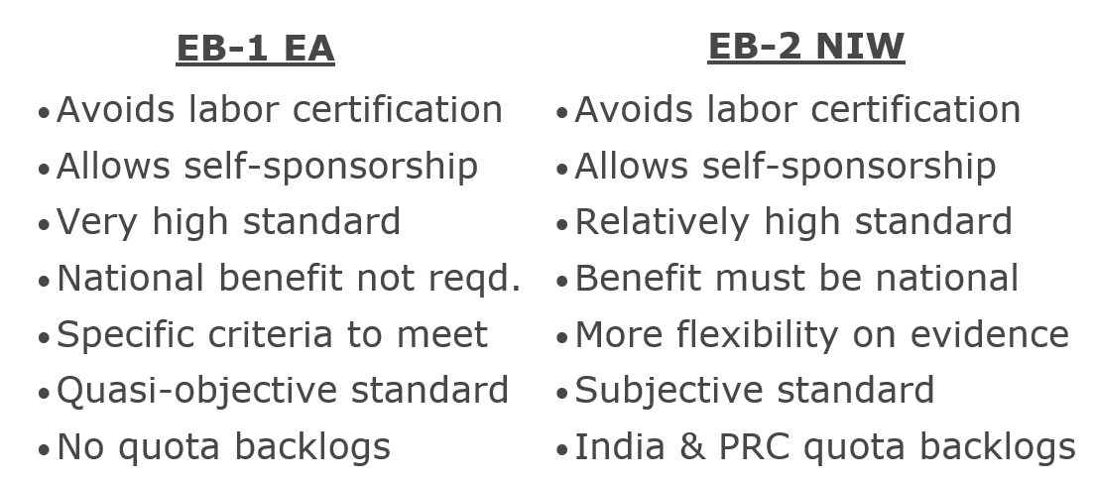
EB-1 EA vs. EB-2 NIW

Slide 6




Extraordinary Ability Criteria
Must have at least 3 of following:
  Awards for excellence
  Membership in organization requiring outstanding achievement
  Articles about employee
  Judging work of peers
  Original contributions of major significance
  Publications by employee
  Leading/critical role in organization with distinguished reputation
  High salary relative to peers
  Work displayed in artistic exhibitions*
  Commercial success in performing arts*
  *Comparable evidence
In lieu of 3/10 criteria, a major, internationally recognized award (e.g. Nobel Prize will satisfy the requirement
Qualitative (comparative) analysis/evidence taken as a whole must indicate extraordinary ability
Notes:
Consider posing certain questions to the client in advance of the meeting to ask if they would be willing to speak to the issues during the meeting, and giving them ample opportunity to prepare, so they're not inadvertently put on the spot during the meeting and unprepared/embarrassed.
Client remarks should be high level, blue sky. Do not ask them to take time to reiterate what we already know.
Also consider asking them what their plans are for the next 1-3 years so we can partner with them strategic to address those issues well in advance and make any appropriate program adjustments in preparation for their plans.

Slide 7
National Interest Waiver
Applicant must meet EB-2 requirements:
  US MS, or higher (or foreign equivalent), or
  US BS, or foreign equivalent, + 5 years of post-BS experience
Proposed endeavor has both “substantial merit” and “national importance”
Applicant is “well-positioned to advance the proposed endeavor; and
On the balance, would be beneficial to the US to waiver requirements of the job offer (and thus the labor certification requirement)
USCIS reviews the totality of the circumstances under a preponderance of the evidence legal standard. Approval is a discretionary.
January 2022 update to USCIS Policy Manual, Vol. 6, Part F, Ch. 5:
  “USCIS recognizes the importance of progress in STEM fields and the essential role of persons with advanced STEM degrees in fostering this progress, especially in focused critical and emerging technologies, or other STEM areas important to U.S. competitiveness or national security.” (emphasis added)
Notes:
Consider posing certain questions to the client in advance of the meeting to ask if they would be willing to speak to the issues during the meeting, and giving them ample opportunity to prepare, so they're not inadvertently put on the spot during the meeting and unprepared/embarrassed.
Client remarks should be high level, blue sky. Do not ask them to take time to reiterate what we already know.
Also consider asking them what their plans are for the next 1-3 years so we can partner with them strategic to address those issues well in advance and make any appropriate program adjustments in preparation for their plans.

Slide 8

Documentation for EB-1 EA and EB-2 NIW Cases
Expert letters (professional associations, employers, PhD advisers, government, etc.)
Establish contributions to field
Detailed and Specific
In laymen’s language
Concrete examples
Explain significance/benefit
Other Documentation
CV, list of publications, copies of degrees & transcripts
Copies of publications & patents
Citation list and copies of citing articles
Copies of press or articles about employee work
Copies of awards (criteria, significance, reputation)
Membership documentation & membership criteria
Peer reviewing of articles & judging awards/grants
Impact factors of publishing & citing journals
Conference participation (organizer or speaker)
Notes:
This slide should be used to provide insightful comparisons into how the client's program stacks up against the competition, including any thoughts as to why their program or policies may differ from the competition.
This slide should be used in connection with the next slide.

Slide 9
Expert/Recommendation Letters
Do’s
Try to diversify authors – current and prior supervisors, third parties, experts in the field/endeavor
Fully describe the writer’s credentials and relationship to the Applicant and Applicant’s work
Submit detailed letters with examples of Applicant’s accomplishments and impact
Don’ts
Copy and paste the same information in each letter
Obtain letters from subordinate employees of the Applicant
Make general statements without concrete examples
Use technical language without explanations in lay terms

Slide 10

Case Processing Steps
Case preparation
  Document gathering
  Collecting expert letters
  Case drafting
I-140 Immigrant Visa Processing
  Variable based on USCIS processing times (https://egov.uscis.gov/processing-times/)
  Premium processing is available for both case types
  Add more time if a Request for Evidence (RFE) received
I-485 Adjustment of Status (AOS) Processing
  Variable based on USCIS processing times Premium processing not available
  Option to concurrently file alternative forms of work and travel authorization (EAD and AP)
  File for Dependent Family Members at this Stage
  Potential to file this step concurrently with the I-140
Notes:
Specific competitor names should not be used where they are clients of the firm, but this is an opportunity to provide general insight into how the client's industry is handling certain issues, to provide an opportunity for them to consider whether any adjustments to their program, policies, and/or immigration benefits offered to their employees might be appropriate.

Slide 11


Questions & Answers

