Slide 1
Sustainability at Fermilab: Engaging Mission and Operations
Catherine Hurley, Sustainability Manager
churley@fnal.gov
July 10, 2024

Slide 2
Agenda
Sustainability Overview & Drivers
Sustainability in Science
Sustainability Strategy
Fermilab Sustainability Context
Key Initiatives
Notes:
Fermilab overview
Energy profile
Sustainability program strategy
Sustainability in Science Foci
New infrastructure / experiments
Existing infrastructure / experiments
Tech transfer
Accelerator Energy Flow Mapping
Existing Efforts:
AI for Accelerator Operations
Data Center
New Efforts
Analyze Accelerator Energy mapping to identify new priorities
New cavity design for MI upgrade using SC
SCA and larger sustainability Workshop
Pursue funding to pilot SC technology on site

Slide 3
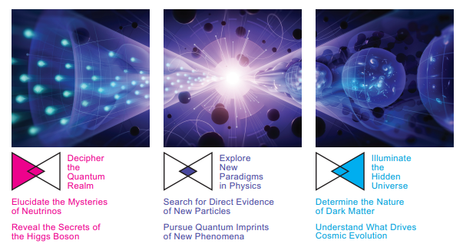
Sustainability and 2023 Particle Physics Project Prioritization Panel (P5) Report
A 10-year strategic plan for US particle physics, in the context of a 20-year global strategy
6 Investing in the Future of Science and Technology
6.9 Sustainability and the Environment
Commitment to sustainability is a high priority for particle physics activities. This includes energy and carbon management, energy efficiency and savings, and environmental impact. It concerns present and future accelerators as well as testing and computing facilities.
Important to:
Establish and launch at an early stage a full lifecycle sustainability effort.
Promote energy efficient accelerator concepts, as well as identification and development of energy saving accelerator technology.
Accelerator technologies play a key role in sustainability:
Investments in high field magnets are benefiting materials science, fusion energy research (FES), and commercial development
Innovation in electric power generation, management and distribution also contribute to sustainable development.

Slide 4
Sustainability and 2023 Particle Physics Project Prioritization Panel (P5) Report
A 10-year strategic plan for US particle physics, in the context of a 20-year global strategy
6 Investing in the Future of Science and Technology
6.9 Sustainability and the Environment
Benefits:
Affect the affordability of new accelerators.
Demonstrate the responsible role of the HEP community in society.
Key Areas of Opportunity:
Define sustainable requirements on industrially procured technology, including construction, electrical, and cooling equipment
Reduce carbon footprint of civil engineering components
Reduction of CO2 from gases and capture/re-use
Re-use of materials and limit of natural resource and rat material use, including critical materials
Reduction in travel
Development of consistent metrics for sustainability of research, construction, and operations.
Area Recommendation 20:
HEPAP, potentially in collaboration with international partners, should conduct a dedicated study aiming at developing a sustainability strategy for particle physics.

Slide 5
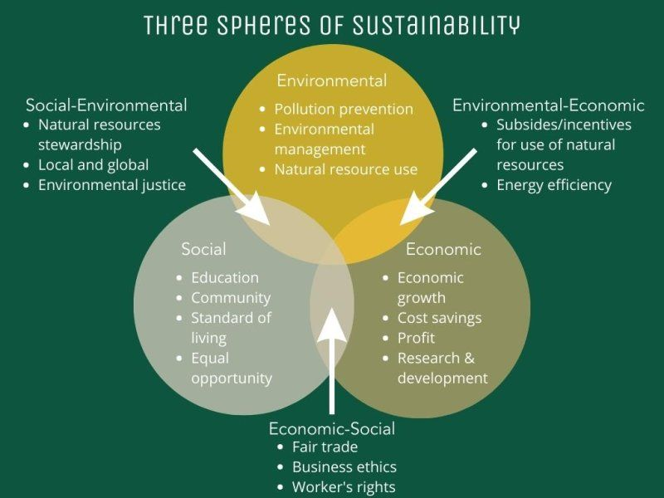
What is sustainability?
Etymologically:
Sustain + able + ity
Sustain = “keep up”, “keep going”, “or support something”.
As a societal goal, means to create and maintain conditions, under which humans and nature can exist in productive harmony, that permit fulfilling the social, economic, and other requirements of present and future generations.¹
1 Our Common Future, commonly called the Brundtland Report.

Slide 6
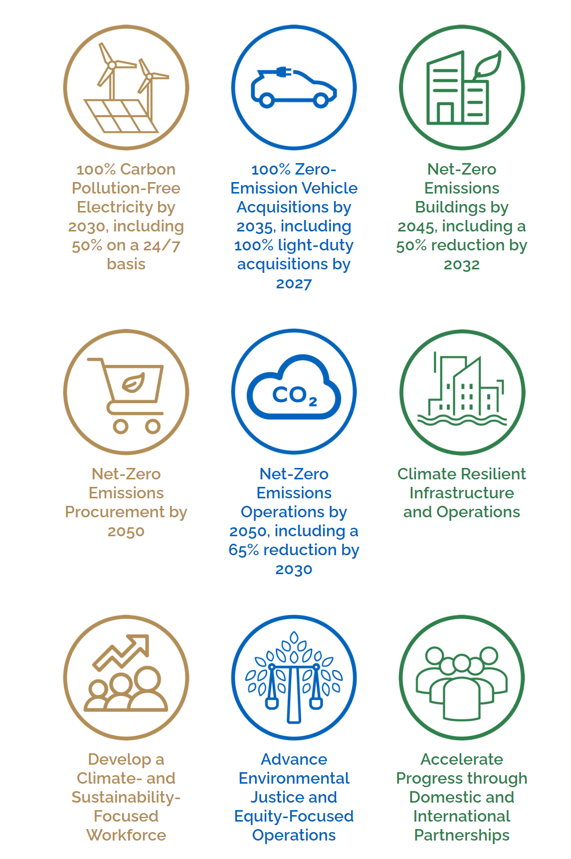
DOE and Fermilab Defines Sustainability as actions taken to:
Maximize energy and water efficiency;
Minimize chemical toxicity and harmful environmental releases, particularly GHG;
Promote renewable and other clean energy development;
Enhance climate adaptation resilience, and conserve natural resources while sustaining assigned mission activities.
Federal Sustainability Plan Goals

Slide 7
Greenhouse Effect and Climate Change
Natural Greenhouse Effect is a natural warming of the earth when gases in the atmosphere trap heat from the sun that would otherwise escape into space, making the earth viable for life.
Human Enhanced Greenhouse Effect is an increased rise in global temperatures from higher concentrations of greenhouse gases, and carbon dioxide (CO2) in particular.
Global concern around to numerous negative effects:
Causing more frequent and/or intense extreme weather events, including heat waves, hurricanes, droughts, and floods.
Exacerbating precipitation extremes, making wet regions wetter and dry regions drier.
Rising sea levels, due to melting ice sheets and glaciers and an increase in ocean temperatures (warmer water expands, which can contribute to sea level rise).
Altering ecosystems and natural habitats; shifting animals’ geographic ranges, seasonal activities, and migration patterns.
Concentration of CO2 was roughly between 200 and 280 parts per million for past 800,000 years
Concentration of CO2 is now over 400 parts per million
https://www.nps.gov/goga/learn/nature/climate-change-causes.htm
Notes:
Global warming is the rise in global mean temperature due to the rampant release of heat trapping gasses like carbon dioxide and methane (see figure below). The atmosphere acts like a blanket that surrounds the earth. When we burn oil, coal, or natural gas for energy, the carbon dioxide released acts like thickening the blanket that envelops our planet. This disrupts the balance of incoming and outgoing solar radiation, and creates a warming system that cannot naturally repair itself in the span of the coming centuries. Based on surface and atmospheric temperatures from thousands of locations, and from satellites worldwide, scientists have determined that the global mean temperature has risen 0.8 degrees C (1.4 degrees F) since 1880. We know the carbon dioxide released from the fossil fuels that humans are burning is responsible for this change because its unique chemical signature matches that found in the carbon dioxide entering our atmosphere right now. Climate change is a more general term that refers to changes in many climatic factors (such as temperature and precipitation) from the global to the local scale. These changes are happening at different rates and in different ways in response to global warming. As a large scale example, the United States has overall become wetter over the 20th century, while the Sahel region of central Africa has become drier. Locally, the timing and amount of rainfall is changing, which is generally resulting in less frequent but more severe storms. This could lead to increased hillside erosion and flooding, even as overall aridity continues to intensify in some areas. Furthermore, global warming and associated climate change is decreasing the Sierra snow pack and melting it sooner, causing water shortages across the state and increasing wildfire risk. In other words, the climate is becoming more extreme in response to global warming.

Slide 8
Equivalent to the annual emissions from 11,500 average homes.
Fermilab FY 2023 Emissions: 71,490 MtCO2e*
*63,000 MtCO2e is not included in total because emission are offset by renewable energy certificates

Slide 9
Fermilab Electricity Use and Projections
Note: Projections reflect operating assumptions as of 1/1/25 and are greatly influenced by booster status (on/off), duration of maintenance shut-downs, and higher rep rate anticipated but not scheduled.

Slide 10
Key Sustainability Metrics 2023

Slide 11
Fermilab Sustainability Strategy
Sustainability Vision: Be a global leader for sustainability in particle and accelerator physics and technology innovation.
Key Strategies
Key Objectives
Improve performance measurement, report progress, communicate success
Reduce impact with infrastructure and operations changes
Substitute carbon-based energy with zero emission
Offset
impacts
Avoid impact with sustainable design, procurement and operations strategies
Culture of Sustainability
Operations Best Practices
Pilot and
Demonstration
Projects
Partnerships to Drive Impact
Sustainability in Science
Notes:
Strategy efficiency integrates DOE Order 436.1A implementation in an easy to understand farmwork
Developed following initial listening tour

Slide 12
Sustainability Management Team
Chartered by COO
Organizationally located in Infrastructure Services – Engineering
46 SMT members
14 groups / departments represented
Catherine Hurley
Lead Lab wide program
Develop strategy
Report & communicate progress
Collaborate with DOE, NL’s and external partners
Sustainability Manager
Shivani Saikar
Kerry Aschenbach
Alyssa Rodway
Analyze energy use
Identify energy savings measures
Develop projects
Coordinate energy procurement
Identify water savings measures
Develop projects
Advance sustainable & resilient buildings
Improve recycling & waste reduction
Increase green purchasing
Environmental justice
Energy Manager
Environmental Engineer
Sustainability Associate
Sub-teams
Sustainability in Science | Water Management | Environmental Stewardship | Communications, Outreach & Reporting
Energy Management | Sustainable & Resilient Infrastructure | Sustainable Operations | Transportation
Notes:
Hired team
Skills Bridge Intern starting 1/8
Expanded SMT with sub-teams
Leveraging people with Subject matter expertise
New sustainability in science sub-team – engaging engineering and science staff in creating opportunities to integrate sustainability into their work proactively
Each sub-team is different but we are engaging a much broader group of people across the lab which is wonderful
Thank you for supporting a robust staff; it has made a big impact and recognized in the PEMP for Section 7.
Share directorate perspective
Provide feedback
Opportunity to enhance role to be more proactive
Directorate Liaisons:
Oliver Kiemchies – TD
Kyle Hazelwood – AD
Cindy Joe – ND
Project Liaisons:
Tiffany Price – PIP-II
Other Advisors:
Cristian Boffo – PIP-II
Bill Pellico - ETD

Slide 13
Sustainable, Net Zero Carbon Infrastructure
Building Design
Efficient Lighting
Green Purchasing
5. Supply Chain Sustainability
1. Energy Efficiency Measures
Efficient plug loads
Waste Reduction & Recycling
Efficient HVAC
Green Construction
Efficient controls
Efficient occupant behavior
Energy Storage
4. Energy Infrastructure Connections
Energy Savings in Scientific Infrastructure
District Heat Recovery
Other carbon free energy pipeline
Heat Recovery Chillers
On Building Renewables
Heat Pumps
Electric Boilers
Campus Scale Renewables
2. Eliminate Fossil Fuel Use
3. Carbon Pollution Free Electricity
Electric Furnaces
Purchased Carbon Pollution Free Electricity
Electric Vehicles
EV Charging
Notes:
https://www.sciencedirect.com/science/article/pii/S1364032121001532

Slide 14
Zero Emission Energy Plan and Projection
Goal: 100% CFE by 2030 w/ 50% 24/7
Notes:
Goal: 100% CFE by 2030 w/ 50% 24/7
Strategy: Diversify energy sources to add CFE from on-site and off-site purchased
Assumptions:
Grid-supplied CFE based on our grid mix for PJM disclosed by our supplier Direct Energy
Current: 35% - Nuclear is 33%, Solar is 1%, Wind is 1%
Projected: Increase to 50% by FY30
On-site CFE potential of 60 MW (min. 2MW planned for FREP)
Off-site contracted CFE planned to take advantage of utility scale investments

Slide 15
Reduction of Natural Gas Use for Net Zero Buildings Goal
Planning:
Reduction from FREP Project
(ESPC funded efficiencies at multiple buildings)
In progress:
88% reduction at CUB from UIP Project (SLI funded utility upgrade project)
Federal Goal: Net Zero Carbon Emission by 2045
Study underway:
Incremental reduction as building and feeder specific projects are completed.
Notes:
Goal: Net Zero Carbon Emissions by 2045
Strategy: reduce natural gas use through large investments and incremental progress

Slide 16
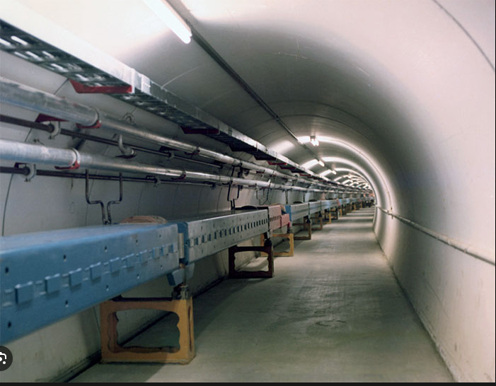
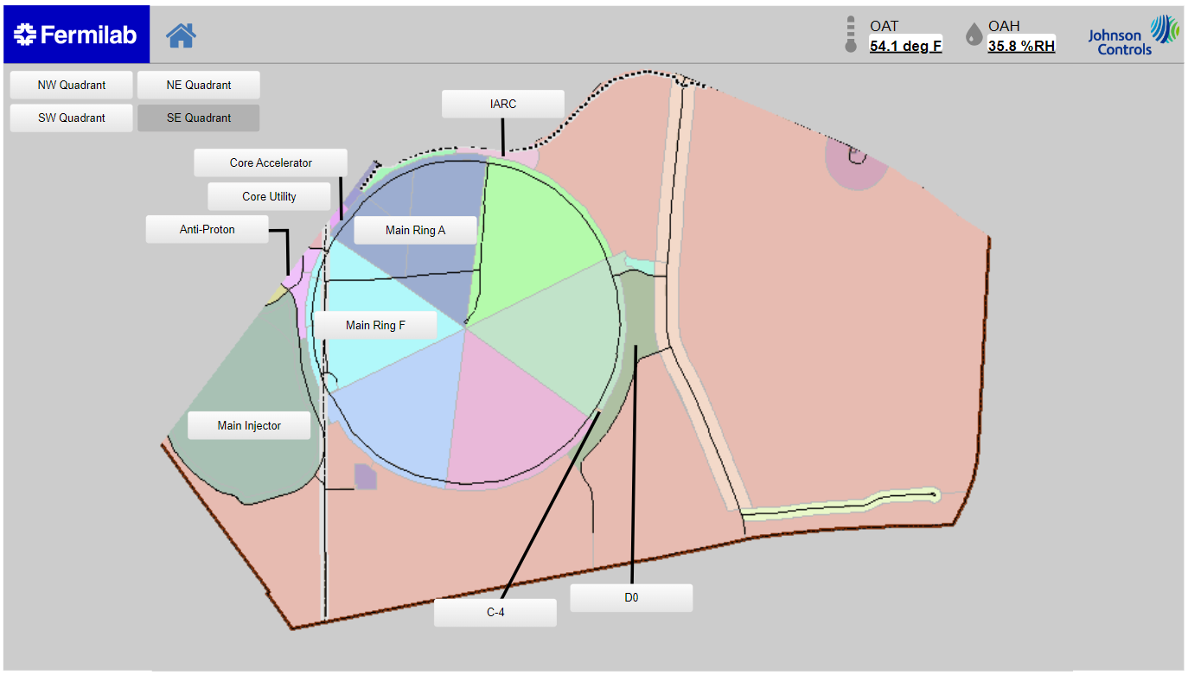
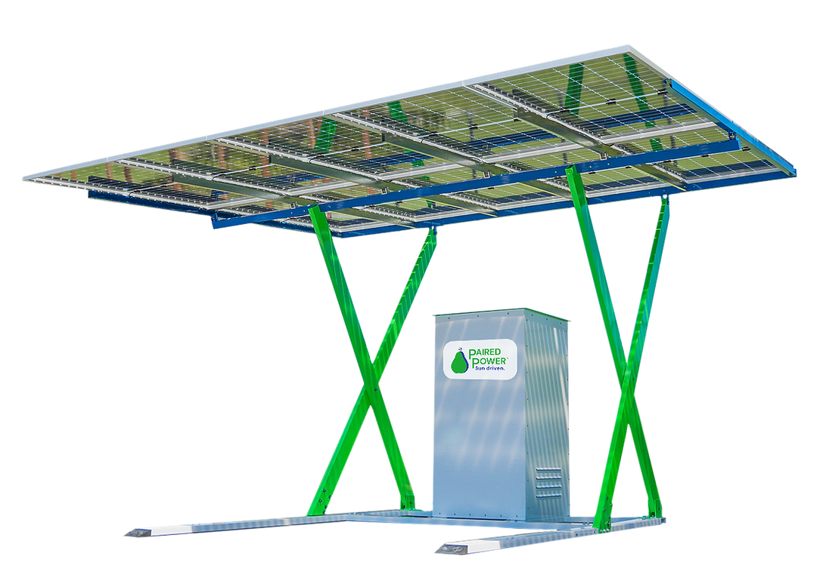
Fermilab Resilience and Efficiency Project
Zero Emission Energy & Buildings
Traditional Energy Conservation Measures
Innovative Energy Conservation Measures
Lighting
Battery Energy Storage
Microgrid
Transformers
Controls
Renewables
EV Charging

Slide 17
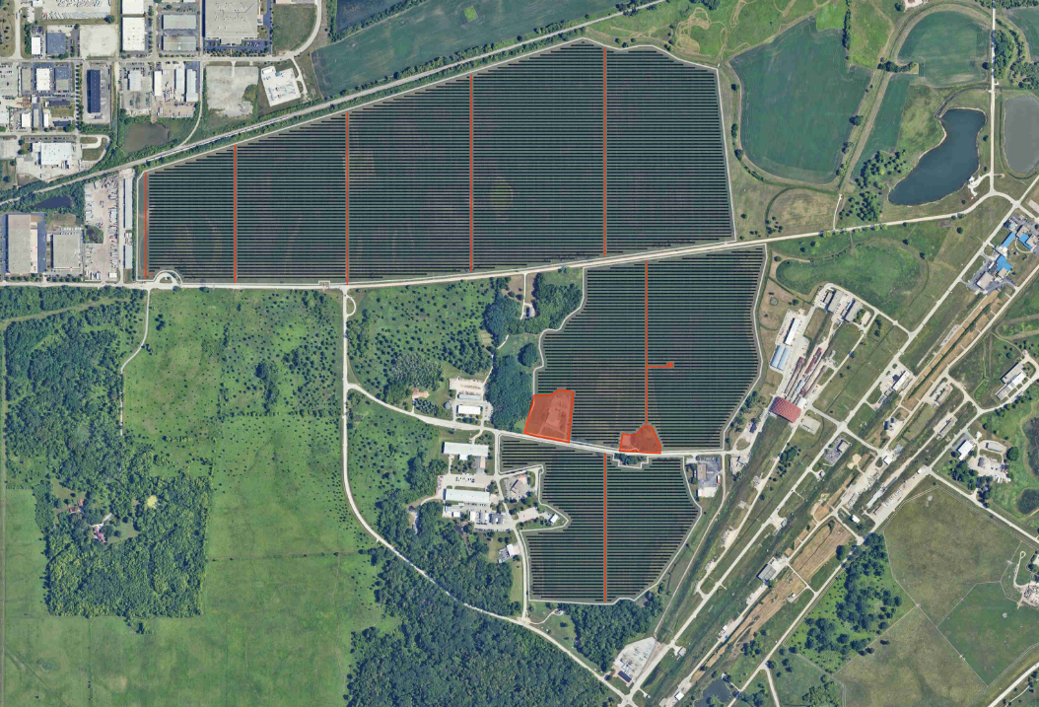
Fermilab Resilience and Efficiency Project Ongoing Development – PV + BESS at Master Sub Station
Zero Emission Energy & Buildings
Goal to maximize on-site generation, provide resilience and minimize environmental impact
Size and scope under development
Potential generation of approximately 135,000 MWh/year.
Current analysis pending:
Interconnection allowances
FNAL feeder & load priorities and analysis (MCS)
Economic analysis

Slide 18
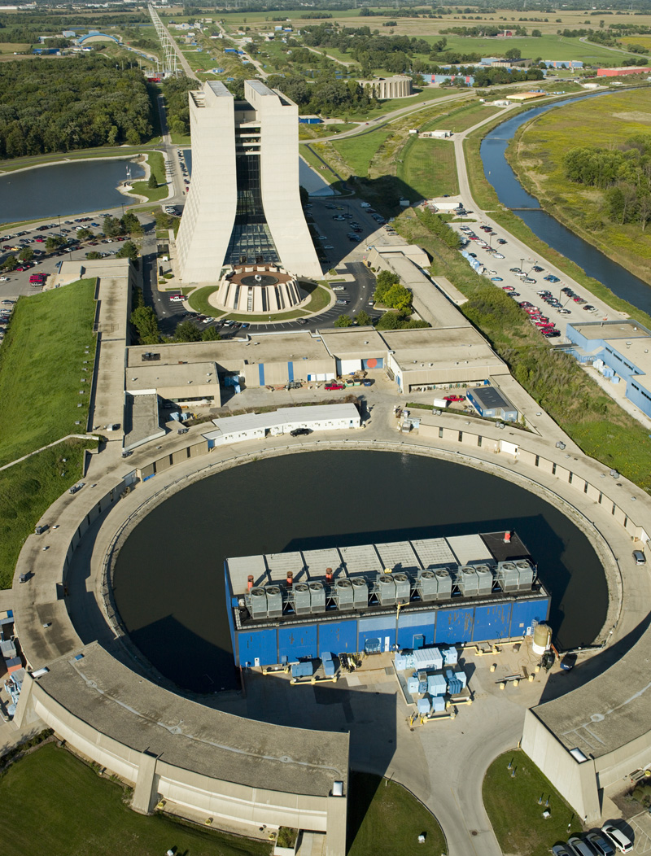
Central Utility Building Improvements Integrate Sustainability
Zero Emission Buildings
DOE funded major renovation of the Central Utility Bldg.
Selected heating and cooling equipment will lead to 88% reduction in natural gas use within project budget
Sustainable design features, compliant with Guiding Principles for Federal Sustainable Buildings:
Commissioning (optimizing) of plant at start up
Maximize daylighting and LED lighting with occupancy sensors
Variable speed controls
Bird safe architecture
30% better than ASHRAE efficiency requirements
Building sited to avoid ecologically sensitive areas; re-utilization of existing footprint and infrastructure
EV charging stations
Energy and water metering
Recycling 50% of construction waste
Maximize use and reuse of alternative water as opposed to potable water
Notes:
50% of peak heating load is met by heat recovery chillers
50% is met by electric boilers
Natural gas back-up boilers installed for resilience
88% reduction in natural gas use
Space allocation included for future heat recovery system to support Wilson Hall heating

Slide 19
Electrification Study
Zero Emission Buildings
Goal: Develop building level roadmaps for electrification
Target buildings not included in FREP or UIP
Scope of work:
Evaluate infrastructure for energy efficiency opportunities and elimination of natural gas use
Electrical infrastructure evaluation
Natural gas and HVAC systems review
Backup generator systems assessment
Building envelop and architectural evaluation
Electrical, and Mechanical Upgrade Options
Impacts of ZEV Master Plan
Develop building electrification plan with ROM cost estimate
Timeline:
Study On-going: April - September

Slide 20
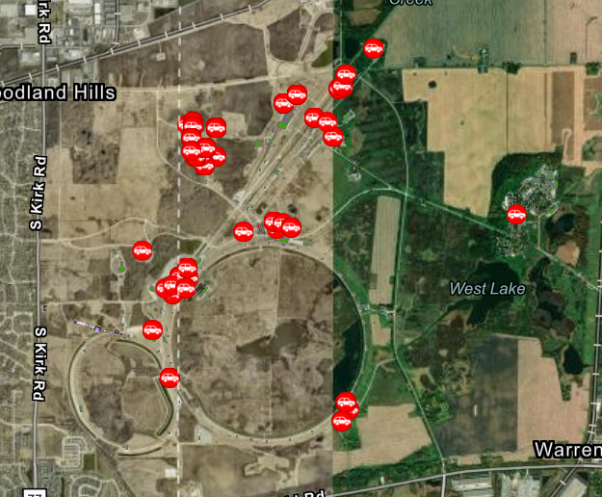
Zero Emission Vehicle Master Plan
Zero Emission Vehicles
EV Charging Master Plan
Maximize ZEVs, seeking lowest emission replacement whenever possible
Accept PHEVs & biodiesel replacements as needed while market adjusts
~78% can be electrified now, 15% have a PHEV replacement, 7% do not have an adequate replacement
Acquisitions vs. fleet makeup – in 2027 acquisitions need to be 100% ZEVs, fleet will take time to convert over fully
66 EV charging stations at ~27 locations
Notes:
Add DOE will require additional paperwork and justification if we do not accept a ZEV if available (lack of charging infrastructure not acceptable reason).

Slide 21
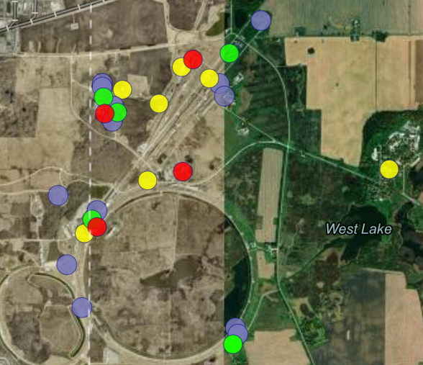
Phase 1 Electric Vehicle Charging Station Project
Zero Emission Vehicles
Fleet ZEV and EVSE master plan developed in FY23
66 EVSE needed at 27 locations vs 2 EVSE existing
Phase 1 Project Defined
24 Dual port EVSE needed to support FY24 ZEVs ordered through GSA
32 Fully Electric and 15 plug-in hybrid electric arriving in waves
Conceptual design completed: in-house engineering resources
Due to limited fiscal year funding, leveraging multi-approach strategy:
Completing detailed design on Phase 1 project
Maximize use of existing Level 2 Charging Stations
Leverage existing Level 1 outdoor outlets
Add EV charging into scope for Fermilab Resilience and Efficiency Project
Stakeholder outreach completed to inform Employee EV Charging program changes to support sharing stations with Fleet
Legend
1st Priority
2nd Priority
3rd Priority
Planned Future
Fermilab awarded DOE Green Fleet Award for FY 24 Vehicle Procurements

Slide 22
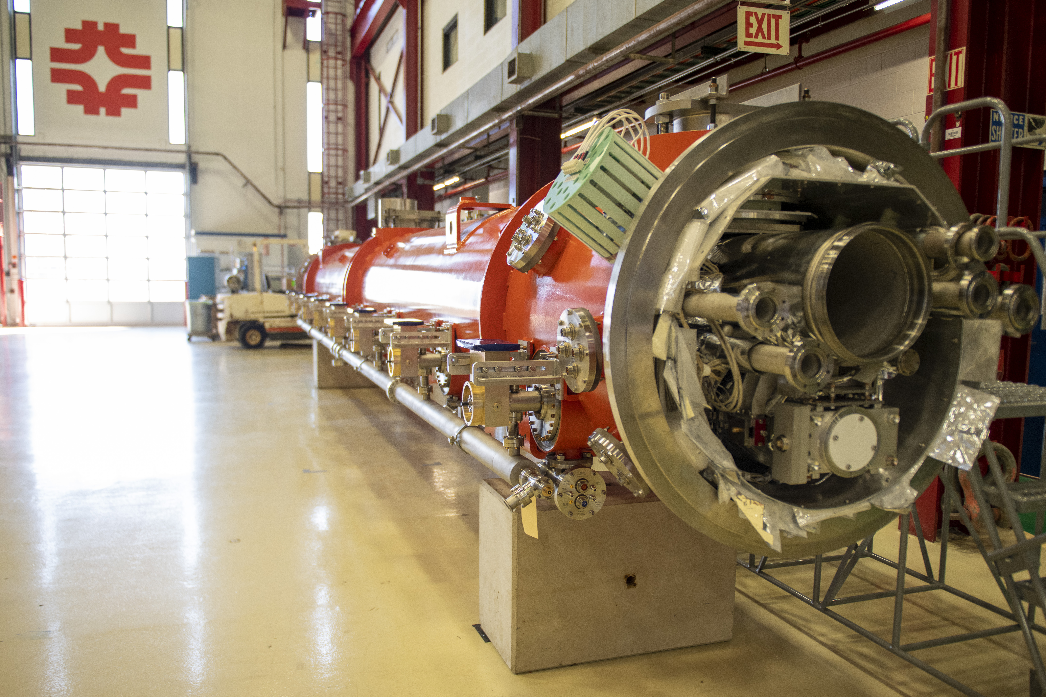
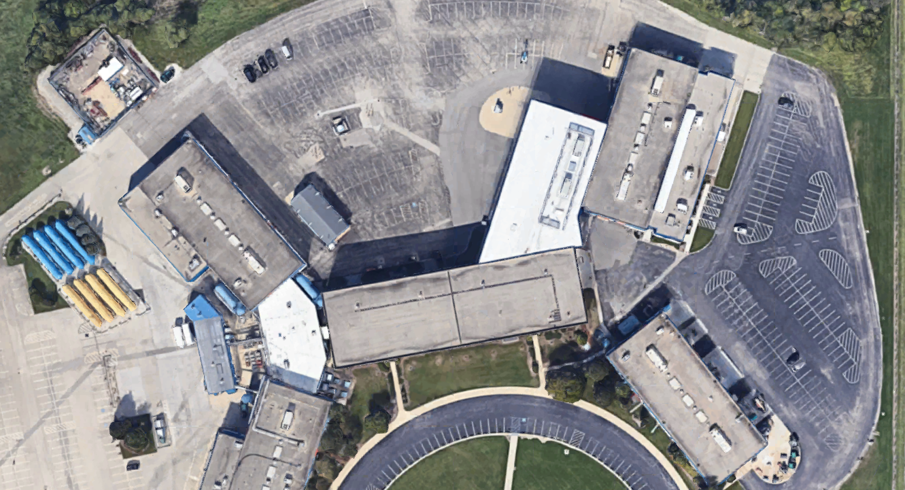
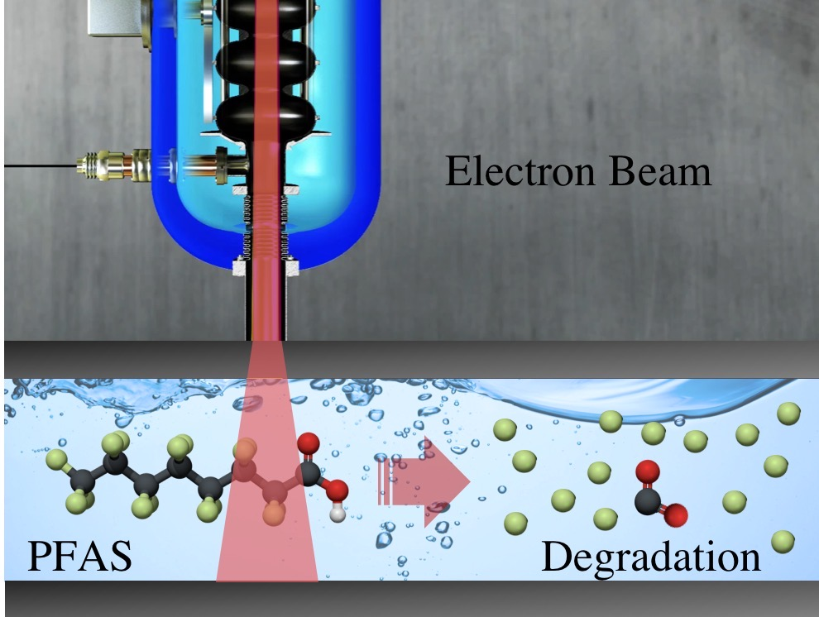
Sustainability in Science Focus Areas and Examples
Engaging the science and engineering community to achieve long-term sustainability goals
Incorporate sustainability into new scientific infrastructure and activities.
Enhance scientific infrastructure and activities to support sustainability.
Export technology and capabilities to advance sustainability in the world.
Conceptual over the roof recovery pipe routing from IB3a to IB1.
IB3a
IB1a
Simplified Schematic of IB3a to IB1a Recovery System.
Nitrogen doped SRF cavities used in the LCLS-II accelerator will help cut the cryogenic losses of this machine by up to a factor of two
Electronic Beam Applications at IARC:
Destruction of PFAS, Water Treatment, Destruction of Toxins in Soil
Notes:
Sustainability in New Scientific Infrastructure and Activities
Partnered with LBNF/DUNE project team for implementing sustainable practices into NSCF design and construction.
Energy savings for Main Injector RF Cavities : Develop an alternative cavity framework that would use superconducting cavities instead of the current copper cavities to save on electricity during PIP-II era.
Sustainability in existing Scientific Infrastructure and Activities
Baseline and benchmark accelerator energy use into stage-by-stage process buckets to identify major energy use systems and need for monitoring and metering investments.
Low conductivity water system: Modernize this system to meet the increased cooling needs for PIP-II and LBNF. A new system would deionize the water using modern electrical systems and removes the need for using different acids.
Tech Transfer to Support Sustainability Outcomes
Collaborate with LDRD Program to encourage proposals that support sustainability goals.
Exploring development of a superconductivity application concept to support sustainability that could engage external partners and be considered for a pilot demonstration project in the future.
Fermilab IARC industrialization effort is exploring development of emerging technologies application concepts to support sustainability that could engage external partners and be considered for a pilot demonstration project in the future.

Slide 23
Sustainability in Science Focus Areas and Activities
Projects
Engaging the science and engineering community to achieve long-term sustainability goals
Incorporate sustainability in scientific infrastructure
Innovate to operate scientific infrastructure more sustainably
Export capabilities to advance sustainability in the world
New Initiative:
Workshop to sustainability for particle accelerators.
Support Active Idea:
Energy savings for Main Injector RF Cavities
New Initiative:
Baseline accelerator energy use and identify systems that can be optimized for energy savings
Support Active Idea:
Low conductivity water system upgrade
New Initiative:
Fermilab IARC industrialization effort is exploring development of emerging technologies application concepts to support sustainability.
Support Active Idea:
Collaborate with Superconductivity Global Alliance to host workshop
Notes:
Develop an alternative cavity framework that would use superconducting cavities instead of the current copper cavities to save on electricity during PIP-II era.
Modernize this system to meet the increased cooling needs for PIP-II and LBNF. A new system would deionize the water using modern electrical systems and removes the need for using different acids.

Slide 24
Communications and Engagement
Annual Earth Day Fair
Monthly Fireside Chats with Sustainability
Annual Reporting
Notes:
What: Opportunity to talk about sustainability topics with your Fermilab colleagues
Where: Users Center
When: Thursday, January 25th from 4-6:30pm Inaugural event
Who: Employees, users, and badged
Why: Learn about sustainability topics, Engage with your colleagues in thoughtful conversation, Connect outside of work with extended team

Slide 25
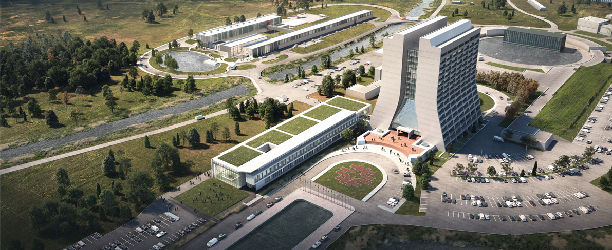
Redefining Implementation through Living Lab Framework
Living labs are open innovation ecosystems in real-life environments using iterative feedback processes throughout a lifecycle approach of an innovation to create sustainable impact.
OPERATIONS
LEARNING
LIVING LAB
RESEARCH
INNOVATION
What sustainability solutions would you like to see created, prototyped, tested and scaled up at Fermilab?
Notes:
Living labs are open innovation ecosystems in real-life environments using iterative feedback processes throughout a lifecycle approach of an innovation to create sustainable impact. They focus on co-creation, rapid prototyping & testing and scaling-up innovations & businesses, providing (different types of) joint-value to the involved stakeholders. In this context, living labs operate as intermediaries/orchestrators among citizens, research organizations, companies and government agencies/levels.

Slide 26
Living Laboratory at Fermilab Concept
Technologies for deep energy, net zero emissions building retrofits
Industry Partnerships
Fermilab Conventional Facilities
National Lab Partnerships
Innovative approaches to reducing accelerator complex energy use
Federal Agency Partnerships
Testbed for integrating clean energy in energy intensive, pulsing energy power
Community Partnerships
Data Analytics
AI and Machine Learning
Educational Partnerships
Accelerator technology applied to societal problems

Slide 27
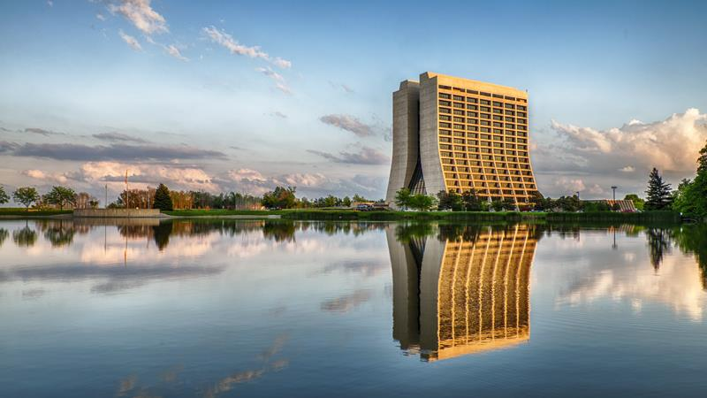
Thank you.
Notes:
Karen

Slide 28
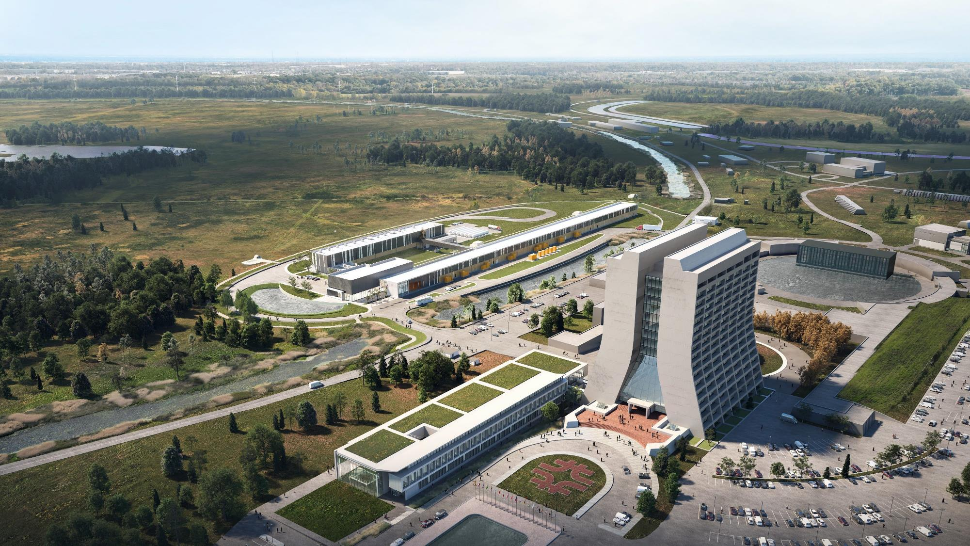
Main Injector
Proton Improvement Plan II – Accelerator Improvement Project
Transfer Line
PIP-II
Electrical Power requirements:
29 MVA
Breakdown:
Cryoplant 14MVA
Acceleration 5MVA Other 10MVA
SRF Linac
Booster
PIP-II is an essential upgrade to Fermilab accelerator complex to enable the world’s most intense beam of neutrinos to LBNF/DUNE, and a broad physics research program for decades to come.
Notes:
https://news.fnal.gov/wp-content/uploads/pip-ii.pdf

Slide 29
Fermilab Emissions Based on Grid Region
Natural Gas and Coal
https://www.epa.gov/egrid/power-profiler#/RFCW

Slide 30
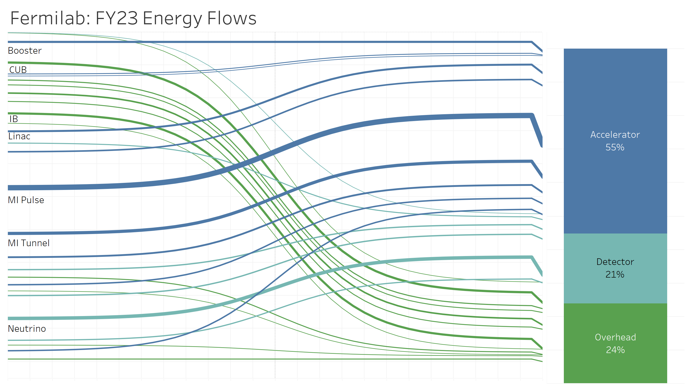
Fermilab Electricity Breakdown FY 2023
Energy consumption by end use

Slide 31
Fermilab Resilience and Efficiency Project
Zero Emission Energy & Buildings
Improving Energy Infrastructure & resiliency
Providing Energy Security
Energy savings in conjunction with continuity of the mission
Addressing building operational issues
Comprehensive
Innovative
Addressing the Mission
Energy Resilient & Secure
Energy Conservation measures at 22 buildings
On Site Generation
Continuous Monitoring of Energy Systems
Energy Security
Operation & Maintenance of Systems
Being first with the proposed level of on-site generation in conjunction with energy security
Providing customized solutions to Fermilab
Integration of advanced technology lighting
Creative Financing & Deal Structures
Integrating utility rebate programs
MCS integrating generation assets & battery energy storage
Maximize new on-site energy PV
Meet Government mandates
Microgrid and fast load shedding paired with generation

Slide 32
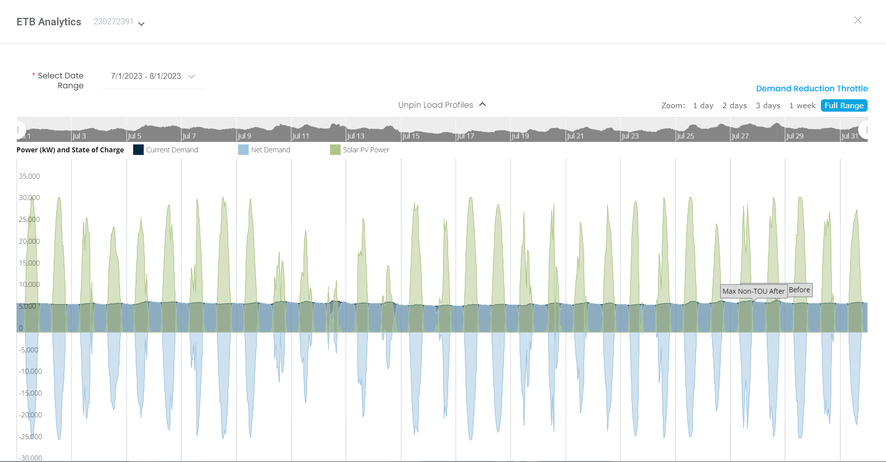
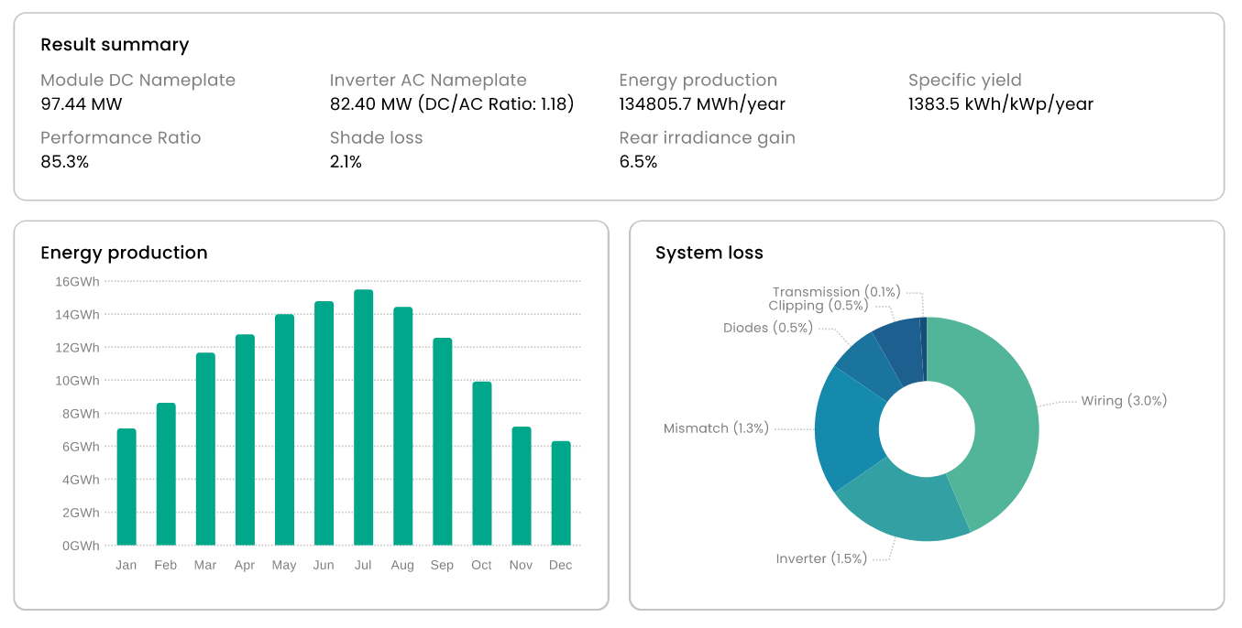
Fermilab Resilience and Efficiency Project Ongoing Development – PV
Zero Emission Energy & Buildings
Solar generation will exceed base load at peak generation and be net metered with ComEd.
Projected generation of approximately 134,805,700 kWh/year.
Offsetting overall fossil fuel electrical usage by more than half.

