Slide 1

Power Over Fiber DEVELOPMENT
4 HEP Detectors
William Pellico FNAL
Emerging Technology
57th Annual Users Meeting

Slide 2
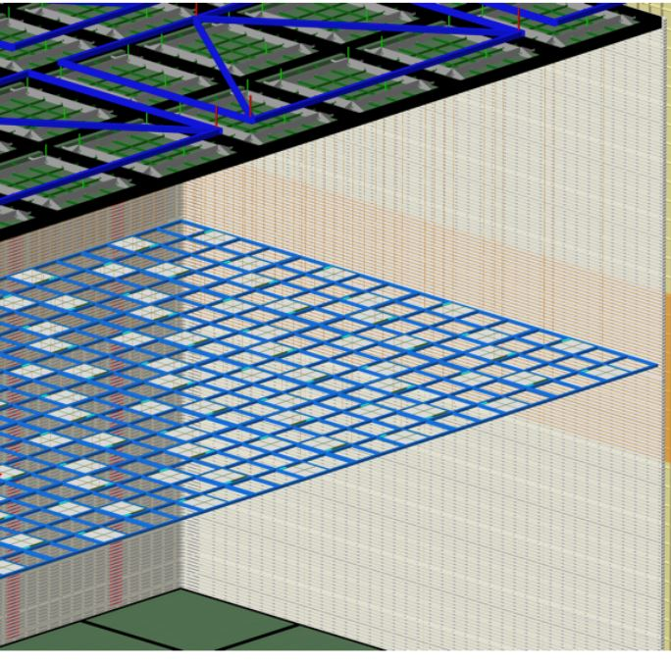
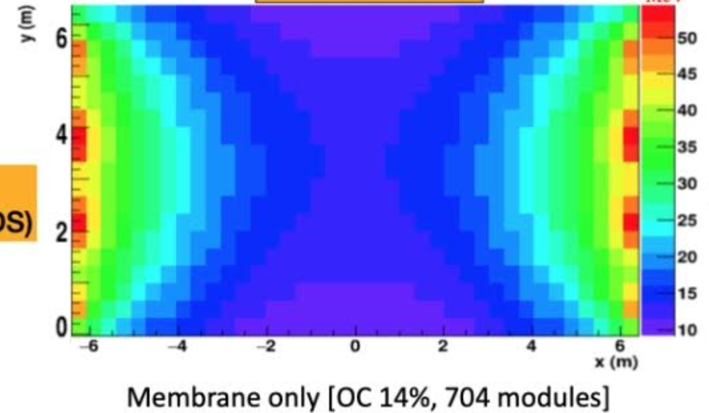
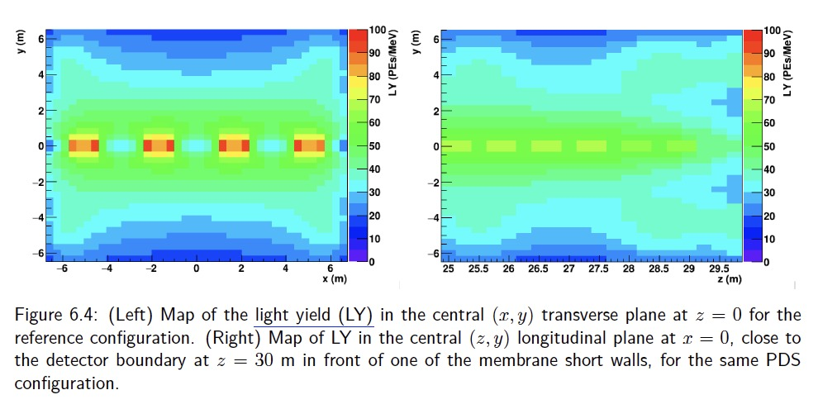
Problem - Solution
Anode
Ground
Photon Detection is hindered by detector size and voltage potentials.
Large parts of the detector are at high voltage potential
The drift volume is very large.
Solution – supply power to components not at ground:
Floating electronics – not tied to ground.
Power the electronics with power delivered via fiber to optical converters (OPC).
Field Cage
Cathode
300kV
No PoF System
PoF System
Anode

Slide 3
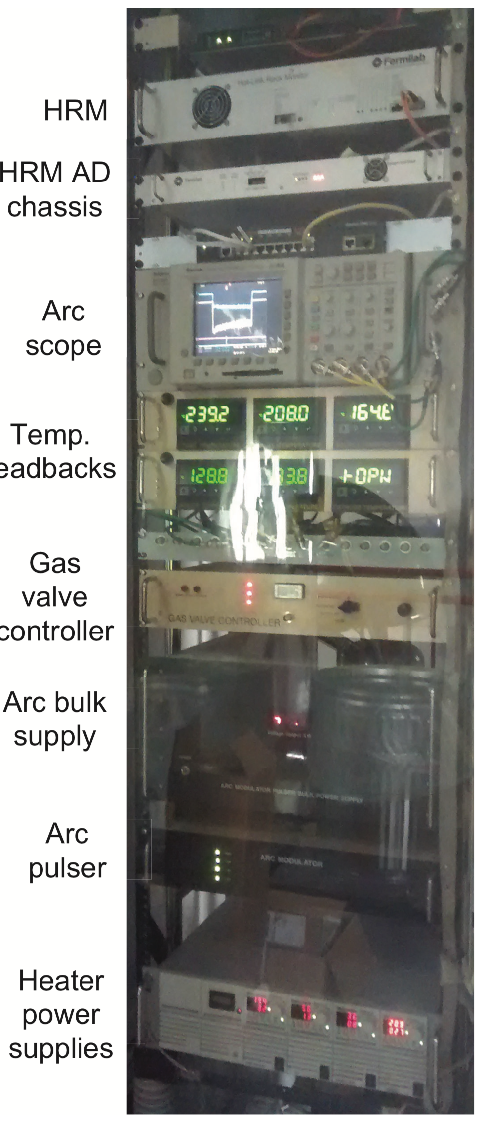
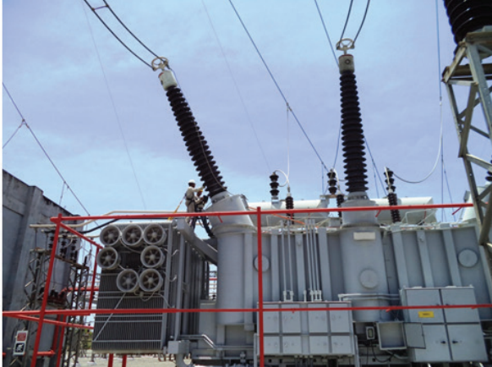
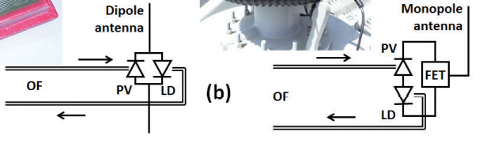
Power Over Fiber (PoF)
PoF has been used for a long time in harsh industrial environments
The applications are typically found in two areas:
Ground Isolation
  High Voltage Systems: Ion Sources, Modulator Decks
  Radar Towers: Controls and Diagnostics
  Power Distribution Monitoring Systems: HV Monitoring and Power Lines
Electromagnetic Noise Reduction and Protection
      Military installments (Filed applications)
      PoF and Data on the same fiber for secure distributed communication
Breaker Monitoring Antennas
Transformer Electronics Power
Ion Source Systems

Slide 4
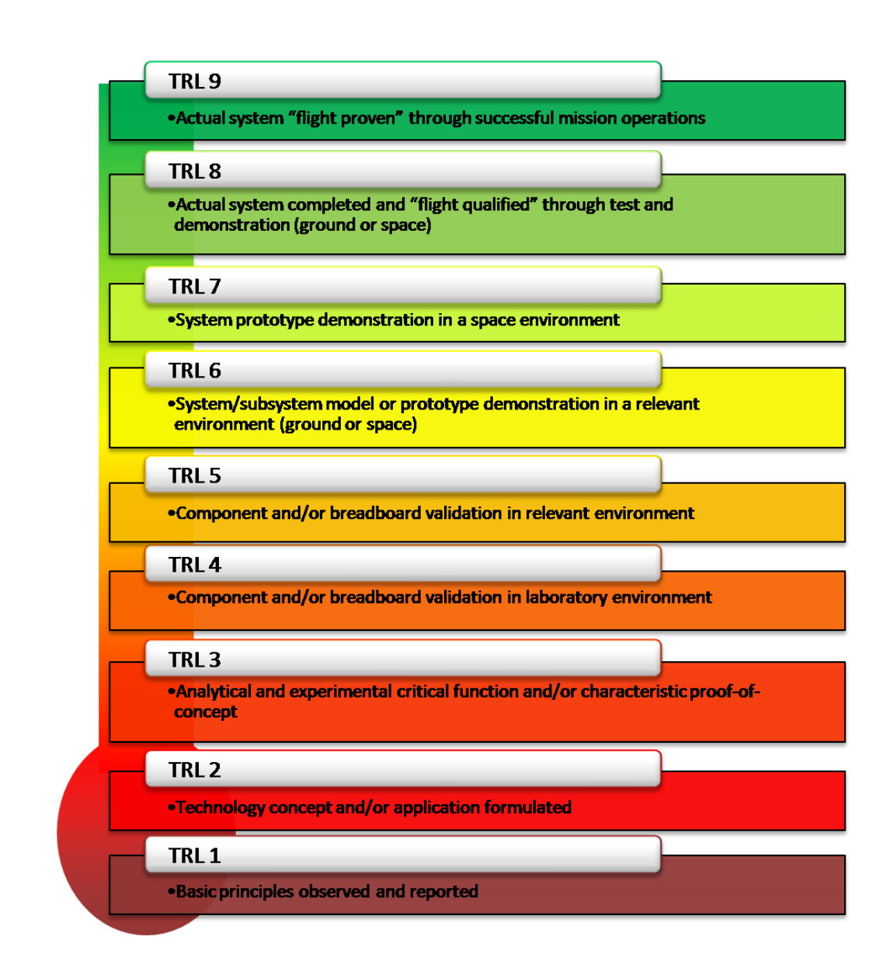
This talk is a technology development talk that follows a development similar to other emerging technologies.
I apply a NASA TRL definition.
DUNE/Large Detectors are a lot like a space launch technology.
(without the budget)

Slide 5
HEP – DUNE offered a new use case
We have been working on PoF since 2017 for use in a cryogenic systems where a HV potentials exists
This PoF effort is similar to other technology developments for implementation of a new use case.
The work took a path for a system from TRL2 to TRl7 (TRL8). (TRL = Technology Readiness Level)
Lasers: TRL 10
Fibers TRL 4
Optical Photovoltaic Converters TRL2
FY17 | FY18 | FY19 | FY20 | FY21 | FY22 | FY23 | FY24
PoF: Wavelength Investigation, HW choice vetting, Risk Mitigation
 | Fiber, Jacket, and Termination Investigation
 |  | Optical Photovoltaic Converter Development
 |  |  |  |  | Stability and Viability Testing
 |  |  | System Design and Implementation (With Lasers)

Slide 6
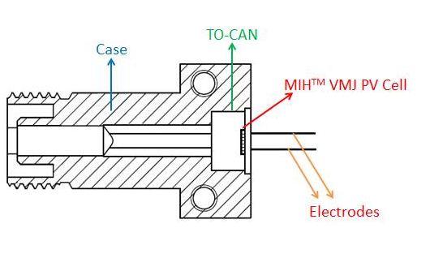
PoF System – Photon Detector
OPC
Liquid Cryo Compatible
HV Isolation
Fiber
Liquid Cryogenic Compatibility
Power Handling
Laser
CW Regulation/Stability
Safety
Power Conversion Efficiency
Viability
Noise
Light Leakage
HV Compatibility
The three components to a PoF system
  Laser, Fiber, OPC
There are warm systems under development pushing the power, but we were the only cryogenic R&D player.
FC connector
OPC
Jacket
Laser
Core – 62.5/0.27 NA
Cladding: 200um

Slide 7
OPC Development
OPC
TRL2
Industrial
Or
Research
Research
Time/Cost
Industrial
Limited
The success of this work hinged on road mapping out the technology quickly and convincing DUNE/DOE that we should pursue this work.
The OPC was our biggest concern, and the path was not clear.
University
UIUC
Broadcom
GoPower
FNALTuned for Liquid&DUNE
Broadcom
R&D Funds
Achieved
72% Efficiency
Broadcom
New Prouduct Interest
TRL 4
TRL 6

Slide 8
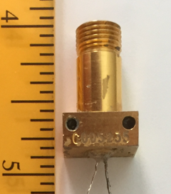
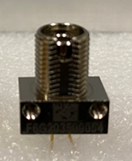
OPC – Initial Evaluation
First tests on off the shelf OPCs
  Silicone: Cheap, Low Efficiency with no path, 977 nm Laser
  GaAs: Medium Price, Low Efficiency with path, 808 nm Laser
  InGaAs: Higher Price, Low Efficiency with path, 1477 nm Laser
Voltage output is a reflection of layer count and conduction R
  Tested units from 4 volts up to 36 volts (cold values)
Power/Current IV curves /Efficiency verses Load/
Selected GaAs for DUNE VD2
  InGaAs may be FD3 OPC and optimized for future detectors

Slide 9
OPC – DUNE – FD2
Working with Industrial Partner Broadcom
  Limits on modifications – too small a market
    What could be changed in their process to improve cold
    Cost Share – reduce their risk
    Testing Shared
Achieved a doubling in efficiency at high power (1W)
  Enlarged the footprint
  Added some metal to the substrate
Package remained the same.
Produced a new product – published
Efficiency stays mostly flat from warm to cold (slightly higher cold)

Slide 10
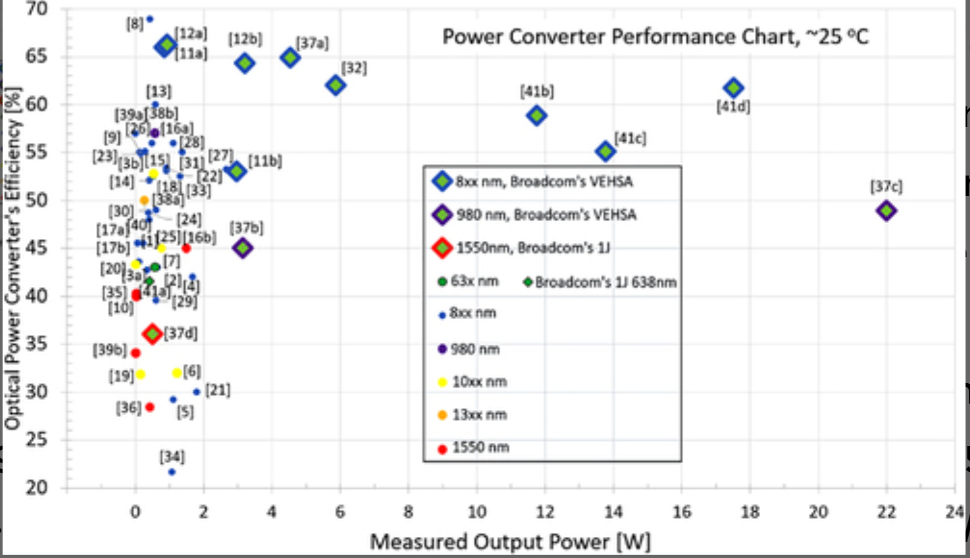
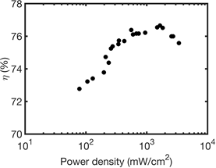
DUNE/PD has helped push the technology
We have worked with our industrial partner to set new limits!
Never used at cryogenic temperatures
Pushing the power/efficiency
We believe we can achieve > 72% above 1 W.

Slide 11
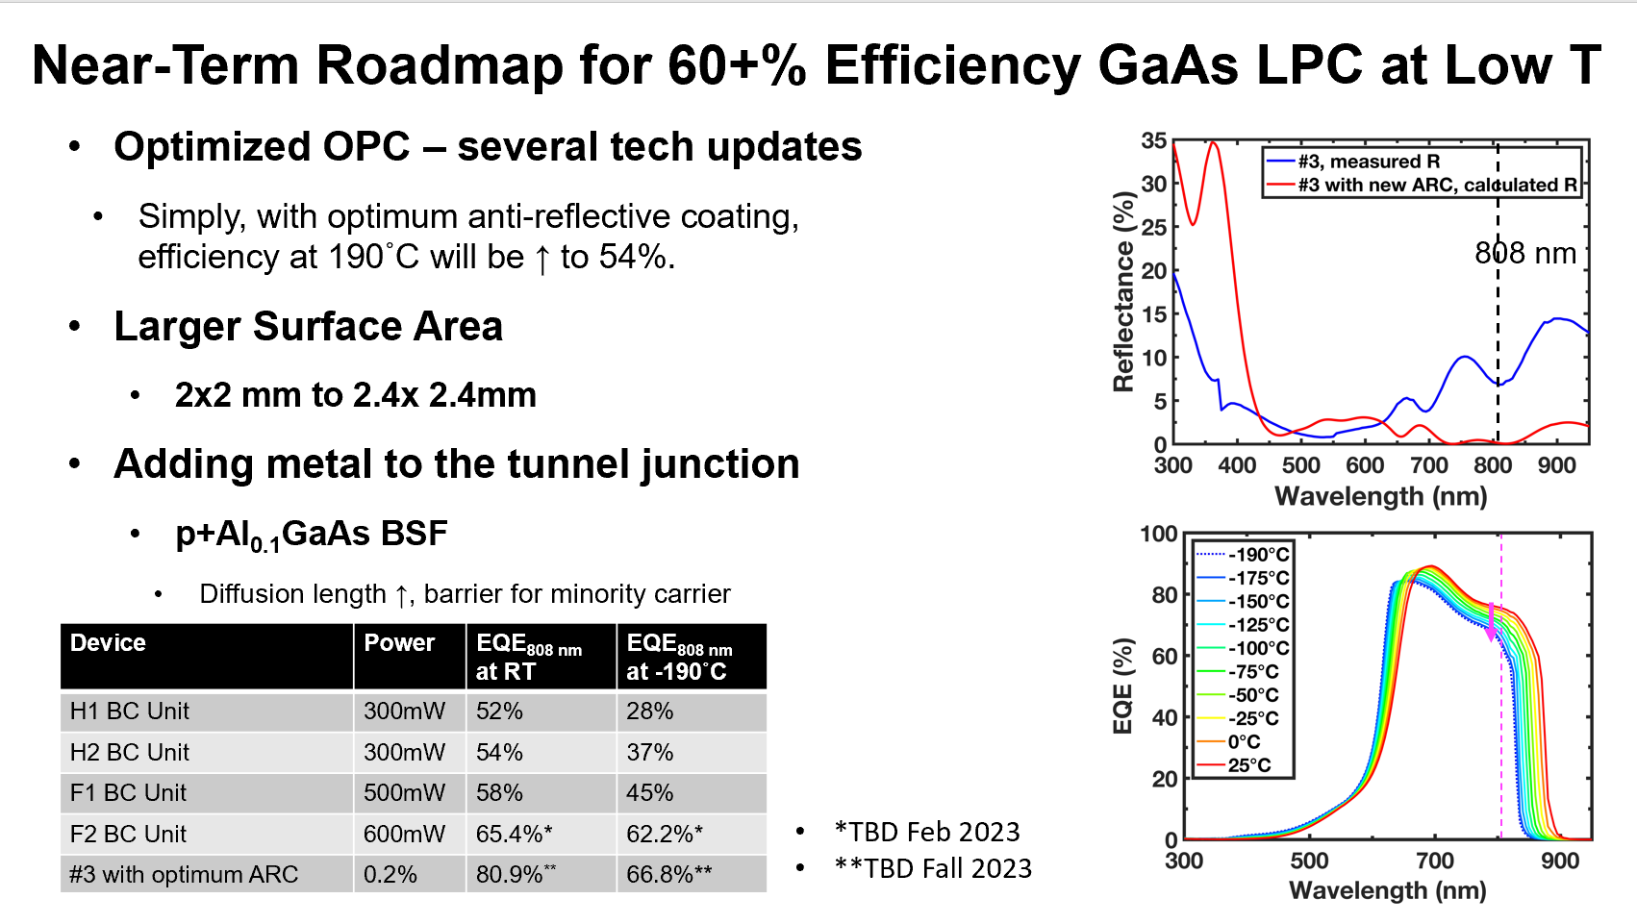
Some of the OPC changes

Slide 12
New LPC Design to Lower Series Resistance (R_{S})
Design
Aspects expected to be improved
Low R_{S} enabled by thick, n+-InGaP
Suppressed majority carrier blocking
Low R_{sheet} (33-35 ohm/sq)
EQE enhancement by DLARC
#1
#3
Au/Ti
Au/Ti
n-GaAs
contact
n-GaAs
contact
TiO₂/SiO₂ DLARC
e-
20nm n-AlInP window, n=1e18
500nm n-InGaP window, n=8e18
-
50nm n-GaAs emitter, n=1e18
80nm n-GaAs emitter, n=1e18
Contact
Emitter
2um p-GaAs base, p=1e17
Window
2um p-GaAs base, p=1e17
+
50nm p-GaAs base I, p=2e18
h⁺ barrier
50nm p-InGaP BSF, p=1e18
100nm p-GaAs BSF,
p=7e18 → 1e17
200nm p-GaAs buffer, p=7e18
400nm p-GaAs buffer, p=7e18
600nm p-GaAs substrate
600nm p-GaAs substrate
Au/Cr
Au/Cr

Slide 13
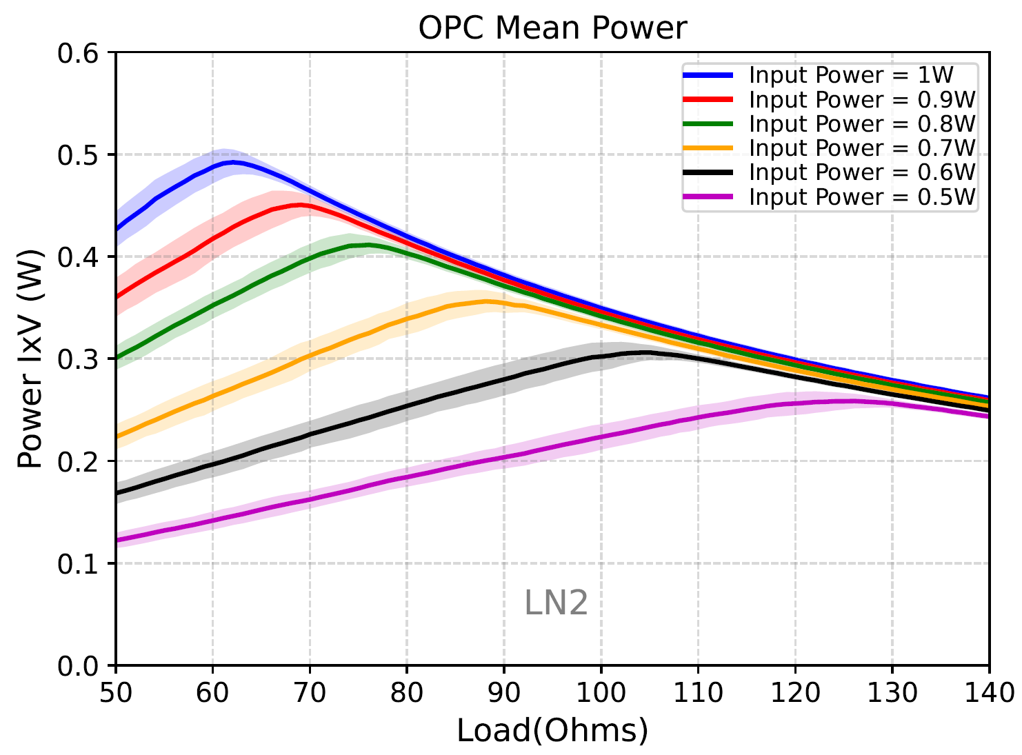
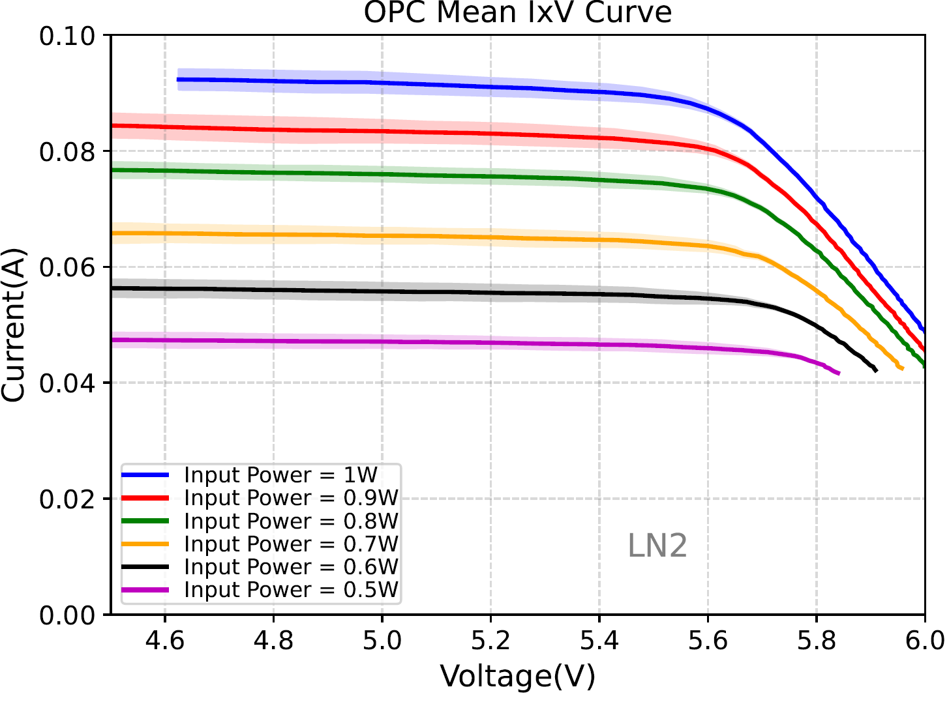
Move from concept to long term viability/capability.
The development and viability is now based upon large number of unit testing. Statistics and documentation to ensure a reliable technology. This is the last step in moving to a project ready TRL.

Slide 14
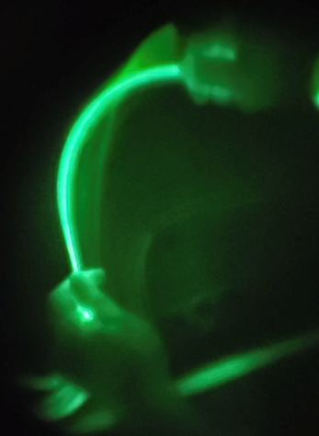
Fiber
TRL4 –>TRL8
Working with Industrial Partners
  Limits on modifications – too small a market
  What could be changed in their process to improve cold pwr
    Compression Loss
    Bend Radius
    Light Leakage
    Tensile Strength
  What options work at high power densities in cryo
    50kW/cm^2
  Safety – Ensure Class 4 laser system operating in Class 1

Slide 15
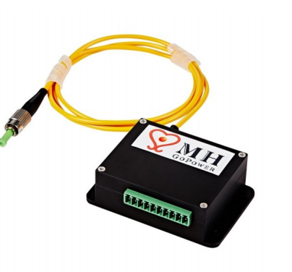
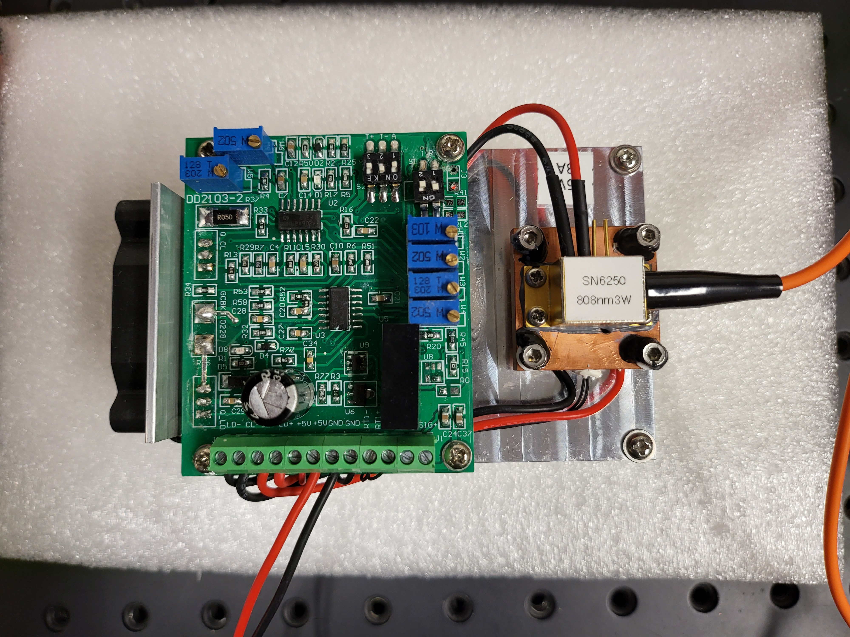
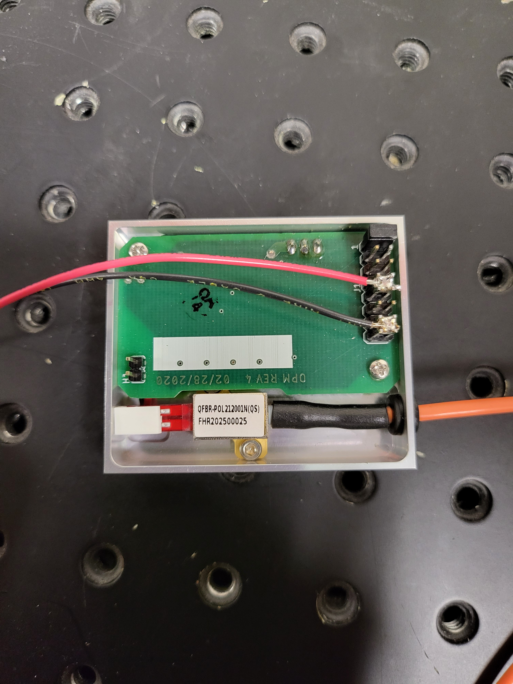
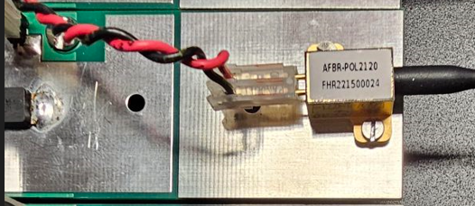
TRL10
Laser
The laser system was not R&D
Cost
Stability
Features for DUNE Operations
  Safety
  Longevity at CW Operations
Final Laser design includes a FNAL high efficiency driver and off the shelf 808 nm Laser in a compact footprint.
  25% wall to light efficiency
  2cmx5cm unit size

Slide 16
PoF Effort
Special Thanks
Fermilab Team
Low TRL/Testing
South Dakota School of Mines and Technology
Viability and Stability Testing
Stoney Brook
PoF Certification Testing
Industrial
GoPower (Silicon and Fiber)
Broadcom (GaAs, InGaAs, Lasers)
Industrial
Laboratory
University

Slide 17
Considerations for Future Proposal
Working with industrial partners in packaging our next version of higher efficiency and tuned voltages is underway.
The next stage:
> 70 units at > 1 W
Units that can generate higher voltages to directly power SiPMs.
Looking to bond OPC and communication links.

Slide 18
Conclusion
The PoF has been very successful in not only generating a tool for HEP detector use – we have forged a collaboration with industrial partners and universities..
The first use case for the DUNE VD2 PDS has expanded the coverage of PDS.
The work will continue beyond this application into industrial applications.
A publication by Broadcom has been completed.
The PD team has just published our work:
"Characterization and Novel Application of Power Over Fiber for Electronics in a Harsh Environment” at DUNE DocDB 30532-v1
ARXIV publication submitted
Thanks for the award - it took many people, many hours .

