Slide 1


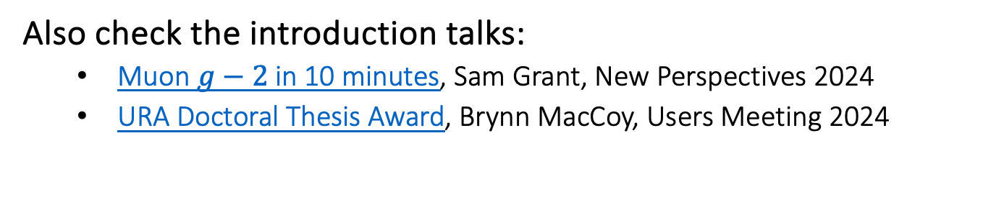
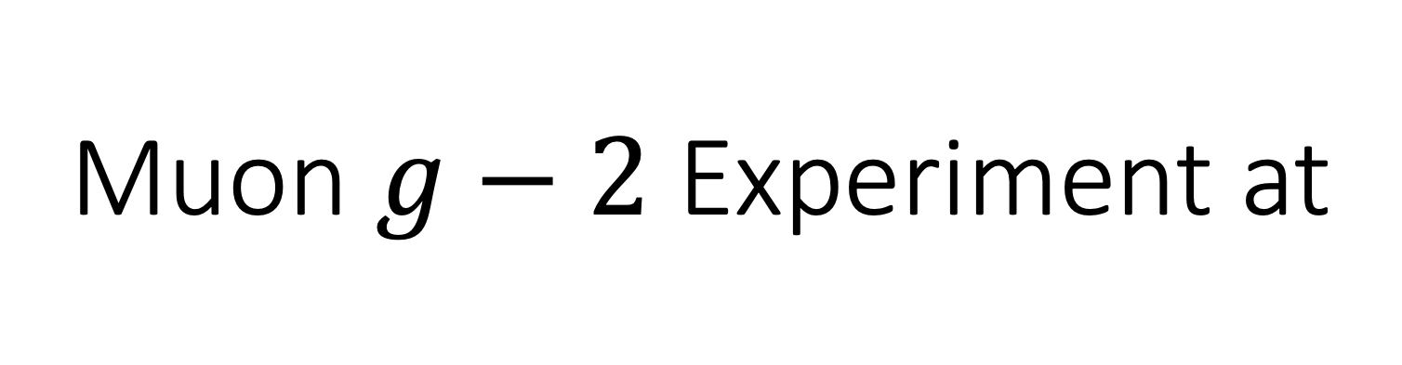
Muon $g−2$ Experiment at
On Kim (University of Mississippi)
On behalf of the Muon $g−2$ Collaboration
Fermilab 57th Annual Users Meeting
2024 July 11th
Also check the introduction talks:
  Muon $g−2$ in 10 minutes, Sam Grant, New Perspectives 2024
  URA Doctoral Thesis Award, Brynn MacCoy, Users Meeting 2024

Slide 2
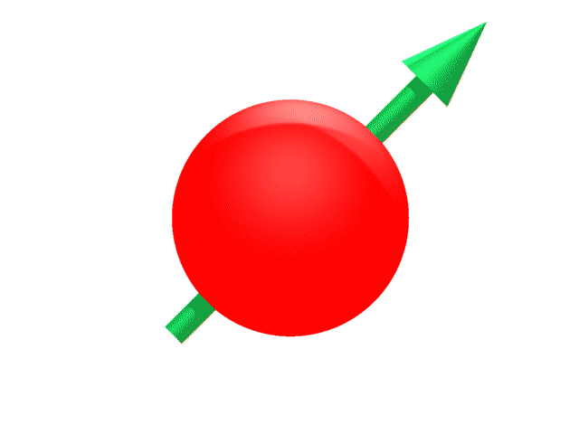
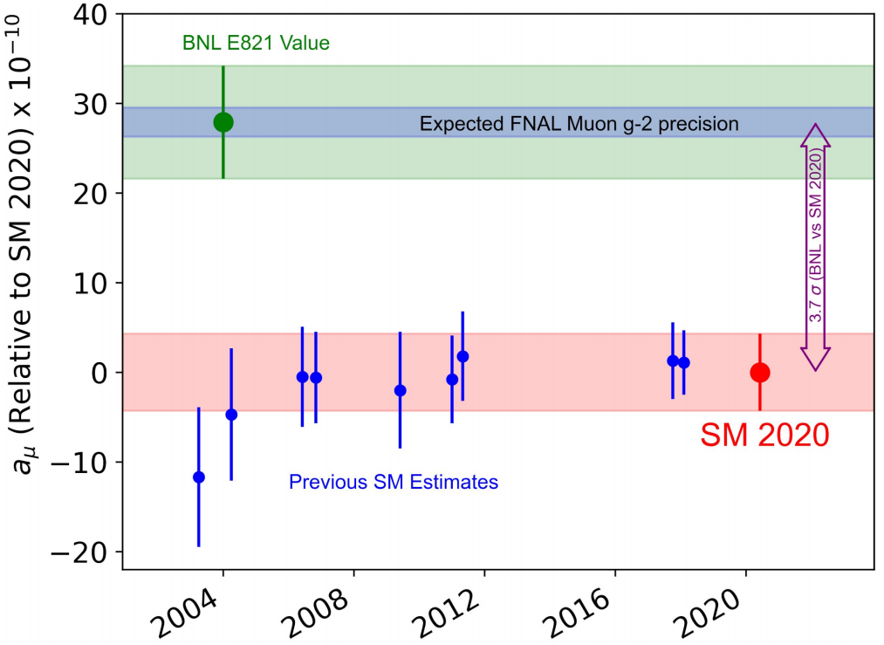
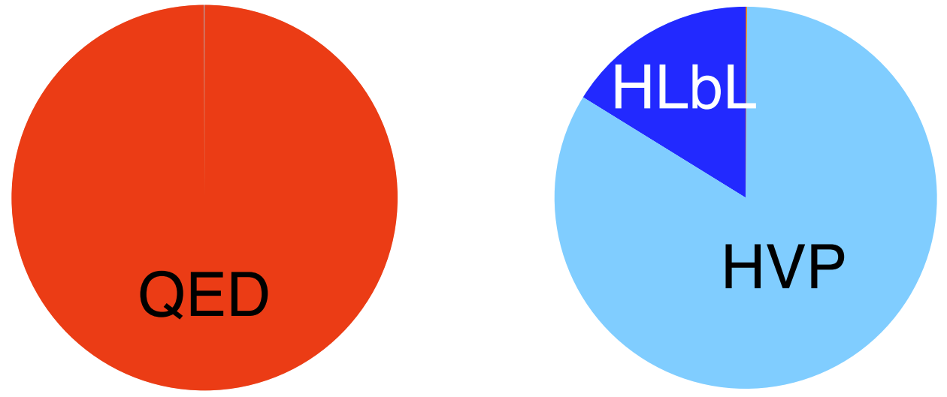


Motivation
More precise measurements of the magnetic moment of the muon can be a window to new BSM physics.
$$a_{μ}=\frac{g_{μ}−2}{2}, μ=g\frac{q}{2m}s$$
$a_{μ}\left(Dirac\right)=0$, but in reality, due to all the contributions from the quantum vacuum,
$$a_{μ}=a_{μ}\left(QED\right)+a_{μ}\left(EW\right)+a_{μ}\left(QCD\right)≠0$$
There have been strong hints of new physics in $a_{μ}$ for decades
(now in a somewhat vague situation – see in a couple of slides).
The SM uncertainty is completely dominated by hadronic contributions,
because evaluating them is notoriously hard.
Muon magnetic anomaly
B
Before Fermilab $g_{μ}−2$
Contribution
Error²
from A. El-Khadra

Slide 3
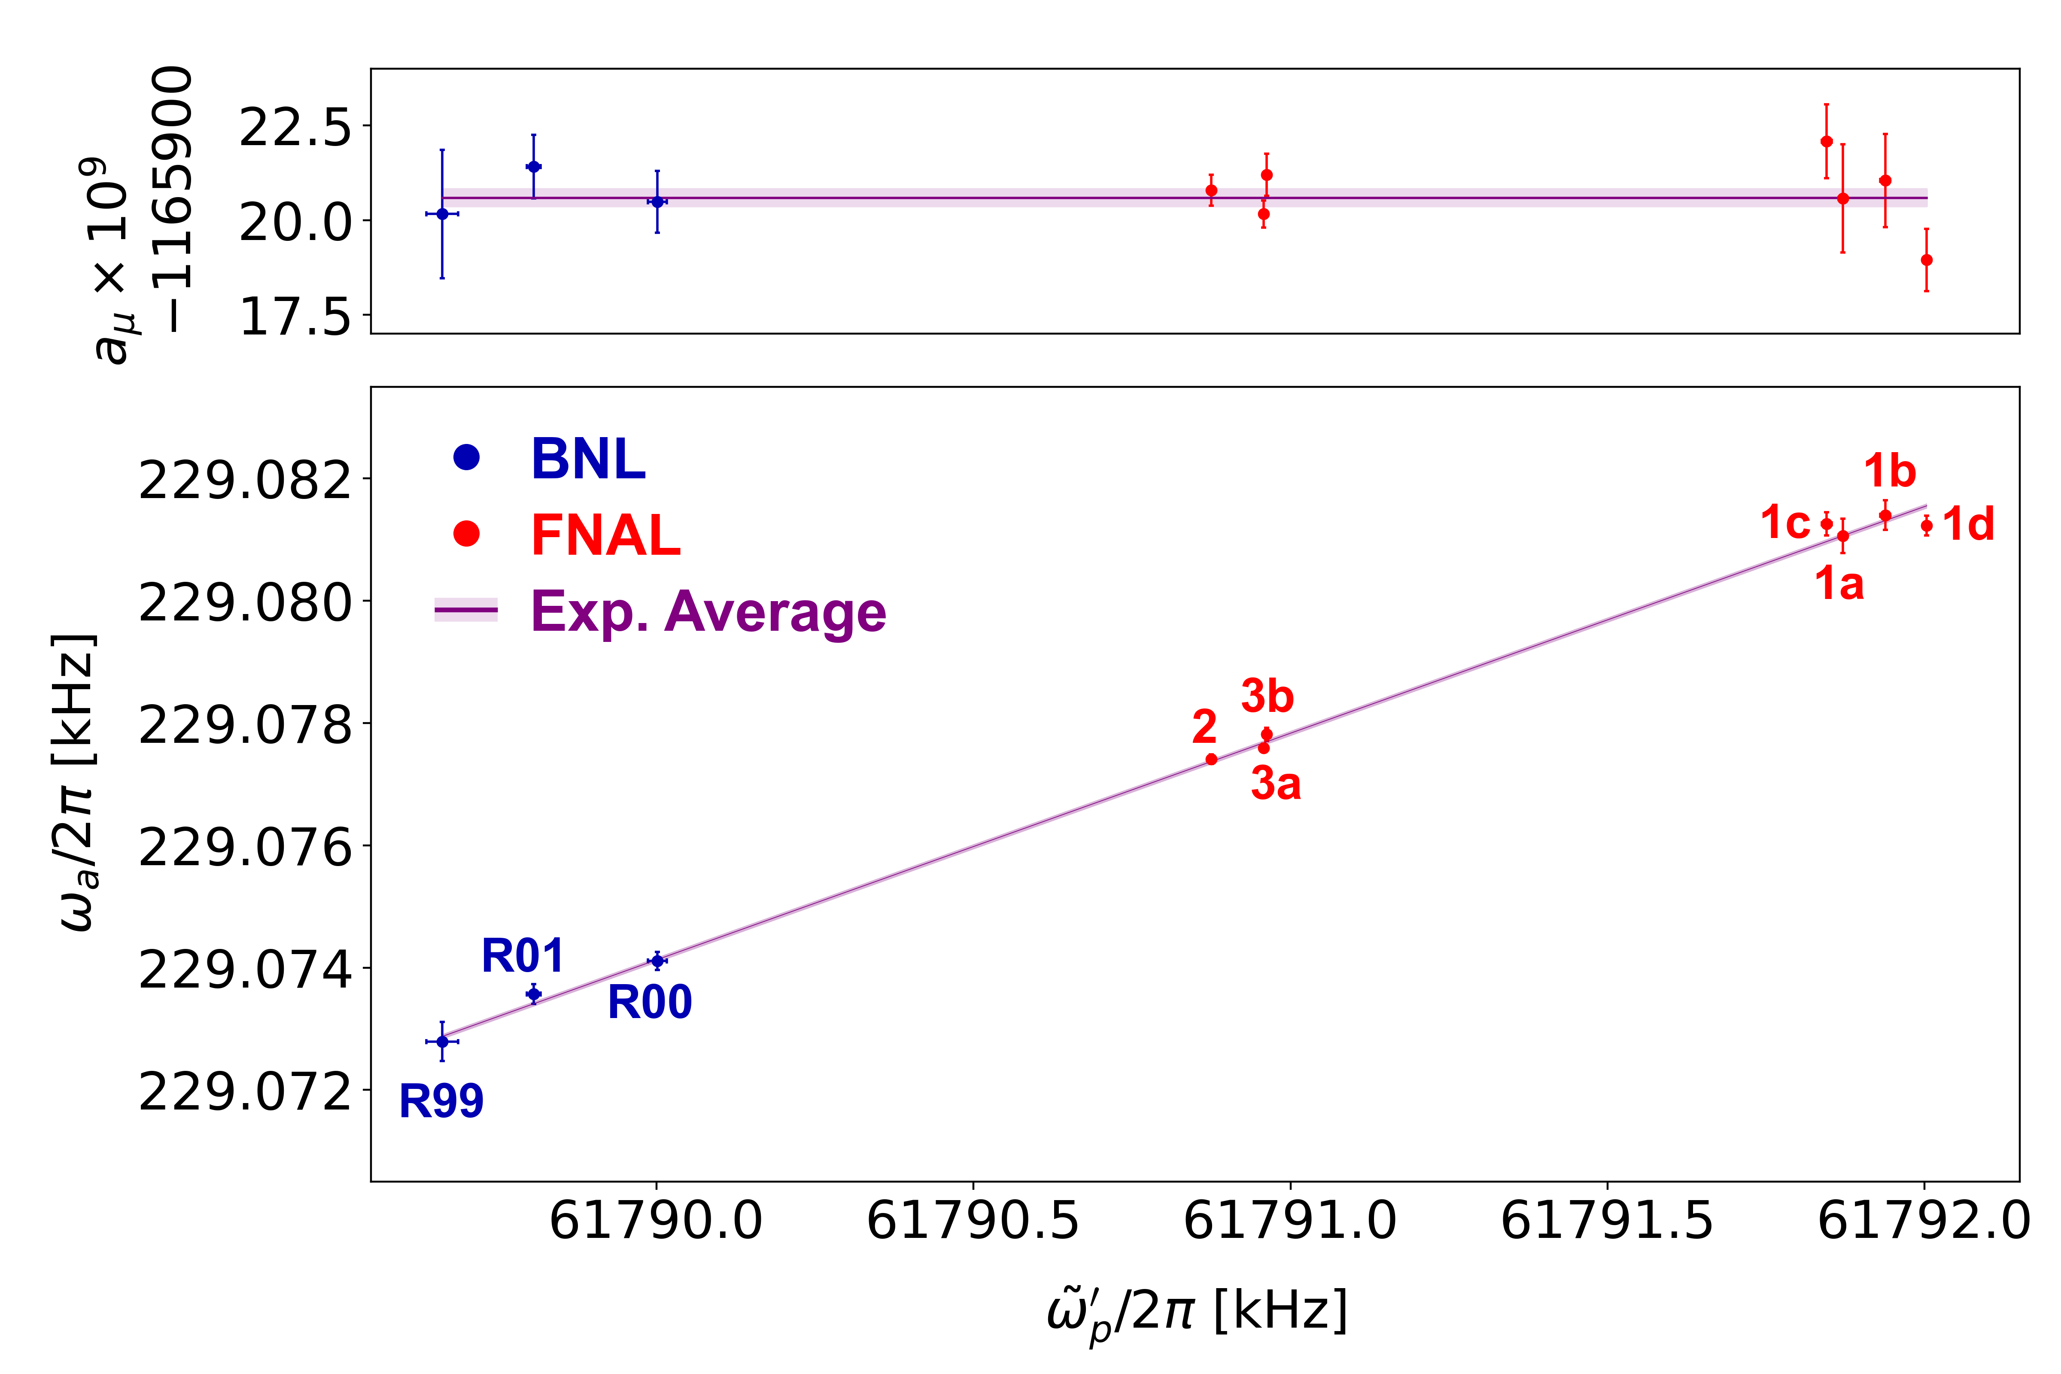
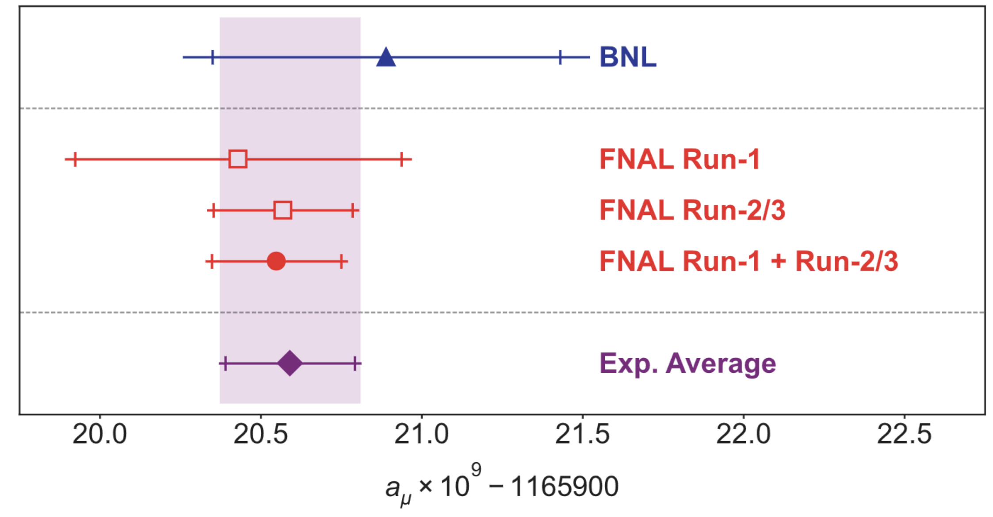

First (2021) and Second (2023) Results
Run-1 result (2018 data) and Run-2/3 result (2019/2020 data) were consistent.
Both renewed the most precise measurement of muon magnetic anomaly.
$$a_{μ}\left(Exp\right)=0.00 116 592 059 (22) [190 ppb]$$
~14 ppm
PRL 126, 141801 (2021)
PRL 131, 161802 (2023)

Slide 4
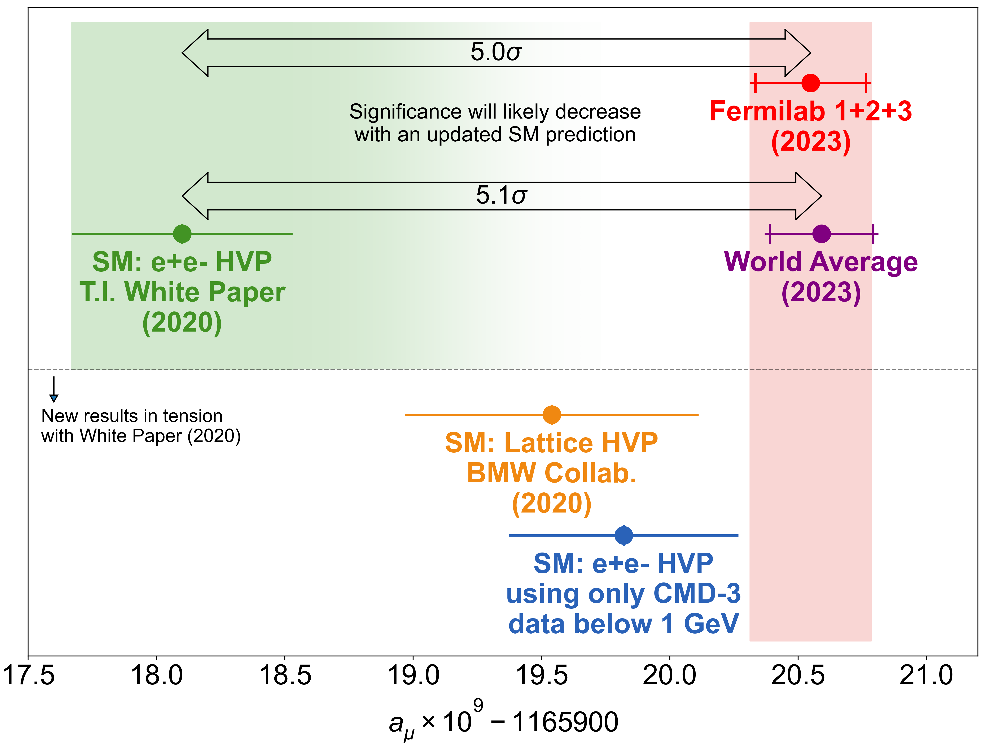


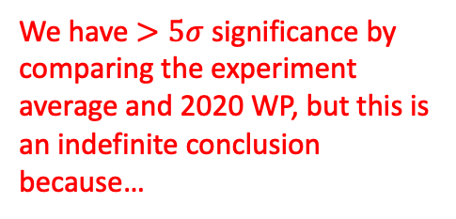

Experiment vs. Theory (SM)
Theory predictions from different approaches (for $a_{μ}\left(HVP\right)$, hadronic vacuum polarization) don’t agree!
We have $>5σ$ significance by comparing the experiment average and 2020 WP, but this is an indefinite conclusion because…
Muon $g−2$ Theory Initiative compiled the SM estimation primarily using the dispersive method for the hadronic vacuum polarization (HVP).
It uses 20+ years of $e^{+}e^{−}$ data (contribution dominated by $e^{+}e^{−}→π^{+}π^{−}$) from various collaborations (BaBar, KLOE, SND, BESIII, etc.)
There are new puzzles on HVP. Ab-initio lattice QCD calculation favors the measured value much better than the dispersive method.
A new dispersive approach result from the CMD-3 that came out recently has a strong tension with the other dispersive method results (even with the previous themselves: CMD-2).
*Disclaimer from A. Keshavarzi’s Lattice 2023 talk:

Slide 5
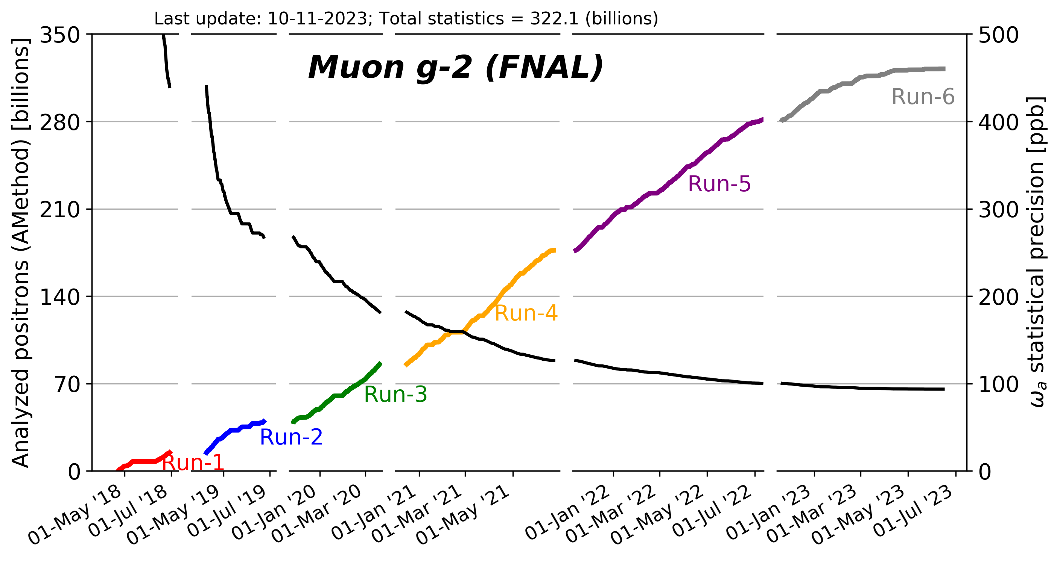


Status
Notwithstanding, we continue our analysis; $\sim$x3 more data are being analyzed!
Our physics operation terminated in June 2023.
We met the TDR
statistics goal!
And surpassed the systematics goal in the Run-2/3 analysis!
Stay tuned for the final result! (2025)
TDR goal
First result (Run-1)
(published 2021)
Second result (Run-2/3)
(published 2023)
Final result (Run-4/5/6)
(anticipated 2025)

Slide 6
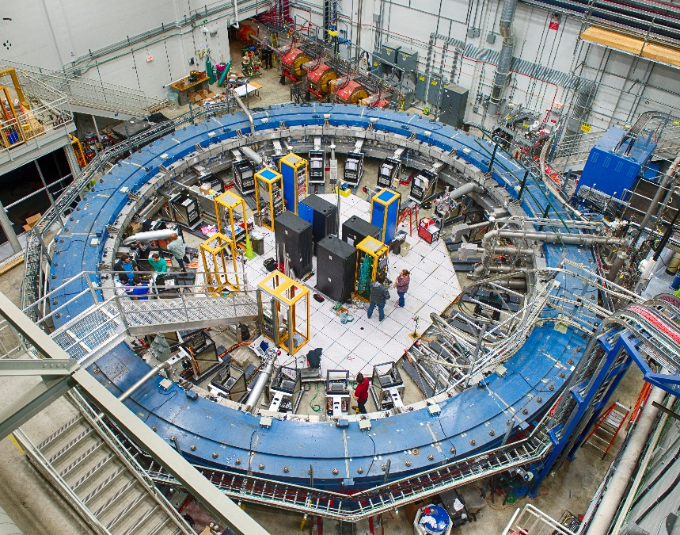
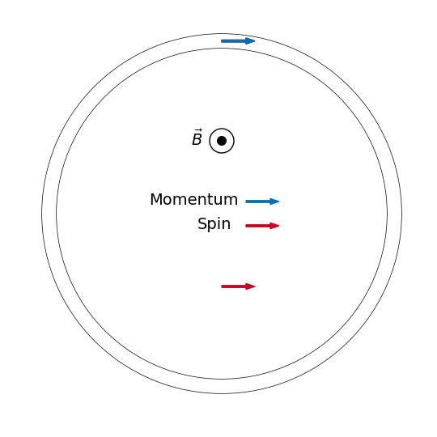


Experimental Overview
$$μ^{+}$$
Muons are stored in the storage ring ($\sim$15 m diameter) under a 1.5 T homogeneous magnetic field.
Muon spins precess under the magnetic field:

Slide 7
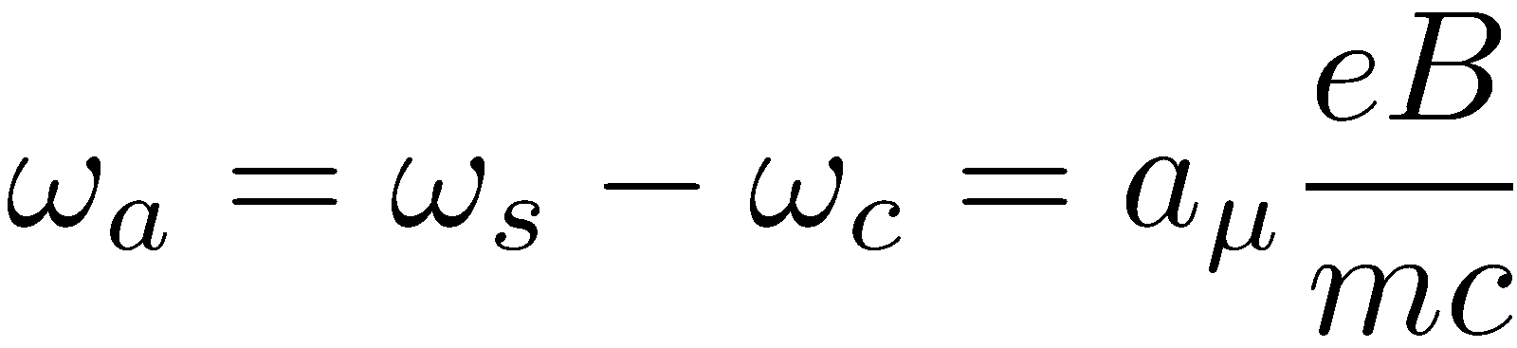

Experimental Overview
$$μ^{+}$$
Muons are stored in the storage ring ($\sim$15 m diameter) under a 1.5 T homogeneous magnetic field.
Muon spins precess at a rate: $ω_{a}$ with respect to momentum.
Measure
Extract

Slide 8
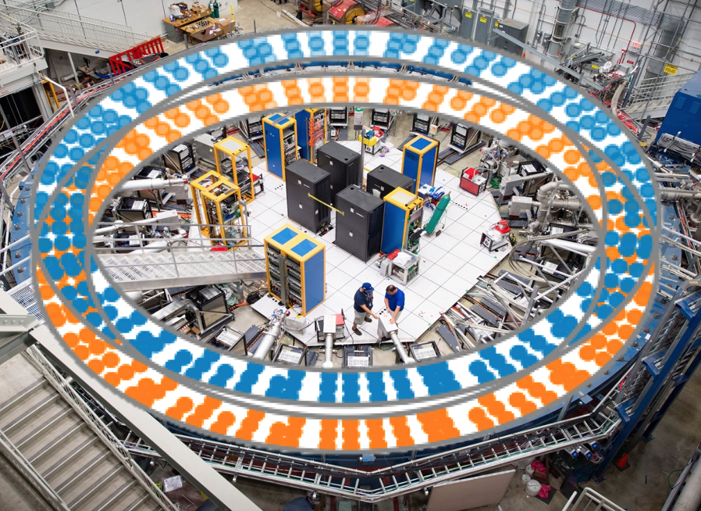
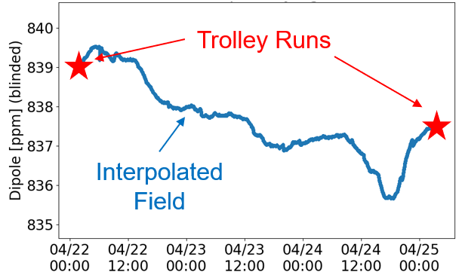
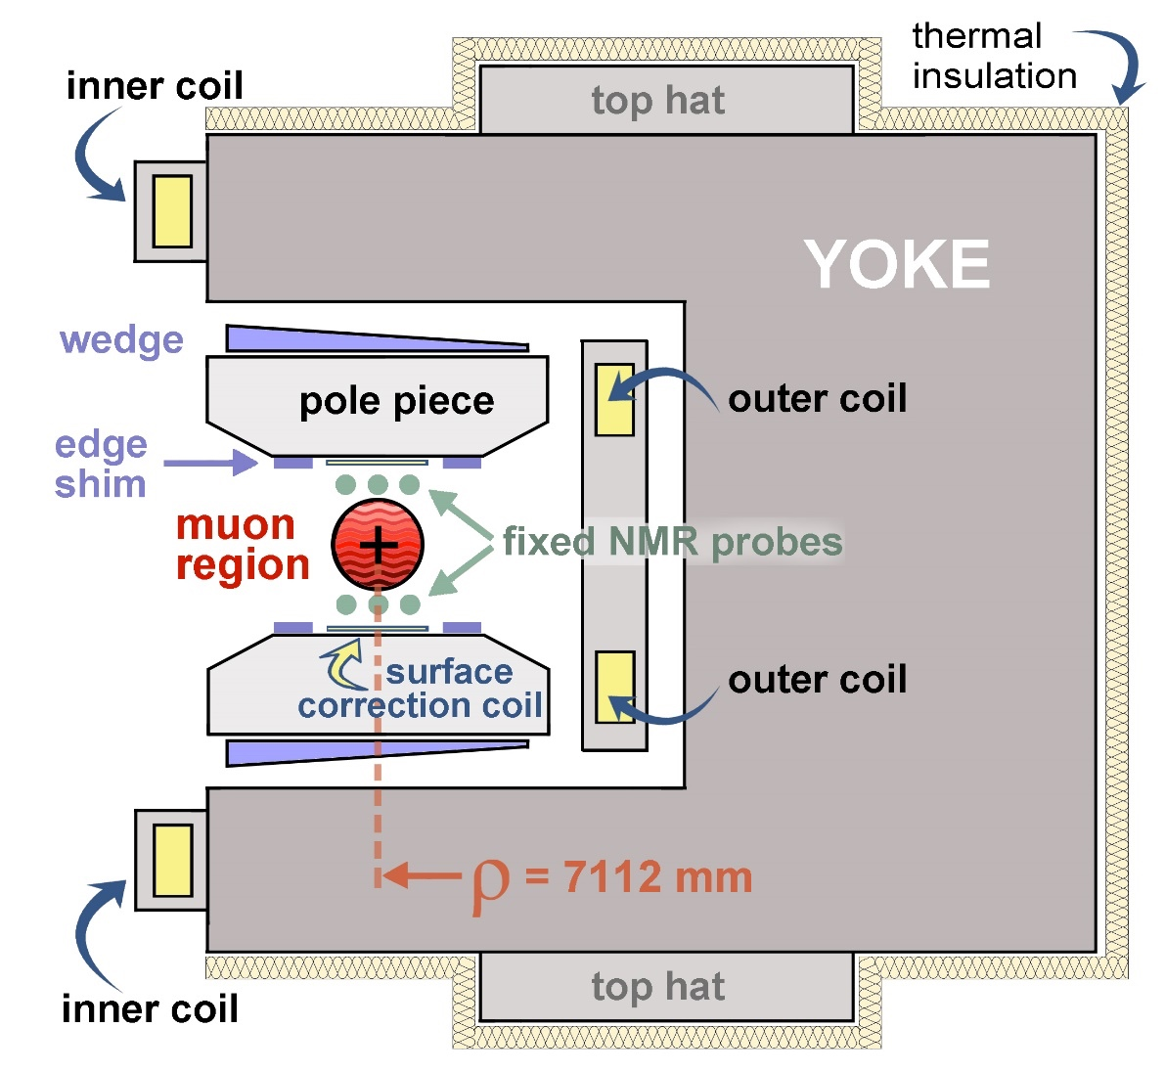
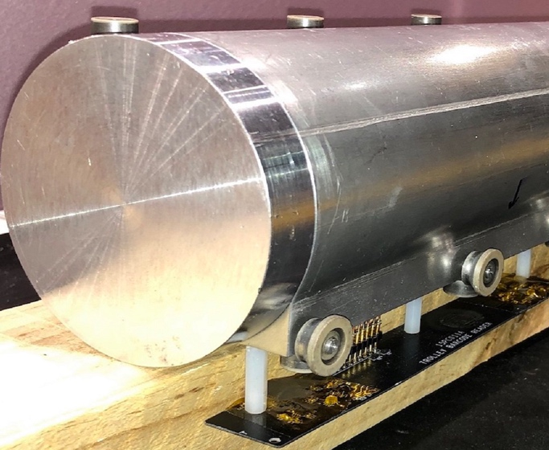
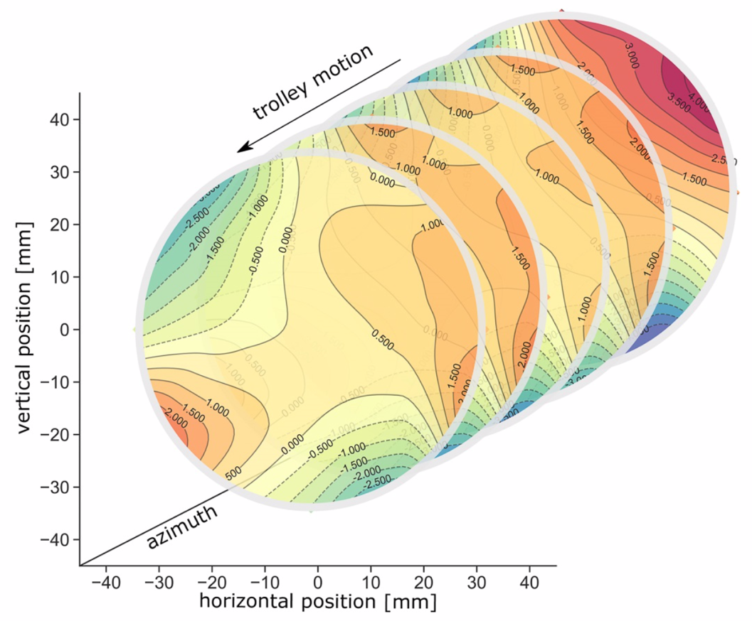
Magnetic Field
Homogeneous 1.5 T magnetic field by superconducting C-shaped magnet (sub-ppm in 9 cm diameter muon storage region).
Use NMR probes to measure the field.
  Fixed probes: 24/7
  Trolley (in vacuum): every 3-4 days
Fixed probes above/below muon storage region
B
17 petroleum jelly NMR probes.
Maps the field as it goes around the storage ring

Slide 9
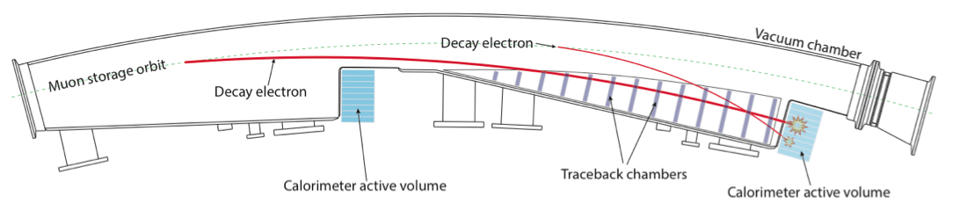
Muon Decay
$$μ^{+}$$
Detection
  Decay positrons curl into 24 electromagnetic calorimeters surrounding the storage ring.
Calorimeter station
PbF₂ crystals + SiPM

Slide 10
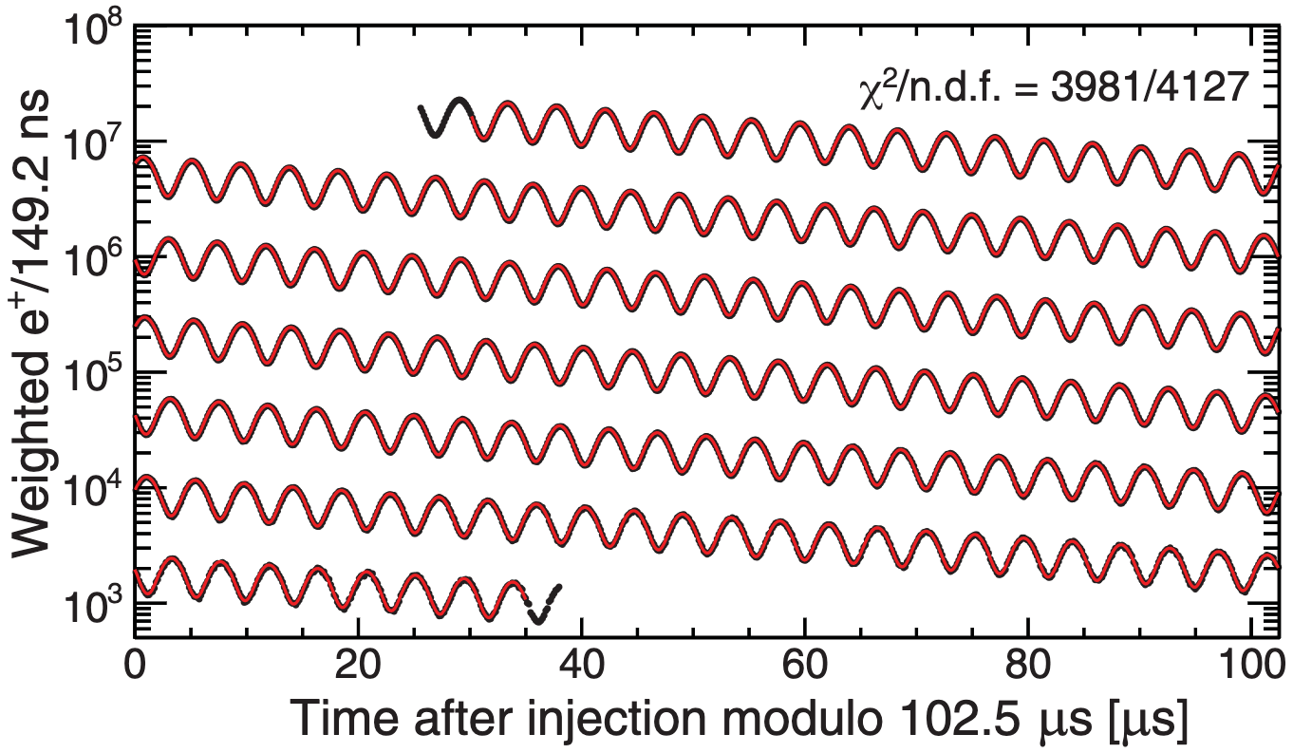
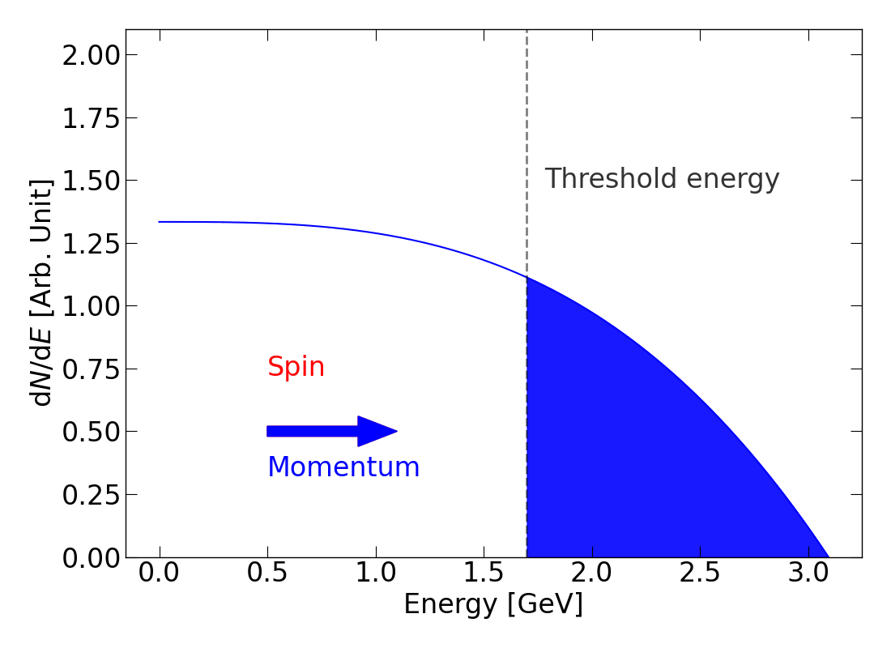


Anomalous Spin Precession of Muon
Parity-violating weak decay: $μ^{+}→e^{+}ν_{e}{\overline{ν}}_{μ}$:
high energy decay $e^{+}$ are preferentially emitted to the muon spins.
Resulting “Wiggle plot”
Fit the wiggle plot to extract $ω_{a}$ (simplified function).

Slide 11
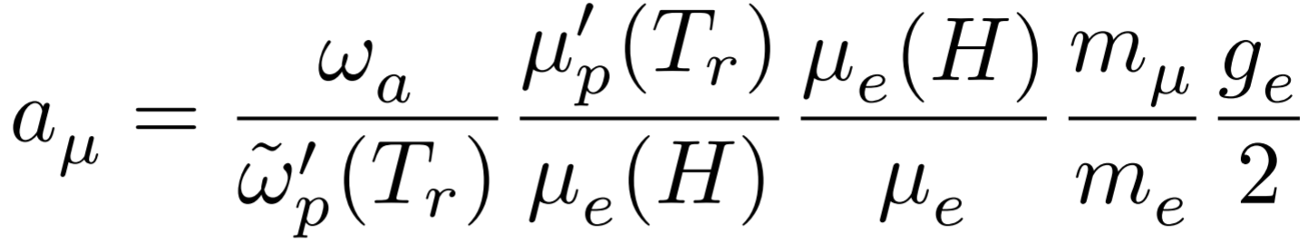
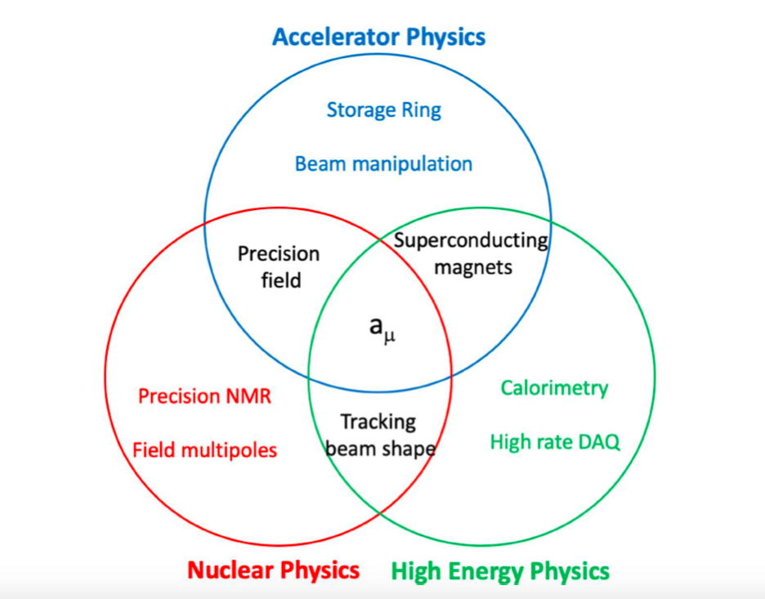
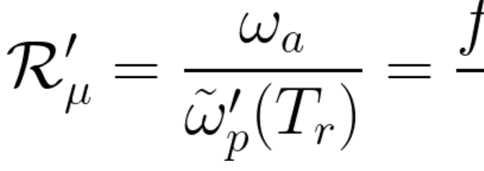
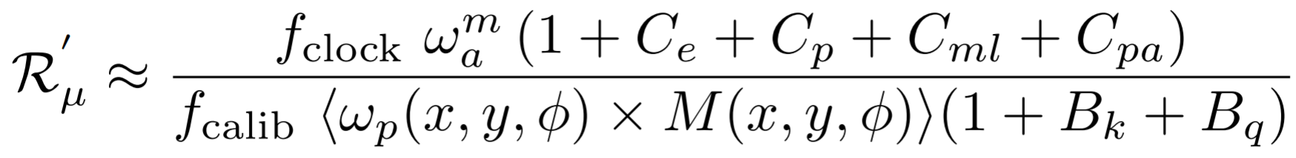
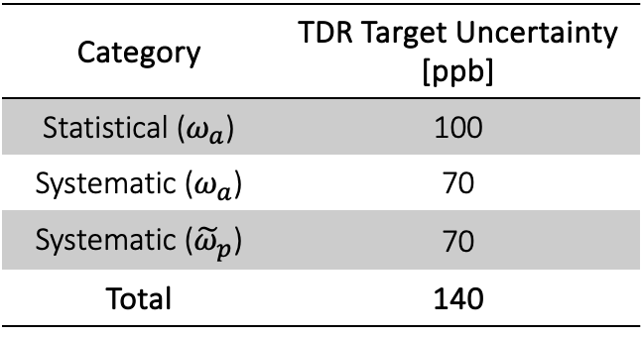
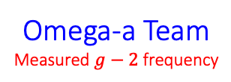
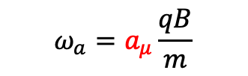
Measurement Quantity Anatomy
Known to 24 ppb
Category | TDR Target Uncertainty [ppb]
Statistical ($ω_{a}$) | 100
Systematic ($ω_{a}$) | 70
Systematic (${\tilde{ω}}_{p}$) | 70
Total | 140
What we measure.
$$ω_{a}=a_{μ}\frac{qB}{m}$$
Omega-a Team
Measured $g−2$ frequency
Beam Dynamics Team
Beam dynamics corrections
Unblinding conversion factor
Field Team
NMR probe calibration factor
Magnetic field weighted over
the muon distribution
Corrections from
the transient magnetic field
Notes:
To be more precise, the expression for a_mu is represented by this form, where the terms other than these frequencies are constants known to 24 ppb precision in total by theory or other measurements. This is negligible to meet our uncertainty goal of 140 ppb. And our measurement quantities broke down into this complicated-looking formula, but essentially the numerator part is the anomalous spin precession frequency and the denominator part is the magnetic field. In big categories, we have groups mainly working on analyzing the omega_a, working on the beam dynamics correction to omega_a, and working on the field measurement. One of the reasons why the muon g-2 experiment is fascinating is that there are various physics realms and backgrounds in our collaboration to achieve high precision in all of these measurements. Let me give you a brief idea of the procedure to measure the omega_a.

Slide 12
Progress – Analysis Focus
“You already published two results for Run-1 and 2/3, so all the analysis tools must have been already established. Isn’t it like now you just put 4/5/6 data into the machinery and get the results out right away?”
Nope, that’s not really what it looks like.
  More data gives us a better resolution for investigating systematics. We always try to comprehend the data as best as we can. It’s worthwhile to put more time/resources into understanding better!
  We also have newly introduced systems/techniques used in Run-4/5/6 data-taking and analysis. Those are supposed to improve our analysis, but they definitely need scrutiny.
  Processing more data (>5 PB of raw data for Runs-4/5/6) takes significantly more time, too. Not just for reconstructing/validating/analyzing the data, but we want to carefully do all consistency checks, e.g., across various external parameters (temperature, pressure, etc.), beam/detector parameters (energy, time, beam-condition, etc.), consistency among various simulation programs, analyzer groups, analysis methods, etc. We also undergo intense reviews on all analyses to gain more confidence.

Slide 13
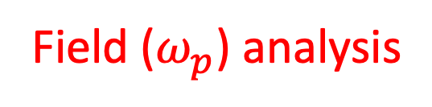
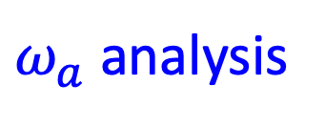
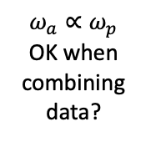
Progress – Analysis Focus
$ω_{a}$ analysis
*Definitely NOT an exhaustive list.
*Font size does NOT represent the importance/scale of the corresponding systematics.
Fit improvements
Slow variation
Muon losses
CBO
$ω_{a}∝ω_{p}$ OK when combining data?
RF/noRF
Consistency checks
Calibrations
New tracker-based analyses
Kicker transient
Simulation inconsistency
Muon weighting
COD
Quad transient
Momentum-y correlation
Beam dynamics
Field ($ω_{p}$) analysis

Slide 14
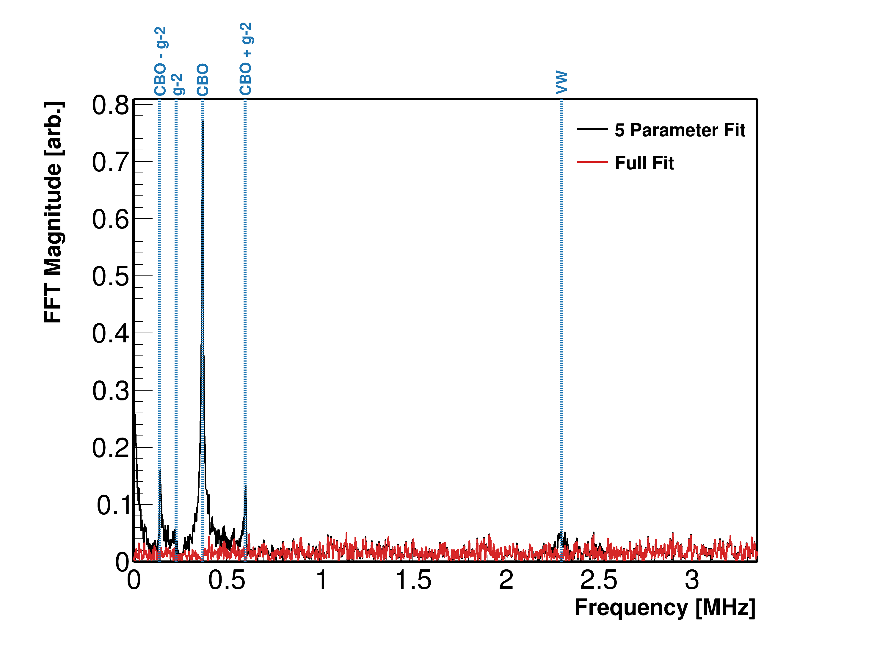
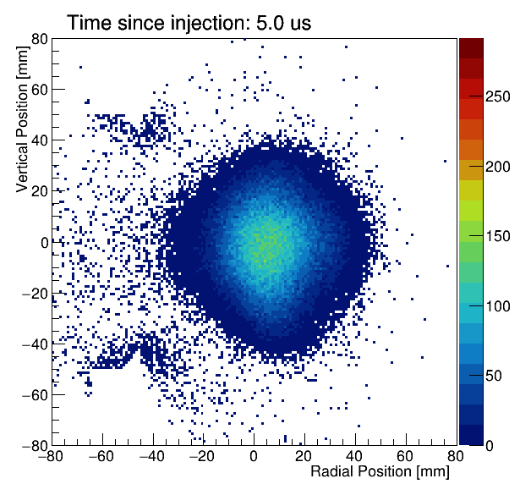

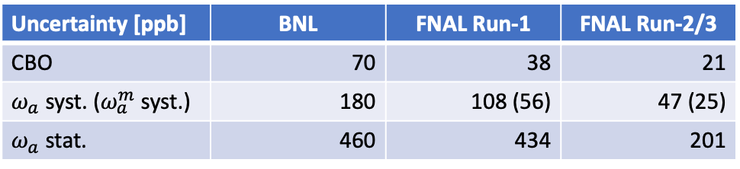
Coherent Betatron Oscillation (CBO)
FFT of fit residuals of the wiggle plot
CBO is coherent muon transverse oscillation.
It is one of the dominant $ω_{a}$ systematic sources.
Detector (Calorimeter)
Closer
Farther
Uncertainty [ppb] | BNL | FNAL Run-1 | FNAL Run-2/3
CBO | 70 | 38 | 21
$ω_{a}$ syst. ($ω_{a}^{m}$ syst.) | 180 | 108 (56) | 47 (25)
$ω_{a}$ stat. | 460 | 434 | 201

Slide 15
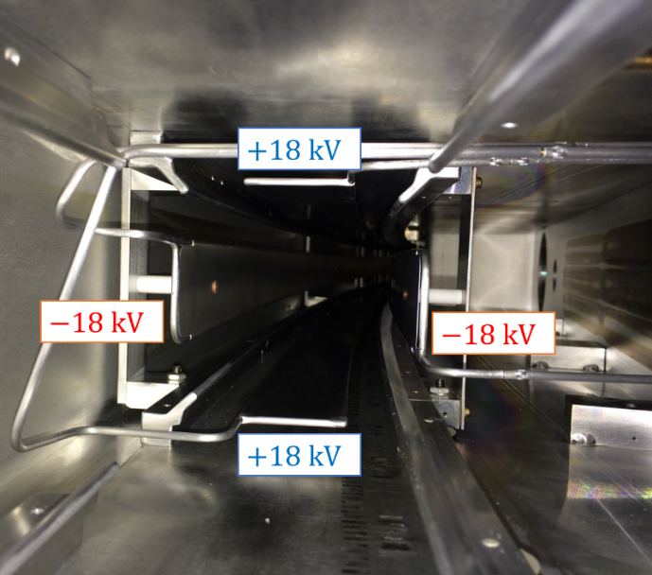
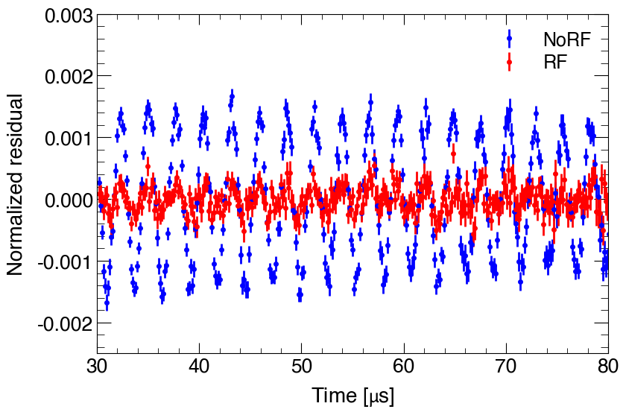
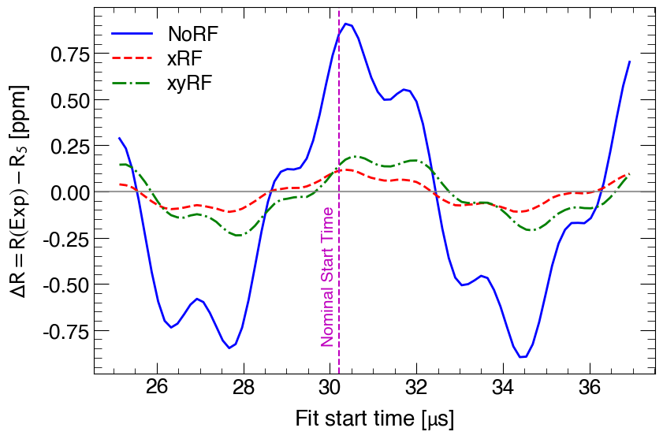
Prospect – Systematics Improvement
Implemented the RF system to reduce the CBO significantly.
Run-5/6 data (almost half of the entire data) was taken with the RF system.
Electrostatic Quadrupole + RF
CBO
CBO systematics proxy
~1kV
RF E-field
~1kV

Slide 16
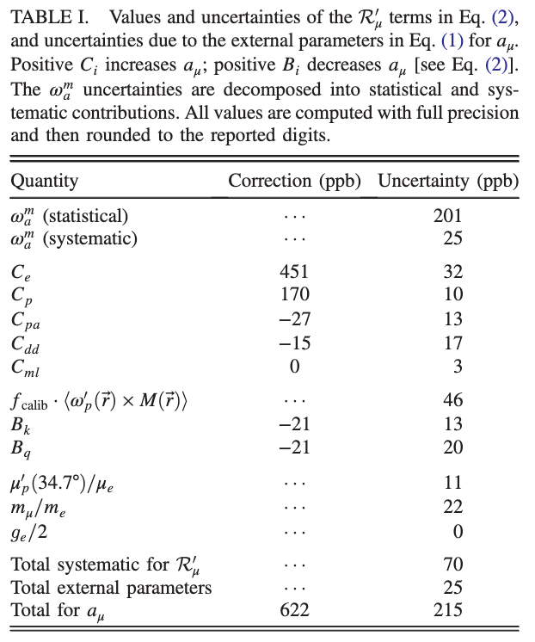



Prospect – Systematics Improvement
Run-2/3 Result: PRL 131, 161802 (2023)
Run-4/5/6 improvements
(No real estimates on systematics yet)
$\sim 100$ (in total Runs 1-6), $\sim$x4 stats
$$ω_{a}$$
$\sim$x10 reduction of CBO with the RF system (Run-5/6).
New signal processing algorithm to suppress backgrounds/sidebands.
Verification with the new beam-monitoring system (miniSciFi).
BD
New tracker-based analysis method for cross-checking.
More calibrations performed in more consistent ways + cross-calibrations.
Better understanding and handling of magnet drift.
$$ω_{p}$$
Significantly more and better measurements (spatial dependence, etc.).
We have already surpassed the TDR systematics goal of 100 ppb.
And possibly even less for Run-4/5/6!

Slide 17
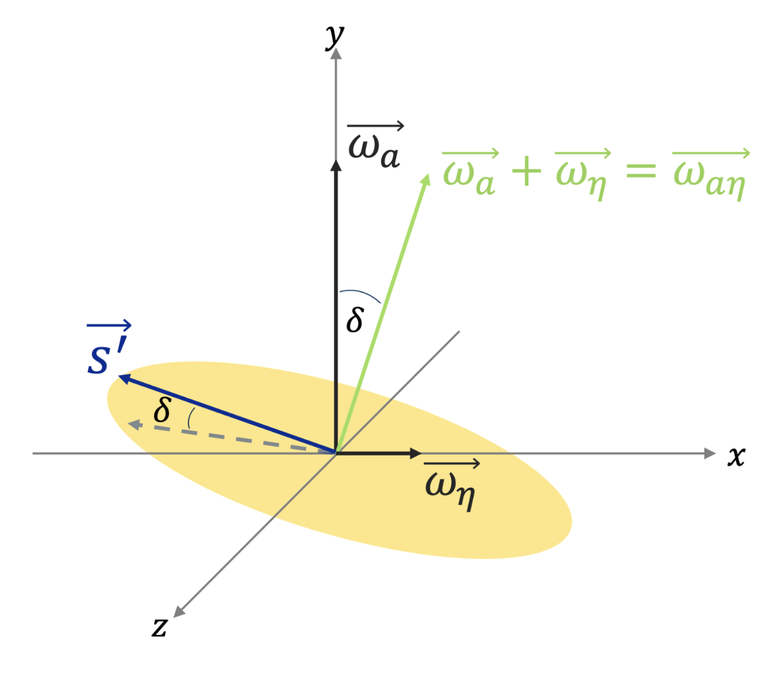
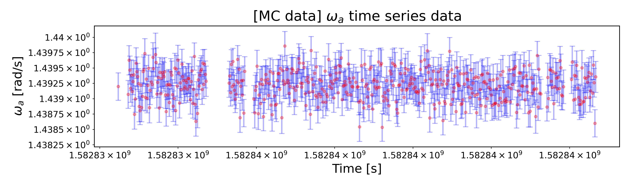


BSM Searches
Electric Dipole Moment (EDM)
  The spin precession plane is tilted in the presence of the EDM.
  Run-1 in review, Run-2/3 in progress
  Current limit (BNL): $1.8 × {10}^{−19} e⋅cm→$
  Projected limit:$≲3 × {10}^{−20} e⋅cm$
$CPT$ and Lorentz Invariance Violation
  $ω_{a}$ modulated at the sidereal motion.
  Run-2/3 in review.
  Current limit (BNL): $1.4 × {10}^{−24} GeV→$
  Projected limit (FNAL Run-2/3): $𝒪\left({10}^{−25}\right) GeV$
Ultralight Muonic Dark Matter (scalar)
  $ω_{a}$ modulated at the DM Compton frequency.
  Run-2/3 in progress.

Slide 18

Take-Home Messages
Fermilab Muon $g−2$ finished data taking in June 2023.
Comparison to the Standard Model is in a vague state at the moment. Many ongoing efforts are being made in HVP communities to scrutinize the calculations.
The final result (Run-4/5/6 data taken in 2021-2023) analysis is underway. It is anticipated that the result will be published in 2025 with $\sim$140 ppb precision.
  We met the TDR target statistics goal and likely will surpass the systematics goal.
  Many improvements have been made in systematics. For instance, Run-5/6 data was taken with the RF system, and CBO (one of the main systematic sources for $ω_{a}$) was dramatically reduced.
BSM searches are underway using our data – EDM, CPT/LIV and DM.
Run-2/3 detailed analysis report: arXiv:2402.15410 (accepted in PRD).

Slide 19













Acknowledgement
Department of Energy (USA)
National Science Foundation (USA)
Istituto Nazionale di Fisica Nucleare (Italy)
Science and Technology Facilities Council (UK)
Royal Society (UK)
Leverhulme Trust (UK)
European Union's Horizon 2020
Strong 2020 (EU)
German Research Foundation (DFG)
National Natural Science Foundation of China
MSIP, NRF and IBS-R017-D1 (Republic of Korea)

Slide 20

April 17-19, 2024 Collaboration Meeting at Argonne National Laboratory, USA
Thanks for your attention!

Slide 21
Backups

Slide 22

Analysis Chain for $ω_{a}$
Data Acquisition
Reconstruction
Data Weighting
Correction
Systematics
Histogramming
Time slices with 50 MeV threshold
Full waveform (combined into 37.5 ns bin width)
Local fitting
Global fitting
Energy-integrated (Q)
No weighting (T)
Asymmetry-weighted (A)
Ratio
Stroboscopic
Pileup
Fast Rotation
Gain
Beam Dynamics
Pileup / Gain
Slow Effects
6 independent $ω_{a}$ analysis groups (involved institutions: BU, CU, UIUC, Ole Miss, INFN, UPisa, ULiverpool, UCL, SJTU, UW, Uky)

Slide 23


Slide 24
~14 ppm

Slide 25


Experimental Overview
Muon $g−2$ Storage Ring
  Radius: 7.112 m.
  Homogeneous magnetic field: 1.45 T.

Slide 26


Experimental Overview
$$μ^{+}$$
Injection
  A polarized anti-muon beam (3.1 GeV) is injected into the storage ring through a superconducting inflector magnet.
  It cancels the main magnetic field to inject the beam tangentially.

Slide 27

Experimental Overview
$$μ^{+}$$
Kick
  The fast non-ferric kicker magnet system kicks the muons onto the design orbit.

Slide 28
Experimental Overview
$$μ^{+}$$
Vertical Focusing
  The Electrostatic Quadrupoles (ESQ) focuses the beam vertically.
  Four Quadrupole sections cover 43% of the circumference.
S
L

Slide 29


Anomalous Spin Precession of Muon
Parity-violating weak decay: $μ^{+}→e^{+}ν_{e}{\overline{ν}}_{μ}$:
high energy decay $e^{+}$ are preferentially emitted to the muon spins.
Resulting “Wiggle plot”
Fit the wiggle plot to extract $ω_{a}$.

Slide 30

E-field & Up/Down motion: Spin precesses slower than in basic equation
Phase changes over each fill:
Phase-Acceptance, Differential Decay, Muon Losses
Transient Magnetic Fields:
Quad Vibrations,
Kicker Eddy Current,
Measured Values

Slide 31


Uncertainty Improvements Summary
Systematic improvements in all parameters
Analysis Improvements
Running Conditions
Improved Measurements
After improvements, total systematic comes from multiple sources

Slide 32
Completed Analysis & Documentation
Internal Group Review
External Review
Collaboration Review
Global Review
Unblinding

