Slide 1

Report from DOE
Regina Rameika
Associate Director of the Office of Science
for High Energy Physics
2024 Fermilab Users Meeting
July 12, 2024
energy.gov/science

Slide 2
Outline
Intro and update from Office of High Energy Physics
Brief recap of the 2023 P5 process
DOE General Response to recommendations
Specific Response to Recommendations involving FNAL
Outlook on Budgets
Conclusions

Slide 3
Office of High Energy Physics at a Glance
FY 2024 Enacted: $1.2B
Largest Supporter (~85%) of Particle Physics in the U.S.
Research:
36%, $426.3M
~30% of Research to Universities
[Snowmass, July 2022, Seattle]
Over 1,120 Ph.D. Scientists and 515 Grad Students Supported
[Vera Rubin Observatory, Chile]
Facility Operations:
29%, $348.5M
[LBNF/DUNE Cavern, SURF, SD]
Projects:
35%, $425.2M
[Fermilab Accelerator Complex]
Over 2,345 Users at
2 SC Scientific Facilities
Funding at >180 Institutions, including 12 DOE Labs

Slide 4
Office of Science
Director (Acting)
Harriet Kung
Deputy Director for Science Programs
Harriet Kung
Deputy Director for Operations
Juston Fontaine
Advanced Scientific Computing Research
Office of Equity and Workforce Development
Ames Site Office
Science Laboratories Infrastructure
Office of Workforce Development for Teachers & Scientists
Argonne Site Office
Basic Energy Sciences
Berkeley Site Office
Office of Isotope R&D and Production
Office of International Activities, Research Security, and Interagency Coordination
Office of Information Management
Biological & Environmental Research
Office of Scientific Workforce Diversity, Equity & Inclusion
Brookhaven Site Office
Office of Safety & Security
Office of Communications & Public Affairs
Fermi Site Office
Office of Budget
Office of Acquisition Management
Fusion Energy Sciences
ORNL Site Office
Pacific Northwest Site Office
Office of Laboratory Policy
Office of Resource Management
High Energy Physics
Office of Scientific & Technical Information
Princeton Site Office
Consolidated Service Center
Nuclear Physics
Office of Project Assessment
Office of Sponsored Activities
SLAC Site Office
Office of Corporate Business Operations
Accelerator R&D and Production
Thomas Jefferson Site Office
Office of Small Business Innovation Research and Small Business Technology Transfer

Slide 5
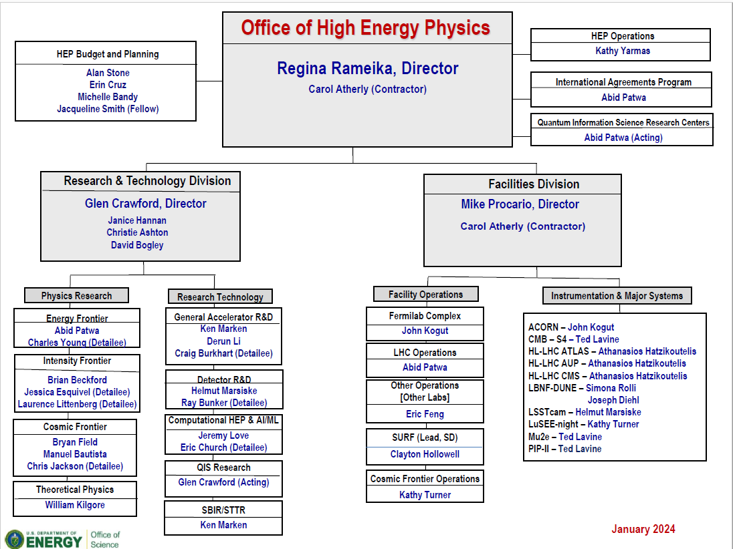
Previous HEP Org Chart

Slide 6
HEP Budget and Planning
Michelle Bandy
Erin Cruz
Alan Stone
Office of High Energy Physics
Regina Rameika, Director
Eric Colby, Sr. Technical Advisor
Carol Atherly, Administrative Support (CONTR)
Janice Hannan, Administrative Support
HEP Support
Christie Ashton
David Bogley
Kathy Yarmas
International Cooperation
Abid Patwa
Broadening Engagement
Alan Stone
Jacqueline Smith (AAAS Fellow)
Accelerator and Technology Division
Regina Rameika, Acting Director
Research Division
Glen Crawford, Director
Facilities and Projects Division
Michael Procario, Director
Accelerator Programs
Camille Ginsburg
Derun Li
Ken Marken
Craig Burkhart (Detailee)
Christine Clarke (Detailee)
Roark Marsh (Detailee)
Energy Frontier
Abid Patwa
Charles Young (Detailee)
Facility Lab Operations
Eric Feng (FACET-II, DUNE, NERSC)
Clayton Hallowell (SURF)
John Kogut (FNAL, BNL, SLAC, LBNL)
Abid Patwa (LHC, ANL)
Kathy Turner (Cosmic Experiments)
Intensity Frontier
Brian Beckford
Jessica Esquival (Detailee)
Laurence Littenberg (Detailee)
Instrumentation and Detector R&D
Helmut Marsiske
Ray Bunker (Detailee)
Projects
Joseph Diehl (LBNF/DUNE)
Athans Hatzikoutelis (HL LHC)
John Kogut (ACORN)
Ted Lavine (mu2e, CMB-S4)
Simona Rolli (LBNF/DUNE)
Kathy Turner (LuSEE night, DMNI)
Cosmic Frontier
Manuel Bautista
Bryan Field
Kathy Turner
Chris Jackson (Detailee)
QIS, AI/ML, Computational HEP
Jeremy Love
Z. Gott-Eldridge, (Glen Crawford & Abid Patwa)
Eric Church (Detailee)
Theory
William Kilgore
AGILE
Glen Crawford

Slide 7
Introducing the Accelerator and Technology Division (ATD)
SC Program Offices
BES
Accelerator and Technology Division
Regina Rameika, Acting Director
Research Division
Glen Crawford, Director
NP
FES
Accelerator Programs
Camille Ginsburg
Derun Li
Ken Marken
Craig Burkhart (Detailee)
Christine Clarke (Detailee)
Roark Marsh (Detailee)
Energy Frontier
Abid Patwa
Charles Young (Detailee)
ASCR
Intensity Frontier
Brian Beckford
Jessica Esquival (Detailee)
Laurence Littenberg (Detailee)
SC
Microelectronics
Instrumentation and Detector R&D
Helmut Marsiske
Ray Bunker (Detailee)
Cosmic Frontier
Manuel Bautista
Bryan Field
Kathy Turner
Chris Jackson (Detailee)
SC Working Groups
QIS, AI/ML, Computational HEP
Jeremy Love
Z. Gott-Eldridge, Glen Crawford & Abid Patwa
Eric Church (Detailee)
QIS
Theory
William Kilgore
AGILE
Glen Crawford
AI/ML

Slide 8




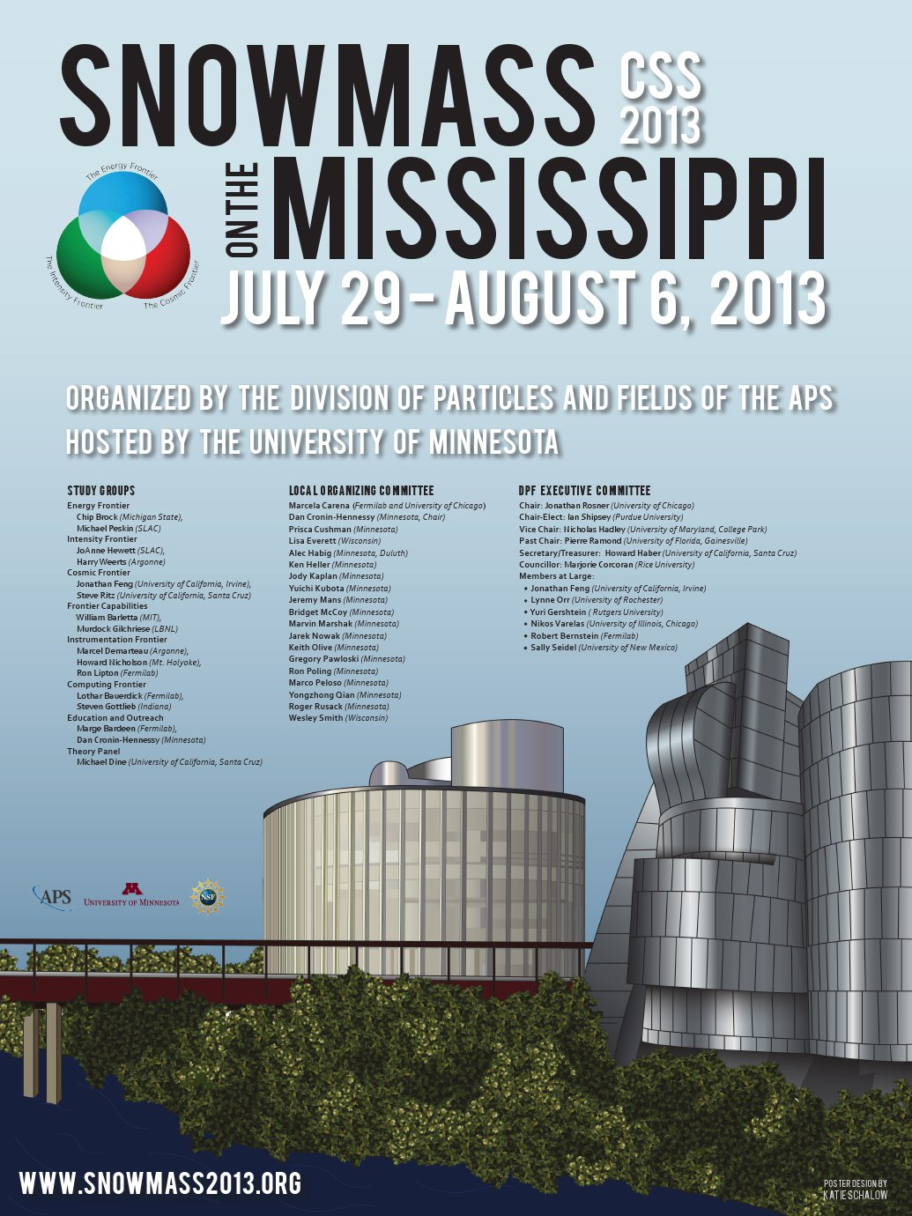

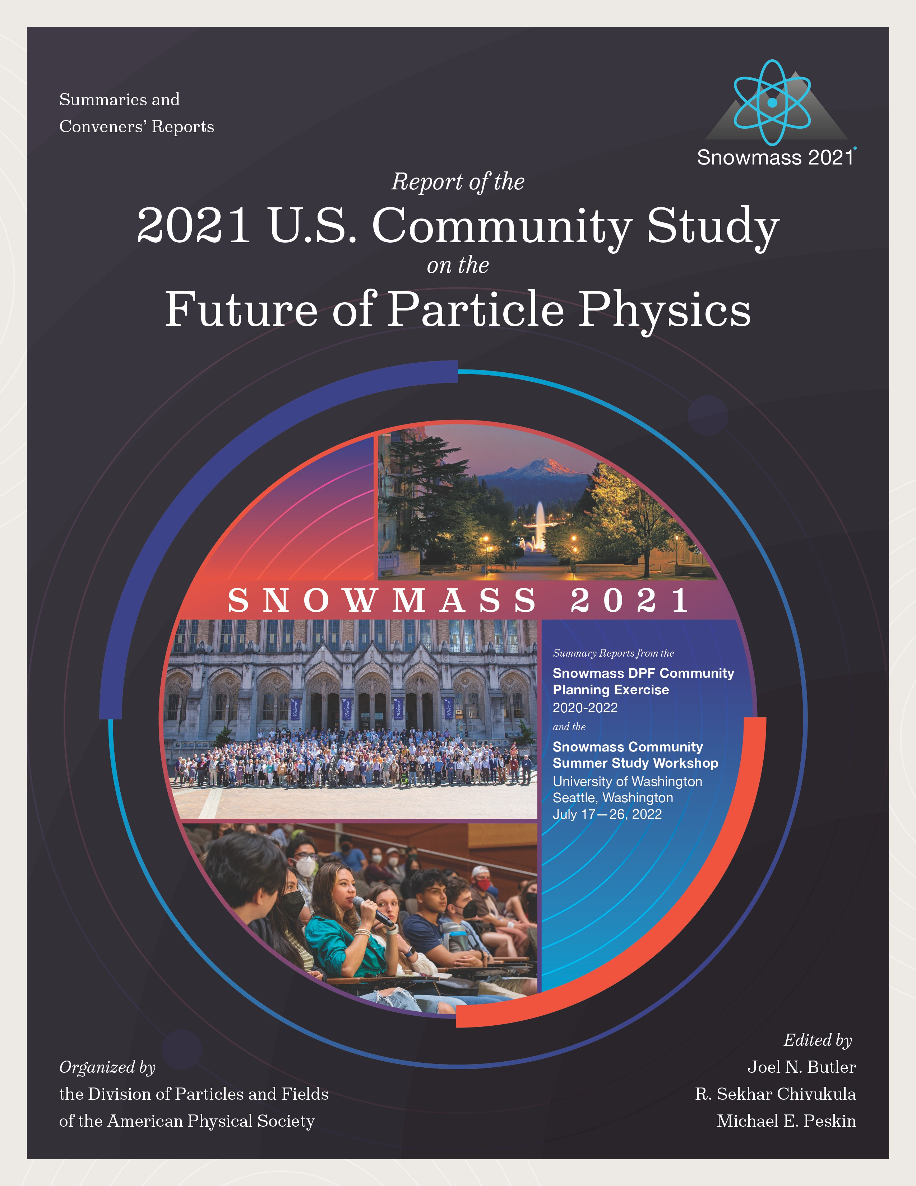
U.S. Particle Physics Strategic Planning Process
2008
2014
2023

Slide 9
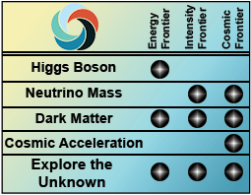






Evolution of the key questions in particle physics
2008 Frontiers
2014 Science Drivers
2023 Science Drivers
2008 Frontiers of
Particle Physics

Slide 10
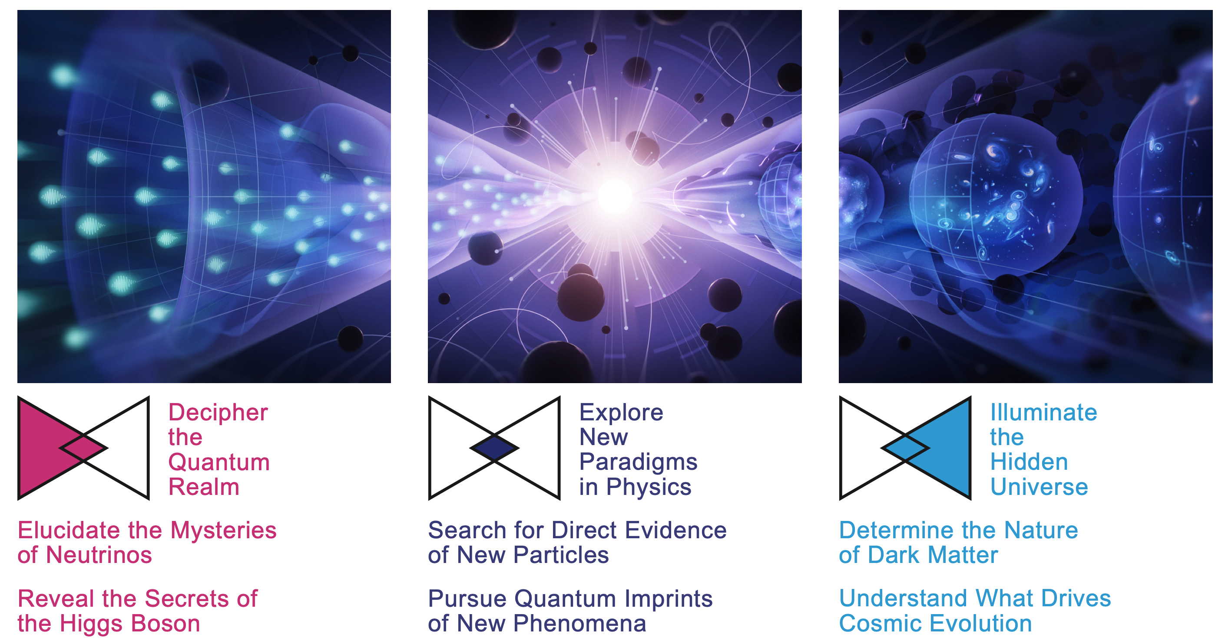
P5 2023 Science Drivers

Slide 11
2023 P5 Recommendation 1
As the highest priority independent of the budget scenarios, complete construction projects and support operations of ongoing experiments and research to enable maximum science. We reaffirm the previous P5 recommendations on major initiatives:
  HL-LHC (including ATLAS and CMS detectors, as well as Accelerator Upgrade Project) to start addressing why the Higgs boson condensed in the universe (reveal the secrets of the Higgs boson, section 3.2), to search for direct evidence for new particles (section 5.1), to pursue quantum imprints of new phenomena (section 5.2), and to determine the nature of dark matter (section 4.1).
  The first phase of DUNE and PIP-II to determine the mass ordering among neutrinos, a fundamental property and a crucial input to cosmology and nuclear science (elucidate the mysteries of neutrinos, section 3.1).
  The Vera C. Rubin Observatory to carry out the Legacy Survey of Space and Time (LSST), and the LSST Dark Energy Science Collaboration, to understand what drives cosmic evolution (section 4.2).
  In addition, we recommend continued support for the following ongoing experiments at the medium scale (project costs > $50M for DOE and > $4M for NSF), including completion of construction, operations and research on:
    NOvA, SBN, and T2K (elucidate the mysteries of neutrinos, section 3.1).
    DarkSide-20k, LZ, SuperCDMS, and XENONnT (determine the nature of dark matter, section 4.1).
    DESI (understand what drives cosmic evolution, section 4.2).
    Belle II, LHCb, and Mu2e (pursue quantum imprints of new phenomena, section 5.2).

Slide 12
2023 P5 Recommendation 1
As the highest priority independent of the budget scenarios, complete construction projects and support operations of ongoing experiments and research to enable maximum science. We reaffirm the previous P5 recommendations on major initiatives:
  HL-LHC (including ATLAS and CMS detectors, as well as Accelerator Upgrade Project) to start addressing why the Higgs boson condensed in the universe (reveal the secrets of the Higgs boson, section 3.2), to search for direct evidence for new particles (section 5.1), to pursue quantum imprints of new phenomena (section 5.2), and to determine the nature of dark matter (section 4.1).
  The first phase of DUNE and PIP-II to determine the mass ordering among neutrinos, a fundamental property and a crucial input to cosmology and nuclear science (elucidate the mysteries of neutrinos, section 3.1).
  The Vera C. Rubin Observatory to carry out the Legacy Survey of Space and Time (LSST), and the LSST Dark Energy Science Collaboration, to understand what drives cosmic evolution (section 4.2).
  In addition, we recommend continued support for the following ongoing experiments at the medium scale (project costs > $50M for DOE and > $4M for NSF), including completion of construction, operations and research on:
    NOvA, SBN, and T2K (elucidate the mysteries of neutrinos, section 3.1).
    DarkSide-20k, LZ, SuperCDMS, and XENONnT (determine the nature of dark matter, section 4.1).
    DESI (understand what drives cosmic evolution, section 4.2).
    Belle II, LHCb, and Mu2e (pursue quantum imprints of new phenomena, section 5.2).

Slide 13
2023 P5 Recommendation 1
As the highest priority independent of the budget scenarios, complete construction projects and support operations of ongoing experiments and research to enable maximum science. We reaffirm the previous P5 recommendations on major initiatives:
  HL-LHC (including ATLAS and CMS detectors, as well as Accelerator Upgrade Project) to start addressing why the Higgs boson condensed in the universe (reveal the secrets of the Higgs boson, section 3.2), to search for direct evidence for new particles (section 5.1), to pursue quantum imprints of new phenomena (section 5.2), and to determine the nature of dark matter (section 4.1).
  The first phase of DUNE and PIP-II to determine the mass ordering among neutrinos, a fundamental property and a crucial input to cosmology and nuclear science (elucidate the mysteries of neutrinos, section 3.1).
  The Vera C. Rubin Observatory to carry out the Legacy Survey of Space and Time (LSST), and the LSST Dark Energy Science Collaboration, to understand what drives cosmic evolution (section 4.2).
  In addition, we recommend continued support for the following ongoing experiments at the medium scale (project costs > $50M for DOE and > $4M for NSF), including completion of construction, operations and research on:
    NOvA, SBN, and T2K (elucidate the mysteries of neutrinos, section 3.1).
    DarkSide-20k, LZ, SuperCDMS, and XENONnT (determine the nature of dark matter, section 4.1).
    DESI (understand what drives cosmic evolution, section 4.2).
    Belle II, LHCb, and Mu2e (pursue quantum imprints of new phenomena, section 5.2).

Slide 14
Recommendation 2
In priority order
Construct a portfolio of major projects that collectively study nearly all fundamental constituents of our universe and their interactions, as well as how those interactions determine both the cosmic past and future. These projects have the potential to transcend and transform our current paradigms. They inspire collaboration and international cooperation in advancing the frontiers of human knowledge.
  CMB-S4, which looks back at the earliest moments of the universe to probe physics at the highest energy scales. It is critical to install telescopes at and observe from both the South Pole and Chile sites to achieve the science goals (section 4.2).
  Re-envisioned second phase of DUNE with an early implementation of an enhanced 2.1 MW beam (ACE-MIRT), a third far detector, and an upgraded near-detector complex as the definitive long-baseline neutrino oscillation experiment of its kind (section 3.1).
  An off-shore Higgs factory, realized in collaboration with international partners, in order to reveal the secrets of the Higgs boson. The current designs of FCC-ee and ILC meet our scientific requirements. The US should actively engage in feasibility and design studies. Once a specific project is deemed feasible and well-defined (see also Recommendation 6), the US should aim for a contribution at funding levels commensurate to that of the US involvement in the LHC and HL-LHC, while maintaining a healthy US on-shore program in particle physics (section 3.2).
  An ultimate Generation 3 (G3) dark matter direct detection experiment reaching the neutrino fog, in coordination with international partners and preferably sited in the US (section 4.1).
  IceCube-Gen2 for study of neutrino properties using non-beam neutrinos complementary to DUNE and for indirect detection of dark matter covering higher mass ranges using neutrinos as a tool (section 4.1).

Slide 15
Recommendation 2
In priority order
Construct a portfolio of major projects that collectively study nearly all fundamental constituents of our universe and their interactions, as well as how those interactions determine both the cosmic past and future. These projects have the potential to transcend and transform our current paradigms. They inspire collaboration and international cooperation in advancing the frontiers of human knowledge.
  CMB-S4, which looks back at the earliest moments of the universe to probe physics at the highest energy scales. It is critical to install telescopes at and observe from both the South Pole and Chile sites to achieve the science goals (section 4.2).
  Re-envisioned second phase of DUNE with an early implementation of an enhanced 2.1 MW beam (ACE-MIRT), a third far detector, and an upgraded near-detector complex as the definitive long-baseline neutrino oscillation experiment of its kind (section 3.1).
  An off-shore Higgs factory, realized in collaboration with international partners, in order to reveal the secrets of the Higgs boson. The current designs of FCC-ee and ILC meet our scientific requirements. The US should actively engage in feasibility and design studies. Once a specific project is deemed feasible and well-defined (see also Recommendation 6), the US should aim for a contribution at funding levels commensurate to that of the US involvement in the LHC and HL-LHC, while maintaining a healthy US on-shore program in particle physics (section 3.2).
  An ultimate Generation 3 (G3) dark matter direct detection experiment reaching the neutrino fog, in coordination with international partners and preferably sited in the US (section 4.1).
  IceCube-Gen2 for study of neutrino properties using non-beam neutrinos complementary to DUNE and for indirect detection of dark matter covering higher mass ranges using neutrinos as a tool (section 4.1).

Slide 16
Recommendation 3
Create an improved balance between small-, medium-, and large-scale projects to open new scientific opportunities and maximize their results, enhance workforce development, promote creativity, and compete on the world stage.
  Implement a new small-project portfolio at DOE, Advancing Science and Technology through Agile Experiments (ASTAE), across science themes in particle physics with a competitive program and recurring funding opportunity announcements. This program should start with the construction of experiments from the Dark Matter New Initiatives (DMNI) by DOE-HEP (section 6.2).
  Continue Mid-Scale Research Infrastructure (MSRI) and Major Research Instrumentation (MRI) programs as a critical component of the NSF research and project portfolio.
  Support DESI-II for cosmic evolution, LHCb upgrade II and Belle II upgrade for quantum imprints, and US contributions to the global Cherenkov Telescope Array (CTA) Observatory for dark matter (sections 4.2, 5.2, and 4.1). Support for Belle-II includes contribution to SuperKEKB .
    DESI*-II
    LHCb
    Belle-II*, SuperKEKB
    CTA
* Fall into the DOE portfolio

Slide 17
General response to recommendations 1, 2, and 3
Recommendation 1 :
  DOE fully supports this recommendation and puts it as the highest priority in planning our allocation of funding.
Recommendation 2 :
    DOE forwarded each of the projects listed in red on slide 7 to the Facilities sub-panel
    These are all large undertakings and careful planning of what we can do is required
Recommendation 3 :
  DOE will implement and execute a plan to accommodate the ASTAE recommendation
  DOE will NOT support scope towards the LHCb Upgrade II
  DOE will continue to meet its commitments to Belle-II; contributions towards SuperKEKB will be considered in the context of accelerator R&D toward e+e- luminosity improvements
  DOE will work with the DESI Collaboration to carefully decide a scope, schedule and cost envelope for a DESI-II upgrade

Slide 18
Off-shore Higgs Factory
From P5 Recommendation 2, Priority 3 out of 5:
An off-shore Higgs factory, realized in collaboration with international partners, in order to reveal the secrets of the Higgs boson. The current designs of FCC-ee and ILC meet our scientific requirements. The US should actively engage in feasibility and design studies. Once a specific project is deemed feasible and well-defined (see also P5 Recommendation 6), the US should aim for a contribution at funding levels commensurate to that of the US involvement in the LHC and HL-LHC, while maintaining a healthy US on-shore program in particle physics (section 3.2).

Slide 19
P5 Recommendation 6
Convene a targeted panel with broad membership across particle physics later this decade that makes decisions on the US accelerator-based program at the time when major decisions concerning an off-shore Higgs factory are expected, and/or significant adjustments within the accelerator-based R&D portfolio are likely to be needed. A plan for the Fermilab accelerator complex consistent with the long-term vision in this report should also be reviewed.
  The panel would consider the following: The level and nature of US contribution in a specific Higgs factory including an evaluation of the associated schedule, budget, and risks once crucial information becomes available.
  The panel would consider the following: Mid- and large-scale test and demonstrator facilities in the accelerator and collider R&D portfolios.
  The panel would consider the following: A plan for the evolution of the Fermilab accelerator complex consistent with the long-term vision in this report, which may commence construction in the event of a more favorable budget situation.
DOE does not envision a single panel to address this recommendation; rather we will work
with NSF, the DOE national laboratories, and the community at-large to convene three
separate panels that each will address one of the above topics.

Slide 20
DOE Initial Response and Actions regarding Higgs Factory
Last year and earlier this year, KEK (Japan) requested that DOE support ILC development efforts through the ILC Technology Network (ITN)
  DOE has decided that we — including our DOE national laboratories — will be observers and not officially join the ITN
In February 2024, we presented our approach to MEXT (Japan) to be observers in the ITN while considering, at some fraction, associated R&D efforts under our existing U.S.-Japan Cooperation Program in HEP
In March 2024, we presented DOE’s view on participating in any potential FCC-ee to the CERN Council

Slide 21
U.S.-CERN Statement of Intent (I)
Through interagency coordination in the U.S., led by The White House Office of Science and Technology Policy (OSTP) and which included the U.S. Department of State, DOE, the National Science Foundation, and NASA, a Statement of Intent was signed at The White House in April 2024 between the U.S. Government and CERN
  Among the topics, the Statement expresses an intent for the United States to collaborate on the FCC-ee should the CERN Member States determine it is likely to be CERN’s next research facility following the HL-LHC
  It also reaffirms our continued collaboration in the ongoing FCC feasibility study

Slide 22
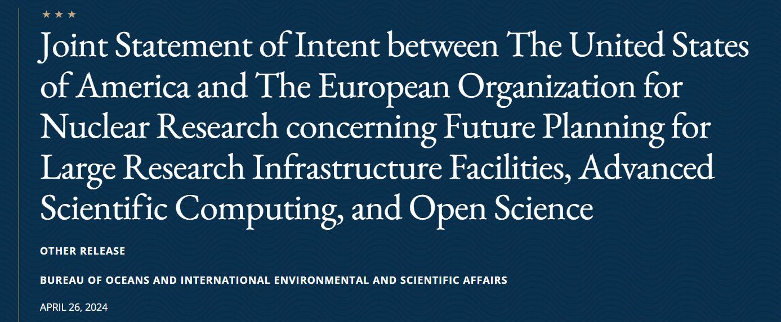
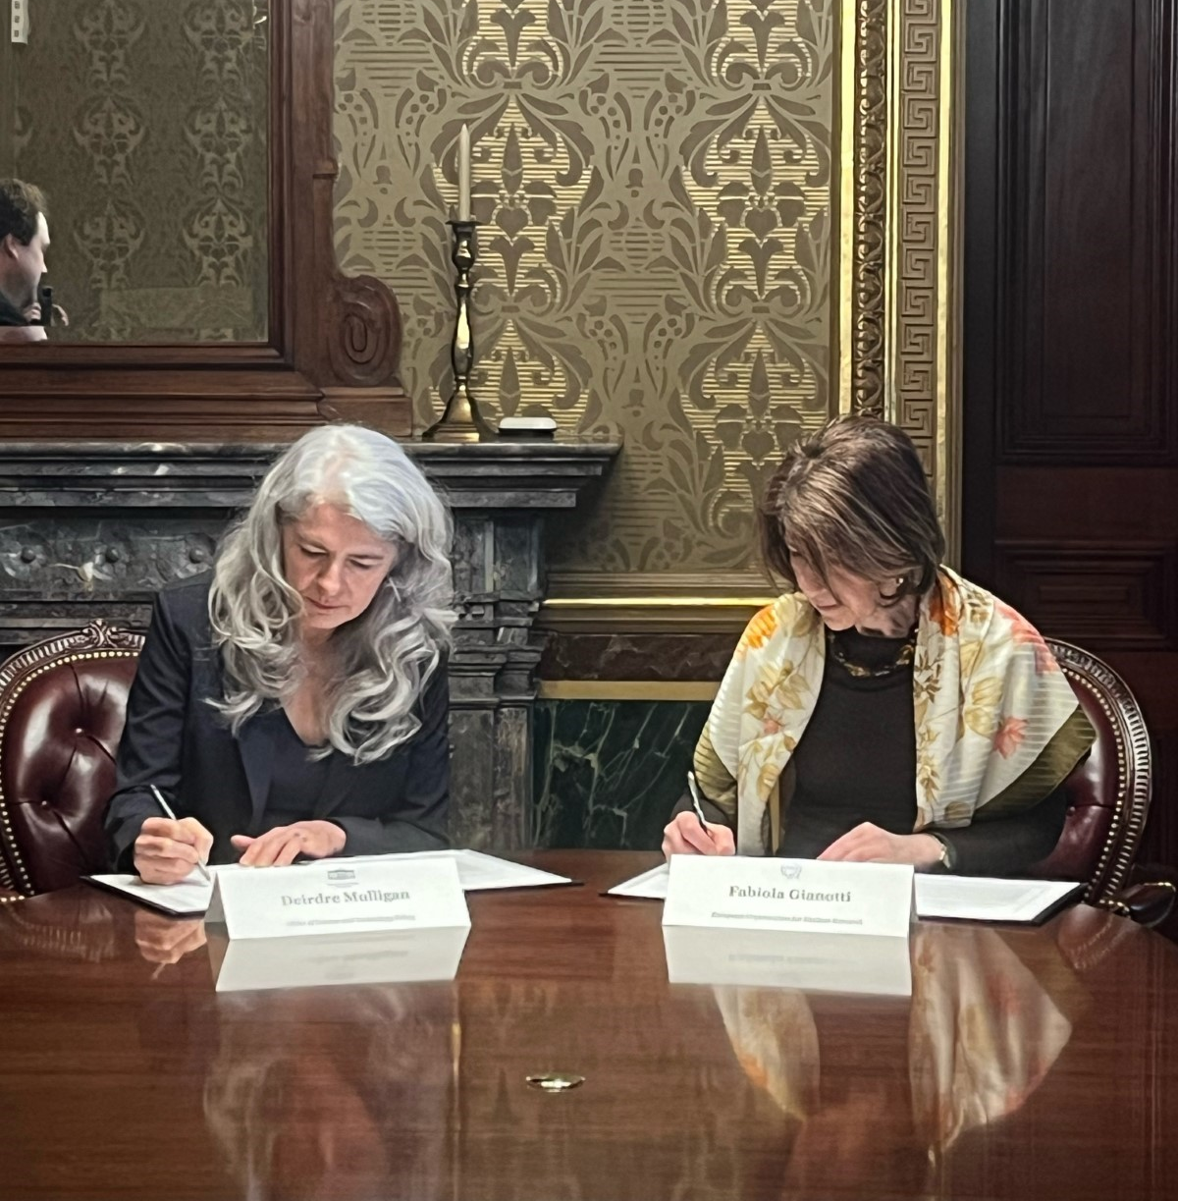
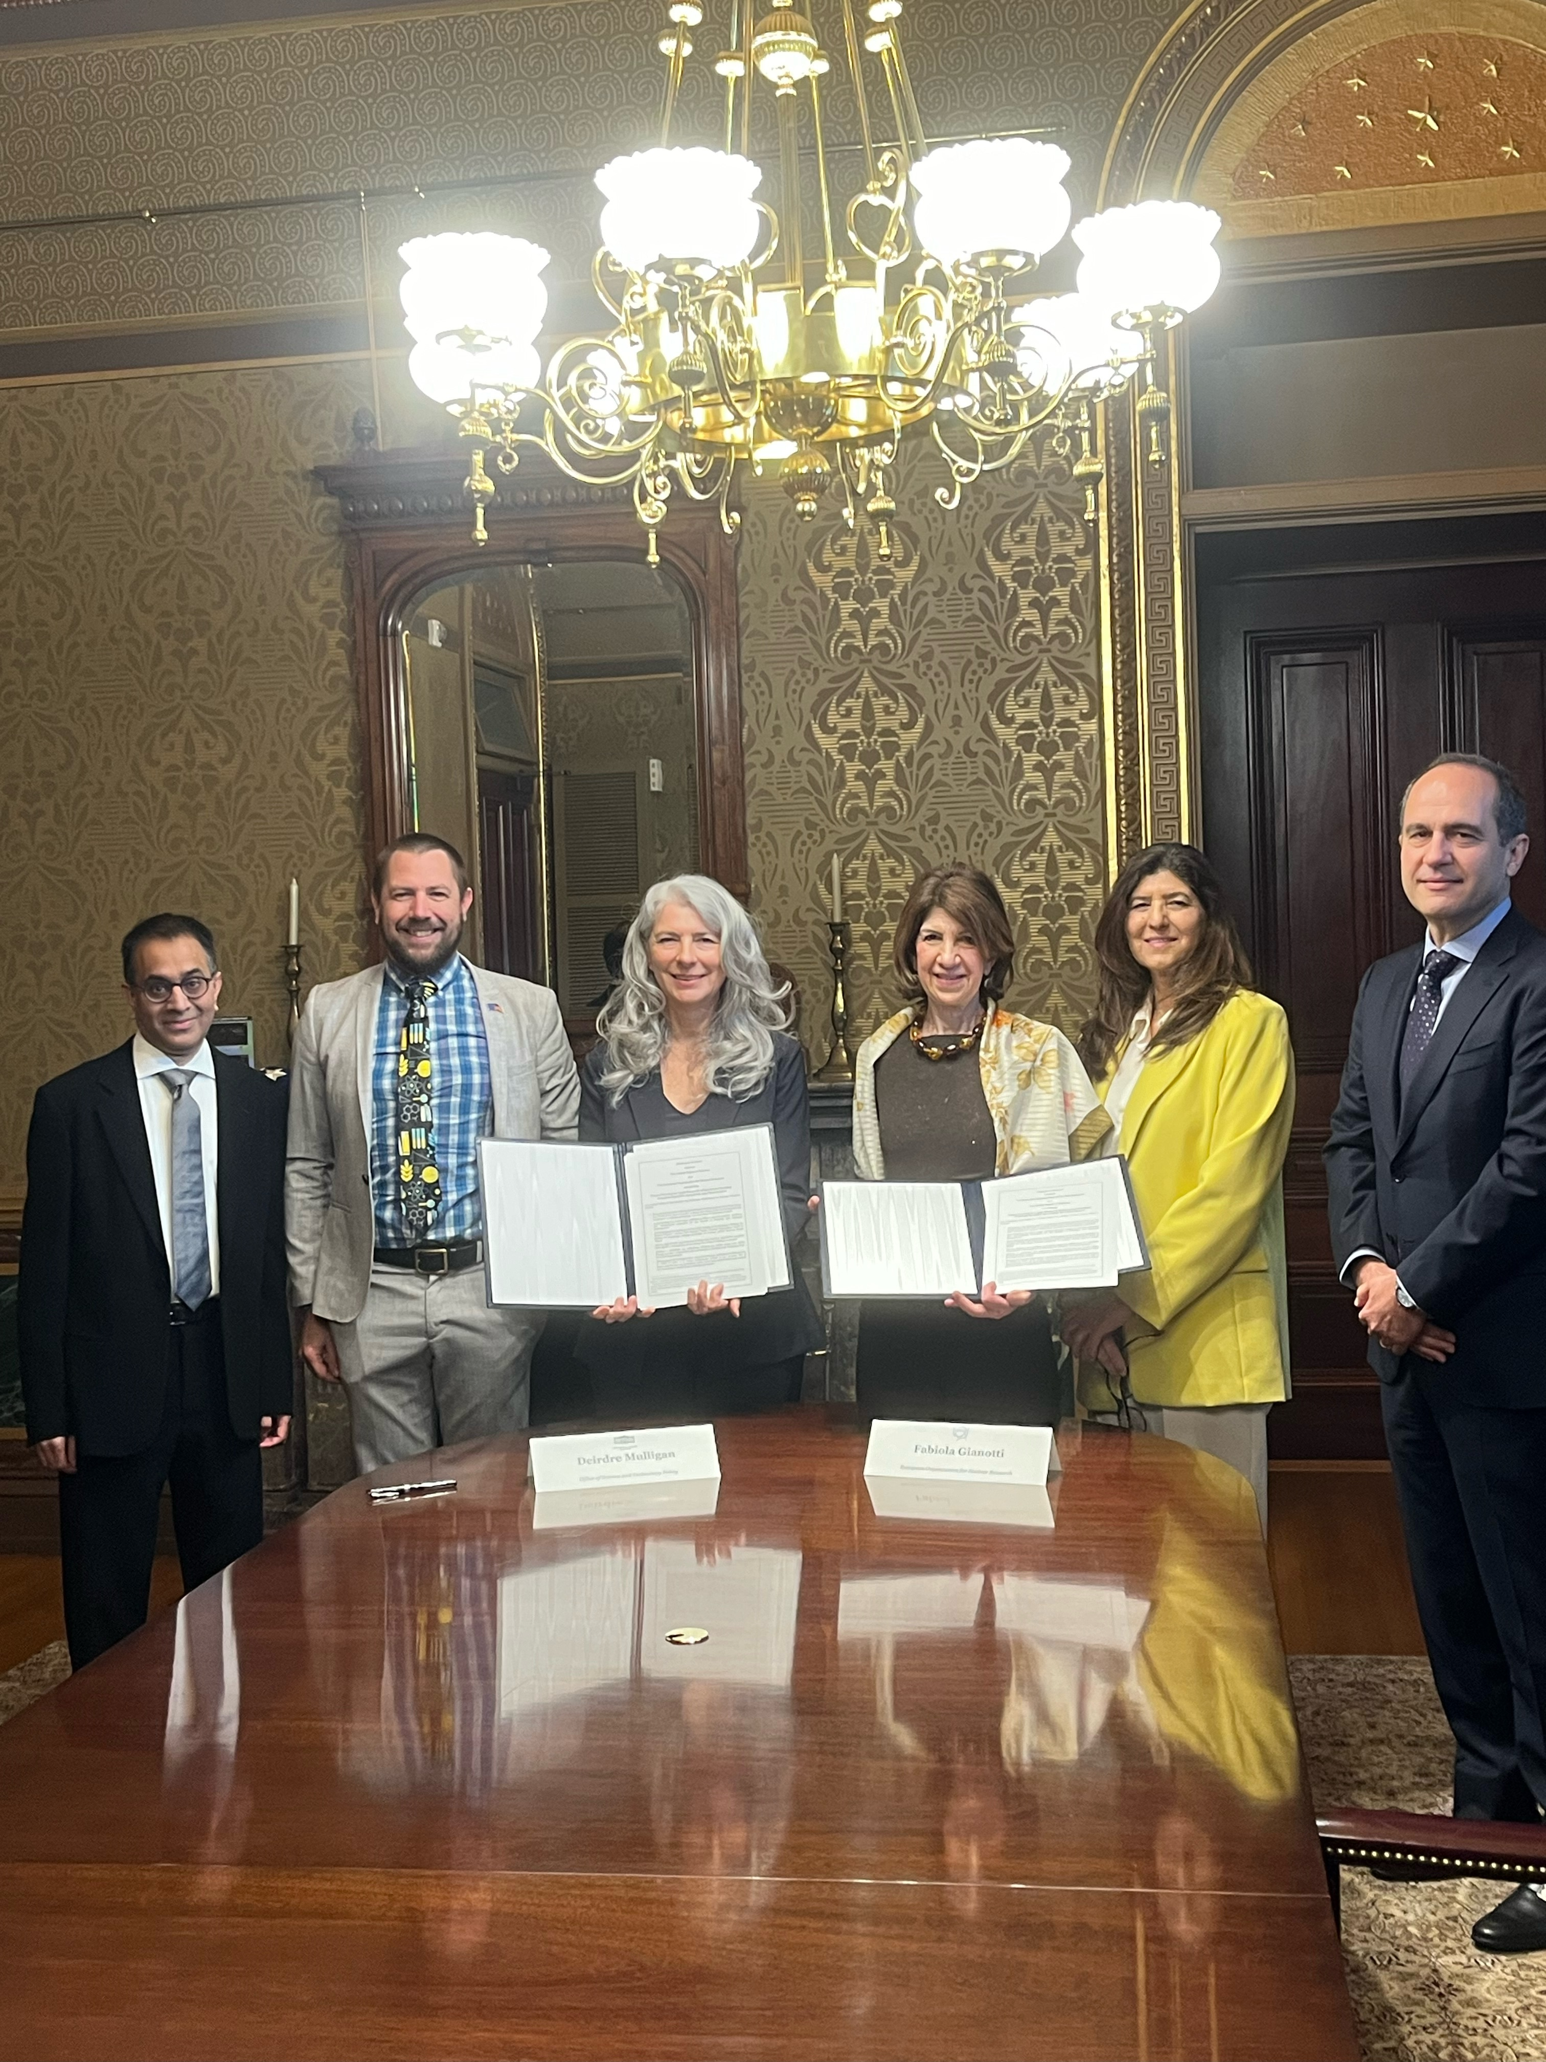
U.S.-CERN Statement of Intent (II)
The text of the following statement was released by the Government of the United States of America and the European Organization for Nuclear Research (CERN), an Intergovernmental Organization having its seat at Geneva, Switzerland. White House Office of Science and Technology Policy Principal Deputy U.S. Chief Technology Officer Deirdre Mulligan signed for the United States while Director-General Fabiola Gianotti signed for CERN.
Text available at: U.S. Department of State Remarks & Releases site
Among the topics in the Statement,
  Expresses intentions by the U.S. and CERN to continue collaborating in the FCC Higgs Factory feasibility study
  Subject to appropriate processes, the intention for the U.S. to collaborate on the FCC-ee, should the CERN
  Member States determine the FCC-ee is likely to be CERN’s next research facility following the HL-LHC
Statement aligned with P5: should FCC-ee receive a “green-light” following the next update of the European Strategy, U.S. intends to collaborate; and nature of the contributions to be discussed by the panel prescribed in 6.1.

Slide 23
U.S. Organization for Higgs Factory Development – PED
DOE and NSF have jointly issued a charge that forms a nationally coordinated U.S. Higgs Factory Coordination Consortium (HFCC) for developing the physics, experiments, and detectors (PED) program.
DOE-NSF Higgs Factory
Joint Oversight Group (JOG)
Lab Coordination Group (LCG)
Labs: ANL, BNL, FNAL, JLAB, LBNL, ORNL, and SLAC
DOE and NSF Program Managers (Ex-Officio)
Higgs Factory Steering Committee (HFSC)
Diversity and Outreach Coordinator
External Partners
Includes: CPAD Representative, CERN Representative, ECFA Representative, and Other Major Stakeholders
Gaseous Detectors
Silicon Tracker
Calorimeter
Readout Electronics
Trigger/DAQ
Simulation Software and Physics Support

Slide 24
U.S. Higgs Factory Development – PED
The U.S. HFCC includes:
  Higgs Factory Steering Committee (HFSC)
  Lab Coordination Group (LCG), which is integral to the U.S. Higgs factory coordination
  Detector systems that report to the HFSC and naturally map onto CERN’s DRD structure
The Consortium is to ensure that collaborations by the U.S. with our international partners are cost-effectively carried out for the Higgs factory initiatives
The LCG will include representatives from each of our DOE labs:
  ANL, BNL, FNAL, JLAB, LBNL, ORNL, and SLAC
  A representative from each lab is to be selected by the respective lab’s management
Representatives in this Consortium also include external partners such as those from the APS/DPF’s Coordinating Panel for Advanced Detectors (CPAD) in the U.S. and the CERN-hosted Detector R&D (DRD) initiative

Slide 25
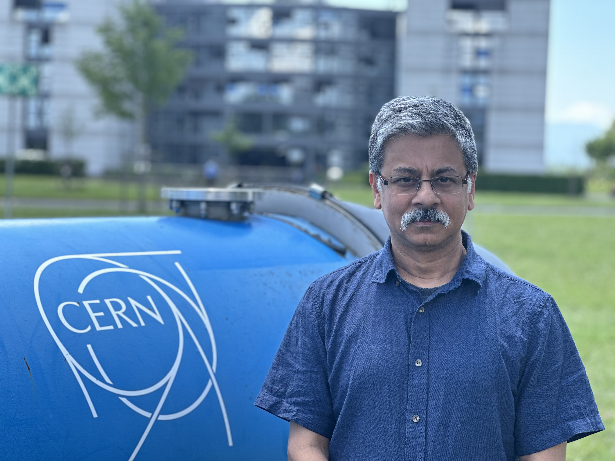

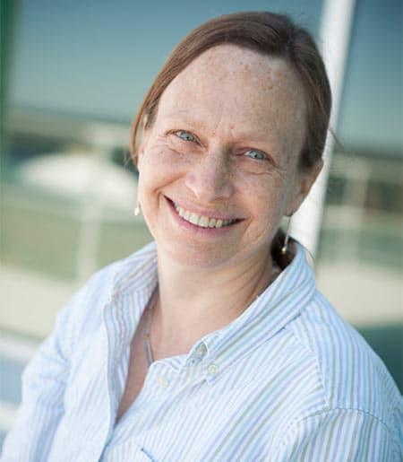
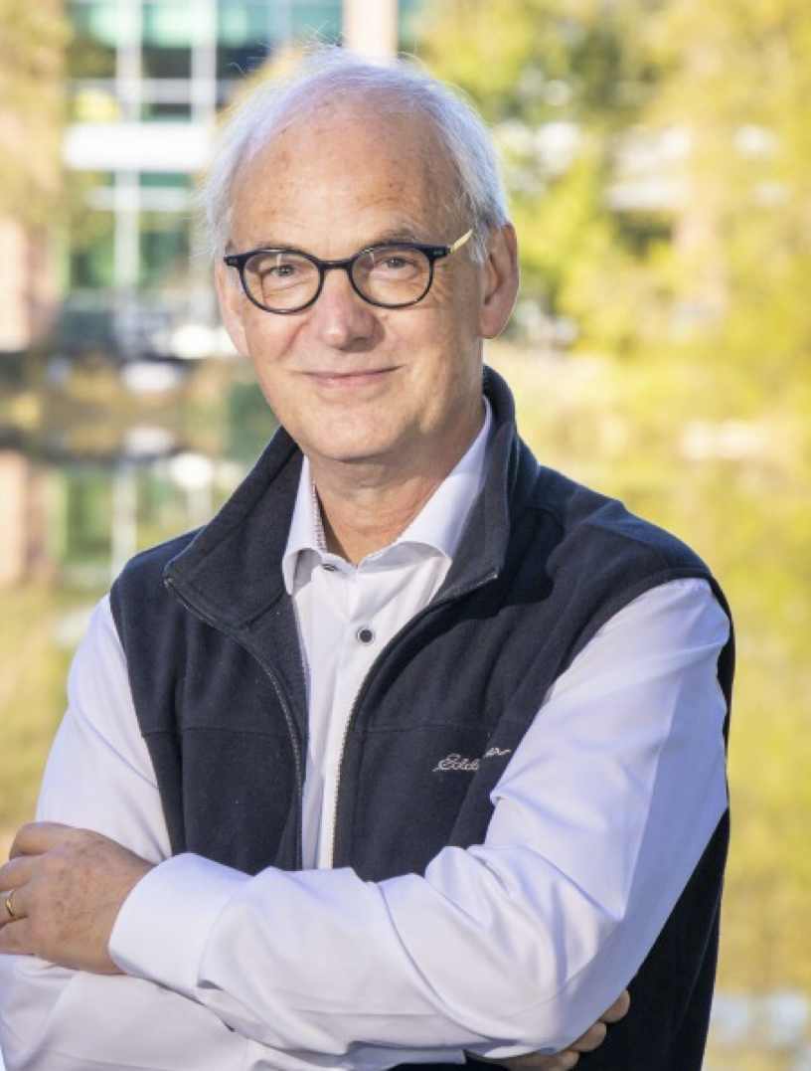
Higgs Factory Steering Committee – PED
Goals and tasks of the U.S. HFCC include:
  Coordinate efforts of the U.S. community,
  bringing together both the linear and circular collider communities
  To be done during the phase which precedes the development of a specific future project
DOE and NSF selected members of the Higgs Factory Steering Committee from the leadership
of the FCC-ee Snowmass Working Group and the Americas’ Linear Collider Committee
  Srini Rajagopalan (Chair), Sarah Eno
  Ritchie Patterson (Deputy Chair), Marcel Demarteau
No lead DOE laboratory is designated for this Consortium
  Each lab collaborating in Higgs factory efforts is represented through the Lab Coordination Group

Slide 26
U.S. Organization for Higgs Factory Development – Accelerators
DOE is separately preparing a charge that forms a nationally coordinated U.S. Higgs Factory Coordination Consortium (HFCC) for developing the accelerators program; the charge to-be-released soon.
In general, similar structure as the U.S. HFCC for PED; includes appropriate partners and accelerator systems
Membership in the Higgs Factory Steering Committee for Accelerators (HFSC-A) is under discussion, and the Committee’s leaders are to be identified soon.
DOE Office of High Energy Physics
Lab Coordination Group for Accelerators (LCG-A)
Labs: ANL, BNL, FNAL, JLAB, LBNL, ORNL, and SLAC
DOE Program Managers (Ex-Officio)
Higgs Factory Steering Committee for Accelerators (HFSC-A)
Diversity and Outreach Coordinator
External Partners
Includes: FCC-ISC representative, ILC-IDT representative, ECFA and ICFA representative, and Other Major Stakeholders
Beam Physics
Diagnostics and Instrumentation
RF System
Magnet System
Machine Detector Interface (MDI)
Infrastructure & Engineering

Slide 27
DUNE Phase-II
From P5 Recommendation 2, Priority 2/5 : Re-envisioned second phase of DUNE with an early implementation of an enhanced 2.1 MW beam (ACE-MIRT), a third far detector, and an upgraded near-detector complex as the definitive long-baseline neutrino oscillation experiment of its kind (section 3.1).
DOE response and actions :
  ACE-MIRT : one element of the near-term evolution of the Fermilab Complex (see next slide)
  Far Detector 3: to be planned and proposed by the DUNE Collaboration in consultation and partnership with DOE and international partners; top priority is to secure an understanding of how the cryostat is funded
  Upgraded near-detector complex (MCND): to be planned and proposed by the DUNE Collaboration in consultation and partnership with DOE and international partners; top priority is to finalize a baseline plan for the Phase 1 Near Detector

Slide 28
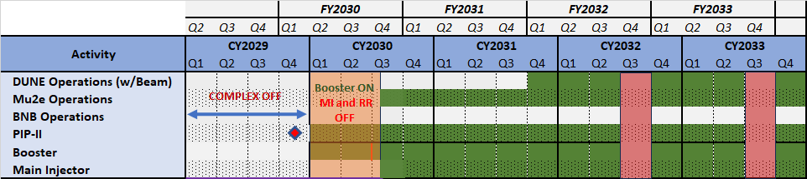
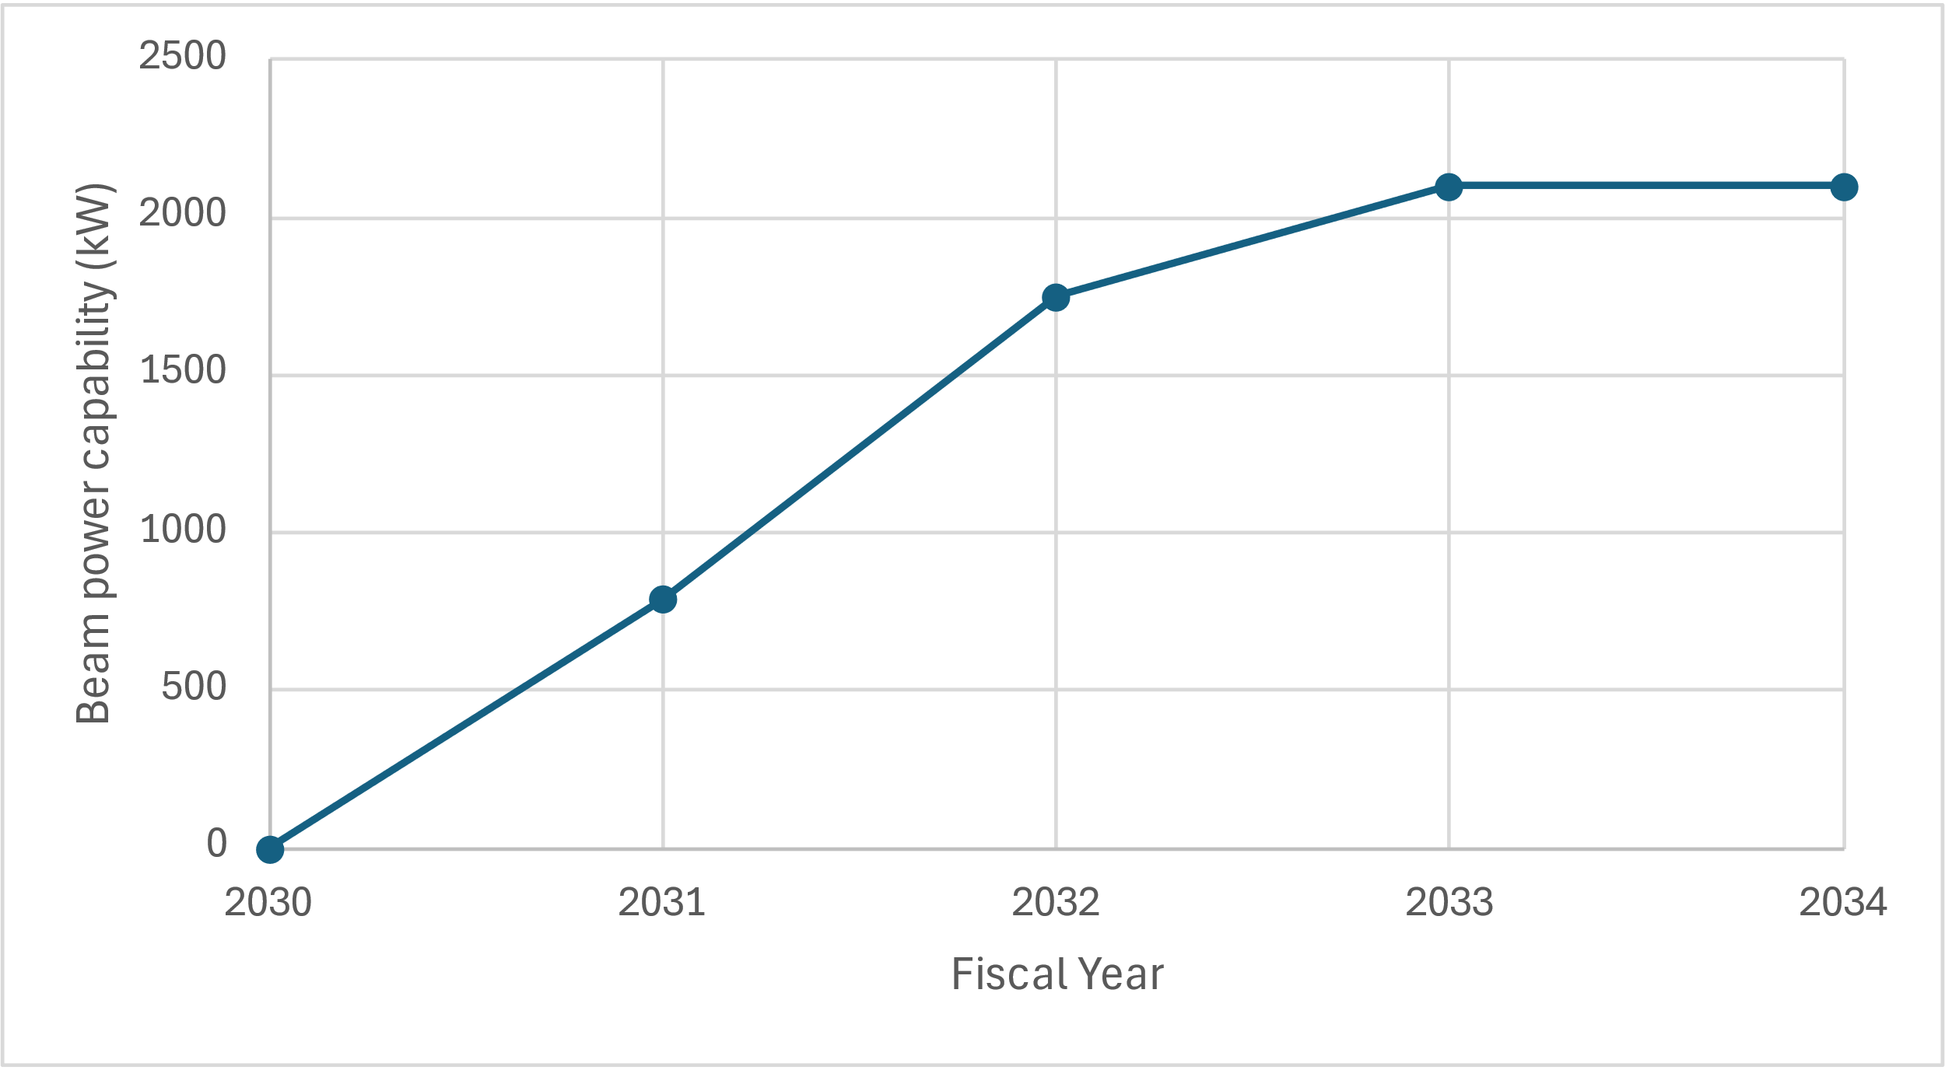
Evolution of the Fermilab Complex – part 1
We first consider the accelerator capability at completion of PIP-II Project
We see a three step path to reach 2.1MW for the early operation of the DUNE experiment :
  Post-PIP-II instrumentation and booster improvements to handle beam power
  ACE-MIRT
    Main Injector upgrade to operate at 0.7 sec cycle time
    Target to handle 2 MW
  Booster improvements to insure reliable operation

Slide 29
Accelerator Test Facilities
From P5 Recommendation 6.2 : The panel would consider the following: Mid- and large-scale test and demonstrator facilities in the accelerator and collider R&D portfolios.
DOE response and actions :
  As a first step in developing a response to this recommendation, DOE will be conducting a review of the GARD program this August.
  This will be followed by an Accelerator Test Facilities comparative review of existing facilities at ANL, BNL, FNAL, LBNL and SLAC; tentative time frame is Fall 2024; more information will be forthcoming.
  In 2025 a panel will be convened to develop a roadmap towards a test facility plan that will be well supported and meet the needs of the emerging directions for future colliders and development of the workforce that will be needed over a 20-30 year time frame.

Slide 30
Evolution of the Fermilab Accelerator Complex – part 2
From P5 Recommendation 6.3 : The panel would consider the following: A plan for the evolution of the Fermilab accelerator complex consistent with the long-term vision in this report, which may commence construction in the event of a more favorable budget situation.
DOE response and actions :
  The panel = A Task Force, led by Fermilab, and drawn from the US HEP community and interested international partners
  The time frame for convening such a Task Force is no sooner than in calendar year 2026 and most likely following the panel initiated to consider the task in Recommendation 6.1
  This gives priority to detailed planning towards the Fermilab accelerator complex evolution – Part 1

Slide 31
Prescriptive P5 Area Recommendations
P5 Recommendation | Funding/year ($M)
ASTAE Initiative | 35
Detector R&D | 20
HEP Theory | 15
General Accelerator R&D | 10
Energy Frontier Detectors | 20
Energy Frontier Accelerator | 35
TOTAL | 135
DOE Office of High Energy Physics
FY 2024 Enacted Budget ($M) | 1,200
FY 2025 President’s Budget Request ($M) | 1,230
Initiative Fraction | 11%
The 2023 P5 Area Recommendations for budgets is >10% of the current DOE-HEP budget. At this moment, 10% increases in the budget look very unlikely.
Our analysis shows the ASTAE (Advancing Science and Technology through Agile Experiments) funding can support a steady stream of one new project starting per year, so it looks quite appropriate.
The other recommendations have not yet been fully studied.
In order, to prevent strain on the core HEP research budget and facility operations, we will need to build up to these levels as current projects ramp down.
We need to emphasize that funding priorities will be towards the execution of P5’s Recommendation #1.

Slide 32
Budget Scenarios Considered by 2023 P5 Panel
Inflation Reduction Act of 2022 provided supplemental funding of +$303.6M for HEP projects

Slide 33
FY 2025 PBR Highlights (don’t reflect House mark-up)
Research $395.8M (-$30.4M, -7.1% from FY 2024 Enacted)
$24M increase for AI/ML. $8M increase for RENEW and FAIR
Facilities Operations $381.7M (+$33.2M, +9.5% above FY 2024 Enacted)
Fermilab Accelerator Complex $166.9M (+$25.3M, +17.9% above FY 2024 Enacted): 5,180 hours
Projects $453.2M (+$28.0M, +6.6% above FY 2024 Enacted)
LBNF/DUNE $280M (+$25M, +10% above FY 2024 Enacted to support LBNF/DUNE’s five subprojects)
$4M decrease as Accelerate Innovations in Emerging Technologies concludes
QIS, Microelectronics, Advanced Computing, and Accelerator Science and Technology continue at the FY 2024 Enacted Level
$59.9M decrease to Core Research. Focus support on high-profile research topics and early research results; key contributions and critical U.S. commitments to experiments & projects; University research & training; other priority cross-cutting initiatives
SLAC FACET-II $17.6M (+$1.1M, +6.9% above FY 2024 Enacted): 3,120 hours
U.S. LHC Detector Operations $57.3M (+$4.5M, +8.5% above FY 2024 Enacted)
Vera Rubin Operations $33M (+$2.1M, +6.7% above FY 2024 Enacted)
Sanford Underground Research Facility $35M (No change from FY 2024 Enacted)
ACORN $10M (+$5M, +100% above FY 2024 Enacted)
ATLAS and CMS Detectors $33.7M (-$2M, -6% below FY 2024 Enacted): as per the baselined profiles
CMB-S4 $4.5M (level funding from FY 2024 Enacted)
PIP-II $125M (level from FY 2024 Enacted): continue support for baseline profile
.

Slide 34
HEP Budget ($K): Research, Facilities & Projects
FY 2001 – FY 2024
ARRA 2009 funds supported Research, Facilities, and Projects
IRA 2022 funds supported Projects only

Slide 35
Summary and Outlook
The 2023 P5 report lays out an ambitious plan for the growth and evolution of the U.S. HEP program
DOE supports the plan and is building its recommendations into our long-term planning
Fermilab is indeed the “gem” of the U.S. HEP program and we in DOE view its evolution as the core element of the U.S. HEP program
Budgets are tight! – We are struggling to keep up with inflation.
In order to execute an ambitious vision, it will require hard decisions and some sacrifice and patience
We in DOE look forward to working with the entire U.S. HEP community and our international partners to realize this exciting future.

Slide 36


