Slide 1
Muon Collider at Fermilab
David Neuffer
Wilson Fellow (1979-1983)
Fermilab (2024 Graduate)
July 2024

Slide 2
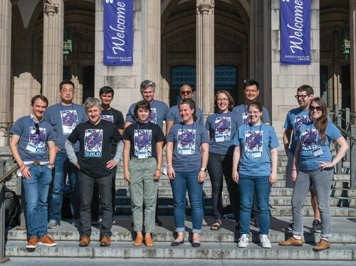
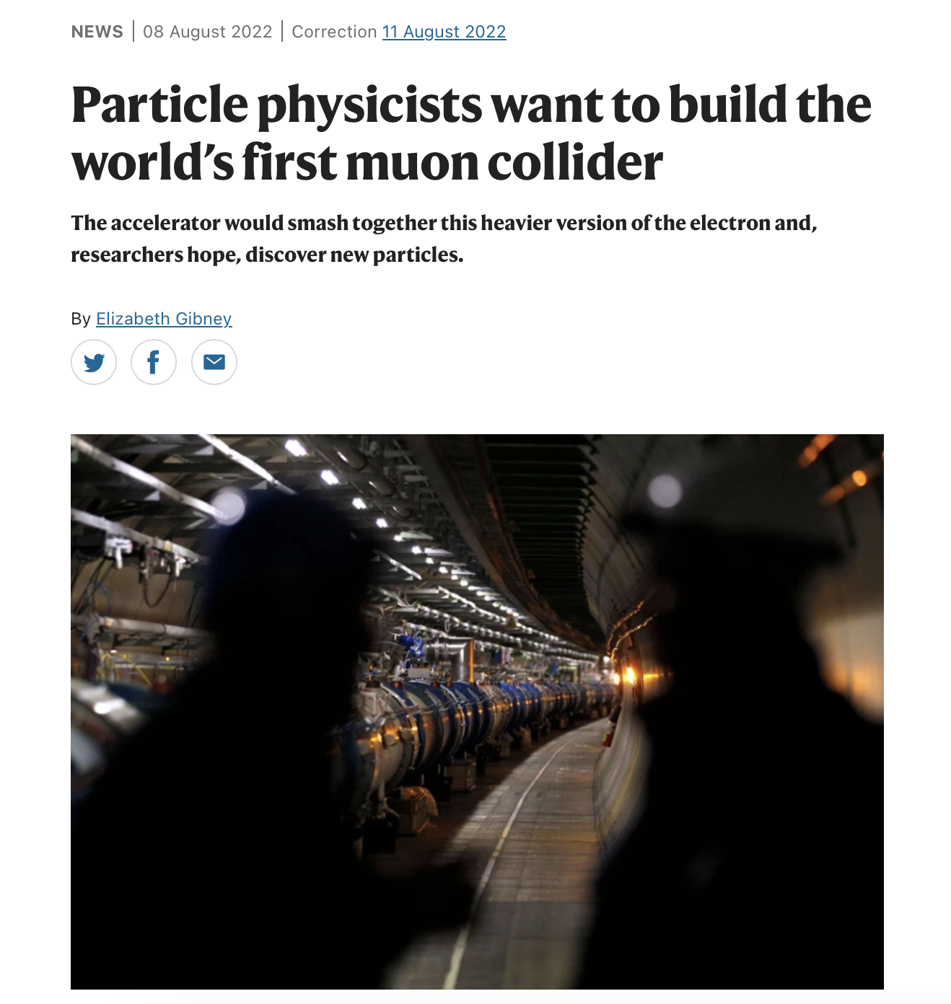
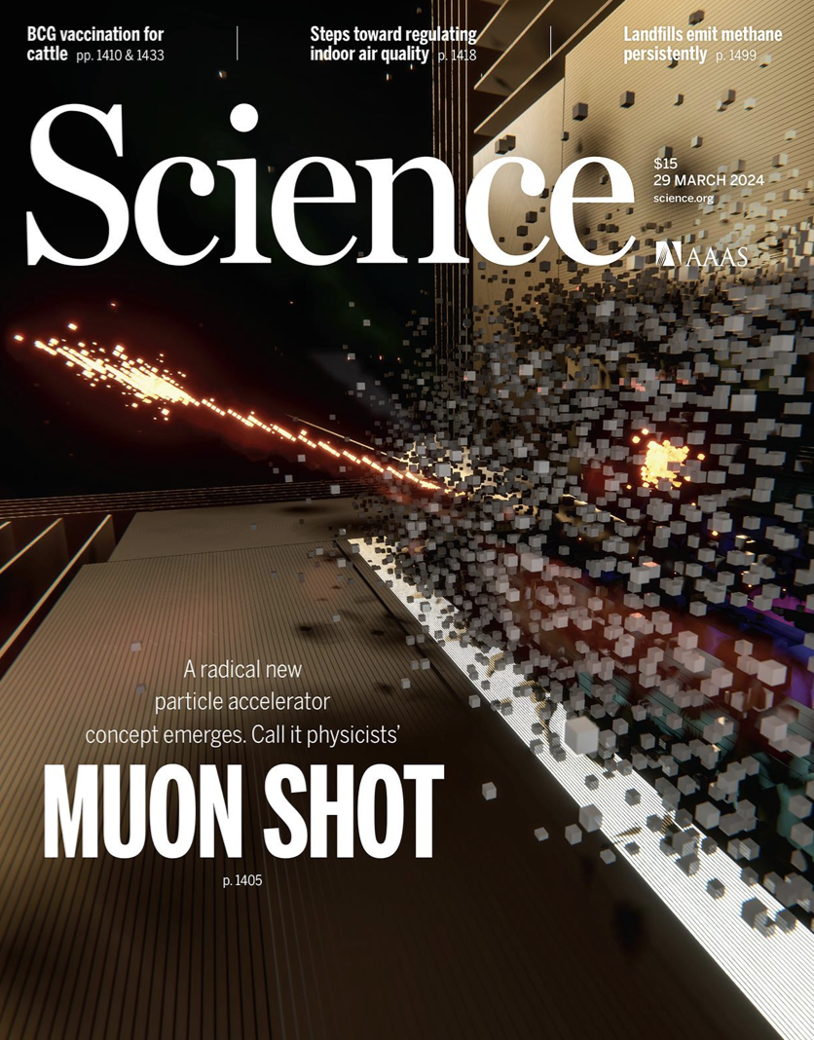
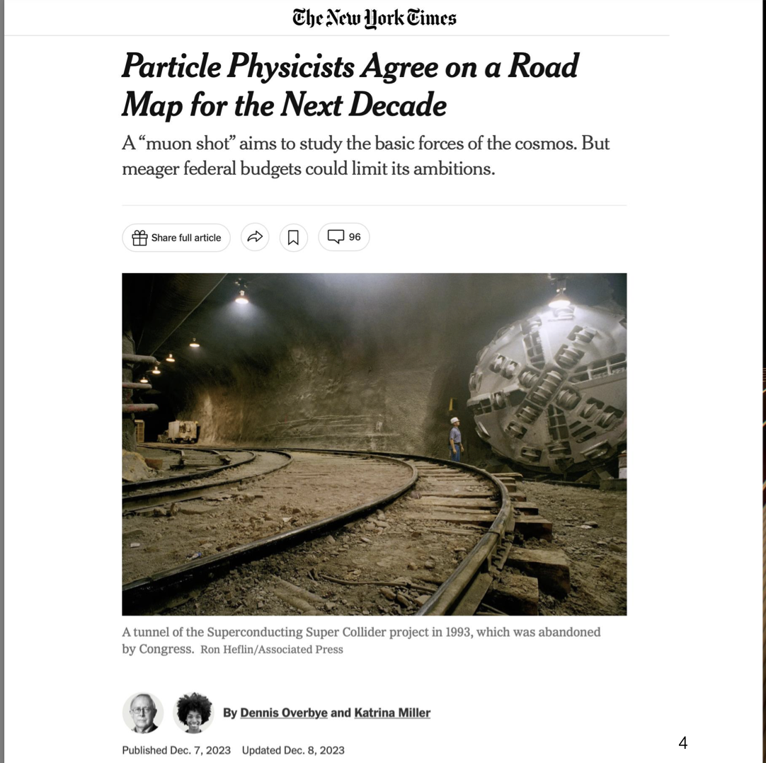
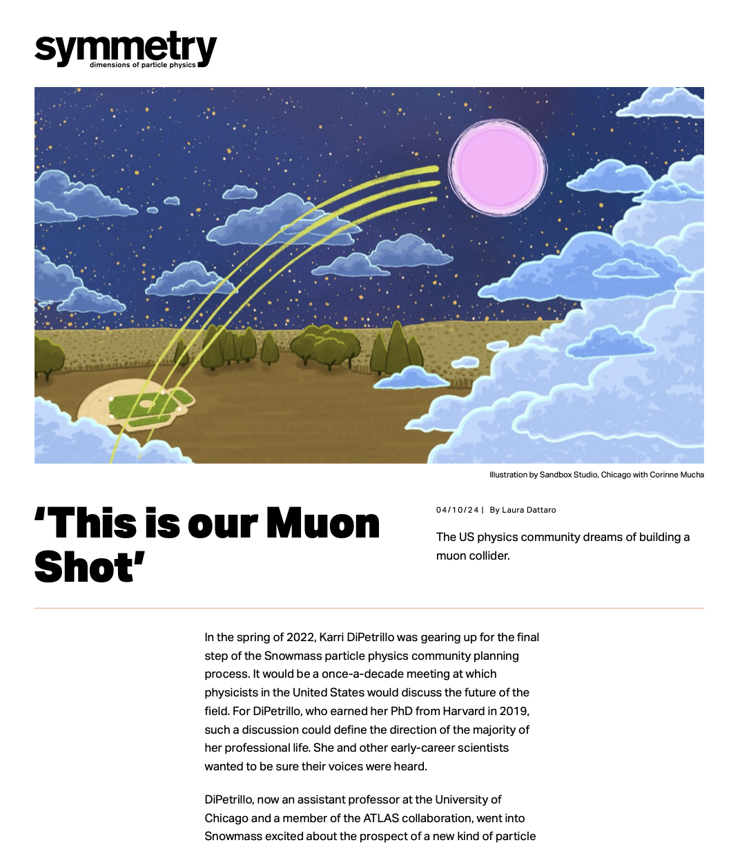
Snowmass → 2023 P5 Report
Muon Fever ?

Slide 3
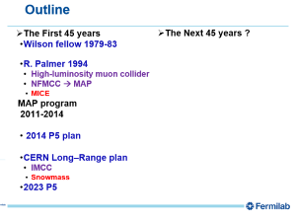
Outline
The First 45 years
  Wilson fellow 1979-83
  R. Palmer 1994
    High-luminosity muon collider
    NFMCC → MAP
      MICE
MAP program
2011-2014
  2014 P5 plan
  CERN Long–Range plan
    IMCC
      Snowmass
  2023 P5
The Next 45 years ?

Slide 4
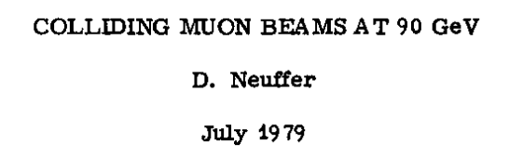

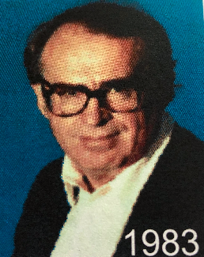
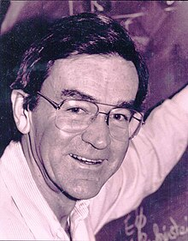
In the beginning …
First RR Wilson Fellow-1979
  e+-e⁻ limited by radiation (to~100GeV)
    -> linear collider?
  Change mass of electron
      m_{e} → m_{μ}
  D. Cline – use μ storage ring for neutrinos
    → ~nuSTORM
  J. D. Bjorken
    Add foil cooling that the Russians are developing
D. Cline
Bjorken

Slide 5
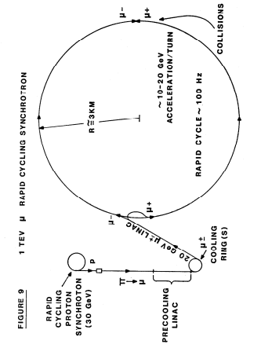
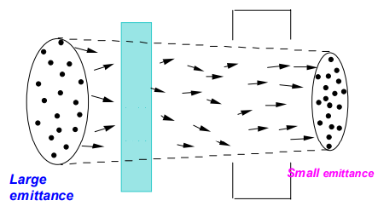
Principles and Applications of Muon Cooling - FN-378
Particle Accelerators 14, 75 (1983)
M. Sands “Physics of Electron Storage Rings”
    Synchrotron radiation → dE/dx, PDG Handbook, Wang
Muon Collider Components
  Proton source
    ~10¹⁴ protons ~1m bunch
  Muon source and cooling
  Accelerator and Collider
    Fast-cycling
1984-1993
  Presentations at Advanced Accelerator Concepts, etc.
  Search for Collaborators …
SLAC-121

Slide 6
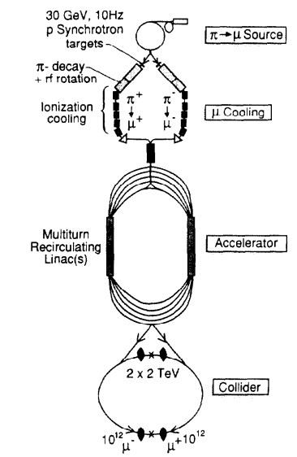
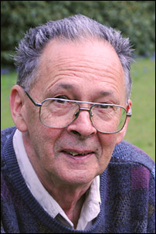
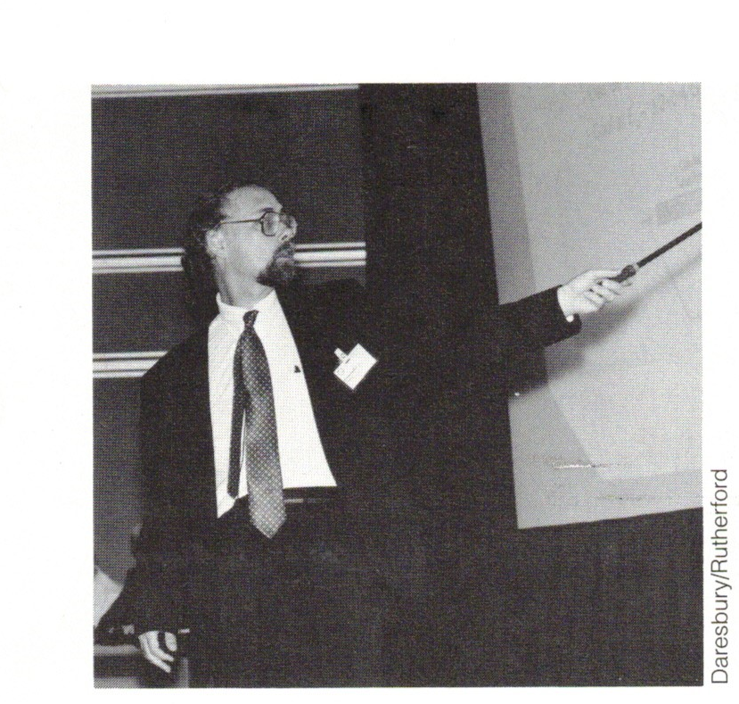
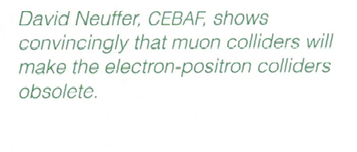
1994-
R. Palmer became interested
    After Isabelle, SSC …
  Collaboration paper for EPAC94
Collaboration with Fermilab, LBL, BNL
  J. Peoples, A. Tollestrup, A. Sessler,
Muon Collider Collaboration
  Snowmass 96
  Return to Fermilab
F Close, SLAC beamline

Slide 7
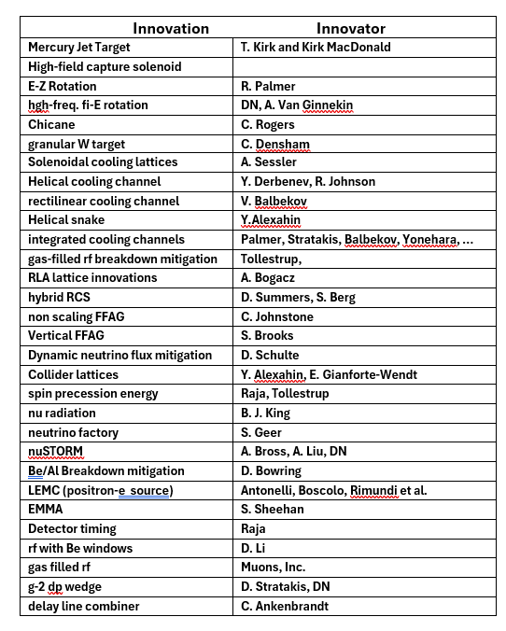
Neutrino Factory- Muon Collider Collaboration
Large Outbreak of “Muon Fever”
Muon properties seem matched to “challenging and difficult”
    Lifetime, cooling, detectors, acceleration
Many Innovations from many contributors
  Cooling
  Neutrino Factory (S. Geer)
    Collider front end + storage ring
    Similar to Tevatron

Slide 8

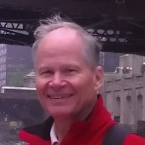
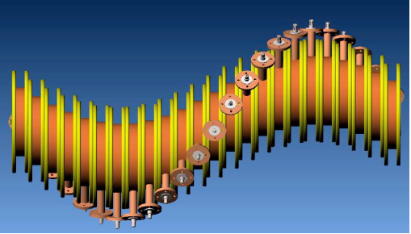

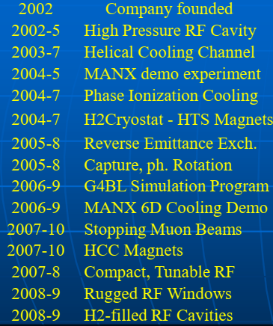
Example: R. Johnson → Muons, Inc.
Rolland Johnson
    Fermilab graduate
Helical Cooling Channel
  Derbenev and Johnson
Started company to participate in muon collider research (2002)
Large Number of innovations and contributions

Slide 9
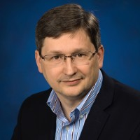
Muon Accelerator Program
MAP Design Study
  2010-2014, M. Palmer, director
Directed toward implementation of a muon program
  Toward specific designs
Staged approach
  Proton driver upgrade (~ Project X)
  Muon and neutrino program
  Staged cooling
  Staged accelerators and colliders
rf studies
  Gas filled rf, breakdown in magnetic field
Implemented MICE experiment
M. Palmer

Slide 10

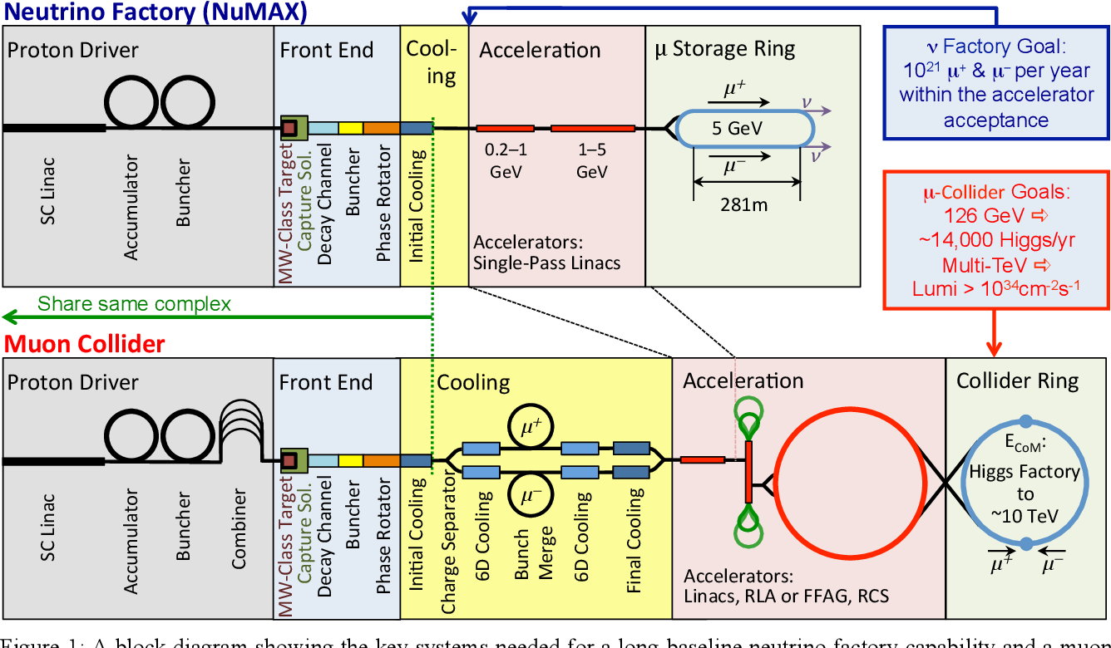
1994→ 2014
Proton Driver
  RCS → Linac + Storage rings
Front End & Cooling
Li lens
-> solenoids
Acceleration
  Recirculating Linacs →
  Rapid Cycling Hybrid Synchrotrons→
Collider
  4 TeV → 10 TeV
    8T → ~16 T

Slide 11
MAP Program

Slide 12
2014 P5 report – limited resources
Emphasis on developing an affordable flagship project
  DUNE + LBNF neutrino project
MAP program progress
  Too expensive
MAP and related programs completely canceled
No compensatory General Accelerator R&D increase
PIP-II (initial part of Proton Driver) funded

Slide 13
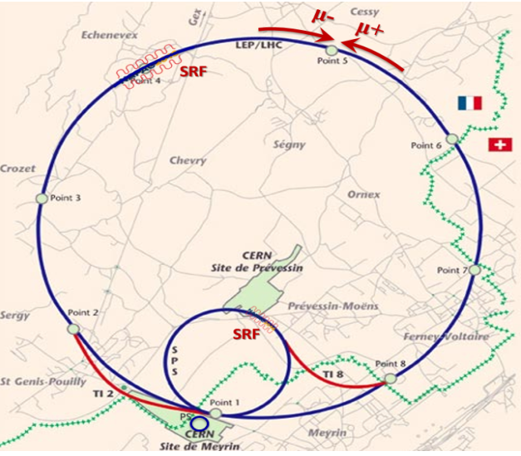
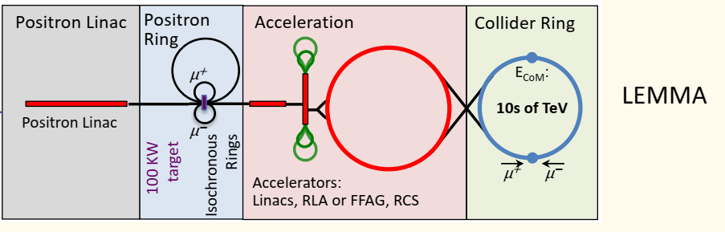
After p5 2014
Muon Collider Effort severely restricted
  Muon Collider → Heavy Lepton Collider
    MTA: rf in magnetic fields
MICE experiment continues
  Published results (2000)
  14 TeV Muon Collider at CERN (IPAC 18, JINST
    D. Neuffer & V. Shiltsev
  “Low EMittance Muon Accelerator\
    Phys. Rev. Accel. and Beams 21, 061005 (2018)
    M. Boscolo, P. Raimondi, et al
  COVID March 2000
    Travel → ZOOM

Slide 14
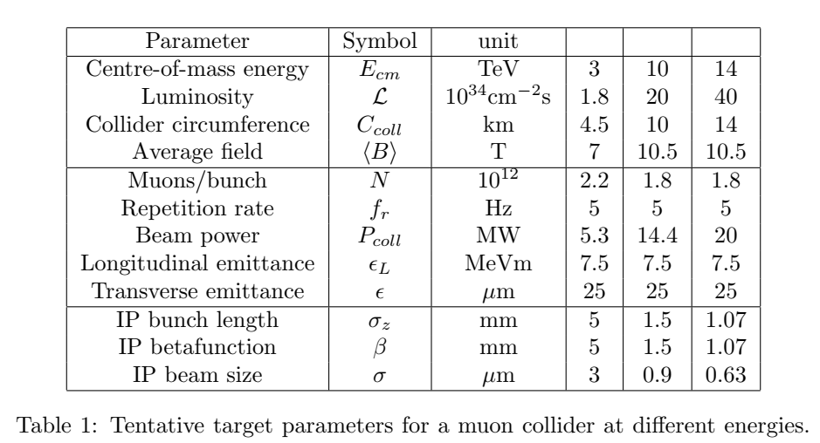
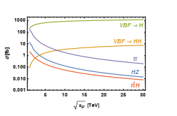
European based Collaboration
An international collaboration on Muon Collider
MUST (MUon STudy)
3 → 10→ 14 TeV Collider
μμ Collider R&D included in European Strategy Document

Slide 15
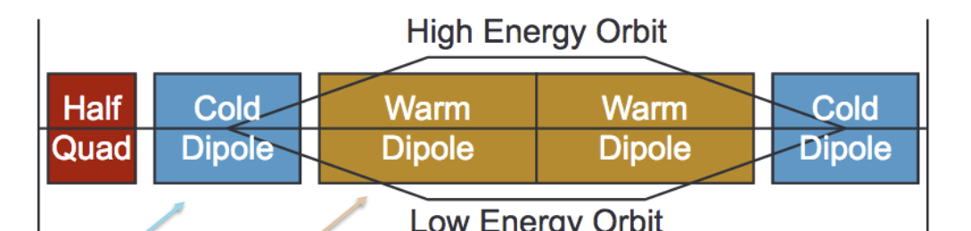
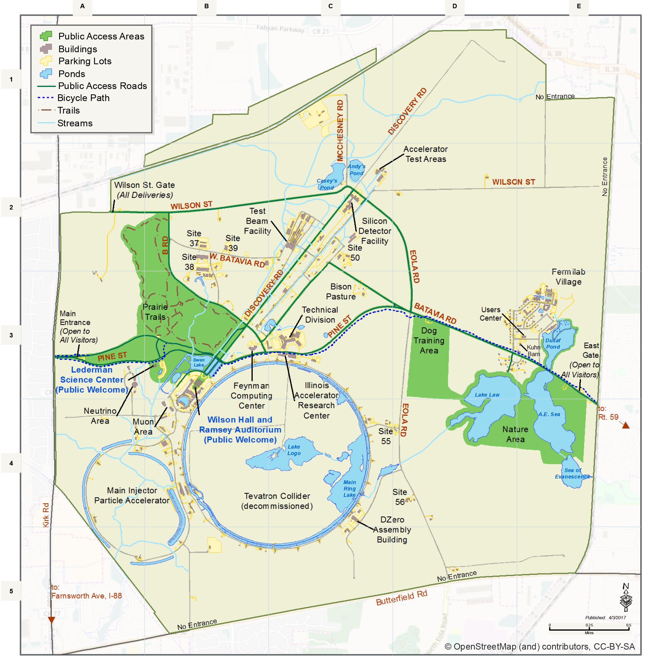
Site filler
Future high energy colliders and options for the U.S
P. Bhat, S. Jindariani et al.
Largest
Radius is ~2.7 km
  ~17km Circumference
    ~2/3 LHC
5 TeV Accelerator
    B_{ave}= 6 T → E_{μ}= 5 TeV
      (B_{max} = 16T, B_{pulse} =±2T)
10 TeV Collider Ring
  B_{ave}= 10 T

Slide 16
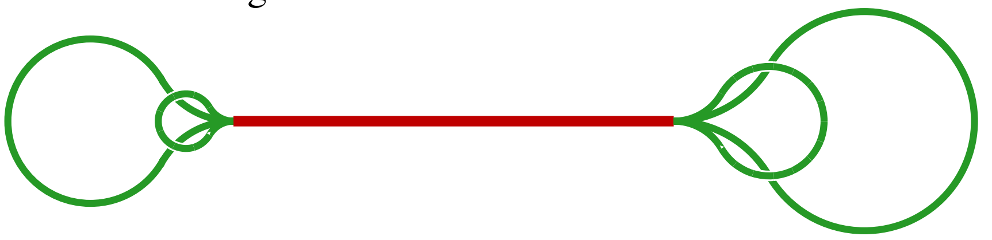
Site filler Accelerator
Proton Source
    PIP-III→target
μ Cooling
Linac + RLA → 65 GeV
RCS 1 and 2 → 1000 GeV
    Tevatron-size
RCS 3&4 → 5 TeV
  Site filler accelerator
  10 TeV collider
  Collider Ring ~10 km
Accelerator Ring
Collider Ring
Protons
Cooling
RCS 1-2

Slide 17
5 TeV with 16 ± 2 T RCS components
0-65 GeV Linac + 10-turn RLA
65 GeV → 5 TeV
  RCS 1 – 65→330 GeV r=1km
    Normal conducting: 0.3→1.55T
  RCS 2 – 330→1000 GeV r=1km
    Hybrid 8±2 T
  RCS 3 and 4 – 1 → 5 TeV
    Hybrid 16±2 T
65 GeV → 5 TeV Scenario
 | RCS-LE(nc) | RCS-HE(hybrid) | RCS-HE 1 | RCS-HE 2
Input Energy | 65 | 330 | 1000 GeV | 3250 GeV
Output Energy | 330 | 1000 | 3250 GeV | 5000 GeV
Circumference | 6.28 | 6.28 | 16.5 km | 16.5 km
Pack Fraction | 0.75 | 0.83 | 0.88 | 0.88
Total straight section | 1.57 | 1.07 | 1.96 | 1.96
B-highfield |  | 8 | 16 T | 16 T
B-lowfield |  | ±2 T | ±2.0 T | ±2.0 T
B_{ave} | 0.3→1.55T | 1.4→4.4 T | 1.44→4.7 T | 4.7→7.2T
Fraction high-field |  | 0.34 | 0.192 | 0.37
Acceleration Scenario
Acceleration turns | 36 | 97 | 161 | 249
Acceleration Time | 0.76 | 2.03 | 8.9 ms | 13.7 ms
Beam survival | 0.80 | 0.85 | 0.80 | 0.85
Rf voltage (φ_{s} = 60°) | 8.63 GV | 7.94 GV | 16.1 GV | 8.1 GV
Ramp Rate | 1650 T/s | 1970 T/s | 450 T/s | 290 T/s
~6 GeV Recirculating Linac
650 MHz
~10 turns to 65GeV
3 GeV Linac
650 MHz SRF

Slide 18
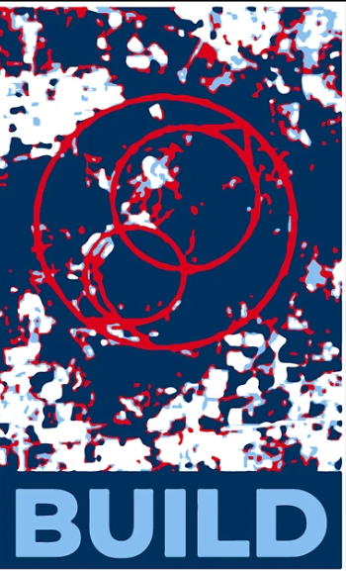
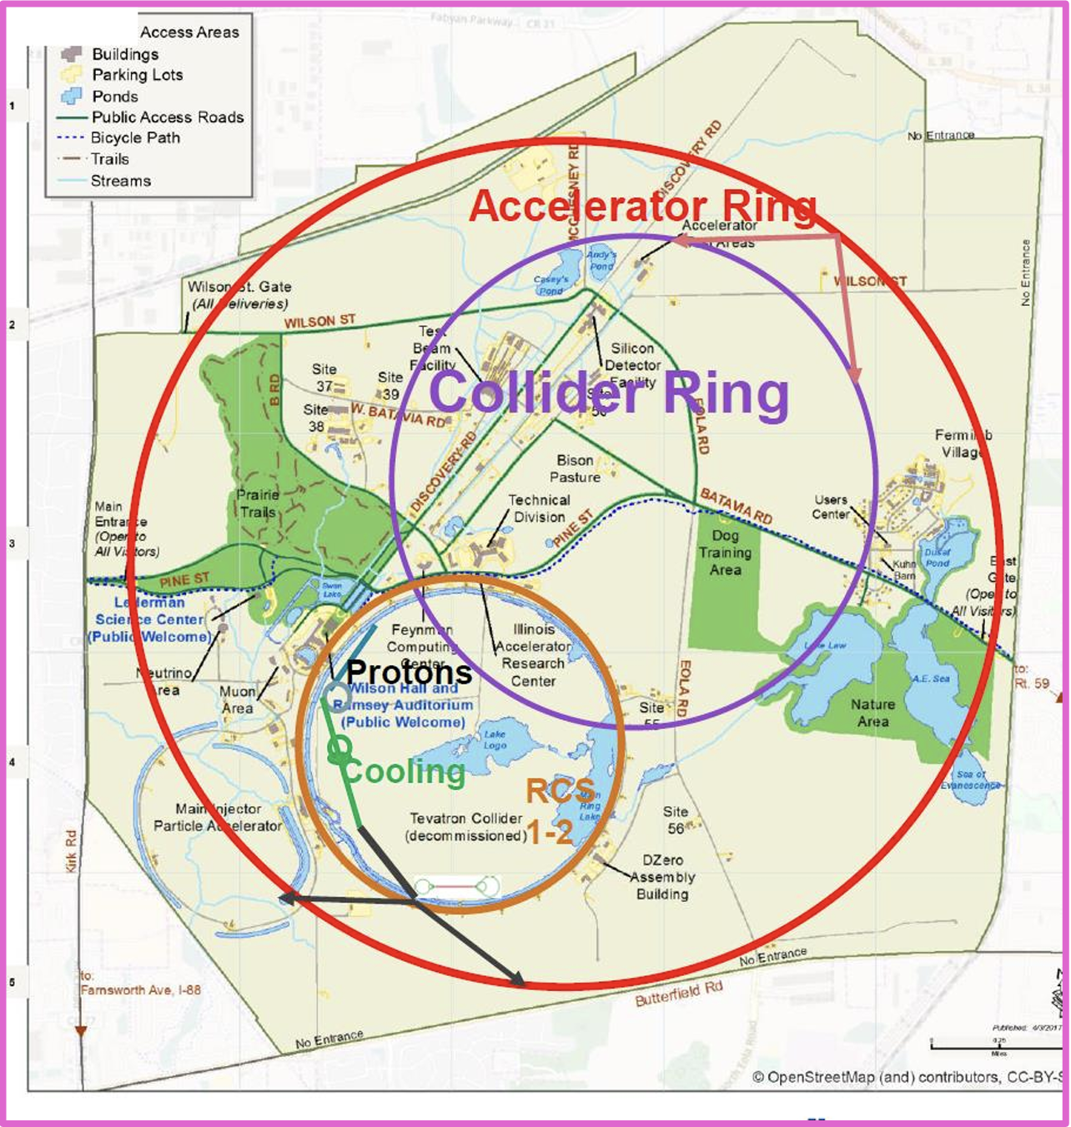
Muon Fever

Slide 19
What changed since the last P5?
Sergo & Diktys
  Physics: Strong surge of interest in Muon Colliders within the theoretical and experimental communities. Shift of emphasis in Muon Colliders from 125 GeV to 10 TeV energy [ref]
  Accelerator Technology:
    Muon Accelerator Program (MAP) results completed and published, including designs of various subsystems [ref]
    Important technological progress: multi-MW proton sources [ref], demonstration of RF in magnetic field [ref], high field solenoids [ref], good solution for neutrino flux mitigation, etc.
    Muon Ionization Cooling Experiment (MICE) confirmed muon ionization cooling principle, results published [ref]
  Detector technology : Large leap in detector technologies in part from R&D done for HL-LHC upgrades. Feasibility of good quality physics established in simulation [ref]
  International Muon Collider Collaboration (IMCC) established. The process of forming US organization is ongoing.

Slide 20

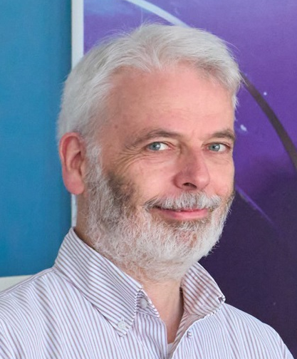
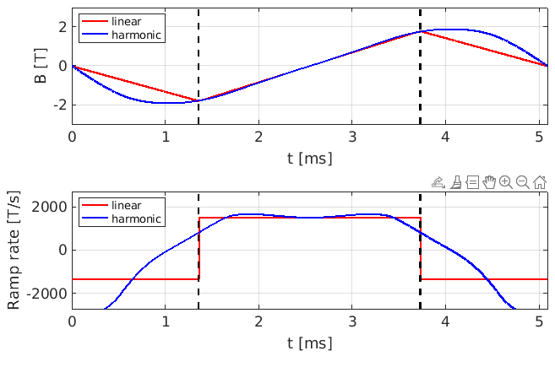
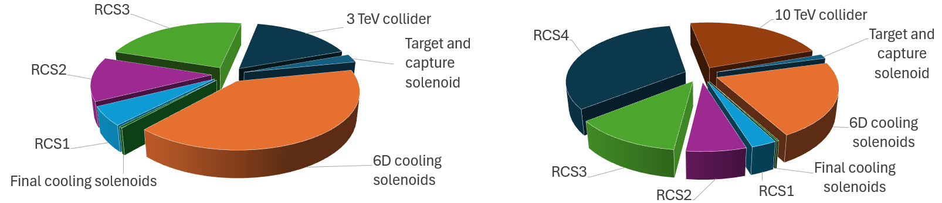
International Muon Collider Collaboration
2021 -
International muon fever outbreak
Large enthusiastic collaboration
  Students, postdocs
Major research effort
  >200 scientists/engineers/
Acceleration
  Hybrid RCS design & simulation
    Vertical FFA alternative
Magnets
  HTS magnet designs
  Complete assessment
D. Schulte
Injection
Ejection
3 TeV
10 TeV

Slide 21
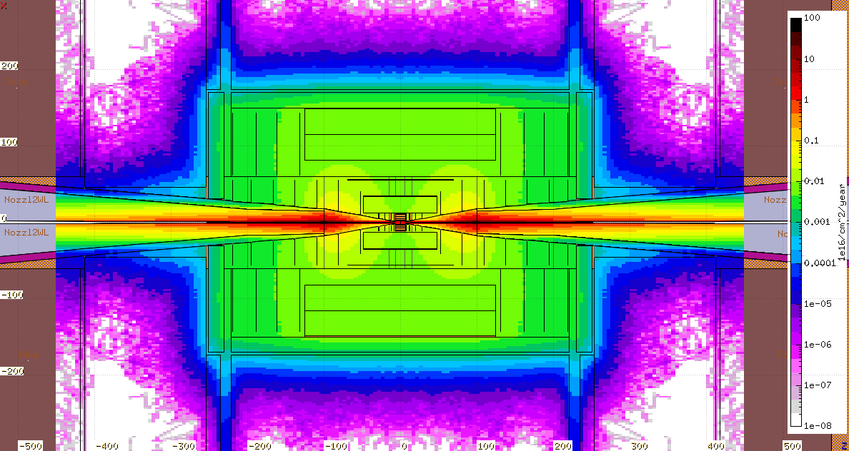
IMCC R&D
Collider Rings
  3 and 10 TeV Colliders and Detectors
  Collider Ring Location
      Nu flux < 1 mrem/year from arcs
    Straight sections point to Jura Mountains (Nu detectors)
    And Mediterranean Sea
  Detectors
    LHC + CLIC experience + improving electronics
Collider ring
Collider ring
B_{ve}= 6 T
Detector
Detector

Slide 22

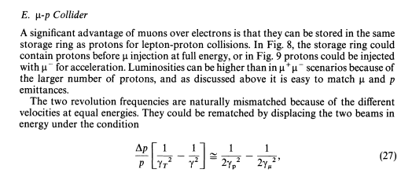
μ⁺μ⁻ Collider will also be p⁺ μ⁻ Collider
Muon accelerator chain will also accelerate protons
~100 GeV → 5 TeV proton accelerator
  Useful debugging mode for
  Muon accelerator
Very natural to store p’s in collider ring
  Can inject µ⁻ for Collisions
Luminosity can be large
  Fermilab has compatible proton source

Slide 23
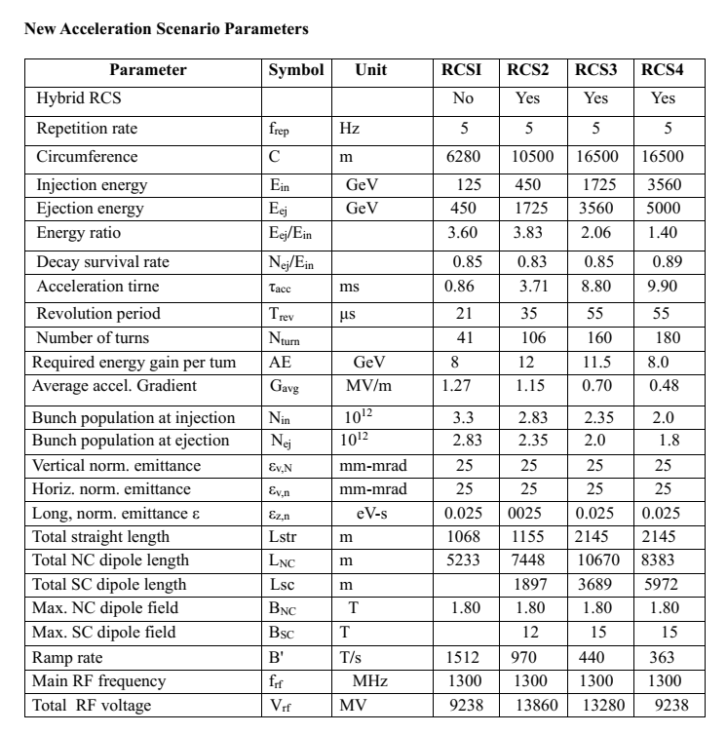
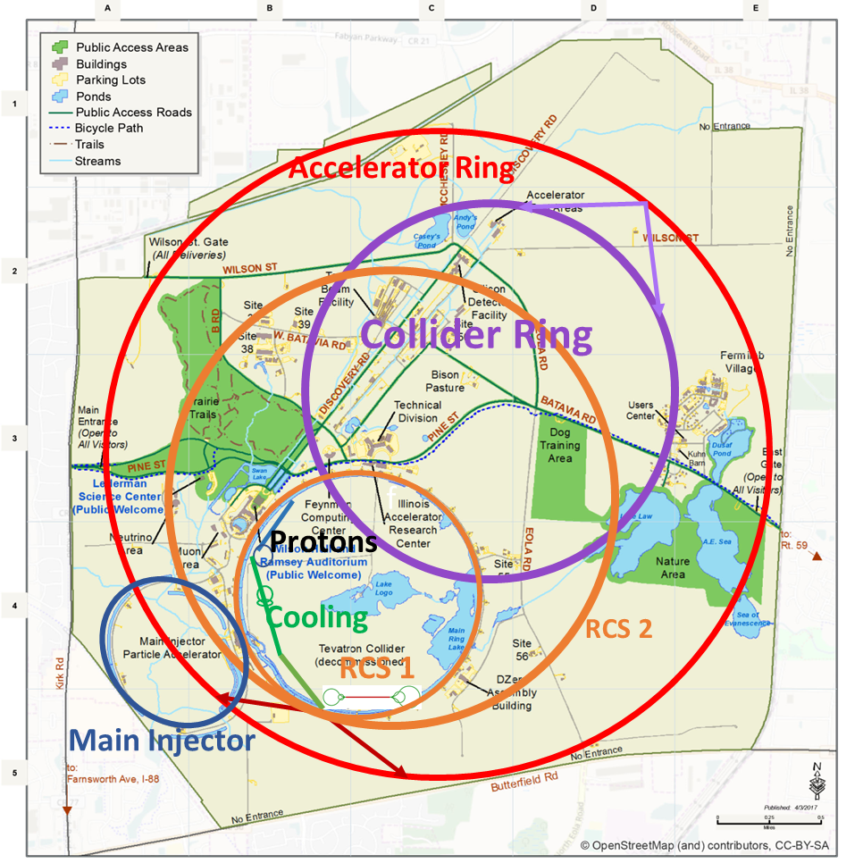
Acceleration variant
B_{max}: 16 →15 T
B_{cycle}:±2 → ±1.8 T

Slide 24
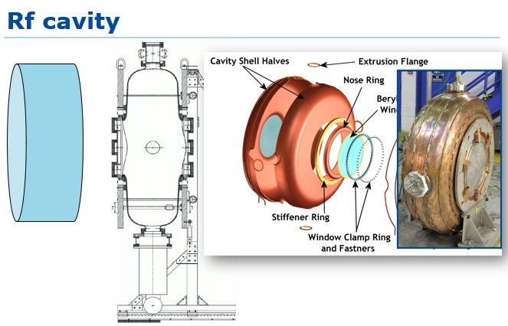
The next 45 years?
Many inventions/innovations/improvements needed
Need to turn concepts into objects

Slide 25
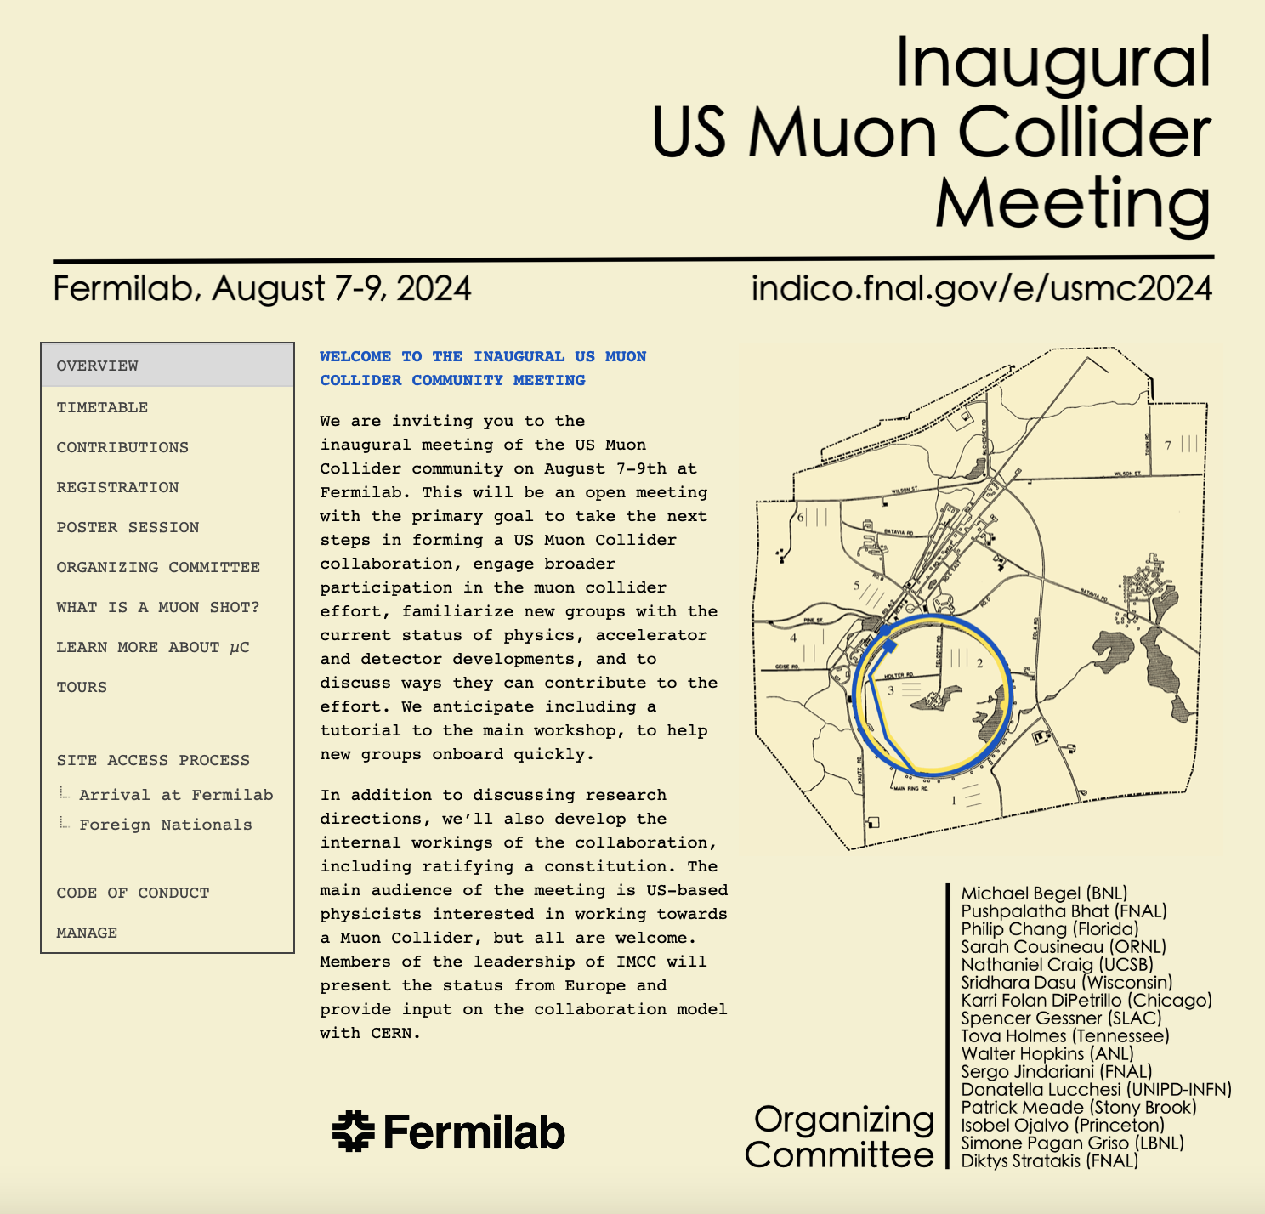
Upcoming Muon Collider Meetings at Fermilab
US Muon Collider Community Meeting August 7-9th, 2024 at Fermilab: https://indico.fnal.gov/e/usmc2024
IMCC Demonstrator Workshop Oct 30th – Nov 1st, indico will be available soon

Slide 26
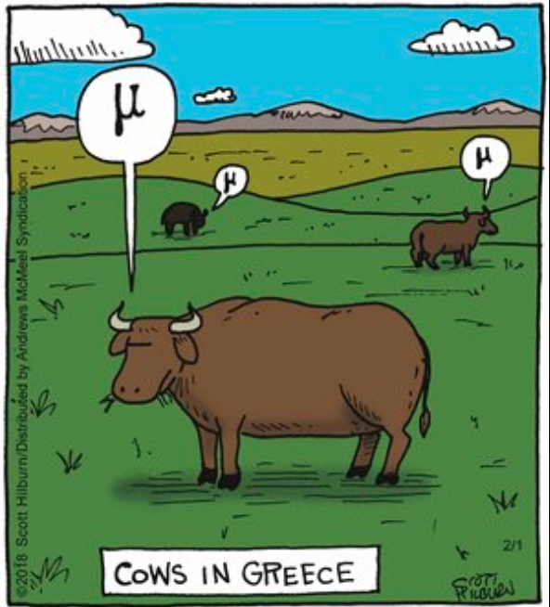
Summary
Fermilab site filler
  ~10 TeV Collider could be built at Fermilab
  (5 × 5 TeV)
“Difficult but perhaps not impossible…” (FN-348, July 1979)

Slide 27

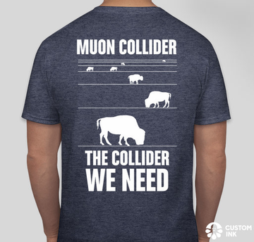
Thank you for your attention

Slide 28
