Slide 1
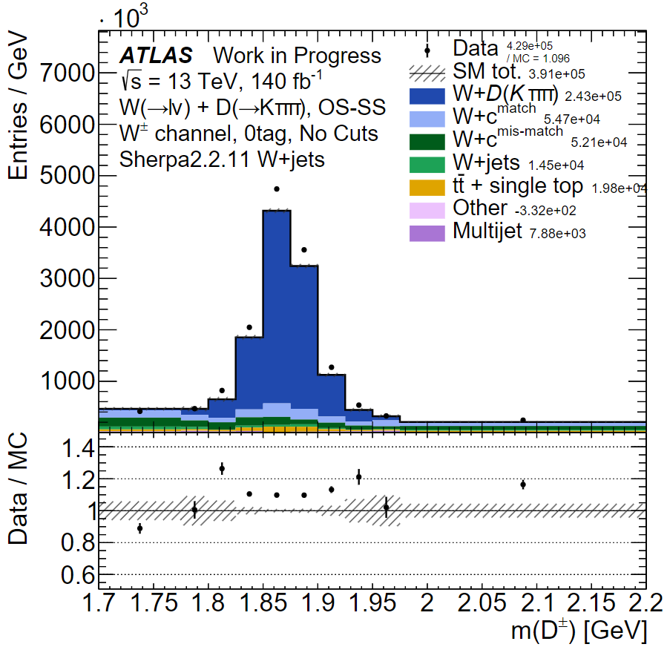
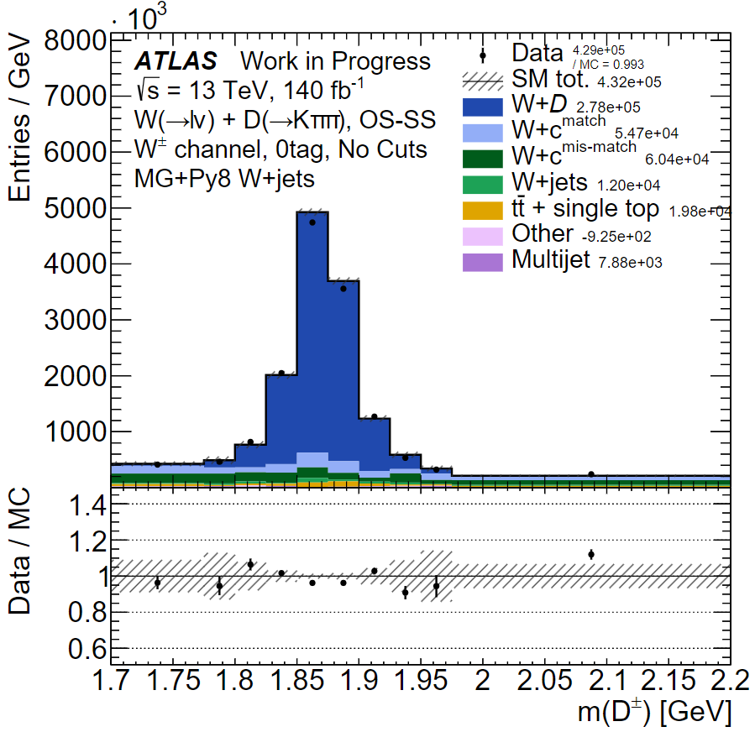
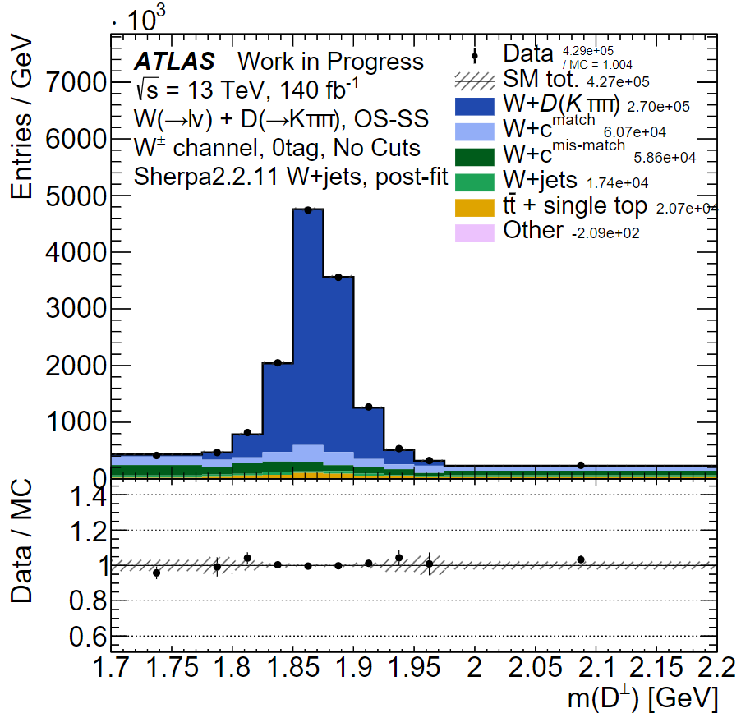
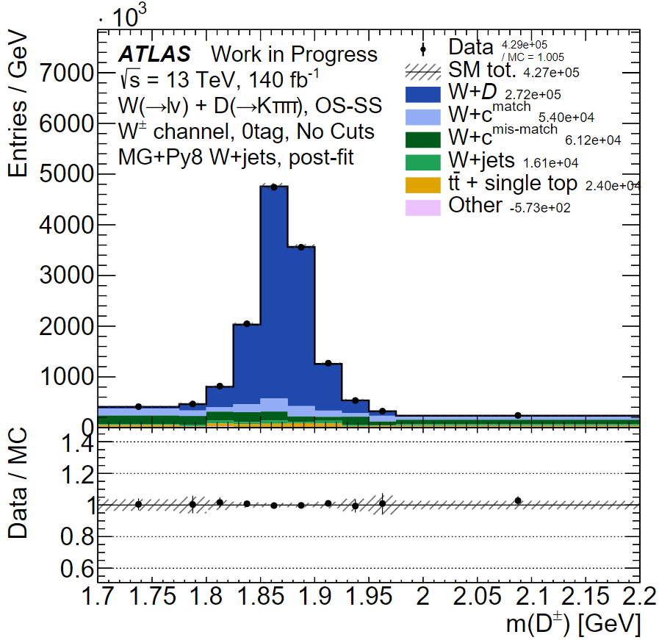
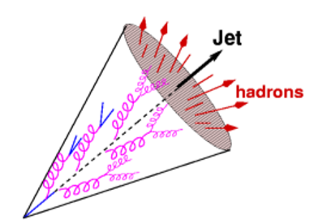
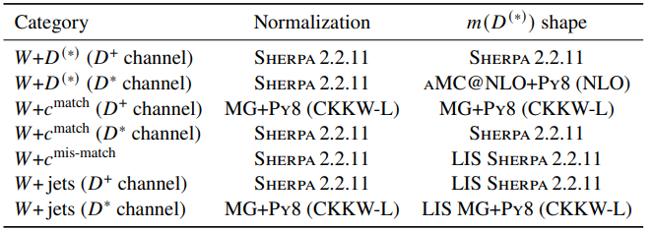
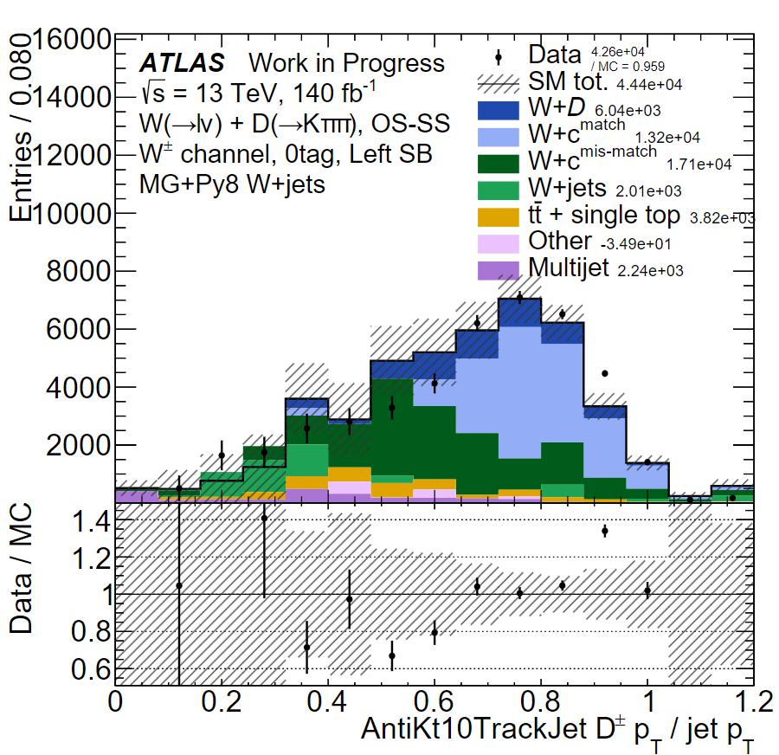
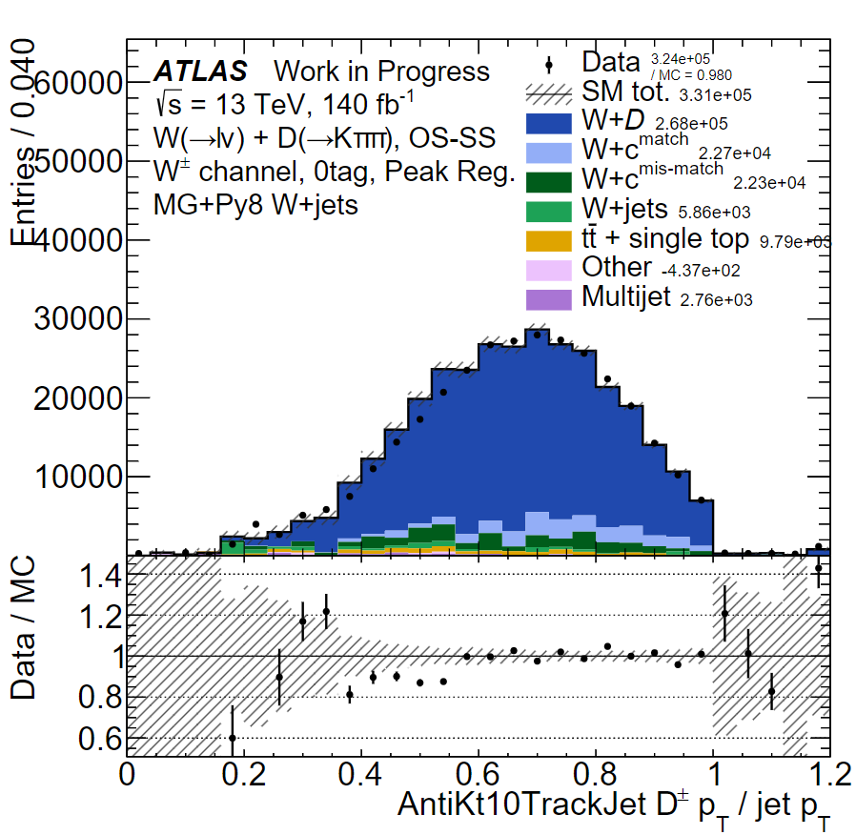
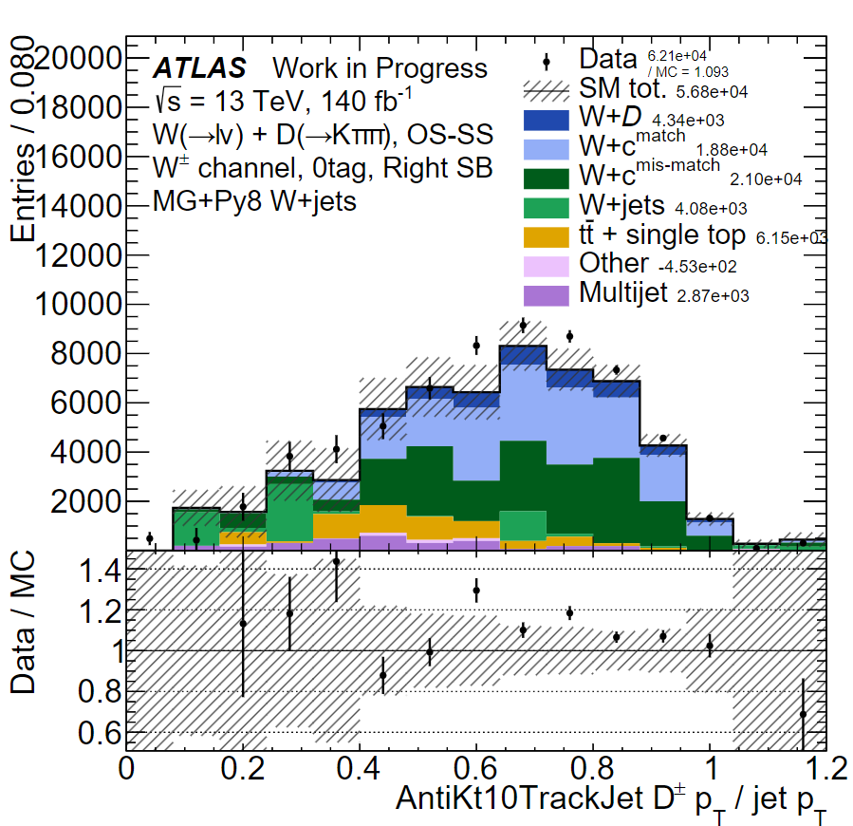
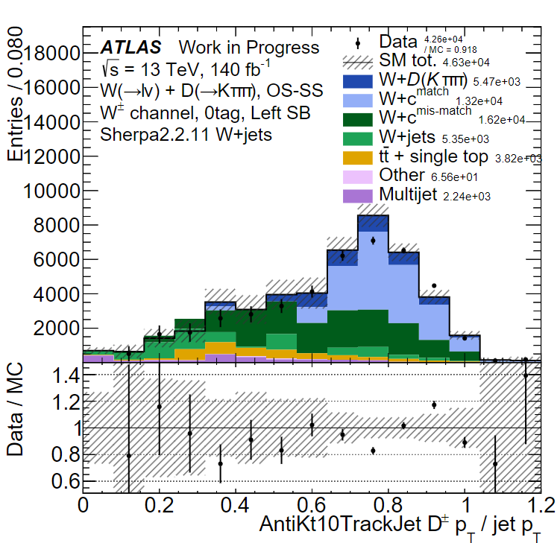
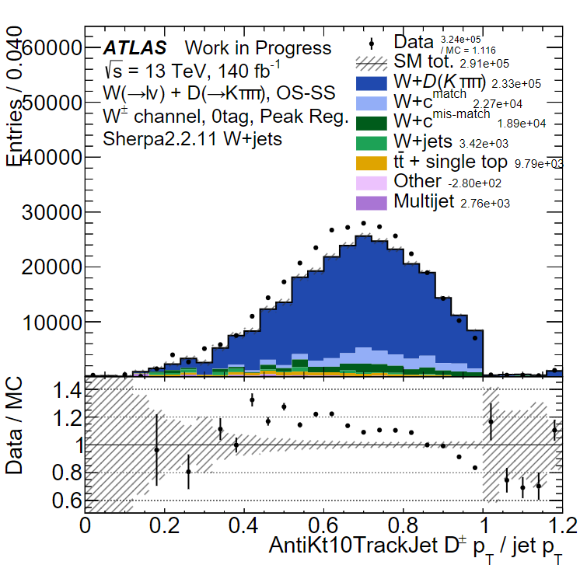
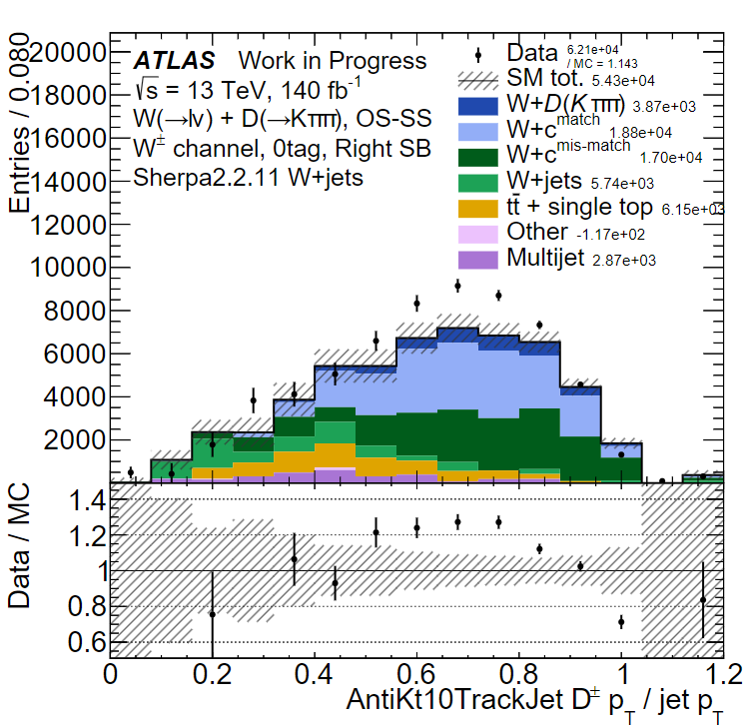
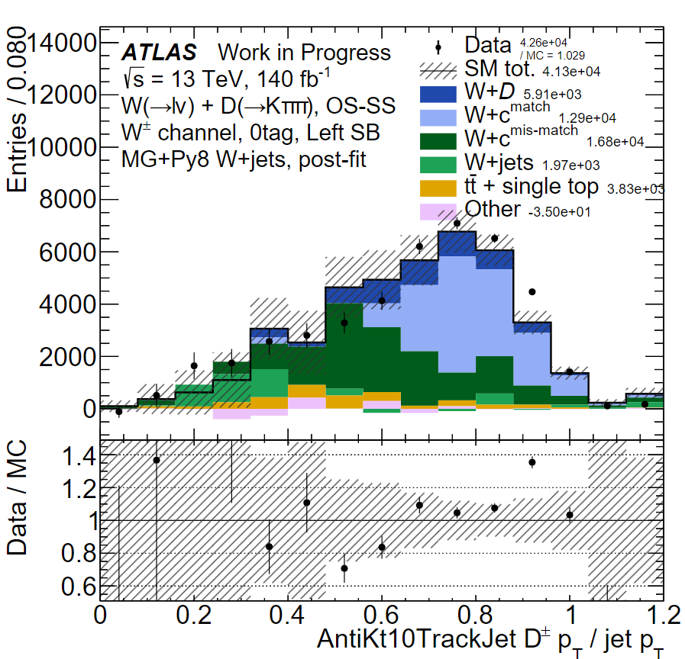
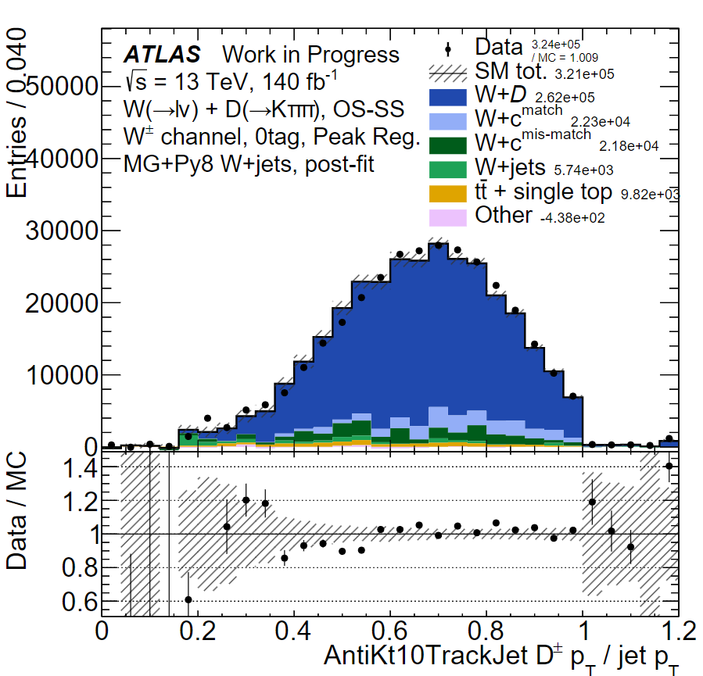
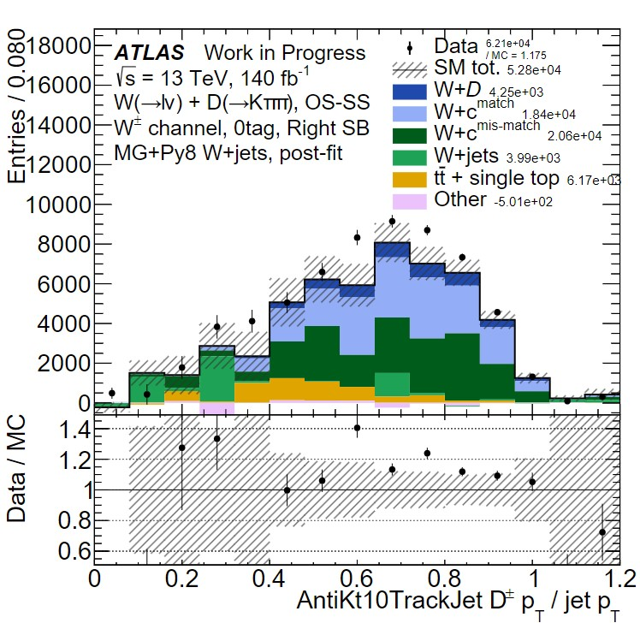
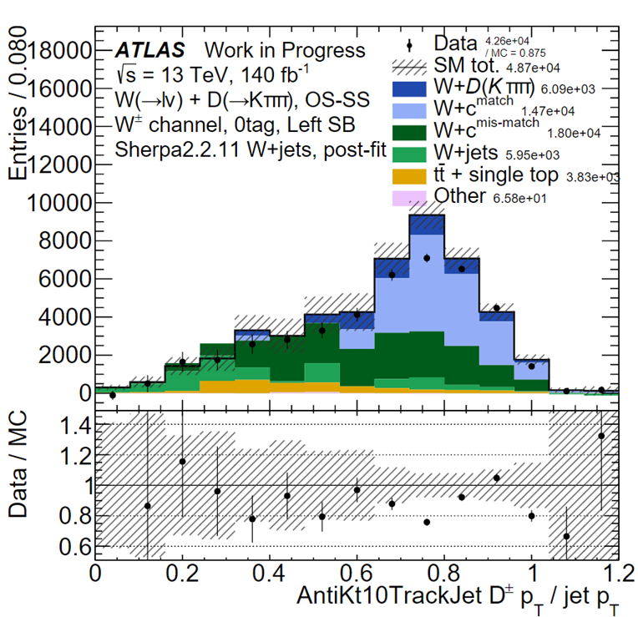
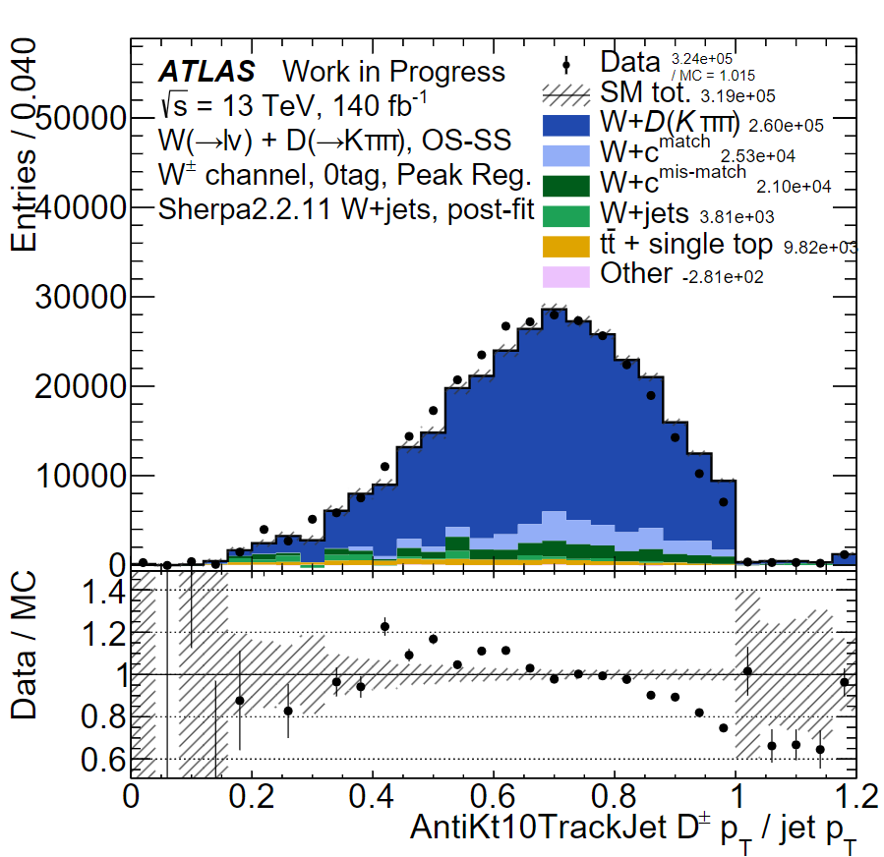
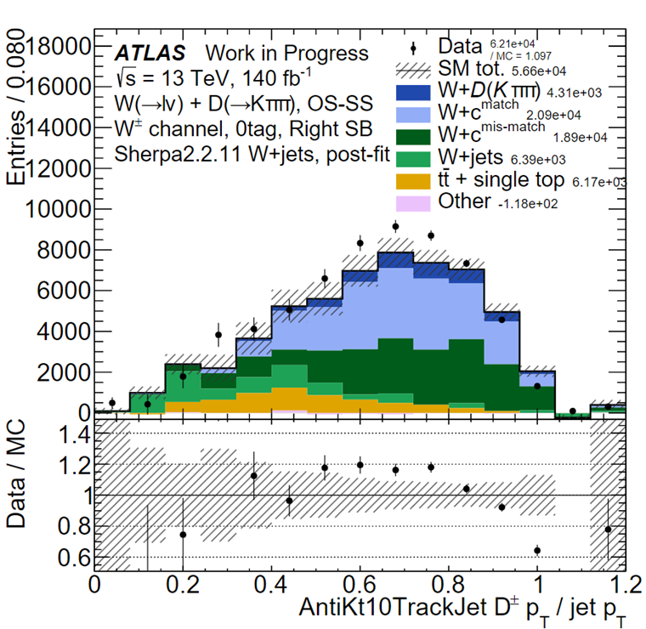
W+D Charm Jet Fragmentation
Alec Lynch*, Marjorie Shapiro, Miha Muskinja, University of California Berkeley, Lawerence Berkeley National Laboratory
FERMILAB-POSTER-24-0147-V
*Continuing work carried on while a member of the Fermilab Mu2e experiment tracker team, Summer 2024
Abstract
D Meson Mass Fit
Using ATLAS Run 2 data, proton-proton collisions at 13 TeV center of mass energy are analyzed to measure the properties of Charmed particle fragmentation. The process $pp→W±c$, where the c-quark fragments to a $D^{+}$ hadron is used. Since quarks are not directly seen from the collision, a jet of particles containing the charmed hadron is used. This is accomplished by comparing the distribution of $z_{T}$, the ratio of the transverse momentum of the $D^{+}$ to that of the track jet containing the hadron, to several Monte Carlo generators.
Pre-fit Mass Plots
Post-fit Mass Plots
Sherpa
MG+P8
Sherpa
MG+P8
To “find” the charmed quarks after the pp collision we use charmed “Jets” that contain the energy indicative of charmed quarks.
Reference: Professor Marjorie Shapiro. Physics 129 Fall 2022
Exploit charge correlations between 𝑊 and 𝐷: Via Opposite Sign (OS) – Same Sign (SS) subtraction
First sign of Sherpa not agreeing with the data as well as MadGraph+Pythia8
Data and Monte Carlo
Via Monte Carlo simulations seen above, simulated data is created to compare to real proton-proton collision events from ATLAS. From these comparisons the Monte Carlo code may be adjusted to more accurately simulate these events.
In Leading Order (LO) W+c production, W bosons and charm quarks always have opposite-sign electric charges.
References: arXiv.2302.00336
AntiKt 1.0 Track Jet $z_{T}$ Distributions
MadGraph+Pythia8
Sherpa
$D^{+}$ Selection and Mass Cuts
Pre-fit $z_{T}$
Study $D^{±}→K^{±}π^{±}π^{±}$ with $p_{T}^{D>8GeV}$and $|η^{D<2},2|$
Mass Cuts
Left Sideband: $1.7≤m\left[GeV\right]≤1.8$
Peak Region: $1.8≤m\left[GeV\right]≤1.95$
Right Sideband: $1.95≤m\left[GeV\right]≤2.2$
These selections cuts in the mass region are used to show how well the two different Monte Carlo simulations model the variables of interest for the background and how much of it is removed.
Post-fit $z_{T}$
Results found that comparing reco level distribution of $z_{T}≡p_{T}^{D}/p_{T}^{jet}$ of data to predictions of Pythia8 and of Sherpa:
There is good agreement between MadGraph+Pythia8 and data.
Sherpa predicts too hard a fragmentation function.
The next steps would be to implement statistical and systematic uncertainties into the samples.
This document was prepared by ATLAS using the resources of the Fermi National Accelerator Laboratory (Fermilab), a U.S. Department of Energy, Office of Science, Office of High Energy Physics HEP User Facility. Fermilab is managed by Fermi Research Alliance, LLC (FRA), acting under Contract No. DE-AC02-07CH11359.

