Slide 1
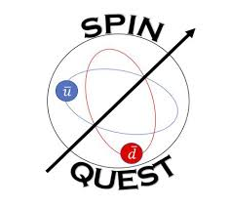

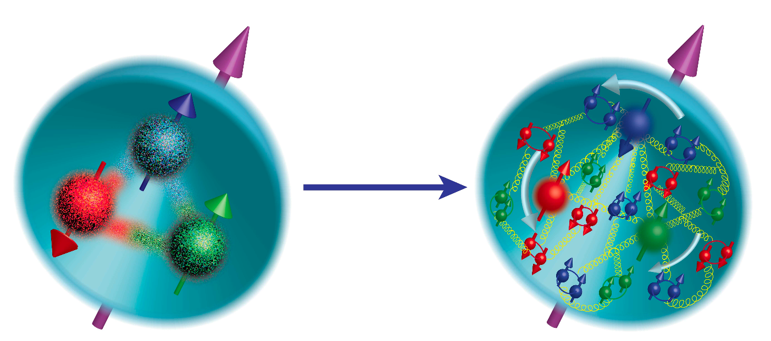
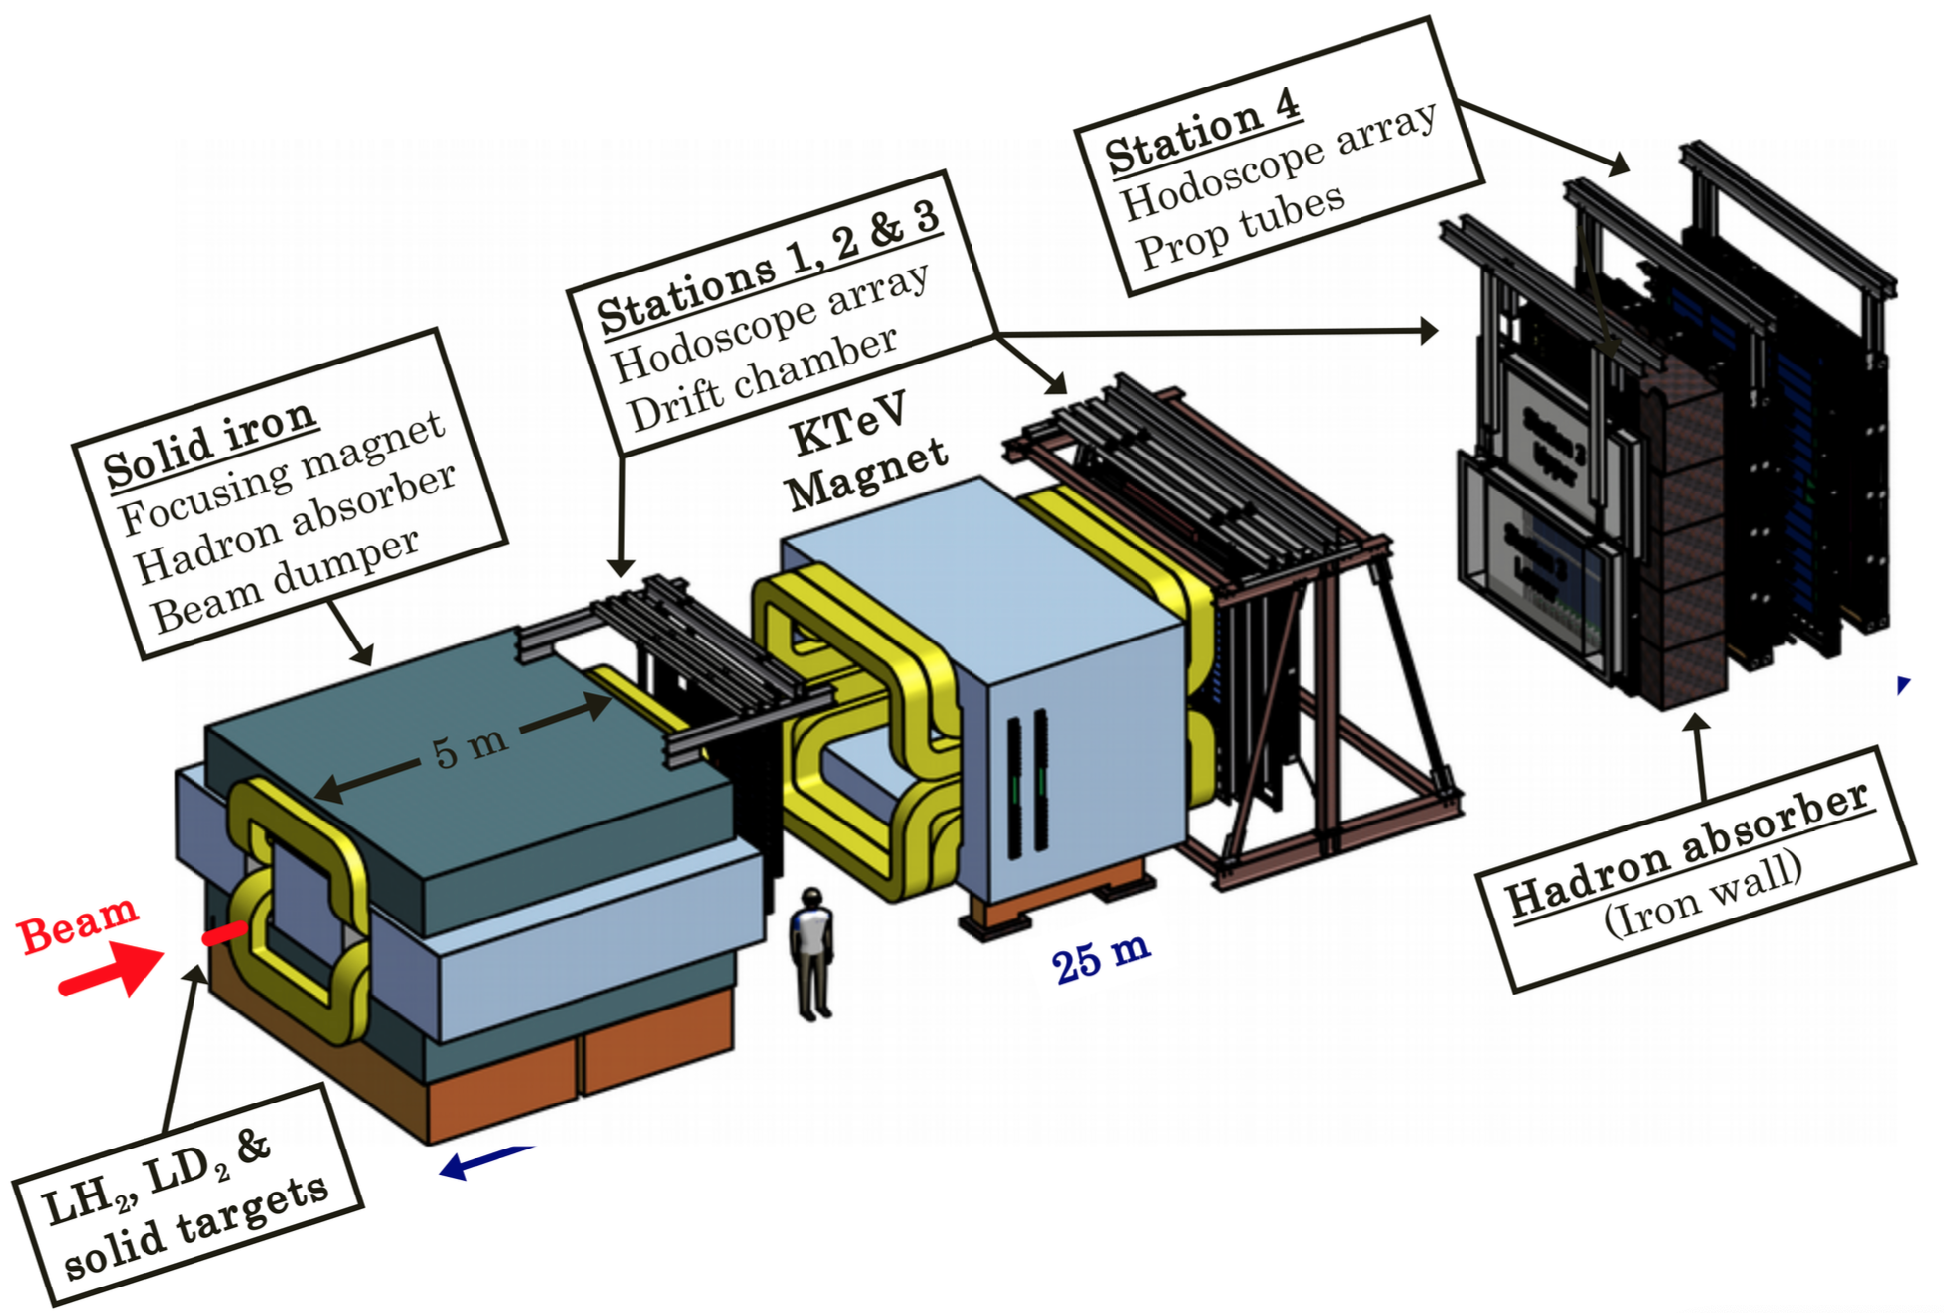
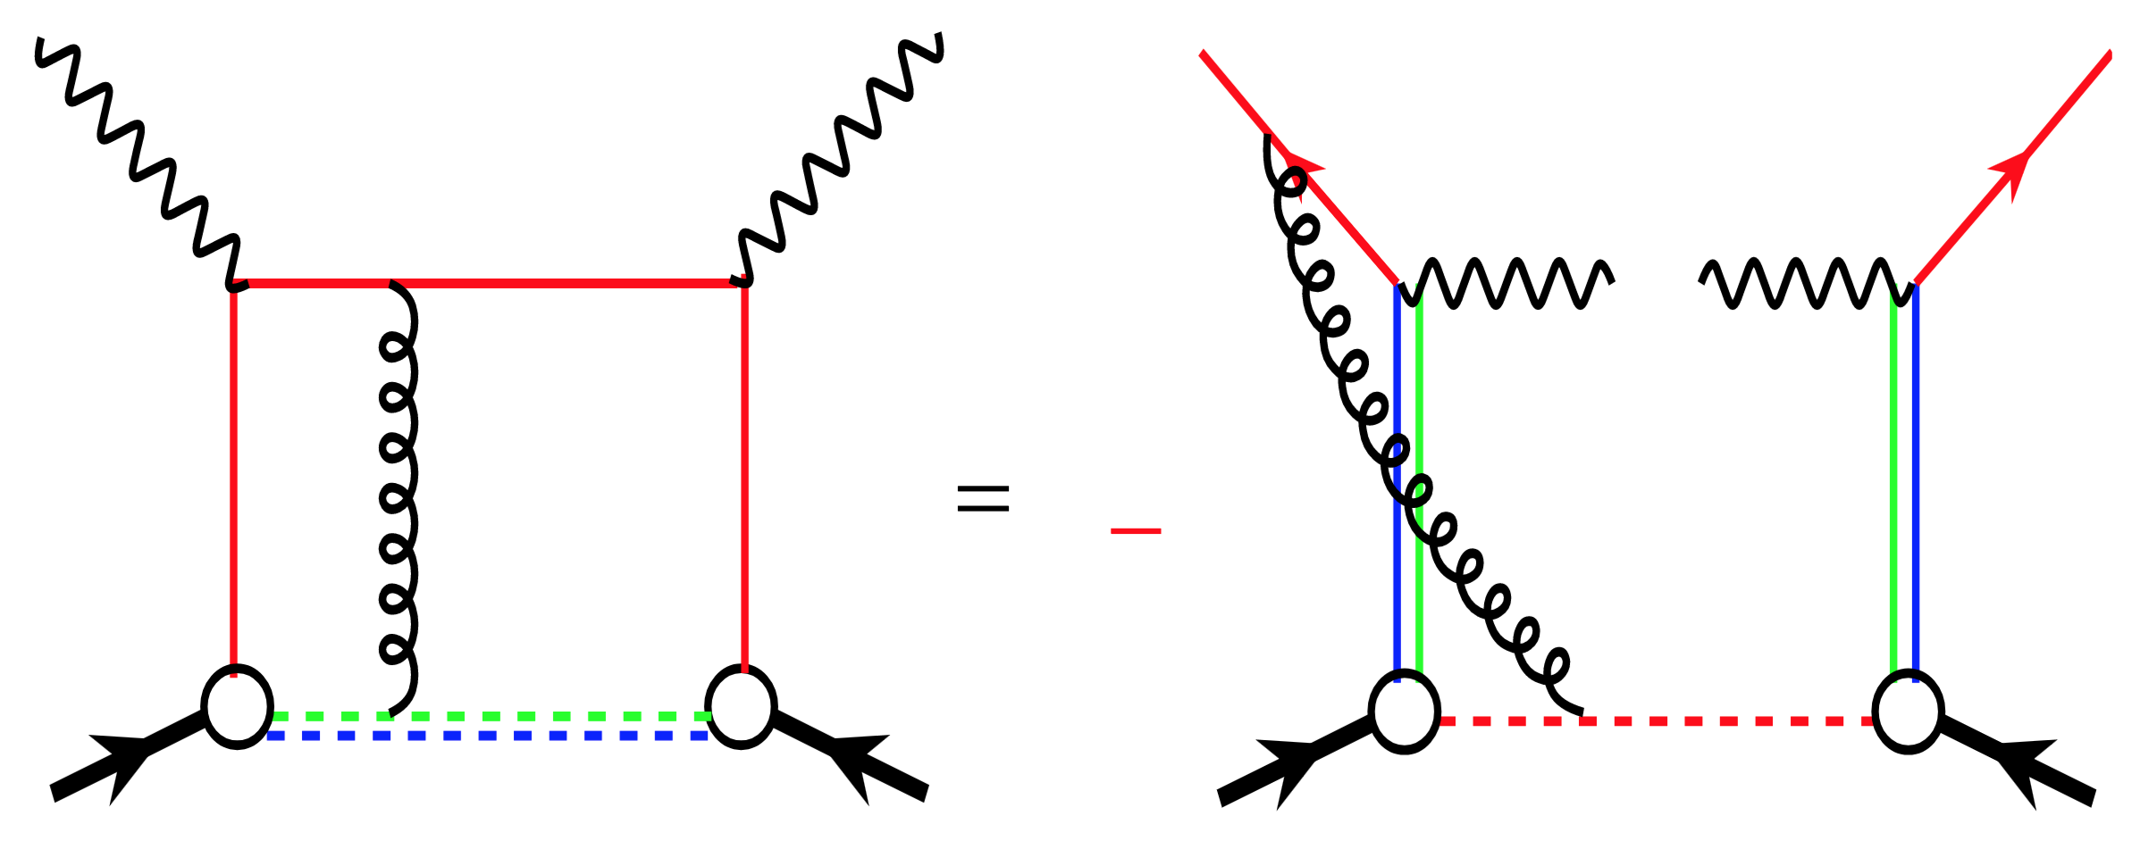
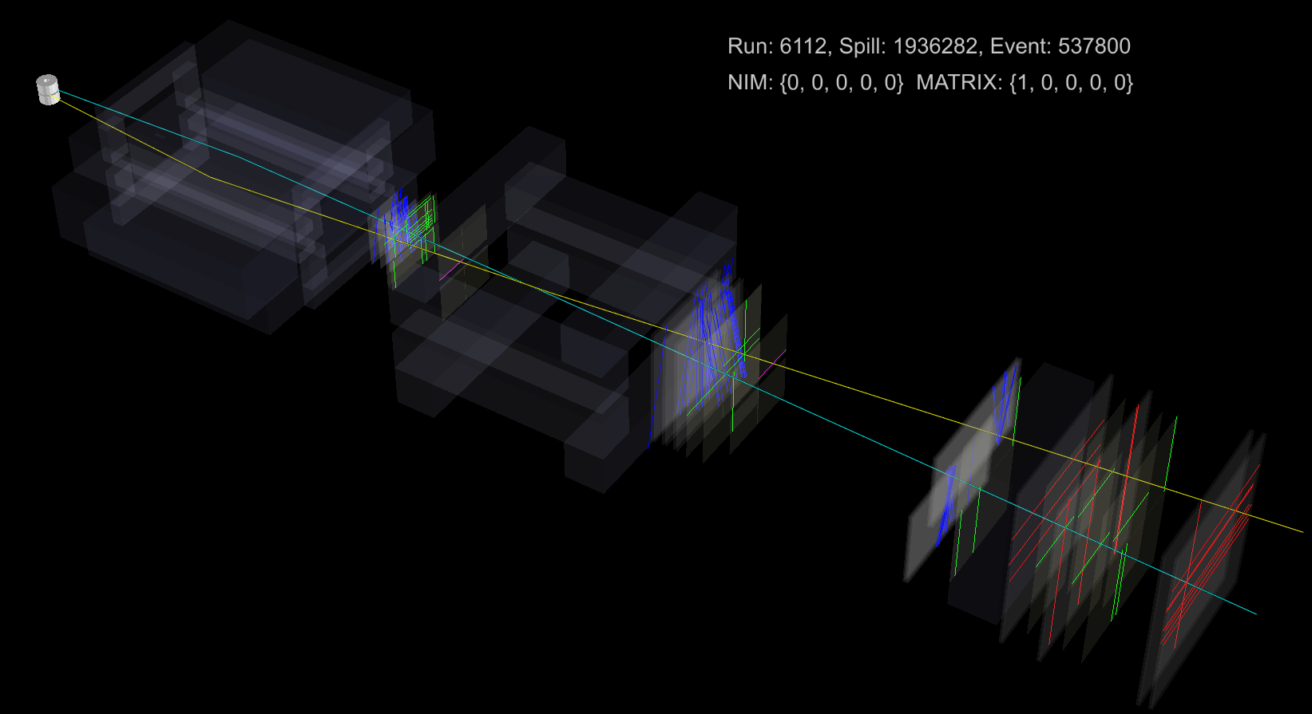
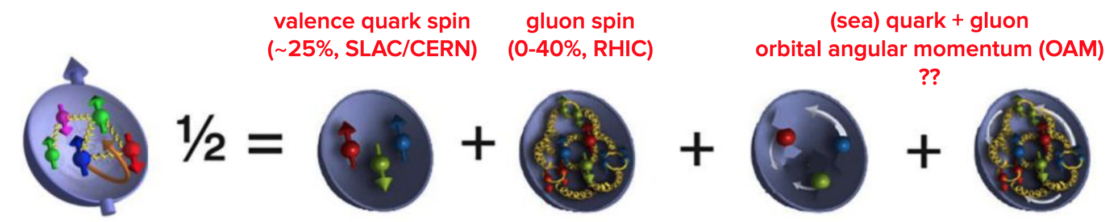
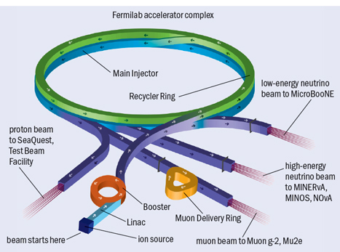
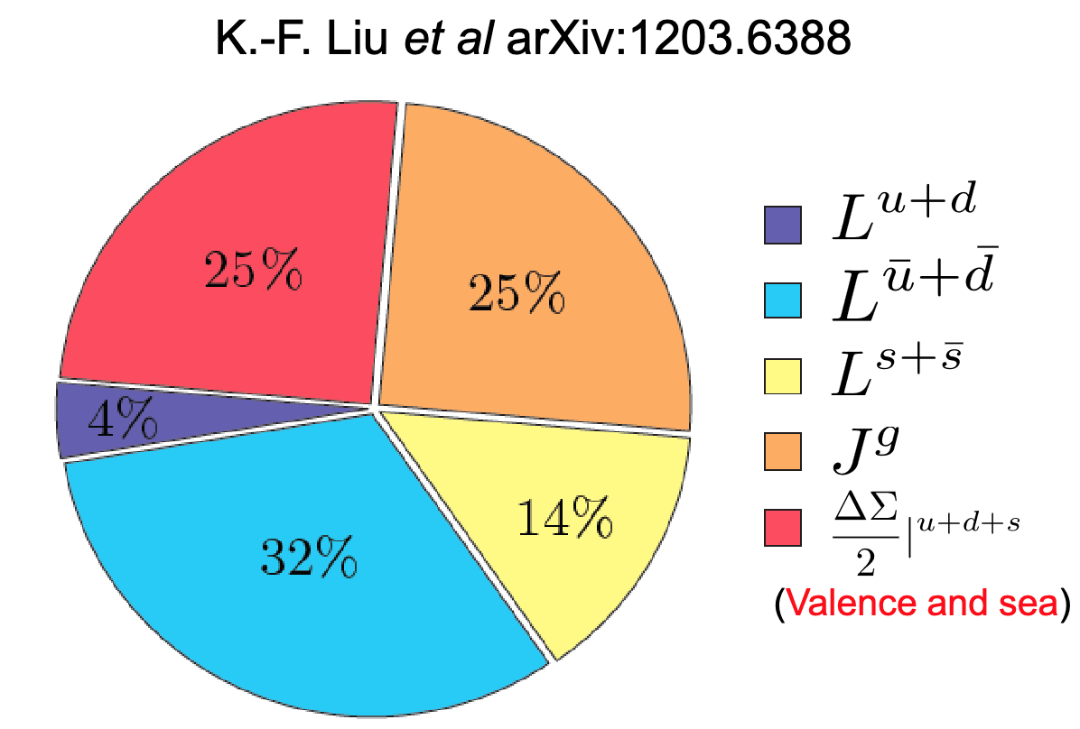
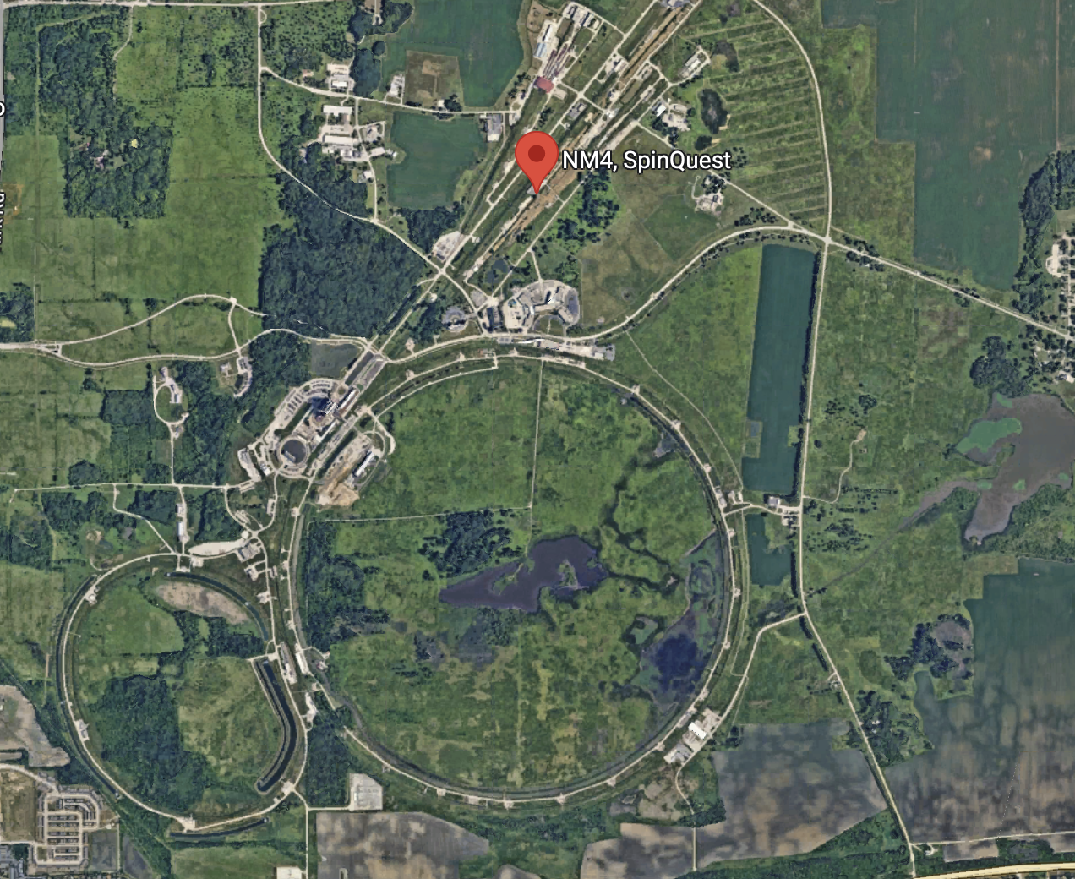
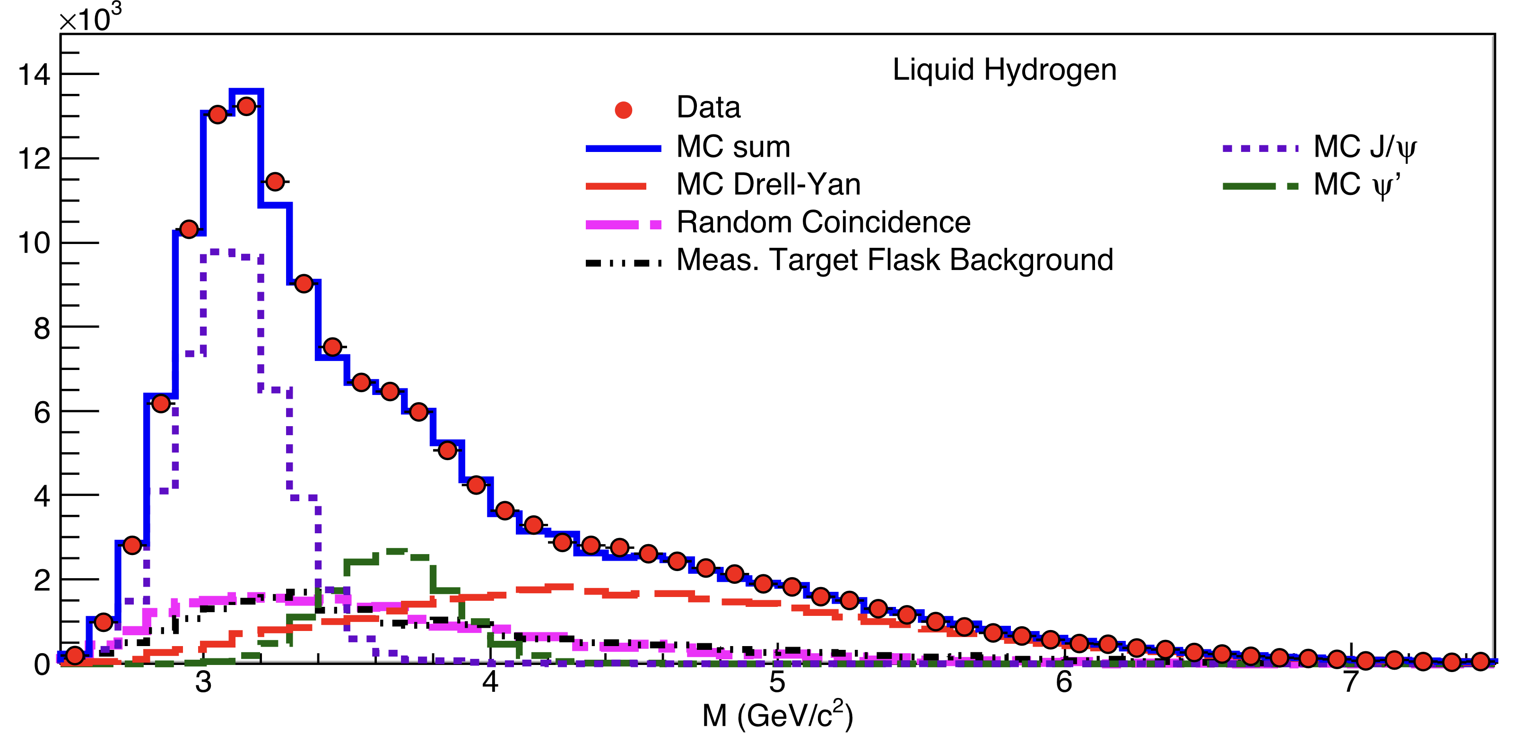
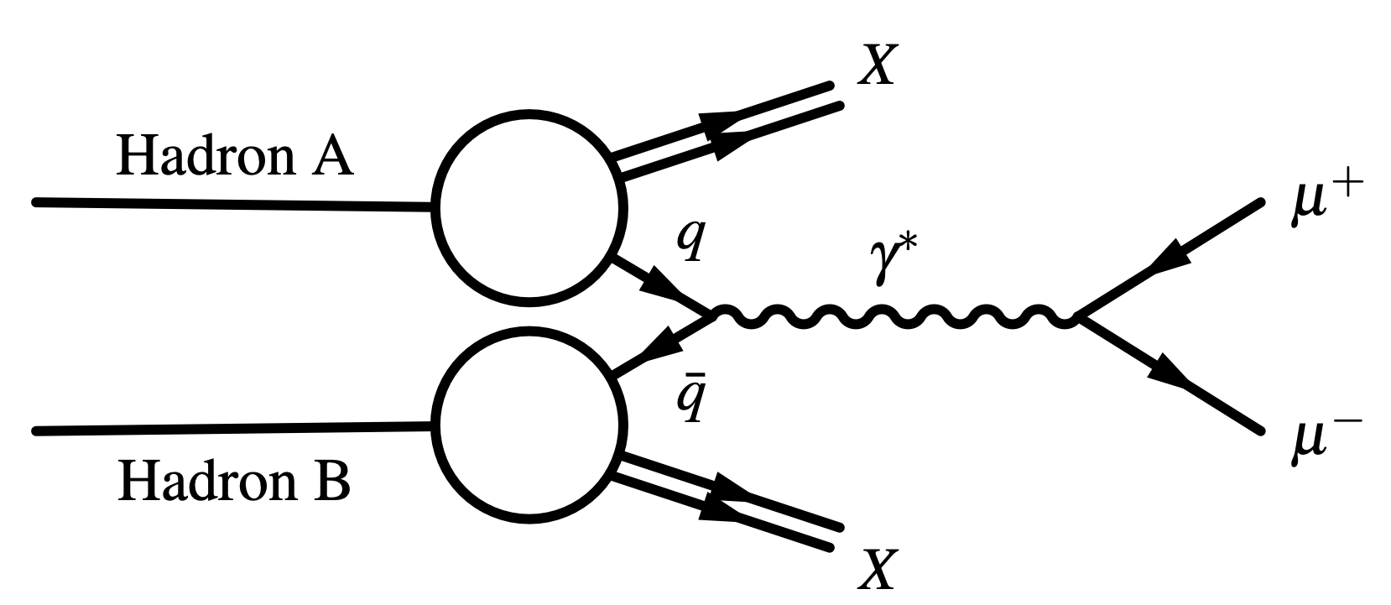
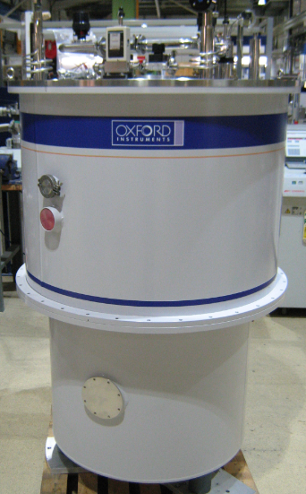
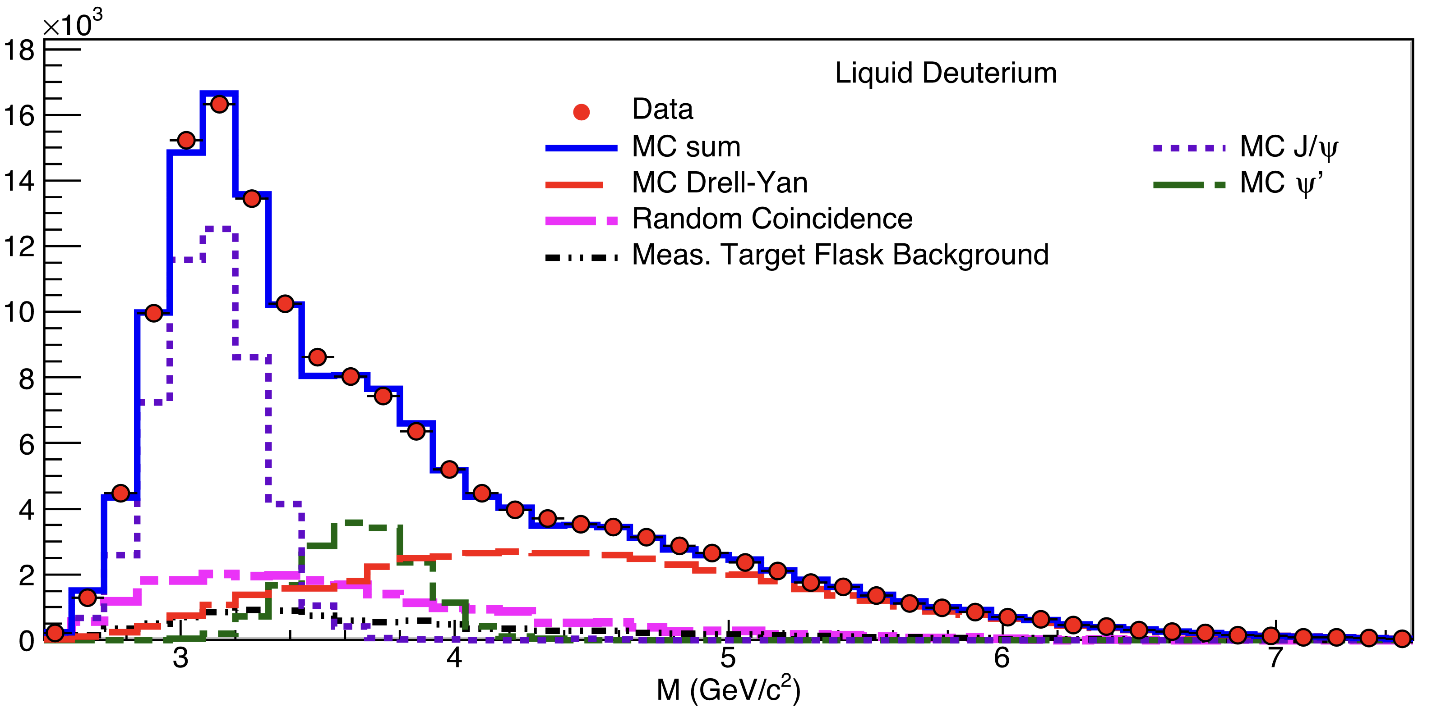
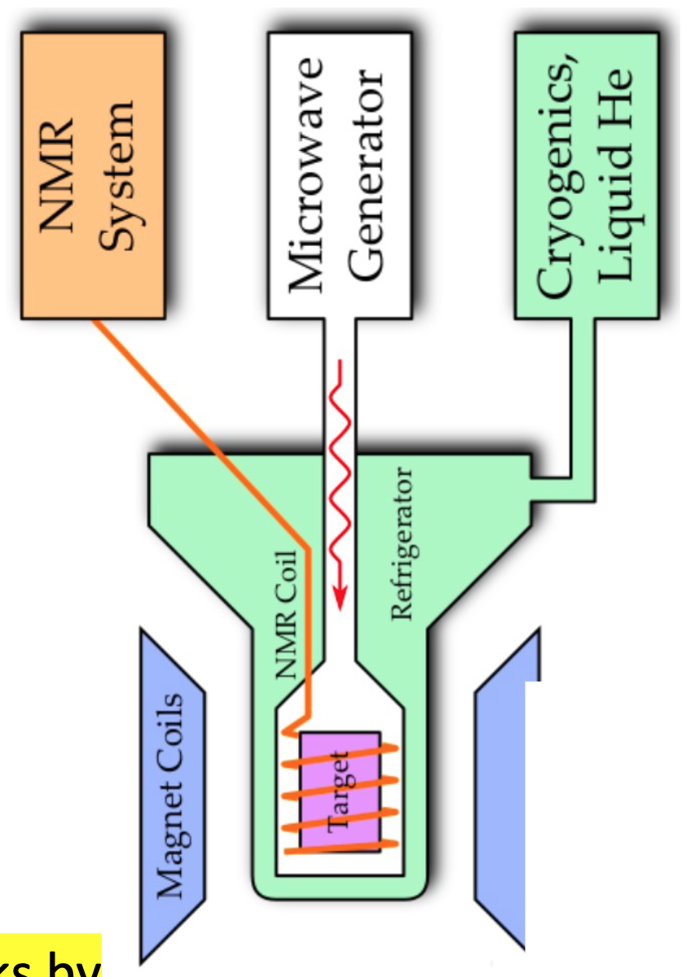
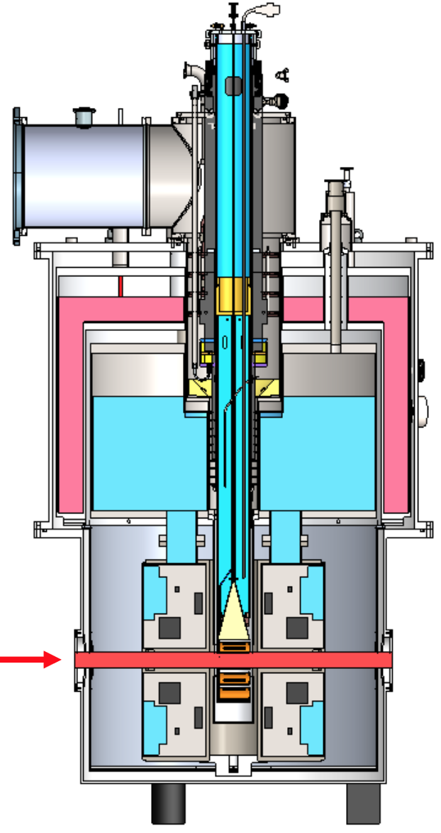
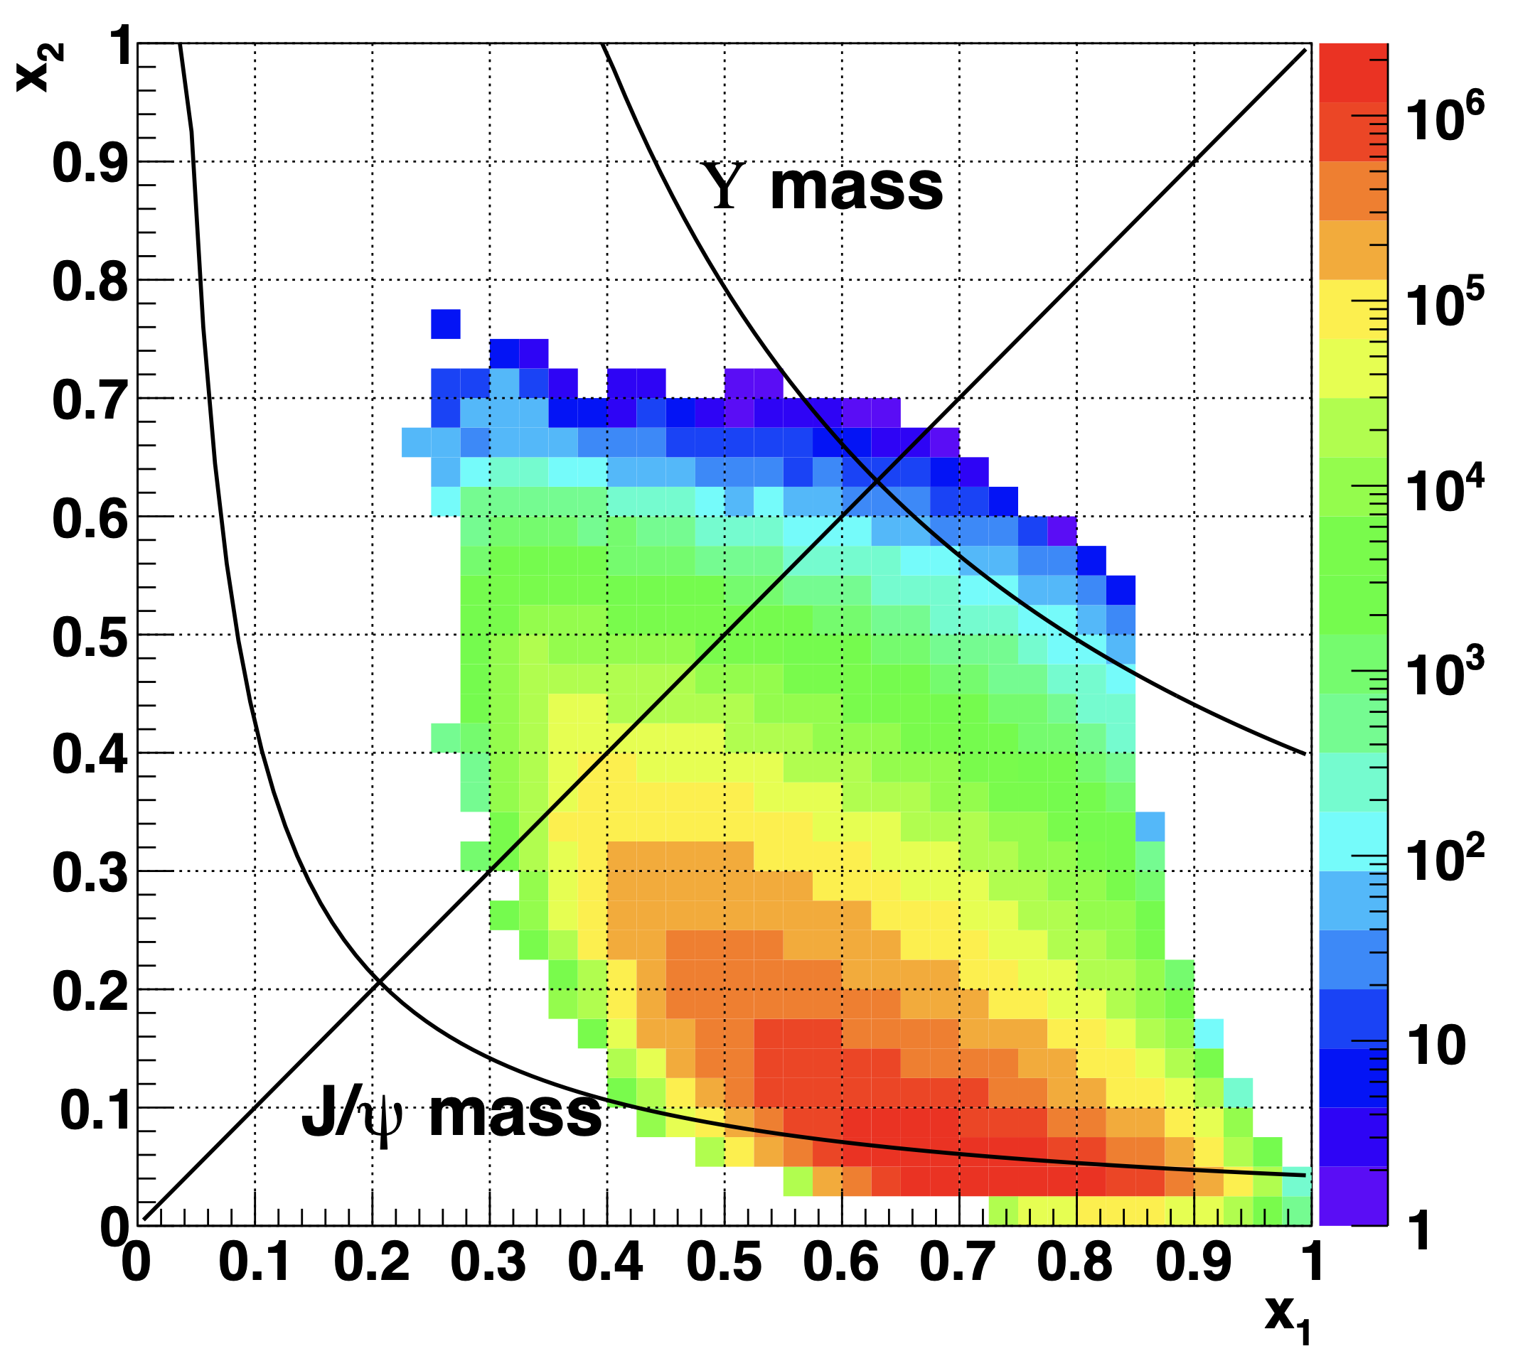
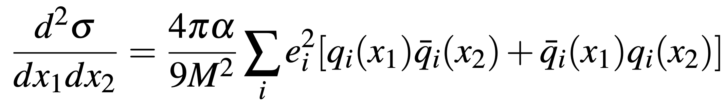









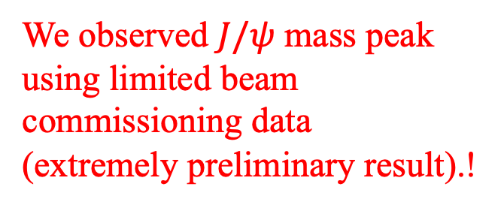


Unveiling Sea Quark Dynamics: Measuring Sivers Asymmetry with Polarized Target at SpinQuest
Chatura Kuruppu, On behalf of SpinQuest Collaboration, New Mexico State University, ckuruppu@fnal.gov
Sea
quarks’ angular
momentum could
be a major part of
the “missing
spin”.
valence quarks, sea quarks and gluons, and their possible orbital motion are expected to contribute to overall nucleon spin.
05. Spectrometer Setup
01. Proton Spin Puzzle.!
03. SpinQuest Objectives
    BDT trained by using kinematics such as missing transverse momentum, transverse momenta, opening angle and visible angle
In the 1980s, a proton’s spin was naively explained by the alignment of the spins of its constituent quarks. EMC experiment measured only ~30% of proton spin comes from valence quarks and 70% of the proton spin is missing (unexpected!)
SpinQuest will conduct the first measurement of the Sivers asymmetry in Drell-Yan proton-proton scattering involving sea quarks ($\overline{u}$ and $\overline{d}$) with sign. $f_{1T}^{⏊q}|_{SIDIS}={−f}_{1T}^{⏊q}|_{DY}$
Measurement of the Sivers function for gluons (J/psi transverse single-spin asymmetry)
Investigate a distinct range of virtualities and transverse momenta that cannot be accessed through Z⁰ or W± measurements
    Taking the advantage of the spectrometer used by E906 experiment
    Made by 24 wire chamber planes, 16 hodoscope planes and 8 planes with proportional tubes
    FMag generates magnetic field of 1.8T to select muons in appropriate momentum region
    KMag generates magnetic field of 0.4T and useful to evaluate momenta of muon candidates
EIC white paper
valence quarks, sea quarks, gluons, and their possible orbital motion are expected to contribute to overall nucleon spin
Lattice QCD predicts non-zero quark Orbital Angular Momentum
The need for a breakthrough to understand the origin of the nucleon spin and the related 3D nucleon structure
$NH_{3}/ND_{3}$
solid targets
Target System:
  8 cm long solid NH3 and ND3 target cells
  Magnetic Field: B = 5 T with uniformity ${dB}/B<{10}^{−4} T$ over 8 cm
  Maintaining the target at 1.1K using $He^{4}$evaporation refrigerator
  140 GHz microwave source (with DNP technique)
  Helium Liquefier System (200 L/day) for sustainable cooling
04. Beamline and the Target System
EIC white paper
Valance quark spin gluon spin (sea) quark + gluon
(~25% SLAC/CERN) (0-40% RHIC) orbital angular momentum (OAM)
???
Beam Direction
Beam:
  proton beam energy 120 GeV
  $\sqrt{s}=15.5GeV$
  Consisting of $5×{10}^{12}protons/spill$
  Beam spill $≈4.4s/min$
  Expect $7×{10}^{17} POT/Year$
$ΔΣ_{q} ≈ 25\%$
$L_{u} ≈{−L}_{d}$
$2L_{q}$ $≈$ 46% [0% (Valance) + 46% (Sea)]
${2J}_{g} ≈25\%$
$J_{g} ={ΔG+L}_{g}$
Event display view of di-muon event recorded during the beam commissioning period
Target System:
  8 cm long solid NH₃ and ND₃ target cells
  Magnetic Field: B = 5 T with uniformity ${dB}/B<{10}^{−4} T$ over 8 cm
  Maintaining the target at 1.1K using $He^{4}$evaporation refrigerator
  Expected polarizations:
    $NH_{3}$: 80%
    $ND_{3}$: 32%
06. Conclusions
In this model, all the quark orbital momentum comes from the sea quark contribution
Sea quarks’ angular momentum could be a major part of the “missing spin”
We observed $J/ψ$ mass peak using limited beam commissioning data
(extremely preliminary result).!
valence quarks, sea quarks and gluons, and their possible orbital motion are expected to contribute to overall nucleon spin.
02. Drell-Yan Process
Drell-Yan is an essential complement to semi-inclusive deep inelastic scattering (SIDIS)
Critical for probing proton spin and testing QCD
It is the cleanest method, free from fragmentation functions, involves two Parton transverse momentum distributions (TMDs), and provides direct access to sea-quark distributions
The antiquark PDF is always involved in the reaction
The kinematics is simple and can be determined experimentally
Most events arise from beam-quarks and target anti-quarks kinematic acceptance is $x_{1}≫x_{2}$ (valance quarks dominance)
The cross section of the Drell–Yan process is:
Already collected data during the beam commissioning and analyzed invariant mass spectrum with the limited data collected by online reconstruction (not full reconstruction)
We expect better efficiency and resolution from offline analysis
Further investigations are ongoing to study:
  transversity, tensor charge, tensor polarized observables, dark sector, polarized proton beam and many more…..
Nature 590, 561–565 (2021)
SpinQuest can measure the transverse single spin asymmetry (TSSA) in Drell-Yan (DY) process and charmonium production
This can provide information to the Sivers function for the quarks and gluons
Projected event selection/reconstruction is expected to be the same for E1039 from E906
$δσ_{M}$(𝐽/𝜓) ~ 220 MeV
Drell-Yan is a critical complement to
SIDIS (semi-inclusive deep inelastic
scattering) for measuring the proton spin
and testing QCD, both are required
Cleanest method with no fragmentation
function, two parton TMDs, direct access
to sea-quark distributions
Beam
Nagai, Kei. FERMILAB-THESIS-2017-05
Stay tuned for more updates!
https://spinquest.fnal.gov/
FERMILAB-POSTER-24-0136
This manuscript has been authored by Fermi Research Alliance, LLC under Contract No. DE-AC02-07CH11359 with the U.S. Department of Energy, Office of Science, Office of High Energy Physics.
57th Annual Fermilab Users Meeting

