Slide 1
Tape rates for CREST
Dmitry Litvintsev

Slide 2
Goal
Estimate what are the tape I/O requirements going forward.
Translate these into amount of tape drives needed to satisfy these requirements.
Use simplistic assumption that as the amount of data stored on tape grows so does the daily I/O rate. In this talk:
We will check of this assumption holds true base on existing historical data
Make projections into the future based on the trends of existing and projected data.
Projected annual data volumes were taken from spreadsheets provided by Lisa for CREST document.

Slide 3
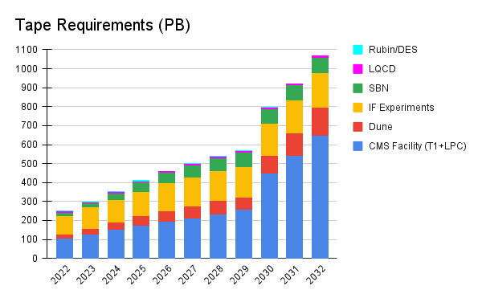
Input data: Tape usage projections

Slide 4
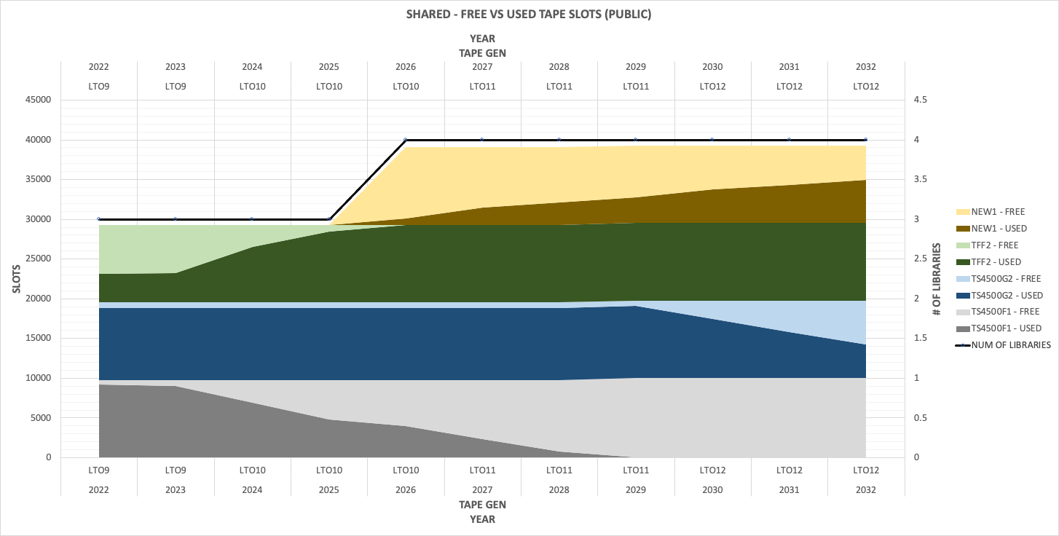
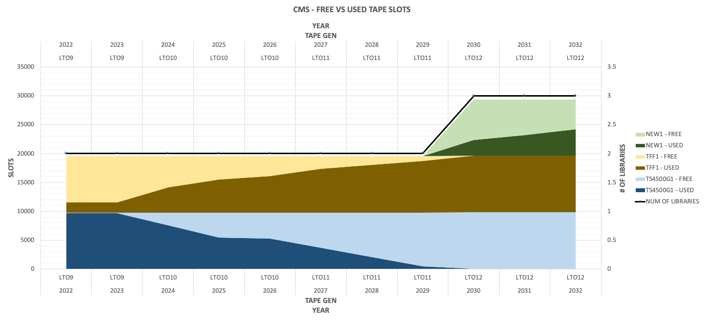
Projecting: how many libraries will be needed
Public: 4 libraries by 2032
CMS: 4 libraries by 2032

Slide 5
What I/O rate current tape volume demands: 3 month window of tape transfers
Average daily rate was about 300 TiB/day
Average number of active drives 50
LTO8 drive speed is 360 MB/s
100% at max rate would have given us 1400 TiB/day rate for 50 drives.
Our efficiency is 20% compared to max rate.

Slide 6
Public (mostly IF) volume on tape per year
Projected slope (beyond year 2023) is not as steep as historical data, but close.
Expect to write 25 PB/year

Slide 7
Public daily rate projections
Purple lines:
Average daily transfer rate (sum(all transferred)/365) for that year.
Liner fit of data on interval [2016:2024] yields rate increase of 32 TiB/day each year.
Green lines:
For each year find a day with maximum transferred on that day. Plot that.
Linear of data on interval [2016:2024] yields rate increase of 66 TiB/day each year
Taking midpoint at the end of 2032 we expect to match 900 TiB/day.
Assuming LTO9 speed of 400 MB/s and 50% (we expect CTA to have better efficiency that Enstore, but still use conservative number). We will need 60 LTO9 drives for public system.

Slide 8
CMS volume on tape per year
Till 2030 slope is similar to Public – 20 PiB/year
HL LHC the volume per year increases by factor of 6 –> 126 PiB/year

Slide 9
CMS rate projections
Rate projection till 2030 follows Public
After that, we need to multiply by 6.
Mid point in Dec 2032 is 900 TiB
6 x 900 = 5400 TiB/day
Assuming LTO9 speed of 400 MB/s and 50% (we expect CTA to have better efficiency that Enstore, but still use conservative number). We will need 343 LTO9 drives for CMS system.
Silver bullet: LTO10 will offer almost factor of two speed boots ~ 700 MB/s.
Therefore we expect to need under 200 drives that fit into 4 libraries (expected).

Slide 10
Conclusion
We have made tape I/O rate projections till the end of 2032.
The main assumption of these projections – that daily tape I/O rate is proportional to total data volume on tape. This seems to be a correct assumption when looking at historic data.
The daily I/O tape rate can be decreased by larger cache / tape volume ratio and reduction of data being analyzed (nano AOD etc.)
Adoption of newer tape technology is crucial not only for meeting expected tape volume requirements but to providing matching overall I/O rate utilizing minimum number of tape libraries.

