Slide 1
Decay Pipe Windows Final Design Review
Quinn Peterson
Decay Pipe Windows FDR
26 June 2024

Slide 2
Topics
LBNF/DUNE Intro
Beamline and NSCF are currently preparing for baselining/early procurements (CD2/3)
Decay Pipe Windows review
Charge Questions
Decay Window Overview
EDMS Requirements
Interfaces
Risks
Schedule
01/25/24 Peer Review
DSDP Window
Design
USDP Window
Design
Cost
Installation
QA/QC
Notes:
Switch Peer Review to after schedule

Slide 3
DUNE & LBNF
The Deep Underground Neutrino Experiment will be a world-leading experiment for neutrino science, potentially transforming our understanding of why the universe exists as it does.
The Long-Baseline Neutrino Facility is the infrastructure necessary to send a powerful beam of neutrinos 800 miles through the earth, and measure them deep underground at South Dakota’s Sanford Underground Research Facility.
DUNE/LBNF project will be the first internationally conceived, constructed, and operated mega-science project hosted by the DOE in the U.S.
The beamline is designed to commission at 1.2MW and increase to 2.4MW
06.26.24

Slide 4
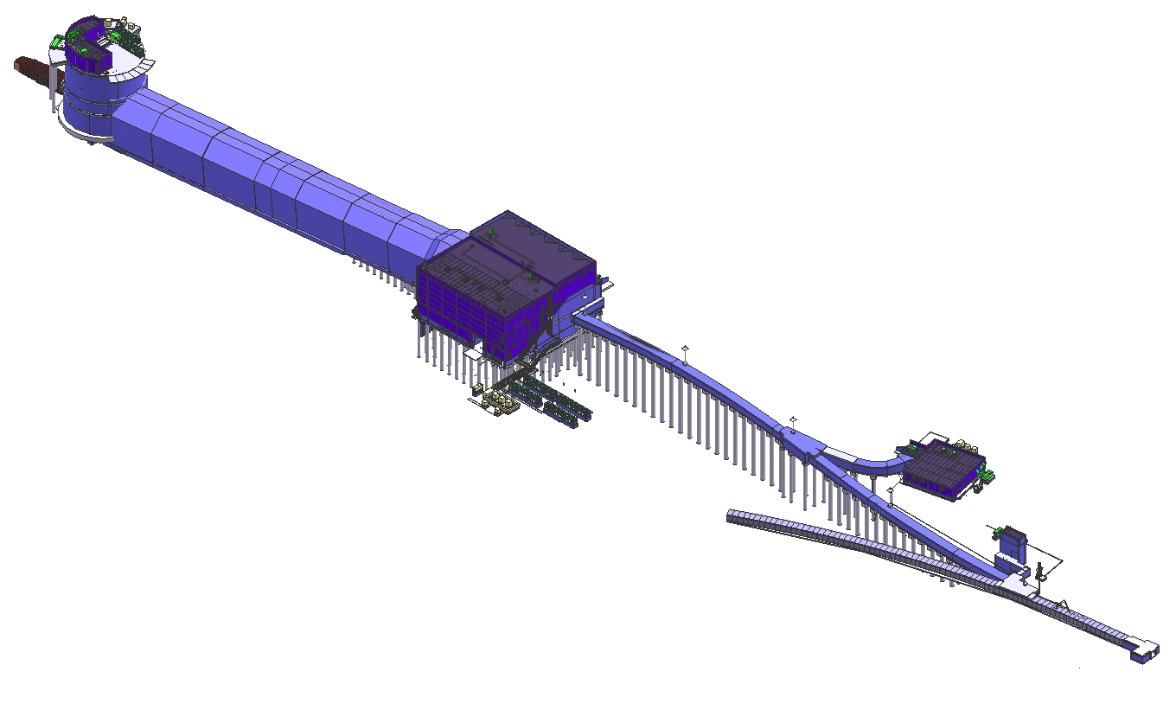
WBS 131.NSCFB.03.04 Scope
Focus of this review – Bulk Shielding in the Target Hall
Neutrino Beam
to SURF, SD
Absorber Complex
(LBNF-30)
Target
Complex
(LBNF-20)
Primary
Beamline
Enclosure
Decay Region
Primary Beam Service Building
(LBNF-5)
Major
Vehicle
Access
Includes the Absorber, Instrumentation,
DS end of Decay pipe
Includes the US Decay Pipe window
The Primary beam window, Instrumentation
Fermilab
Main Injector
Tunnel
Extraction
Enclosure
Proton Beam
From MI-10
06.26.24

Slide 5
Decay Pipe Windows Final Design Review
Technical Peer Review Conducted January 25, 2024
Committee: Patrick Hurh, Kris Anderson, Kavin Ammigan
The design of the Decay Pipe windows is ready for final design review
Technical Peer review recommendations have been addressed or are close to completion
Drawings are done
The design is sufficiently mature
The Upstream Decay Pipe Window is being designed, procured, and fabricated and installed under the Beamline Scope.
The Downstream Decay Pipe Window is being designed and installed by CF as part of the Decay Pipe System. Beamline Scope is to provide a thermal/structural analysis including beam energy deposition to be appended to the AECOM FESHM 5031.5 engineering note and will be included as part of the FESHM Peer Review.
Note that the Upstream Decay Pipe Window and associated documentation refer to and rely in part on the design of a Remote Exchange Mechanism, however, this mechanism is outside of the scope of this review
This review will help to confirm our design choices, cost and schedule
06.26.24

Slide 6
Charge Questions
Charge #
Do the design choices satisfy the requirements?
Have all engineering analyses been performed and documented, and reviewed/peer reviewed and approved, where applicable? Does it meet FESHM standards?
Are all 2D/3D mechanical model drawings complete and documented?
Is there a centrally maintained, accessible to all, CAD assembly model with the appropriate level of detail needed for an integration model?
Have all lessons learned been incorporated into the final design?
Have the ESH issues been identified and analyzed appropriately?
Are installation, and testing plans in development?
Have sufficient resources for installation and testing been identified?
Do project planning materials including interface documents, QA/QC plans, risk assessments, schedules, and cost estimates exist at a sufficient level of development for this stage of the design?
Have all recommendations from previous reviews been adequately addressed and approved by the relevant authority?
Has a peer review been done on the analysis?
06.26.24

Slide 7
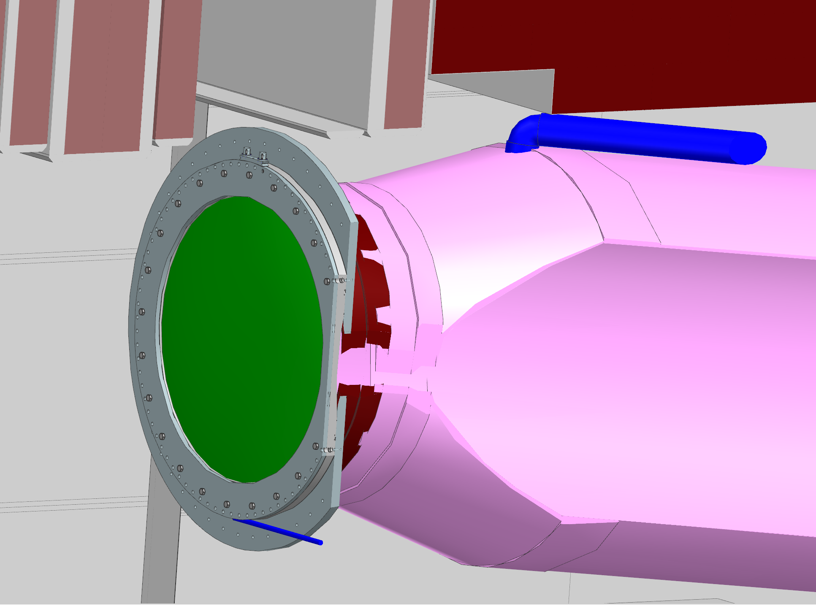
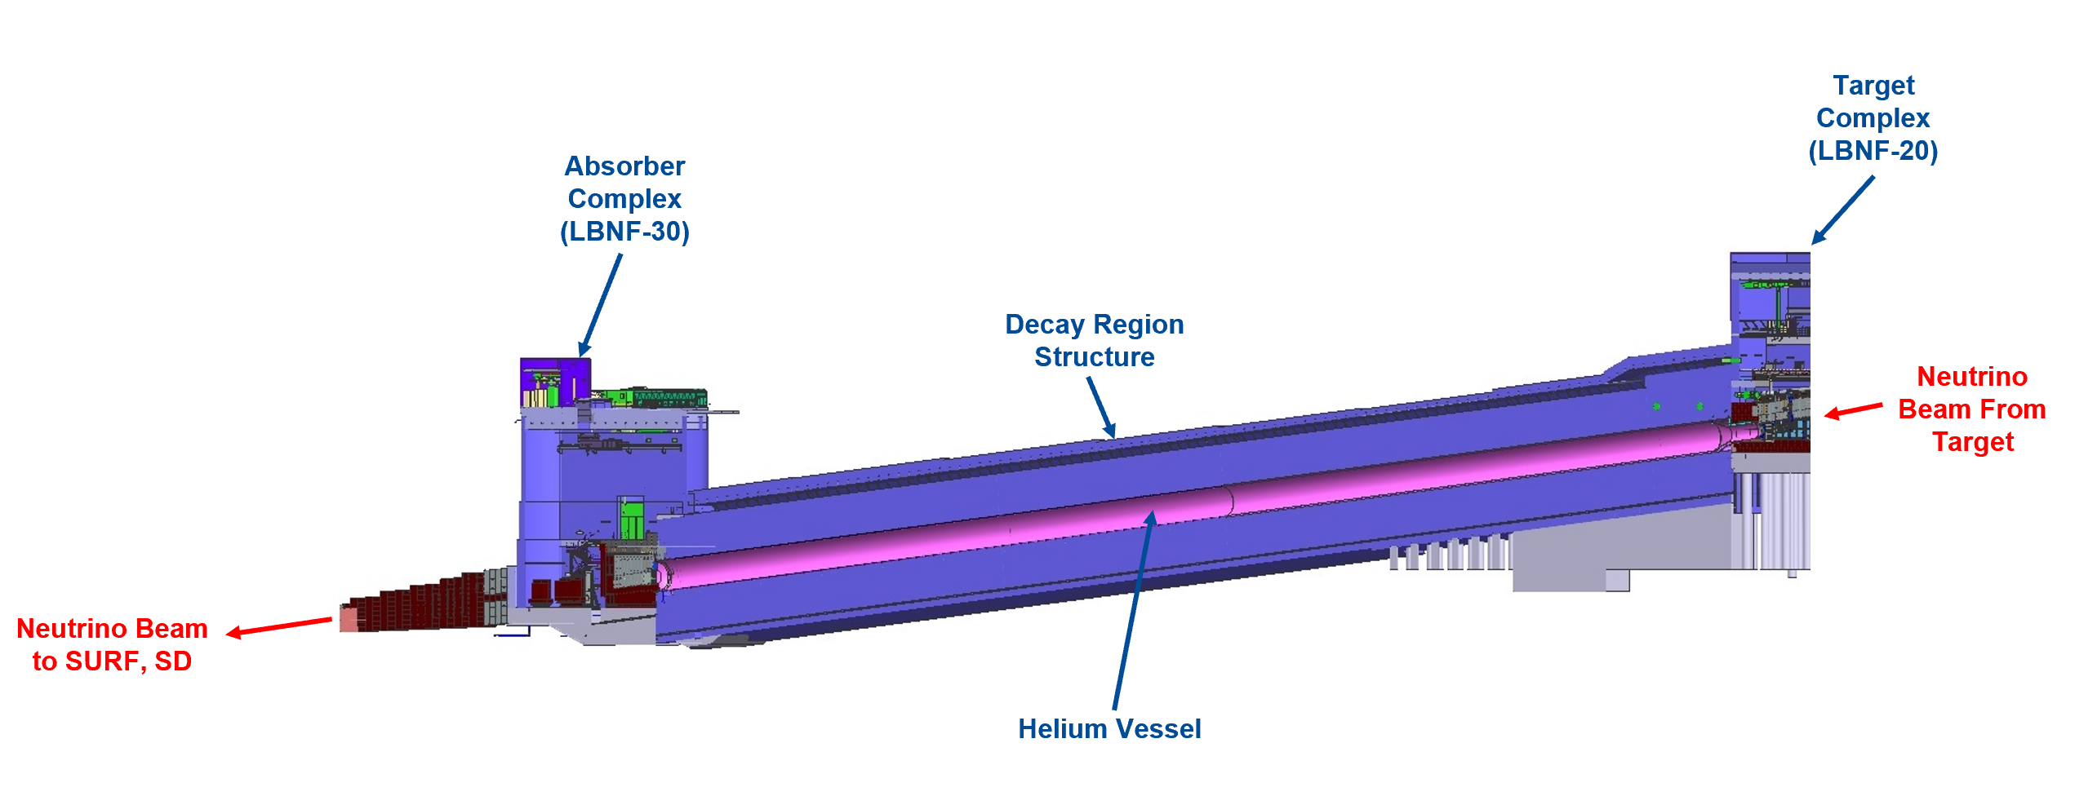
Decay Windows Overview
DSDP Window
USDP Window
Comprises a Low Press Vessel Per FESHM 5031.5

Slide 8
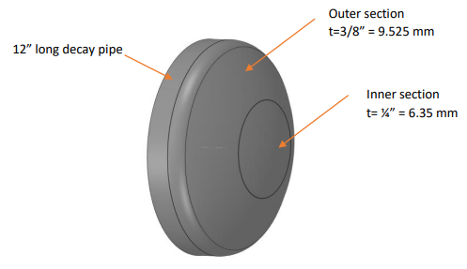
DSDP Window Overview
As this “Window” design is a weldment on the downstream end of the Decay Pipe, this assembly is considered a part of the pressure vessel and is designed, installed and tested by AECOM.
Beamline is responsible for providing design requirements and Thermal/Structural analysis to include beam loading on the window for design validation
Designed for 2.4MW Operation as this cannot be upgraded
DSDP Window

Slide 9
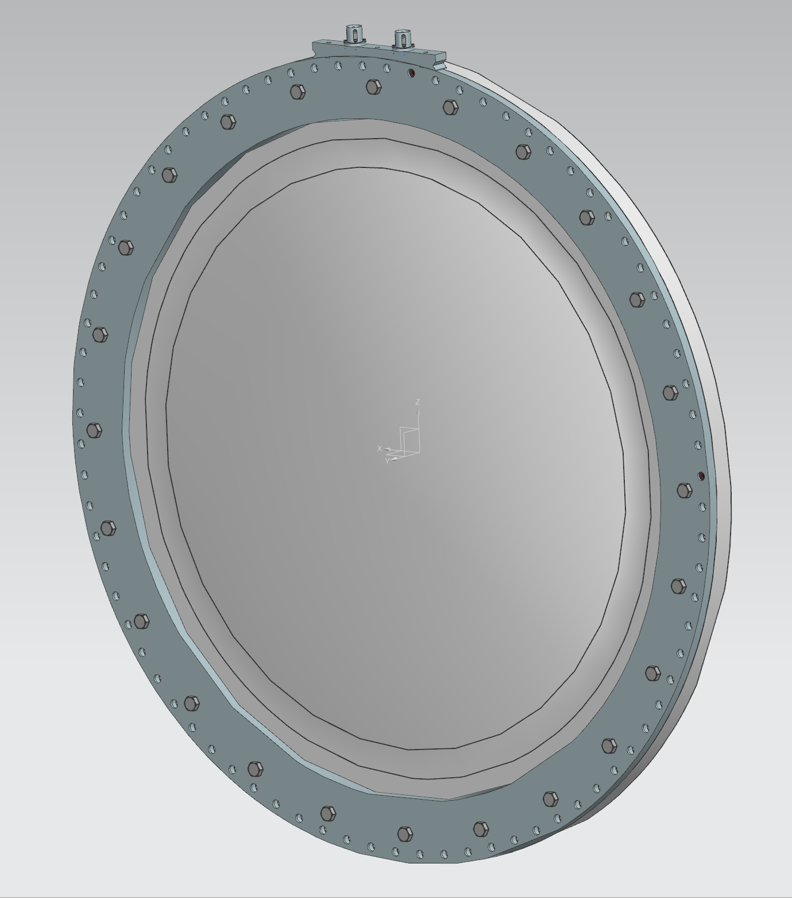
USDP Window Overview
1.8m Diameter Al-6061-T6 aluminum window provided by Beamline to be installed at the Upstream Decay Pipe Snout Flange.
This is designed as a removable window separate from the Decay Pipe and a separate engineering note will be generated and attached to the AECOM note.
The flange defines the line that separates the Beamline deliverable USDP Window from the CF provided Decay Pipe structure at the USDP Decay Pipe Snout
Designed for 1.2MW but should survive 2.4MW operation
USDP Snout Flange
USDP Window

Slide 10
Decay Windows Overview
Requirements:
USDP Window:
1. Shall be replaceable consistent with safety practices
2. Shall incorporate best practices to maximize lifetime
3. Shall have a maximum leak rate of 200 cubic feet helium per year
4. Shall be transparent to the beam as conventionally possible while meeting accepted engineering standards for pressure safety and facility lifetime requirements
5. Shall minimize decay pipe helium loss when a window replacement is required
Requirement 5 falls under the scope of the Remote Exchange Mechanism and will be reviewed during its FDR
DSDP Window:
1. Shall be designed such that it will not require replacement
2. Shall incorporate best practices to maximize lifetime and consider corrosion in addition to thermal and pressure
Absorber:
The absorber shall sustain at least 2 successive accident beam pulses without damage to components or loss of functional ability
While this is not a Decay Windows requirement, the windows must be able to sustain the accident case as well
Accident case is defined as No-Target beam activation.

Slide 11
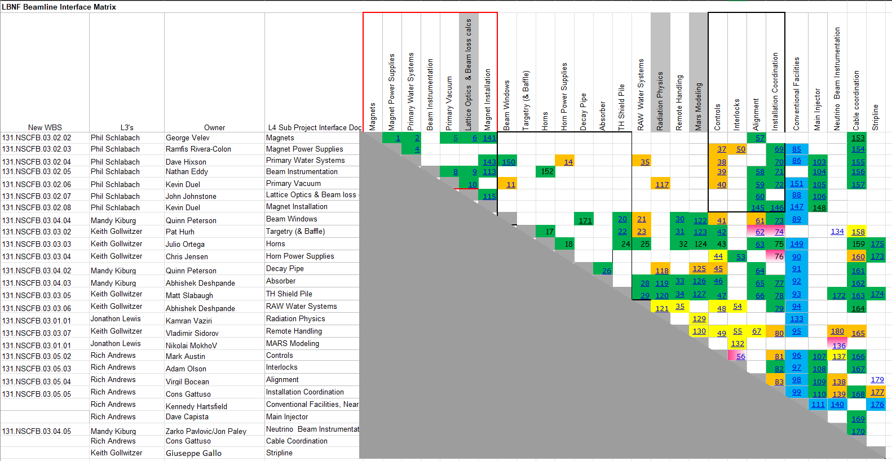
Decay Windows Beamline Interfaces
Charge 6
Beam Windows Interfaces: ICD’s 20, 21, 30, 41, 61, 73, 122, 171

Slide 12
Decay Windows Interfaces
Charge 6
Beamline Interfaces:
20: BW to TH Shield Pile
21: BW to RAW Water System
30: BW to Remote Handling
41: BW to Controls
61: BW to Alignment
73: BW To Installation Coordination
122: BW to MARS Modeling
171: BW to Decay Pipe
All interfaces checked and approved by system owners
CF Interface:
NSCF to Decay Pipe
Controlled in separate document than Beamline Interfaces. (Located docdb-31052)
Signed off by NSCF and Beamline
Notes:
Remove color coding and refer to everything has checked and approved by owners

Slide 13
Decay Windows Risks
Charge 4, 6
Engineering Risk Assessment
Risk Register
Manufacturing/Procurement Issues
Contingency: 3mm thick USDP Window

Slide 14
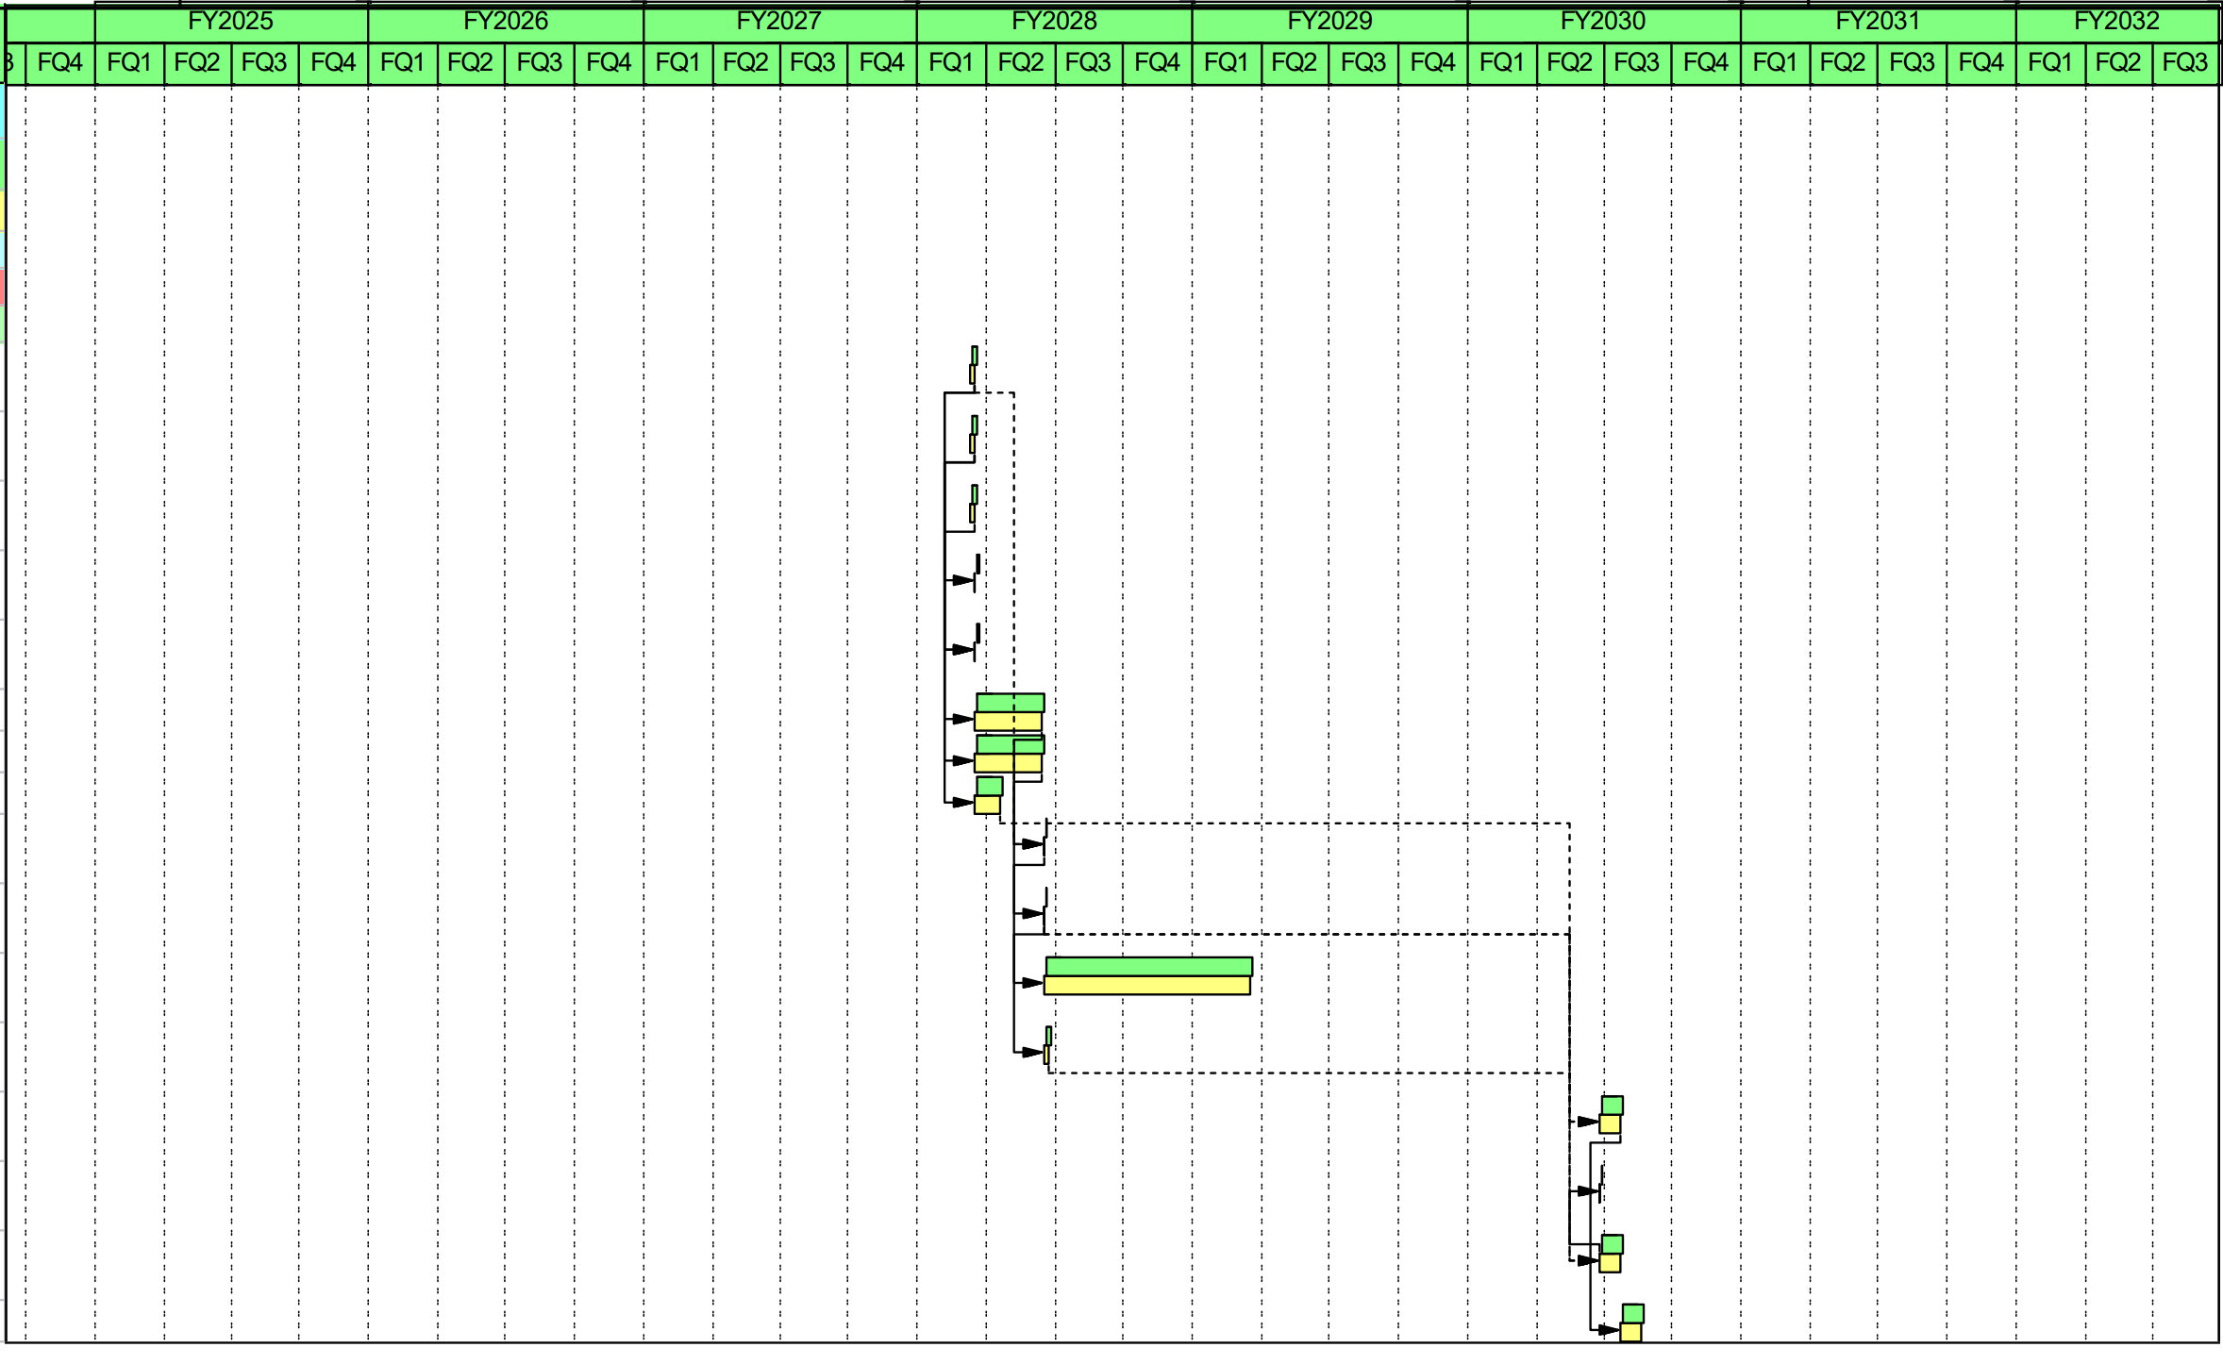
Schedule
Charge 6
Procurement of USDP Window
Procurement of USDP Window Spare
Install of USDP Window

Slide 15
January Technical Peer Review Recommendations
Charge 8
Rec. #
Technical Peer Review 01/25/24
Reviewers: Patrick Hurh, Kris Anderson, Kavin Ammigan
Downstream Decay Pipe Window
1. Evaluate and address comments on window materials and weld requirements with CF
Upstream Decay Pipe Window
2. Re-design the USDP as a one-piece machined window and flange
3. repeat analysis with one-piece design geometry and apply updated parameters
4. Perform in-depth bolted joint engineering design/analysis
Account for differential thermal expansion
Evaluate impact of clamping to a non-flat snout flange surface
5. Consider using the flange seal leak check mock-up to test impact thermal cucling of the snout flange on the seal quality
6. Consider adding a permanent water-cooling line on the snout flange to keep USDPW seal joint/flanges a more uniform and lower temperature

Slide 16
January Technical Peer Review Recommendations
Charge 8
Rec. #
BCR being processed. Once complete, recommendation is closed.
Design finalized and available on TC
Ang Lee’s analysis is complete. A writeup once he returns from vacation will close this recommendation
Bolted analysis conducted and requires peer review. Successful peer review will close this recommendation
Thermal cycling added to pressure test procedure. Completion of the test and documentation of results will close recommendation
Consideration has been made and a discussion on the impact documented. Review and approval by Beamline will close this recommendation
Specification drawing being created with flatness and bolt hole clocking tolerance. Release and delivery to CF will close this recommendation

Slide 17
Downstream Decay Pipe Window

Slide 18
DSDP Window Design
Charge 2, 7, 8
Rec. 1
Specification Drawings located in Docdb-31052
Material: S304L Stainless Steel
BCR Changing to S316L
Thickness: Varies among sections
Diameter Decay Pipe Connection: 4019.53 mm (13’ – 2.25”)
Outer Section Diameter: 2743.2 mm (9’)
Inner Section Diameter: 1828.8 mm (6’)
Design Standards:
FESHM 5031.5
ASME BVPC, Section VIII, Div. 1 & 2
ASME XI
BCR being conducted to use weld code NAS1514 and to specify weld passivation to increase corrosion resistance

Slide 19
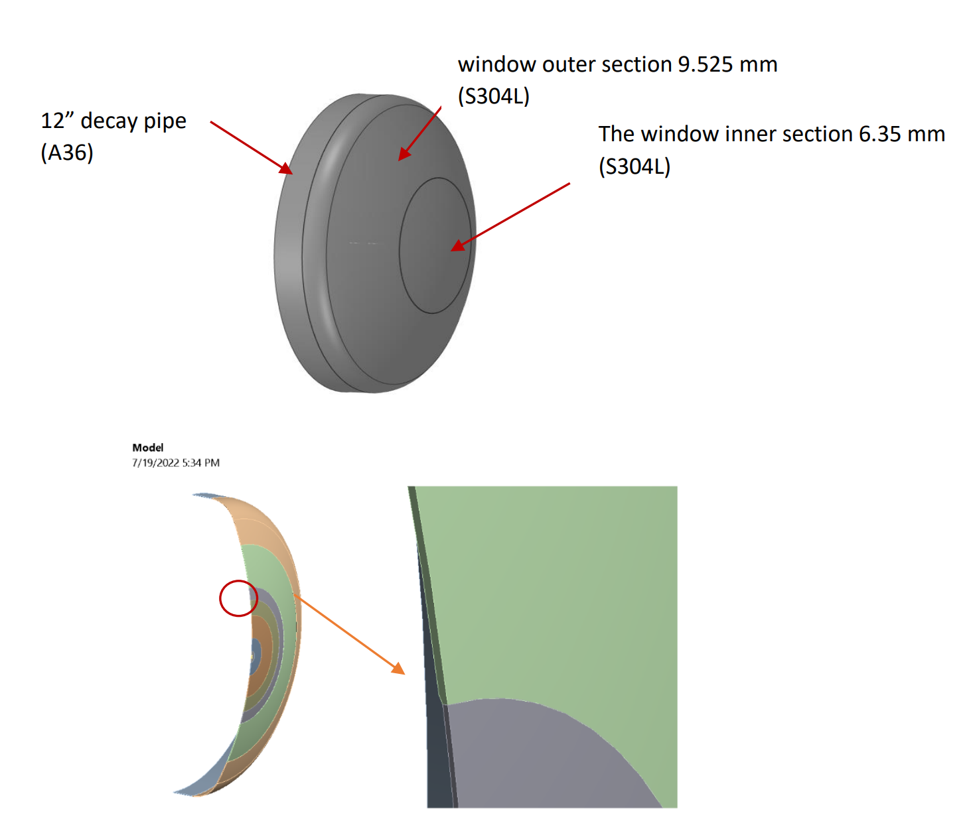
DSDP Window Analysis
Charge 2, 7, 8
Overview
Design requirement to have window sustain accident case defined
Accident case investigated at 2 and 5 accident pulses
2 pulses is design requirement, 5 is investigated for insight into how close to failure and accident case will bring the window
Analysis located at docdb-26309
Model and Boundary Conditions:
Solid Model located in LBNF-doc-24999
Energy deposition provided by Igor Rakhno located in LBNF-doc-23236
Convective film coefficient hf=3 watt/m^2*K
Conservative natural convection
Fixed Temperature of 52C is placed at 12in Decay Pipe end based on AECOM analysis
Off axis (72 cm) accident case
Notes:
Add in that a FESHM note cannot be approved until after the vessel is constructed and a pressure test is conducted

Slide 20
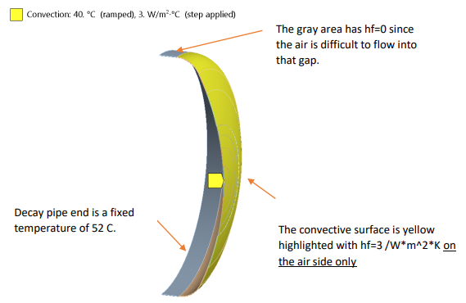
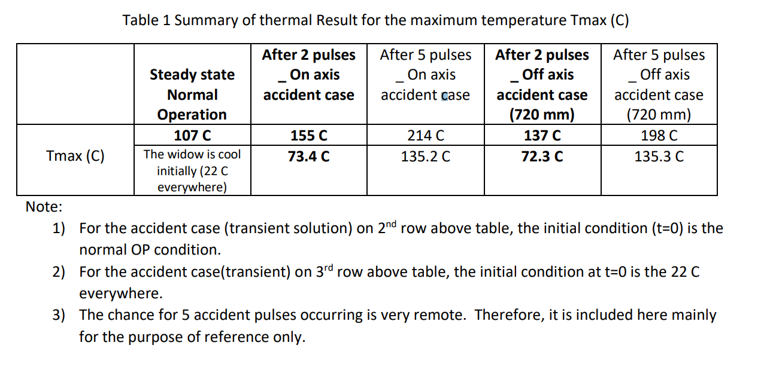
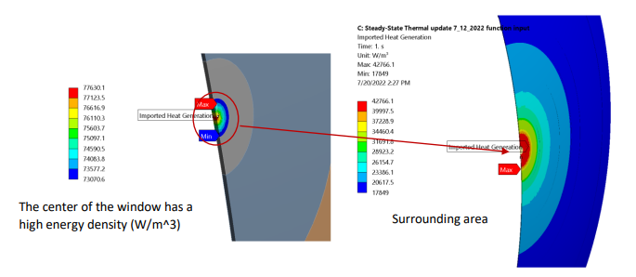
DSDP Windo Analysis
Charge 1, 2, 7, 8
Thermal Results:
On Axis Tmax after 2 and 5 accident pulses:
Tmax 2 pulses: 155 C (311 F)
Tmax 5 pulses: 214 C (417.2 F)
Tmax change due to pulses: ~23 C/pulse (73.4 F)
Off Axis (72 cm) Tmax after 2 and 5 accident pulses:
Tmax 2 pulses: 158 C (316.4 F)
Tmax 5 pulses: 198 C (388.4 F)

Slide 21
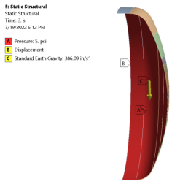
Decay Pipe Downstream Window Analysis Under 2.4 MW
Charge 2, 7, 8
Structural Results:
On Axis:
2 pulses: 13.5 ksi
5 pulses: 28.2 ksi
Off Axis:
2 pulses: 10.1 ksi
5 pulses: 25.2 ksi
Per ASME VIII, DIV 2, part 5, allowable is 49.5 ksi
Stress around weld joint area is ~2.2 ksi regardless of normal or accident cases
Even after severe accident cases, the window remains functional
Analysis approved at Technical Peer Review
Analysis to be uploaded through TC and attached to AECOM FESHM 5031.5 note.
FESHM Note located docdb-23864

Slide 22
Upstream Decay Pipe Window

Slide 23
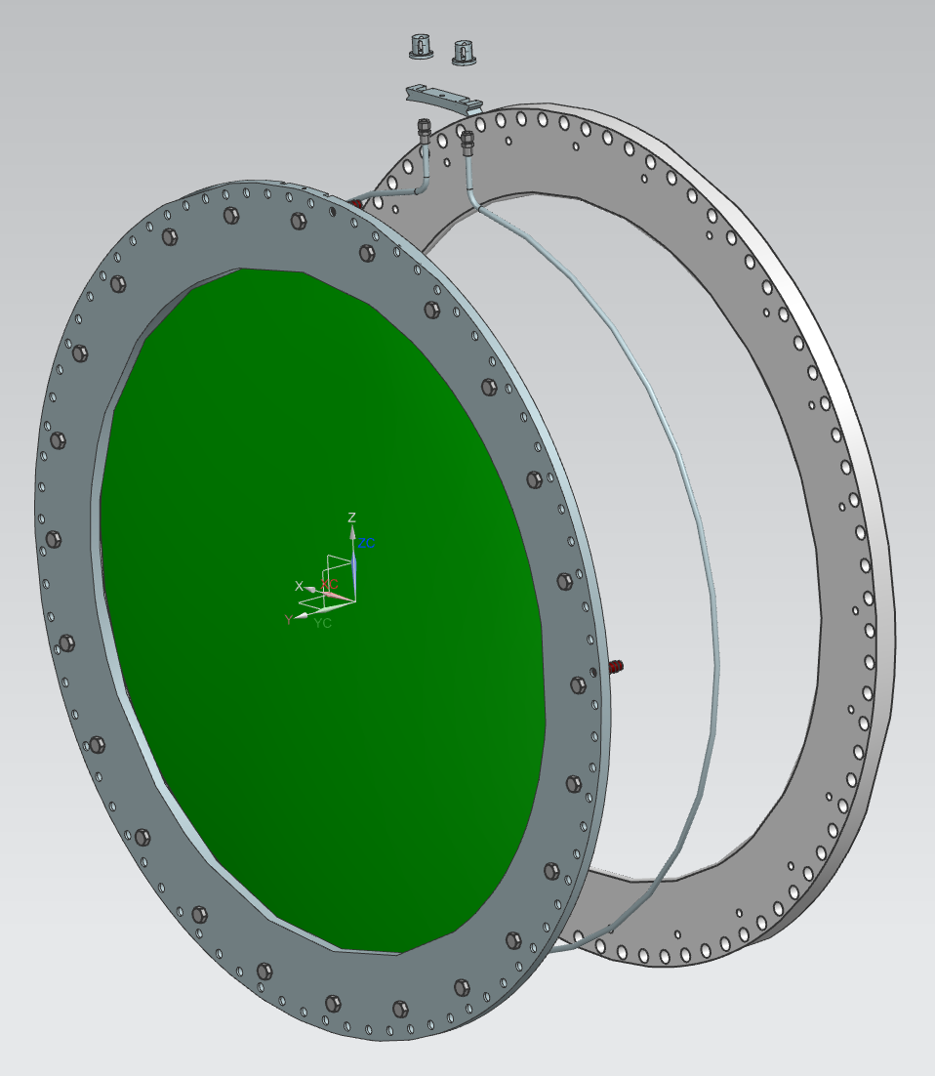
USDP Window Design Overview
Charge 1, 2, 8
Topics:
Dome Geometry
Capture Bolt System
Helicoflex Seal
Cooling Loop
Thermal/Structural Analysis
Bolt Joint Analysis
Model controlled in TC: F10118812
Drawings Complete and compiled in docdb 31052
Technical Peer Review conducted 01/25/24
Design Standards:
Fermilab Engineering Manual
FESHM 5031.5, Low Pressure Vessel
ASME BVPC, Section VIII, Div. 1 & 2
ASME PCC-1, Guidelines for Bolted Flange Joint Assembly
MIL-HDBK-5, Metallic Materials and Elements for Aerospace Vehicle Structures

Slide 24
USDP Window Design Overview
Charge 1, 2, 7
Rec. 2
Total Internal pressure against window.
MAWP = 5psi
Specified by AECOM in their engineering calculations
Interface with TH-Shield pile stating that internal pressure must be at or greater than TH Nitrogen
Domed window is one-piece machined window
Aluminum Window Diameter:
1.5 m (~4.9 ft)
Aluminum Window Thickness:
1.5 mm (~0.06 in)
Thickness accepted and published in TDR as acceptable for neutrino yield
TDR located
Outer Flange Diameter:
1.8 m (~5.9 ft)

Slide 25
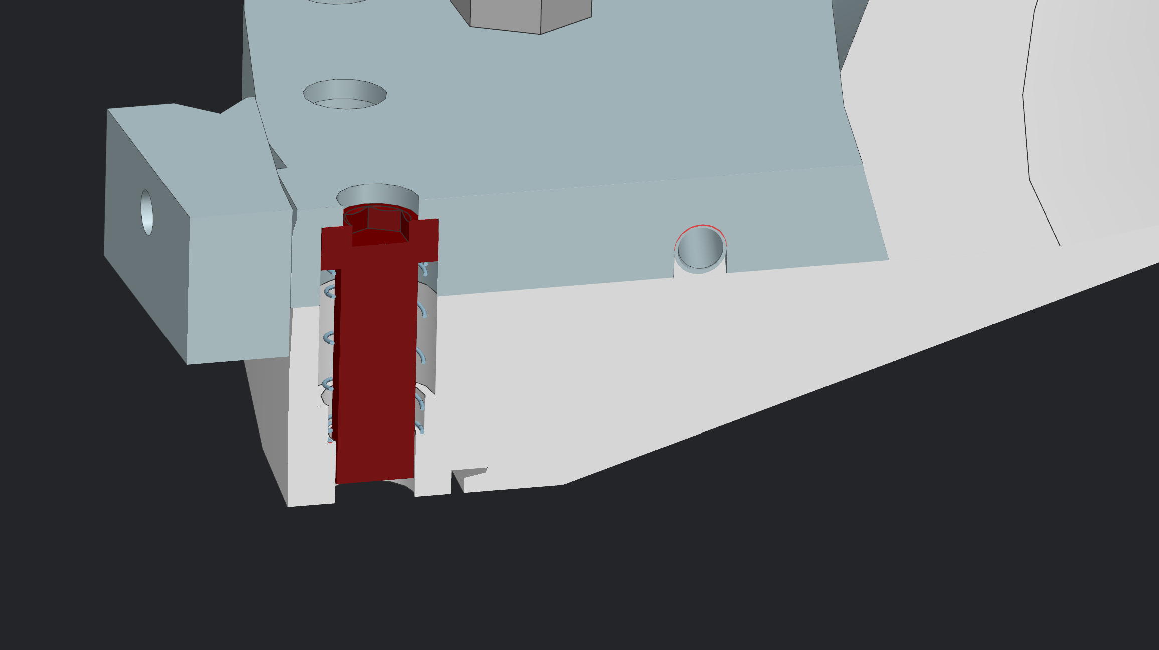
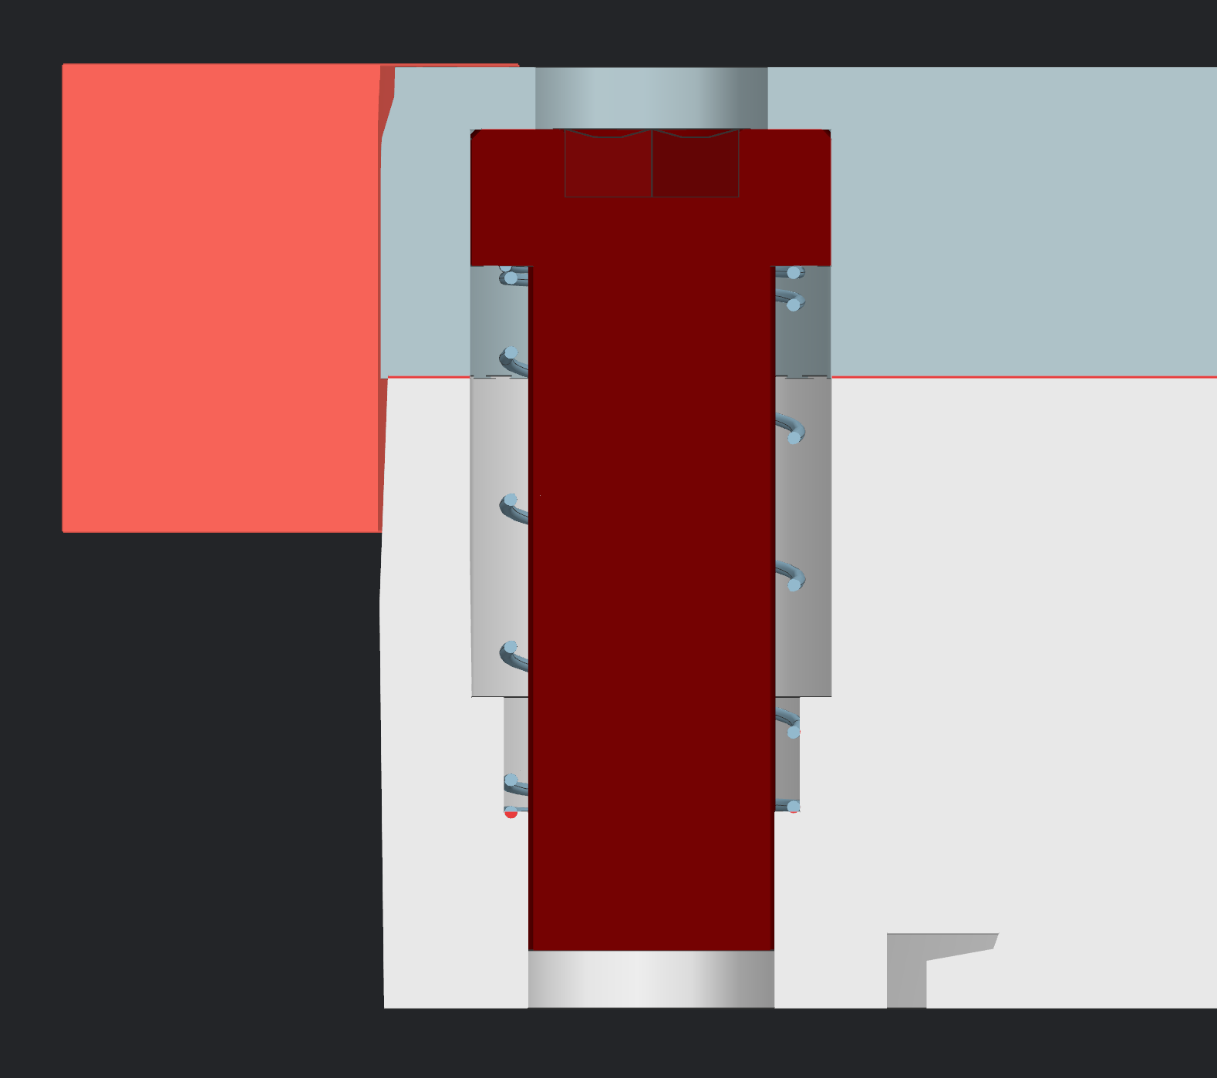
USDP Window Design Overview
Charge 1, 2, 3
Capture Bolts:
Design based on Mu2e target window capture bolts
Spring Loaded and held in place by cover plate
Spring compresses into pocket. Does not interfere joint compression
Design allows for bolts to be captured during a changeout procedure to assist with removable design
Bolt Size: ¾-16 in
Material: Grade 5 Titanium
Corrosion Resistant
Tungsten Disulfide coating to reduce friction and prevent galling
Cover Plate
0.75in Bolt
Spring

Slide 26
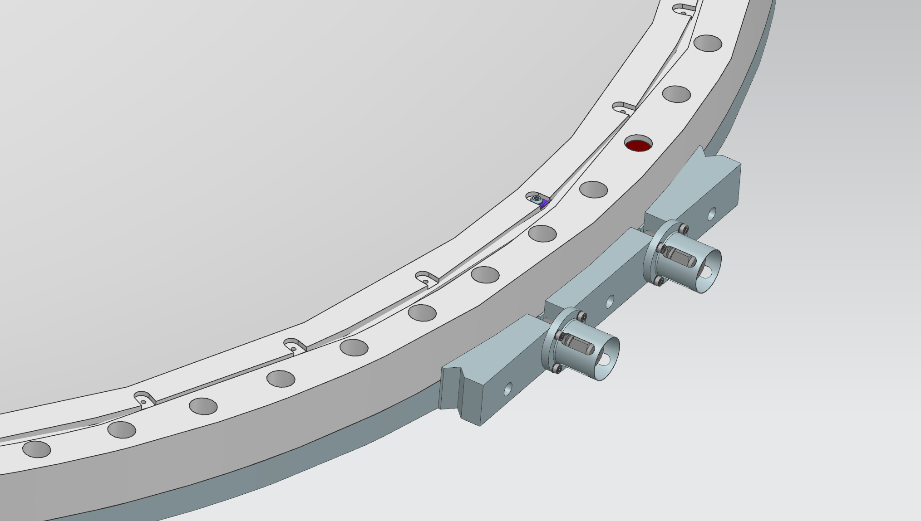
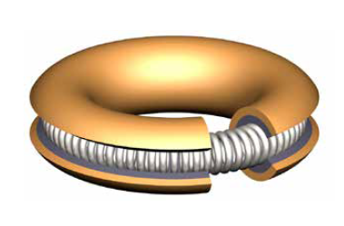
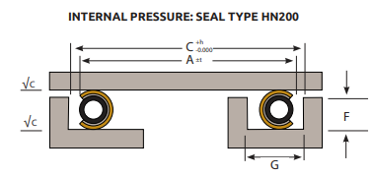
Helicoflex Seal
Seal Parameters:
Specialized for Helium Sealing
Cross Section: 0.276 in
Diameter: 68.7in
Manufacturer Specifications
Compression Force: 1542 lbs/in
w/ 80 Bolts = 4160 lbs/bolt
Max Operating Temp.: 392ºF = 200ºC
Groove Design parameters provided by manufacturer to ensure proper seal seating

Slide 27
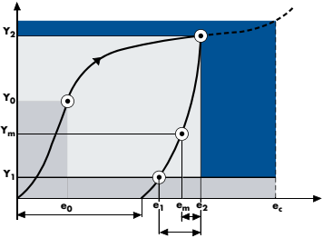
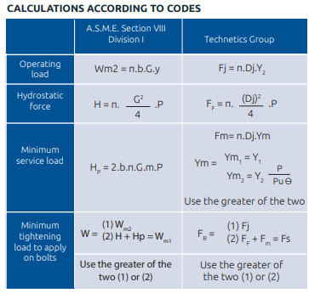
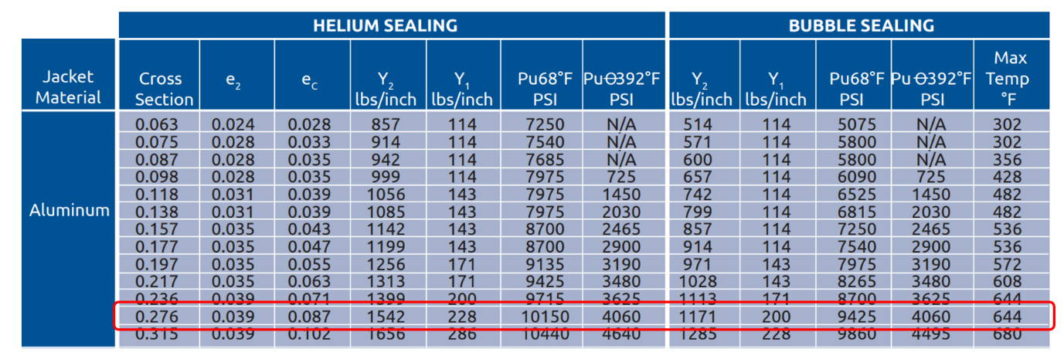
Helicoflex Seal
Charge 1
Compression Load Requirements:
Manufacturer Catalogue located at docdb-31052
Optimal sealing load (Y_2) = 1542 lbs/in
Minimum sealing load (Y_0) = 660 lbs/in
Minimum service load (Y_m) = 228 lbs/in
Minimum sealing load after seating (Y_1) = 228 lbs/in
Manufacturer claims Helium leak tight up to 10150 psi at 68°F (20°C) and 4060 psi at 392°F (200°C)

Slide 28
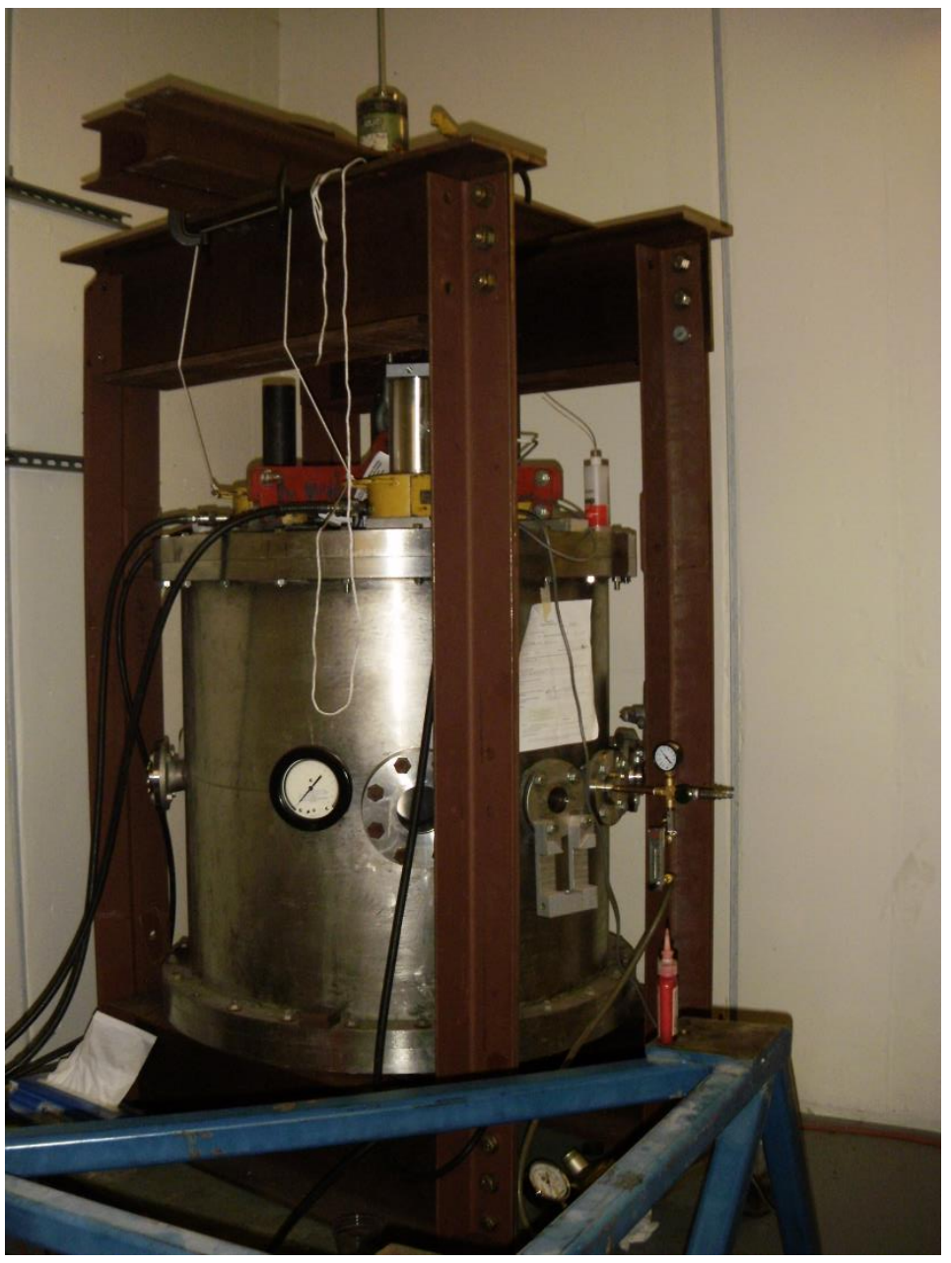
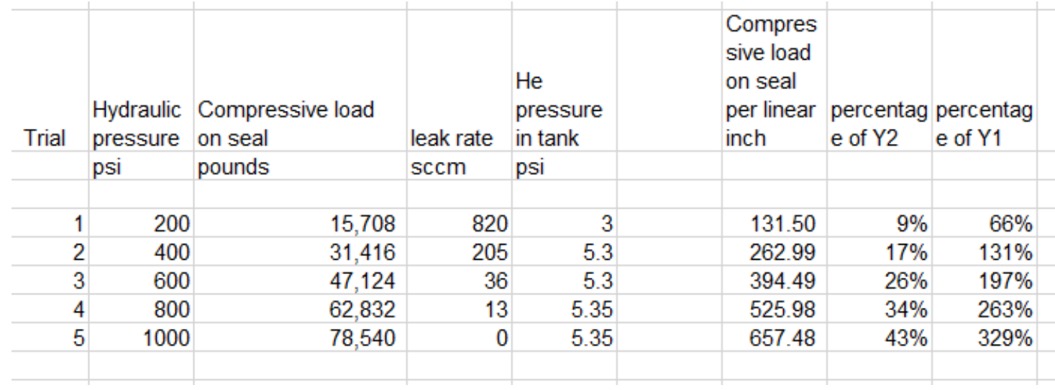
Helicoflex Seal
Charge 1, 2, 5
Seal Test 2016:
Location docdb-981
Conducted using test setup at Fermilab MI-8 service building
At 660 lbs/in shows <1sccm
Requirement is 10 cc/min (200 ft^3/year)
Proves minimum sealing pressure
1542 lbs/in
660 lbs/in
228 lbs/in

Slide 29
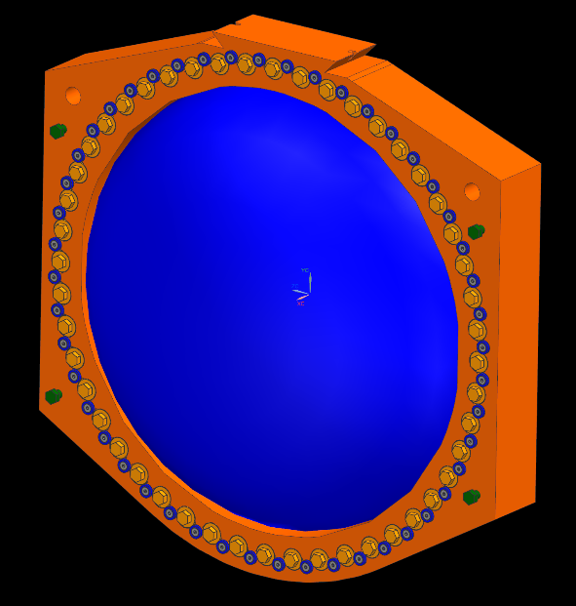
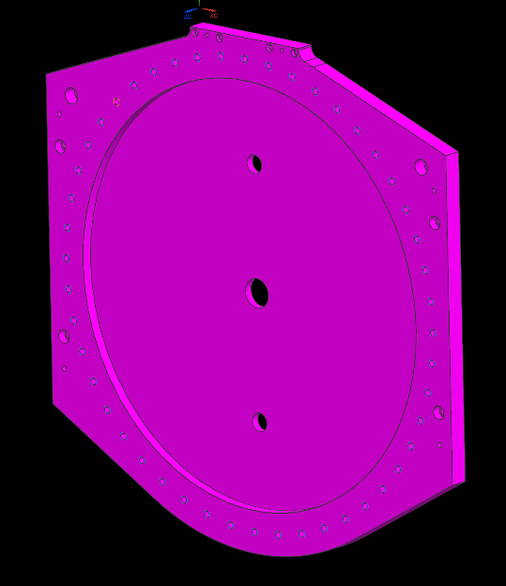
Helicoflex Seal
Charge 5
Rec. 5
Additional Seal Test:
Seal test being conducted at MI-8 looking at additional parameters of sealing.
Draft of pressure test located in docdb-31135
3 Tests:
Confirming torque requirements for seal compression in ideal parameters
Sealing to out of flatness sealing face to determine sealing force requirements
0.032 Amplitude. Twice manufacturer specification
Ideal seal environment with thermal cycling using heat tape
Cycling between max expected temperature and ambient

Slide 30
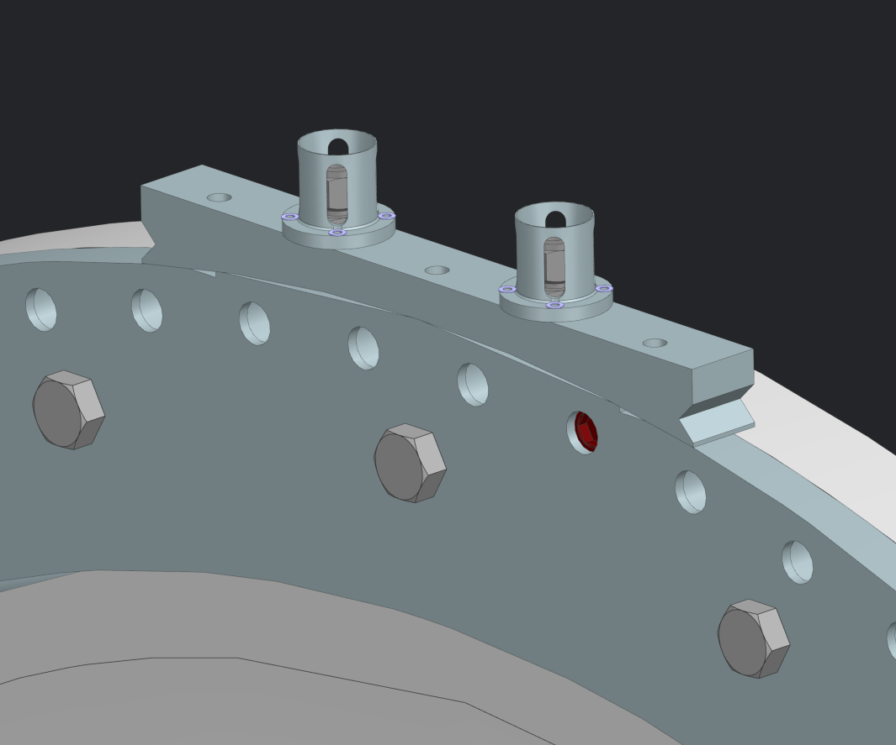
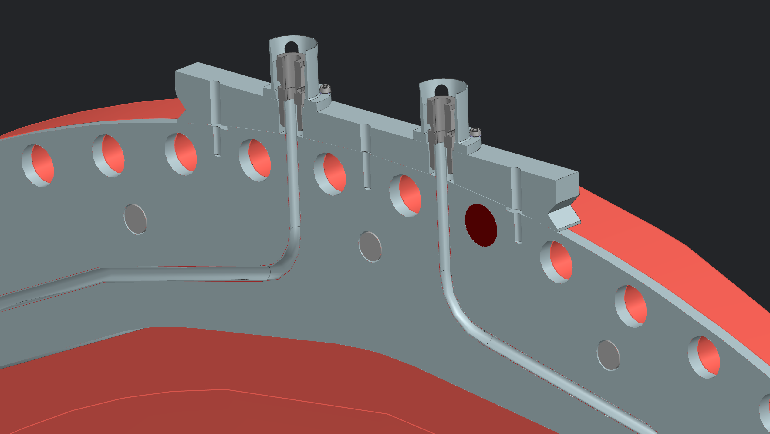
USDP Window Cooling Loop
Charge 2
Cooling loop necessary to reduce heat in flange at 2.4 MW to keep Helicoflex seal within operating temperature.
Cooling loop required to be removable to meet requirement of USDP Window being removable
Utilizing Swagelok compression fittings proven in NuMI Horn operation
Cooling lines only needed for 2.4 MW Operation

Slide 31
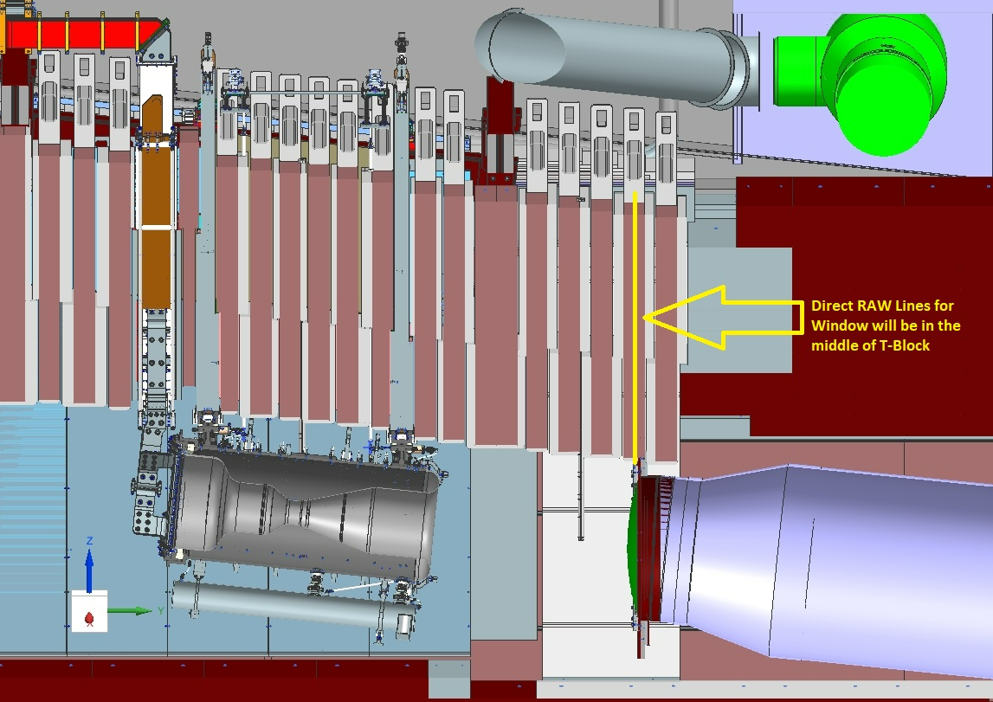
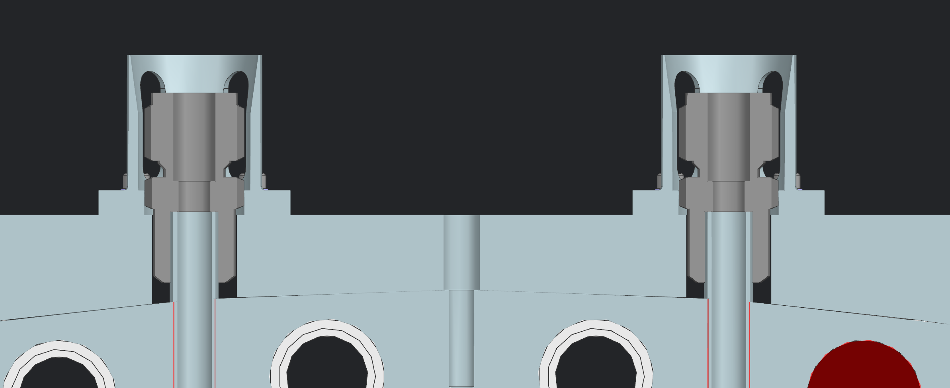
USDP Window Cooling Loop
RAW Lines reach window through labyrinthed penetrations in the above T-Block
Characteristics:
Heat Load = 16500 kW
ΔT inlet to outlet = 10C
Flow Rate = 6.2 gpm
SS316 Piping
Connection accessed from top of T-Block shielding
Guide brackets on the top side of the window aid in aligning compression fittings
Same design used for the NuMI Horns
RAW Piping Envelope drawing located docdb-31052

Slide 32
USDP Window Permanent Cooling Loop Discussion
Charge 7
Rec. 6
Per Technical Design Review of the Decay Windows, consideration was given to the addition of a permanent cooling loop on the USDP Snout Flange to provide more uniform temperature on sealing surface.
Full discussion of conclusion located in docdb-31052
Decision is to not include this additional cooling loop.
1. Previous design used outdated thermal loading. New loading shows reduction in sealing area temperature by roughly 10C
2. The project has pushed for all systems with the potential to leak to be serviceable
3. Inclusion of a larger cooling loop that is to accommodate this recommendation would add substantial scope to the project to design a method of servicing the component

Slide 33
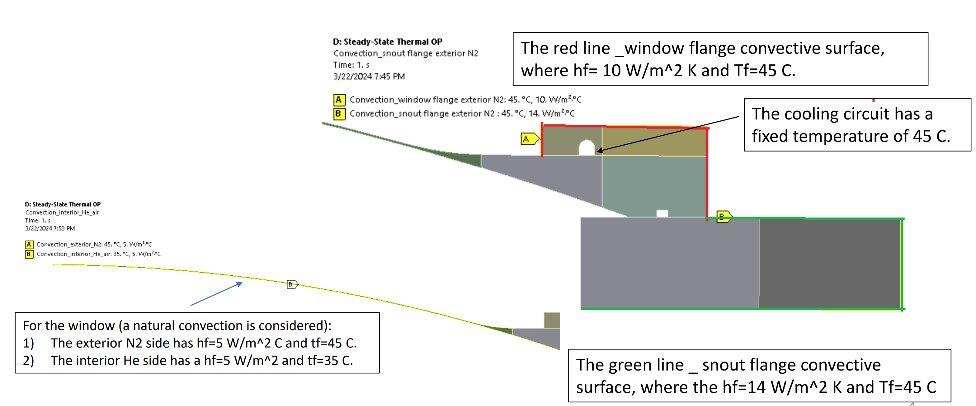
USDP Window Thermal/Structural Analysis
Charge 2
Rec. 2
Overview
Updated from previous analysis with peer review recommended modifications
Model and Boundary Conditions:
Model located TC: F10118812
Convection provided in docdb-28069
Cooling channel is held at 45 C
Calculation shows difference from wall to cooling fluid is roughly 4 C
Calculation for temperature difference across piping wall located in docdb 31132

Slide 34
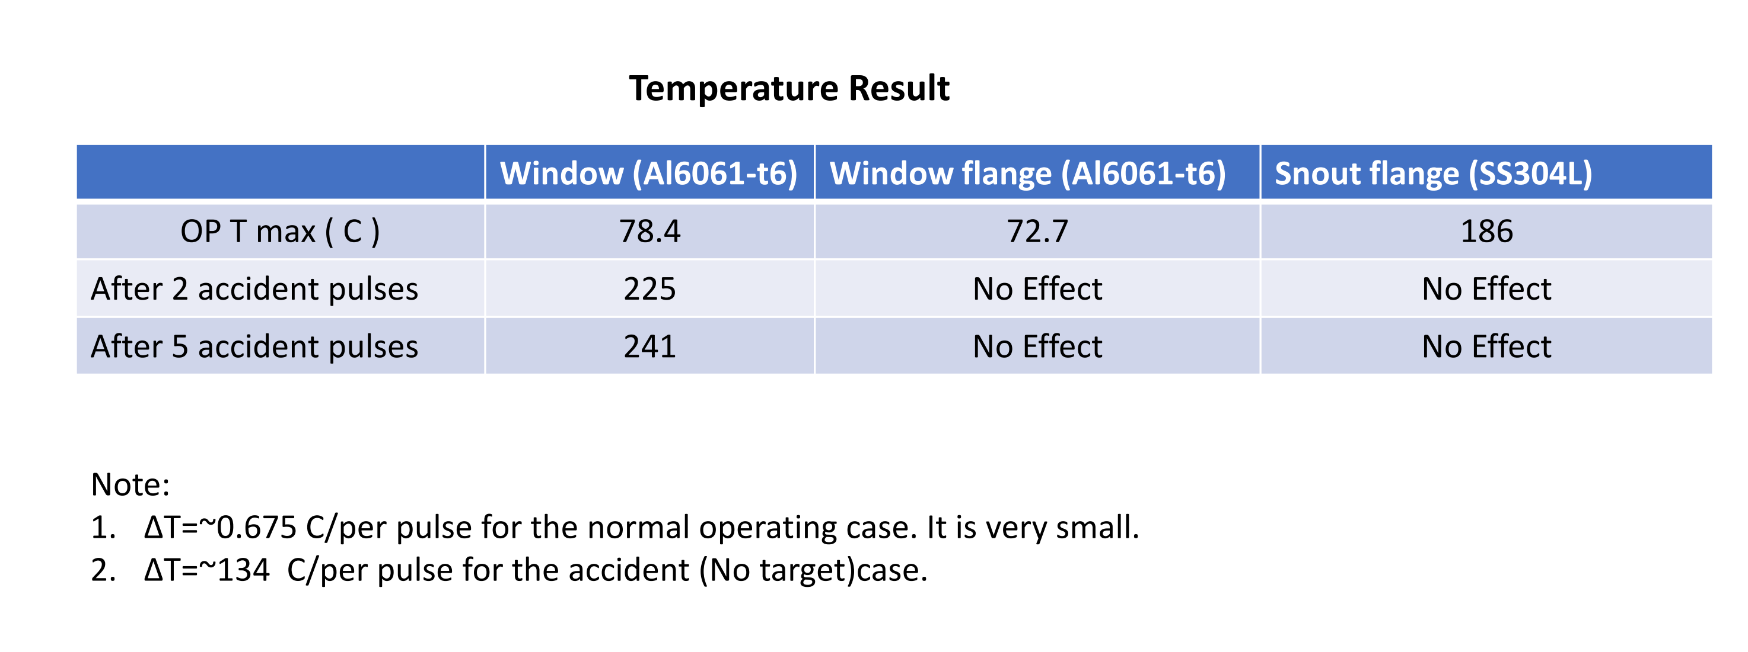
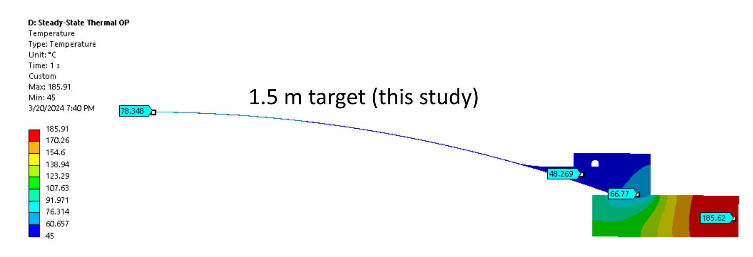
USDP Window Thermal/Structural Analysis
Charge 2
Rec. 2
Thermal Results:
Successfully hold sealing surface within optimal operating conditions at all accident cases
Accident Cases:
2 Pulses
Tmax = 225 C
5 Pulses
Tmax = 241 C

Slide 35
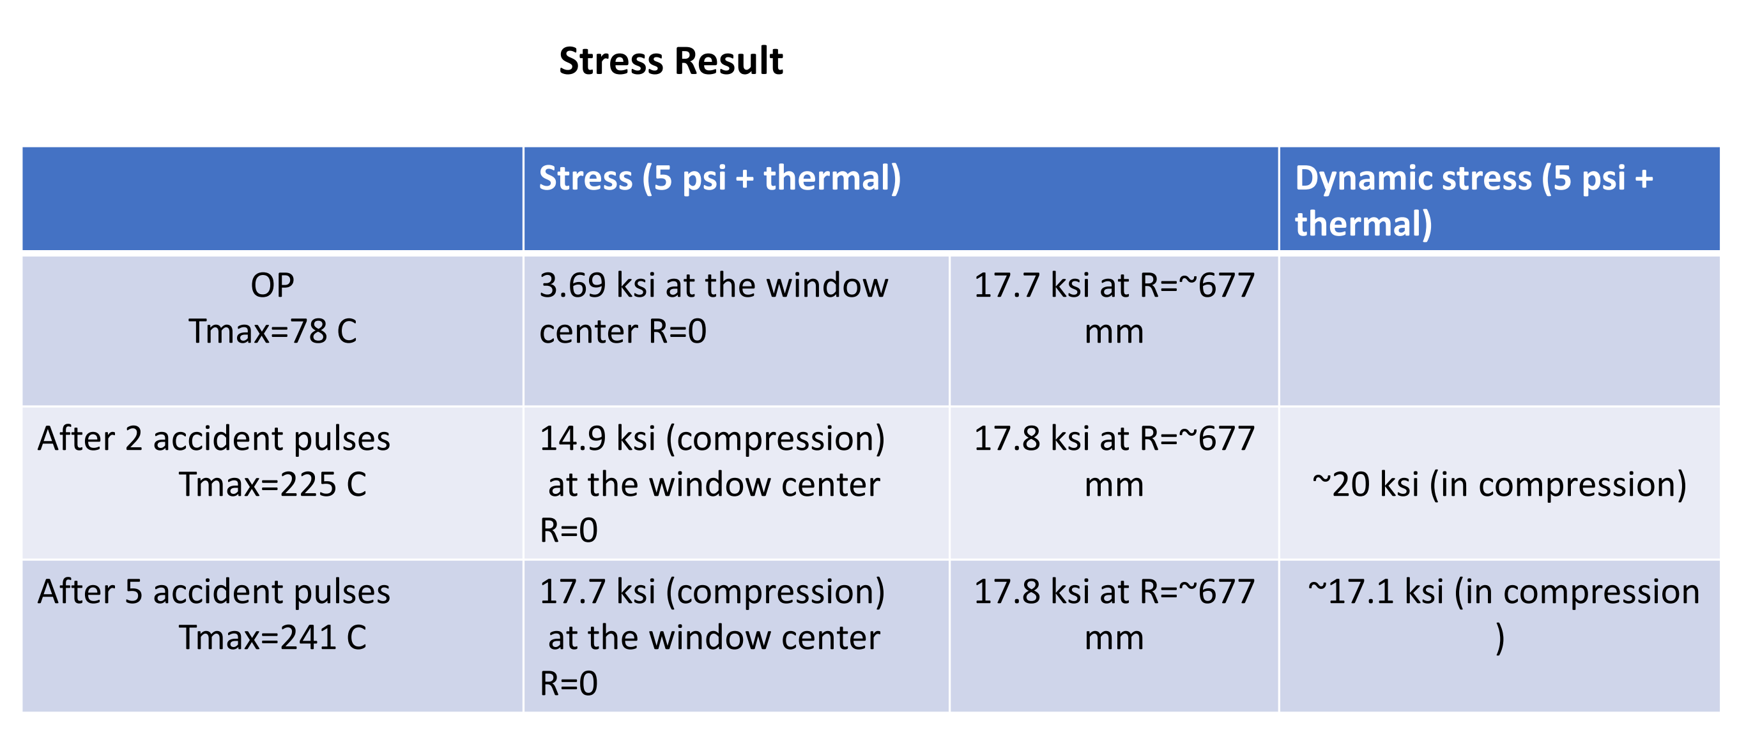
USDP Window Thermal/Structural Analysis
Charge 2
Rec. 4
Structural Results:
Stresses are less than allowable for 2 pulse accident cases
Accident Cases:
2 Pulses:
Max Dynamic Stress = 17.1 ksi
5 Pulses:
Max Dynamic Stress = 20 ksi
ASME Allowable (ASME BPVC. II. D.C-2021, Part D, Table 5B):
Yield = 34.2 ksi
Ultimate = 42 ksi
MIL-HDBK-5 (MIL-HDBK-5 SECTION 3.6.2, Edition 5G, for 6061 ALLOY):
Yield = 20.52 ksi
Ultimate = 21.884 ksi
Analysis to be uploaded through TC and attached to AECOM FESHM 5031.5 note.
FESHM Note located docdb-23864

Slide 36
USDP Window Bolted Joint Study
Charge 2
Rec. 4
A bolted joint analysis was conducted to identify the required forces for clamping and effects of thermal expansion on the joint for bolt loosening and low-cycle fatigue
Analysis located at docdb-
Analysis is in draft state and requires peer review before Technical Peer Review recommendation is considered met
References:
Machinery’s Handbook
Engineers Edge

Slide 37
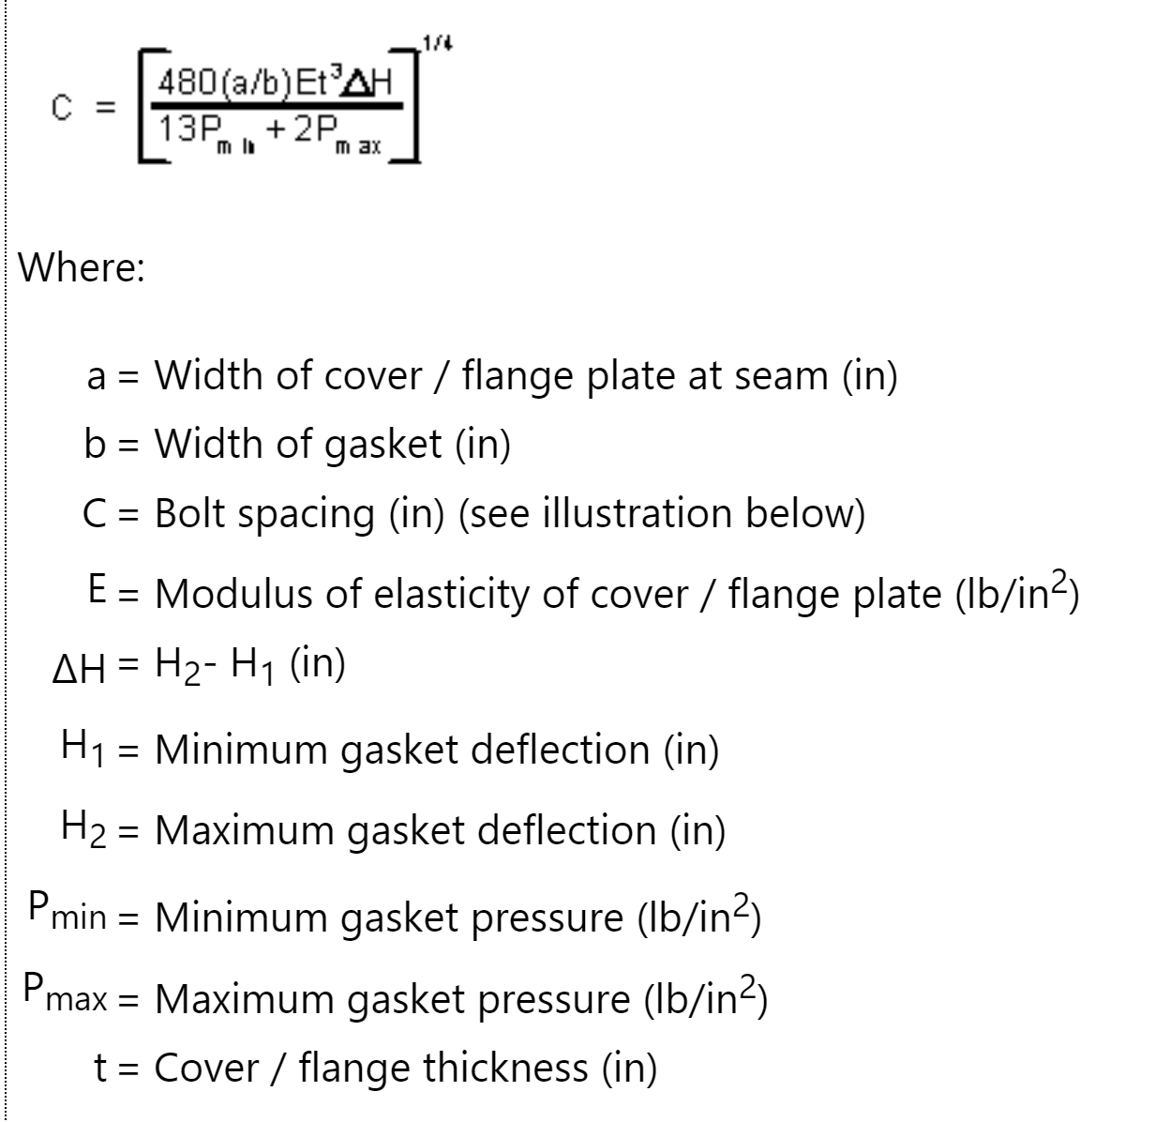
USDP Window Bolted Joint Study
Charge 2
Rec. 4
Minimum Bolt Spacing for Gasket Compression:
Minimum Force: 228 lbs/in
Minimum service load of Seal
Maximum Force: 1542 lbs/in
Seating force of seal. Seal groove diameter further compression after seating is reached
Safety factor of 3 used
Minimum bolt spacing: 7.47 in
Current Bolt Spacing: 2.7 in

Slide 38
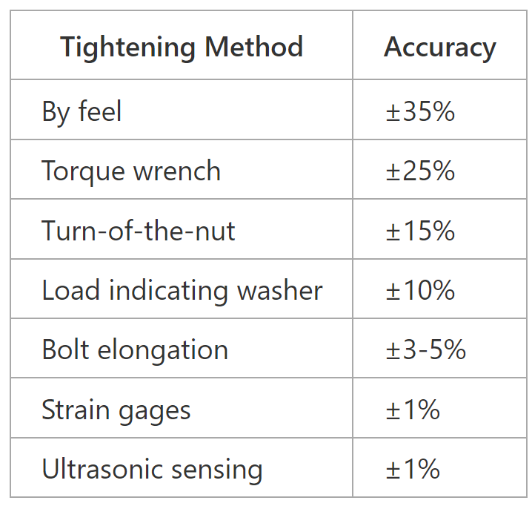
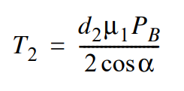
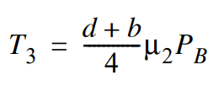
USDP Window Bolted Joint Study
Charge 2
Rec. 4
Required Torque:
Machinery’s Handbook 30th edition
Standard 70% yield preload
Torque wrench uncertainty = 25%
Allow for 10% preload loss due to local yielding
Tensile Yield of Ti-6Al-4V = 128000 psi
Calculated Preload = 13535.1 lbs
Load required by Helicoflex for seating
4160 lbs
Required Torque = 60.1 ft-lbs

Slide 39
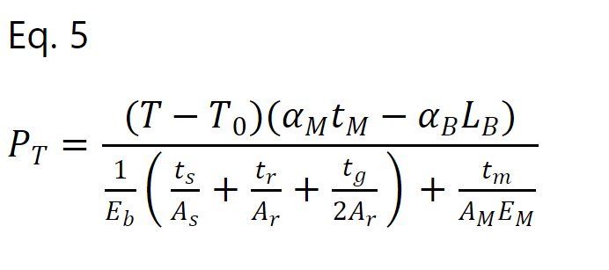
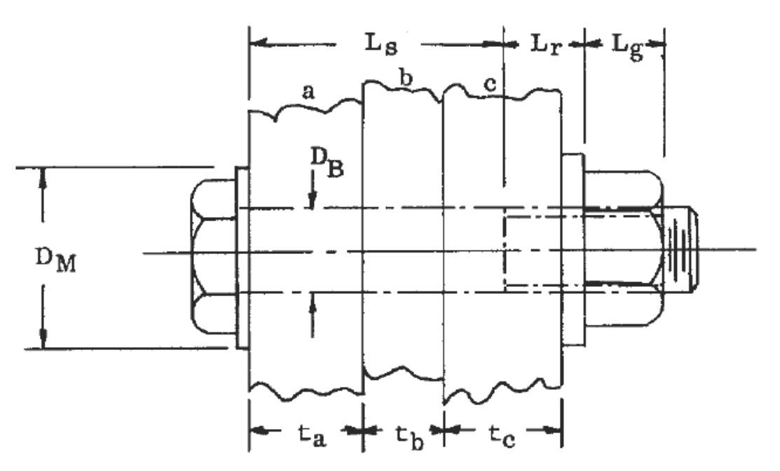
USDP Window Bolted Joint Study
Charge 2
Rec. 4
Change in preload due to thermal loading:
Bell Helicopter Structural Design Manual
Bolt load after temperature change from ambient temperature and the product of the net thermal expansions and combined internal stiffness
Temp change of 41°C used taken from Ang Lee’s Analysis
P_T = 224.4 lbs
This force is adding to the preload 9375 lbs present in system. Change is not enough to loosen bolts

Slide 40
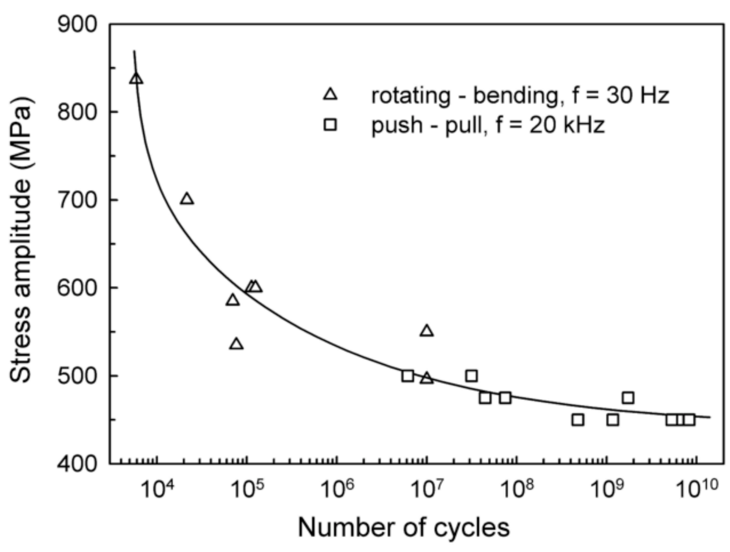
USDP Window Bolted Joint Study
Charge 2
Rec. 4
Investigation for Low-Cycle Fatigue:
Low cycle fatigue we are defining as 10^4 cycles or less from beam induced thermal expansion and contraction
Stress from restricted thermal expansion equations
2 systems analyzed
Restricted aluminum expansion
Reinforced Titanium threaded into SS flange
Total Stress Amplitude
σ = 94.14 MPa
At 10^4 cycles, stress amplitude must be ~700 Mpa to induce fatigue failure
S-N Curve for Ti-6Al-4V

Slide 41
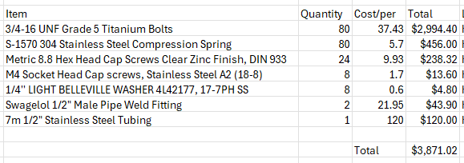
USDP Window Cost Estimates
Charge 2
Rec. 4
Cost:
Fabricated Pieces = $60332.6
Hardware = $3871.02
Tungsten Disulfide Coating = $28800
Total = $93003.62

Slide 42
USDP Window Installation
Charge 2
Rec. 4
Installation will be conducted using the USDP Window Remote Exchange Mechanism. As such, a full definition on installation requirements or procedures is not able to be conducted until the FDR of the Remote Exchange Mechanism
Installation Plan:
Phase 1 (Preparation):
Window will be retrieved from storage. Perform pressure test and check for defects
Mechanism will be retrieved and moved to high bay. Electrical and controls connections made and mechanical assemblies tested
Phase 2 (Window Loading):
Window is loaded onto mechanism
Phase 3(Installation of Window):
Window is installed onto flange
Preliminary Installation Procedure located docdb-31052
Full installation procedure will be reviewed at Exchange Mechanism FDR

Slide 43
USDP Window QA/QC
Charge 2
Rec. 4
Draft Located docdb-31077
QC Procurement
Vendor fabrications shall be procured with dimensional inspection reports, to be spot checked upon receipt
QC Fabrication
An engineer or designated inspector will spot check these in-process measurements
Fabrication records will be kept by the engineer
Cooling loop will be pressure tested and certified
QC Installation
Beamline is responsible with coordinating with NSCF for in process quality control measurements to meet design requirements for the USDP Window
Beamline will coordinate with NSCF to conduct installation of USDP Window utilizing the USDP Window Remote Exchange Mechanism

Slide 44
Questions?

Slide 45
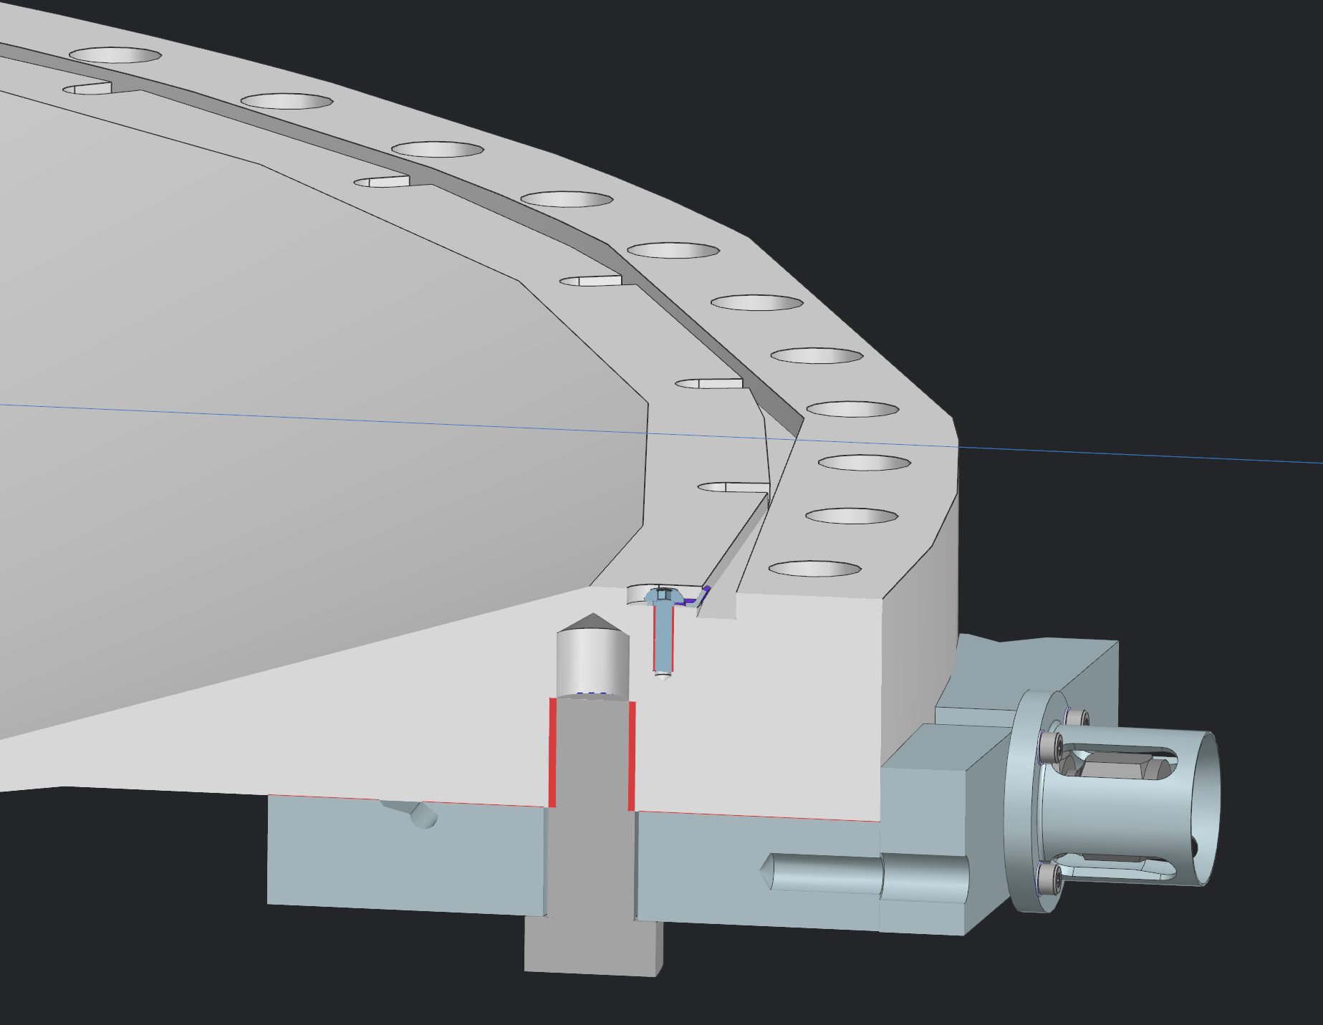
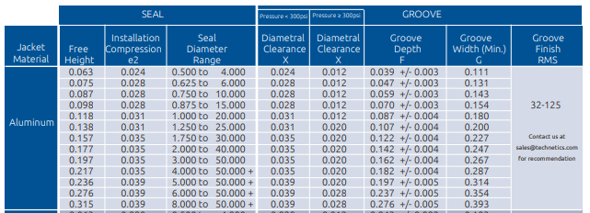
Helicoflex Seal
Charge 2
Groove Design:
Depth = 0.237 ± 0.005in
Width = 0.354
Groove Finish = 32
Catalogue listed in Docdb-31052

Slide 46
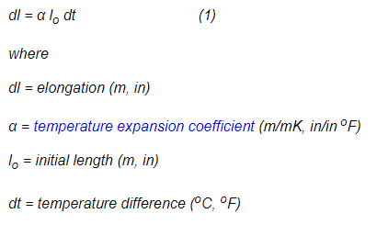
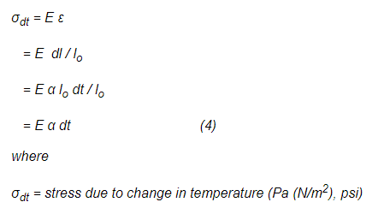
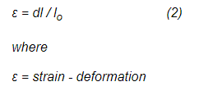
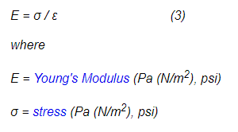
USDP Window Bolted Joint Study
Charge 2
Rec. 4
Stress From Differential Thermal Expansion:

