Slide 1
PPD Department Heads Meeting
ES&H
08 May 2024

Slide 2
Summary
Training/ITNA Status
Injuries in April
ORPS/NTS in April
FESHM Updates
Emergency Warden Program Discontinuation

Slide 3
ES&H Training and ITNA Status for employees – as of 05/07/2024
 | Training Courses |  |  |  | Individual Training Needs Assessments
Div/Sec | Completed | Required | Percent | Employees | < 1 Year Old | Percent | Missing | Missing for New Hires
 | 64 | 93 | 68.82% | 8 | 8 | 100.00% | 0 | 0
AD/ACTD | 5,738 | 6,110 | 93.91% | 234 | 234 | 100.00% | 0 | 0
AD/ARD | 328 | 349 | 93.98% | 17 | 17 | 100.00% | 0 | 0
AD/BD | 4,183 | 4,389 | 95.31% | 159 | 156 | 98.11% | 0 | 0
APS-TD/CS | 1,276 | 1,530 | 83.40% | 41 | 40 | 97.56% | 0 | 0
APS-TD/DFS | 990 | 1,029 | 96.21% | 55 | 53 | 96.36% | 0 | 0
APS-TD/MAG | 2,282 | 2,471 | 92.35% | 103 | 101 | 98.06% | 0 | 0
APS-TD/SRF | 1,455 | 1,543 | 94.30% | 70 | 70 | 100.00% | 0 | 0
COM | 558 | 594 | 93.94% | 54 | 54 | 100.00% | 0 | 0
COO/COAS/QU | 141 | 143 | 98.60% | 8 | 8 | 100.00% | 0 | 0
CSAID/DSSL | 547 | 563 | 97.16% | 45 | 45 | 100.00% | 0 | 0
CSAID/RTPS | 401 | 427 | 93.91% | 33 | 31 | 93.94% | 0 | 0
CSAID/SCSS | 652 | 661 | 98.64% | 60 | 55 | 91.67% | 0 | 0
DCO | 10 | 12 | 83.33% | 2 | 2 | 100.00% | 0 | 0
DI | 2,029 | 2,185 | 92.86% | 246 | 221 | 89.84% | 0 | 2
DI/IA | 44 | 44 | 100.00% | 4 | 4 | 100.00% | 0 | 0
ES | 3,009 | 3,332 | 90.31% | 110 | 104 | 94.55% | 0 | 0
ETD/IARCD | 202 | 229 | 88.21% | 10 | 10 | 100.00% | 0 | 0
ETD/MD | 291 | 321 | 90.65% | 24 | 22 | 91.67% | 0 | 0
ETD/QID | 202 | 234 | 86.32% | 15 | 13 | 86.67% | 0 | 0
FI | 1,128 | 1,187 | 95.03% | 110 | 91 | 82.73% | 0 | 0
FRA | 12 | 12 | 100.00% | 1 | 1 | 100.00% | 0 | 0
HR | 627 | 649 | 96.61% | 57 | 50 | 87.72% | 0 | 0
ISD | 5,837 | 6,104 | 95.63% | 224 | 217 | 96.88% | 0 | 0
ITD | 1,145 | 1,147 | 99.83% | 127 | 127 | 100.00% | 0 | 0
LBNFDUNE | 757 | 805 | 94.04% | 52 | 41 | 78.85% | 0 | 2
NQC/NQCDIV | 719 | 775 | 92.77% | 48 | 40 | 83.33% | 0 | 0
PIPII/PIPII | 268 | 283 | 94.70% | 20 | 14 | 70.00% | 0 | 0
SEC | 2,443 | 2,576 | 94.84% | 104 | 96 | 92.31% | 0 | 0
ND | 1,589 | 1,685 | 94.30% | 93 | 88 | 94.62% | 0 | 0
PPD | 4,409 | 4,808 | 91.70% | 249 | 243 | 97.59% | 0 | 0
THD | 372 | 417 | 89.21% | 53 | 38 | 71.70% | 0 | 0
Fermilab Total | 43,708 | 46,707 | 93.58% | 2,436 | 2,294 | 94.17% | 0 | 4
This month:
Last month:
ND | 1,725 | 1,833 | 94.11% | 95 | 86 | 90.53% | 1 | 0
PPD | 4,664 | 5,097 | 91.50% | 252 | 247 | 98.02% | 0 | 0
THD | 393 | 457 | 86.00% | 53 | 38 | 71.70% | 0 | 0

Slide 4
Injuries/Illnesses in April
04/02/2024 - First Aid Only/Not Reportable, ISD
An employee was exiting a work van after getting some tools when they placed their right foot on uneven ground and felt a twist in their ankle. The employee stated that they felt fine at first, but after a few hours the discomfort increased. They then reported to the Fermilab Occupational Medical Office (FOMO) for first aid.
04/05/2024 - Medical Treatment Beyond First Aid, ISD
While moving a box stored over shoulder height, an employee realized it was too heavy and twisted their lower back while trying to push back onto the shelf. The employee was first provided first aid treatment by FOMO. The employee later went to immediate care.
04/05/2024 – First Aid Only/Not Reportable, PPD
An employee was exiting an office when they dropped their pen. They bent down to retrieve the pen and when they stood back up, they hit the back of their head on the underside of the interior door handle to the office. The employee reported to FOMO for first aid.

Slide 5
Injuries/Illnesses in April
04/16/2024 - First Aid Only/Not Reportable, PPD
An employee was lifting multiple items with their left hand, one of which was a full gallon of paint being carried with their ring finger and pinky finger. The employee felt nerve pain in their hand and reported to FOMO a few days later for first aid.
04/16/2024 - First Aid Only/Not Reportable, ESH
An employee bent over to retrieve an approximately 30-40 pound box from their vehicle when they felt pain in their lower back. Employee reported to FOMO and then for an orthopedic review.
04/18/2024 - First Aid Only/Not Reportable, ESH
A chair slid out from underneath an employee when they attempted to sit down to review data on a computer. The employee fell backwards landing on their right hand and then fell flat onto the floor. Employee reported to FOMO for first aid.

Slide 6
Injuries/Illnesses in April
04/22/2024 - Medical Treatment Beyond First Aid, LBNFDUNE
While putting on their welding hood, some dust/dirt debris fell out of the welding hood and onto the subcontractor employee's face. The next morning (4/23/2024) the employee felt discomfort in their right eye while getting ready for work and immediately reported the issue to the safety supervisor. The employee's eye was flushed by the site medic, but they could still feel something in their eye. The employee was taken to urgent care where the eye was flushed again. The employee was then sent to an eye doctor, where the eye doctor observed a small sliver in the upper eye lid. The eye doctor flushed the eye and was able to remove the sliver, then provided a prescription.

Slide 7
ORPS/NTS in April
Booster electrical event, 04/02/2024 (ORPS Event, Level 1)
On Tuesday April 2, 2024 approximately 10:45AM an Radiological Control Technician (RCT) was changing out the Booster L16 Badge in Booster East (not in the enclosure). The RCT contacted an RF Team member immediately after the incident stating:
"As I was changing the Booster L16 badge and after I pulled it from the old chipmunk cord, the cord fell and knocked into the buss resulting in a spark. I was not hurt from this and we moved the cord away from the buss. The chipmunk cord is, however, still damaged."
Subsequent investigation showed the Plexiglass cover for the Ferrite Power Supply Bus at Booster Station 6 was damaged and did not fully cover the Bus. The disused chipmunk cord had been wrapped around piping very near the Ferrite Bias Power Supply Bus. It is this chipmunk cord with a metal MS type connector that swung and contacted the Bus, causing a spark. These Ferrite Bias Power Supplies operate at a low voltage, ~35v but with high amperage on a pulsed delivery. There was no injury or risk of injury from this exposure. Damage to the bus from the arcing was negligible.
Upon notification from the RCT, the RF Team immediately relocated the chipmunk cables away from the bus to prevent a recurrence and started inspecting and creating a plan to repair or replace the damaged and missing bus covers.
Notes:
https://www-esh.fnal.gov/pls/apex/f?p=165:2:8228580963917::::P2_EVENT_ID:4141&cs=3nGfNL6tbr_UsI3SOO4o0fWsi-0h59K6iItc6HXOzUC0cPE_EK61-l5Lv2hMUmIB1S_zExtRTtiml4Weqyaw85g

Slide 8
ORPS/NTS in April
MI-40 sump controller event, 04/03/2024 (ORPS Event, Level 2)
On the afternoon of Wednesday, April 3rd a group of personnel were requested to troubleshoot a potential sump pump issue in the MI-40 tunnel. The team held a radiological safety briefing in the morning that discussed the radiological hazards, and the unique sump pump controller panel was also discussed. The sump pump controller panel has the manual controls for the pumps located within the panel in front of other electrical components that are 120 VAC and 480 VAC. Personnel were told that they would not be able to enter the panel without appropriate work control documents but could open the panel to visually inspect. The group was told they could access the space to see if there was flooding and potentially troubleshoot the sump pump floats.
During the initial access in the morning, the team of FRA electricians, mechanics, radiation safety technicians, and an area escort accessed the tunnel and found approximately 1.5 feet of standing water in the hallway that contains the sump pumps. The team exited the tunnel to obtain additional sump pumps, and made plans to return after lunch to start pumping water out. The personnel reconvened and had a brief discussion of the plan for this second access. The group met up at the entrance to the building, ensured they had the appropriate radiological
control PPE and other items for accessing the space. Inside the stairwell, the majority of the group waited at a landing while an electrician and escort went down the steps, stopping at the second to last step to avoid the water. The electrician reviewed the area and opened the panel of the sump controller to manipulate the manual toggle switches for the pumps inside the panel to try to jostle the floats loose. The control panel contained exposed 480V and 120V equipment. The electrician was not wearing the appropriate electrical PPE for this hazard, nor did the electrician team have an approved Electrical Hazard Analysis and Work Permit, which is required per the Fermilab Environment Safety and Health Manual.
Notes:
This information is copied directly from the final ORPS report with no edits.

Slide 9
FESHM Updates
The following chapters have been updated in the last month. A brief summary is provided below.
04/26/2024 - FESHM 6020.4: Concepts of Egress is out for Lab-wide review until May 10th, 2024
Changes:
Update consciences codes to current editions. Exit/Entry door numbers will be assigned by the fire department and placed on HazMaps
04/26/2024 - FESHM 6040.3: Protection of Openings in Fire Rated Assemblies, is out for Lab-wide review until May 10th, 2024
Changes:
Updated code editions.

Slide 10
FESHM Updates
The following chapters have been updated in the last month. A brief summary is provided below.
04/26/2024 - FESHM 7090: Tech Shop Safety, is out for Lab-wide review until May 10th, 2024
Changes:
Added link to the Tech Shop Safety Webpage to the introduction.
Complete re-write of the definition of “Qualified Operator Lists” and minor edits to other existing definitions in section 2.0.
Added the following new definitions:
Anti-Restart Protection
Emergency Stop
Exact operator’s manual
General Tech Shop workspace
Like operator’s manual
Machine Guarding
Operator’s Manual
Restricted Tech Shop workspace
Added and updated responsibilities in the following sections:
3.1 Division/ALD Head
3.2 ES&H Division
3.4 Tech shop Point of Contact (POC)
3.5 Tech Shop Educator
Updated training requirements in section 4.1.2 training for Tech Shop users.
Added section 4.1.3 Training for Tech Shop POCs.
Updated expectations for machine guarding, anti-restart, and emergency stop in section 4.2 for compliance with NFPA 79 and OSHA 1910.212 Subpart O. Requirements also updated for provisioning of operator’s manuals.
Updated requirements in section 4.2.1 and divided it into sections 4.2.1 and 4.2.2 to separate annual and pre-operational inspection procedures.
Section 4.4 Record Keeping is now section 4.6 with updated training documentation requirements and ES&H contact information.
Added section 4.4 Establishment and Decommissioning of A Tech Shop.
Section 4.5 Exemptions is now section 4.7.
Added Section 4.5 Designation of A Secondary Tech Shop POC.

Slide 11
FESHM Updates
The following chapters have been updated in the last month. A brief summary is provided below.
04/30/2024 - FESHM 5032.1: Cryogenic Dewar Installation and Operation Rules, is out for Lab-wide review until May 14th, 2024
Changes:
Generalized chapter to apply to cryogenic dewars regardless of the fluid
Removed volume limitation for vendor owned and filled portable dewars
Updated D/S/P nomenclature to ALD/SD/PD
Updated FESS nomenclature to ISD
Removed code specific requirements and replaced with references to applicable FESHM chapters
Minor editorial changes
04/30/2024 - FESHM 4260: Lasers, is out for Lab-wide review until May 14th, 2024
Changes:
Updated reference to the current standard – ANSI Z136.2022
Updated definitions for grammar to align with Z136.2022

Slide 12
FESHM Updates
The following chapters have been updated in the last month. A brief summary is provided below.
05/07/2024 - FESHM 1100: Sustainable Acquisition, is out for Lab-wide review until May 21st, 2024
Changes:
Address iTrack items to include foams and aerosols
Update terminology per lab reorganization

Slide 13
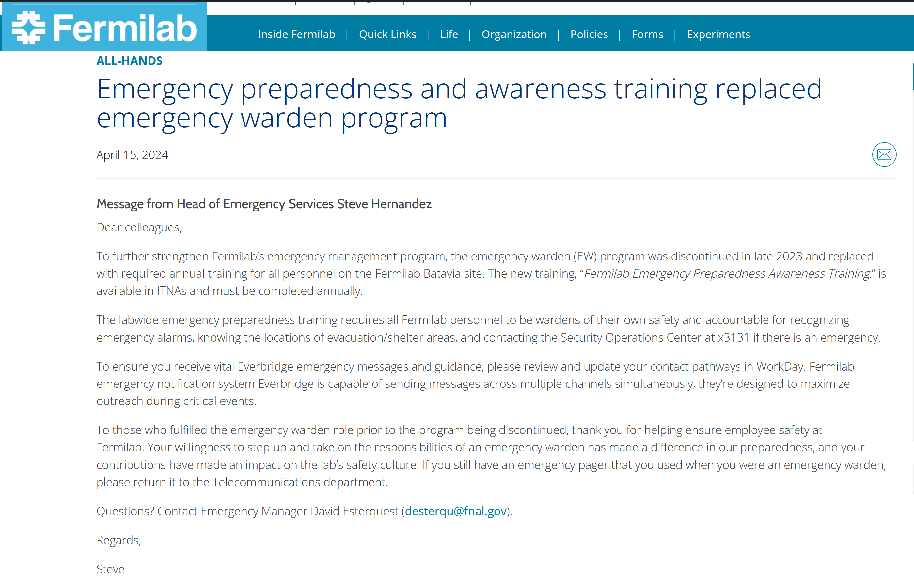
Emergency Warden Program Discontinuation
Emergency preparedness and awareness training replaced emergency warden program
Fermilab Emergency Preparedness Awareness Training [FN000741/CB/01]
Notes:
Last October, Emergency Management made the decision to discontinue the emergency warden program. Since then, ESH has been working to increase awareness around this policy shift and the new emphasis on individuals being "wardens of their own safety."
While emergency wardens played a crucial role in our emergency preparedness in the past, we believe that everyone possesses the capability and responsibility to contribute to a safe and orderly response to an emergency situation. By empowering each person to be a "warden of their own safety," we aim to enhance overall safety and preparedness while promoting a sense of collective responsibility for the safety of everyone at Fermilab.
You may read the communication put out in Fermilab today at this link: Emergency preparedness and awareness training replaced emergency warden program
In line with this shift, new training was rolled out to communicate emergency preparedness procedures that will ensure everyone is equipped with the information they need to respond effectively to emergencies.
You may review the new annual training at this link: Fermilab Emergency Preparedness Awareness Training
If you have any further questions on this matter, please don't hesitate to reach out to your DSO/DSS, Dave Esterquest, Corey Mulryan and/or Steve Hernandez.

