Slide 1
Post-swap Horizontal Drift PDS Schedule/MOU
David Warner
Colorado State University
May 19, 2024

Slide 2
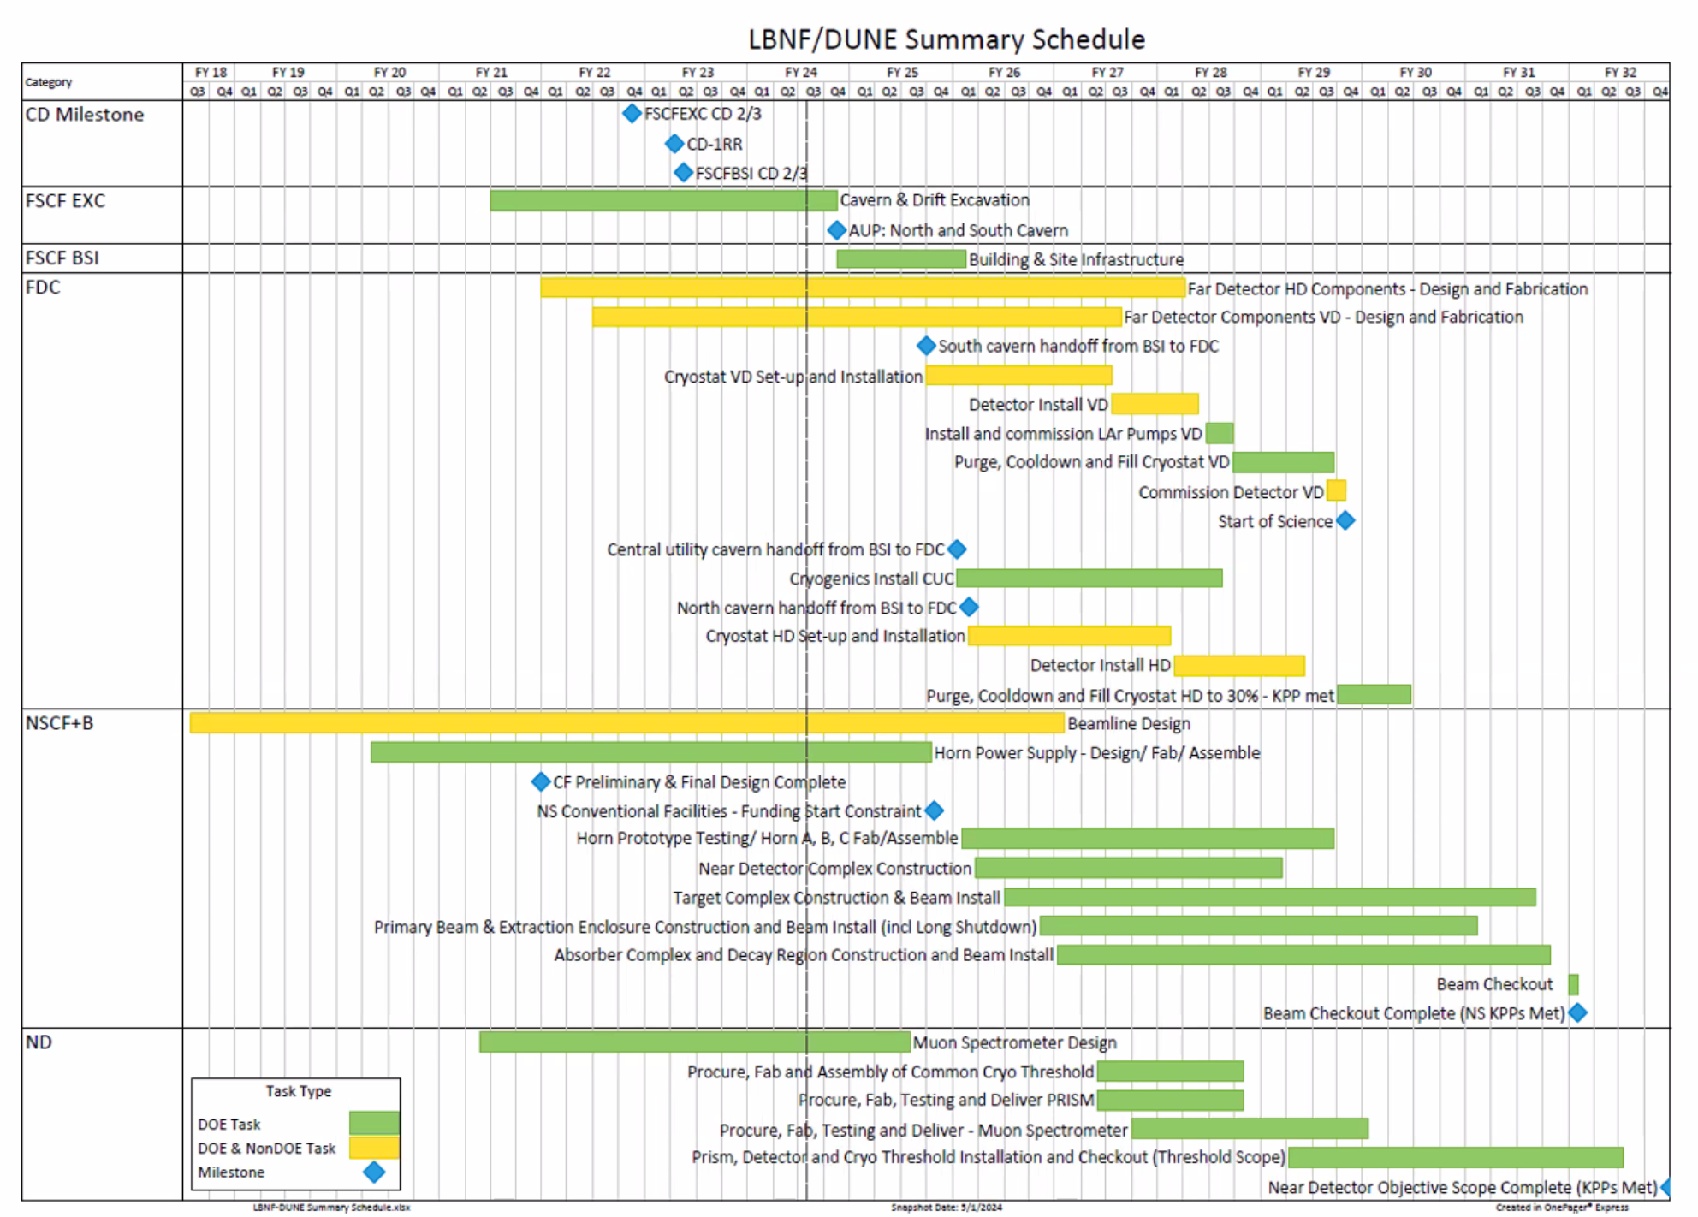

Slide 3
Updated Far Detector Schedule
Installation Overlap VD/HD

Slide 4
General Workflow
Pre PRR Validation
PRR (2/25)
Production Setup
Not discussed this meeting
Production & testing
Installation at SURF

Slide 5
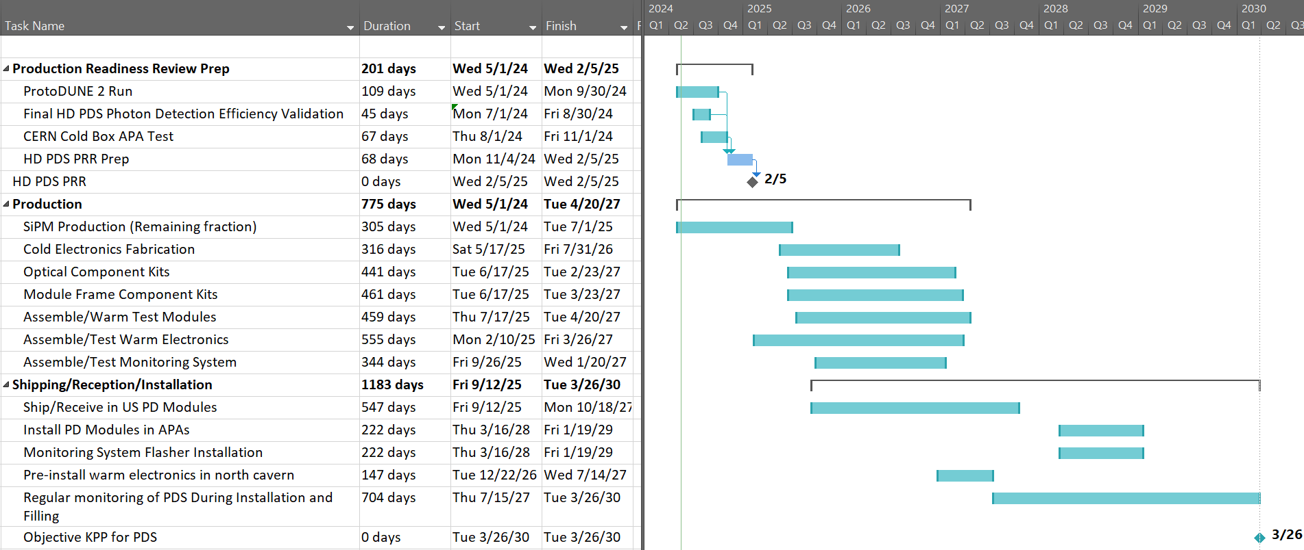
Updated High-Level HD PDS Schedule

Slide 6
General HD PDS Workflow as reflected in P6 (1)
Optical Module Fabrication/Testing
Photosensor Production & testing
Italy, Spain, Czech Rep. (HPK, FBK)
Cold Electronics (Fab. and testing)
Italy
Module Assembly and Testing
Brazil (UNICAMP)
Module Cold Testing
USA (CSU)
South Dakota Storage Facility (?)
USA (CSU)
Optical Components
Brazil
WLS Plates (G2P)
Dichroic fliters (OPTO)
Dichroic filter coating (UNICAMP)
Module mechanical components
Brazil (Equitorial)
Warm Electronics (DAPHNE) Fabrication/Testing
Procure components
(FNAL)
Procure PCBs
(FNAL)
DAPHNE Assembly/Checkout
USA (FNAL)
DAPHNE Pre-Delivery Testing
USA (NIU)
South Dakota Storage Facility (?)
USA (CSU)
Procure Chassis

Slide 7
General HD PDS Workflow as reflected in P6, (2)
Readout Cables/Power Supplies/Flanges
LV Power Supplies
Spain, Czech Republic (WEINER)
Cryostat Flanges
Spain (recent addition to scope)
South Dakota Storage Facility
USA
Readout Cables
USA (Recent addition to scope)
APA-Flange cables
Flange-DAPHNE warm cables
HV cables
Monitoring System
Procure/Assemble/Test Fibers and Diffusers (USA, SDSMT)
System Assembly/Checkout
USA (SDSMT)
South Dakota Storage Facility (?)
USA (CSU)
Procure/Assemble/Test flanges, flasher modules (USA, ANL)

Slide 8
General HD PDS Workflow as reflected in P6, (3)
Integration and Installation (I&I)
Optical Module Delivery
Install Dichroic filters (Above ground)
Readout Cables/Flanges
Install Modules/Monitoring in APA (Cryostat, Underground)
Monitoring System Delivery (Diffusers, fibers)
Post installation checkout and monitoring
Warm Electronics
Monitoring System (Flashers, flanges)
Install Warm Electronics
(Mezzanine/Cryostat roof, Underground)
Power Supplies & Cables
2 shifts of 4 PDS personnel, 4 days/week, Through duration

Slide 9
Photosensors (Spain, Italy, Czech Republic)
A photosensor “Kit” is the number of boards needed for 1 module (32 boards) + 5% spares.
Testing runs May 2023 – July 2025.
Assumes ~ 2,500 boards per month.
Currently reporting 360 (~25%) kits complete.
Currently uses US calendar assumptions (holidays…).
Separate contemporaneous lines (not shown) for Spanish and Czech contributions.

Slide 10
HD Cold Electronics (Italy)
Cold electronics include 1,500 cold amplifiers and 6,000 signal Routing Boards boards (+10% spares).
Production and testing currently starts July 2025, ends July 26.
It is understood that this will need to be moved earlier to meet the INFN funding profile (Procurement line must occur in 2024).
Will require additional PRR to accommodate this schedule.

Slide 11
Optical Components (UNICAMP)
An optical component “Kit” includes the WLS bars and coated dichroic filters for a single module
Fabrication occurs June 2025 – February 2027
Maximum required production rate of 4 kits/day

Slide 12
Module Frame Components (UNICAMP)
A frame component “Kit” includes the mechanical components for a single module
Fabrication occurs June 2025 – March 2027
Maximum required production rate of 4 kits/day

Slide 13
Module Assembly (UNICAMP)
Modules assembled at UNICAMP
2 modules/day initially, 4 modules per day for second half of production
Production occurs July 25 through April 27.

Slide 14
Warm Electronics (Spain, Czech Republic, Fermilab, NIU, U Michigan, CSU)
Includes multiple activities associated with warm-side readout
Flanges, power supplies (Spain, Czech Republic)
Power Supply Testing (U of Michigan)
Warm cables (CSU)
DAPHNE Fabrication (FNAL)
DAPHNE testing (NIU)

Slide 15
Monitoring System (ANL, SDSMT)
Includes 192 diffuser/fiber assemblies (+20 spares, SDSMT) and 20 Light source modules (ANL)
Production occurs September 2025 through January 2027.

Slide 16
Module Reception/Testing/Storage
Following assembly and initial warm testing at UNICAMP, Modules are shipped to the US module reception facility at CSU for cold testing and repair, then storage
60 day shipping UNICAMP – CSU
Modules tested at a rate of 10/day
5 day shipping CSU – SURF
Reception/Inspection starts 9/25, Ends 10/27

Slide 17
Installation and Integration
Light Detector
I&I activities occur at SURF site in Lead SD
Warm Electronics installation occurs Dec. 26 through July 27 (with availability of cryostat roof)
Light detector and monitoring installation occurs March 28 – January 29
2 4-person crews for modules, 1 2-person crew for flashers/diffusers
Monitoring
Warm Electronics

Slide 18
Horizontal Drift Photon Detector System MOU

Slide 19
Items not currently explicitly covered in MOU
LV Power supplies
Flanges
Readout cables
While the intention was that the warm cables and APA-flange cold cables would be made in Brazil, the existing MOU text can be read to include those cables so no edits are needed
Subsystem | Description | Quantity (HD PDS) | Contributing Nation | Funding Agency
LV Power Supplies | WEINER power supplies and crates for DAPHNE and monitoring flashers | 150 channels + 10% spares | Spain, Cz. Republic
Cryostat Flanges | Flanges for HD PDS signal/calibration cryostat penetration | 75 flanges + 10% spares | Spain (Grenada)

Slide 20
Other MOU/scope changes (resulting from this meeting
Subsystem | Description | Quantity (HD PDS) | Contributing Nation | Funding Agency

Slide 21
Backup

Slide 22
HD/VD Overlap topics
Resource utilization is not monitored carefully across HD/VD PDS boundaries.
Shared human resources and facilities need to be carefully evaluated to ensure resource utilization duplication is avoided.
Particular examples include:
SiPM fabrication/testing HD vs. VD. HD and VD fabrication and testing share amy share CACTUS testing sites and operators, and definitely share vendors for fabrication.
Dichroic filters: While HD and VD use separate vendors for dichroic filters mitigating overlap, there may be competition for pTP coating facilities. P6 includes separate HD and VD sites, but the risk of overlapping resources needs to be monitored.
WLS plates: Both HD and VD PDS plan to use the same vendor (Glass to Power) for wavelength shifting plates. Care must be taken to overtax this vendor.
DAPHNE: While HD and VD DAPHNE production is conducted at separate sites in Europe and the US, intellectual leadership of the effort is provided by the same teams. This possibility exists for resource conflict at FNAL primarily, however care must be taken to manage intra-European responsibilities for the VD PDS .
~3 months explicit I&I HD and VD overlap exists in P6, which will need to be managed.
+ resource overlaps with multiple different tasks at the same institution.
Several institutions are involved in hardware tasks for both HD and VD PDS.
Additionally, some are involved in HD fabrication during VD I&I.
This potential interference may be mitigated by:
Involving more groups in some tasks.
Shifting the P6 schedule to better “Load level” resource utilization.

