Slide 1
Muon Campus Operation Report
Jim Morgan
Friday 09:00 Operations Meeting
May 10, 2024

Slide 2
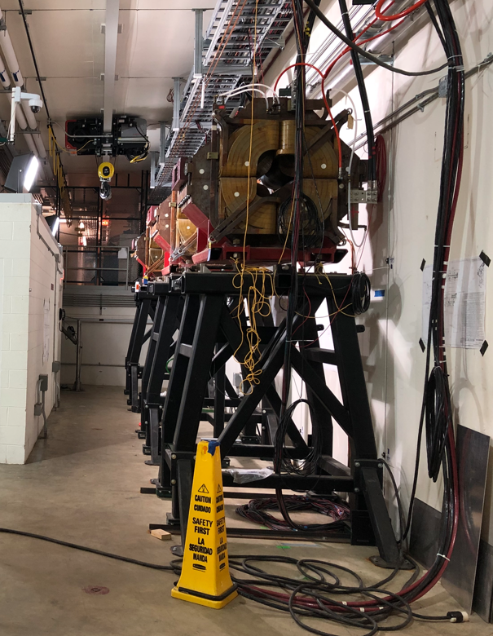
Muon Campus status
Working towards permission for beam operation
Interlocks testing mostly done (we think), but no sign off yet on start-up sheet
Sign-offs in progress for SAD/ASE documents, need for RPO signature
Power supplies were turned on Wednesday and remain on
RR 2.5 MHz RF has a chiller problem, need for beam to Muon Campus
Two M4 Line vacuum valves unplugged, need access to send beam to M4DA
Could still run beam to Delivery Ring, just not be able send beam down M4 Line
D:ESS2, prototype electrostatic septum in Delivery Ring tunnel, turned back on to reduced voltage and will need to be conditioned
ESS1 & ESS2 Electrostatic Septa
ESS1 high voltage conditioning at NWA completed
ESS2 foil plane straightness good, cathode being straightened in Machine Shop
AP-0 A/C work continues to be stalled (now at 55 weeks)
Waiting for controls sub-contractor to show up
Technical Division personnel working on water leak on LQ magnet in downstream M4 Line (Mu2e area, outside of interlocked enclosures)
Study – M1-M3 Optics
Study – Alternative M5 optics

Slide 3
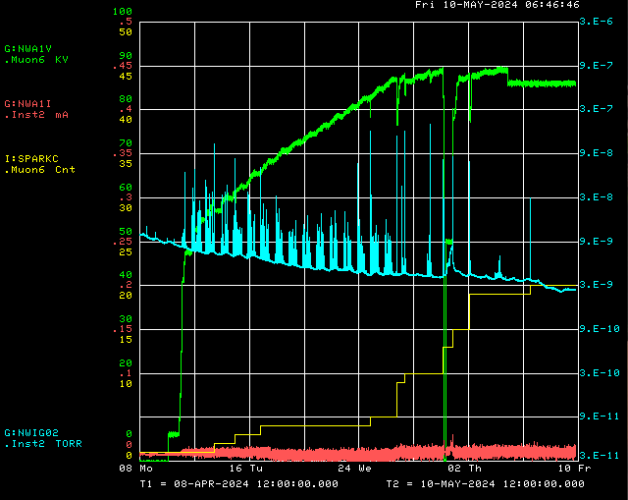
ESS1 high voltage conditioning at NWA
Conditioning target voltage
Operational Voltage
ESS1 P.S. Voltage
Ion Gauge
Spark Detector
ESS1 P.S. Current

Slide 4
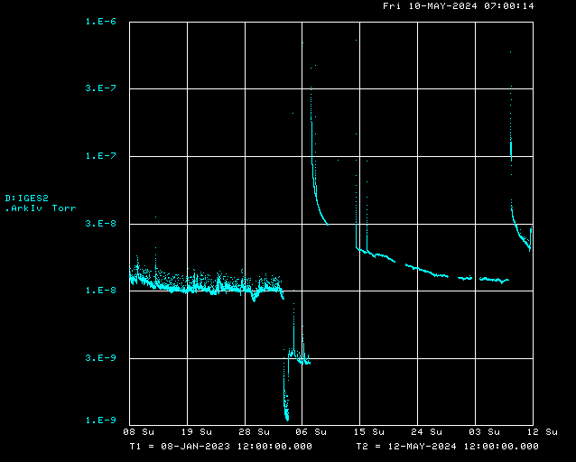
Vacuum at prototype ESS2 installed in D30

Slide 5
Upcoming work
Hope to have signing party soon
Waiting on Interlocks testing to be finished
Need final sign-offs on SAD/ASE documents
Still need signatures from Interlocks, RPO, EPB Department and Operations
Will continue power supply testing while waiting for approval to run beam
Would like to do test of new Mu2e TLG module this afternoon
ESS1 and ESS2
ESS1 conditioned and could be prepared for installation in the Delivery Ring
ESS2 subassembly work, followed by assembly into tank
Key remaining issues and tunnel work
Recycler 2.5 MHz RF not working
Two closed vacuum valves in M4 Line have control cables disconnected
LCW leak rate up to 190 Gal/Week
Plan to valve out D30 PWC’s and IC in hopes of improving ESS2 vacuum
M3 Line Extinction Monitor test apparatus needs to be finished
AP-0 A/C work paused while awaiting controls sub-contractor
Will need access to AP-0 Water Cage and rad fence area, turns off beam to Muon
Estimate six days of work needed for system to be operational
Expect to resume use of portable A/C unit in near future

