Slide 1
Introduction to FD1 and FD2 Detector installation
Jim Stewart
Stewart@bnl.gov

Slide 2
FD detector installation overview
Installation FDR review April 25 23
https://indico.fnal.gov/event/59023/timetable/
FDR review documents
https://edms.cern.ch/document/2805054
https://docs.google.com/spreadsheets/d/1zTIKihuZT2z3zBNps2jLCMQka5_RitzXj1lKzopOyuA/edit#gid=376429220
Review overview talks (several hours of presentation)
FD1 installation - https://edms.cern.ch/document/2885626
FD2 Installation - https://edms.cern.ch/document/2885629
FD2 installation has changed in that the Field Cage is installed before the Cathode.

Slide 3
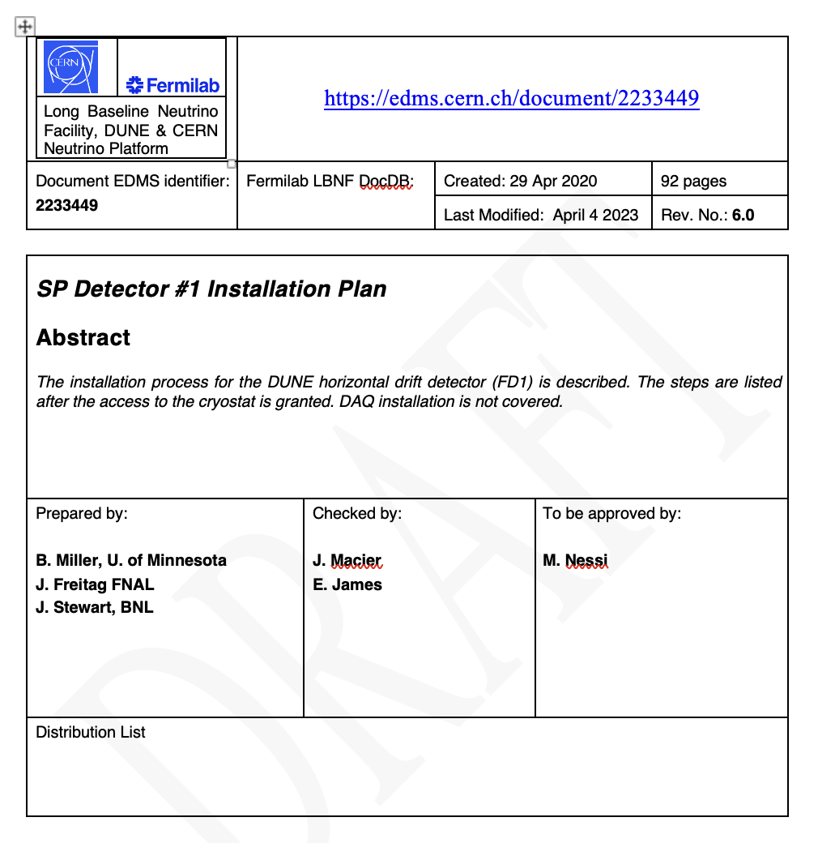
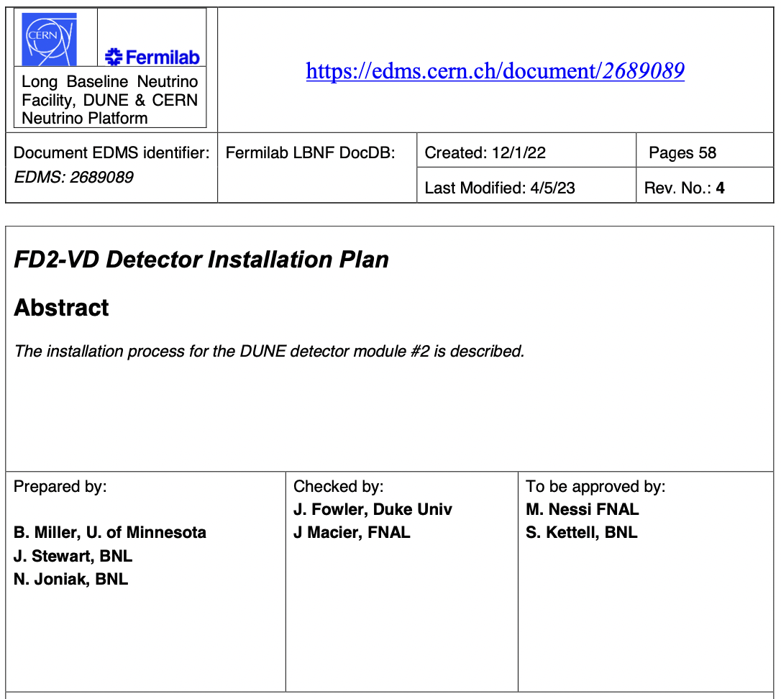
DUNE Detector Installation Plans
Charge question 3
FD1 Detector Installation Plan | https://edms.cern.ch/document/2233449
FD2 Detector Installation Plan | https://edms.cern.ch/document/2689089
These documents detail each step of the detector installation.
A detector installation manual
Basic division of responsibilities:
I&I crew perform all heavy work.
I&I will operate the lifts, hoists and other heavy equipment.
I&I will operate power tools and perform general mechanical tasks.
I&I performs mechanical work on detector components as agreed upon by the consortia, following consortia procedures, and with consortia oversight.
Consortia are responsible for all work on their detector components.
Assembly of sub-components.
All QC and testing.
Detector installation on the consortia deliverables (assisted by I&I as agreed).
The installation plan is a high-level planning document designed to give the overall plan for the installation. It defines each step and describes the responsibilities in each step.
The next level down in documentation below the installation plans are the actual procedures.
Quality control information is in the procedures for each installation step.
The division of responsibilities is defined in the Interface Control Documents

Slide 4
Labor Planning spreadsheets
Labor planning spreadsheets were created to estimate the time and resources for each installation act.
The FD1 detector installation planning was done in ½ shift blocks
The FD2 detector installation planning was done in shift time blocks.
The spreadsheets are found at:
FD1 Labor planning spreadsheet
https://edms.cern.ch/document/2523457
New FD2 Installation Schedule Sequence
https://edms.cern.ch/document/2957537

Slide 5
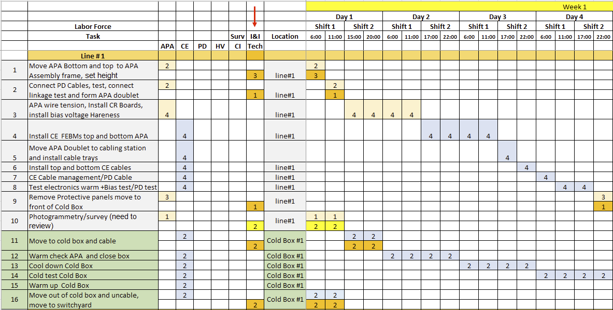
Detector Installation Summary Schedule
Charge questions 4,5
The schedule was developed in conjunction with the consortia. The activities were all discussed, and the work planned at the ½(1) shift level for FD1(FD2). Resource allocation between I&I and consortia were agreed upon. The planning spreadsheets were matched to the P6 output.
Installation Planning Spreadsheets | https://edms.cern.ch/document/2523457/LAST_RELEASED
I&I is responsible for overall planning.
I&I operates all heavy equipment and assists in mechanical operations.
Example from FD1

Slide 6
Infrastructure installation
The planning for the infrastructure installation has not been done at the same level as the detector installation.
This will need improved going forward.
Few examples of exercises
The Basis of estimate documents contain explanations for the planed durations and resources but this needs improved.

Slide 7
Basis of Estimates
BOE for WBS 131.FDC.05.03 - Far Detector #1 Installation for CD-2/3 Aug 2023
https://docs.dunescience.org/cgi-bin/sso/ShowDocument?docid=28813
BOE for WBS 131.FDC.05.04 - Far Detector #2 Installation for CD-2/3 Aug 2023
https://docs.dunescience.org/cgi-bin/sso/ShowDocument?docid=28816
The spreadsheets are large but have a lot of information

Slide 8
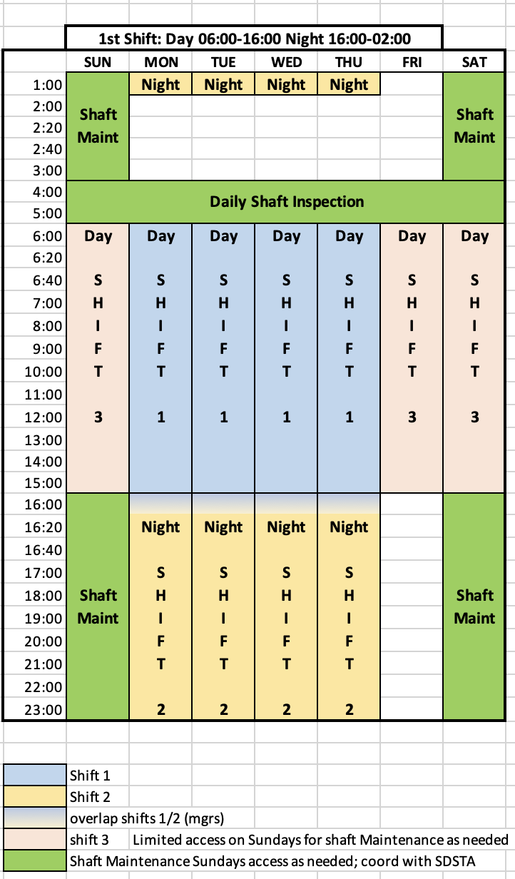
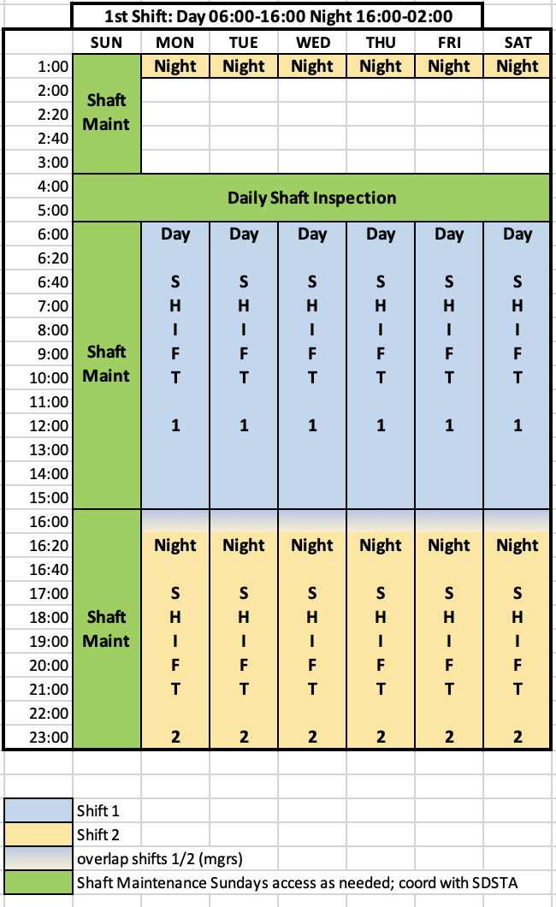
Installation Shift Number and Duration
There is significant overhead in working underground making 10 hr shifts preferable.
Roughly 3 hr. per shift will be spent getting below ground, reaching the job site, changing into and out of cleanroom garb, safety sessions, shift change meeting, lunch and breaks.
Overall, a 50% efficiency in underground work is factored into planning.
The 10hr shifts reduce the impact of the large unproductive time.
This allows using overtime to make up schedule.
Cavern crane rigging crew only available for (1) 10 hr. shift per day for 5 days per week.
All cavern crane rigging required for weekend work will need to be finished by end of shift Friday.
Limited or no work is planned for Sunday. This day is needed for shaft inspection and maintenance by SURF and the argon pipe installation.
FD1 installation is planned based on (2) 10 hr. shifts per day for 4 days per week. With a minimal Shift-3 over the weekend for testing.
This allows overtime on Friday and Saturday to make up any schedule delays
Consortia can work weekends to test their detectors
The cryogenic detector testing runs 24-7
FD2 installation is planned based on (2) 10 hr. shifts per day for 6 days per week.
Allows concentrated work periods by foreign collaborators.
The double deck cages is limited to 31 people and each trip is 20 min so staggered shift starts will be planned.

Slide 9
Shifts
The optimum shift organization will depend on the phase of the far site work.
During cryostat construction it must adapt to the cryostat installers schedule.
Need to evaluate the optimum shift schedule for I&I at this time.
During the cryostat insulation and primary membrane installation it will also adapt to the installers schedule.
During detector installation the needs of the consortia have to be taken into account.

