Slide 1
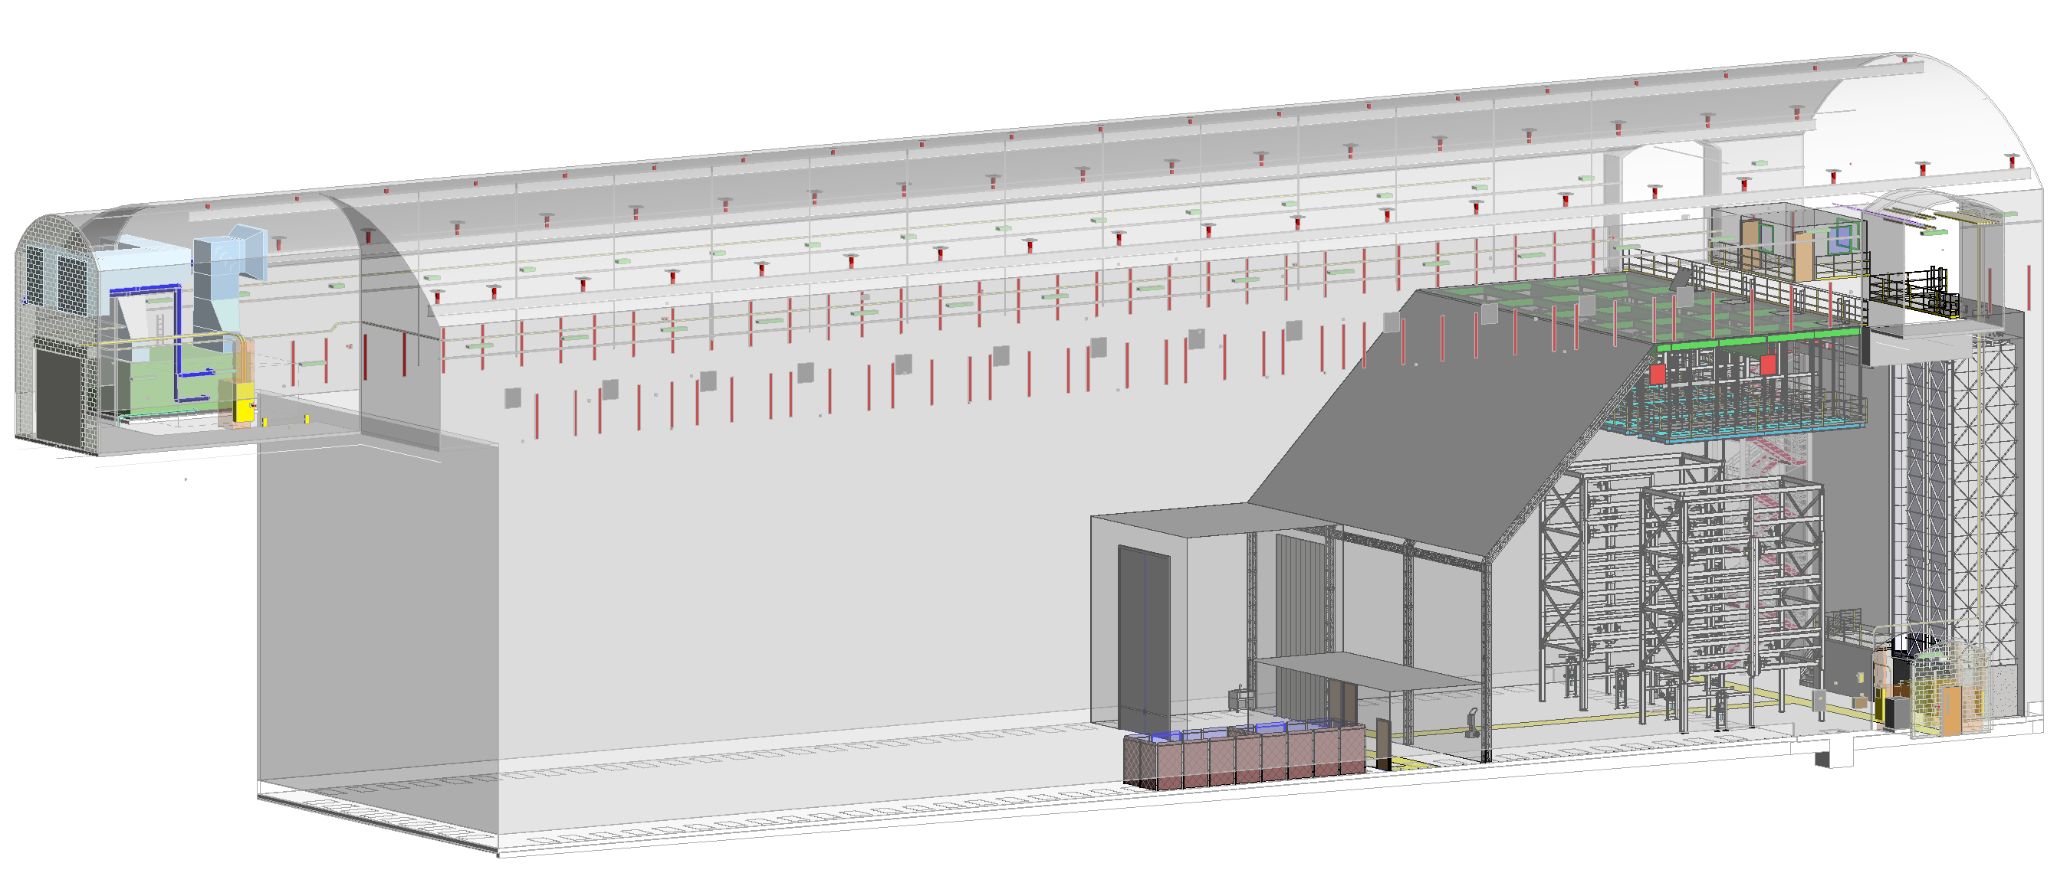
LBNF Clean Room Infrastructure Installation
Justin Freitag, Jim Stewart, Bill Miller

Slide 2
Manpower and time resources
Work will be done in shifts
Shift 1 Day shift 05:00 to 15:00 Monday to Thursday (7h/d at 4d/w) Services available: 3 riggers and 2 surveyor
Shift 2 Evening shift 13:00 to 23:00 Monday to Thursday (7h/d at 4d/w) Services available: 3 riggers
Shift 3 Day shift from 06:00 to 16:00 Friday to Saturday (7h/d at 2d/w) Service available: 2 riggers
Personnel (per shift)
Management
  1 x CERN Supervisor
  1 x Shift Manager
  1 x Safety Officer
Subcontractor Technicians
  6 x Main Technicians (3 teams of 2 persons) Including one lead technician
To assemble the 4 main pieces in the gabarits, and at its final location. Mainly placing bolts by hand.
  6 x Bolt Tightening Technicians (3 teams of 2 persons)
To tighten the bolts
I&I Core Technicians
  4 x Bolt Tightening Technicians (2 team of 2 persons) Shift 3
To tighten the remaining bolts
  2 x G10 Technicians (1 team of 2 persons)
To glue the G10
  2 x Woodwork Technician (1 team of 2 persons)
To do the woodwork and the polystyrene
  Total: 20+3 persons/shift
        Main assumptions: Warm structure in 156 d (2’200h at 56h/w)
                Floor 26 d
                Small wall 6 d (per wall)
                39 portals 78 d
                Warm Skin 40 d (560h for 560 plates)
Needs Updated

Slide 3
Assumptions and questions
The Cold boxes are constructed in parallel to the cryostat steel and are installed as step 1.
  How much of the cold boxes will be assembled on the surface?
  How much of the steel is fabricated at a factory and how much is self performed?
Do we want to install a small 2t bridge crane under the 4850 changing room so the room can stay in place when David installs his equipment?

Slide 4
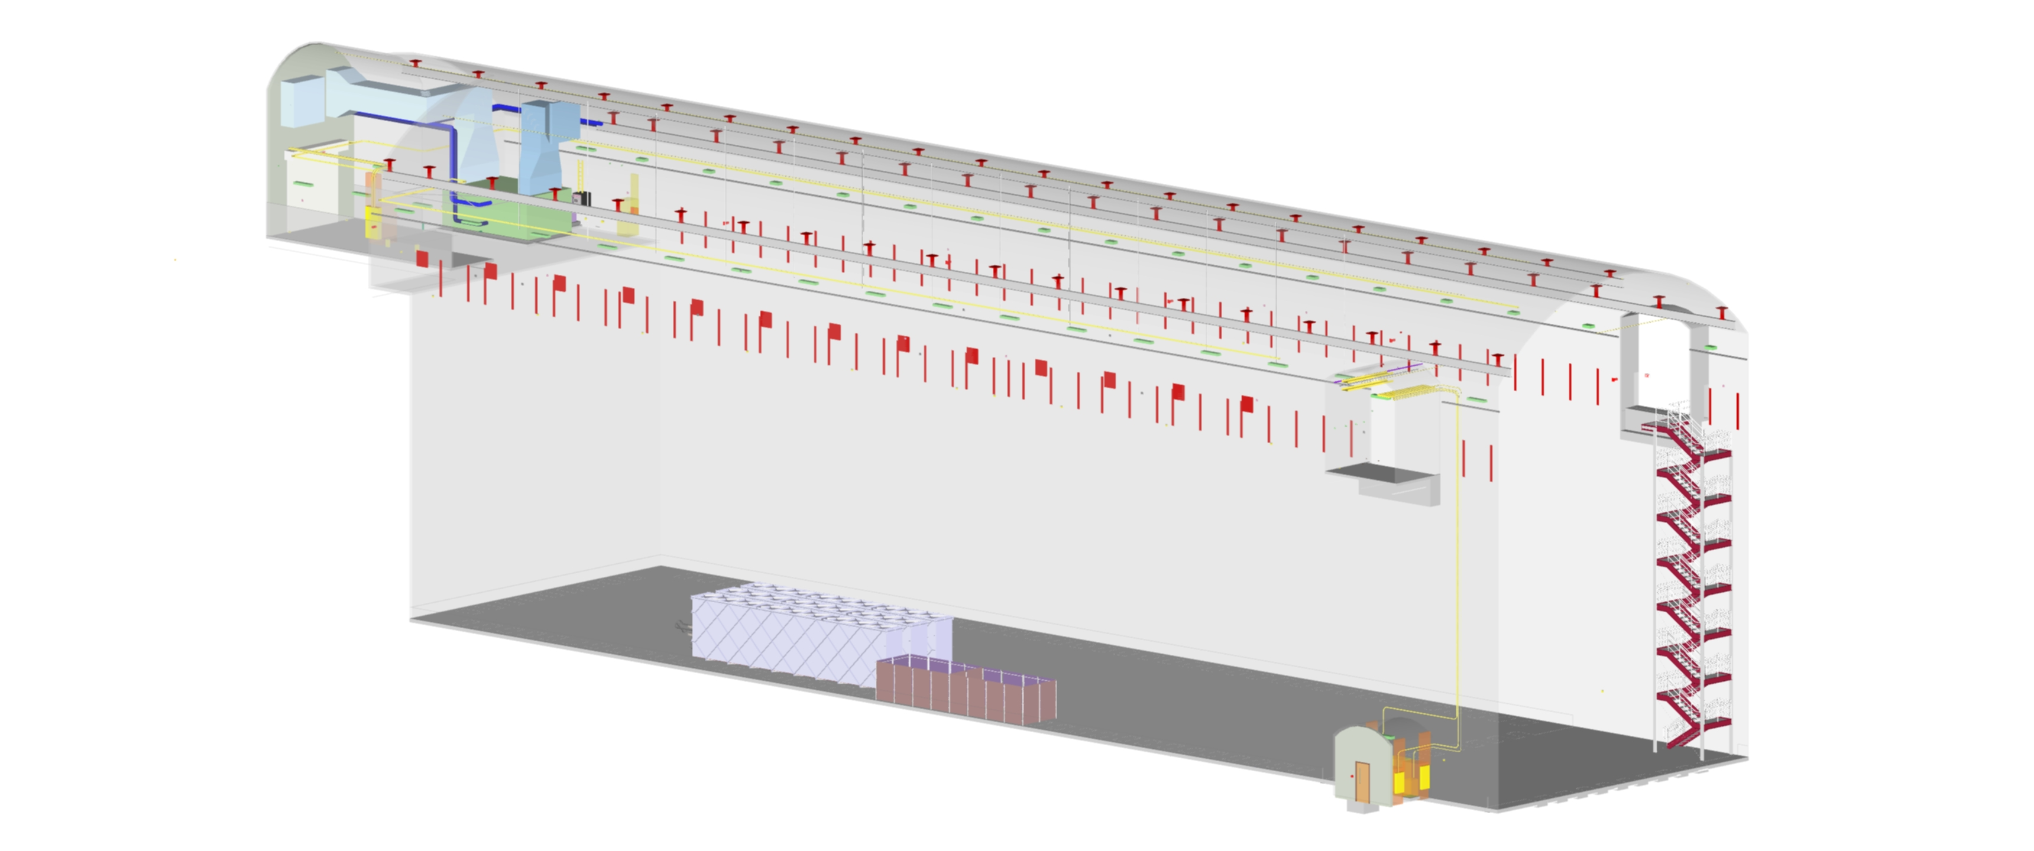
Fabricate Cold Box #3
  Duration: 3mo
  Crew: x welder x MT
T0-3mo
Cold box
Laydown/Assembly
Area

Slide 5

Install Cold Box Pedestals
  Duration: 40 hrs
  Crew:
~2days
Do we need to install the pedestal in front of the cryostat here?
Cold Box Pedestals
Cold box
Laydown/Assembly
Area

Slide 6
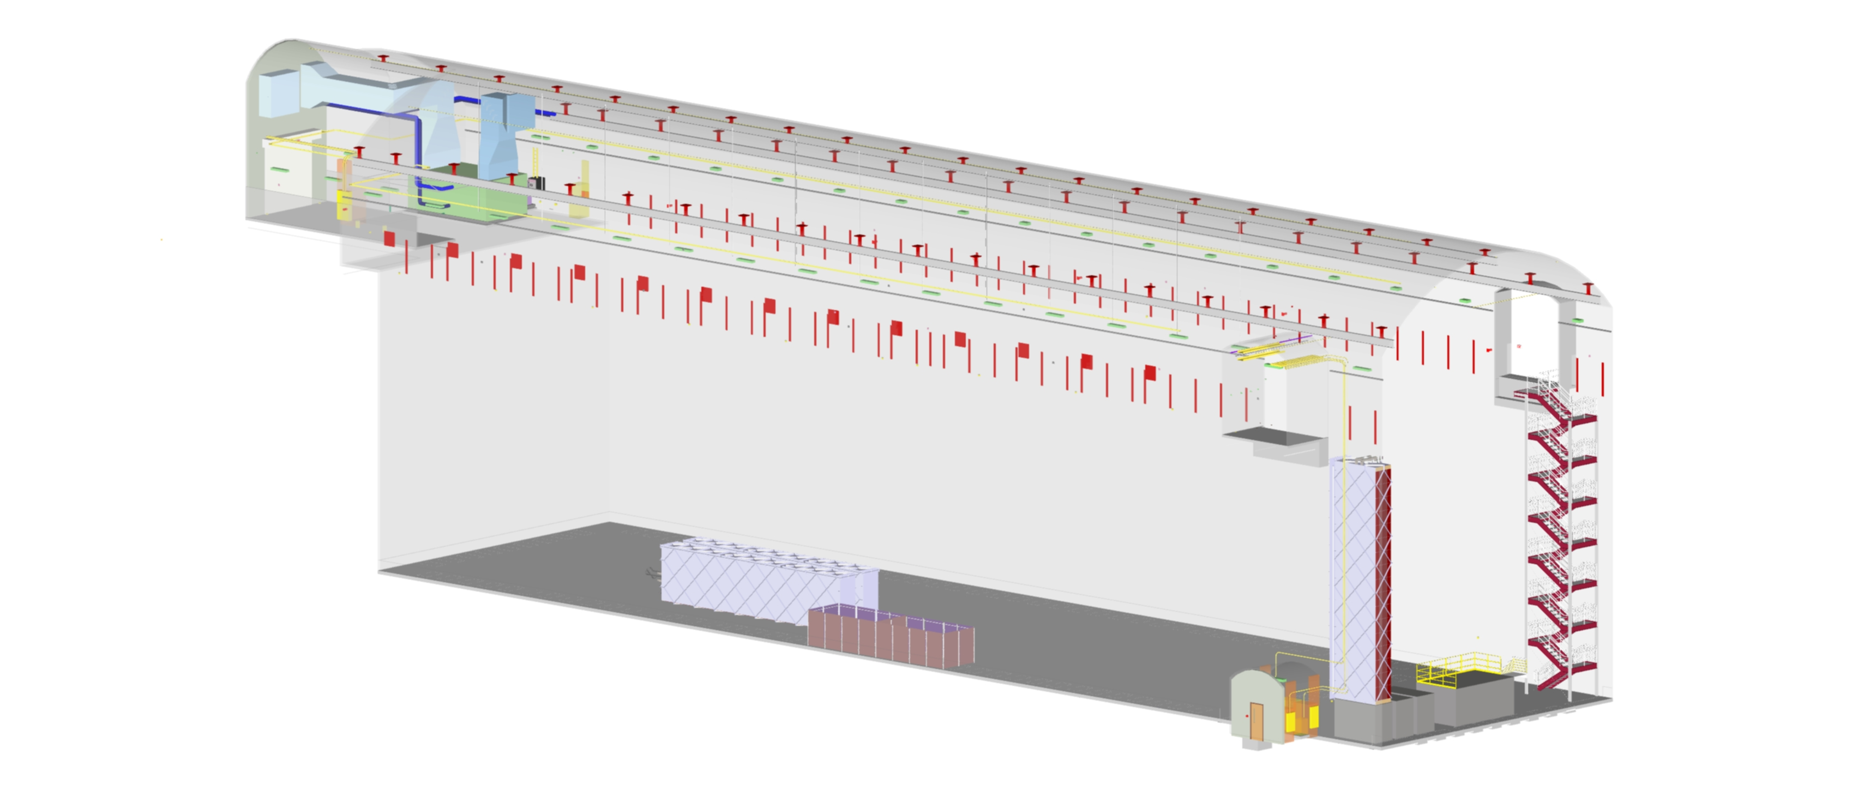
Install Cold Box#1
  Duration: 40 hrs
  Crew:
~2days
Cold Box #1
Cold box
Laydown/Assembly
Area

Slide 7
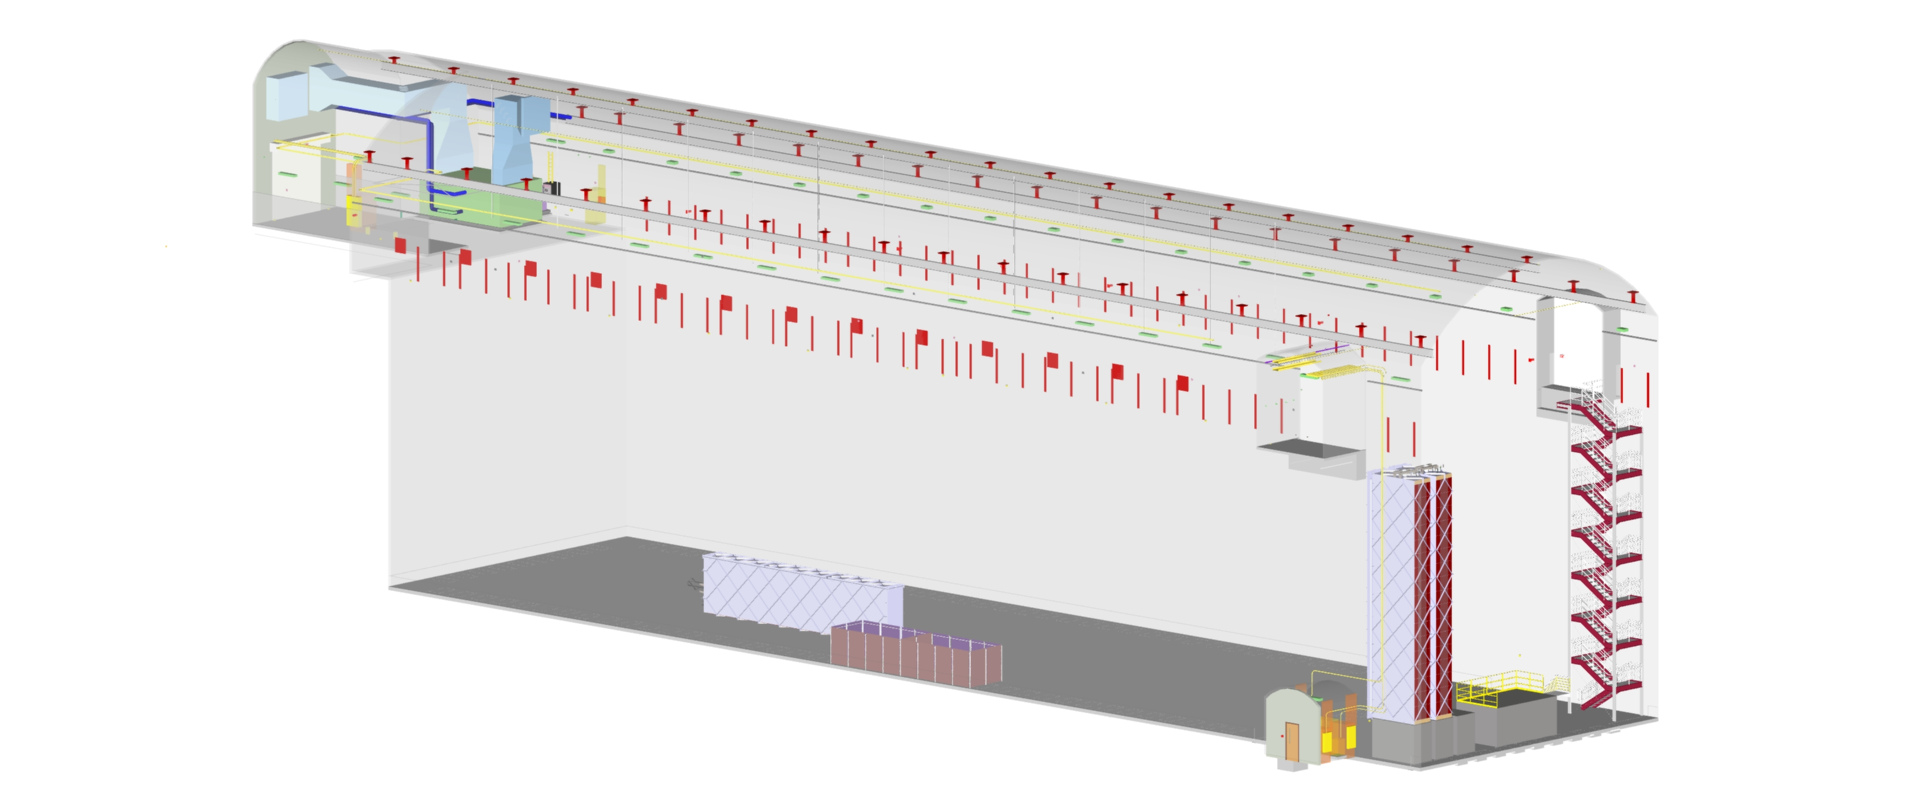
Install Cold Box#2
  Duration: 40 hrs
  Crew:
2days
Cold Box #2
Cold box
Laydown/Assembly
Area

Slide 8
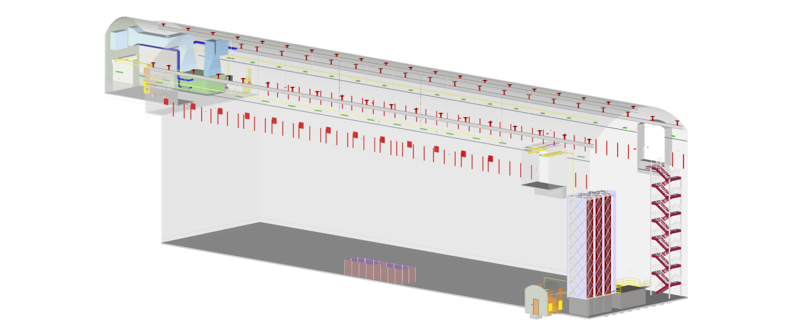
Install Cold Box#3
  Duration: 40 hrs
  Crew:
2days
Cold Box #3
Cold box
Laydown/Assembly
Area

Slide 9

Install N-S Bridge I-Beam #1
  Duration: 20 Hrs
  Crew:
Day 1
Bridge I-Beam#1

Slide 10
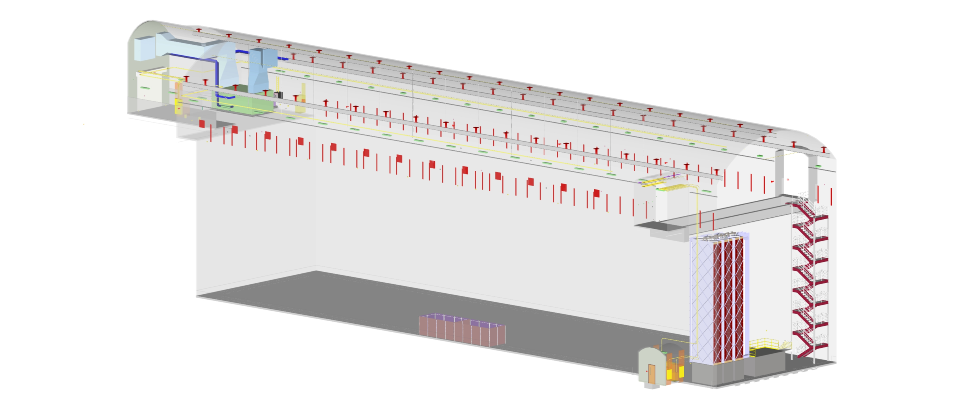
Install Bridge I-Beam #2
  Duration: 20 Hrs
  Crew:
Day 2
Bridge I-Beam#2

Slide 11

Install Bridge Internal Steel
  Duration: 20 Hrs
  Crew:
Day 5
Bridge internal steel

Slide 12

Install Bridge Walking Surface
  Duration: 40 Hrs
  Crew:
Day 7
Walking Surface
Walking surface is either a metal decking or a concrete pad

Slide 13
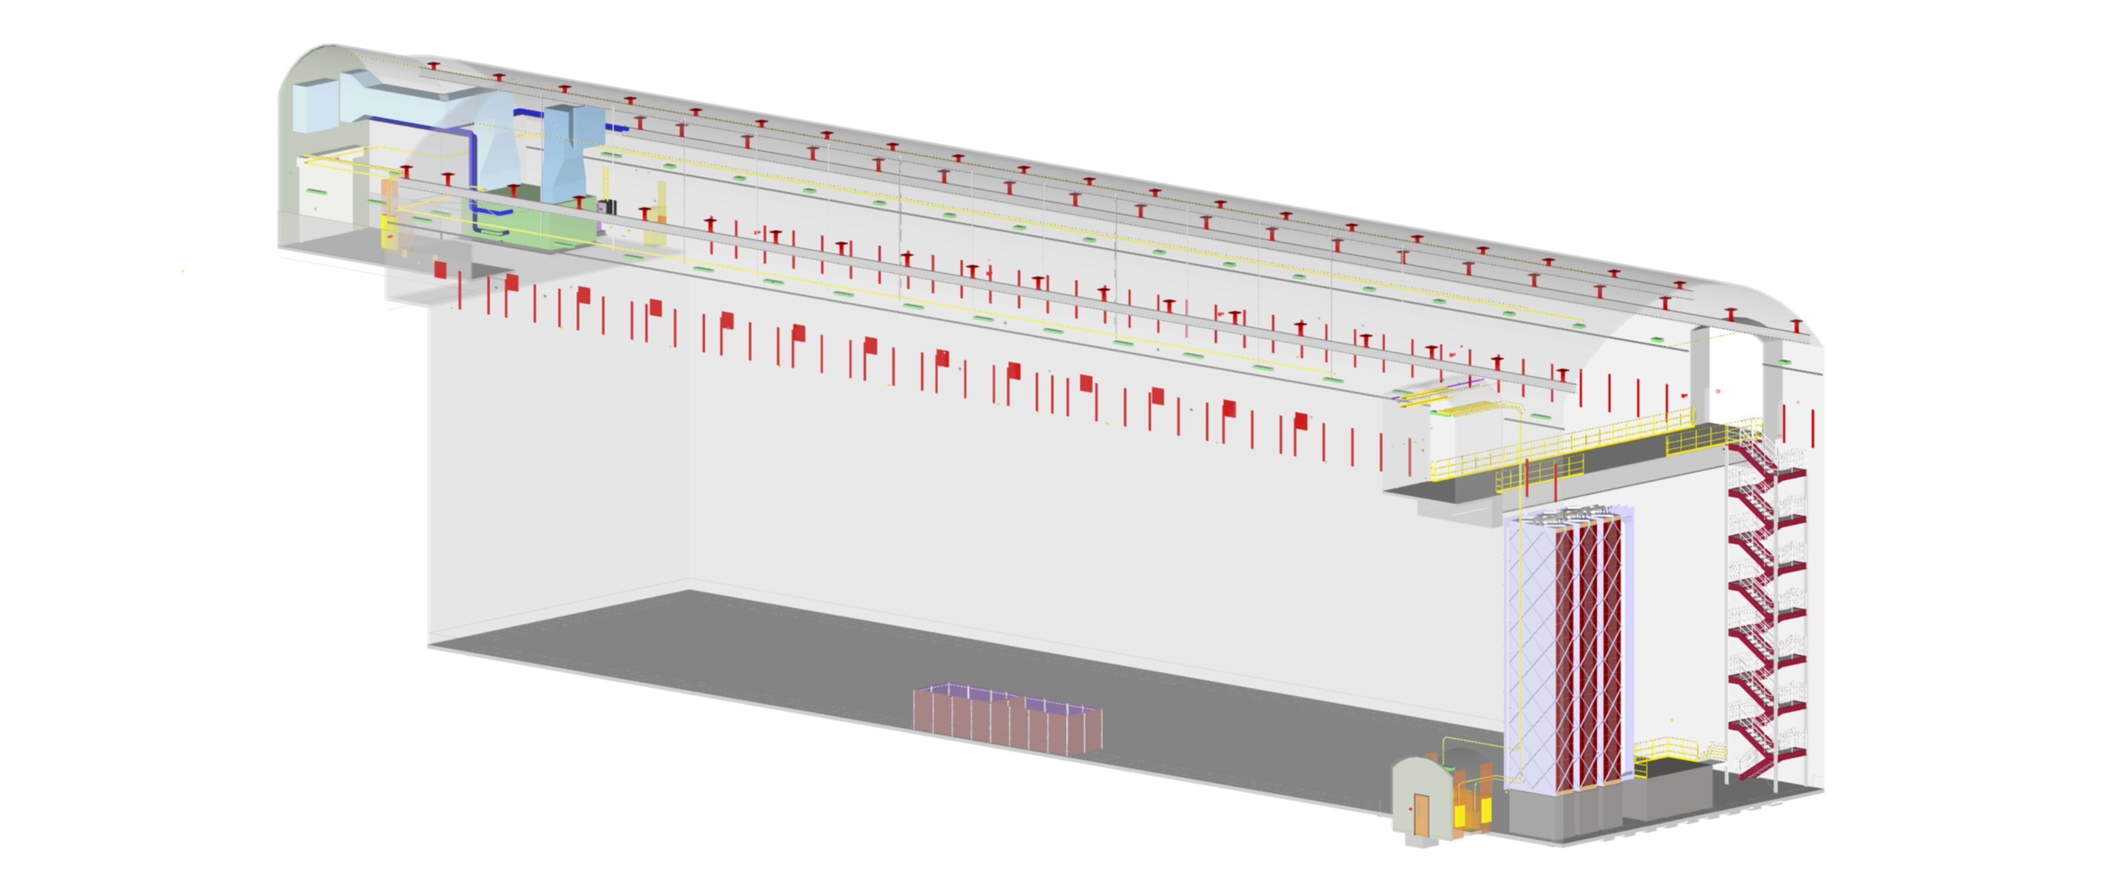
Install Bridge Guard Rails
  Duration: 20 Hrs
  Crew:
Day 8
Guard rails

Slide 14

Install TCO Beams
  Duration: 40 Hrs
  Crew:
Day 10
TCO beams

Slide 15

Install Bridge-to-Cryostat Structures
  Duration: 40 Hrs
  Crew:
Day 12
Walkway Structure

Slide 16
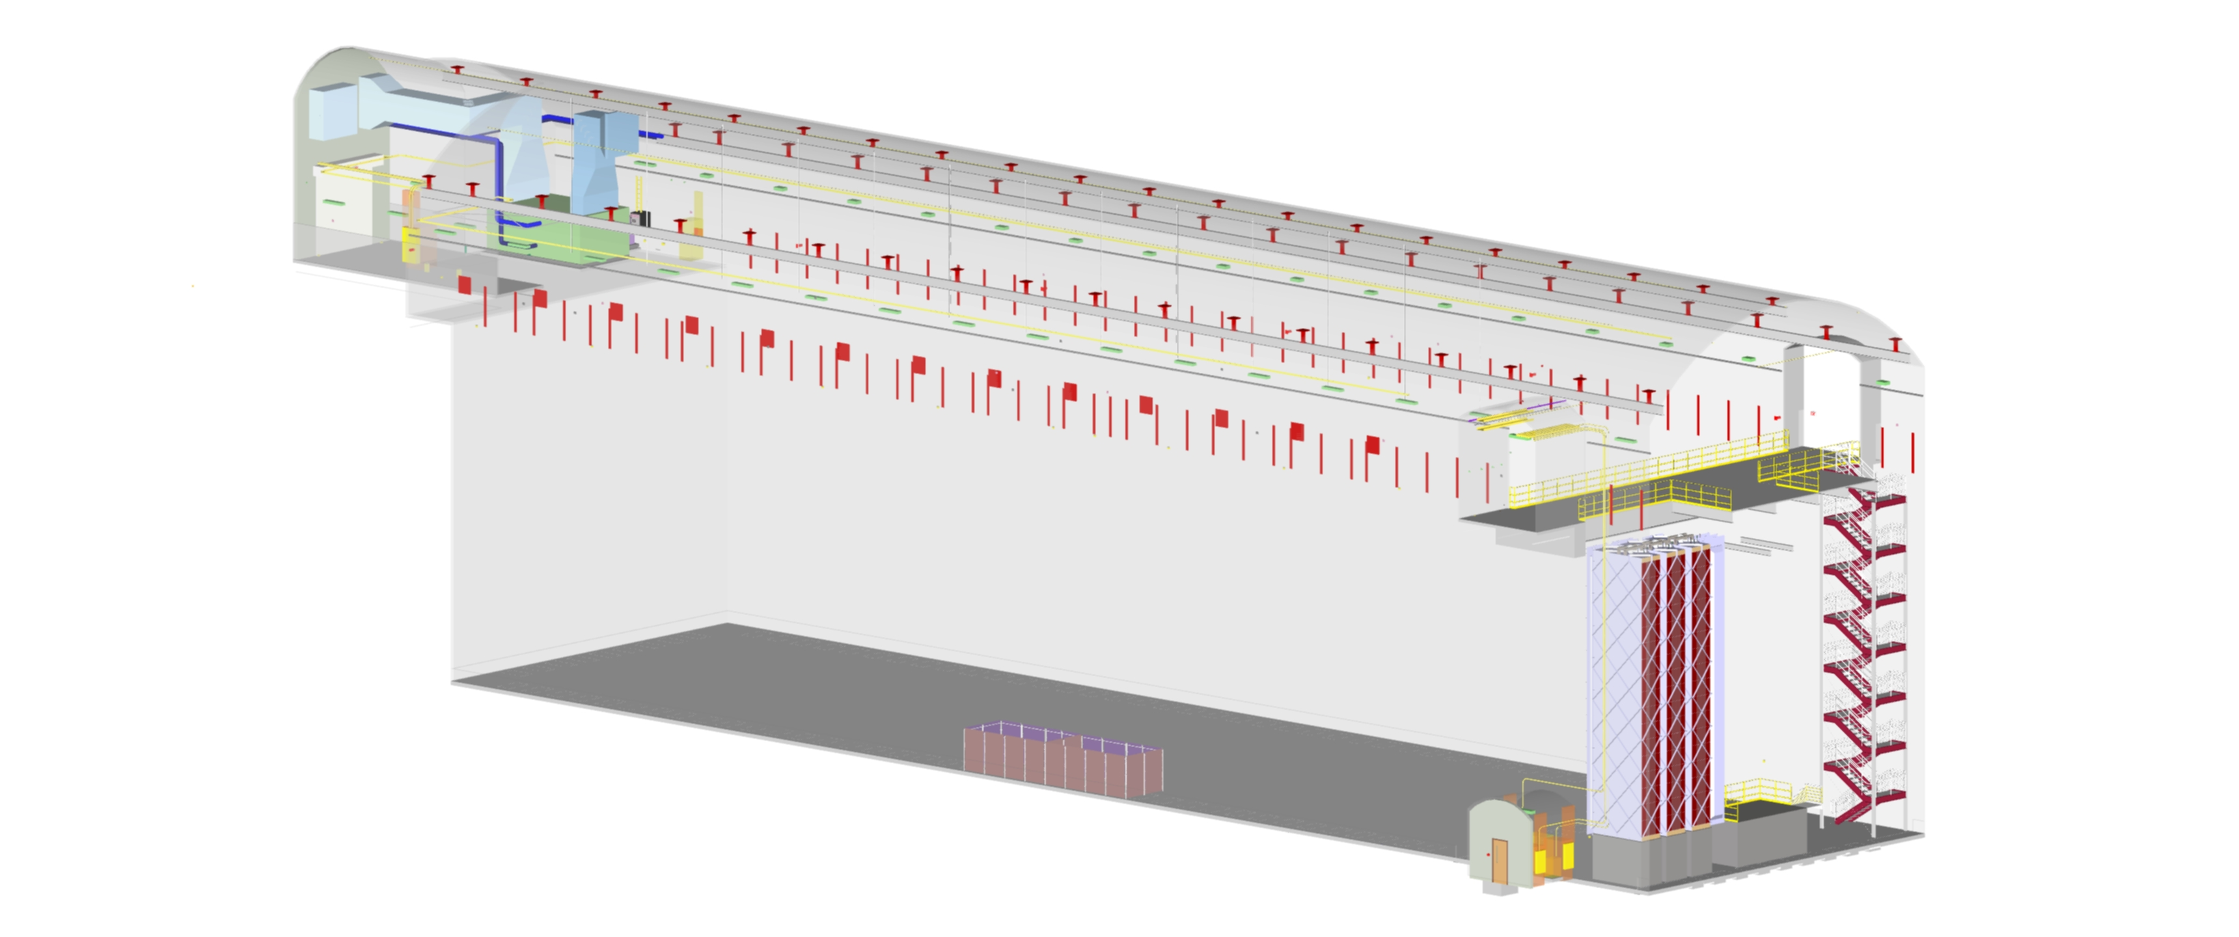
Install Floor for 4850L Changing Room/Walkway
  Duration: 80 Hrs
  Crew:
Changing room floor support

Slide 17
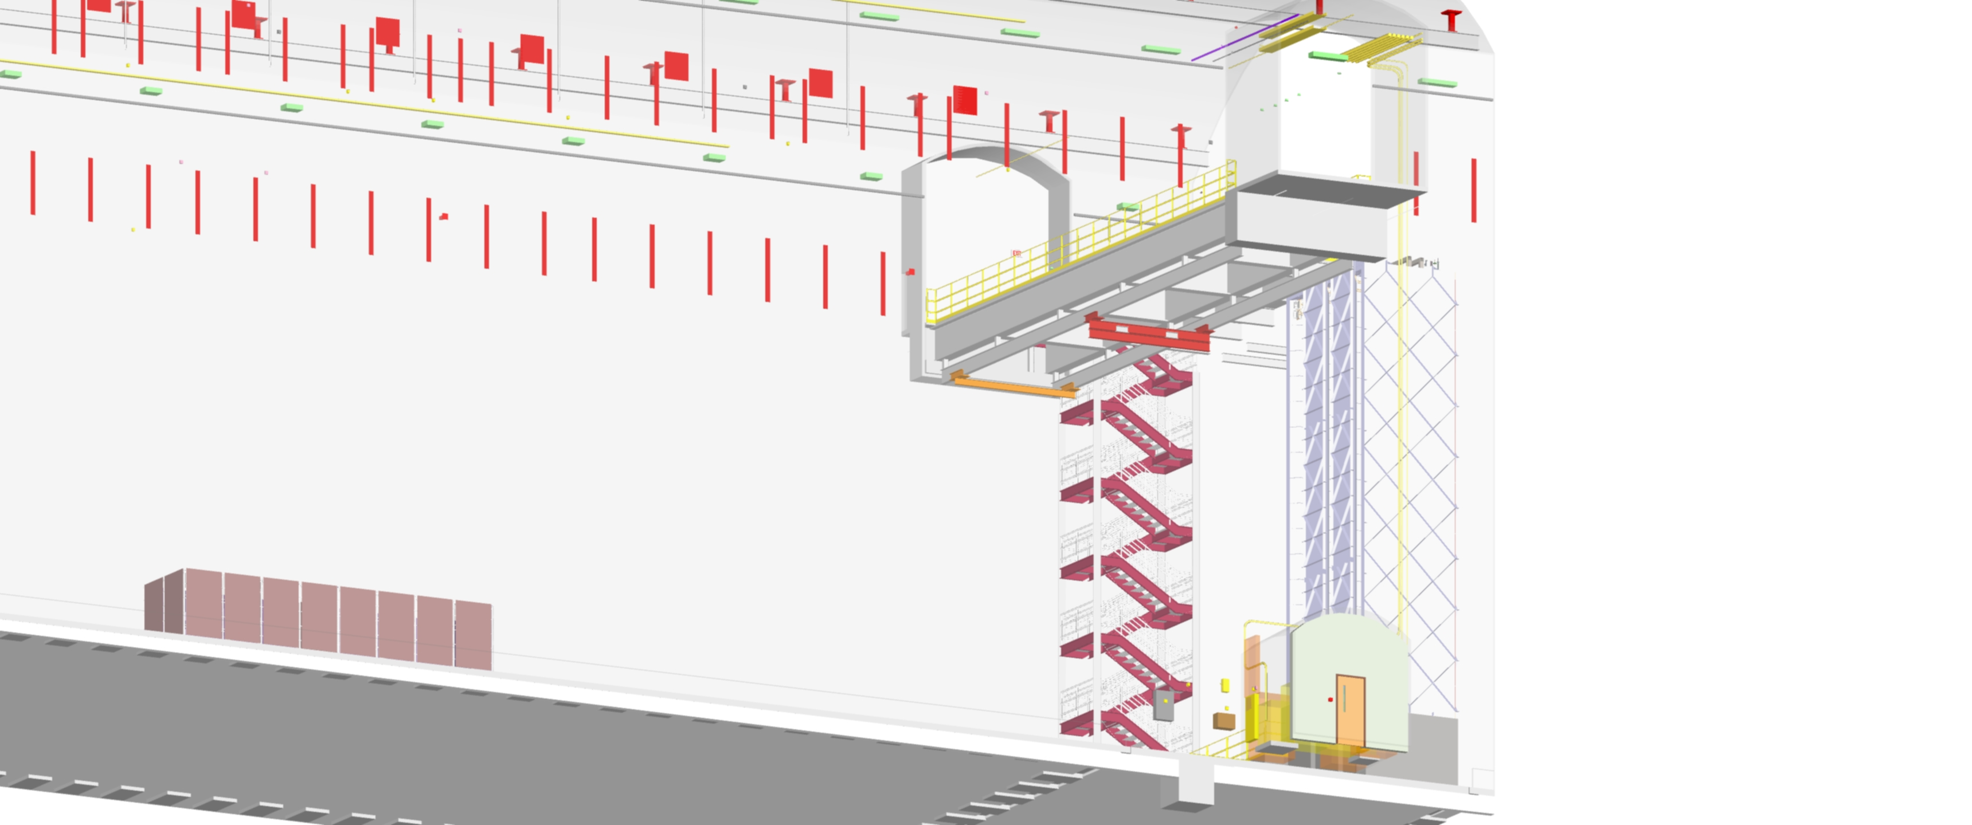
Install Cleanroom Crane (Mechanical)
  Duration: 80 Hrs
  Crew:
Connect Cleanroom Crane Power and Commission
  Duration: 80Hrs
  Crew:
Day 16
Month 1
-Activities are in parallel
-Commission should be in parallel to the next step

Slide 18
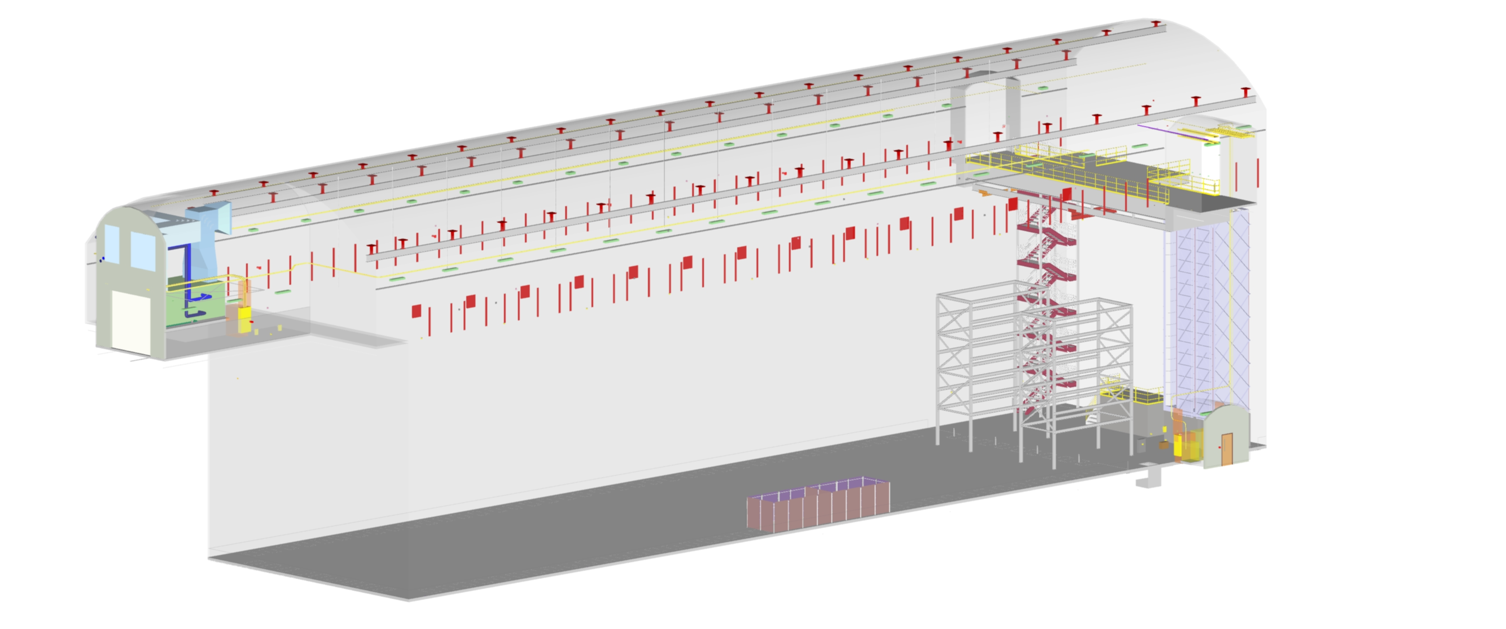
Assemble/Install North and South APA Towers
  Duration: 120 Hrs (6 work days)
  Crew:
Day 22
Towers

Slide 19
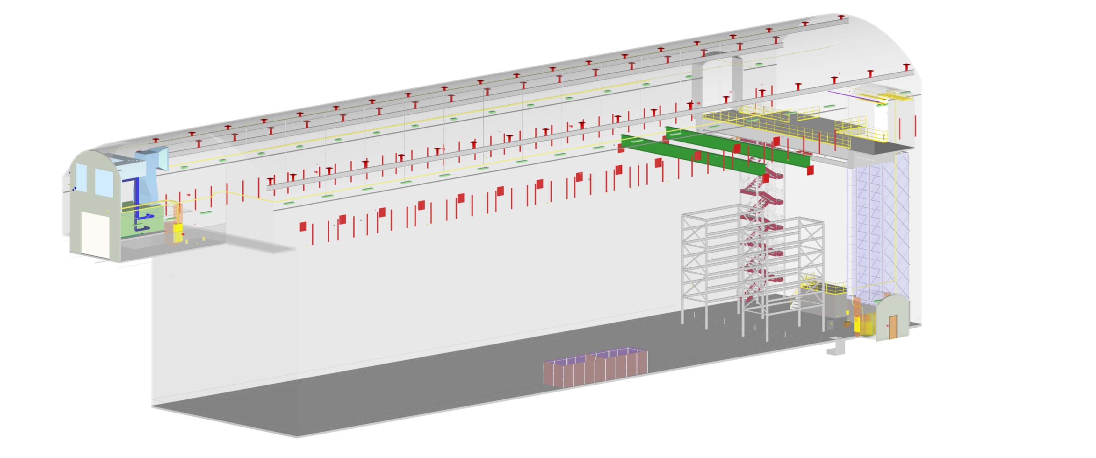
Install Cleanroom I-Beam #1&2
  Duration: 40 Hrs
  Crew:
Day 24
CR I-Beam #1 and #2

Slide 20
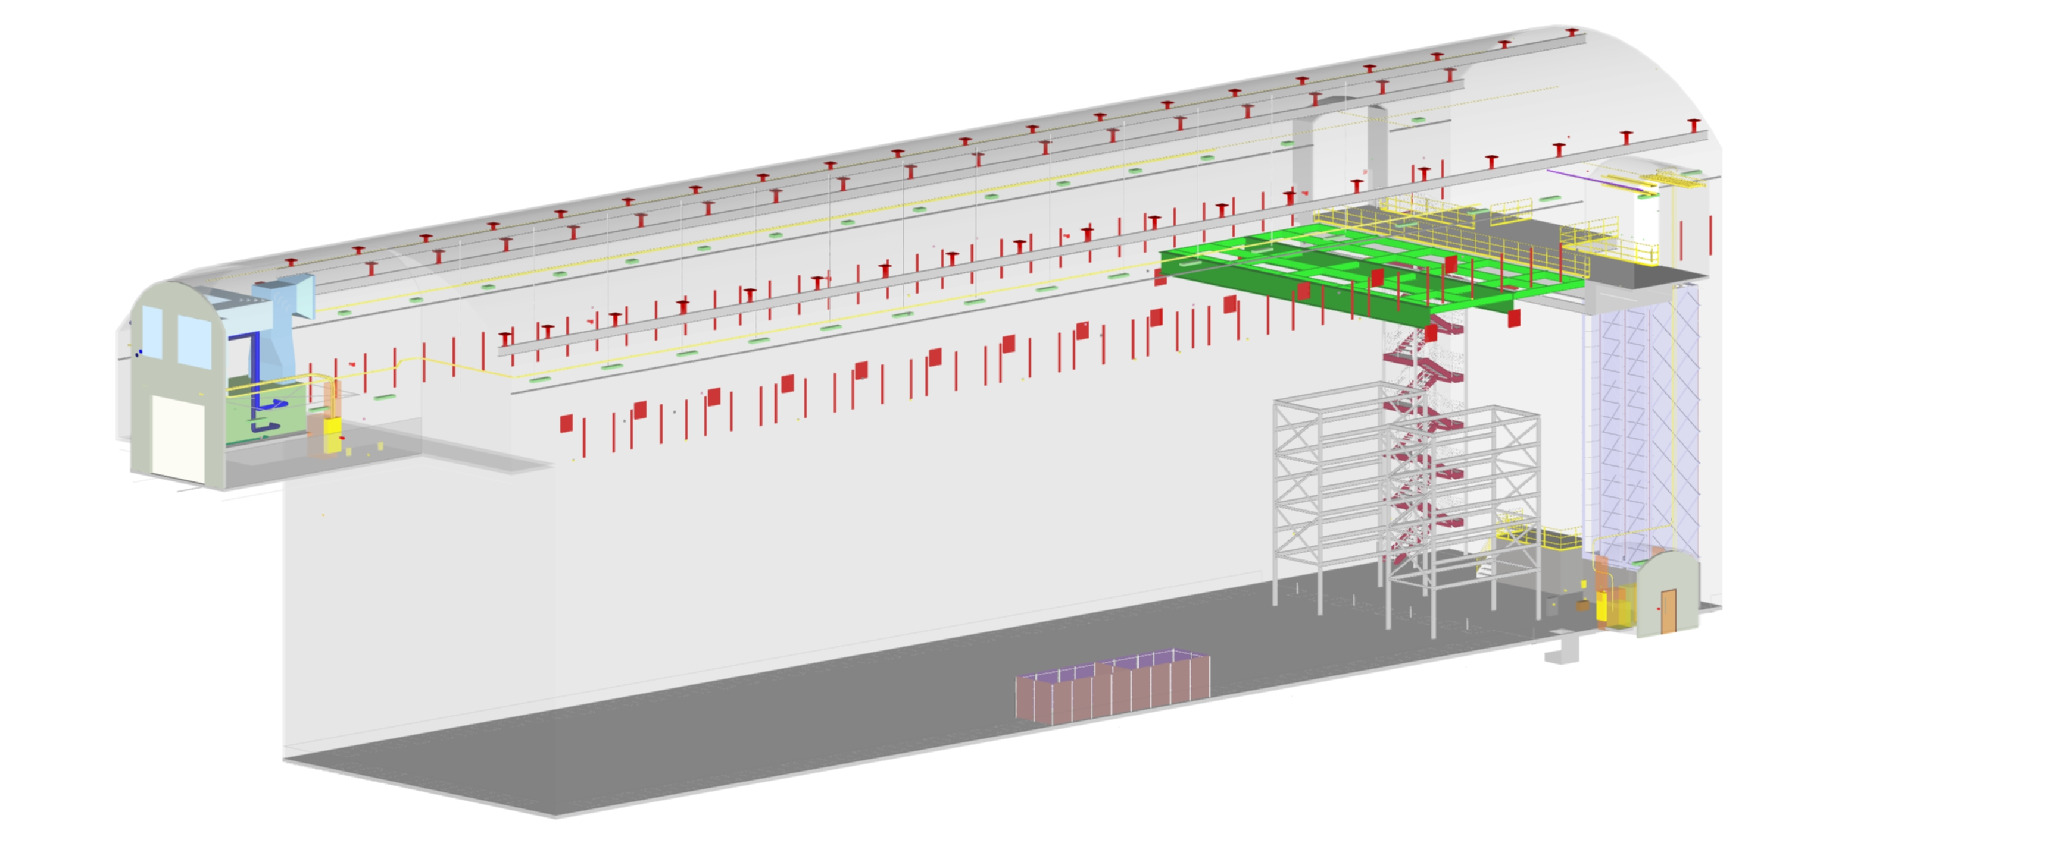
Install Cleanroom Roof Structure
  Duration: 40 Hrs
  Crew:
Day 26
CR roof internal steel

Slide 21
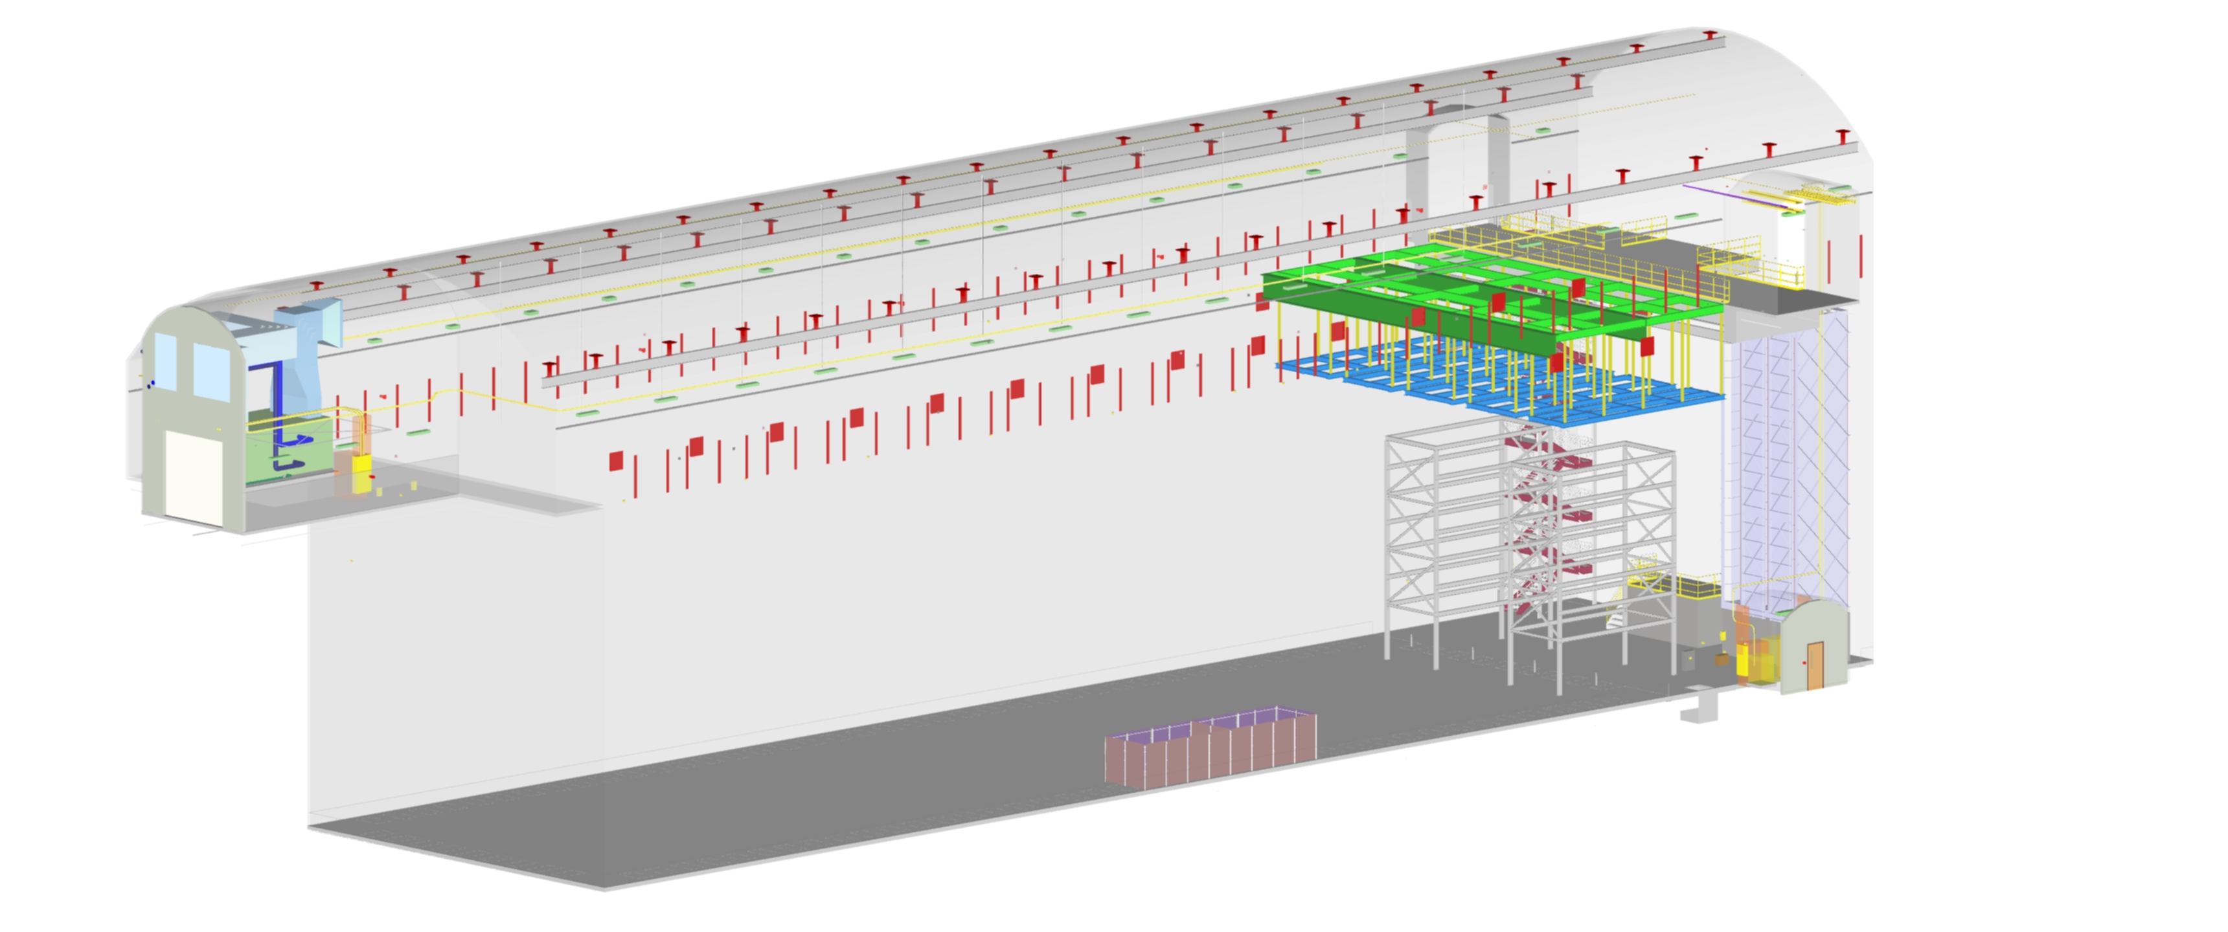
Install Raised Platform Supports
  Duration: 60 Hrs
  Crew:
Day 29
Floor supports

Slide 22
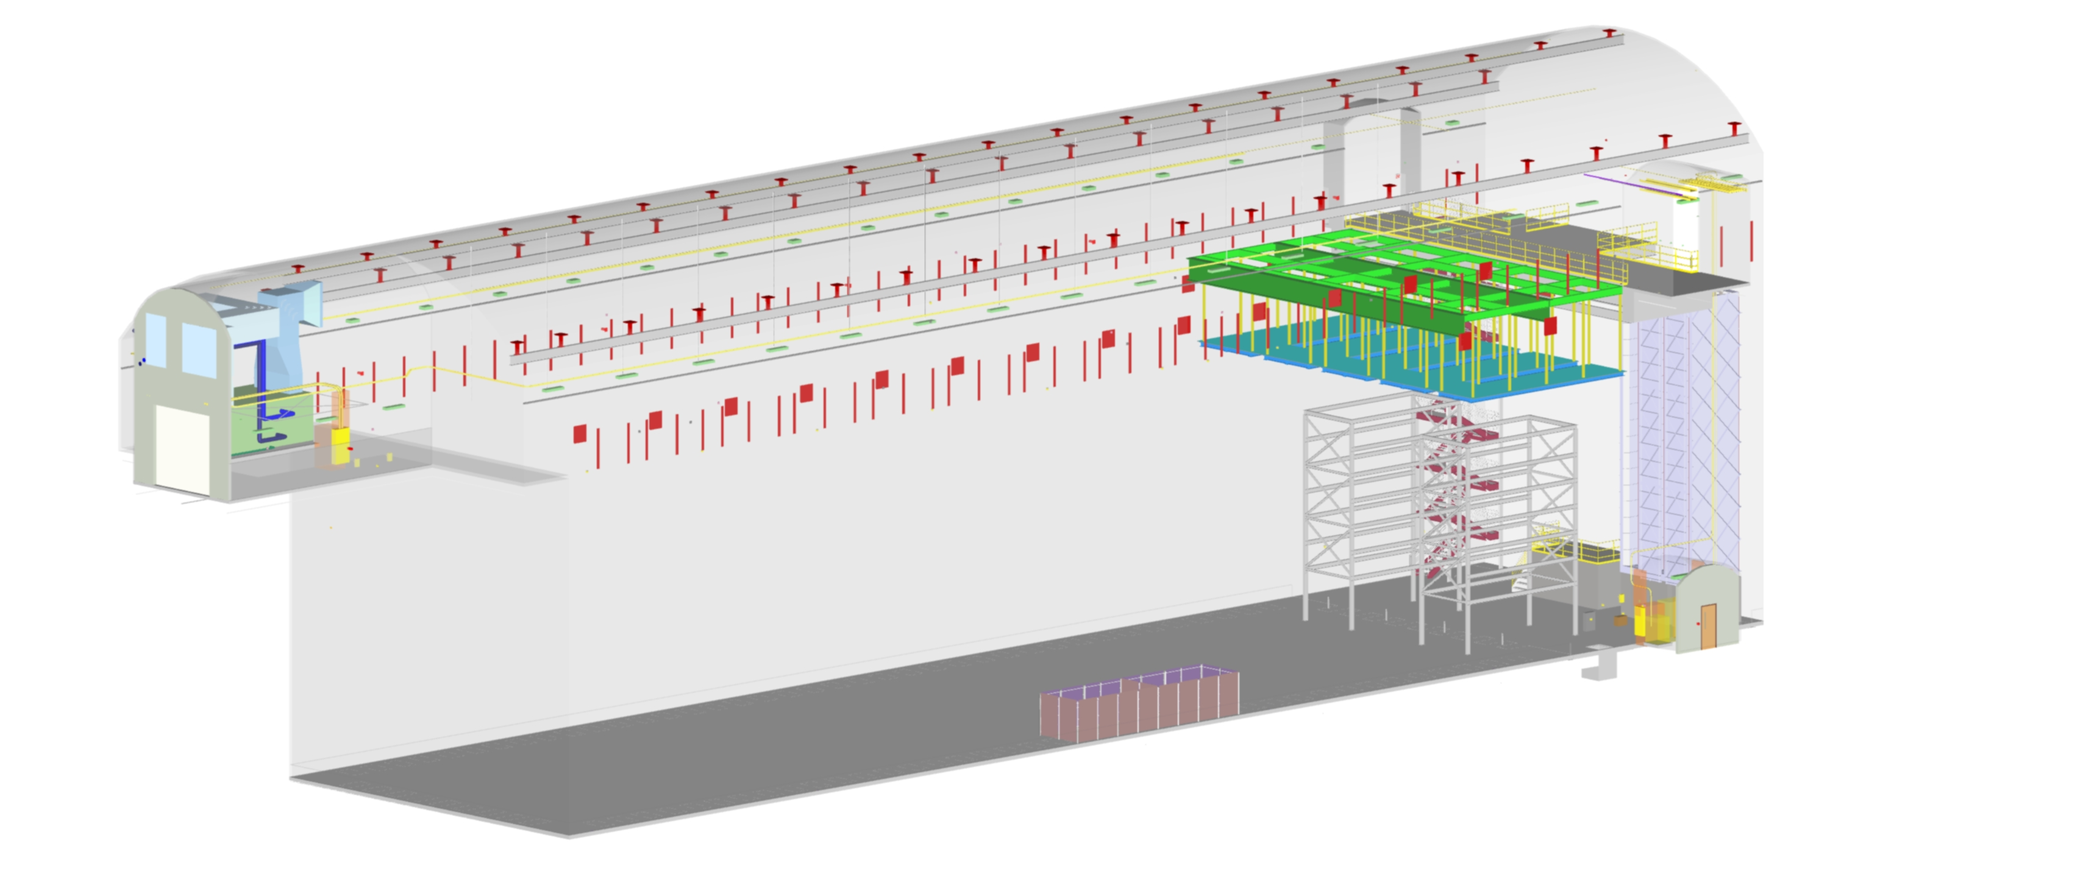
Install Raised Platform Decking and Walkways
  Duration: 60 Hrs
  Crew:
Day 31
Floor decking

Slide 23
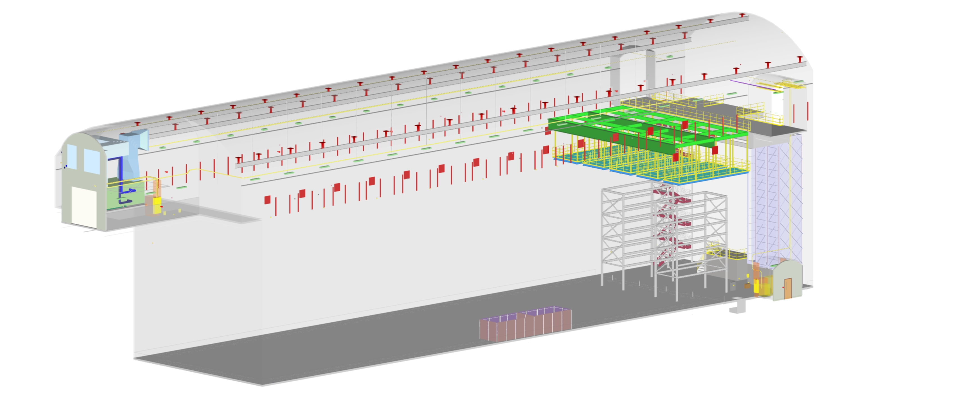
Install Raised Platform Railings
  Duration: 60 Hrs
  Crew:
Day 32
Railings

Slide 24

Install Raised Platform Stairs and Ships Ladders
  Duration: 60 Hrs
  Crew:
Day 35
Month 2
Ships Ladders/monorails

Slide 25
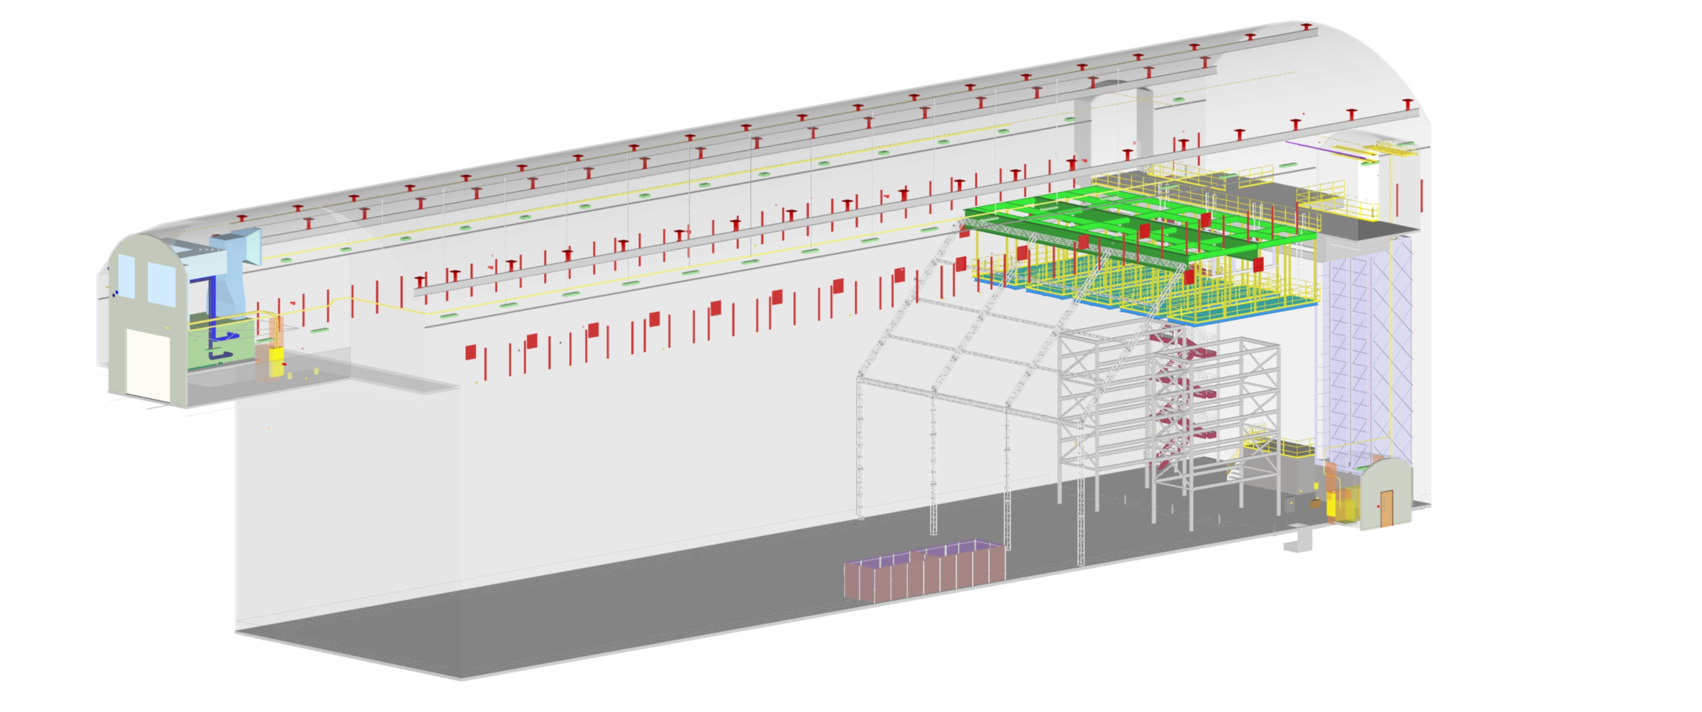
Install Cleanroom West Wall Truss
  Duration: 80 Hrs
  Crew:
Day 42
Truss West wall

Slide 26

Install Rails, Hoists, and Trollies
  Duration: 40 Hrs
  Crew:
Day 43
Assembly Rails/ Hoists/trollies

Slide 27
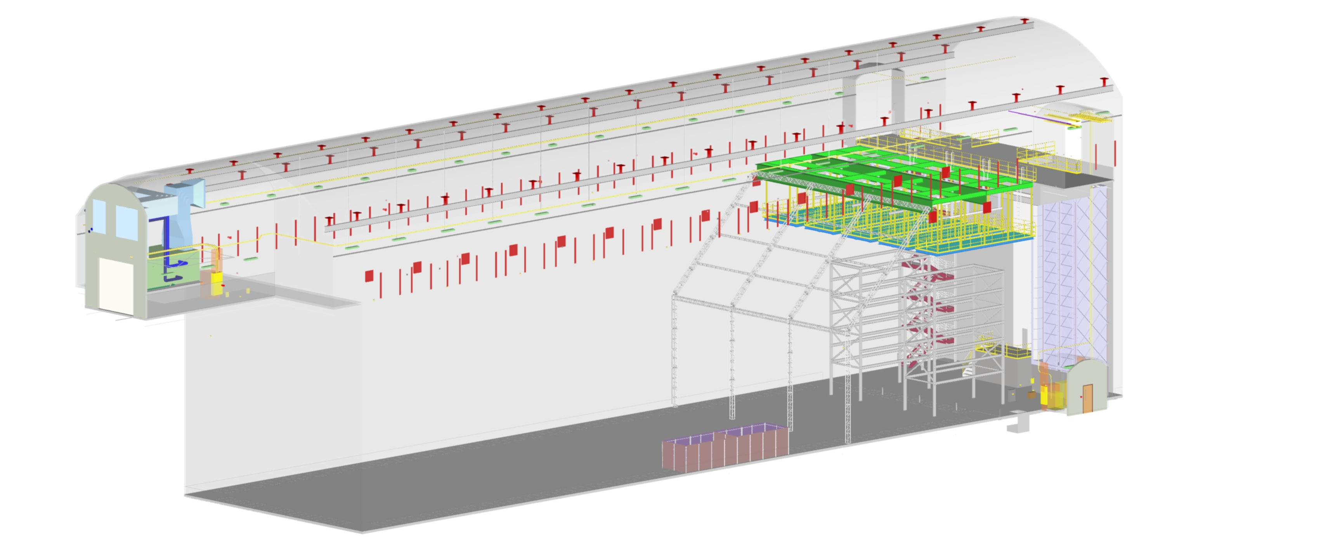
Install Cleanroom East Wall
  Duration: 80 Hrs
  Crew:
NOTE: END PHASE 1 CLEAN ROOM CONSTRUCTION
Day 46
Seal cryostat to wall
Here the gaps between the cryostat and the cavern are sealed with plastic sheet.
The cryostat wall may be cleaned at this time if it is really dirty.

Slide 28

Install APA Assembly Fixtures #1&2
  Duration: 80 Hrs
  Crew:
Install Cleanroom sprinklers
  Duration: xx Hrs
  Crew:
NOTE: BEGIN PHASE 2 CLEAN ROOM CONSTRUCTION
Day 4
Install 4 fixtures

Slide 29

Install Temporary Cleanroom Power
  Duration: 80 Hrs
  Crew:
Day 13
Cleanroom Power Carts

Slide 30
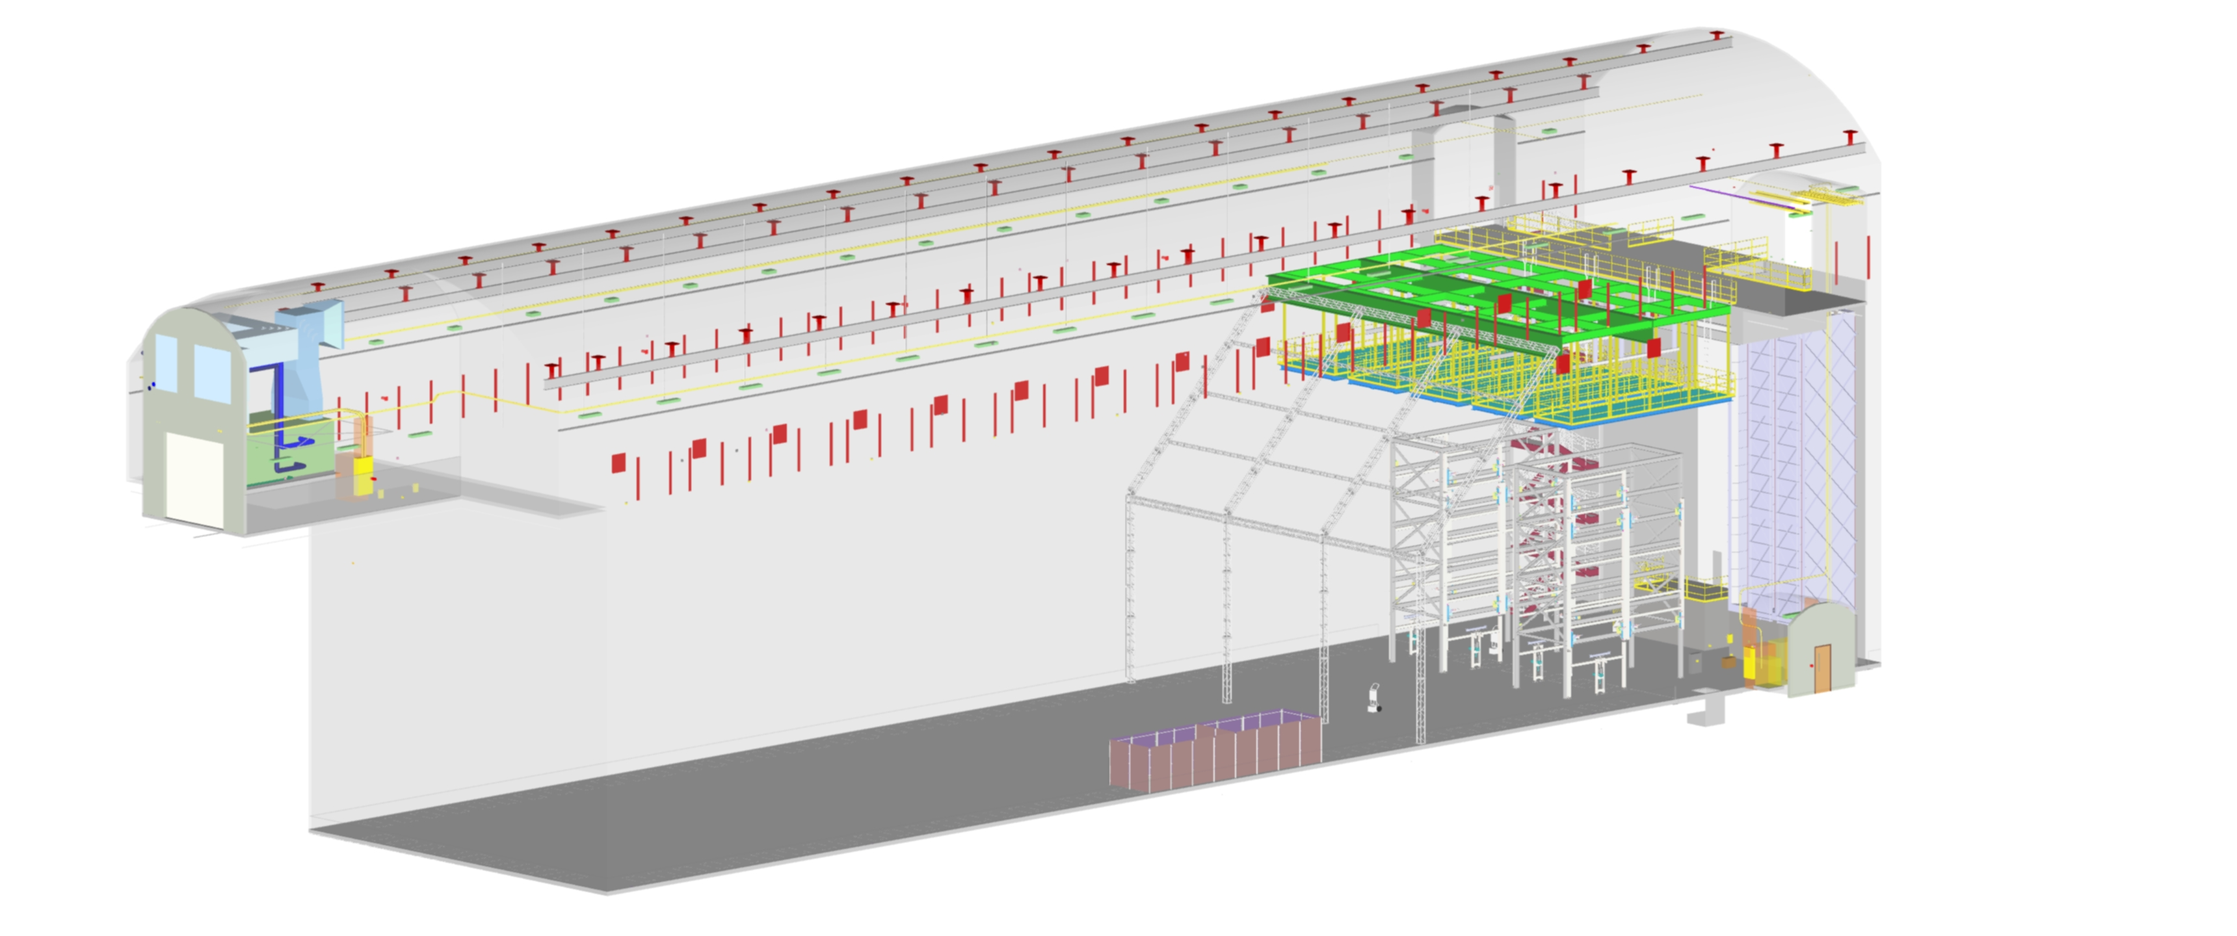
Install APA Assembly Fixtures #3&4
  Duration: 80 Hrs
  Crew:
Day 17
Month 1
Install 4 fixtures

Slide 31
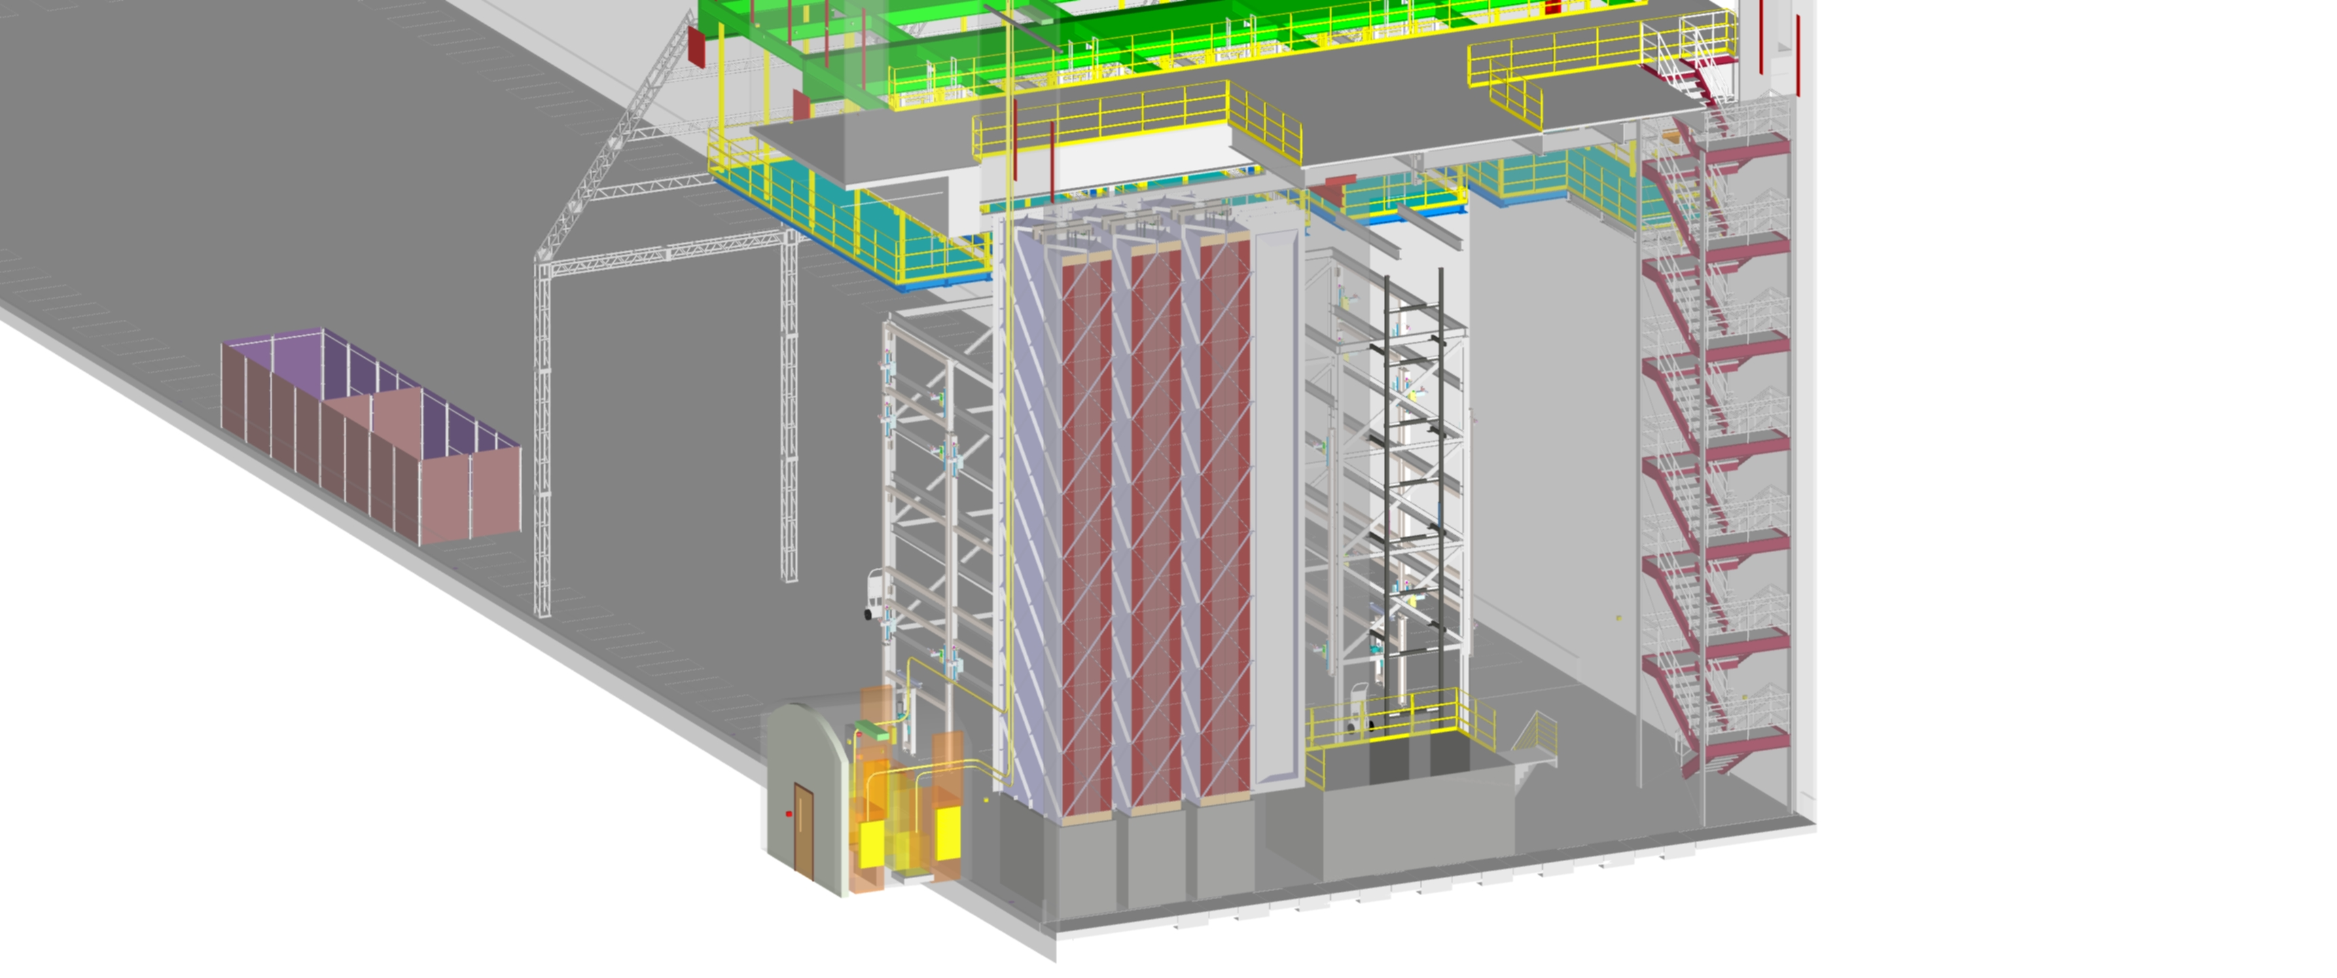
Install CPA Assembly Fixture
  Duration: 80 Hrs
  Crew:
Day 21
CPA assembly fixture
When is the jib crane installed?

Slide 32
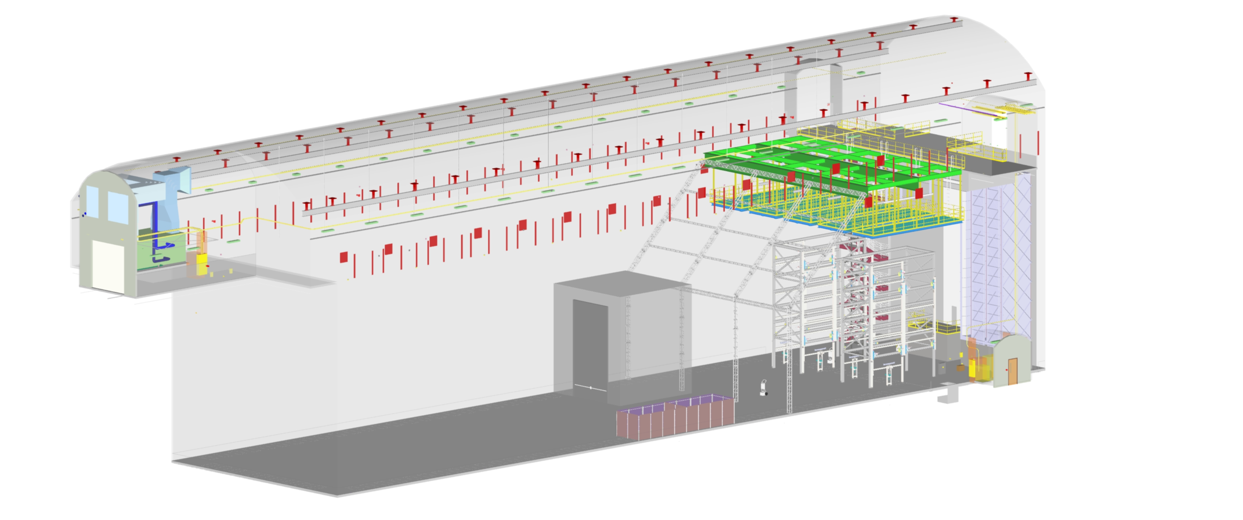
Construct 4910L Material Airlock
  Duration: 80 Hrs
  Crew:
Day 25
SAS

Slide 33
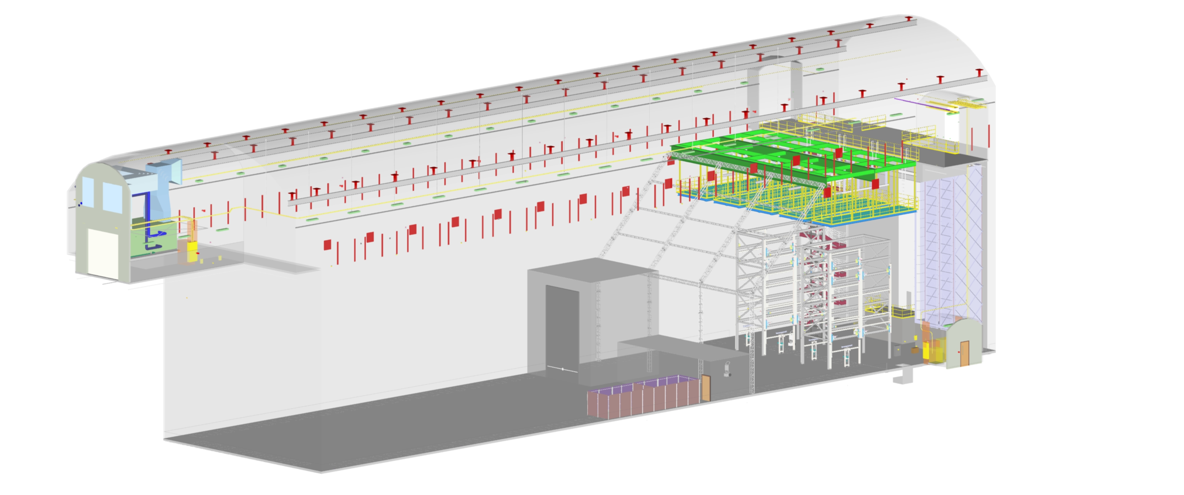
Construct 4910L Changing Room
  Duration: 40 Hrs
  Crew:
Day 33
Month 2
Changing room 4910

Slide 34
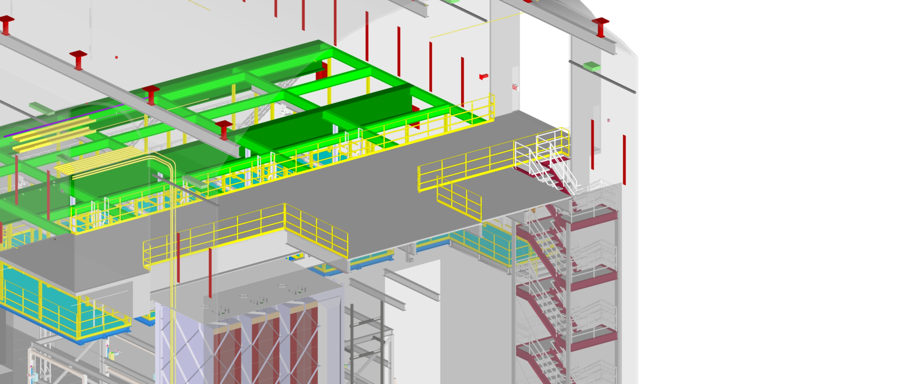
Install Walking Surface Over Cold Boxes
  Duration: 60 Hrs
  Crew:
Day 36
Cold box platform

Slide 35
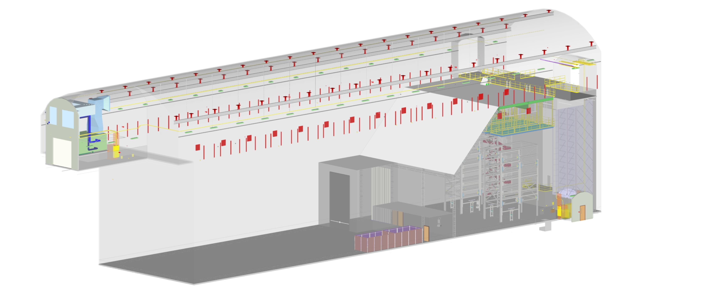
Install Remaining Roof and Wall Covering
  Duration: 160 Hrs
  Crew:
Day 44
North wall
South wall
West wall
Roof

Slide 36
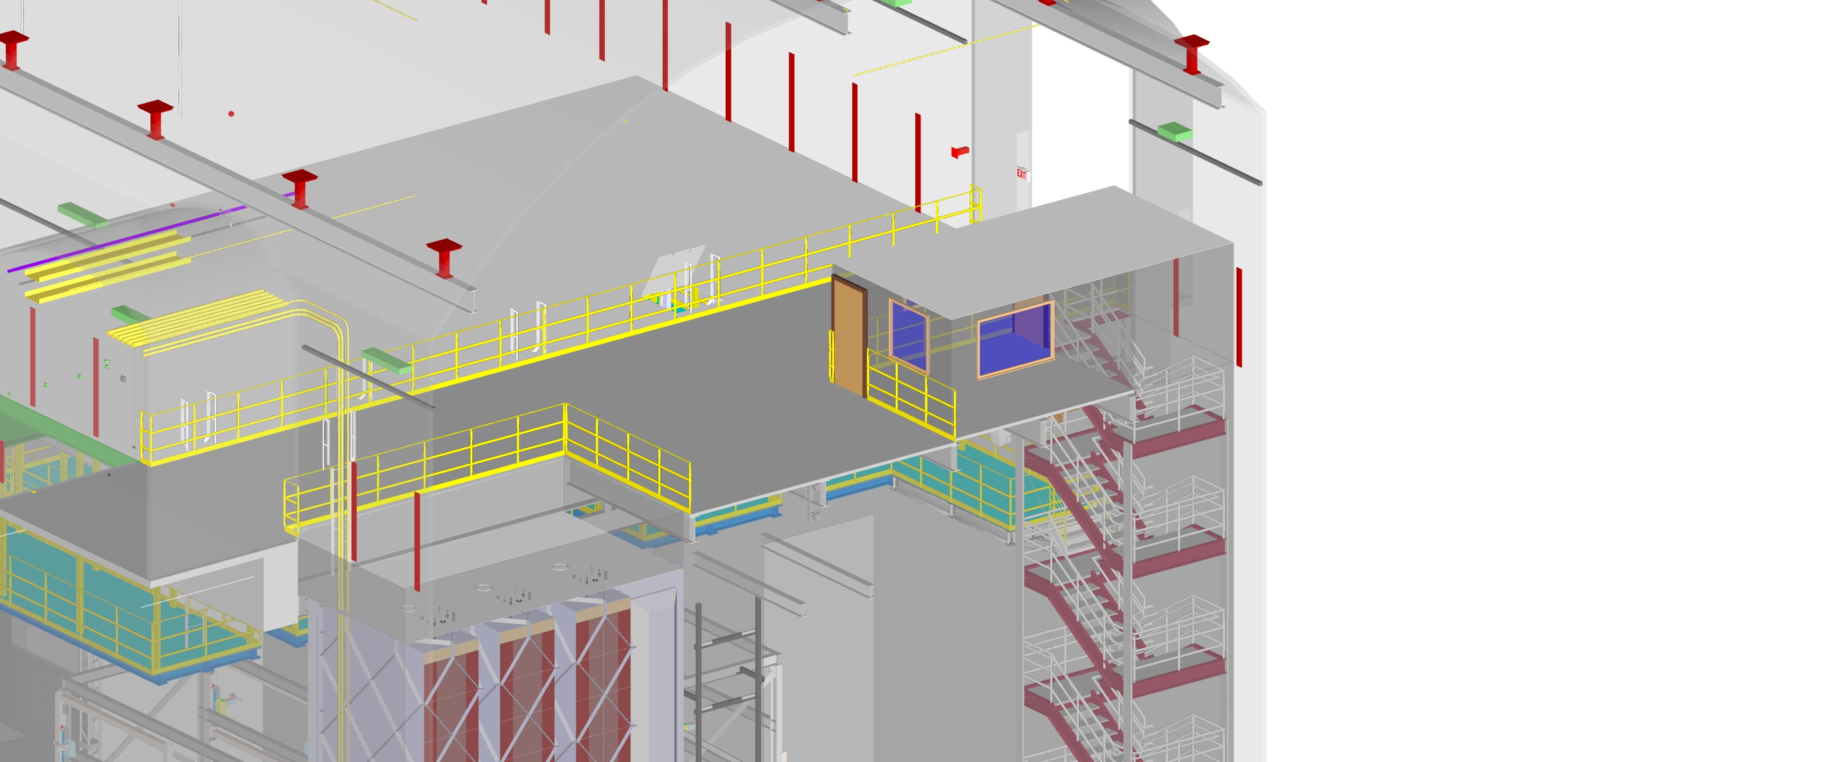
Construct 4850L Changing Room
  Duration: 80 Hrs
  Crew:
Day 48
Changing room

Slide 37
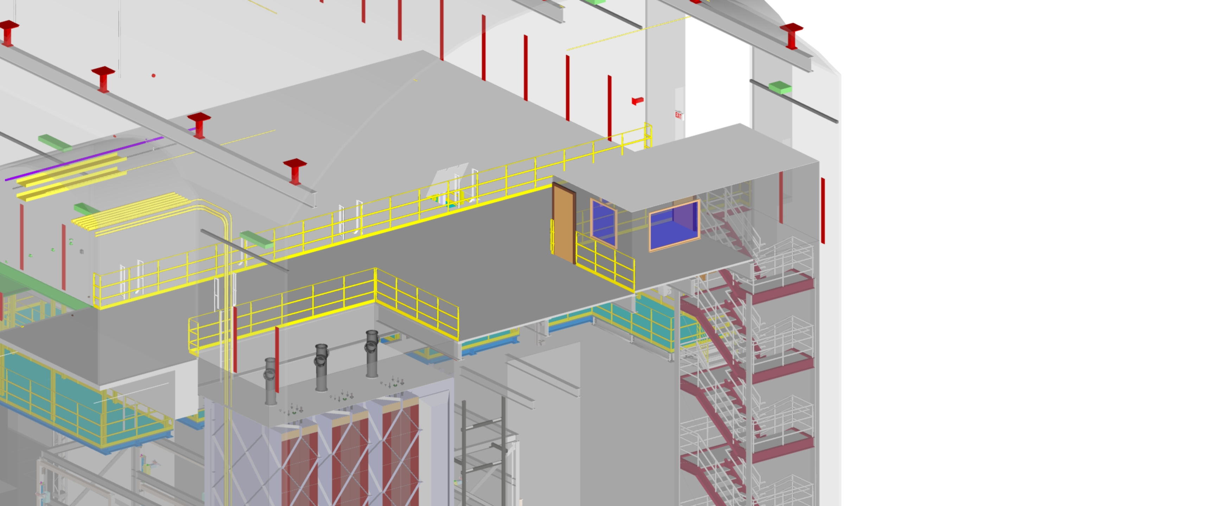
Install CE Crosses on Cold Boxes
  Duration: 20 Hrs
  Crew:
Day 49
Crosses

Slide 38
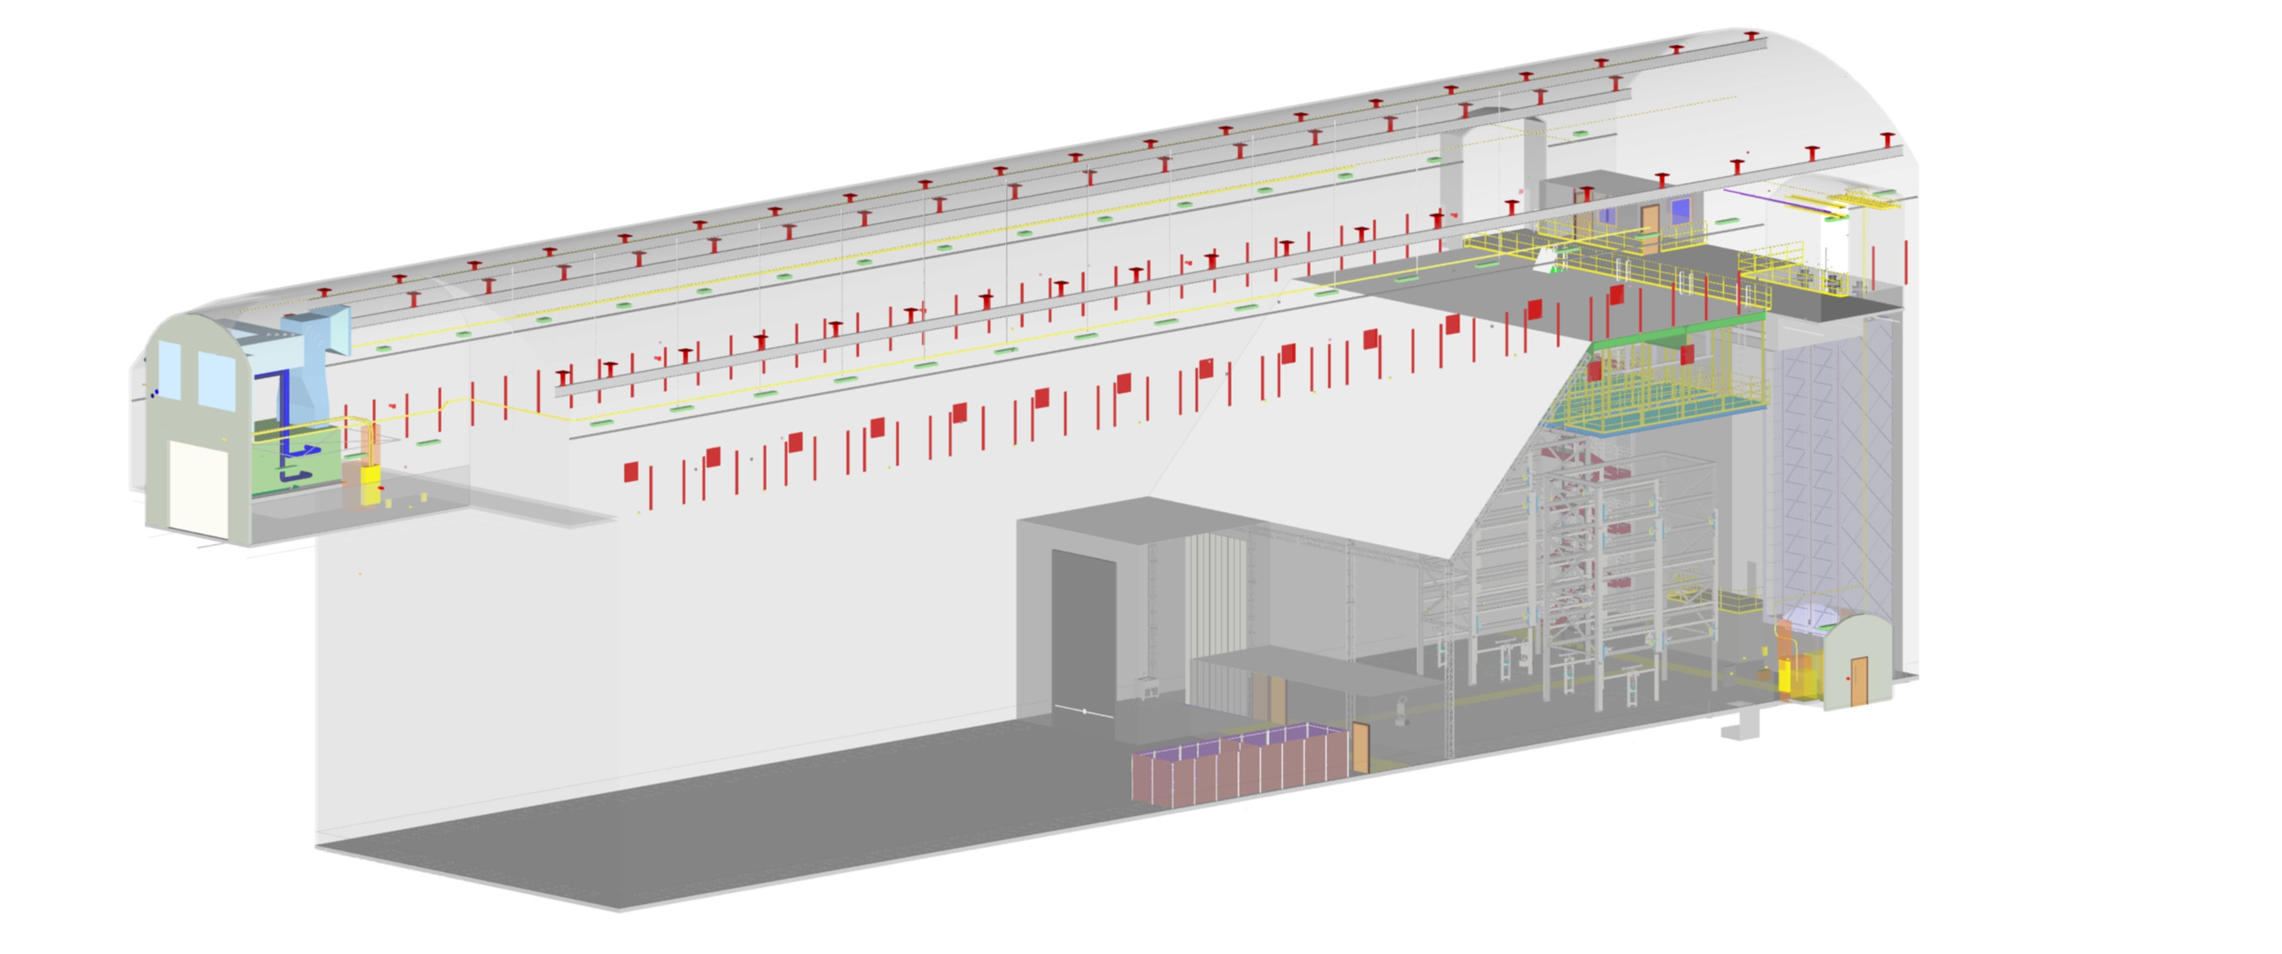
Install Washing Station in 4910L Material Airlock
  Duration: Hrs
  Crew:
Day 51
Month 3
Kitchen sink

Slide 39
Add all loose eqp
ORC for all eqp
Dry-run tests
Clean everything
Commission cleanroom
  Duration: 1 month
  Crew:
Day 68
Month 4

Slide 40
Discussion

