Slide 1
48 Hour Summary
Colin T. Barrett
MCR Crew Chief
May 15, 2024

Slide 2
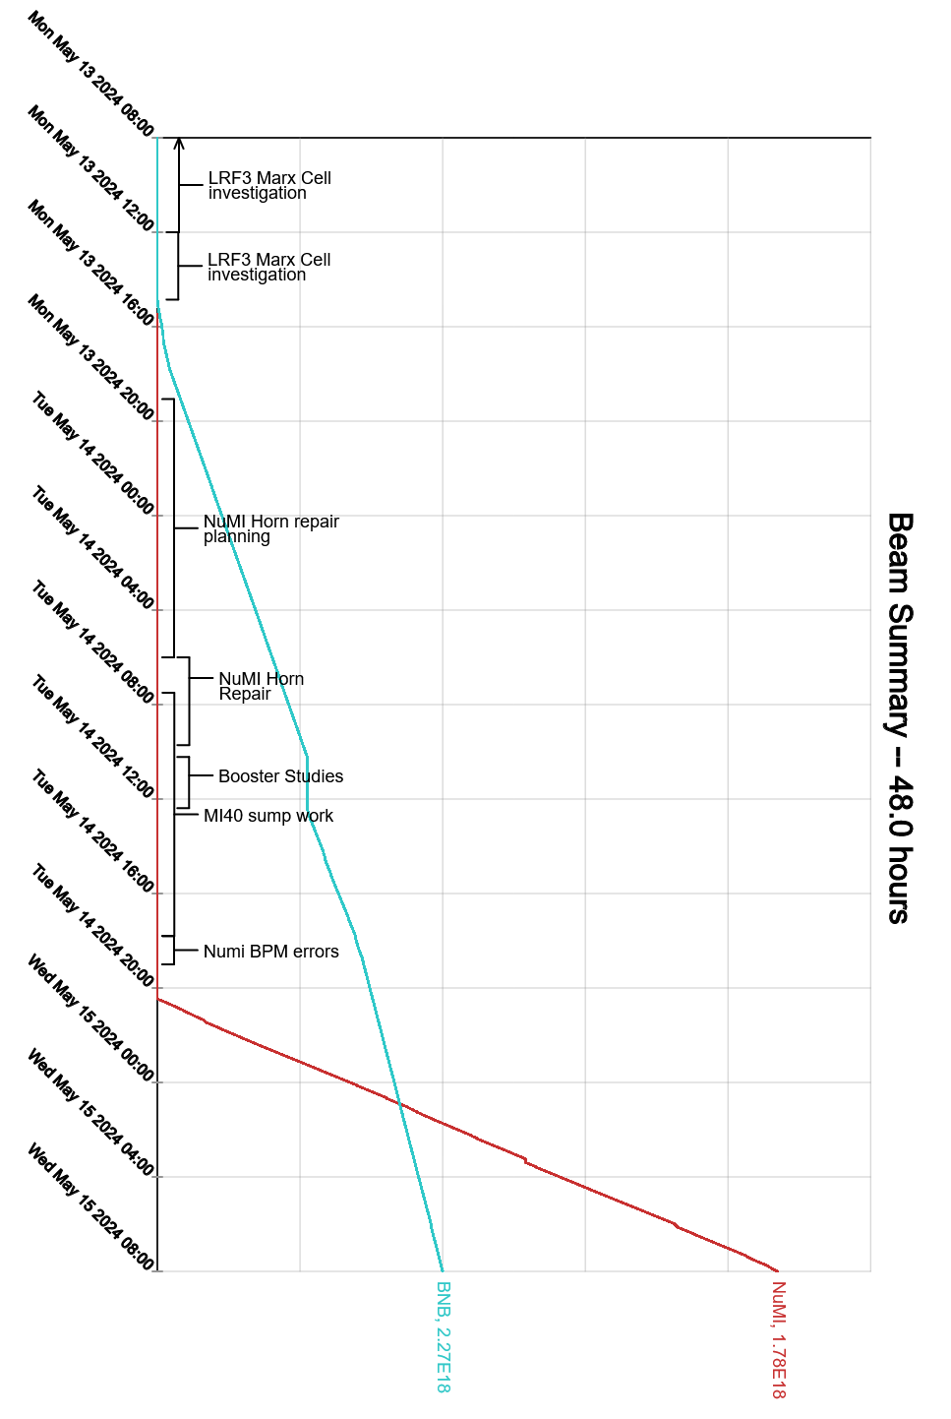
Summary
In General:
Supporting machine studies
Tuning up the machines
Prepared enclosures for access
Monday:
Down time for LRF3 Marx cell troubleshooting
Down time for NuMI horn capacitor issues
Opportunistic Booster access
Tuesday:
NuMI horn capacitor swapped out
Booster studies in the morning
MI20-62 access for sump float repair
NuMI BPM issues held off beam after access
Established beam to NuMI
Today:
Machine tuning to recover intensity
MECAR issues, Experts investigating
Current Conditions
NuMI: 788 kW
BNB: 4.96E16 p/hr

