Slide 1
FAST / IOTA Shutdown 2023-2024
Enclosure STATUS: ODH-0 & Supervised Access (“same as it ever was”)
General: -ICW Strainer leak. IOTA Bake GFCI (AD/Web 57570).
-ESB Laser Lab electrical Req “in Procurement” ™ (357980).
ES&H: -OSC Mode in LL. New South Gate. Interlock Test.
IPI: -480/120VAC Electric PO “being scheduled” ™ (714305).
-Alignment Crew done, DON’T TOUCH beamline stuff.
-Exciting updates to follow (Chip)
Water: -Chiller “PO generated” (713355). Waiting on subcontractor.
-New Fluids Engineer for us: Mike Hanson
AD Shutdown’24 starts July 12 (8 weeks away)
— Contact FAST RunCo with any work or access requests —

Slide 2
ISD/CFM Report on NML Status
HiBay LEDs: Completed™. North row needs boom-lift. (Date?)
Exterior lighting: RFQ to contractors, still!
Emergency lights: fix in progress
Bathroom Lights: fixed.
ICW: flushing this Spring. (Date being worked out with CMTF)
Adams Strainer leaking –fix in progress
ESB HVAC: installation – Waiting on NTP (Summer??)
Mechanical Rooms: Cleanup in progress.
Entrance Striping: Needs our P/T.
R&G: Gravel work. Turf grading.

Slide 3
NML Strainer leak, May 2024 Flush-out line developed a small sprayer. Fix requires isolate & drain strainer then replace nipple

Slide 4
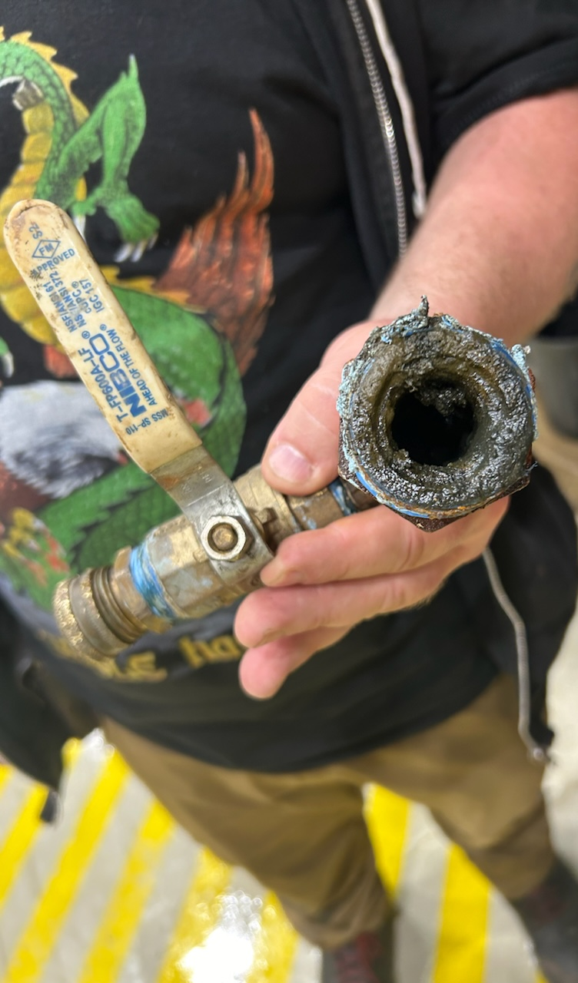
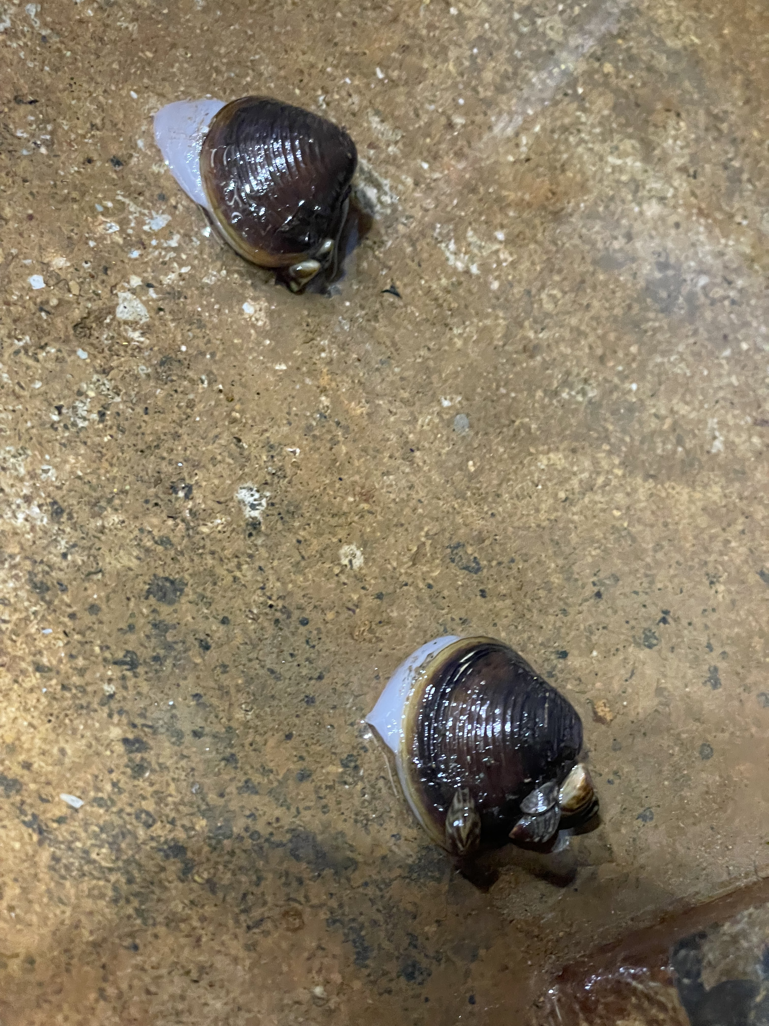
NML Strainer leak, May 2024. Drain line broke off (Dissimilar metals). Flooding floor. Escaping zebras.

Slide 5
FAST / IOTA 9:00 Report
FAST shutdown continues til summer for the installation of the IOTA Proton Injector. Thanks to support groups helping us.
(PESD, HLRF, Instrumentation, MSD, ISD, ect..)
IPI source still stable at 50kV. Commissioning.
Trying to make protons but Arc Modulator issues.
IPI electrical work waiting on subcontractor schedule.
LCW chiller repair waiting on subcontractor schedule.
ICW strainer developed a small leak. ISD responded promptly.
Thanks to OPS for helping with installations & being vigilant on ACNET alarms.
— Contact FAST RunCo with any work or access requests —

