Slide 1
302.4.04 – Cryo-assemblies Horizontal Test Weekly status report
Guram Chlachidze
May 20th, 2024

Slide 2
CA02 test preparations
Cryo-improvements at TS4 in progress, check work status here:
TS4 action item list - 11_30_2023.xlsx (sharepoint.com)
Stand 4 ORC/Operation status
APS-TD DSO will be contacted after the cryo-improvements are completed - at least one month before the expected date of CA02 cooldown
New DSO was informed about expected CA-02 transportation early June
Addendum to the electrical ORC has been initiated for the helium line heater operation
Ready to initiate the Stand 4 cryogenic ORC renewal
Need to obtain the cryo-panel recommendation (Jacob Kintner) and then then approval by the ALD (Sam Posen)
Magnetic probe orientation measurements with a single target
LT measurements are in progress

Slide 3
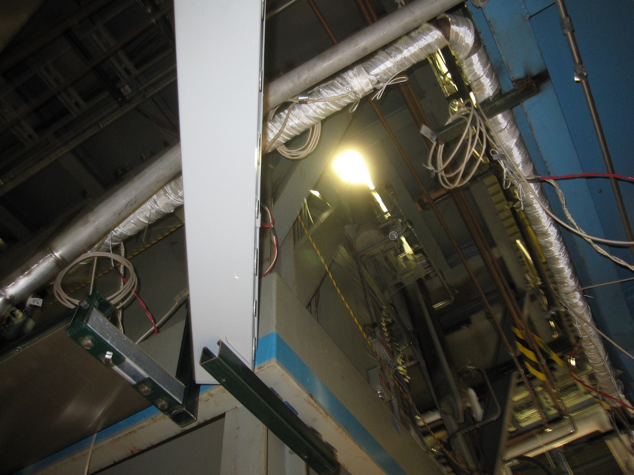
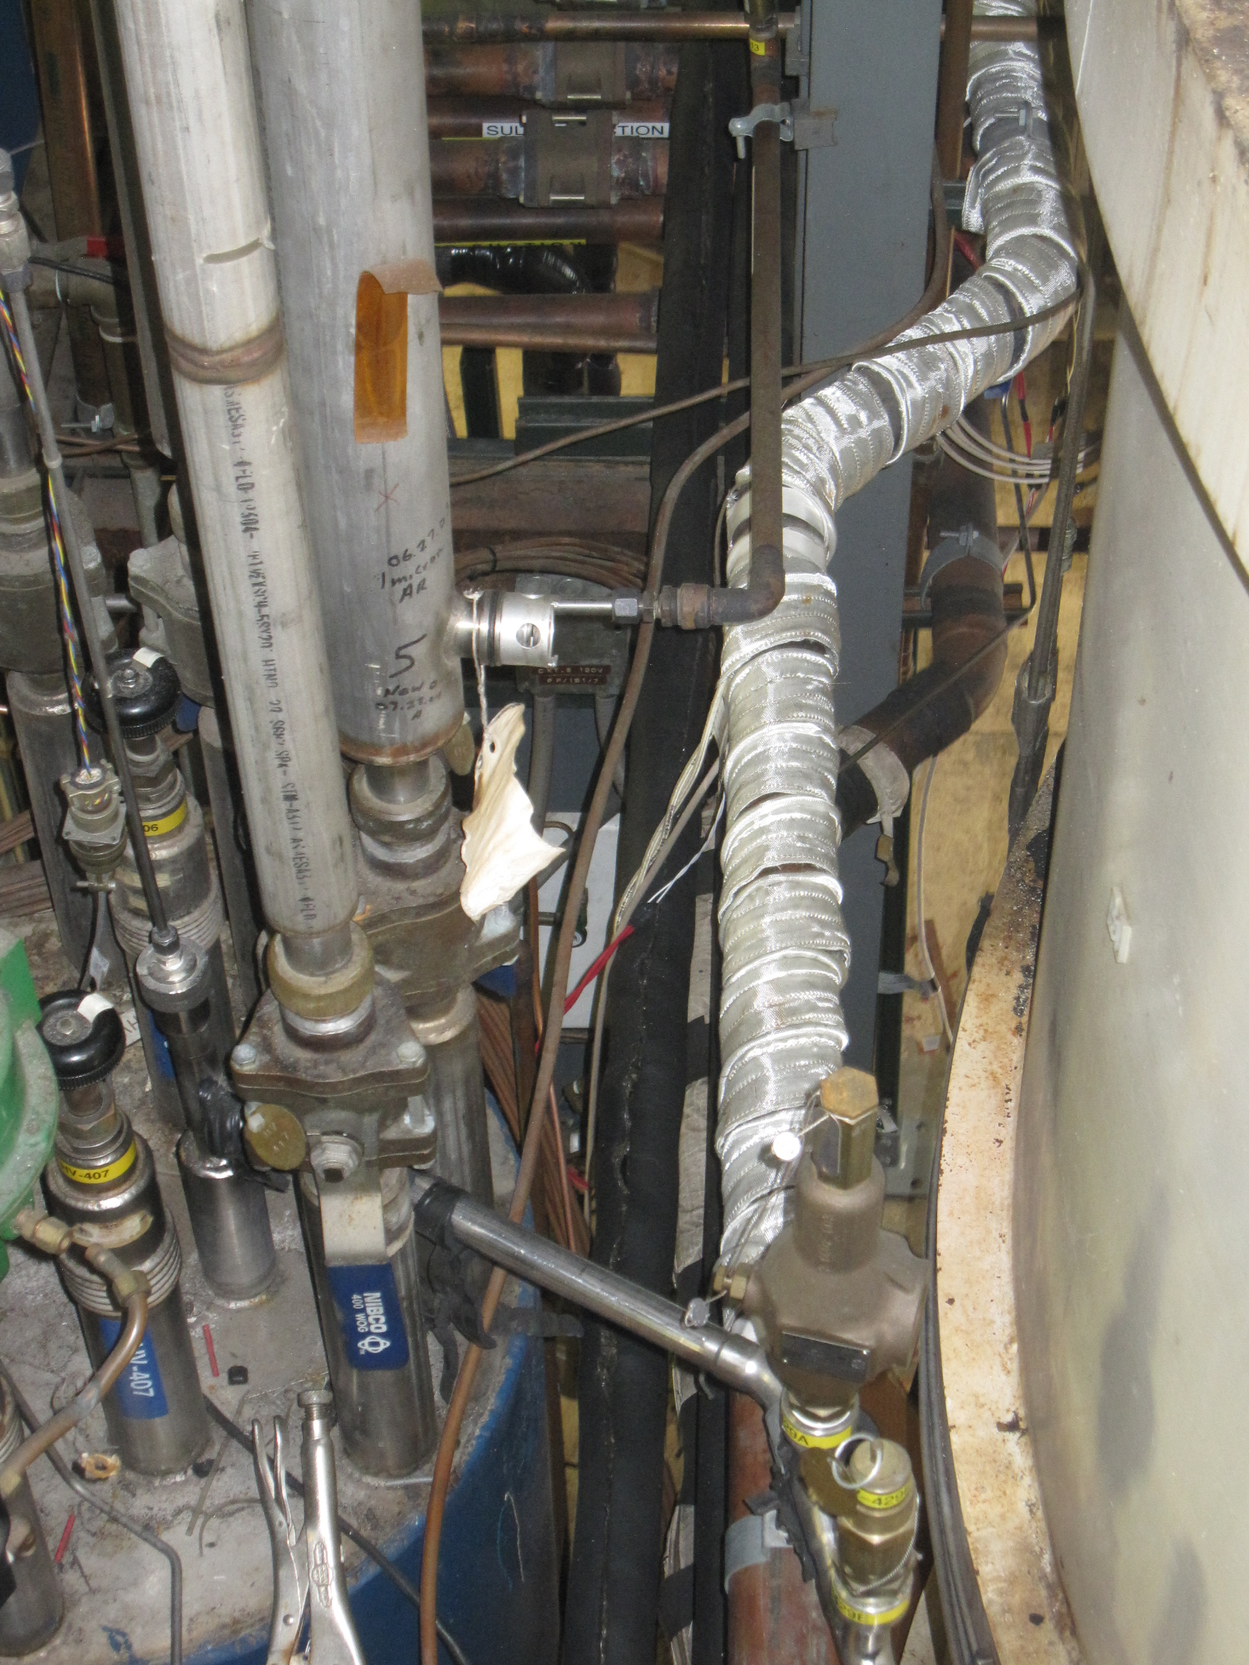
CA02 test preparations (2)
Helium line heater installation
Total of 10 heaters are installed (both on the supply and return lines)
Operating procedure has been developed
Addendum to the electrical ORC has been initiated
Installation of the shelves is complete
Grounding all shelves

Slide 4
More test preparations
Stand 4 documentation
Test plan and Test readiness verification document have been updated
Production traveler (464759) for LQXFA/B-02 will be released this week
Remaining components for CA-03 transportation and testing
Return End Box – PO # 711063 awarded to Meyer Tools Inc.
Regular Thursday meetings with Meyer Tools Inc.
All material purchased
Promised delivery - last week of May
Interconnect components required for CM pressure test are ready
Fabrication of the remaining interconnect components in progress at MW9 and IB1, see next slide
Cryo-Operations group very busy

Slide 5
Remaining Interconnect Components for CA-03

