Slide 1
PXIE Overview: Goals, Scope, and Organization
Sergei Nagaitsev
Project X Machine Advisory Committee
March 18-19, 2013

Slide 2
Project X R&D program
Goal is to be prepared for a construction start in Q1FY18
  Most likely, Stage 1
Goal of the R&D Program is to mitigate risk: technical/cost/schedule
      The unique capabilities of Project X depend entirely on the front end, in particular the wideband chopper.
Technical Risks
  Front End
    CW ion source through SSR1
  H- injection system
    Booster in Stage 1, 2; Recycler in Stage 3
  High Intensity Recycler/Main Injector operations
  High Power targets
Cost Risks
  Superconducting rf
    Cavities, cryomodules, rf sources – CW to long-pulse
PXIE

Slide 3
Front-End R&D Program
(as proposed in Oct 2011)
We are building an integrated systems test of the first ~30 MeV of Project X.
  Validate the concept for the Project X front end, thereby minimizing the primary technical risk element within the Reference Design.
  Demonstrate wideband chopper; low-β acceleration
  Operate at full design parameters
Integrated systems test goals:
  1 mA average current with 80% chopping of beam delivered from RFQ
  Efficient acceleration with minimal emittance dilution through ~30 MeV
Collaboration between Fermilab, ANL, LBNL, SLAC, SNS, India
Beam through β=0.1 , 0.2 CM at ~30 MeV with nearly final parameters (1 mA cw, 5 mA peak, arbitrary bunch chopping)

Slide 4
Bunch structure
The concept of Project X relies heavily on a bunch-by-bunch chopper in the MEBT and transverse rf splitters at high energy
  Some elements of this system are beyond present state of the art

Slide 5
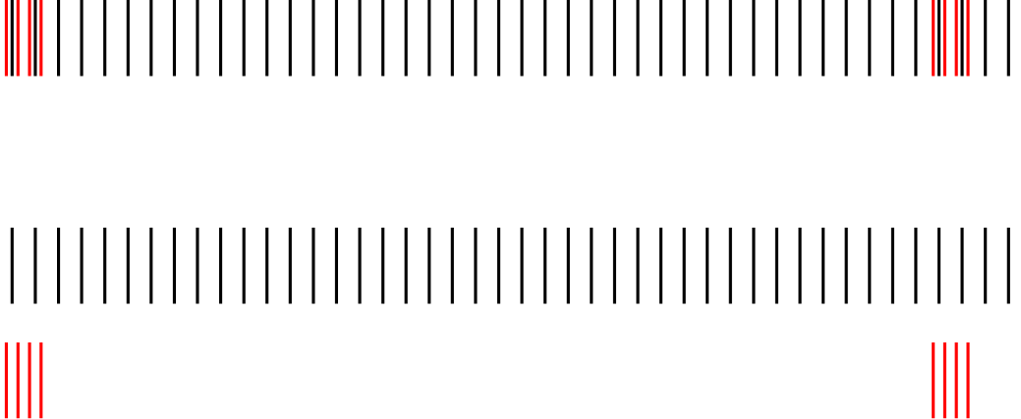
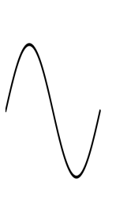
Project X (Stage 1)
Bunch pattern created in the MEBT
1 mA
f₀/2
Transverse RF splitter at 1 GeV
1 GeV
0.91 mA
0.09 mA
1 μsec
RFQ beam Current: 3.64 mA
Average Linac beam current: 1 mA

Slide 6
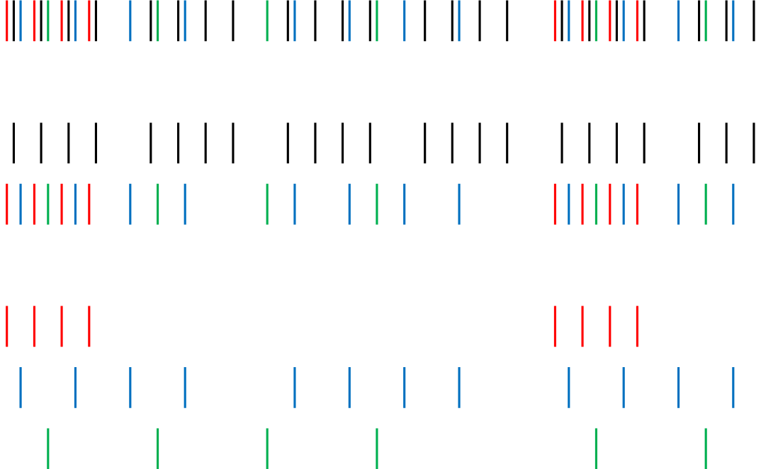
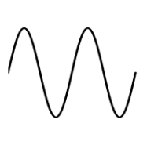
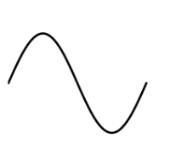
Project X (Stage 2)
2 mA
1 GeV
f₀/4
1 mA
1 mA
f₀/8
3 GeV
0.25 mA
0.5 mA
0.25 mA
0.5μsec
RFQ Beam Current: 5.0 mA

Slide 7
PXIE vs Project X
PXIE goal – 1 mA average current
Project X (Stage 1) – 1 mA
Project X (Stage 2,3) – 2 mA
Project X (upgrade capability) – 5 mA
Ion source: 0 – 15 mA (DC)
RFQ design: 1 – 10 mA, 5 mA (nominal)

Slide 8
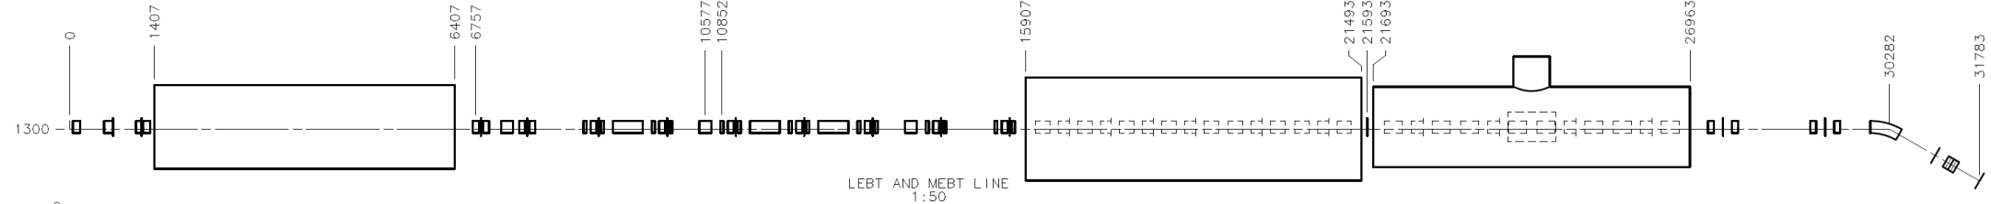
Project X Injector Experiment: PXIE
LEBT
RFQ
MEBT
HWR
SSR1
HEBT
~ 40 m long
CW H- source delivering 5 mA at 30 keV
LEBT with beam pre-chopping
CW RFQ operating at 162.5 MHz and delivering 5 mA at 2.1 MeV
MEBT with integrated wide-band chopper and beam absorbers capable of generating arbitrary bunch patterns at 162.5 MHz, and disposing of 4 mA average beam current
Low beta superconducting cryomodules: 1 mA to ~25 MeV
Beam dump capable of accommodating 2 mA at 25 MeV (50 kW) for extended periods.
Associated beam diagnostics, utilities and shielding

Slide 10
PXIE Goals
Validate the Project X concept and eliminate technical risks
  CW RFQ
  Bunch-by-bunch chopper (2 kickers and absorber)
  MEBT vacuum level and MEBT/HWR interface
  High-current beam acceleration in HWR and SSR1
    Complications can be due to beam loss of RFQ tails in SC linac
  Extinction for the removed bunches better than
    10⁻⁴ – specified by the PXIE FRS and determined by multi-experiment operation
    <10⁻⁹ – as desired by μ-to-e experiment (no formal specification)
Obtain experience in design and operation of SC proton linac
  SSR1 cryomodule will be designed and built by Fermilab

Slide 11
Major PXIE Features
“Adiabatic optics” – small beta-function variation
  Mitigation of space charge
LEBT
  LEBT chopper
    Supports machine tuning in pulsed mode: Δt ~ 0.5 – 10 μs, f_{rep}=60 Hz
RFQ
  162.5 MHz RFQ
    freq. low enough for bunch-by-bunch chopping,
    T ≈ 6.2 ns, bandwidth of ~ 1 GHz
MEBT
  “Two-kickers chopping” makes chopping possible with present technology
  21 kW beam dump for chopped-out beam
  Differential pumping to minimize H₂ leakage to the SC cryomodules and RFQ

Slide 12
Major PXIE Features (continue)
SC cryomodules operating at 2 K
  Solenoidal focusing
  Warm gap between cryomodules
  Fast vacuum valves at both sides of the cryomodules
RF separation at the top energy for beam extinction studies, f=1.5*162.5 MHz
  Can help in measurements of bunch length and longitudinal tails
Instrumentation (not a complete list)
  Toroids, BPMs, wire scanners, laser wires, scrapers
Spectrometer at the end of the machine
50 KW beam dump
  can support operation up to 2 mA beam current

Slide 13
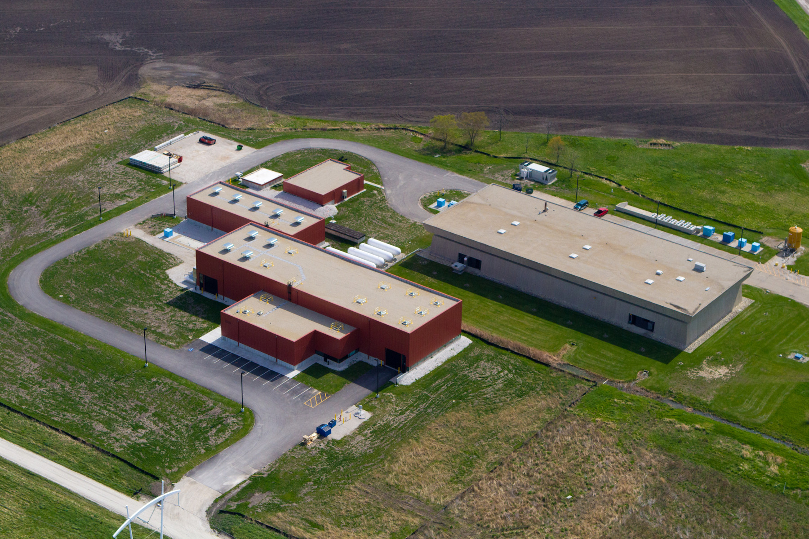
PXIE location

Slide 14
PXIE stages
Stage 1:
  Ion source, LEBT, prototype chopper
  RFQ at full power
  Full MEBT with prototype kickers, (possibly) prototype absorber, temp. dump, bunchers, diagnostics
  Cryo system
  SSR1 CM – cold and rf powered, no beam
Stage 2:
  HWR CM – cold and rf powered, no beam
Stage 3:
  Full diagnostics line, final MEBT kickers, final 50 kW beam dump, 1-mA CW beam delivered to the dump.

Slide 15
PXIE time line
Stage 1 complete – early FY17 (~Nov 2016)
  Beam delivered to the end of MEBT with nearly final parameters (2.1 MeV, 1 mA CW, 80% arbitrary chopping)
Stage 2 complete – Aug 2017
Stage 3 complete – Aug 2018

Slide 16
PXIE Summary Schedule
16

Slide 17
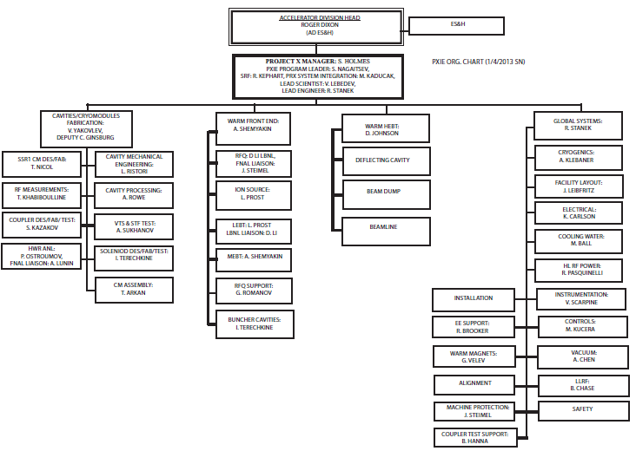
PXIE Organization

Slide 18
India contributions
MEBT/HEBT Quadrupoles, Dipoles
SSR1 Solid State Amplifiers
BPM Electronics
Associated Design, Spec, Procurement Labor

Slide 19
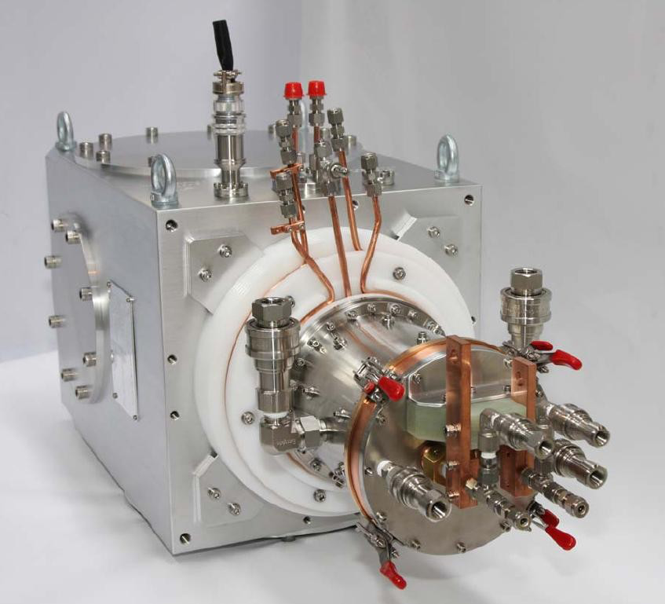
Ion Source
The Linac beam starts from an H- ion source operating at a constant current, set for a given bunching scenario:
  The minimum ion source current is 1 mA
  The nominal ion source beam current used in Linac design is 5 mA
  The ion source is capable of 15 mA, RFQ and MEBT are designed to 10 mA
Regardless of the ion source current, the average linac beam current is 1 mA
  this is achieved by a LEBT and MEBT choppers

Slide 20
PXIE LEBT
No BEND in PXIE design

Slide 21
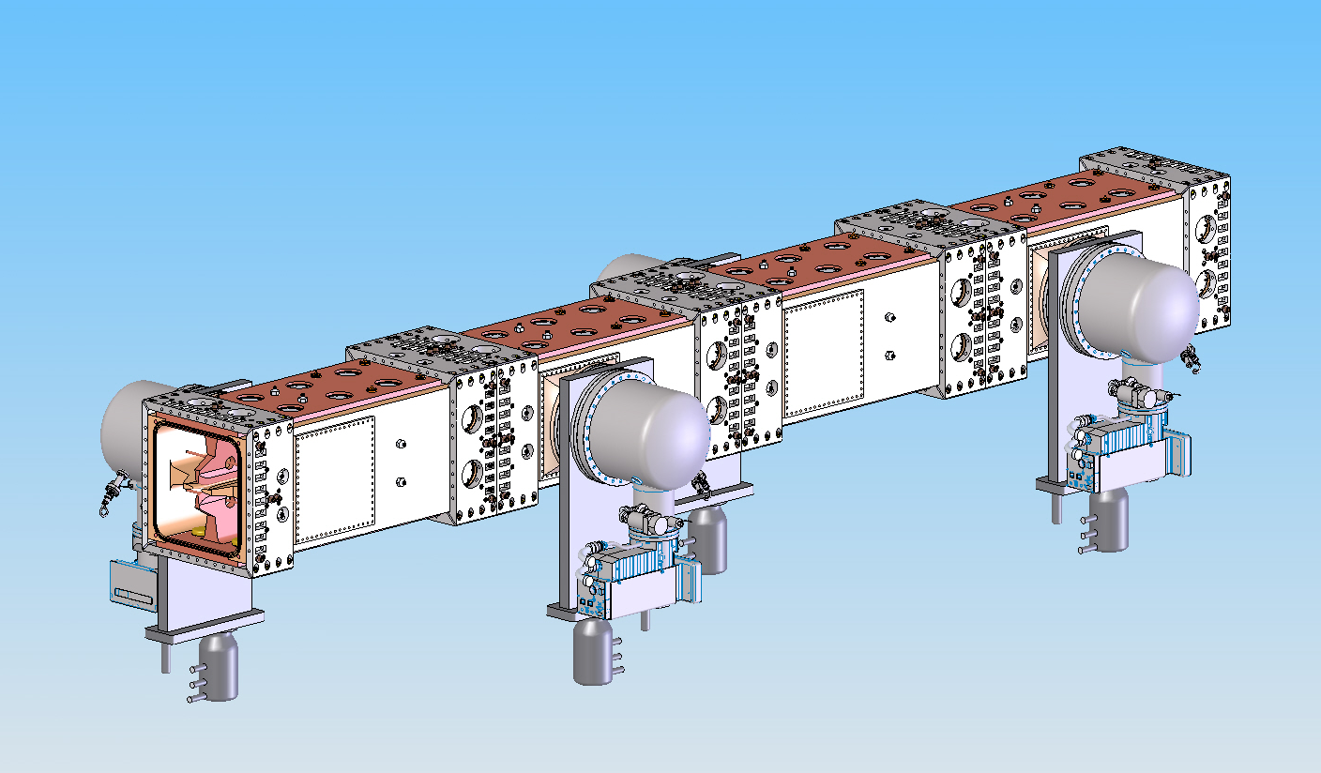
RFQ
Ion type: H-
Beam current: 5 mA (nominal); 1 – 10 mA
Transverse emittance (norm, rms): < 0.25 mm-mrad
Longitudinal emittance (rms): 0.8 – 1.0 keV-nsec
Input energy: 30 keV
Output energy (kinetic): 2.1 MeV
Duty factor: 100% (CW)
Frequency: 162.5 MHz
Length: ~4.4 m

Slide 22
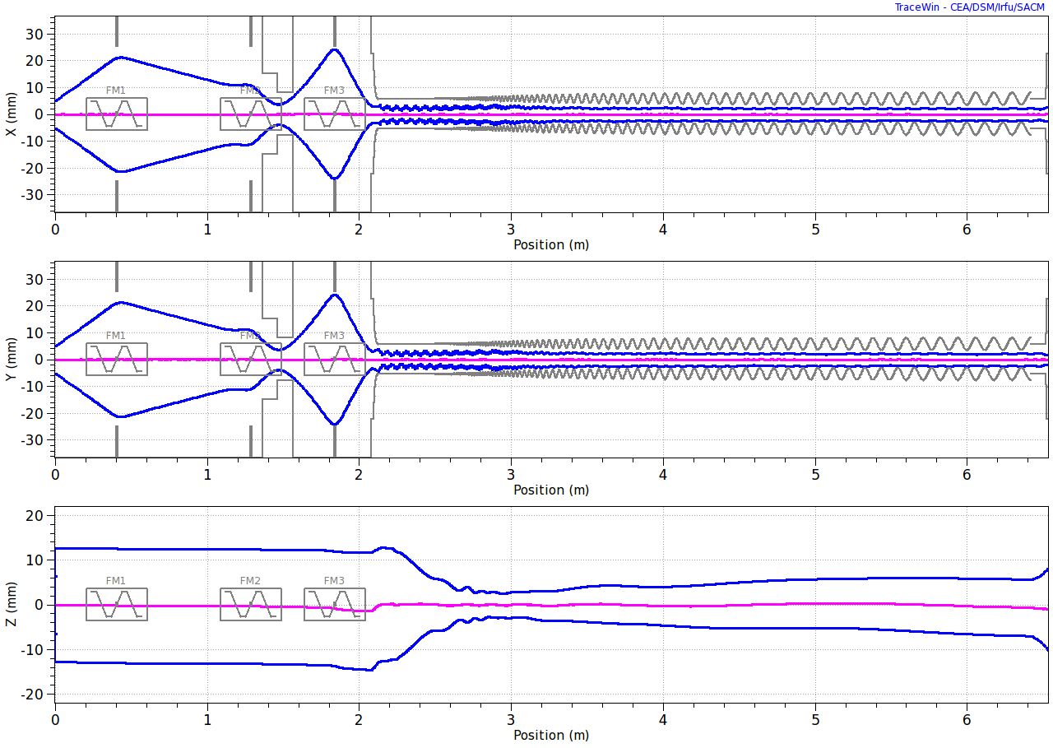
Beam in LEBT and RFQ
Input = Gaussian Beam, Envelopes (3-sigma)
LEBT
RFQ
DC beam
Neutralized
un-neutralized
Details in F.Ostiguy presentation, Nov.29,2012

Slide 23
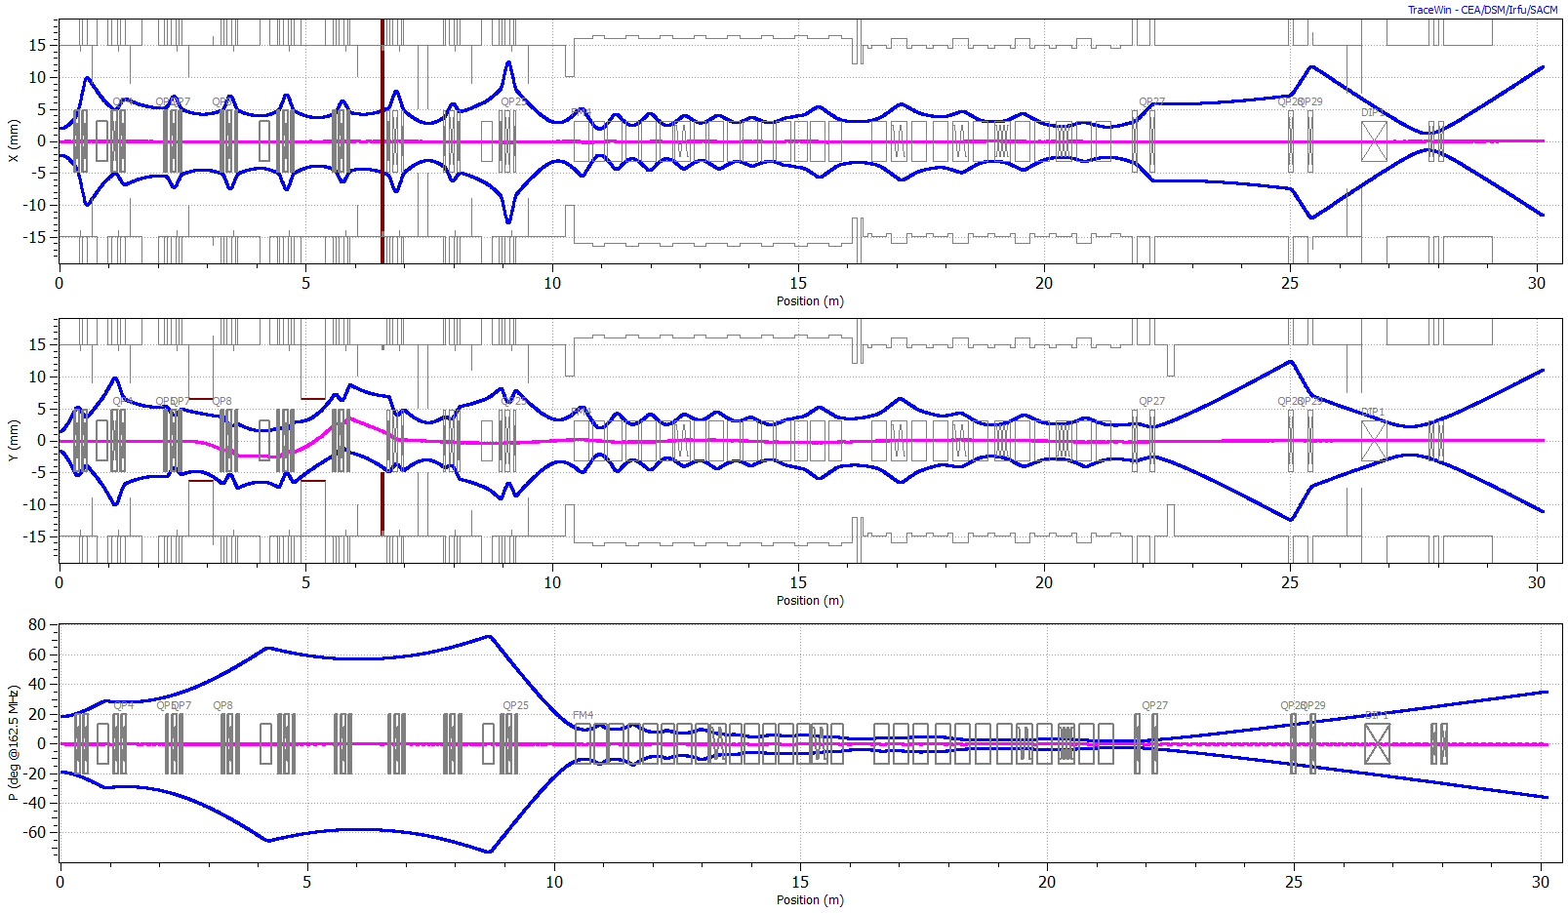
PXIE Optics from RFQ to beam dump
Beam Dump (50 kW)
RFQ
MEBT
SC
HWR
SSR1
Diagnostics & Dump
8 x (S-C)
4 x (C-S-C)
Kicker polarity in chopper is set for passing beam

Slide 24
MEBT schematic
Beam energy 2.1 MeV
Input current 1-10 mA
Output current 1 mA
Max bunch
Frequency 162.5 MHz
Bunch-by-bunch selection
Matching from RFQ to MEBT
Chopping system
Differential pumping/ scraping
Measure parameters of the beam coming out of RFQ
Measure parameters of the beam coming into SRF linac
Sections with bunching cavities
Specifications and scheme are stable since Jan 2012

Slide 25
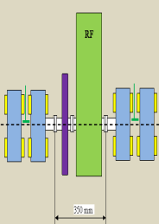
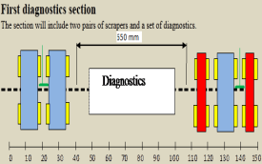
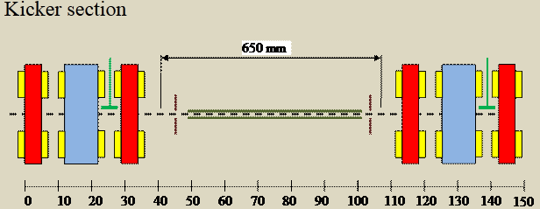
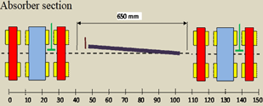
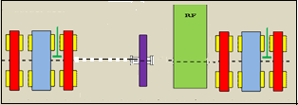
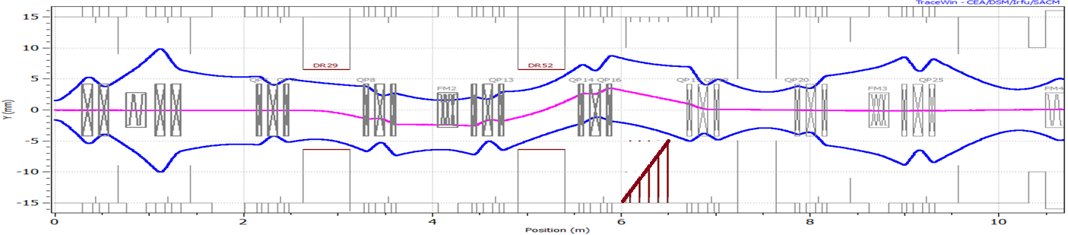
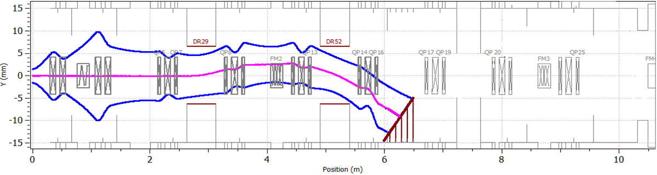
MEBT
#1-Emitttance, laser, Wire scanner, scrapper
#0-
Scrapper, RF
#2-Kicker
#4-Kicker
#5-Absorber, OTR
#7-Scrapper, RF, Slow valve, Extinction monitor
#6–Diff. pumping, scrapper,
wire scanner,
#8 –
Fast valve, DCCT, Toroid, Laser wire, wire scrapper,
Scrapper ?
Slow valve, Toroid
#3-Wire scanner, fast Faraday cup, RF
Passing beam
Chopped beam

Slide 26
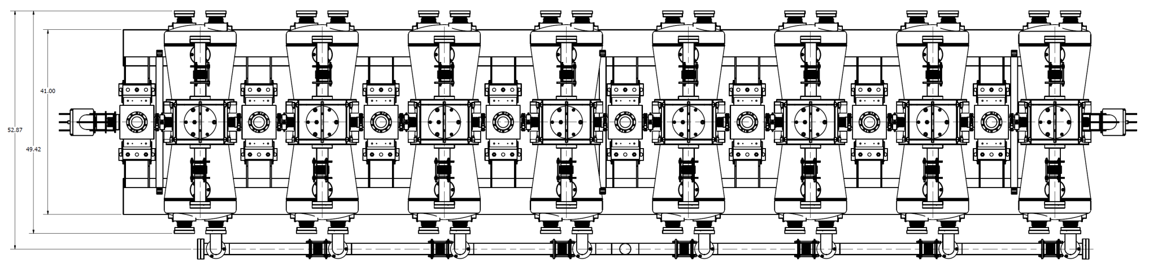
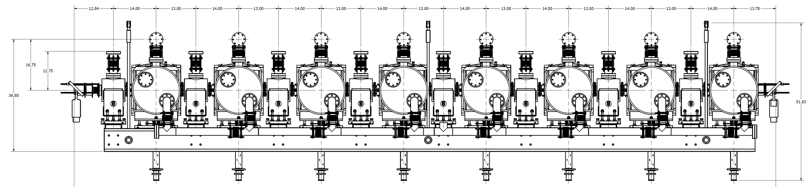
HWR cryomodule (β_{G}=0.11)
8 cavities, 8 SC solenoids (x,y correctors) and 8 BPMs
Beam energy: 2.1 -- 11 MeV
The first upstream element is a SC solenoid to mitigate vacuum transition
CM Length (flange-to-flange) ~ 5.9 m
P.Ostroumov, Collaboration meeting LBNL,April 10-12,2012,

Slide 27
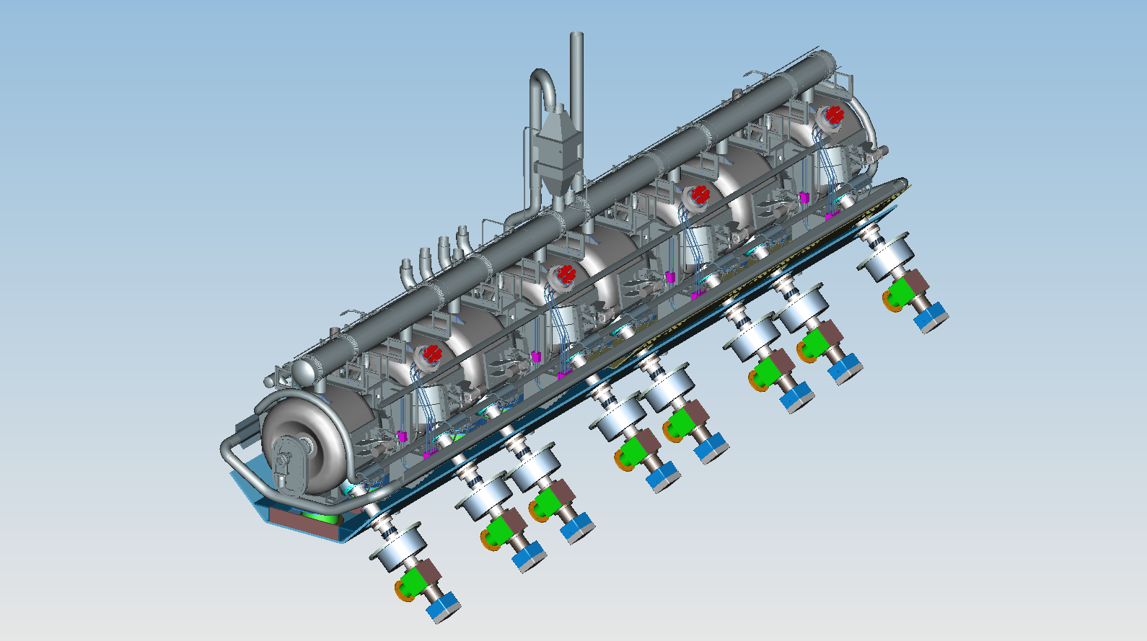
SSR1 Cryomodule (β_{G}=0.22)
8 cavities, 4 SC solenoids (x,y correctors) and 4 BPMs
Beam energy: 11 – 25 MeV
CM Length (flange-to-flange) ~ 5.2 m

Slide 28
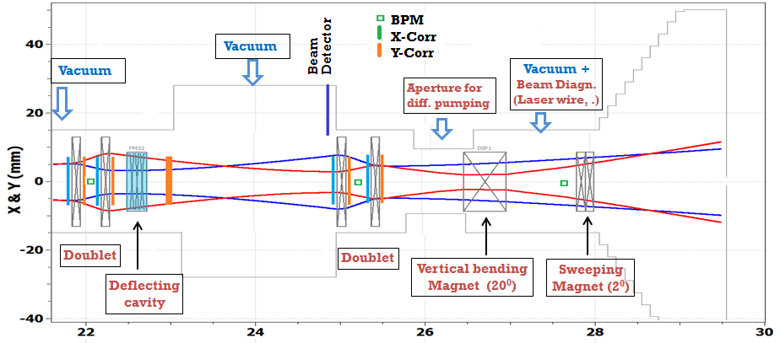
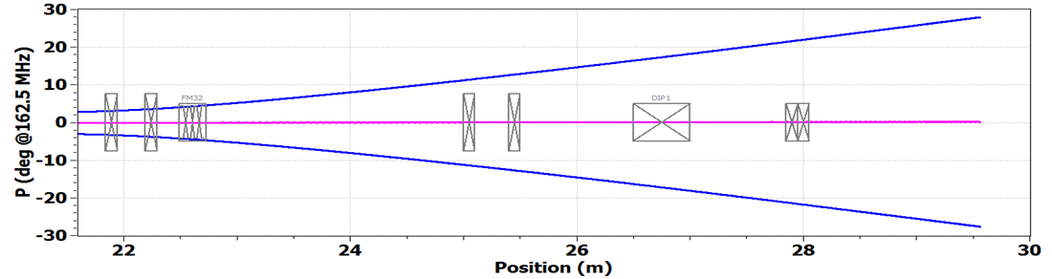
HEBT
Beam current monitor
Emit.diagn. Box: slit, LW/WS

Slide 29
Summary
No change in PXIE design for > 1 year
Organization is in place and functioning
Developed RLS and adjusted the schedule to align with projected budgets
Published the PXIE design handbook

