Slide 1
Accelerator Facility Design: Safety and Radiation Shielding
Tony Leveling
Project X Machine Advisory Committee
March 18-19, 2013

Slide 2
Outline
Shield Design Process
Generic radiation shield requirements
Shield design basis
Facility Radiological Goals
Facilities design
Shield Design Status
Challenges
Non-technical
Technical

Slide 3
Shield Design Process
Safety Analysis
Radiological design goals
Shield Calculations
Facilities Design
Generic Shielding Requirements
Shield Design

Slide 4
Generic Shield Requirements
Fermilab Radiological Controls Manual
Design requirements source
Shielding Policy
Fermilab Safety Assessment Document, Appendix B ESHQ DocDB Document 1067-v9
Machine Beam Loss Scenario Documents
ESHQ DocDB Document 1935-v4
Provides risk based guidance for shielding design

Slide 5
Shield design basis
Normal losses
Goal: generally, limit beam loss to <100 mW/m
H- stripping
Intra-beam stripping – dominant source
Inelastic beam gas scattering
Halo scraping at apertures
Lorentz force (magnetic stripping)
Blackbody photon interactions
To be defined by region in the safety analysis

Slide 6
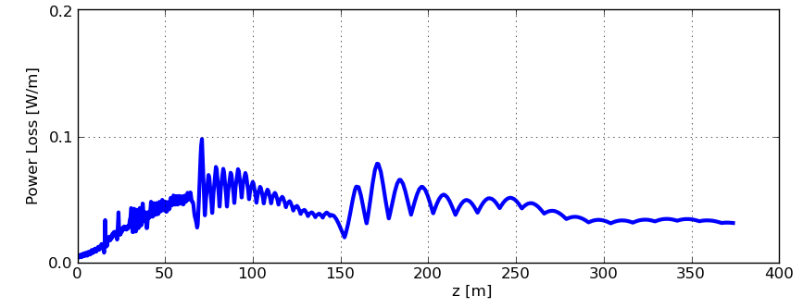
Shield design basis
Intra-beam stripping is the dominant nominal beam loss at CW Linac

Slide 7
Shield design basis
Accident Condition
Nominally full beam power loss for 1 hour
Impractical to apply this principal to megawatt machines
Implies the use of passive shielding
Could result in irreparable harm to the machine
Suggests that active protection is a more sensible approach
Some credit can be taken for machine protection and controls
ESHQ DocDB Document 1935-v4
A list of controls will need to be developed for Project X
A credible accident condition needs to be developed
e.g., full beam power loss for 2 seconds

Slide 8
Shield design basis
Safety analysis will be required
Preparation is by Project X staff
Contains
Normal beam loss conditions
Credible accident condition
Machine protection elements
Active Radiation Safety System controls (if adopted)
SA requires review and approval of SRSO

Slide 9
Facility Radiological Goals
Limit radiation effective dose to < 0.05 mrem/hr to all spaces
service buildings, shielding berms, parking lots, control rooms, and associated areas
Limit average beam loss in all accelerator and beam line enclosures to < 1 Watt/m
Minimize personnel radiation exposure due to maintenance activities
Limit radiation exposure to activated air both on site and at the site boundary
Limit ground water and surface water activation (including tritium) to levels well below regulatory standards
Prevent the activation of beam component surfaces to avoid the generation of removable radioactivity
Simplify maintenance activities
Minimize the activation of accelerator components
Provide indefinite component service life

Slide 10
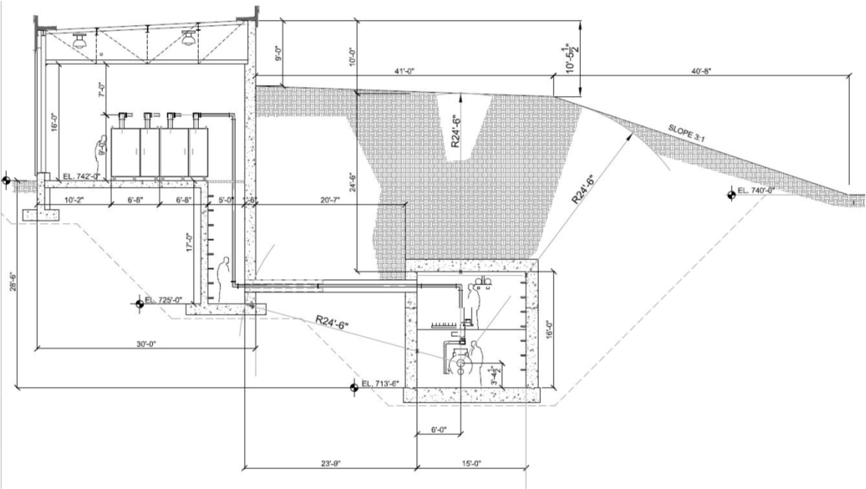
Facilities Design
Tunnel enclosure
Size and shape of tunnel
Position of machine components within enclosures
Support facility requirements
Service buildings and proximity requirements
Other design features
Penetrations
Exit labyrinths
Drop hatches
Elevators

Slide 11
Shield Design Status
Safety Analysis
Radiological design goals
Shield Calculations
Don’t have these
Have these
Facilities Design
Generic Shielding Requirements
Shield Design

Slide 12
Shield Design Process

Slide 13
Challenges
Non-technical
Develop a draft safety assessment for submittal to SRSO
List of machine protection features to get credit
e.g., machine protection system
Develop basis for a credible accident condition
Include consideration of active protection
Obtain approval of the safety assessment
Technical
A total loss monitor system (TLM) is a candidate system which could provide active protection
Development work is ongoing
Goal is for approval of a prototype system in February 2014
If the system is not approved, determine an alternate active protection system

Slide 14
Extra slides

Slide 15
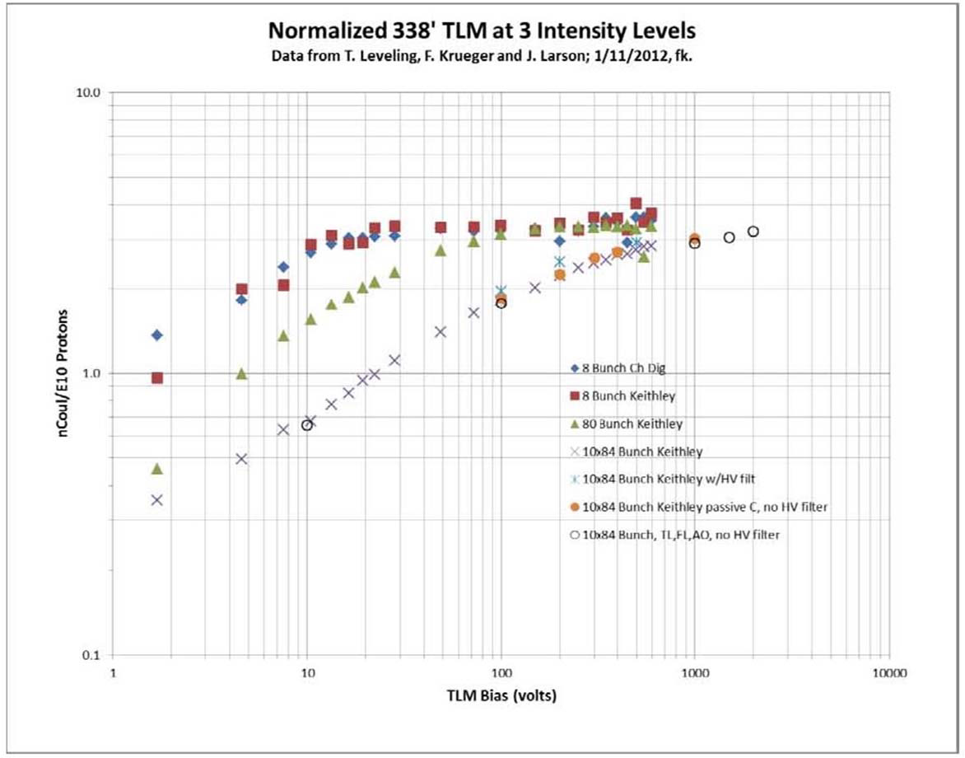
TLM response to 8 GeV proton beam loss

