Slide 1
Sight Riser Specification-Preliminary

Slide 2
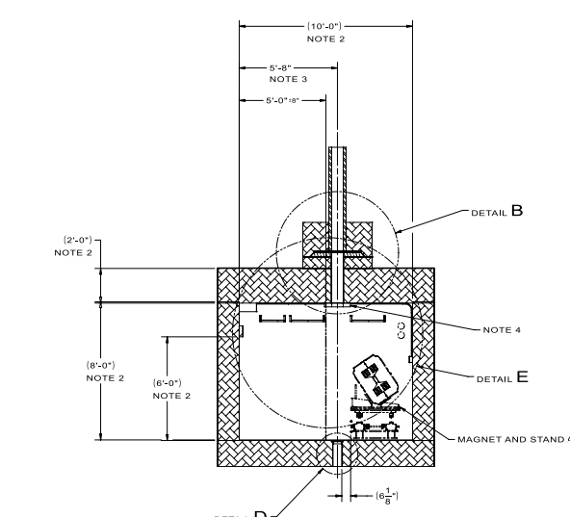
Cross-section of Primary Beamline

Slide 3
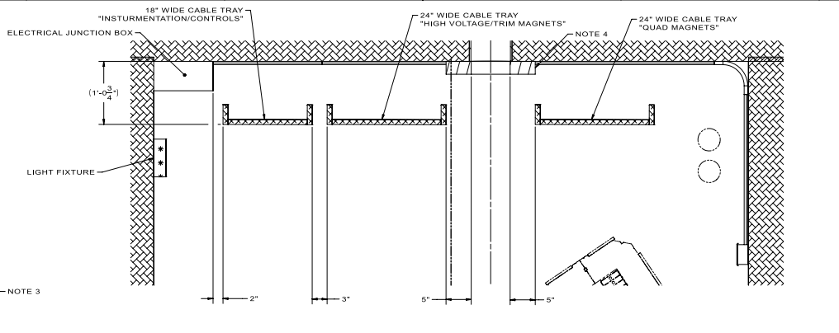
Cable Tray Sizes and Configuration

Slide 4
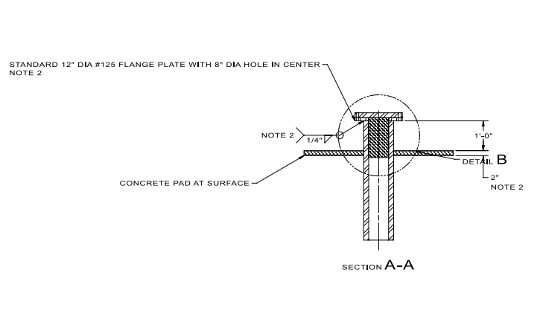
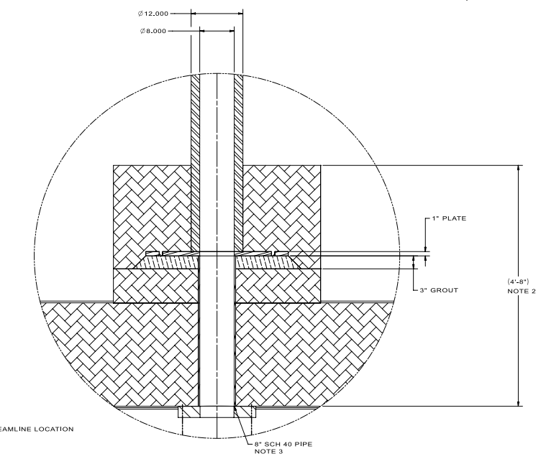
Sight Riser
Sight Riser Fill:
7.5’ of sand polyethylene mix
5’ sand + 2.5’ polyethylene
1’ tall polyethylene cylinder at top of sight riser (inside)
2” thick steel plate at top of sight riser (with air seal)
Primary Beam Tunnel ceiling

Slide 5
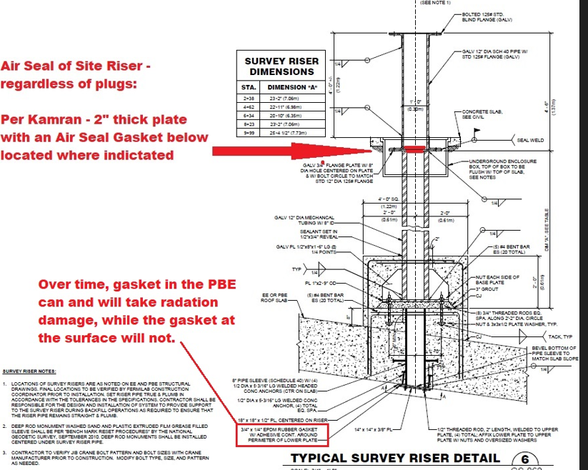
Sight Riser Details
Thin-walled tube will be 3’ long
There will be a pipe joint 1’ off the ground.
At the joint, there will be a 2” thick steel plate with a 1’ long polyethylene cylinder
3 foot
2 inch plate
Grade
1.0 foot

Slide 6
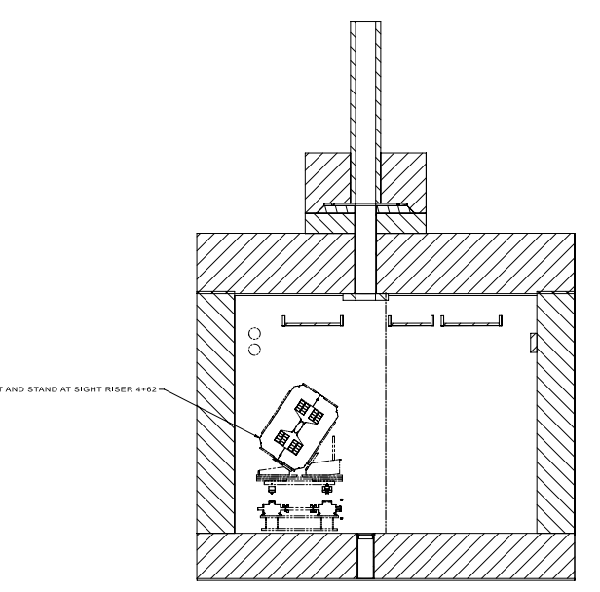
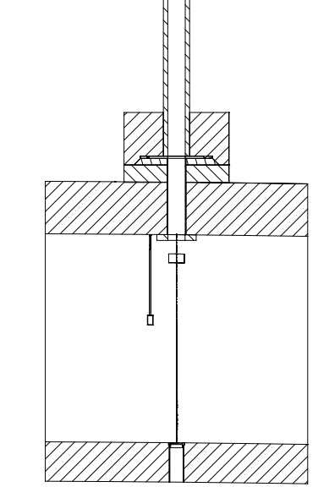
Alignment Between Sight Riser and Monument
Required Tolerance=1”

Slide 7
Detail of Sight Riser On The Surface

