Slide 1
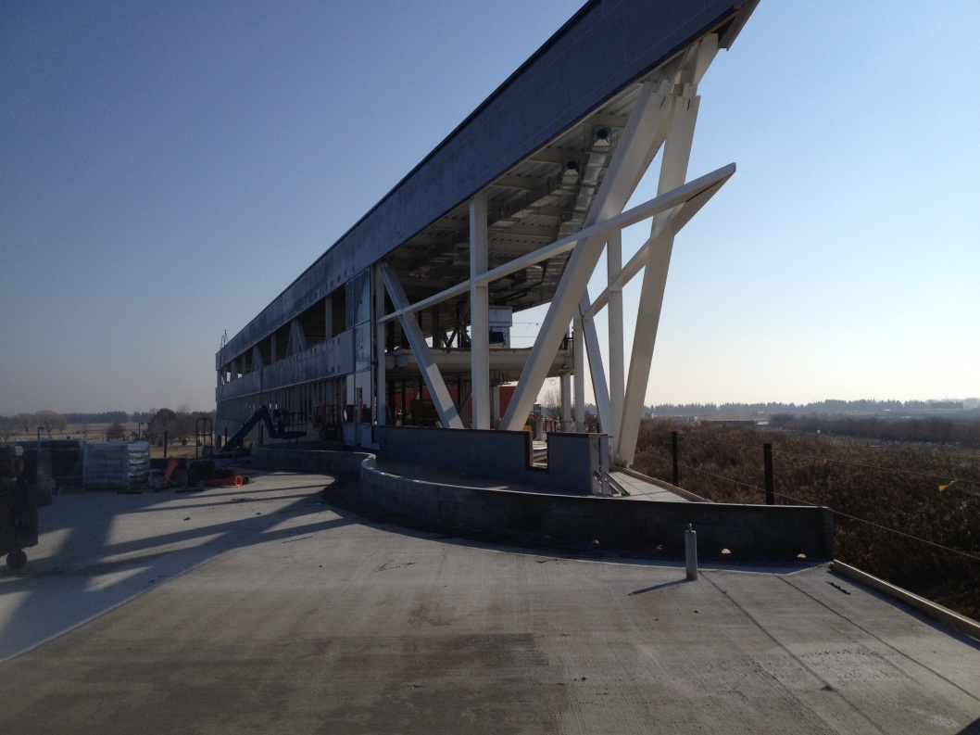
OTE Building PMG Report February 25, 2013 Rhonda Merchut

Slide 2
Agenda
Coordination
OTE Building Project
State Activities
Schedule & Fiscal
Summary Action Items

Slide 3
IASU Update (IGPP)
Phase 2 scope approximately 85% complete.
CDF Coordination
Demolition for 1st floor OTE/CDF entrance underway.
CDF barrier to remain in place until OTE is environmentally enclosed & CDF protected from all dirt and dust.

Slide 4
OTE Outfitting GPP G13-211
Project Request Approved 1/14/13.
FY 13: $2M for VoIP/networking & Contingency.
Develop Plan for moving ahead with VoIP/Networking w/out tenant layouts.

Slide 5
OTE Project Status:
Shop drawing review continues
More than 225 RFI’s rec’d from contractor have been responded to.
RFI’s slowing down.
Schedule analysis, reporting, and cost curve on-going. Continue to work with contractor to provide coordinated information.
Safety procedures continue to be expanded as more subs come onto the project.

Slide 6
OTE Project Status:
LEED procedures & Action Plan implemented.
Contractor reporting 99% construction waste has been recycled.
On track to meet goal of 20% (by cost) of regionally manufactured materials.
On track to meet goal of 20% (by cost) of recycled content in materials used.

Slide 7
OTE Building Construction Status:
14 sub-subs working on site.
30-40 workers daily.
Exterior enclosure well underway.
Weather barrier
Window framing & glazing
Roofing
CDF 1st floor connection demo nearing completion.
MEP & FP pipe hanging
Polished Concrete
Stairway installation
Post Tensioning complete

Slide 8
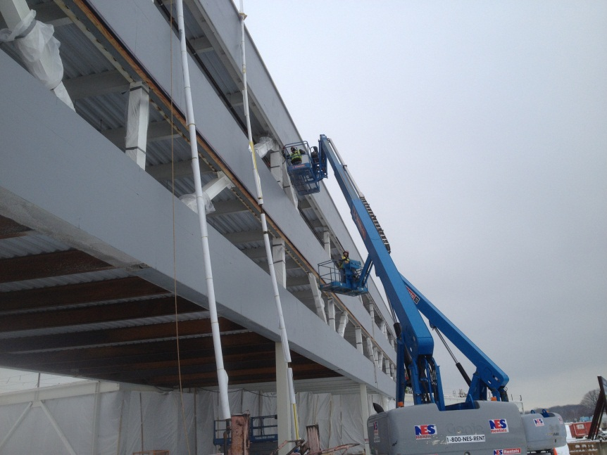
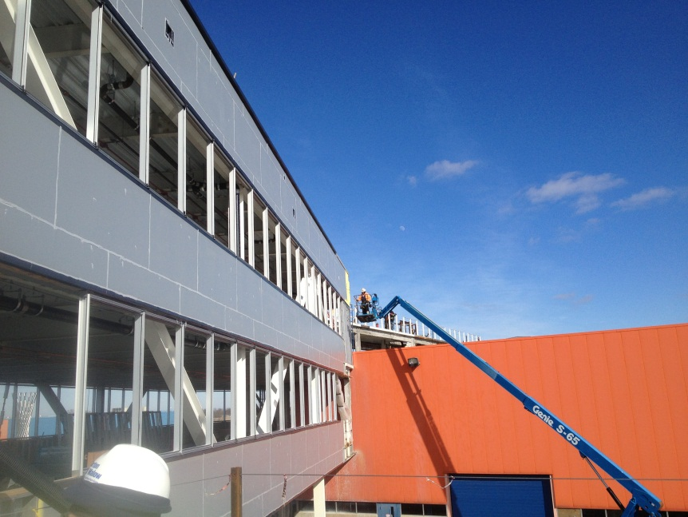
Exterior Enclosure

Slide 9
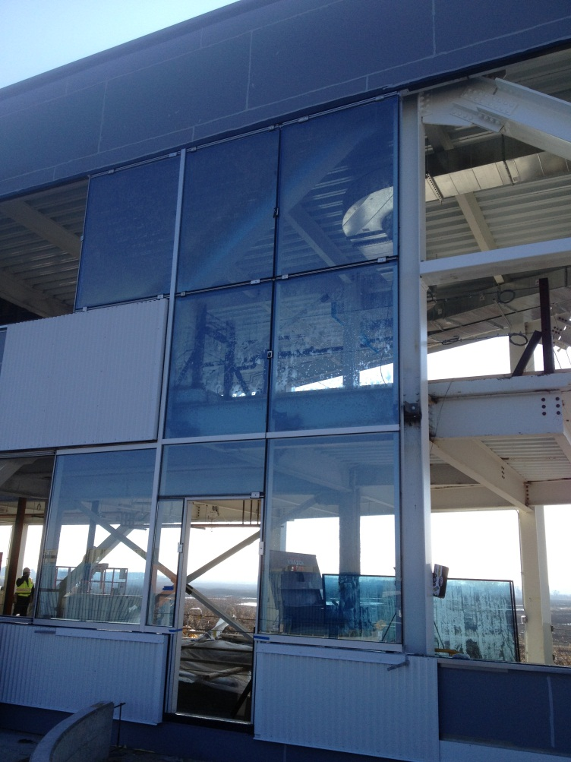
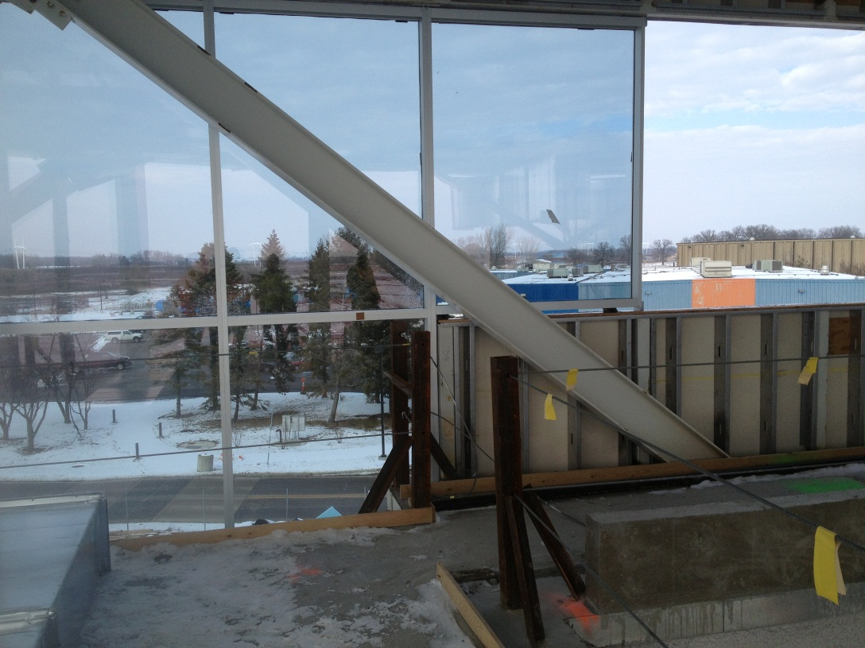
Enclosure Mock-up

Slide 10
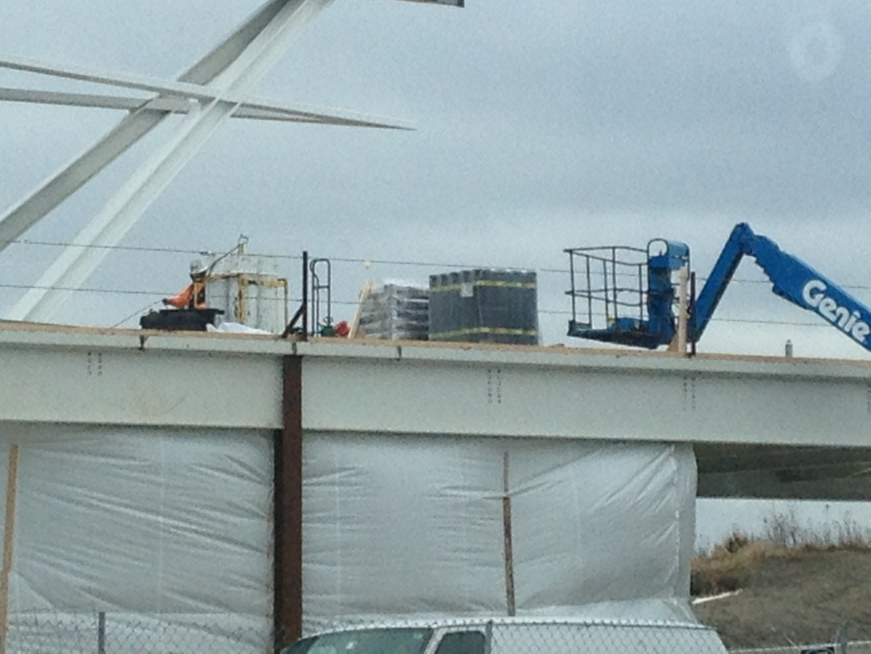
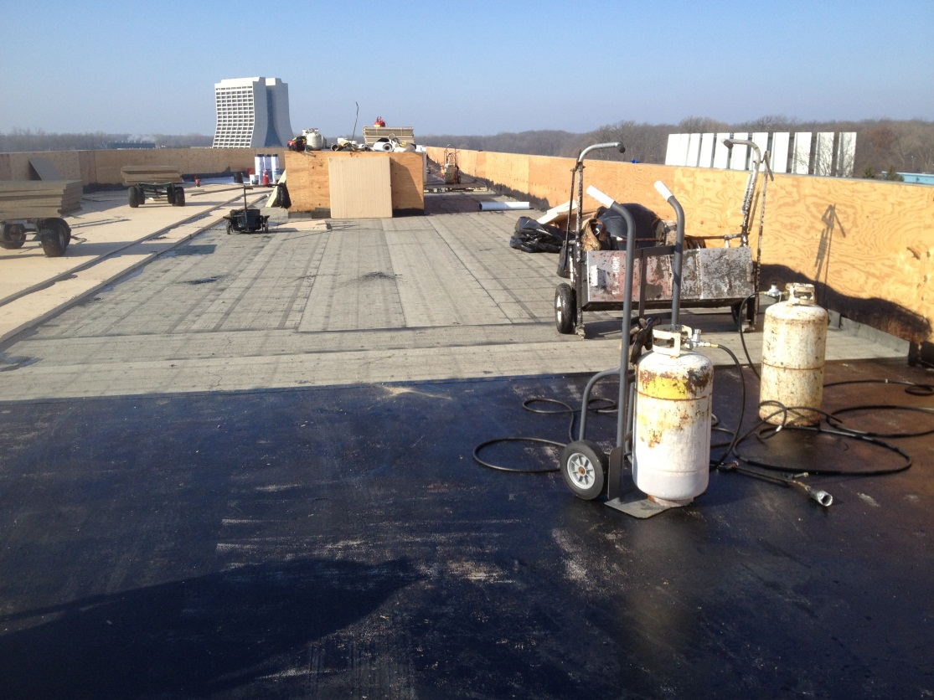
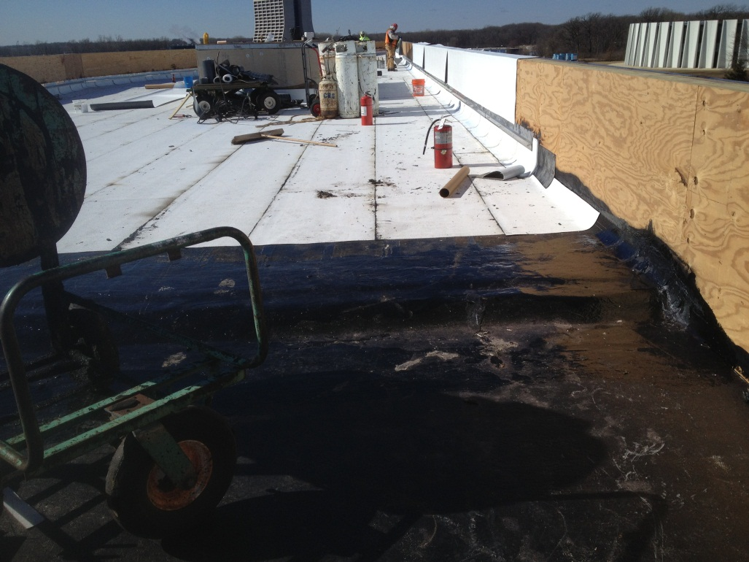
Roofing

Slide 11
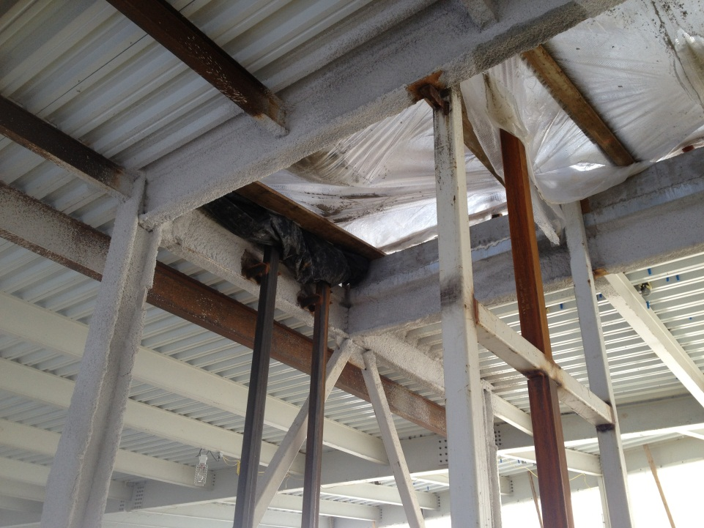
Elevator Steel

Slide 12
East Stair
Roof Hatch

Slide 13
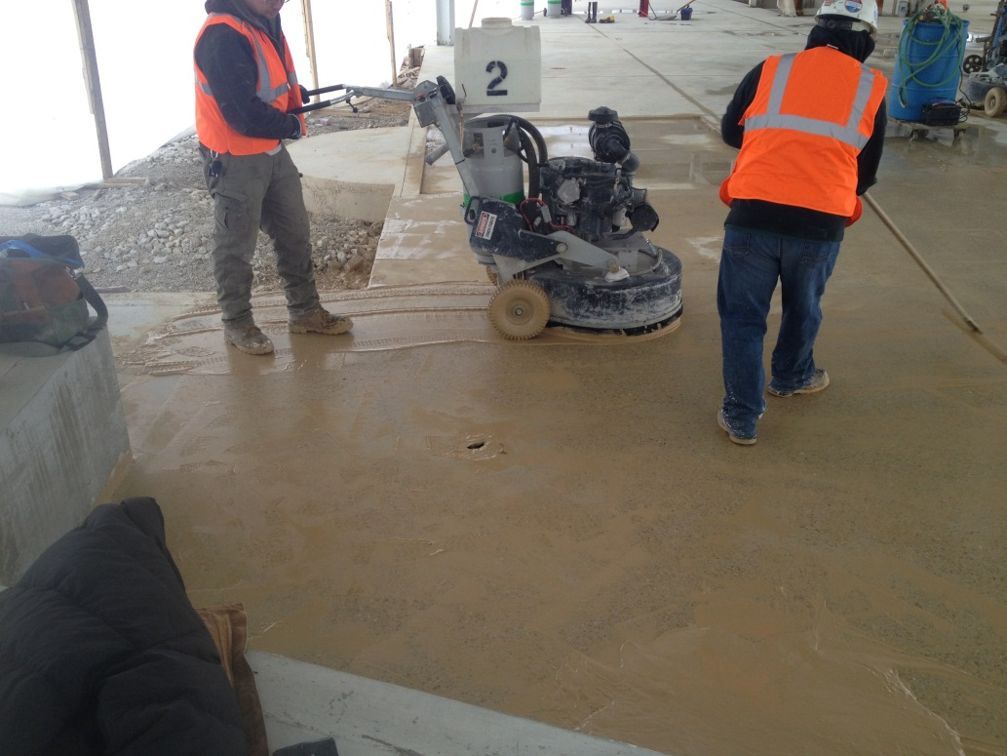
Polished Concrete Floor

Slide 14
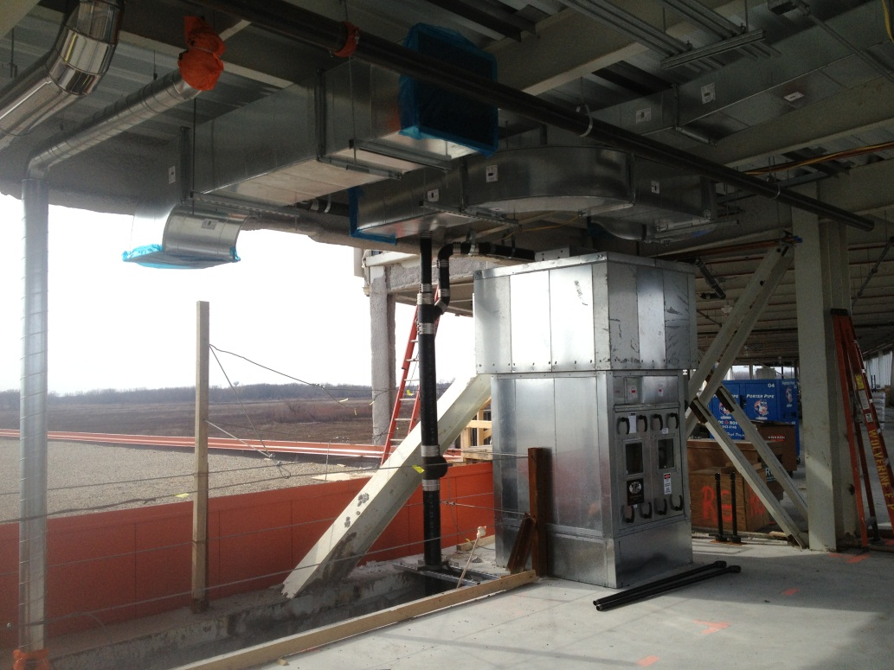
MEP, FP

Slide 15
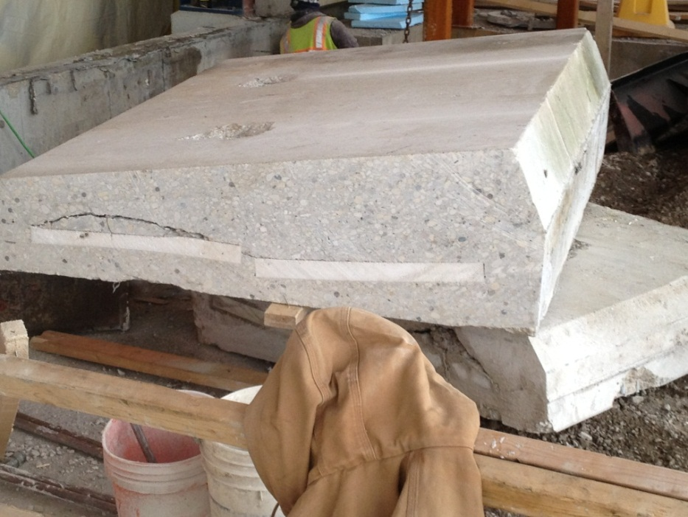
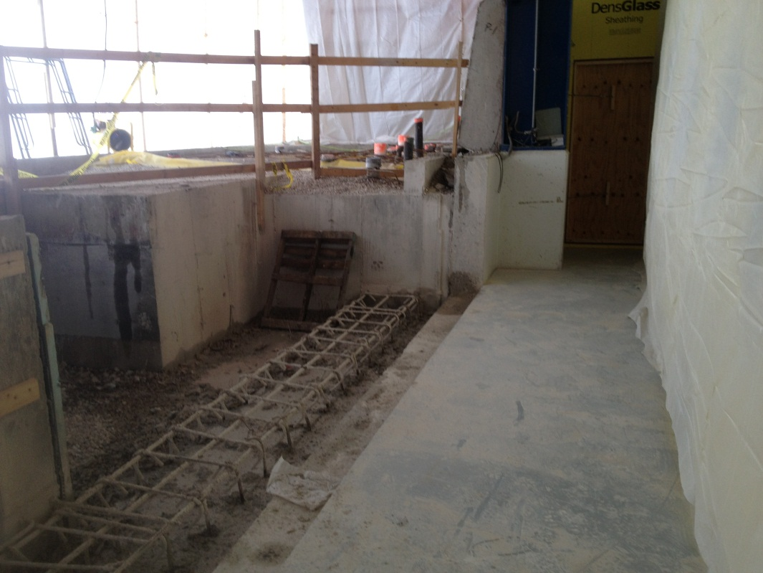
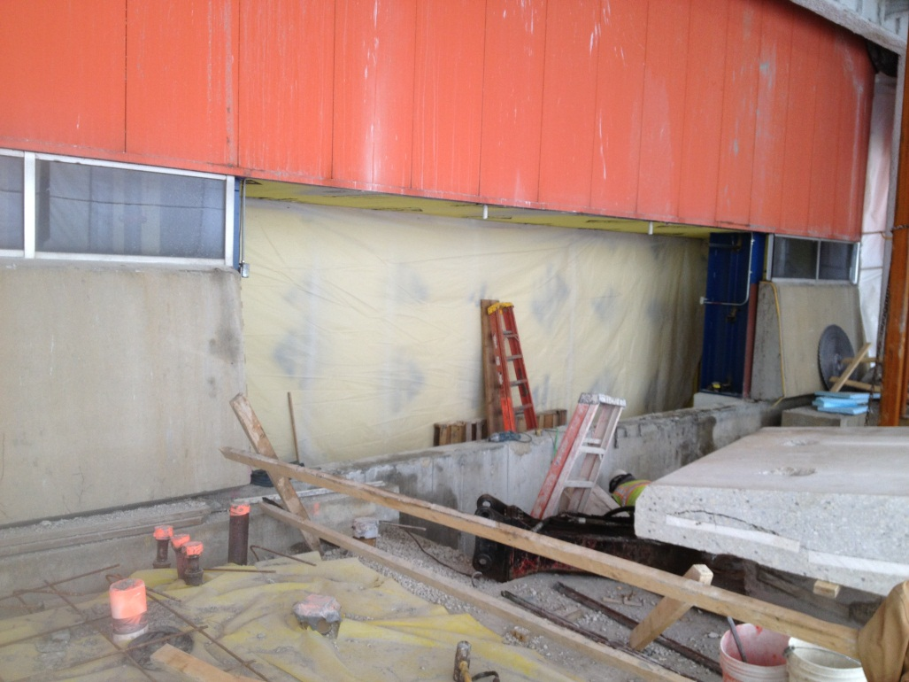
CDF Demo

Slide 16
Two Week Look Ahead
Roofing continues on high roof.
Curtain wall framing.
Exterior panels 2nd & 3rd floor.
Glass installation 2nd & 3rd floor ribbon windows.
MEP, FP equipment & pipe runs
1st floor window steel.

Slide 17
State DCEO Activities
Next DCEO quarterly report to State due 3/29/13 for quarter ending 2/28/13.
Project on schedule for grants to be 100% costed by 5/31/14 grant requirement.

Slide 18
Schedule Adjustments
44 additional days for additional steel work (SA 16)
MS 1 Bldg Shell Complete: 5/9/13
MS 2 Substantial Completion: 11/5/13
(Project is fully costed at MS 2, retention remains)
MS 3, Project Complete: 1/29/14

Slide 19
BMC Schedule

Slide 20
Schedule

Slide 21
Schedule

Slide 22
Schedule Oversight
Weekly Construction Coordination meetings.
Present status
2-week look ahead
Problems, changes effecting upcoming work
Weekly Fermi PM/BMC PM meetings.
Contractor’s issues & priorities
Work progress & schedule review, issues impact
Weekly PA change order meetings.
Review status/priorities of MRFP’s, COR’s
Bi-weekly Design Team/Construction Team meetings.
Discuss issues, expedite solutions
Monthly Updates.
Construction Coordinator/Contractor review of as-built work progress percentage of completion

Slide 23
Tracking Milestones
Project is fully costed at MS 2, retention remains

Slide 24
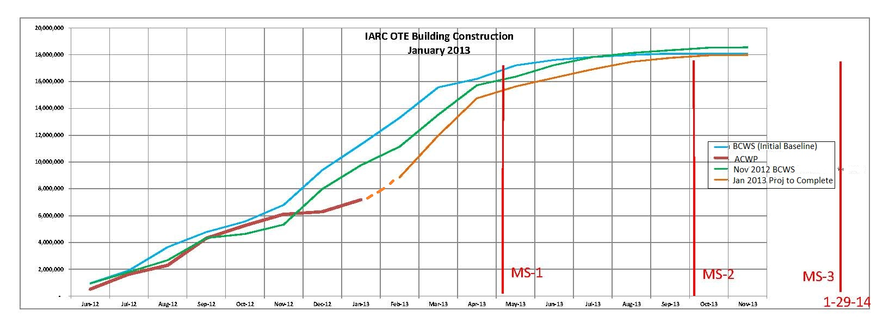
BMC Construction BCWS & ACWP
39% costed
41% time
Monthly Average to date: $897,979.54
Required Monthly Average to complete: $1,012,196.95
Per BMC projected: 1 month @ $1.2M,
2 months @ $3M,
8 months @ ~$0.5M

Slide 25
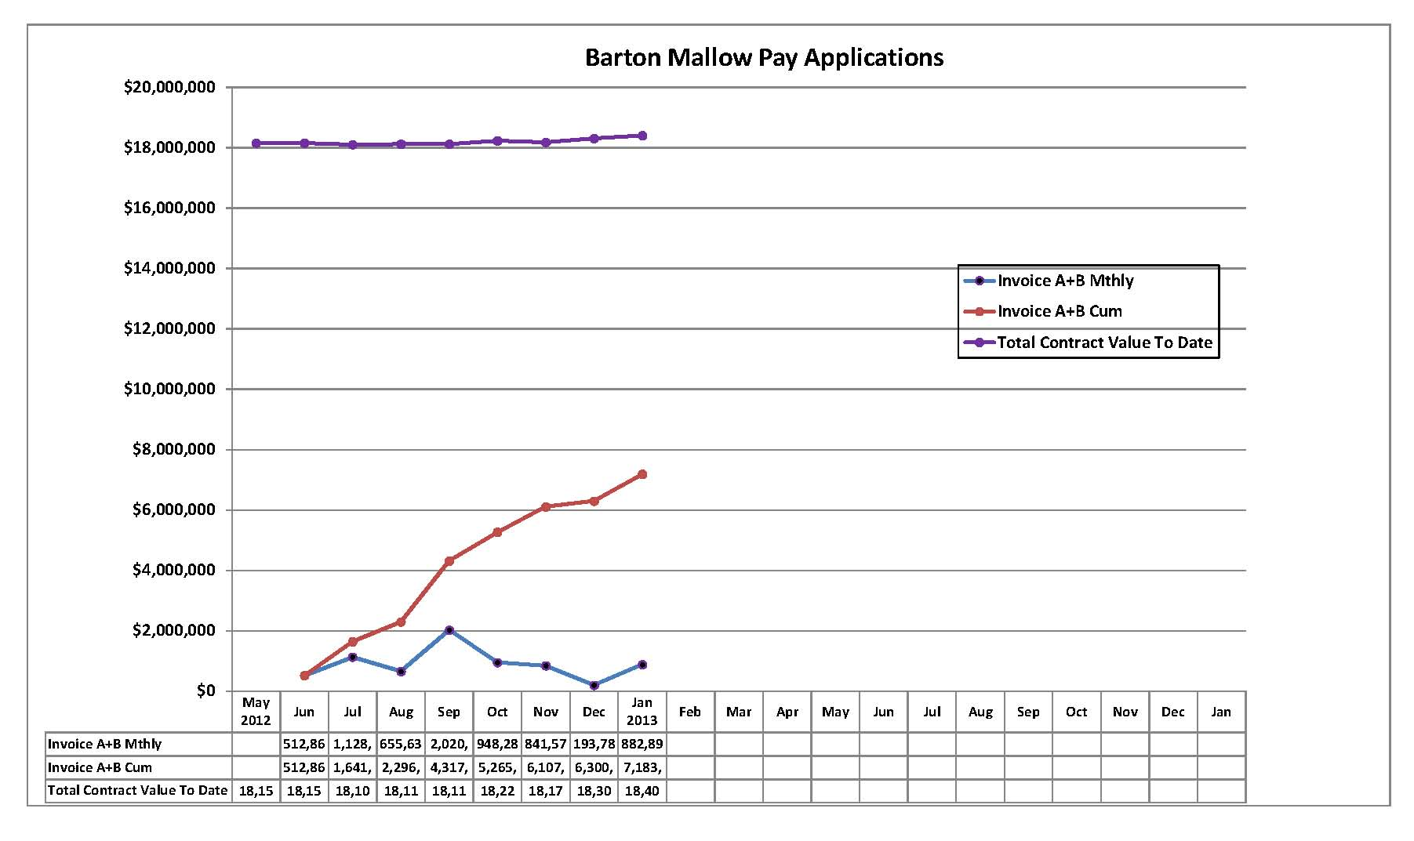
Monthly Average to date: $897,979.54
Required Monthly Average to complete: $1,012,196.95
Per BMC projected: 1 month @ $1.2M,
2 months @ $3M,
8 months @ ~$0.5M
BMC Monthly Costing

Slide 26
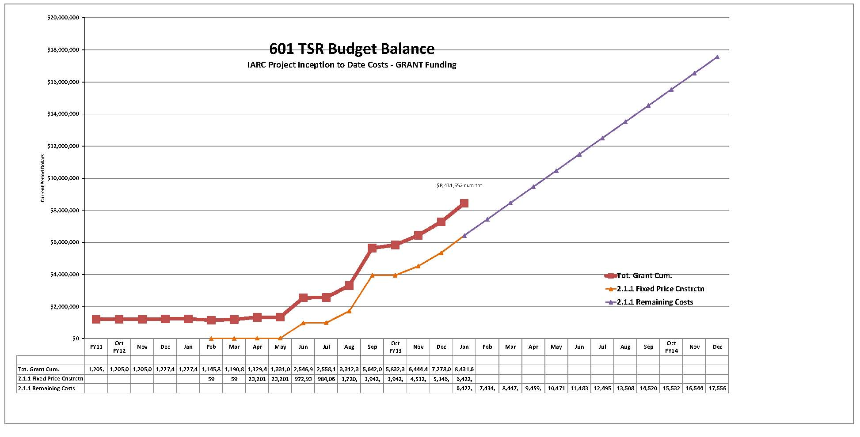
601 TSR Budget Balance
ALL Grant Costing w/ BMC Projection

Slide 27
Financial – GPP Budget for Contingency

Slide 28
Contingency Management
Sources available to fund change orders:
IGPP;
De-scope from anticipated T&M work;
De-scope from A/E support work;
DOE backstop (GPP Outfitting project);
De-scope from main construction work (will not recover all funds);
Value engineering main construction work

Slide 29
Supplemental Agreements a/o 2-11-13
9% contingency remaining at SA 17 (incl IGPP, Grant, & GPP)

Slide 30
Summary Action Items
Continue shop drawing & change order review, RFI responses
Continue construction coordination & oversight.
Initiate plan for engineering design Outfitting GPP including VoIP, networking, furnishings

